Slide 1
LEARNING
Psychology

Slide 2
Learning Outcomes
Review of previous session
Punishment
Cognitive-Social Approaches to learning
Latent Learning
Observational Learning
Behavior modification

Slide 3
Punishment
“A stimulus that decreases the probability that a previous behavior will occur again”.
e.g. received a shock to decrease the likelihood of any behavior.
Positive punishment (weakens the response through application/presentation of an unpleasant stimulus)
e.g. punishing a child or ten years in jail for committing crime.
Negative punishment (removal of something pleasant)
e.g. removal of favorite toy after misbehaving.

Slide 4
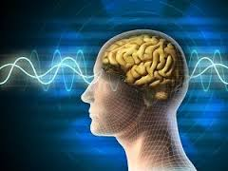
Cognitive-Social Learning Theory
The study of thought/mental processes (not observable) that underline learning is called cognitive-social learning theory”.
Focused on unseen mental processes and cognition
No concentration solely on external stimuli, responses and reinforcement.
e.g. learn to drive a car.

Slide 5
Latent Learning
“Learning in which a new behavior is acquired but is not demonstrated until reinforcement is provided”.
Examples:
A young boy learns how to play basketball but does not demonstrate that knowledge until he joins a basketball team.
A person learns to cook by watching cooking shows on television, but exhibits the knowledge later, when asked to make a dish for a work event.
A university student is taught how to teach, but is unable to demonstrate that knowledge until she receives a teaching job.

Slide 6
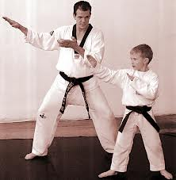
Observational Learning
“Learning through observing the behavior of another person (called a model )is known as observational learning”.
Albert Bandura (1977, 1986)
Observational learning is the form of social learning because it involves interaction with other people.
This form of learning does not need reinforcement to occur, but instead, requires a model.
e.g. piloting an airplane
Performing brain surgery

Slide 7
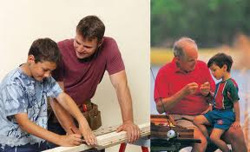
Steps of Observational Learning
Paying attention and perceiving the most critical features of another person’s (model)behavior.
Remembering the behavior
Reproducing the action
Being motivated to learn and carry out the behavior.
Model can be a friend, teacher, sibling, colleague, celebrity etc.

Slide 8
Behavior Modification
A formalized technique for promoting the frequency of desirable behaviors and decreasing the incidence of unwanted ones.
Proved to be helpful in a variety of situations: lose weight, give up smoking, behave more safely etc.

Slide 9
THANK YOU
HAPPY LEARNING STUDENTS!

