Slide 1
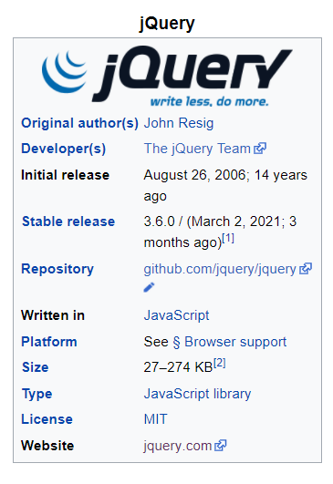
This is brief information

Slide 2
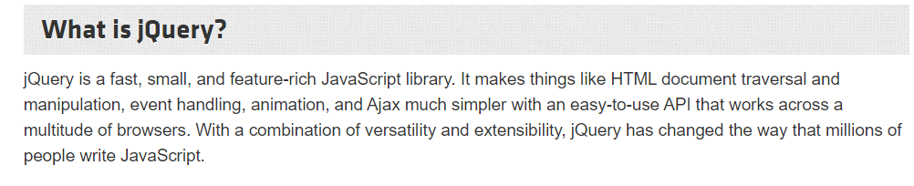
-jQuery is a JavaScript Library. -jQuery greatly simplifies JavaScript programming. -jQuery is easy to learn.

Slide 3
jQuery Get Started
There are several ways to start using jQuery on your web site. You can:
- Download the jQuery library from jQuery.com
- Include jQuery from a CDN, like Google
Downloading jQuery
There are two versions of jQuery available for downloading:
- Production version - this is for your live website because it has been minified and
compressed
- Development version - this is for testing and development (uncompressed and
readable code)
Both versions can be downloaded from jQuery.com.

Slide 4
jQuery CDN
If you don't want to download and host jQuery yourself, you can include it from a CDN (Content Delivery Network). Google is an example of someone who host jQuery:
<script src="https://ajax.googleapis.com/ajax/libs/jquery/3.5.1/jquery.min.js"></script>
The best practice to put the script of CDN at the end of <body> tag and just above the other <script> tags:
<body>
….
<script src="https://ajax.googleapis.com/ajax/libs/jquery/3.5.1/jquery.min.js"></script> <script src=“./index.js”></script>
</body>

Slide 5
jQuery Syntax
-With jQuery you select (query) HTML elements and perform "actions" on them.
Basic syntax is: $(selector).action()
-A $ sign to define/access jQuery
-A (selector) to "query (or find)" HTML elements
-A jQuery action() to be performed on the element(s)
Examples:
$(this).hide() - hides the current element.
$("p").hide() - hides all <p> elements.
$(".test").hide() - hides all elements with class="test".
$("#test").hide() - hides the element with id="test".

Slide 6
jQuery Selectors
-jQuery selectors are one of the most important parts of the jQuery library.
-jQuery selectors allow you to select and manipulate HTML element(s).
-jQuery selectors are used to "find" (or select) HTML elements based on their name,
id, classes, types, attributes, values of attributes and much more. It's based on the
existing CSS Selectors, and in addition, it has some own custom selectors.
-All selectors in jQuery start with the dollar sign and parentheses: $().
- You can select all <p> elements like this:
$("p")
-To find an element with a specific id, write a hash character, followed by the id of the HTML element:
$("#test")
-To find elements with a specific class, write a period character, followed by the name of the class:
$(".test")

Slide 7
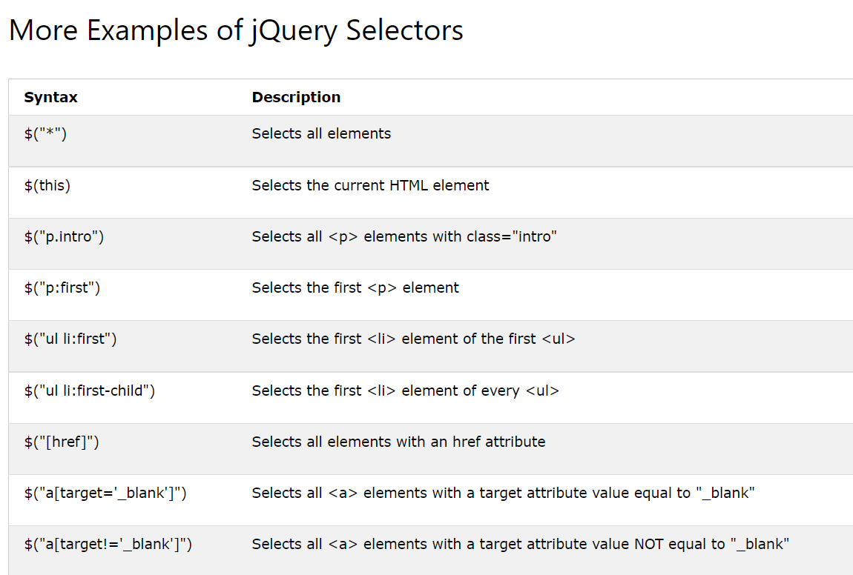

Slide 8
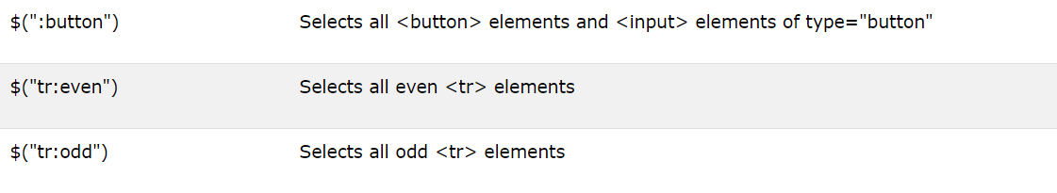

Slide 9
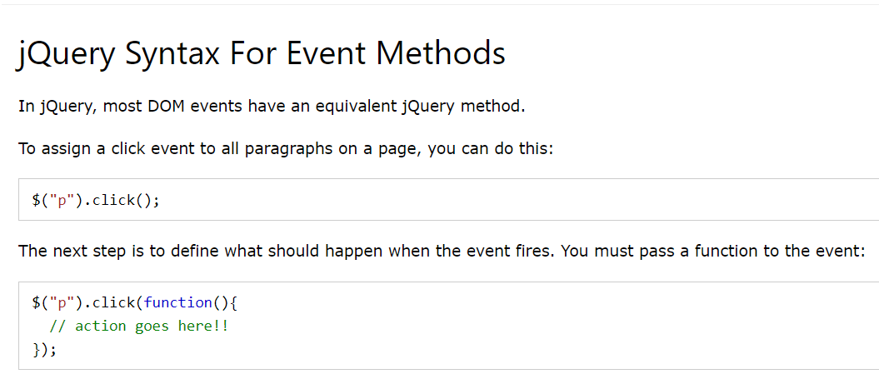
jQuery Event Methods

Slide 10
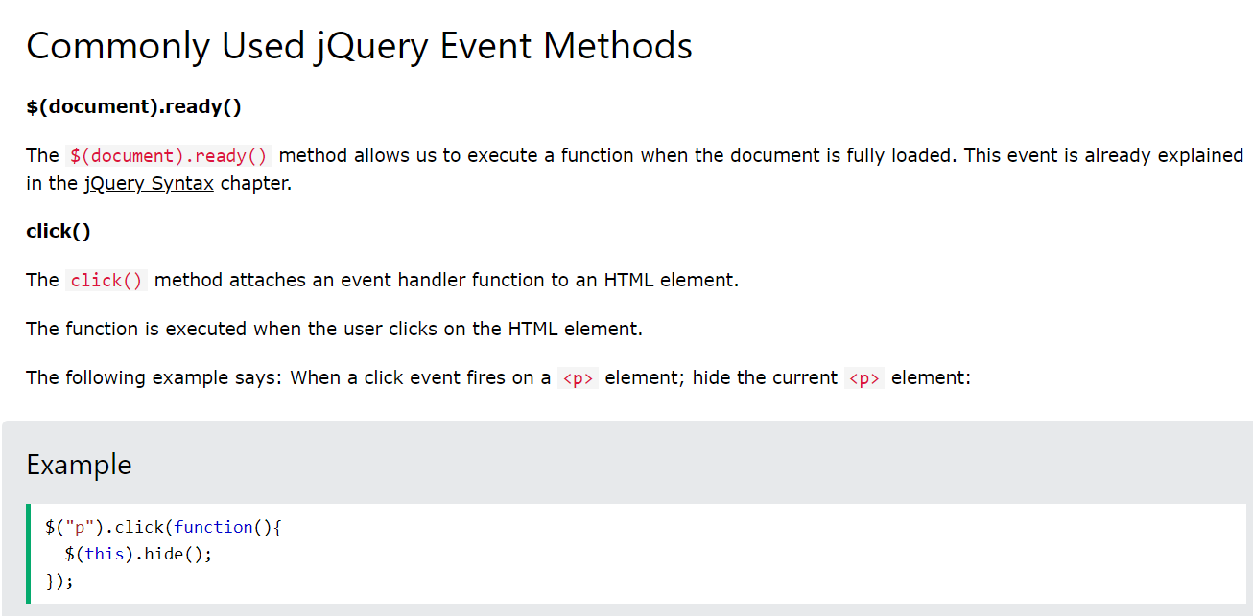

Slide 11
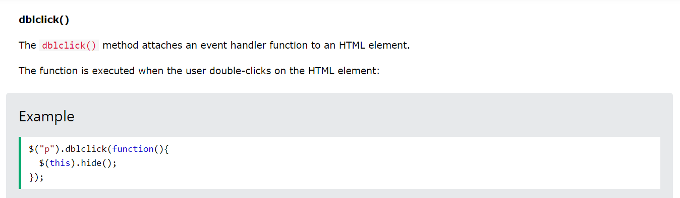
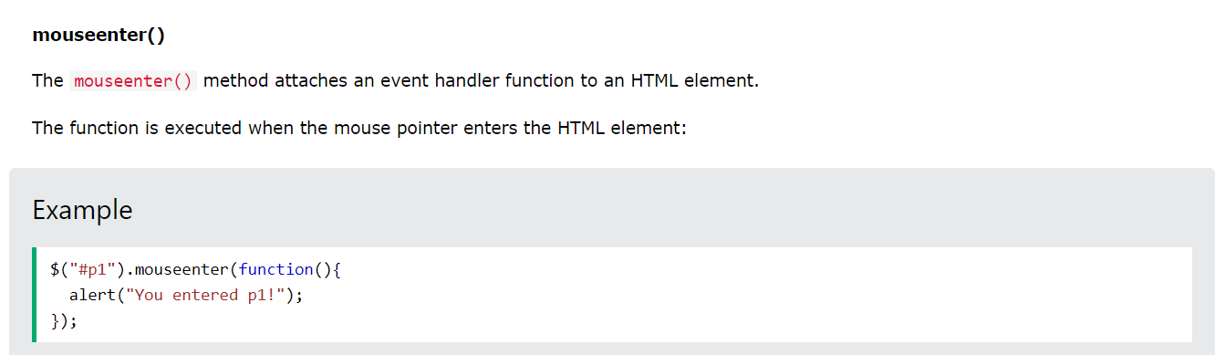

Slide 12
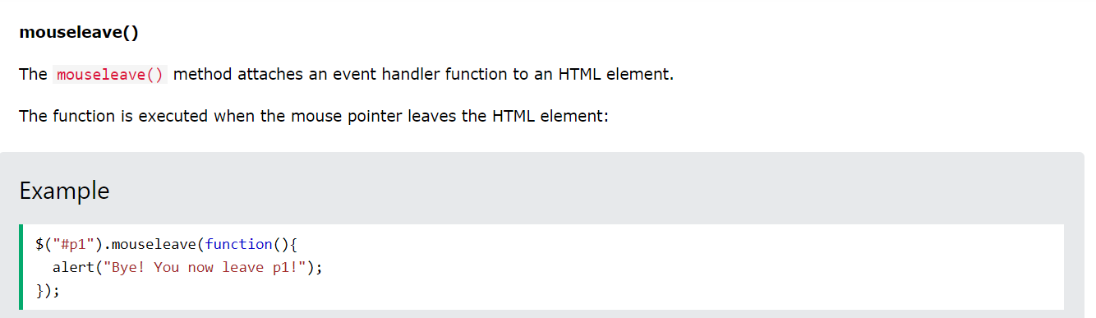
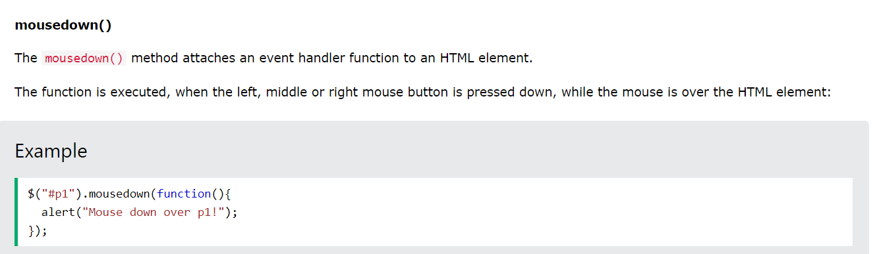

Slide 13
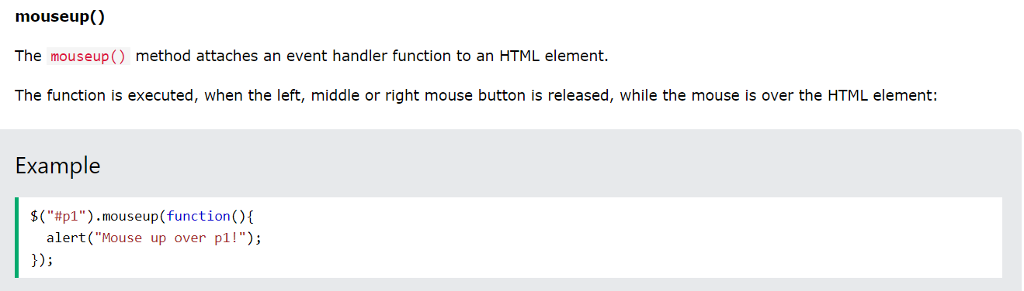
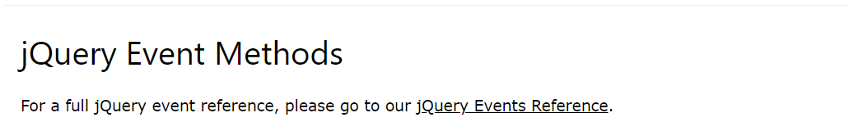

Slide 14
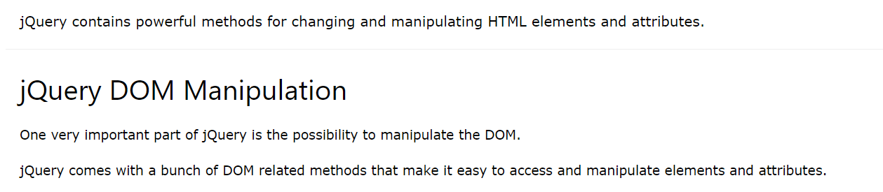
jQuery - Get Content and Attributes

Slide 15
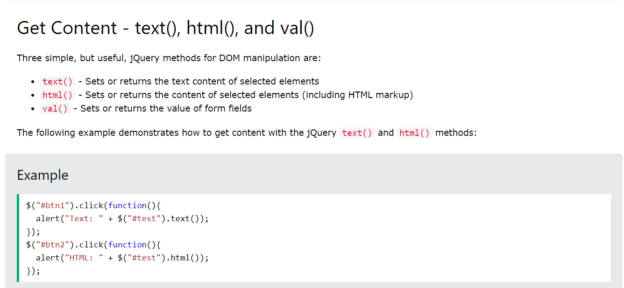
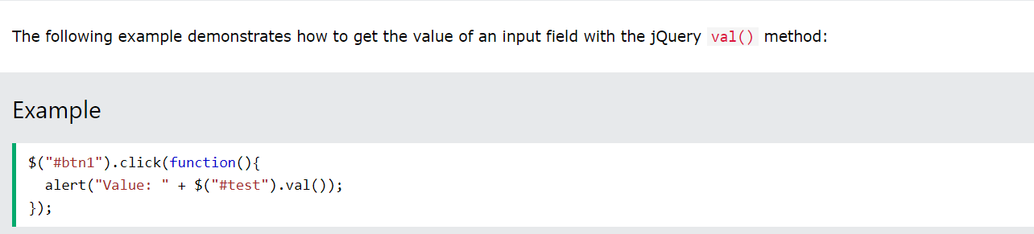

Slide 16
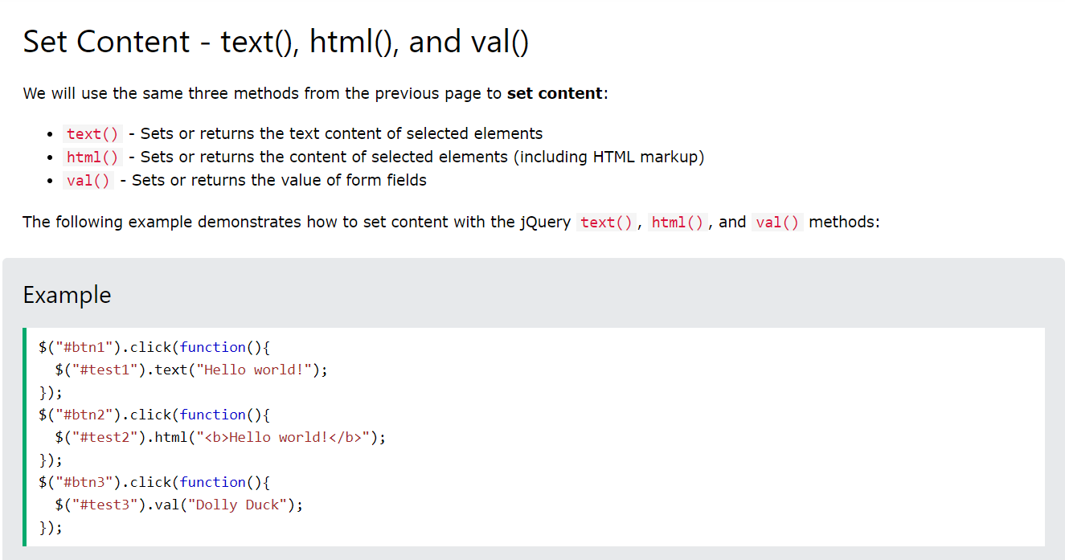
jQuery - Set Content and Attributes

Slide 17
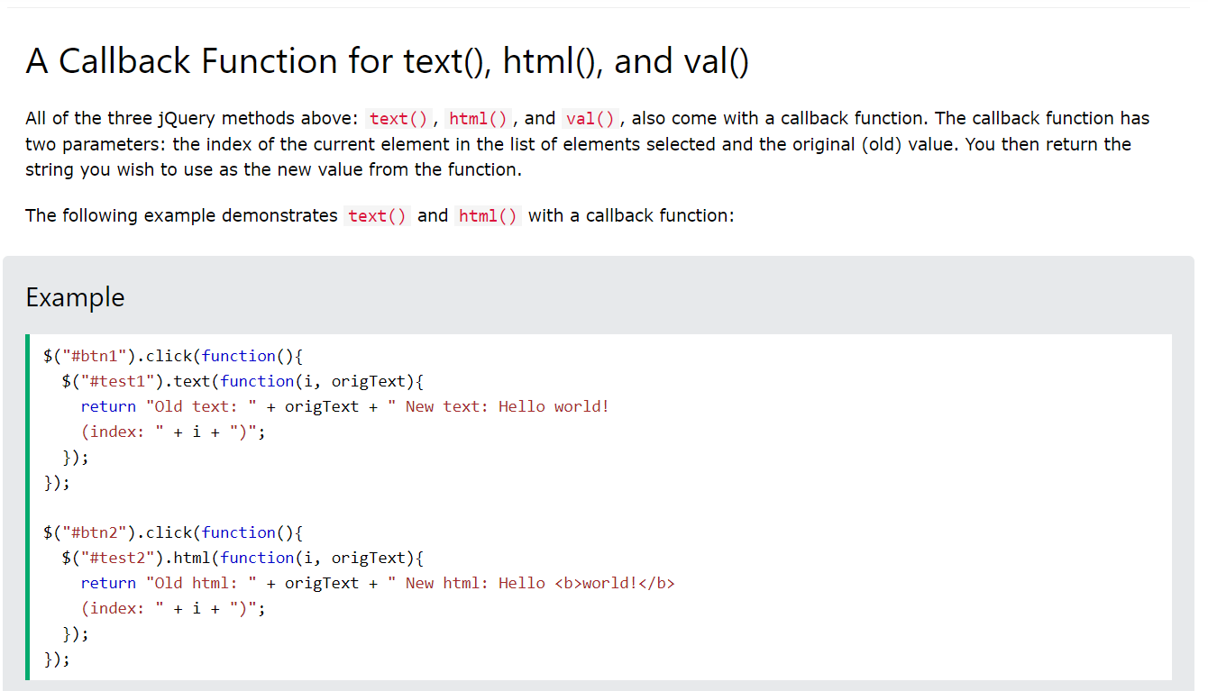

Slide 18
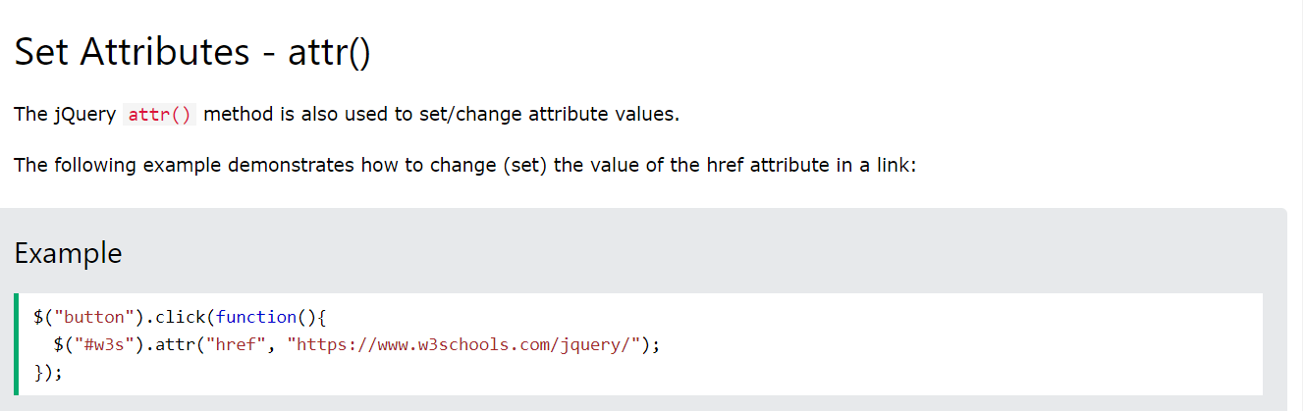
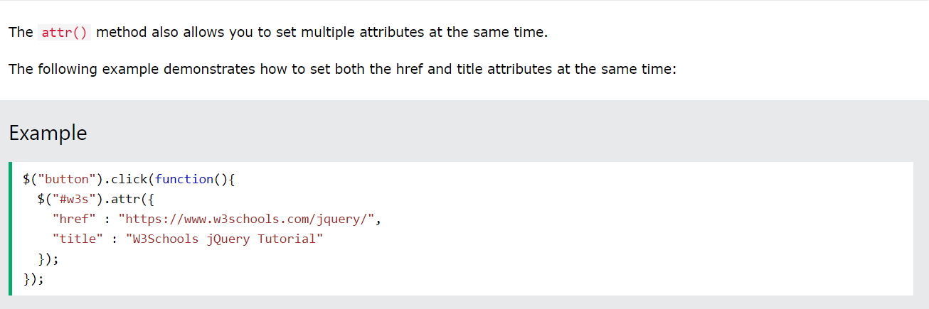

Slide 19
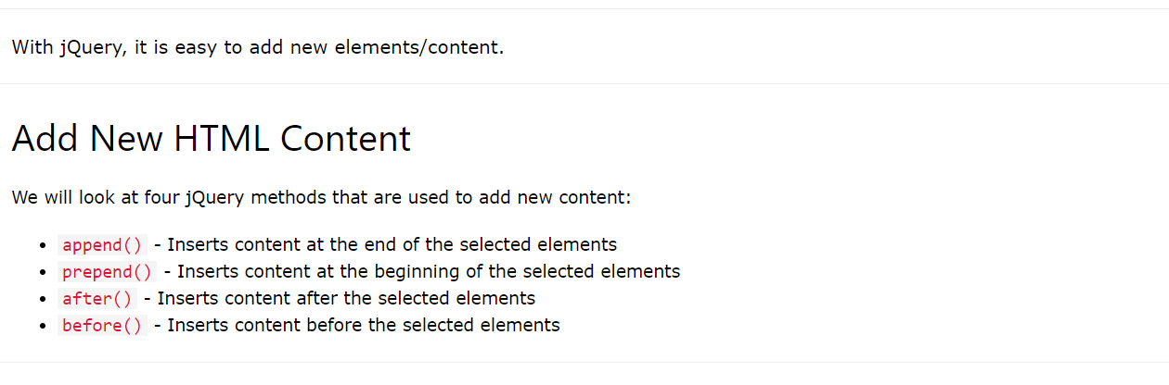
jQuery - Add Elements

Slide 20
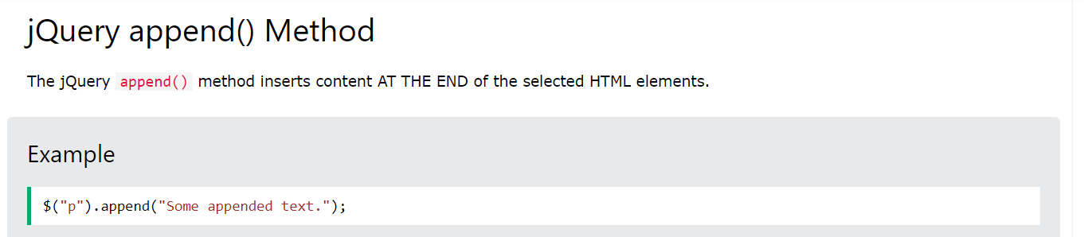
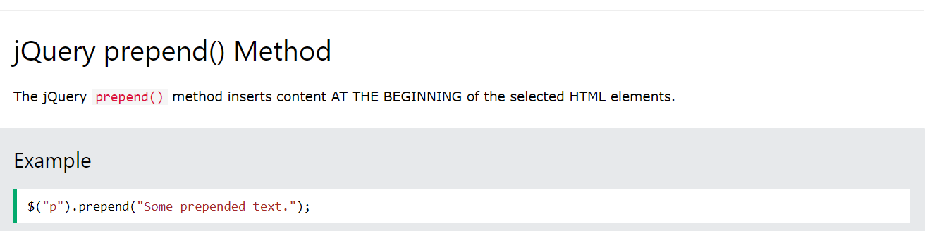

Slide 21
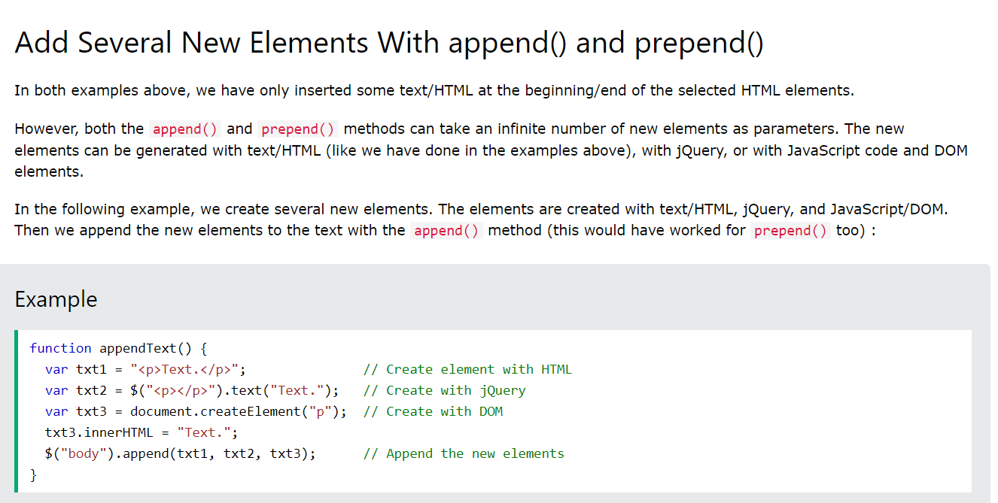

Slide 22
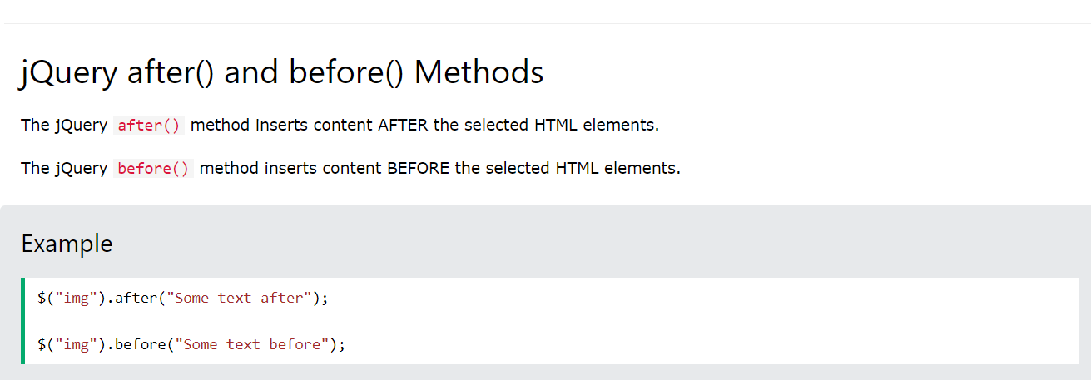

Slide 23
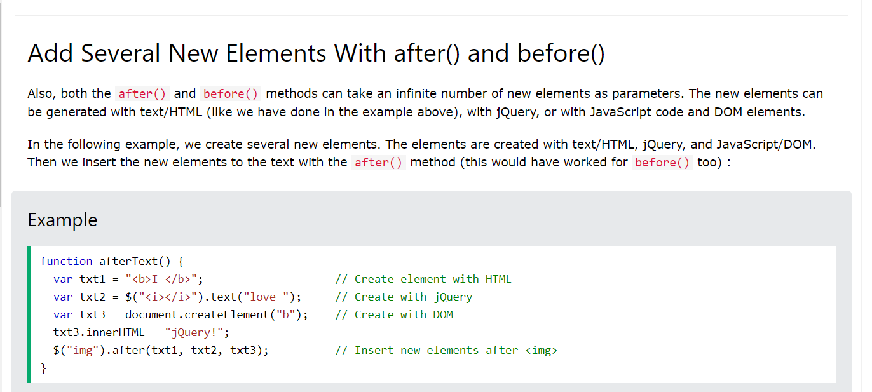

Slide 24
Best resources for learning jQuery
jquery.com
W3school.com
jqueryui.com
Or search from Google.com

