Slide 1
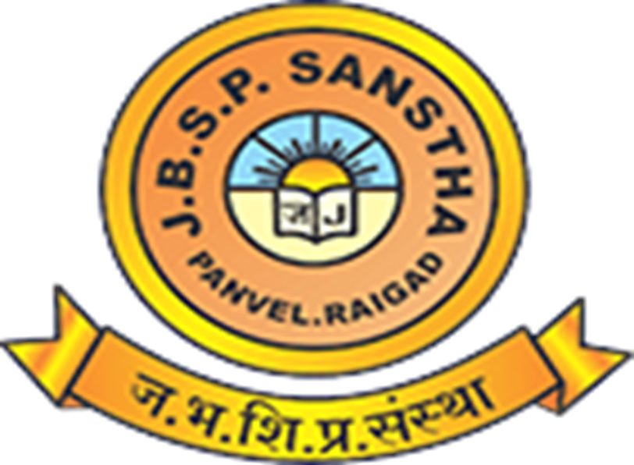

J.B.S.P. Sanstha's College, Panvel
Digital Marketing
Connecting Businesses with Customers Online
Name: Aymaan Aejaz Khalfe & Muskan Santosh Walilkar
Guided By : Rahul Kamble Sir
Notes:
Good morning everyone. Today I will present on Digital Marketing, a topic that has completely changed how businesses reach customers. Along with me is my partner, and together we will walk you through what digital marketing means, its types, benefits, and where this field is heading. Let us get started.

Slide 2





What is Digital Marketing?
Promoting products or services using internet
Reaches people through phones, apps and websites
Important because most customers search online first
Cheaper and faster than traditional advertising methods
Example: Instagram ads, Google search, email offers
J.B.S.P. Sanstha's College, Panvel
2
Notes:
Digital marketing simply means promoting a business using the internet instead of newspapers or TV. It matters because almost every customer today searches online before buying anything. Whether it is a Google search, an Instagram ad, or an email offer, all of this falls under digital marketing. It is faster, cheaper, and reaches more people.

Slide 3



Types of Digital Marketing
SEO
Social Media Marketing
Email Marketing
Ranking higher in search results
Promoting through Instagram, Facebook
Sending offers directly to inbox
Content Marketing
PPC Advertising
Affiliate Marketing
Blogs, videos and useful posts
Paid ads, pay only per click
Others promote and earn commission
J.B.S.P. Sanstha's College, Panvel
3
Notes:
There are six major types of digital marketing. SEO helps websites rank higher on Google. Social media marketing uses platforms like Instagram and Facebook. Email marketing sends offers directly to customers. Content marketing includes blogs and videos. PPC means paid ads where you pay per click. Affiliate marketing rewards others for promoting your product.

Slide 4
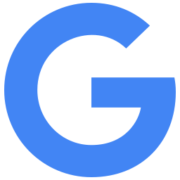





Popular Digital Marketing Platforms
Google
Facebook
Instagram
Search ads reach active buyers
Wide audience, detailed targeting options
Visual promotion through reels, stories
YouTube
LinkedIn
WhatsApp
Video ads and content marketing
Best for B2B, professional marketing
Direct, personal customer communication
J.B.S.P. Sanstha's College, Panvel
4
Notes:
These are the platforms most businesses use. Google helps reach people who are already searching to buy. Facebook and Instagram are great for visual ads and reaching a large audience. YouTube works well for video content. LinkedIn is used for professional and B2B marketing. WhatsApp helps businesses talk to customers directly and personally.

Slide 5





Advantages of Digital Marketing
Global Reach
Low Cost
Better Engagement
Reach customers anywhere in the world
Cheaper than TV or newspaper ads
Direct conversation with customers
Measurable Results
24x7 Marketing
Higher Sales
Track clicks, views and sales easily
Business runs even while you sleep
More visibility leads to more orders
J.B.S.P. Sanstha's College, Panvel
5
Notes:
Digital marketing offers many advantages. It has global reach, meaning even a small business can sell worldwide. It costs much less than traditional advertising. Businesses can engage directly with customers and measure exactly how ads are performing. Marketing runs all day and night, which naturally leads to higher sales over time.

Slide 6






Disadvantages of Digital Marketing
High Competition
Privacy Issues
Requires Skills
Many brands compete for attention
Customer data misuse concerns
Needs training and constant learning
Algorithm Changes
Fake Reviews
Time Consuming
Platform rules shift without warning
Can mislead or harm trust
Results take patience and effort
J.B.S.P. Sanstha's College, Panvel
6
Notes:
Along with benefits, digital marketing also has challenges. Competition online is very high, so standing out is difficult. There are privacy concerns about customer data. It requires skills and constant learning since platforms and algorithms keep changing. Fake reviews can also hurt trust, and building real results takes time and patience.

Slide 7




Digital Marketing Process
1. Research
2. Planning
3. Content Creation
4. Promotion
7. Improvement
6. Analysis
5. Customer Engagement
J.B.S.P. Sanstha's College, Panvel
7
Notes:
Digital marketing follows a clear process. It starts with research to understand the audience, then planning the strategy. Next comes content creation, followed by promotion across platforms. After that, businesses focus on customer engagement, then analyze the results using data. Finally, they make improvements and repeat the cycle to get better results.

Slide 8

Real-Life Example
A small clothing shop grows online sales using Instagram and Facebook ads
Opens a business page
Posts product photos
Runs paid ads
Sales grow steadily
Creates shop profile on Instagram
Shares reels and daily updates
Targets local, interested buyers
Gains regular repeat customers
J.B.S.P. Sanstha's College, Panvel
8
Notes:
Let us look at a simple real-life example. A small clothing shop opens an Instagram business page and starts posting product photos and reels regularly. It then runs small paid ads targeting people nearby who are likely to buy. Over time, this steady effort brings more visibility, more orders, and repeat customers, all without opening a new physical store.

Slide 9






Future Scope
AI in Marketing
Chatbots
Influencer Marketing
Smarter targeting and predictions
Instant replies, 24x7 support
Trusted voices promote brands
Voice Search
Personalization
Automation
Searching using Alexa, Google
Ads matched to each user
Saves time on repeat tasks
J.B.S.P. Sanstha's College, Panvel
9
Notes:
Digital marketing keeps evolving quickly. Artificial intelligence is helping brands target the right audience more accurately. Chatbots now provide instant customer support any time of day. Influencer marketing continues to grow in trust and reach. Voice search, personalization, and automation are also shaping how businesses will market themselves in the coming years.

Slide 10


Career Opportunities
SEO Specialist
Social Media Manager
Content Writer
High Demand
Growing Fast
Steady Demand
PPC Expert
Digital Marketing Executive
Freelancer
High Demand
Entry Friendly
Flexible Income
J.B.S.P. Sanstha's College, Panvel
10
Notes:
Digital marketing also opens up many career paths for students. You can work as an SEO specialist, social media manager, content writer, or PPC expert. Many companies also hire digital marketing executives, and this field is entry friendly for freshers. Freelancing is another popular option, offering flexible income and the freedom to work with multiple clients.

Slide 11
Summary
What It Is
Types
Benefits
Future
Marketing done through the internet
SEO, social, email, content, PPC, affiliate
Low cost, wide reach, measurable results
AI, automation, and personalized marketing
J.B.S.P. Sanstha's College, Panvel
11
Notes:
To summarize, digital marketing is promoting a business using the internet. It includes types like SEO, social media, email, content, PPC, and affiliate marketing. Its main benefits are low cost, wide reach, and measurable results. Looking ahead, AI, automation, and personalization will shape the future of this growing field.

Slide 12
Thank You
Any Questions?
Notes:
Thank you for listening. That covers everything about digital marketing, from its meaning and types to its benefits, challenges, and future scope. We hope this gave you a clear and simple understanding of the topic. We are happy to answer any questions you may have.

