Slide 1

DATAFLOW-PLATFORM
090950 - Distributed Systems’s project
Prof. G. Cugola & A. Margara
A.Y. 2023-2024

Slide 2




OUR CHOICES
Distributed File System
Network Channels
Batch
Streaming
VS
VS
In order to lighten communications between coordinator and workers, we’ve chosen a DFS approach in order to, through network channels, exchange only job’s details/operations and not job’s releted data.
We’ve chosen batch processing because we wanted to focus on processing large amounts of data at scheduled time, instead of providing real time data continuosly to the system.

Slide 3
PLATFORM STRUCTURE
Controller Layer
DFS Layer
Physical Layer

Slide 4

GENERIC STRUCTURE
Worker
Worker
Coordinator
Worker
Worker

Slide 5




PHYSICAL LAYER
Worker Server
Worker Server
Coordinator
Worker Server
..…
Worker Server

Slide 6
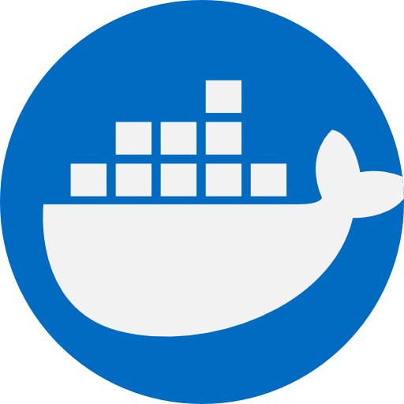

DFS LAYER
Worker
Worker
Coordinator
Worker
..…
Worker

Slide 7
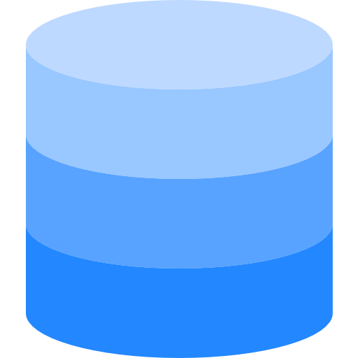
DFS LAYER (example)
Partition3
Partition1
Worker
Worker
Partition4
Partition0
Partition8
Coordinator
Partition5
Worker
Partition7
Partition6
Partition2
Worker

Slide 8
Coordinator Job Execution
CompilationUnitTree cut = parser.parse(programFileName, src, info -> /**/); Program program = ProgramNashornTreeVisitor.parse(src, cut, fileLoader, dfs);
var remainingOps = new ArrayList<>(program.ops()); for (int step = 0; !remainingOps.isEmpty(); step++) { var currOps = nextOpsBatch(remainingOps); currOps.forEach(_ -> remainingOps.removeFirst()); LOGGER.info("Executing step {}...", step); long startStepTime = System.nanoTime(); final var currDfsFile = currDfsFile0; final var dstDfsFileName = dfsFilesPrefix + "_step" + step; int jobId = currentJobNumber.getAndIncrement(); final List<DfsFilePartitionInfo> dstPartitions =
/* schedule each partition on a worker and get results */; DfsFile dstDfsFile = dfs.createPartitionedFile(stDfsFileName, dstPartitions); if (currOps.stream().anyMatch(o -> o.kind().isShuffles())) dfs.reshuffle(dstDfsFile); currDfsFile = dstDfsFile; }

Slide 9


PROGRAM INSERTION
Partition3
Partition1
Program
Worker
Worker
Partition4
Partition0
Partition8
Coordinator
Partition5
Worker
Partition7
Partition6
Partition2
Worker

Slide 10
Coordinator operations splitting logic
private List<Op> nextOpsBatch(Iterable<Op> remainingOps) { var ops = new ArrayList<Op>(); boolean wasShuffled = false; for (Op op : remainingOps) { if (wasShuffled && op.kind().isRequiresShuffling()) return ops; ops.add(op); wasShuffled = wasShuffled || op.kind().isShuffles(); } return ops; }

Slide 11


PROGRAM COMPILING
Partition3
Partition1
Processing…
OpsBatch
Worker
Worker
Partition4
Partition0
Partition8
Coordinator
Partition5
Worker
Partition7
Partition6
Partition2
Worker

Slide 12
Coordinator scheduling for each partition
final List<DfsFilePartitionInfo> dstPartitions; try (var scope = new JobStructuredTaskScope<JobResult>(currDfsFile.partitionsNum())) { var remainingPartitions = new HashSet<>(currDfsFile.partitions()); // Start by the ones that have a close worker currDfsFile.partitions().forEach(partition -> workerManager.getCloseToDfsNode(partition.dfsNodeName()) .stream() .min(Comparator.comparingInt(WorkerClient::getCurrentScheduledJobs)) .ifPresent(worker -> { remainingPartitions.remove(partition); scope.fork(() -> scheduleJobPartition( jobId, worker, currOps, currDfsFile, partition, dstDfsFileName)); })); // Rest of them remainingPartitions.forEach(partition -> { var worker = workerManager.getWorkers() .stream() .min(Comparator.comparingInt(WorkerClient::getCurrentScheduledJobs)) .orElseThrow(() -> new IllegalStateException("No nodes left to schedule")); scope.fork(() -> scheduleJobPartition( jobId, worker, currOps, currDfsFile, partition, dstDfsFileName)); }); dstPartitions = scope.join().result(IOException::new).stream() .map(r -> new DfsFilePartitionInfo( dstDfsFileName, r.result().pkt().dstDfsPartitionFileName(), r.partition(), r.result().worker().getDfsNodeName(), false)) .toList(); }
JobStructuredTaskScope: will wait until we get at least one result for each partition

Slide 13

WORKERS SEARCH
Partition3
Partition1
Searching workers close to partitions…
ScheduleJobPartition packet (partition 3)
Worker
Worker
Partition4
Partition0
Partition8
Coordinator
Partition5
Worker
Partition7
Partition6
Partition2
Worker

Slide 14
WORKERS SEARCH
Partition3
Partition1
Worker
Worker
Partition4
Partition0
Partition8
Coordinator
ScheduleJobPartition packet (partition 3)
Partition5
Worker
Partition7
Partition6
Partition2
Worker

Slide 15

WORKERS SEARCH
Partition3
Partition1
Processing…
Worker
Worker
Partition4
Partition0
Partition8
Coordinator
JobSuccess packet
ScheduleJobPartition packet (partition 3)
Partition5
Worker
Partition7
Partition6
Partition2
Worker

Slide 16

WORKER SEARCH (2)
Partition3
Partition1
Searching workers close to partitions…
0 close worker found
Worker
Worker
Partition4
Worker crashed || Connection lost
Partition0
Partition8
Coordinator
Partition5
Worker
Partition7
Partition6
Partition2
Worker

Slide 17
WORKER SEARCH (2)
Partition3
Partition1
Searching for any active worker…
ScheduleJobPartition packet (partition 3)
Worker
Worker
Partition4
Worker crashed
Partition0
Partition8
Coordinator
Partition5
Worker
Partition7
Partition6
Partition2
Worker

Slide 18
WORKER SEARCH (2)
Partition3
Partition1
Worker
Worker
Partition4
Worker crashed
Partition0
Partition8
Coordinator
ScheduleJobPartition packet (partition 3)
Partition5
Worker
Partition7
Partition6
Partition2
Worker

Slide 19

WORKER SEARCH (2)
Partition3
Partition1
Worker
Worker
Partition4
Worker crashed
Partition0
Partition8
Coordinator
DFS «connection»
Partition3
Partition5
Processing…
Worker
Partition7
Partition6
Partition2
Worker

Slide 20
WORKER SEARCH (2)
Partition3
Partition1
Worker
Worker
Partition4
Worker crashed
Partition0
Partition8
Coordinator
DFS «connection»
Partition3
Partition5
JobSucess packet
Worker
Partition7
Partition6
Partition2
Worker

Slide 21
Worker execution
var engine = engineFactory.create(); var dfsSrcFile = dfs.findFile(
pkt.dfsSrcFileName(), pkt.partitions(), pkt.dfsSrcPartitionNames()); var restoredBackup = dfs.loadBackupInfo(
pkt.jobId(), pkt.partition(), pkt.dfsDstFileName()); // Create the partition in which we are going to put the results var dfsDstFilePartition = restoredBackup != null ? restoredBackup.dstFilePartition() : dfs.createTempFilePartition( pkt.dfsDstFileName(), pkt.partition(), CreateFileOptions.IF_NOT_EXISTS); // Initialize backup information if(restoredBackup == null) dfs.writeBackupInfo(pkt.jobId(), pkt.partition(), dfsDstFilePartition, null); var compiledOps = ThreadPools.executeSync(cpuThreadPool,
() -> Program.compile(engine, pkt.ops())); // Work loop executing the task // …
return new JobSuccessPacket(dfsDstFilePartition.partitionFileName());

Slide 22
WORKER EXECUTION
Partition3
Partition1
Worker
Worker
Partition4
Partition0
Partition8
Coordinator
Partition5
Worker
Checking for backup...
Restore it if found
Initialize it if not found
Partition7
Partition6
Partition2
Worker

Slide 23

WORKER EXECUTION
Partition3
Partition1
Worker
Worker
Partition4
Partition0
Partition8
Coordinator
Partition5
Worker
Compiling received ops
Compiled ops
Partition7
Partition6
Partition2
Worker

Slide 24
Worker execution loop
Integer nextBatchPtr = restoredBackup != null ? restoredBackup.nextBatchPtr() : null; while (true) { if(Thread.interrupted()) throw new InterruptedException(); var currentBatch = dfs.readNextBatch(dfsSrcFile, pkt.partition(), 1000, nextBatchPtr); if (currentBatch.data().isEmpty()) { break; } var currentBatchData = currentBatch.data(); var currentBatchRes = ThreadPools.executeSync( cpuThreadPool, () -> CompiledProgram.execute(compiledOps, currentBatchData.stream()).toList()); dfs.writeBatchInPartitionAndBackup( pkt.jobId(), pkt.partition(), dfsDstFilePartition, currentBatchRes, currentBatch.nextBatchPtr()); nextBatchPtr = currentBatch.nextBatchPtr(); }

Slide 25
WORKER EXECUTION LOOP
Partition3
Partition1
Worker
Worker
Partition4
Partition0
Partition8
Coordinator
Partition5
Worker
Execute comp. ops, write data in partition & backup
Partition7
Partition6
Partition2
Worker

Slide 26
WORKER EXECUTION LOOP
Partition3
Partition1
Worker
Worker
Partition4
Partition0
Partition8
Coordinator
Partition5
Worker
JobSuccessPacket
Partition7
Partition6
Partition2
Worker

Slide 27
Coordinator stragglers handling
private PartitionResult<JobResult> scheduleJobPartition(…) throws InterruptedException { Function<WorkerClient, ScheduleJobPacket> pktFactory = worker -> new ScheduleJobPacket(…); try (var scope = new StructuredTaskScope.ShutdownOnSuccess<PartitionResult<JobResult>>()) { var numOfRunningTasks = new AtomicInteger(); scheduleJobPartitionInScopeFork(scope, pktFactory, initialWorker, numOfRunningTasks); while (true) { try { scope.joinUntil(
Instant.now().plus(STRAGGLERS_TIMEOUT_MILLIS, ChronoUnit.MILLIS)); break; } catch (TimeoutException e) { // Timed out } // If there's anybody not doing any work,
// make him work and get the result of whoever finishes first (IDLE_WORKER_THRESHOLD = 1) findBestWorkerFor(srcPartition.dfsNodeName(), IDLE_WORKER_THRESHOLD) .ifPresent(freeWorker -> scheduleJobPartitionInScopeFork(
scope, pktFactory, freeWorker, numOfRunningTasks)); } return Objects.requireNonNull( scope.result(e -> new IllegalStateException(…)), STR."Scope result of job \{jobId} for partition \{srcPartition} is null"); } }
StructuredTaskScope.ShutdownOnSuccess: keeps the first successful result for a particular partition and discards the rest

Slide 28
STRAGGLERS HANDLING
Partition3
Partition1
Search a worker in idle…
ScheduleJobPartition packet
Worker
Worker
Partition4
Partition0
If present
Partition8
Coordinator
Partition5
Execute comp. ops, write data in partition & backup
Worker
Taking too much time…
Partition7
Partition6
Partition2
Worker

Slide 29
STRAGGLERS HANDLING
Partition3
Partition1
Worker
Worker
Partition4
Partition0
Partition8
Coordinator
ScheduleJobPartition packet
Partition5
Worker
Partition7
Partition6
Partition2
Worker

Slide 30
STRAGGLERS HANDLING
Partition3
Partition1
Worker
Worker
Partition4
Partition0
Partition8
Coordinator
JobSuccess packet
Take the first result received
Partition5
Worker
JobSuccess packet
Partition7
Partition6
Partition2
Worker

Slide 31
Coordinator worker failure handling
private PartitionResult<JobResult> scheduleJobPartitionInScope[Fork](…) throws Exception { var pkt = pktFactory.apply(worker); var unschedule = worker.scheduleJob(pkt.jobId(), pkt.partition()); numOfRunningTasks.getAndIncrement();
try (var _ = unschedule; var ctx = worker.getSocket().send(pkt, JobResultPacket.class)) { return switch (ctx.getPacket()) { case JobSuccessPacket resPkt -> new PartitionResult<>(pkt.partition(), new JobResult(worker, resPkt)); case JobFailurePacket(Exception ex) -> { // The job failed for an exception in the submitted program (most likely), so we are done var jobFailureEx = new JobFailureException(ex); scope.shutdown(); throw jobFailureEx; } }; } catch (JobFailureException ex) { throw ex; // Submitted program failed, we are done } catch (InterruptedIOException ex) { threadPool.execute(() ->
worker.getSocket().send(new CancelJobPacket(pkt.jobId(), pkt.partition())));
// Interrupted we are done throw (InterruptedException) new InterruptedException().initCause(ex); } catch (Throwable t) {
// Log errors and go on } boolean reschedule = numOfRunningTasks.decrementAndGet() == 0; if (reschedule) rescheduleJobPartitionInScopeFork(
scope, pkt.dfsSrcFileName(), pktFactory, numOfRunningTasks); // If it disconnects and reconnects, we want to make it pick it up from where it left off WorkerClient reconnected = workerManager .waitForReconnectionOf(worker.getUuid(), pkt.jobId(), pkt.partition()) .get(); return scheduleJobPartitionInScope(scope, pktFactory, reconnected, numOfRunningTasks); }

Slide 32
FAILURE HANDLING
Partition3
Partition1
Worker
Worker
Partition4
Partition0
Partition8
Coordinator
Partition5
Execute comp. ops, write data in partition & backup
Worker
Some error (connection || execution) happen…
Partition7
Partition6
Partition2
Worker

Slide 33
FAILURE HANDLING (1)
Partition3
Partition1
Worker
Worker
Partition4
Partition0
Partition8
Coordinator
Partition5
Worker
JobFailure packet
If execution error:
Partition7
Partition6
Partition2
Worker

Slide 34
FAILURE HANDLING (2)
Partition3
Partition1
Try to reschedule the job…
ScheduleJobPartition packet
Worker
Worker
Partition4
Partition0
Partition8
Coordinator
Checking for reconnection…
Partition5
Worker
If crash:
Partition7
Partition6
Partition2
Worker

Slide 35
FAILURE HANDLING (2)
Partition3
Partition1
Processing…
Worker
Worker
Partition4
Partition0
Partition8
Coordinator
Checking for reconnection…
Take the first result received
Partition5
ScheduleJobPartition packet
Worker
JobSuccess packet
If crash:
Partition7
Partition6
Partition2
Worker

Slide 36
Coordinator desperate handling
private void rescheduleJobPartitionInScopeFork(…) { scope.fork(() -> { var maybeNewWorker = findBestWorkerFor(dfsSrcFileName, Integer.MAX_VALUE); WorkerClient newWorker; if (maybeNewWorker.isPresent()) { newWorker = maybeNewWorker.get(); } else { try { newWorker = workerManager.waitForAnyReconnections() .get(NO_NODES_TIMEOUT_MILLIS, TimeUnit.MILLISECONDS); } catch (TimeoutException ex) {
scope.shutdown(); throw new IOException("No nodes connected for more than " + TimeUnit.MILLISECONDS.toSeconds(NO_NODES_TIMEOUT_MILLIS) + "s", ex); } } return scheduleJobPartitionInScope(scope, pktFactory, newWorker, numOfRunningTasks); }); }

Slide 37
FAILURE HANDLING
Partition3
Partition1
Try to reschedule the job…
0 nodes found connected
Worker
Worker
Partition4
Partition0
Partition8
Coordinator
Checking for reconnection…
Program execution aborted
Partition5
Worker
If crash:
Partition7
Partition6
Partition2
Worker

