Slide 1



Agentic Workspace for Insurance
ADD LOGO
HERE
AI Workspace for Insurance
furtherai.com
1

Slide 2
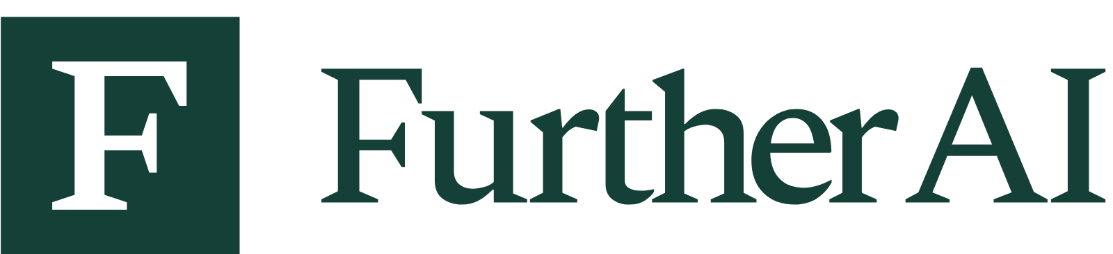



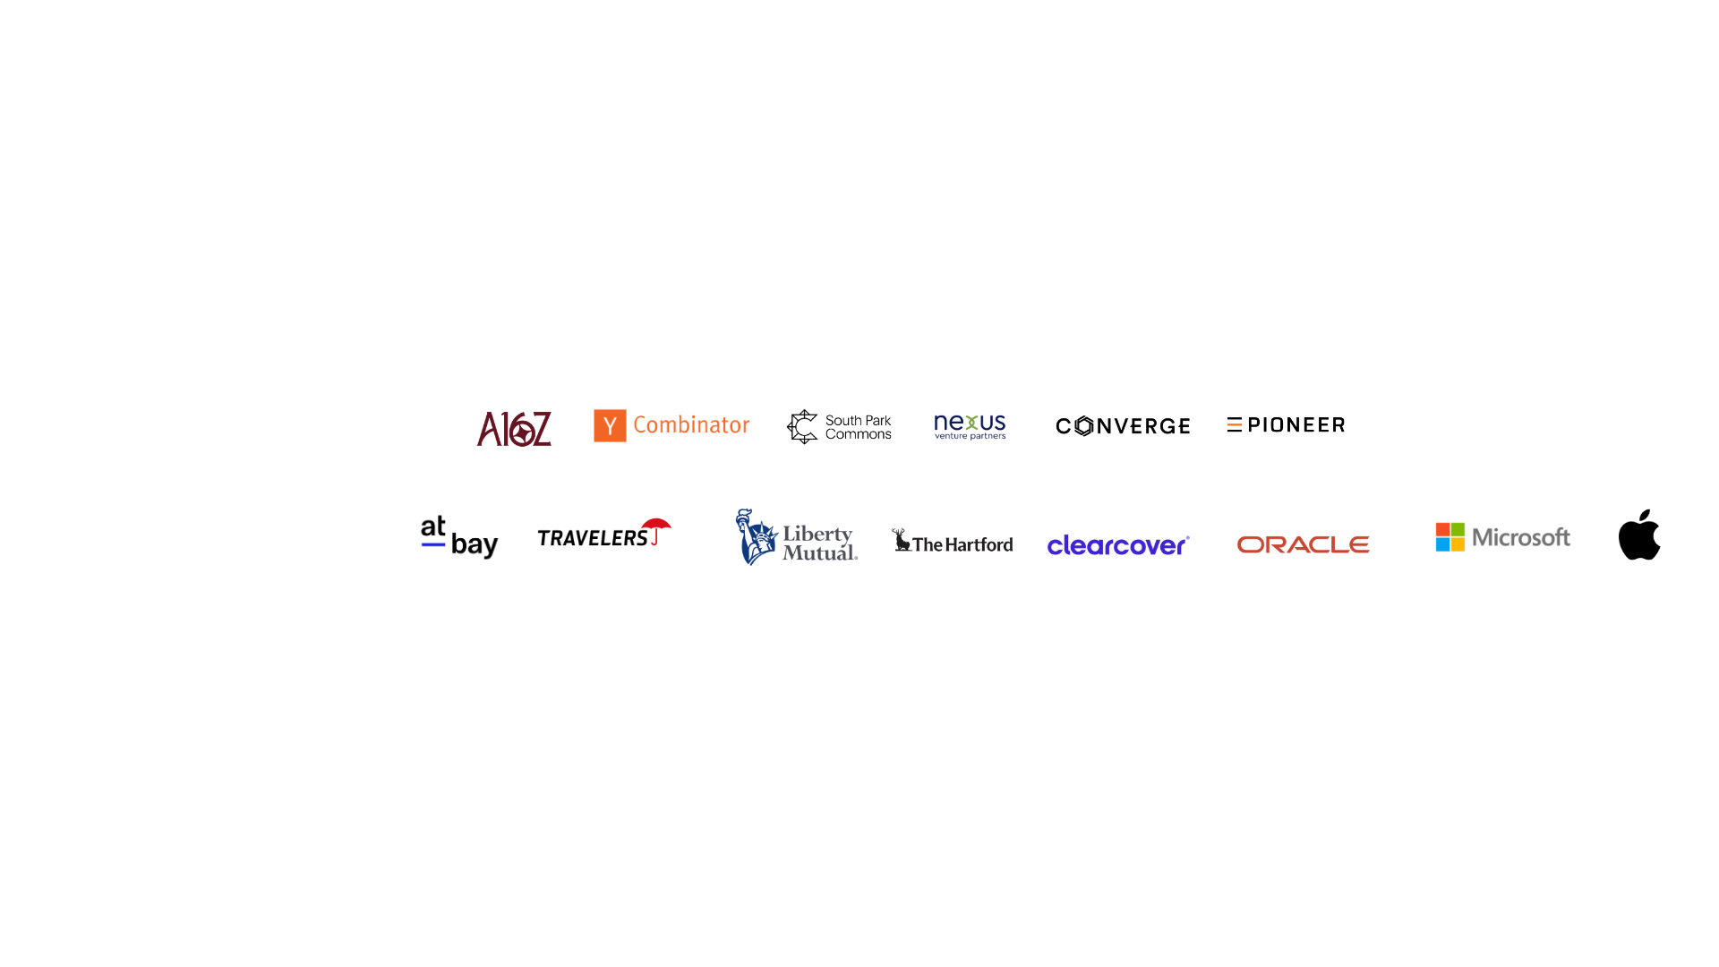
Our Team
Aman Gour
Kush Agarwal
Danny O’Lenic
CEO & Co-Founder
Director, AI Solutions
Product Lead, Insurance
Backed by
Team Experience

Slide 3
Our Team
Aman Gour
Kush Agarwal
CEO & Co-Founder
Director, AI Solutions
Backed by
Team Experience

Slide 4

Our Team
Aman Gour
Logan Krumholz
CEO & Co-Founder
Director, Strategic Partnerships
Backed by
Team Experience

Slide 5

Our Team
Aman Gour
Bobby Glasco
CEO & Co-Founder
Enterprise Account Executive
Backed by
Team Experience

Slide 6

Our Team
Aman Gour
Mike Harris
CEO & Co-Founder
Enterprise Account Executive
Backed by
Team Experience

Slide 7

Our Team
Aman Gour
Sashank Gondala
CEO & Co-Founder
CTO & Co-Founder
Backed by
Team Experience

Slide 8

Our Team
Aman Gour
Dani Salgado
CEO & Co-Founder
AI Solutions
Backed by
Team Experience

Slide 9

Our Team
Aman Gour
Gavin Foltz
CEO & Co-Founder
Enterprise Account Executive
Backed by
Team Experience

Slide 10

Our Team
Aman Gour
Nia Casso
CEO & Co-Founder
Enterprise Account Executive
Backed by
Team Experience

Slide 11
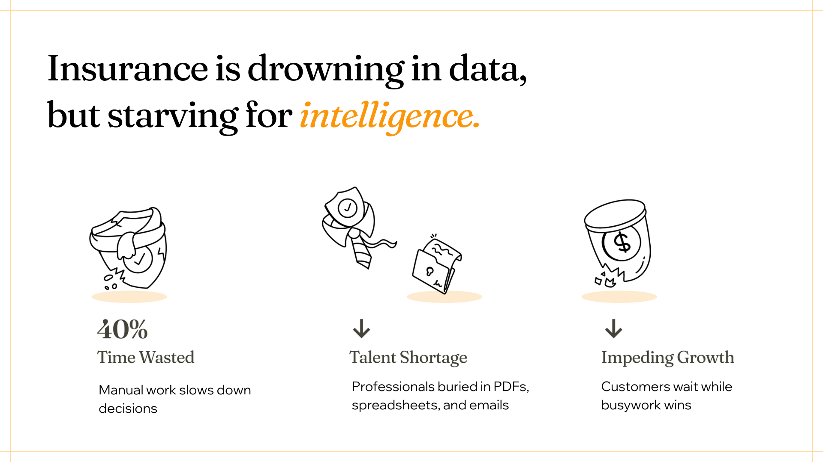
Every manual workflow
is a ceiling on growth.
Siloed Data
Disconnected Workflows
Narrow AI Projects
Underwriting doesn't see claims. Distribution doesn't see operations. Everyone works with half the picture.
Work moves between teams through email, spreadsheets, and manual handoffs — nothing flows end to end.
Point solutions automate one task. They don't compound into enterprise-wide impact.

Slide 12





Agentic Workspace for Insurance
Frontier AI Models
Agentic Workflows
Multi-modal AI
tailored for Insurance
Automates end-to-end Work
With
human-in-the-loop
Integrates with Insurance systems
AI Workspace for Insurance

Slide 13


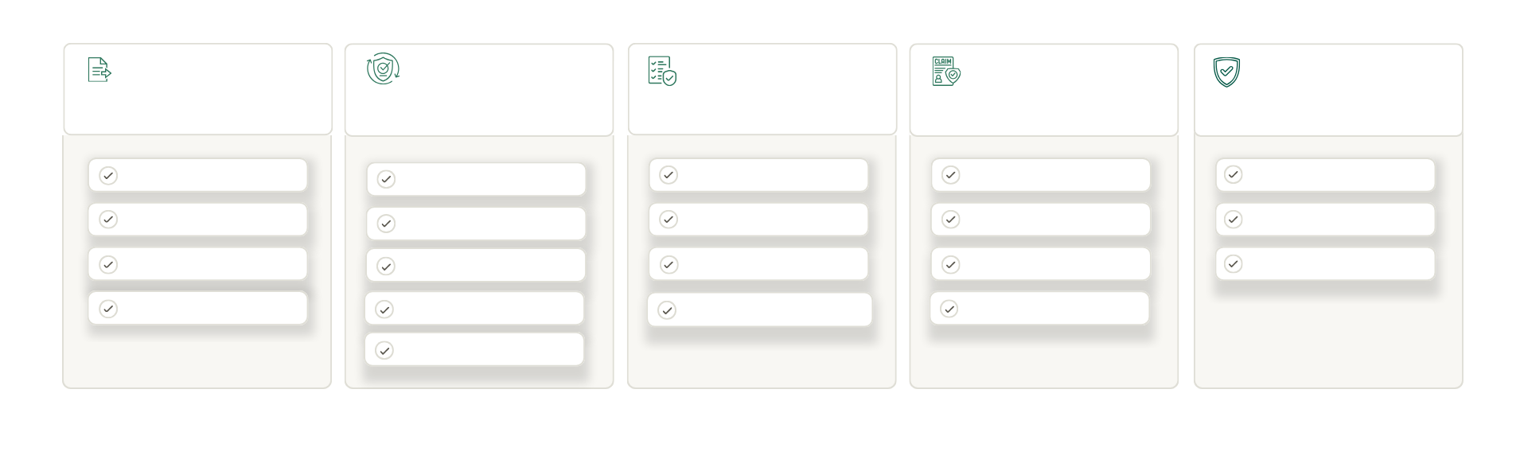

Example Use Cases
Automate Complex End to End Insurance Workflows
and more
Agency Ops
Underwriting
Policy
Claims
Compliance
Proposal Generation
Intake & Triage
Policy Renewal
Claims Intake
Underwriting Audit
Guideline Validation
Create Submission
Submission Clearance
Policy Change
Segmentation
Transaction Audit
Audit Trail
Policy Compare
SOV Processing
Quoting & Issuing
Claims Assignment
Claims Audit
Segregation of Duties
Quote Compare
Loss Run Processing
Reinstatement
Claims Adjudication
Portfolio Analytics/Mgmt
AI Workspace for Insurance
Notes:
We’re not just solving one task — we’re automating end-to-end insurance workflows, from submission intake to policy checking, audits, and claims validation.
Some people don’t agree with this kind of holistic approach but Our customers love it.

Slide 14
Agentic Workspace for Insurance
Out of box
usecases
Distribution
UW
Claims
Policy Servicing
Compliance
Agentic Workflow Library
Agents and guardrails
Agent Orchestrator
Agent Evaluations
Agentic Workflows
Intelligence + Contextual Data
Skills
Web & 3rd Party Data
Policy Forms
SOVs
Loss Runs
+10 More
Identity Data
Asset Data
Financial Data
Hazard Data
Model Router
Insurance Systems
ChatGPT
Claude
Gemini
Llama
CRM
AMS
PMS
MCP
Misc.
AI Workspace for Insurance

Slide 15

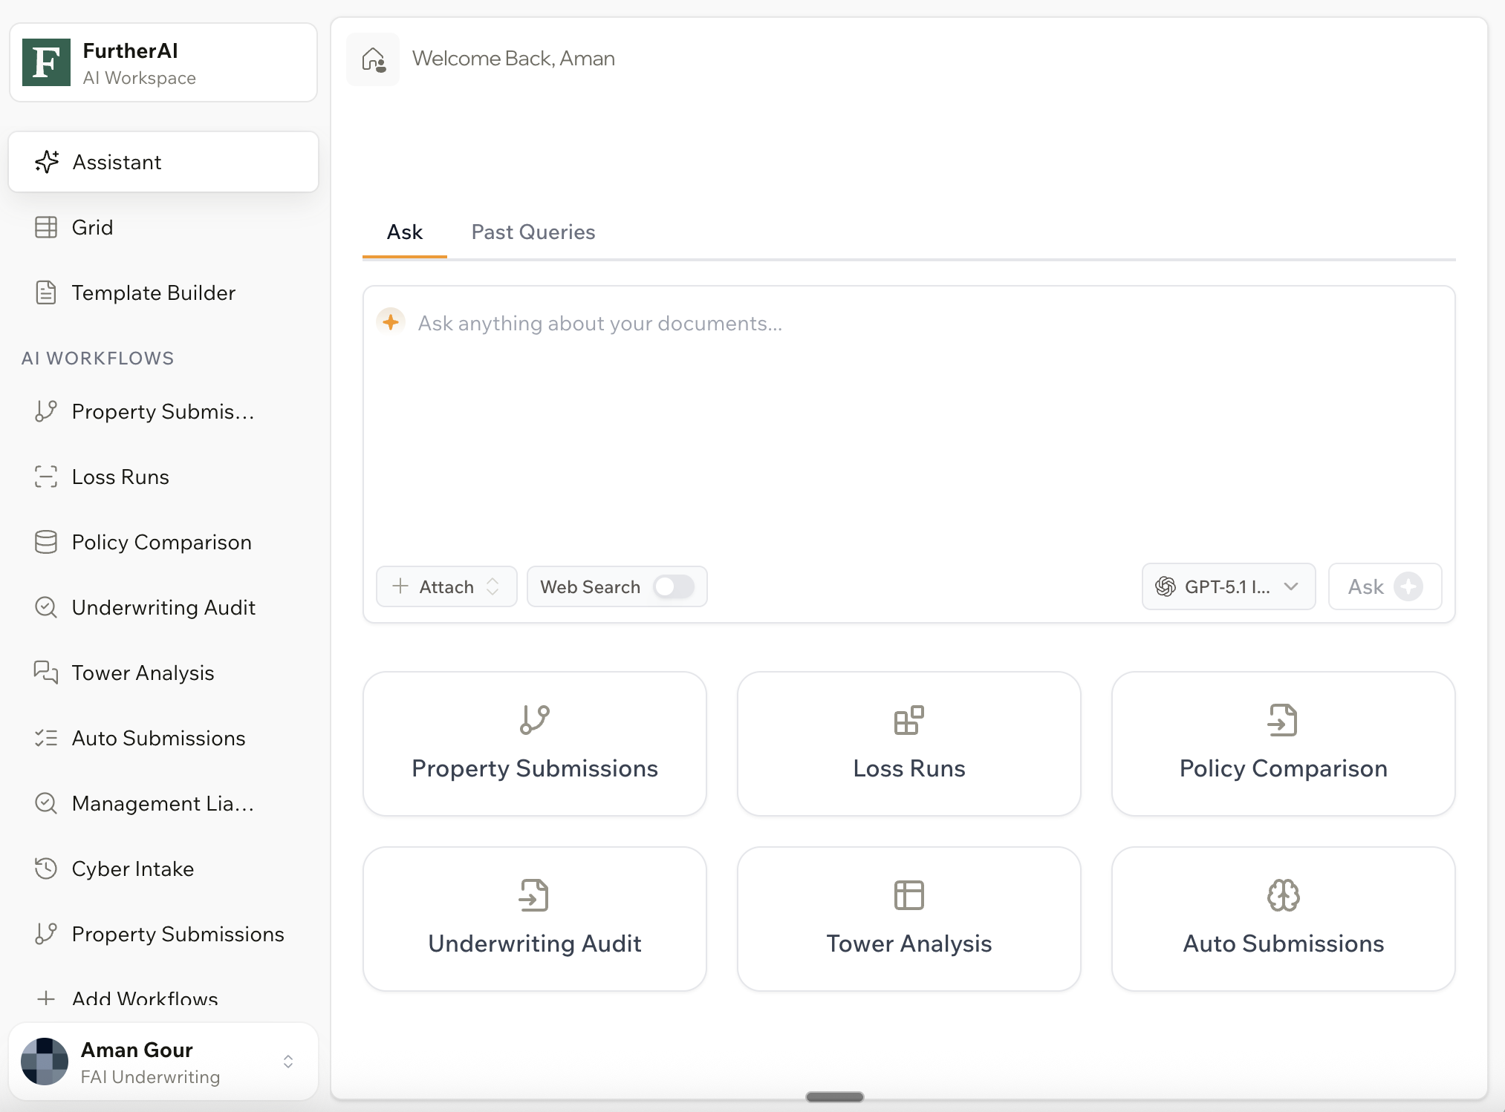

Demo
Assistant
Workflows
Orchestrator
Eval Studio
Portfolio
AI Workspace for Insurance
6

Slide 16


Demo Workflow
Broker
Email
Exposure & Loss Run Processing
Clearance Checks
(OFAC, Legal, Insurity)
Document Classification & Data
Extraction
Extracted Loss Run information
Checked OFAC Sanctions
Calculated Triage Score & Summary
Completed Document Classification
Verified Claims
Checked Legal Case History
Received Submission
(Email)
Outgoing Email
AI
Completed Aggregate Loss Runs
Extracted Submission Information from ACORDs
Processed SOV Files
Check for Clearance
(Internal System)
Extracted Occupancy Classification
AI Workspace for Insurance
Notes:
Add team to this

Slide 17
Workflow
Broker
Email
UW
Request More Documents
Request for BOR
Send To Insurity
No
All Documents Present?
Yes
Data Ingestion
Yes
Prior
Clear
AI
Triage
(Additional Questions)
Data Extraction
Clearance
Summarize
w/ Risk Score
Guideline Check
Check For Clearance
Enrichment
AI Workspace for Insurance
Notes:
Add team to this

Slide 18
Workflow
Submissions
Submissions Platform
Program 1
Policy Admin 1
Program 2
Policy Admin 2
Program 3
Policy Admin 3
AI Workspace for Insurance
Notes:
Add team to this

Slide 19

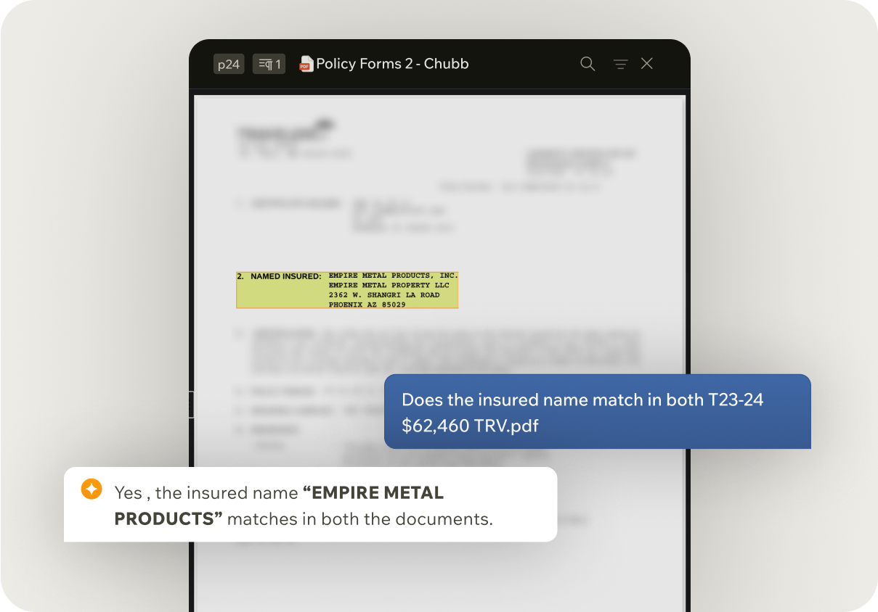

Distribution
Proposal Generation
Generate compliant, carrier-ready proposals in minutes — enabling 2–3× more proposals per producer per week.
Create Submission
Turn inbound emails and attachments into complete, structured submissions with >90% automation.
Policy Checking
Compare binders, endorsements, and policies line-by-line to catch discrepancies before they reach the insured.
Quote Compare
Normalize and compare quotes across carriers so brokers can advise faster and bind with confidence.
AI Workspace for Insurance
Notes:
We’re not just solving one task — we’re automating end-to-end insurance workflows, from submission intake to policy checking, audits, and claims validation.
Some people don’t agree with this kind of holistic approach but Our customers love it.

Slide 20
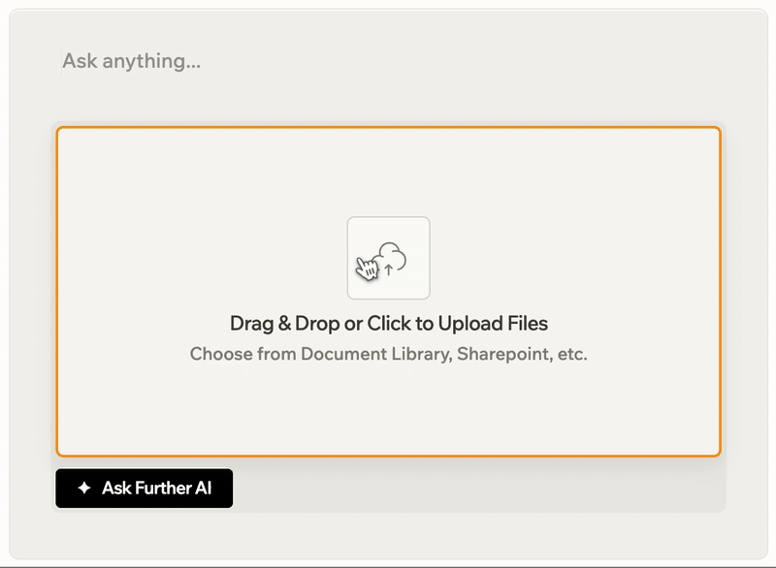
Underwriting
Intake & Triage
Automatically ingest submissions and surface risk signals upfront, cutting triage time by up to 70%
Clearance
Run OFAC, legal, and clearance checks automatically to reduce review cycles from days to minutes.
SOV Conversion
Convert messy, multi-format SOVs into structured, analysis-ready data with >95% accuracy.
Loss Run Processing
Extract, verify, and summarize loss runs automatically — reducing processing time by 70–90%.
AI Workspace for Insurance
Notes:
We’re not just solving one task — we’re automating end-to-end insurance workflows, from submission intake to policy checking, audits, and claims validation.
Some people don’t agree with this kind of holistic approach but Our customers love it.

Slide 21
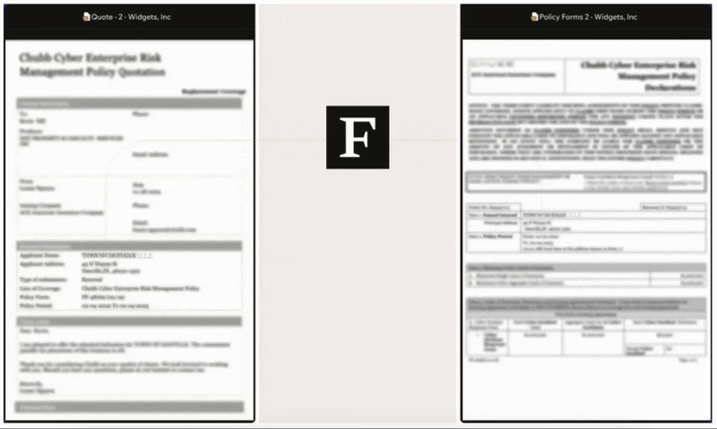
Policy Servicing
Policy Comparison
Compare binders, endorsements, and issued policies line-by-line to surface discrepancies before they become E&O risk.
Policy Checking
Validate policies against underwriting intent and guidelines to prevent post-bind rework.
Quote Comparison
Normalize and compare carrier quotes side-by-side so teams can advise and bind with confidence.
AI Workspace for Insurance
Notes:
We’re not just solving one task — we’re automating end-to-end insurance workflows, from submission intake to policy checking, audits, and claims validation.
Some people don’t agree with this kind of holistic approach but Our customers love it.

Slide 22
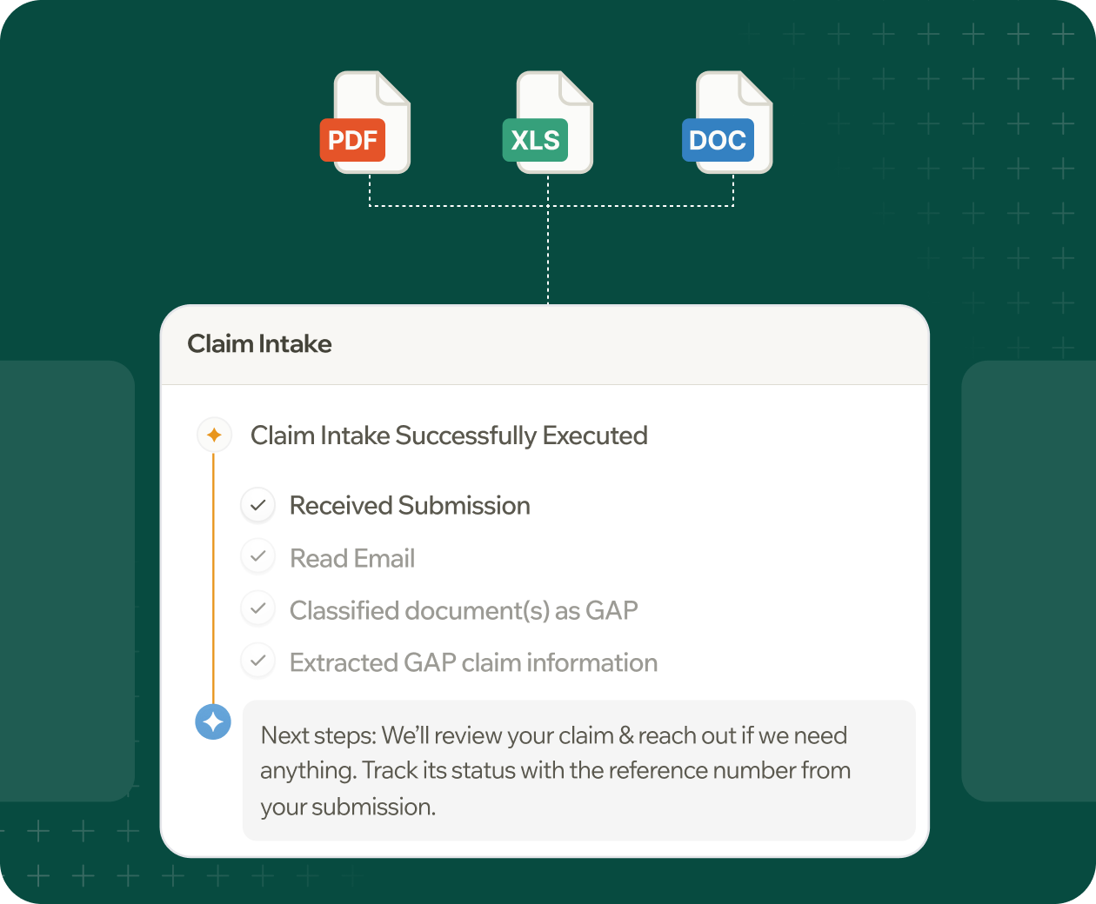
Claims
Claims Intake
Automate first notice and document intake to process claims 10× faster with >90% automation.
Segmentation
Route claims by complexity and severity automatically so adjusters focus on the cases that need judgment.
Summary Generation
Generate clear, audit-ready claim summaries instantly — eliminating manual write-ups and rework.
Domain Specific AI for Insurance
AI Workspace for Insurance
Notes:
We’re not just solving one task — we’re automating end-to-end insurance workflows, from submission intake to policy checking, audits, and claims validation.
Some people don’t agree with this kind of holistic approach but Our customers love it.

Slide 23
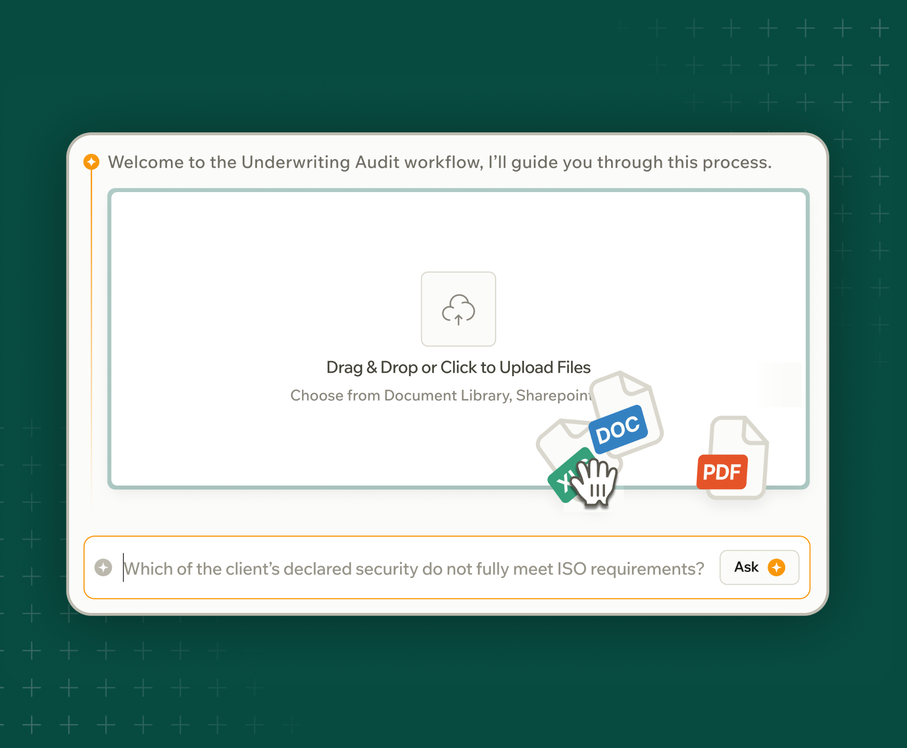
Compliance & Audit
Underwriting Audit
Audit underwriting decisions automatically to reduce review time by up to 45% while improving guideline adherence.
Transaction Audit
Automatically audit policy and endorsement transactions to ensure accuracy, completeness, and regulatory compliance.
Claims Audit
Review claims files automatically to identify leakage, inconsistencies, and compliance gaps at scale.
AI Workspace for Insurance
Notes:
We’re not just solving one task — we’re automating end-to-end insurance workflows, from submission intake to policy checking, audits, and claims validation.
Some people don’t agree with this kind of holistic approach but Our customers love it.

Slide 24

AI is transforming how insurance works.
But the question for insurers is:
How do we unlock millions in value
with AI?
AI Workspace for Insurance
furtherai.com

Slide 25
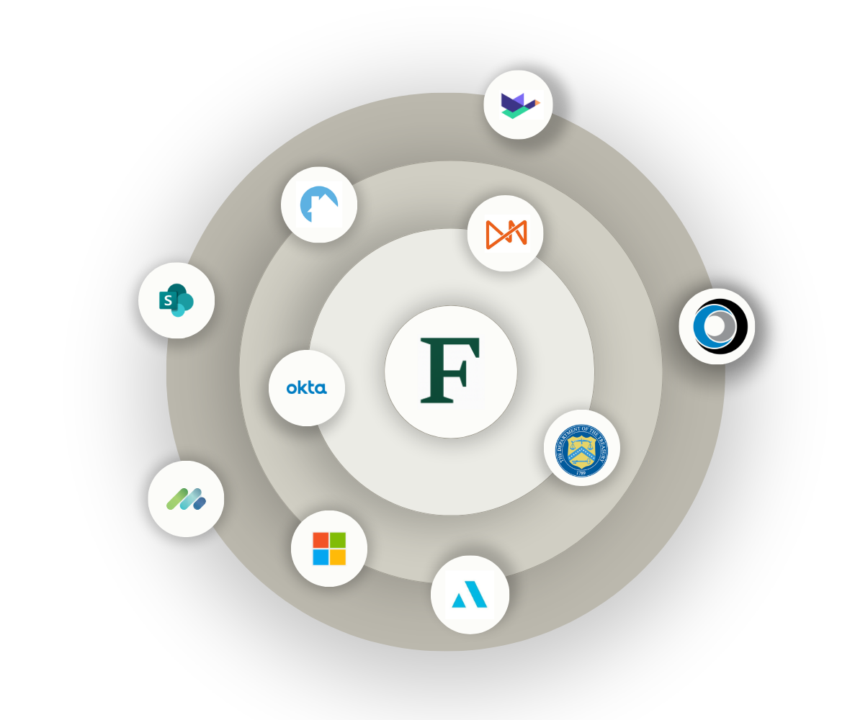
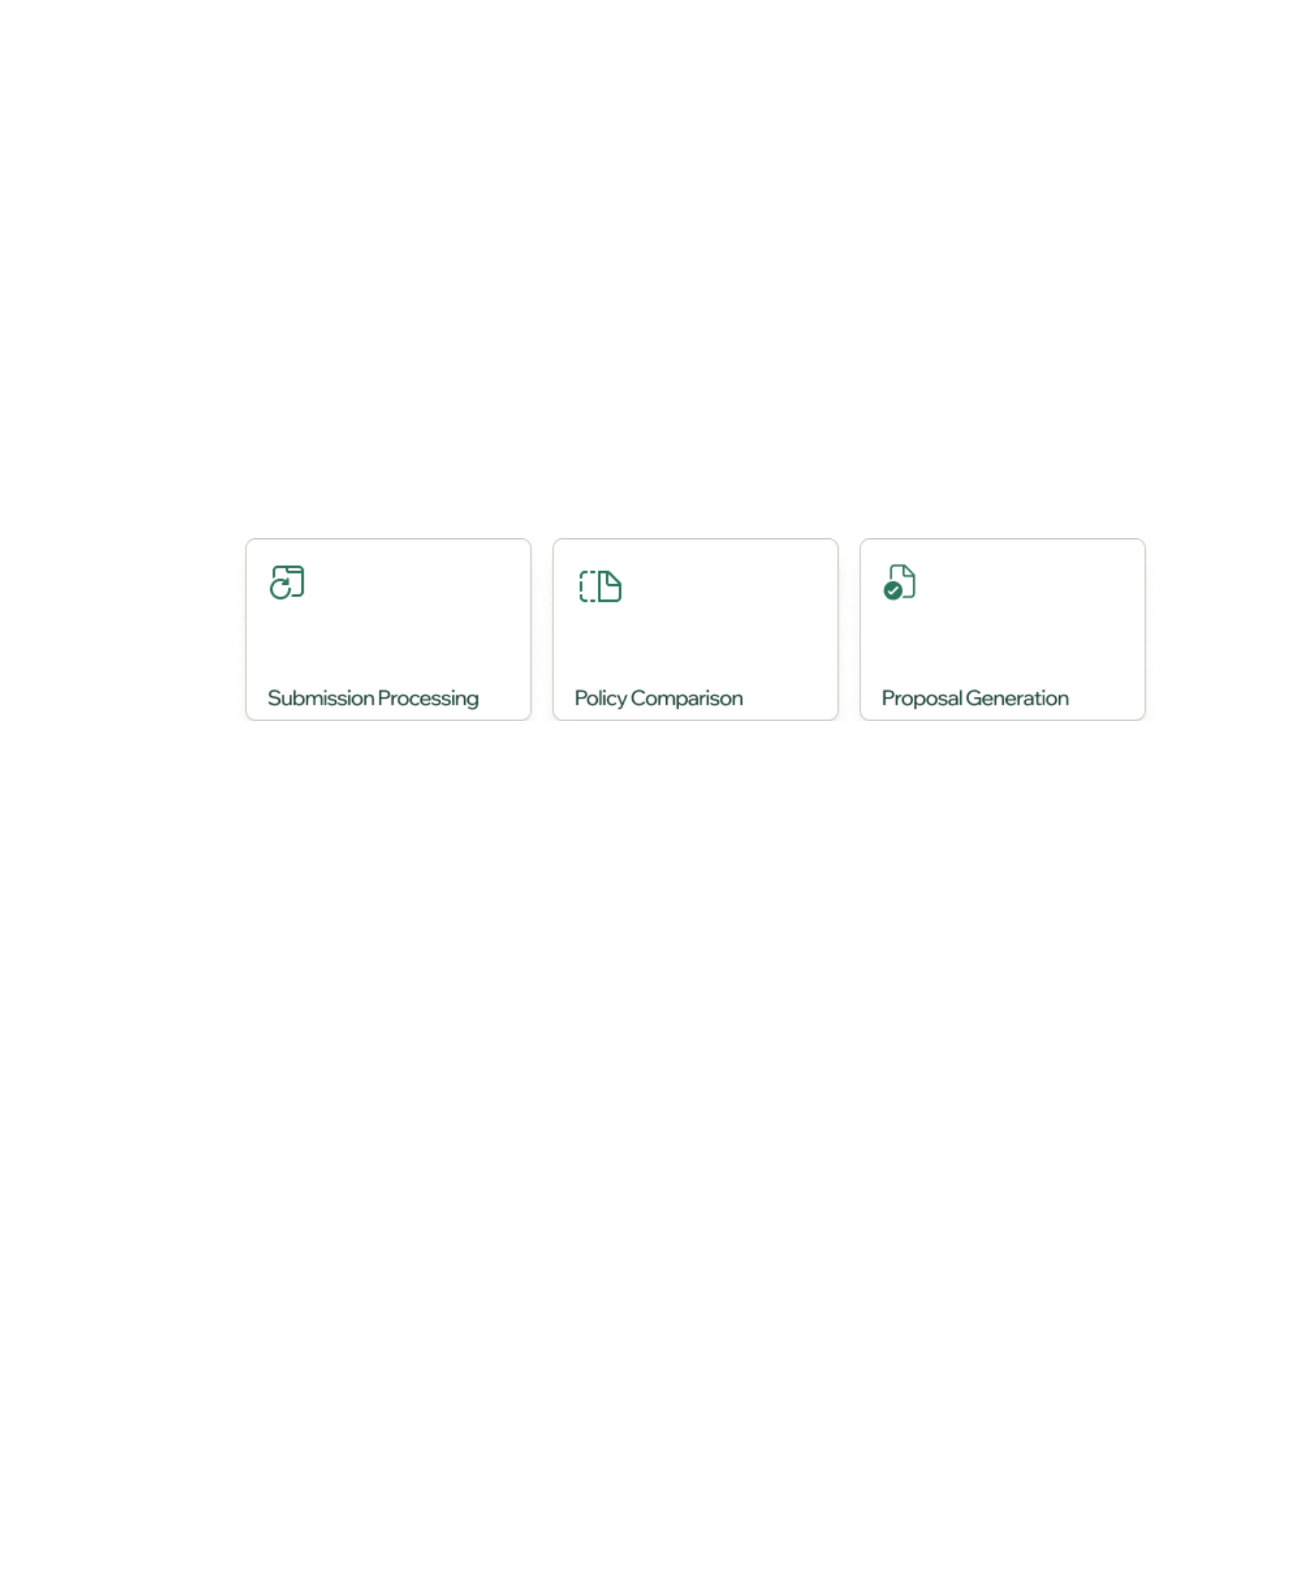
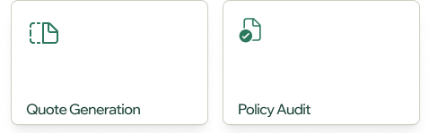
We provide a different approach
Start with one workflow
Preserve your systems
Expand as value compounds
AI Workspace for Insurance

Slide 26

Proven Playbook | Top 5 Engagements
Company | Initial Workflow | Current Status | Expected Value In 12 months
Large Fronting Carrier | Underwriting audit | Policy Audit, Submissions Processing | $9M
Top-5 Carrier | SOV Mapping (Large commercial property) | E&S Submissions, Surety Bond Intake, Financial Statement Processing | $35M
MGA with >$1B GWP | Commercial Property Submissions | Expansion across CGL, D&O and Personal Lines | $19.5M
Top-20 Broker | Policy comparison, Proposal Generation | Quote compare, loss analysis | $24M
Fortune 50 Insurer | Claims Intake | Submissions Processing, Claims Intake | $15M
Large E&S Carrier | Submissions Ingestion | Appetite Check | $20M

Slide 27

How FurtherAI Fits Your Stack
Use Cases
Underwriting
Claims
Policy Admin
Distribution
Compliance
Document
Understanding
Research
& Analysis
Multi-System
Reasoning
Human
Judgement
Autonomous
Execution
Your Systems
Policy Admin
CRM/AMS
Email
Third Party Data
File Stores
AI Workspace for Insurance
Notes:
We’re not just solving one task — we’re automating end-to-end insurance workflows, from submission intake to policy checking, audits, and claims validation.
Some people don’t agree with this kind of holistic approach but Our customers love it.

Slide 28
Multi-agent System
Inbox
Workflow
Intake
Workflow
Risk
Workflow
Rating
Workflow
AI Workspace for Insurance
Notes:
Add team to this

Slide 29
Agent #1
Inbox Workflow
An agent that can identify submissions, extract key document data, and intelligently route new or existing cases to intake.
Email
No
Start new workflow
Inbox
Agent
Yes
Intake Agent
Is
Submission?
Process Email & Attachment
Follow-up?
Merge with existing
Classify
Documents
Extract Data
Broker, Account Product, Date
Yes
AI Workspace for Insurance
Notes:
Add team to this

Slide 30
Agent #2
Intake Workflow
An agent that validates submission completeness, processes core underwriting data, and screens against appetite rules before routing to risk assessment.
Inbox
Agent
Email
Appetite Rules
Send Email
No
Send Email
No
Intake
Agent
Risk
Agent
Yes
Process Core Data
Appetite Check
Complete?
Yes
LoB Specific Info
Loss Run Data
Check For Clearance
Account Details, Broker Details etc.
Push to Duck Creek
AI Workspace for Insurance
Notes:
Add team to this

Slide 31
Agent #3
Risk Workflow
An agent that performs OFAC and legal compliance checks, triages flagged submissions, and screens against underwriting guidelines to qualify cases for the Rating Agent.
Intake Agent
Inbox Agent
Email
Appetite Rules
Guidelines
Update summary
Send Email
Risk
Agent
Compliance
No
Guideline Check
No
Rating Agent
Triage Score
Yes
Yes
OFAC Check
Legal Check
AI Workspace for Insurance
Notes:
Add team to this

Slide 32
Agent #4
Rating Workflow
An agent that identifies the appropriate rating path — API-based or Excel-based — fills in the required inputs from prior agents, and produces a final quote.
Risk Agent
Intake Agent
Inbox Agent
Email
Appetite Rules
Guidelines
Call APIs
Risk
Agent
Excel
Rater?
Generate Quote
Fill Excel
AI Workspace for Insurance
Notes:
Add team to this

Slide 33
Your data, models, and knowledge
stay secure. Always.
SOC2
Industry Leading Certifications
We adhere to the highest security standards - SOC2, GDPR, ISO 27001, HIPAA, CCPA, etc.
Zero Data Training Policy
GDPR
Your data and prompts are never used to train our models. What’s yours stays yours.
End-to-End Encryption
All data is fully encrypted - both in transit and in rest - using enterprise-grade protocols.
ISO 27001
Single Tenant Architecture
Dedicated infrastructure per customer. No shared data, no shared risk.
HIPAA

Slide 34

Why FurtherAI?
Insurance-Native
Holistic
AI trained on insurance data & workflows—it knows industry terminology, documents, & processes.
AI Assistant works directly within existing tools like email and policy administration systems, eliminating the need to switch between platforms.
Unlike general-purpose AI tools that fall short on insurance workflows, FurtherAI is built from the ground up for insurance. Its AI models are purpose-built for the industry, work seamlessly with insurance systems, and follow the highest standards of security and compliance.
Enterprise-Ready
Further AI was built from the ground up with the stringent security requirements and on-prem deployment options via Azure Managed App or Amazon VPC.
AI Workspace for Insurance
Notes:
There’s been a lot of hype around AI in insurance — but most tools today don’t fit how the industry really works.
So we built FurtherAI to be insurance-native — wired into your tools, and enterprise ready.
We’re not reinventing the wheel here — just helping it turn a whole lot faster.

Slide 35
Implementation Process
Weeks 1-2
Weeks 3-8
Weeks 9-12
Onboarding and Implementation
Activation and Iteration
Understanding and Scaling
FurtherAI
Customer
AI Workspace for Insurance

Slide 36
ADD LOGO
HERE
AI Workspace for Insurance
furtherai.com

Slide 37
Data Extraction Accuracy >95%
Fields | AI Accuracy | AI + Human Accuracy
broker_first_name | 95.50% | >99%
broker_last_name | 95.50% | >99%
broker_email | 96.40% | >99%
broker_phone | 96.40% | >99%
broker_mobile_phone | 96.60% | >99%
insured_name | 99.00% | >99%
insured_address_formatted | 98.70% | >99%
insured_address_street | 99.50% | >99%
insured_address_city | 98.70% | >99%
insured_address_state | 98.40% | >99%
insured_address_postal_code | 98.70% | >99%
effective_date | 98.60% | >99%
policy_number | 98.20% | >99%
requested_by_date | 98.20% | >99%
Notes:
Add team to this

