Slide 1



Agentic Workspace for Insurance
AI Workspace for Insurance
furtherai.com
1

Slide 2

1
Discuss overall approach of our effort
Agenda
2
Outline methodology for process mapping and evaluation
3
Initial findings for Zurich New Business MM
4
Align on what success looks like & next steps

Slide 3

1. From solution-first to foundation-first
FROM
TO
Solution-first
Foundation-first
Identifying specific agentic use cases per process
Designing automation workflows for individual pain points
Pitching solutions before the underlying processes were fully understood
Risk: point solutions that don't compound; rework when process knowledge surfaces later
Process discovery & readiness capability
Capturing SME knowledge in structured, reusable artifacts
Scoring many processes for agentic fit before choosing what to build
Outcome: informed prioritization at leadership level — then build with conviction
→
AI Workspace for Insurance
furtherai.com

Slide 4
1. Two foundational pillars
Both required to unlock durable, scalable agentic execution. Neither sufficient alone.
Current focus
PILLAR 01
PILLAR 02
Process Discovery & Optimization Capability
Knowledge Repository Optimization
Discovery, mapping, and readiness scoring across Construction's processes.
Make the knowledge ecosystem AI-ready — foundational for any future agent family, regardless of use case.
i · Discovery & Mapping
Inventory
Engage SMEs through structured interviews; aggregate input; produce validated current-state representation of each process.
Identify where knowledge lives today — SharePoint, job aids, guides, tribal knowledge — and how it's accessed.
ii · Readiness & Optimization Layer
Audit & restructure
Score each captured process for automation potential, complexity, effort, time-to-implement, and directional ROI.
Surface duplication, gaps, inconsistencies; restructure content for reliable agent retrieval and consistent responses.
OUTPUT (a) Validated process catalog and (b) prioritization for implementation
OUTPUT AI-ready knowledge ecosystem supporting human + agent workflows
AI Workspace for Insurance
furtherai.com

Slide 5
2.A. Discovery & Mapping: Core process
i. DISCOVERY & MAPPING
Option A: Agent-driven discovery
Process capture approach
Discovery & Mapping Agent runs steps 1–7 automatically — interviews SMEs, aggregates input, produces the artifact
Future-state capability — automation feasibility still to be assessed
1
Pointed at a target process
Owner identifies a process to explore.
2
Engage relevant SMEs
Identifies and invites the right subject-matter experts.
Structured 30-60 min interviews
Option B: Manual execution (FurtherAI-led)
3
Conversational format, consistent across SMEs.
FurtherAI team runs steps 1–7 live with Miles, Crystal’s team and other SMEs
Structured interview templates ensure consistency across processes
Ready to start now — grounds the capability in real discovery work before automating it
4
Probe for what's not documented
Variations, workarounds, exceptions, handoffs, hidden coordination.
5
Aggregate input across SMEs
Reconciles overlapping perspectives into a single representation.
6
Produce validated current-state
Process artifact reusable across automation projects.
Effort kicked-off with New Business MM
7
Iterate with SMEs until alignment
For each process with map, we plan to hold a working group session (Crystal’s team - 2h) with SMEs to validate
"Yes, this is how the process actually works."

Slide 6
2.B. Readiness & Optimization Layer: Prioritization approach
ii. READINESS & OPTIMIZATION LAYER
Scorecard - how each process is scored
Evaluation approach
Technical feasibility
Every process captured is scored against five dimensions
Applied consistently across the catalog, the framework produces a holistic, comparable view of every mapped process — enabling structured prioritization based on data, not gut feel
Output: a ranked candidate list for agentic exploration, with transparent rationale at the leadership level — just enough signal to prioritize intelligently, not full solution design.
Data-constrained
Human-judgment
Highly automatable
Complexity
Low
Medium
High
Speed to value
Short
Medium
Long
Relative effort (resource intensity)
Low
Medium
High
Directional ROI
Low
Medium
High

Slide 7
3.A. New business – Middle Market: Intake & Clearance
Owner: Underwriter · ~15-60 min hands-on · ~6 days TAT · Tools: Outlook · MyBook (Pega) · Sixfold · Guideline IQ
CURRENT PROCESS — DETAILED
MANUAL ACTIVITIES IDENTIFIED
1
Broker emails submission to UW's individual inbox — no central mailbox; per-UW handling varies. Some UWs sit with 100+ unread emails; submissions get lost when UWs leave/are on leave.
M1
Decentralized email inboxes
Critical
No central mailbox; no behavior tracking; 6-day average delay; emails lost on UW departure/leave.
2
UW reads & makes initial appetite decision — ~6 days average delay between broker send and clearance (per recent timing logger data).
M2
Quick decline path multi-step post-migration
High
Was 1-click via Outlook plugin pre-MyBook; now: send to MyBook → CONVR → enter MyBook → decline.
3
Path A — Quick decline — UW knows in ~5 min the risk is out of appetite (e.g., explosive manufacturer); historical 1-click Outlook plugin decline lost in MyBook migration.
M3
Manual pre-qualification by UW
High
4
Path B — Send to MyBook for pre-qualification — Outlook plugin (2 clicks) creates clearance record + triggers CONVR engagement on attachments.
Reading loss runs, safety docs, aggregating claims — flagged by Loris & Kelly as most time-consuming step.
5
Engages Sixfold for pre-qual — Sixfold returns operation description + SIC code recommendation; delivered as PDF email back to UW.
M4
Non-standardized UW→UA rating instructions
High
Free-text email varies per UW; UW saves 5 min upfront but UA spends 30-40 min in rework downstream.
6
UW reviews Sixfold output + own pre-qual analysis — Crystal: some UWs spend 1 hr/submission on pre-qual (loss runs, safety docs, claims aggregation); Sixfold targets ~10-20 min.
M5
No management transparency
Med
UW fully clears in MyBook & sends rating instructions to UA — Free-text email or chat; no structured template; instruction quality varies entirely by UW preference.
No visibility on where in the funnel time is spent; no proactive intervention possible.
7

Slide 8
Favorable
Neutral
Unfavorable
3.B. Preliminary prioritization hypothesis: Detailed assessment
New Business MM processes
Metrics
Intake & Clearance
Rating & Data Entry
Risk Assess., Pricing, Quoting
Bind, Book, Issuance
Technical feasibility
Email parsing, classification, appetite rules, etc. are all codifiable; proceed/ decline call is judgment
Doc extraction, completeness checks, VIN decoding, and PC/ Ultra population are rule-based or data-driven
High-leverage automatable piece is QC audit; broker negotiation is external
Bind, combine, subjectivity chase, e-delivery - automatable workflow
System complexity
Four systems but clean touchpoints. Only unknown is Pega case-structure access
Five systems involved; PC has quirks (Calculate, non-descriptive errors); Ultra is legacy DOS-era
Filing rules + rate-need targets + UW preferences + contractor segmentation overlap
Three systems + DocuSign; rules well-defined; PC-native flows
Speed to value
Inputs are structured documents and rule-based decisions — fast to encode
Extraction layer + Guidewire integration is workable; Ultra is the scoping risk / dependency
Building the contractor- segmented templates (lacking today) is sequencing dependency
Rules already articulated by Miles; e-delivery is a workflow fix, not AI
Relative effort (resource intensity)
Mostly classification + routing + drafting — no new content modeling required
Most systems, most data volume, most edge cases of any step
Biggest content-encoding lift in the funnel (incl. pricing logic, compliance rules)
Clean workflow automation — no judgment encoding
Directional ROI
Front-door dead time (6-day delay) directly compresses the 34-day TAT
Largest hands-on block; team’s explicit "cut handling time in half" goal lives here.
High internal savings, but 5–10 days of the 16-day TAT is broker negotiation - incompressible.
Small hands-on block (45–75 min), but clears 600+ stuck accounts

Slide 9
3.B. Preliminary prioritization hypothesis: Overview
New Business MM processes
Metrics
Preliminary assessment
Intake & Clearance
Rules-based work across only a few systems, easy to encode, and fixing the upfront delay directly improves overall turnaround — high value for low effort.
Rating & Data Entry
The biggest opportunity to reduce manual work, but the most systems, most data, and most edge cases — feasible in pieces, heavy to deliver end-to-end.
Risk Assess., Pricing, Quoting
Most of the work is judgment-heavy and the templates needed to automate it don't exist yet, and a large share of the time sits in broker negotiation that can't be automated.
Bind, Book, Issuance
Clean workflow automation with well-defined rules and few systems — small step, but the fastest path to a visible improvement.

Slide 10

Current focus
Key milestones
4. Timeline & next steps
Timeline
Apr
May
Jun
Jul
Aug
Sep
Oct
Nov
Dec
Key outputs
Process mapping (via interviews) and initial prioritization
Conclusion of interviews with SMEs and mapping of key processes
AI application scoping
Mapping of processes/ pain points to AI applications with highest potential ROI
POC development
Alignment b/w Zurich and FurtherAI and development of POC
Alignment on the scope of our collaboration and preparation for implementation kick-off
Prep for implementation and contract signing
Implementation/ continuous support
Next steps
[Zurich] Share additional high-level processes beyond new business MM
[FurtherAI] Hold working group session to validate / adjust mapped processes and expand to new ones (with Crystal’s team)
Today (5/14)

Slide 11
2. Two concrete partnership options emerge
Phase 1
Phase 2
Phase 3
Customer first
Customer
ResourcePro adopts FurtherAI internally. Builds usage and the "we run it ourselves" credibility they need to resell.
Joint solutioning
We co-identify deals and deploy them together into their network. FurtherAI holds the direct contract.
Independent solutioning
ResourcePro solutions on top of the base we've already built.
Solutioning first
Joint build (one client)
FurtherAI leads solutioning into one of RP client accounts; ResourcePro brings the relationship.
Joint scale
We expand the joint motion across more of their network
Independent solutioning
ResourcePro extends on top of the deployed base.
Our recommendation: a starting point to shape together. We'd suggest beginning with a focused first step and scaling toward Resource Pro-led solutioning as we build a shared delivery track record. The phasing is deliberate: start with one or two concrete wins, prove value together, then expand — rather than scoping everything up front.
This is meant as a basis for discussion, and we'd welcome your input on where to begin and how fast to move.

Slide 12
2. Typical pricing structure
Component
Description
Fee type
Workflow Subscription
Annual access to each AI workflow; per-workflow rate with usage commitment (min. runs or documents) and overage pricing
Annual fee – depends on usage
Platform & Tenant Fee
Dedicated single-tenant environment, platform access, monitoring & standard support
Annual fee
Integration
Field mapping with existing systems (e.g., Policy Center) and API integration
Variable — effort-based
Implementation & Setup
One-time configuration, workflow build & deployment
One-time fee
To be waived for high value prospective partners
User Access
Named platform seats with full workflow access
Variable – per user
Support & Training
Onboarding, training & monthly office hours
One-time fee
Pricing across three options
Customer
As outlined above; Implementation, User Access, and Support fees waived
Solutions / Reseller
As outlined above + RP’s mark-up;
FAI invoices RP + RP invoices customer
FDE / Certified Delivery
Customer pays FurtherAI as outlined;
RP bills FAI for setup / run services

Slide 13





Agentic Workspace for Insurance
Frontier AI Models
Agentic Workflows
Multi-modal AI
tailored for Insurance
Automates end-to-end Work
With
human-in-the-loop
Integrates with Insurance systems
AI Workspace for Insurance

Slide 14

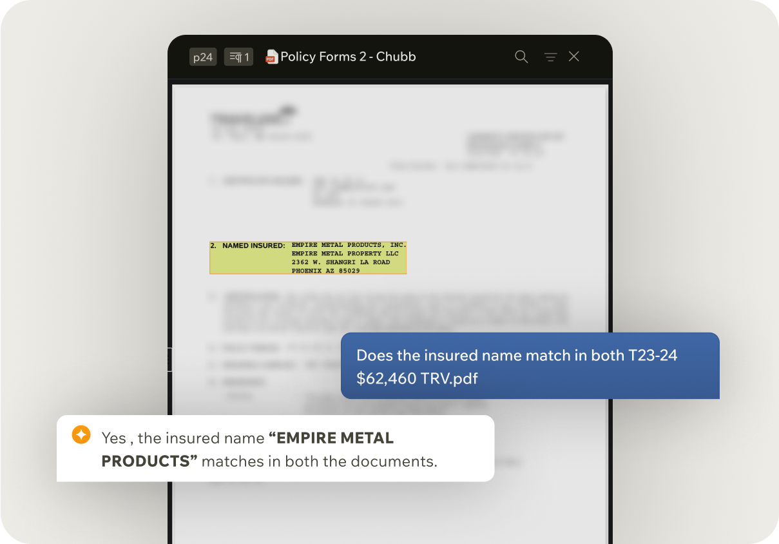


Distribution
Proposal Generation
Generate compliant, carrier-ready proposals in minutes — enabling 2–3× more proposals per producer per week.
Create Submission
Turn inbound emails and attachments into complete, structured submissions with >90% automation.
Policy Checking
Compare binders, endorsements, and policies line-by-line to catch discrepancies before they reach the insured.
Quote Compare
Normalize and compare quotes across carriers so brokers can advise faster and bind with confidence.
AI Workspace for Insurance
Notes:
We’re not just solving one task — we’re automating end-to-end insurance workflows, from submission intake to policy checking, audits, and claims validation.
Some people don’t agree with this kind of holistic approach but Our customers love it.

Slide 15
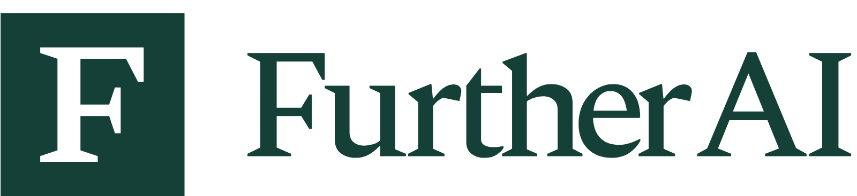
Multi-agent System
Inbox
Workflow
Intake
Workflow
Risk
Workflow
Rating
Workflow
AI Workspace for Insurance
Notes:
Add team to this

Slide 16
Your data, models, and knowledge
stay secure. Always.
SOC2
Industry Leading Certifications
We adhere to the highest security standards - SOC2, GDPR, ISO 27001, HIPAA, CCPA, etc.
Zero Data Training Policy
GDPR
Your data and prompts are never used to train our models. What’s yours stays yours.
End-to-End Encryption
All data is fully encrypted - both in transit and in rest - using enterprise-grade protocols.
ISO 27001
Single Tenant Architecture
Dedicated infrastructure per customer. No shared data, no shared risk.
HIPAA

Slide 17
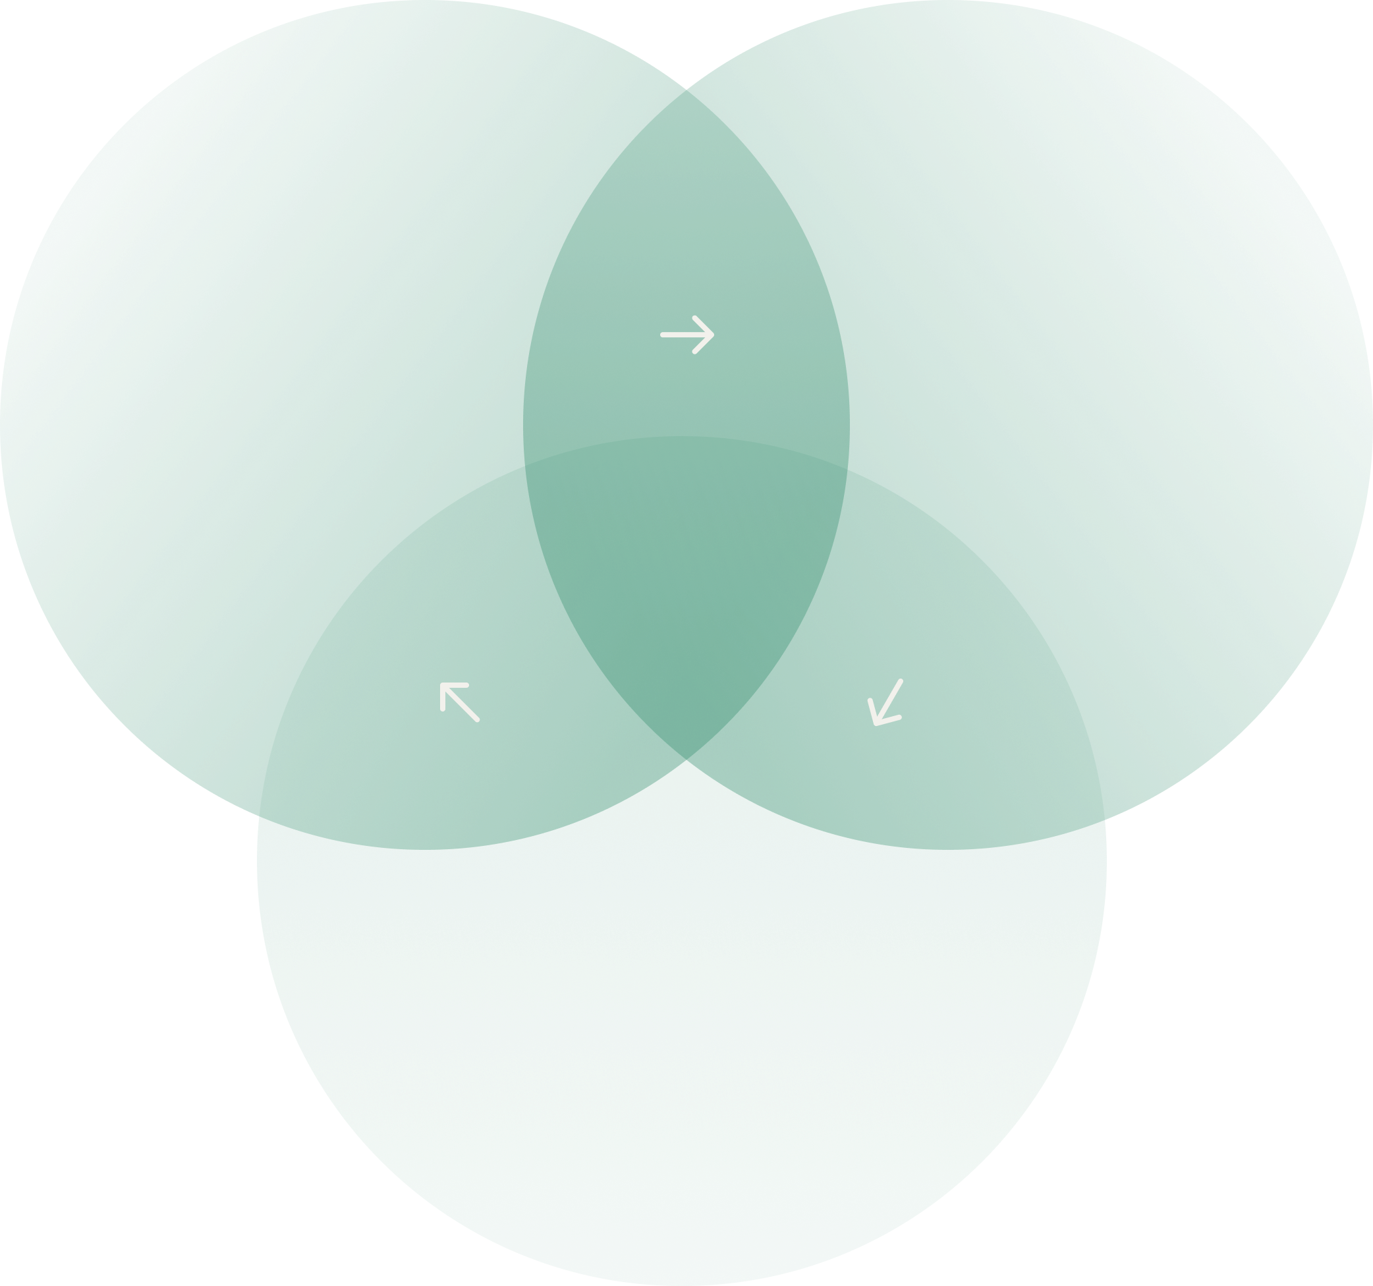
Why FurtherAI?
Insurance-Native
Holistic
AI trained on insurance data & workflows—it knows industry terminology, documents, & processes.
AI Assistant works directly within existing tools like email and policy administration systems, eliminating the need to switch between platforms.
Unlike general-purpose AI tools that fall short on insurance workflows, FurtherAI is built from the ground up for insurance. Its AI models are purpose-built for the industry, work seamlessly with insurance systems, and follow the highest standards of security and compliance.
Enterprise-Ready
Further AI was built from the ground up with the stringent security requirements and on-prem deployment options via Azure Managed App or Amazon VPC.
AI Workspace for Insurance
Notes:
There’s been a lot of hype around AI in insurance — but most tools today don’t fit how the industry really works.
So we built FurtherAI to be insurance-native — wired into your tools, and enterprise ready.
We’re not reinventing the wheel here — just helping it turn a whole lot faster.

Slide 18
AI Workspace for Insurance
furtherai.com

