Slide 1
Agent Architecture Deep Dive
Inside the Multi-Agent Engine
2026

Slide 2
The Agent Loop
• OBSERVE → Perceive environment state
• REASON → LLM generates thought process
• ACT → Execute tool or return response
• LEARN → Update memory from feedback

Slide 3
Framework Popularity
GitHub Stars growth trajectory

Slide 4
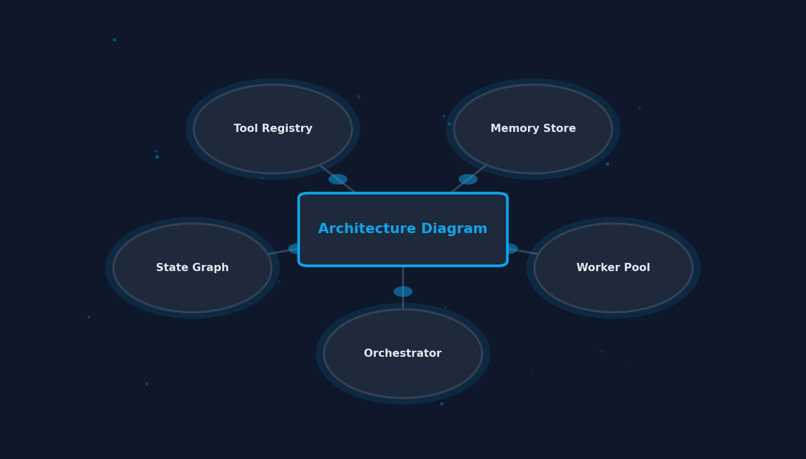
Architecture Diagram
• Orchestrator: Central controller dispatches tasks
• Worker Pool: Specialized agents execute sub-tasks
• Memory Store: Shared context + episodic memory
• Tool Registry: External APIs + custom functions
• State Graph: LangGraph manages execution flow

Slide 5
Performance Benchmarks
Latency vs accuracy trade-offs
Framework | Latency | Accuracy | Scalability
MetaGPT | High | 92% | Medium
AutoGen | Medium | 88% | High
CrewAI | Low | 85% | Medium
LangGraph | Medium | 90% | High
OpenAI | Low | 86% | Low

Slide 6
Production Readiness
3x
Faster iteration with agent frameworks vs hand-built

Slide 7
Agents are not the future. They are the present, and they are already eating software.
— swyx, 2025

Slide 8
Build the Future
Agents are the new abstraction layer.

