Slide 1
Sail c_emulator system call

Slide 2
以實作的syscall
sys_write
sys_read
sys_times
sys_gettimeofday
sys_open
sys_lseek
sys_fstat
sys_close
sys_exit
sys_getmainvars

Slide 3

Mibench
automotive | consumer | network | office | security | telecomm
basicmath | jpeg | dijkstra | ghostscript | blowfish | CRC32
bitcount | lame | patricia | ispell | pgp | FFT/IFFT
qsort | mad |  | rsynth | rijndael | ADPCM
susan | tiff2bw |  | sphinx | sha | GSM
 | tiff2rgba |  | stringsearch
 | tiffdither
 | tiffmedian
 | typeset
https://www.twblogs.net/a/5efca879d496dddbb541c26c

Slide 4
Mibench
根據 "Understanding the Memory Consumption of the MiBench Embedded Benchmark" 測試前說明， 35 embedded applications ，其中19 applications ，因為有些含有 x86 assembly code 或是 long-running 或 office applications

Slide 5
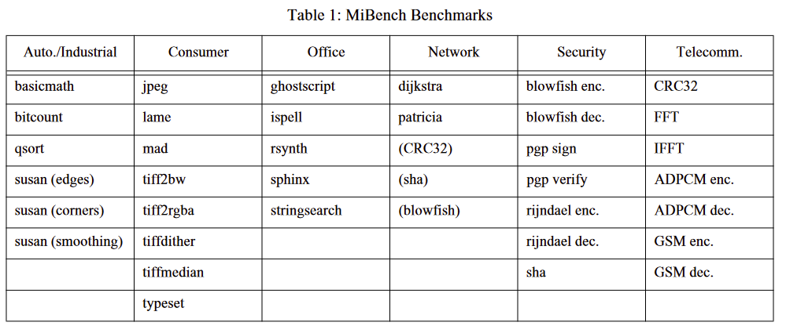

Slide 6
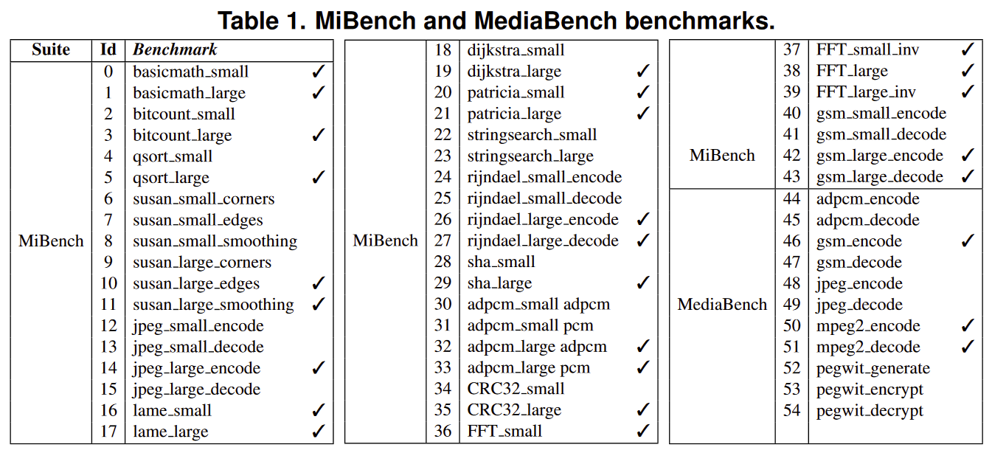

Slide 7
無法編譯的測資
consumer:
Jpeg : gcc編譯出現多個error
lame : newlib 不支援多個header 例如: #include<termcap.h>
Mad : newlib 不支援多個header 例如: # include <esd.h>
tiff-v3.5.4: newlib不支援多個header 例如: #include<gl/image.h>
Typeset : newlib 不支援多個header 例如: #include<nl_types.h>
office:
ghostscript : newlib 不支援多個header 例如: #include<dirent.h>
Ispell : newlib 不支援多個header 例如: #include<dirent.h>
Rsynth : newlib 不支援多個header 例如: #include<sys/audio.h>
Sphinx : 當配置時出現 “no audio interface for host type”

Slide 8
無法編譯的測資
Security:
blowfish : newlib riscv 沒支援 alarm()
Pgp: 80386.S 需在32位元下編譯，另外它是用X86寫的 riscv-gcc不能編譯
Telecomm:
Gsm : newlib riscv 沒支援 utime()

Slide 9


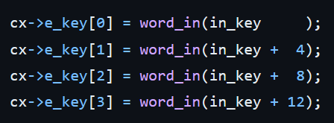

Security/rijndael 修改
aesxam.c : char 需改成 signed char (newlib的char預設unsigned)
aes.c : word_in()將byte*轉成word*並解引用會出錯，改用memcpy()可以解決對齊問題，因為它不會去解引用，它是一個個byte去做複製

Slide 10
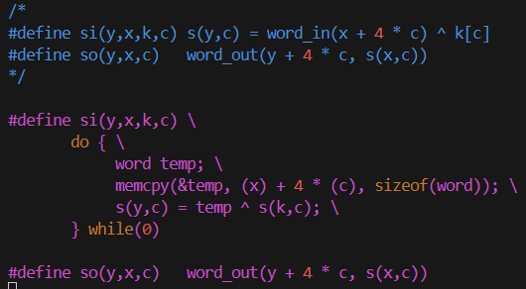
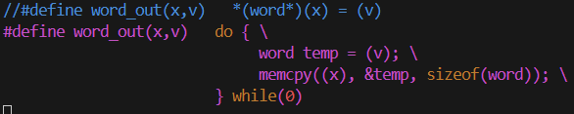

Slide 11
Network/patricia 修改
patricia_test.c : 拿掉三個header, rpc/rpc.h, netinet/in.h, arpa/inet.h
, 補上其他函數及變數的定義

Slide 12
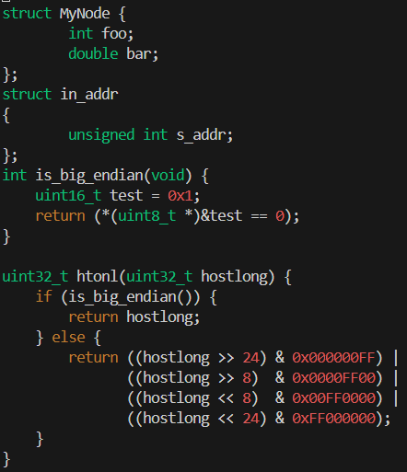

Slide 13
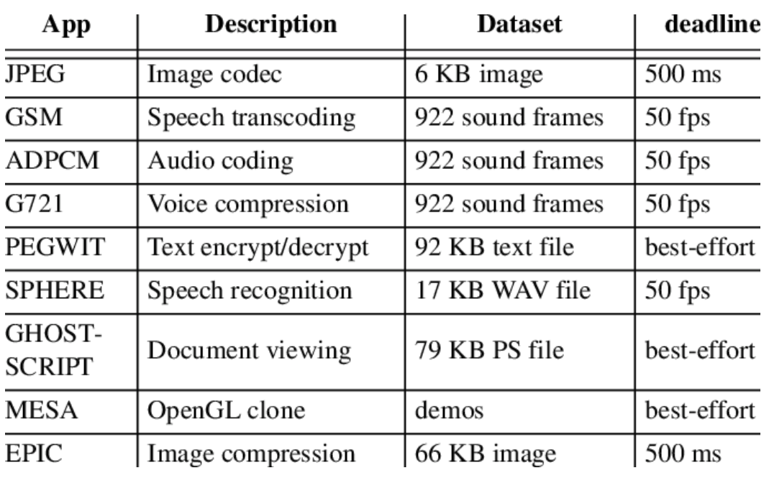
Mediabench

Slide 14
EEMBC: Coremark
CoreMark is a simple, yet sophisticated benchmark that is designed specifically to test the functionality of a processor core. Running CoreMark produces a single-number score allowing users to make quick comparisons between processors.
CoreMark is small, portable, easy to understand, free, and displays a single number benchmark score.
CoreMark was designed to avoid problematic aspects of Dhrystone
major portions of Dhrystone actually expose the compiler’s ability to optimize the workload rather than the capabilities of an CPU
library calls consume the majority of the time consumed by the benchmark. Since the library code is not part of the benchmark

Slide 15
Coremark source code
a. Matrix multiply (allow for use of MAC operations, common math use)
b. Linked list search/sort/read (common pointer use)
c. State machine (common use of data dependent branches)
d. CRC (common in embedded)

Slide 16
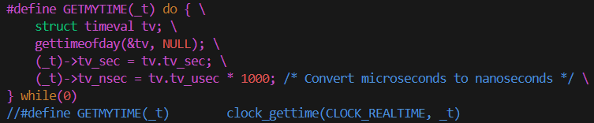
System call問題
Newlib riscv不支援clock_gettime()
core_portme.c : clock_gettime() 替換成 gettimeofday()
clock_gettime()提供的時間精度為10⁻⁹ s, gettimeofday()為10⁻⁶ s

Slide 17
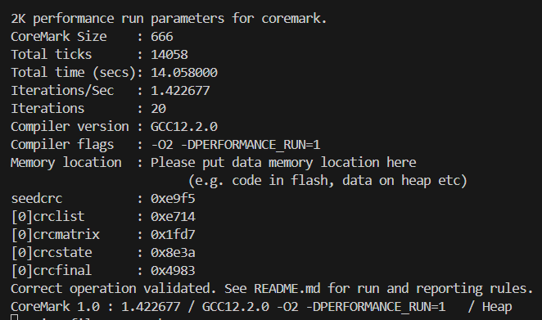
Coremark執行結果
輸入make，執行結果放在.log裡

Slide 18
參考資料
https://web.eecs.umich.edu/~taustin/papers/WWC4-mibench.pdf
https://inria.hal.science/hal-01349421/document
https://www.researchgate.net/figure/MiBench-and-MediaBench-benchmarks_tbl1_328314399
https://www.researchgate.net/figure/Mediabench-apps-used-in-workload-model_tbl2_4056981
https://www.cnblogs.com/henjay724/p/8729364.html

