Slide 1
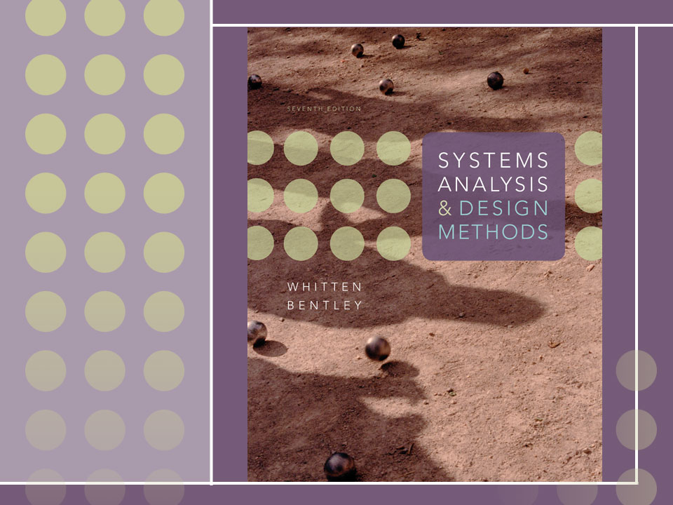
Chapter 7
Modeling System Requirements with Use Cases

Slide 2
Objectives
Describe the benefits of use-case modeling.
Define actors and use cases and be able to identify them from context diagrams and other sources.
Describe the relationships that can appear on a use-case model diagram.
Describe the steps for preparing a use-case model.
Describe how to construct a use-case model diagram.
Describe the various sections of a use-case narrative and be able to prepare one.
Define the purpose of the use-case ranking and priority matrix and the use-case dependency diagram.

Slide 3
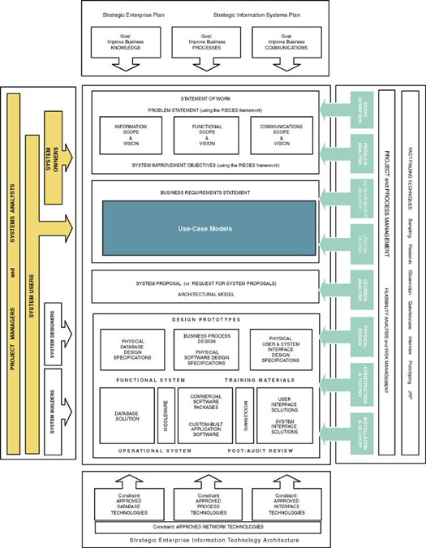

Slide 4
An Introduction to
Use-Case Modeling
One of the primary challenges is the ability to elicit the correct and necessary system requirements from the stakeholders and specify them in a manner understandable to them so those requirements can be verified and validated.
The hardest single part of building a software system is deciding precisely what to build. No other part of the conceptual work is a difficult as establishing the detailed technical requirements, including all the interfaces to people, to machines, and to other software systems. No other work so cripples the resulting system if done wrong. No other part is more difficult to rectify later. Fred Brooks

Slide 5
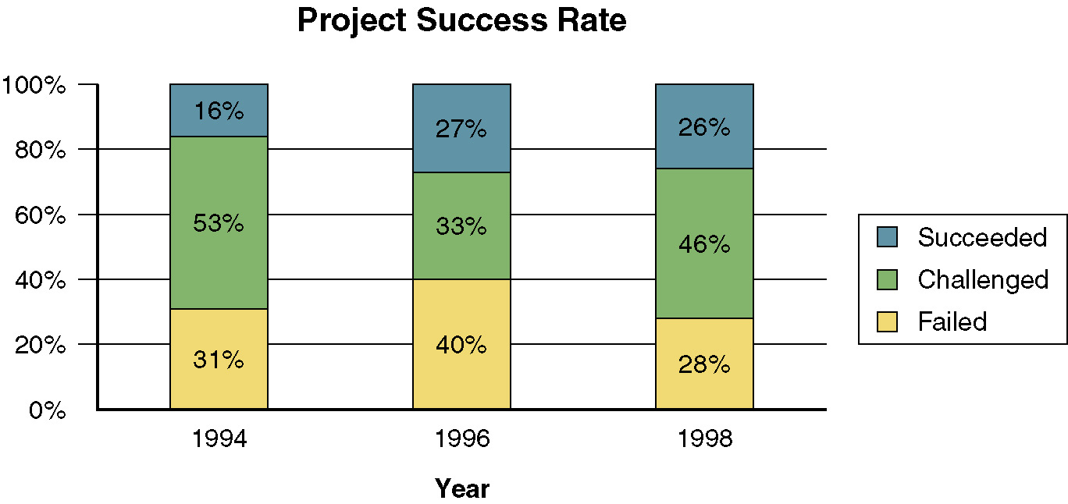
IS Development Project
Track Record
canceled before completion
Over budget, late, or without needed features
Source: The Standish Group International, Inc., “Chaos: A Recipe for Success”

Slide 6
User-Centered Development and Use-Case Modeling
User-centered development – a process of systems development based on understanding the needs of the stakeholders and the reasons why the system should be developed.
Use-case modeling – the process of modeling a system’s functions in terms of business events, who initiated the events, and how the system responds to those events.
  Use-case modeling has roots in object-oriented modeling.
  Gaining popularity in non-object development environments because of its usefulness in communicating with users.
  Compliments traditional modeling tools.

Slide 7
Benefits of Use-Case Modeling
Provides tool for capturing functional requirements.
Assists in decomposing system into manageable pieces.
Provides means of communicating with users/stakeholders concerning system functionality in language they understand.
Provides means of identifying, assigning, tracking, controlling, and management system development activities.
Provides aid in estimating project scope, effort, and schedule.

Slide 8
Benefits of Use-Case Modeling (continued)
Aids in defining test plans and test cases.
Provides baseline for user documentation.
Provides tool for requirements traceability.
Provides starting point for identification of data objects or entities.
Provides specifications for designing user and system interfaces.
Provides means of defining database access requirements.
Provides framework for driving the system development project.

Slide 9
System Concepts for
Use-Case Modeling
Use case – a behaviorally related sequence of steps (scenario), both automated and manual, for the purpose of completing a single business task.
  Description of system functions from the perspective of external users in terminology they understand.
Use-case diagram – a diagram that depicts the interactions between the system and external systems and users.
  graphically describes who will use the system and in what ways the user expects to interact with the system.
Use-case narrative – a textual description of the business event and how the user will interact with the system to accomplish the task.

Slide 10
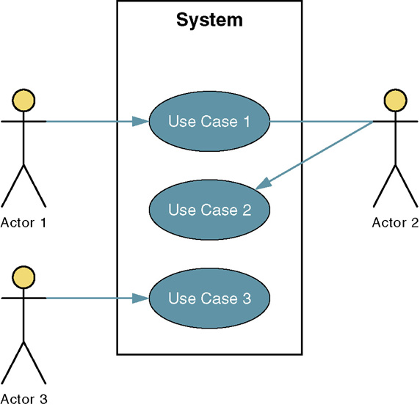
Sample Use-Case Model Diagram

Slide 11
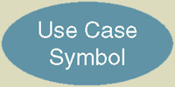
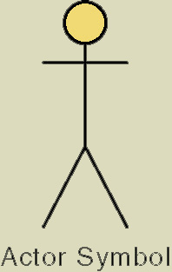
Basic Use-Case Symbols
Use case – subset of the overall system functionality
  Represented by a horizontal ellipse with name
  of use case above, below, or inside the ellipse.
Actor – anyone or anything that needs to interact with the system to exchange information.
  human, organization, another information system,
  external device, even time.
Temporal event – a system event triggered by time.
  The actor is time.

Slide 12
Four Types of Actors
Primary business actor
  The stakeholder that primarily benefits from the execution of the use case.
  e.g. the employee receiving the paycheck
Primary system actor
  The stakeholder that directly interfaces with the system to initiate or trigger the business or system event.
  e.g. the bank teller entering deposit information
External server actor
  The stakeholder that responds to a request from the use case.
  e.g. the credit bureau authorizing a credit card charge
External receiver actor
  The stakeholder that is not the primary actor but receives something of value from the use case.
  e.g. the warehouse receiving a packing slip

Slide 13
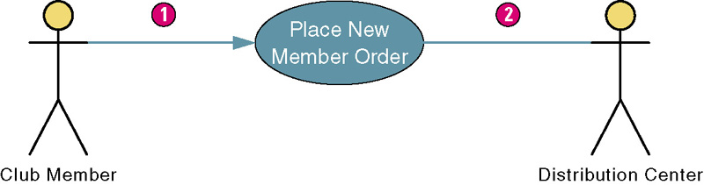
Use Case Association Relationship
Association – a relationship between an actor and a use case in which an interaction occurs between them.
  Association modeled as a solid line connecting the actor and the use case.
  Association with an arrowhead touching the use case indicates that the use case was initiated by the actor. (1)
  Association lacking arrowhead indicates a receiver actor. (2)
  Associations may be bidirectional or unidirectional.

Slide 14
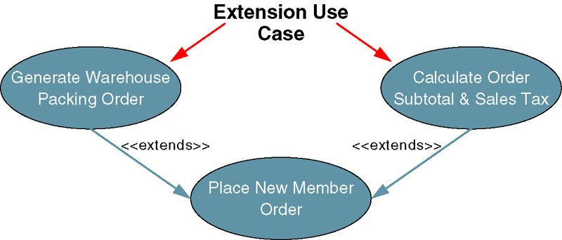
Use Case Extends Relationship
Extension use case –use case consisting of steps extracted from another use case to simplify the original.
  Extends the functionality of the original use case.
  Generally not identified in the requirements phase
  Extends relationship represented as arrow beginning at the extension use case and pointing to use case it is extending.
  Labeled <<extends>>.

Slide 15
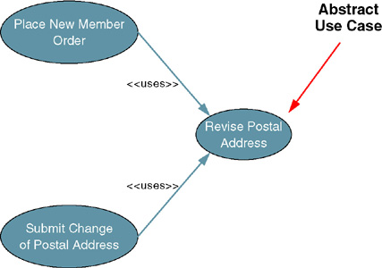
Use Case Uses Relationship
Abstract use case – use case that reduces redundancy in two or more other use cases by combining common steps found in both.
  Available by any other use case that requires its functionality.
  Generally not identified
  in requirements phase
  Relationship between
  abstract use case
  and use case that
  uses it is called a
  uses (or includes)
  relationship.
  Depicted as arrow
  beginning at
  original use case
  and pointing to
  use case it is using.
  Labeled <<uses>>.

Slide 16
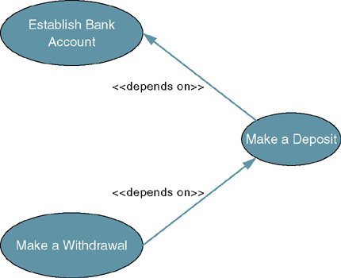
Use Case Depends On Relationship
Depends On – use case relationship that specifies which other use cases must be performed before the current use case.
  Can help determine
  sequence in which
  use cases need to
  be developed.
  Depicted as arrow
  beginning at one
  use case and
  pointing to use case
  it depends on.
  Labeled
  <<depends on>>.

Slide 17
Use Case Inheritance Relationship
Inheritance – a use case relationship in which the common behavior of two actors initiating the same use case is extrapolated and assigned to a new abstract actor to reduce redundancy.
  Other actors can inherit the interactions of the abstract actor.
  Depicted as an arrow beginning at one
  actor and pointing to the abstract actor whose
  interactions the first actor inherits.

Slide 18
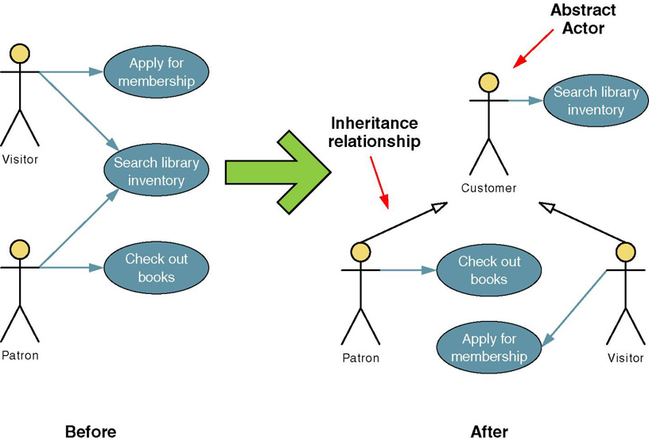
Use Case Inheritance Relationship

Slide 19
The Process of Requirements
Use-Case Modeling
Objective is to elicit and analyze enough requirements information to prepare a model that:
  Communicates what is required from a user perspective.
  Is free of specific details about how system will be implemented.
To effectively estimate and schedule project, may need to include preliminary implementation assumptions.
Steps
  Identify business actors.
  Identify business use cases.
  Construct use-case model diagram.
  Documents business requirements use-case narratives.

Slide 20
Step 1: identify Business Actors
When looking for actors, ask the following questions:
  Who or what provides inputs to the system?
  Who or what receives outputs from the system?
  Are interfaces required to other systems?
  Are there events that are automatically triggered at a predetermined time?
  Who will maintain information in the system?
Actors should be named with a noun or noun phrase

Slide 21
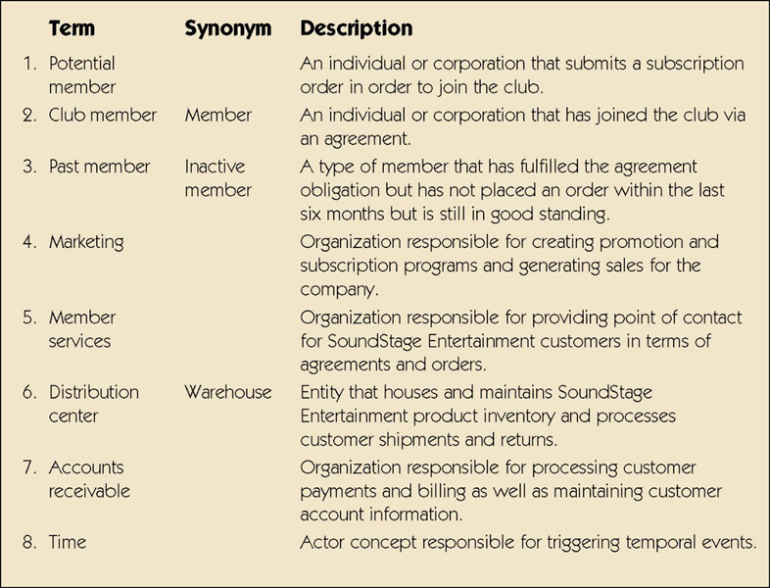
Sample List of Actors

Slide 22
Step 2: Identify Business Requirements Use Cases
Business Requirements Use Case - a use case created during requirements analysis to capture the interactions between a user and the system free of technology and implementation details.
  During requirements analysis, strive to identify and document only the most critical, complex, and important use cases, often called essential use cases.

Slide 23
Step 2: Identify Business Requirements Use Cases (cont.)
When looking for use cases, ask the following questions:
  What are the main tasks of the actor?
  What information does the actor need form the system?
  What information does the actor provide to the system?
  Does the system need to inform the actor of any changes or events that have occurred?
  Does the actor need to inform the system of any changes or events that have occurred?
Use cases should be named with a verb phrase specifying the goal of the actor (i.e. Submit Subscription Order)

Slide 24
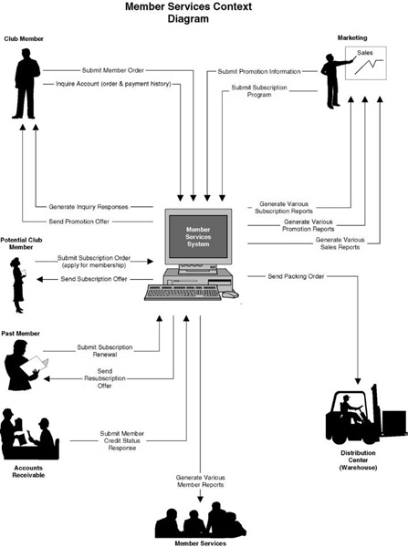
Sample Context Diagram

Slide 25
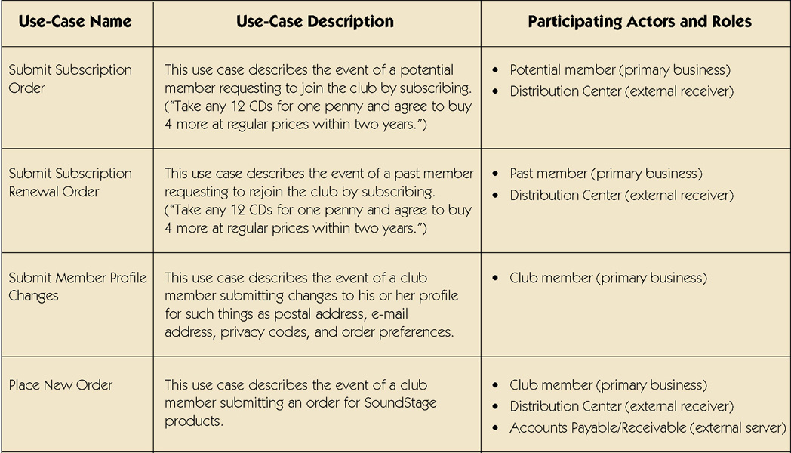
Sample Use-Case Glossary
continued

Slide 26
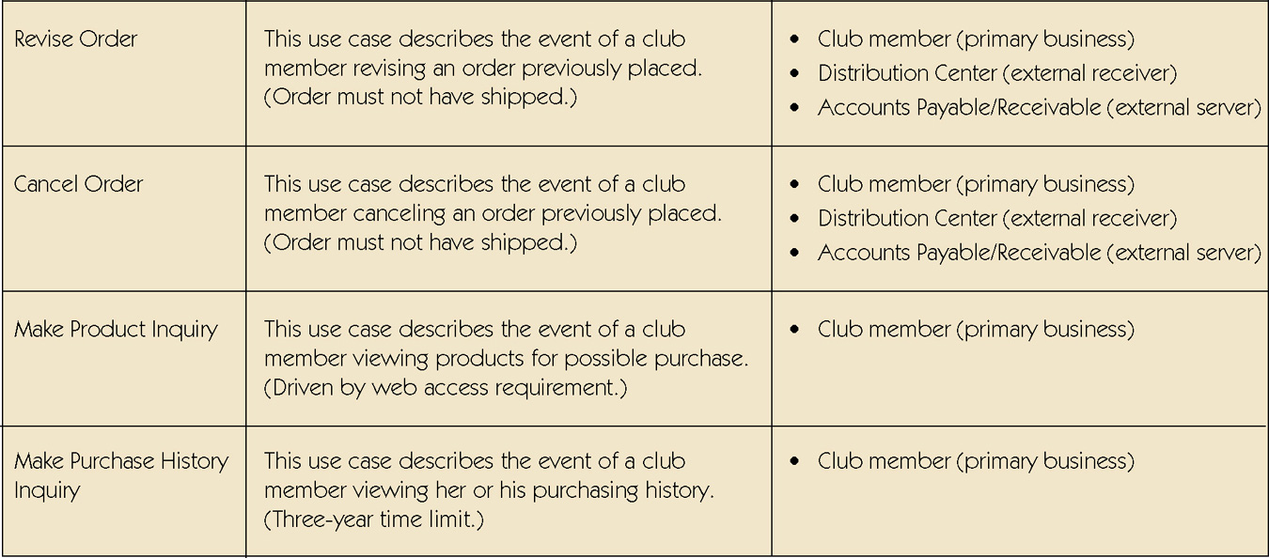
Sample Use-Case Glossary (cont.)
continued

Slide 27
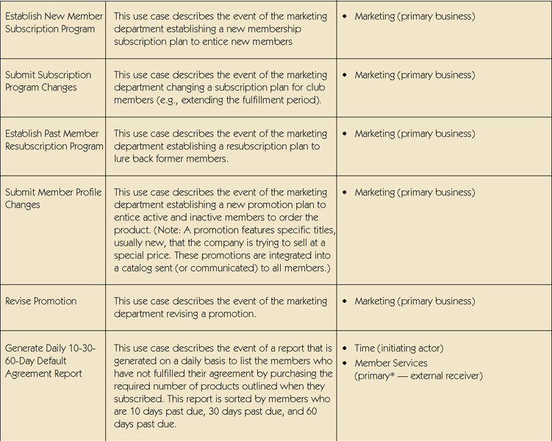
Sample Use-Case Glossary (cont.)

Slide 28
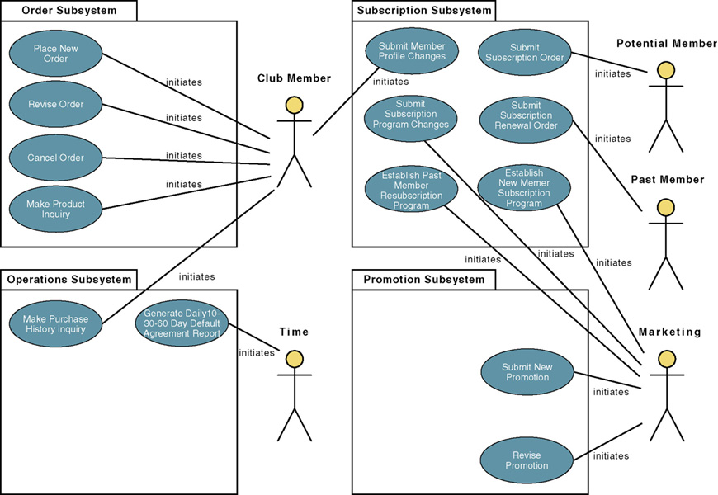
Step 3: Construct Use-Case
Model Diagram

Slide 29
Step 4: Document Business Requirements Use-Case Narratives
Document first at high level to quickly obtain an understanding of the events and magnitude of the system.
Then expand to a fully-documented business requirement narrative.
  Include the use case’s typical course of events and its alternate courses.

Slide 30
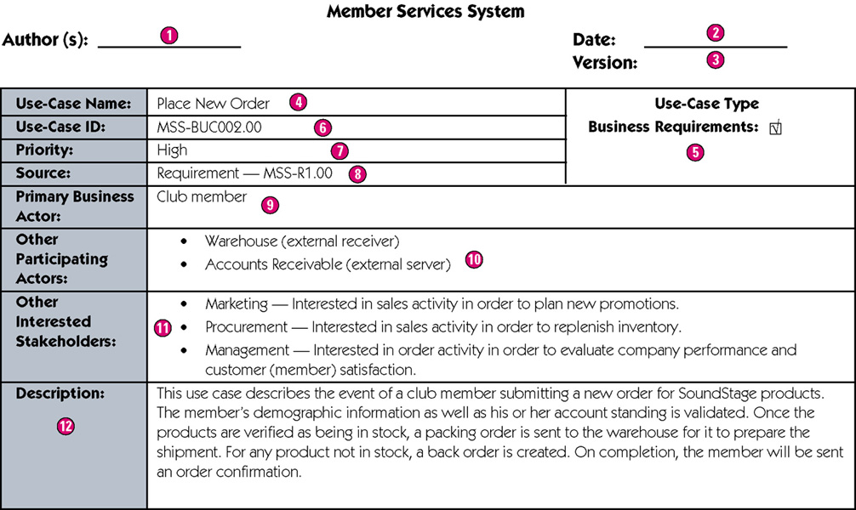
Sample High-Level Version of a Use-Case Narrative

Slide 31
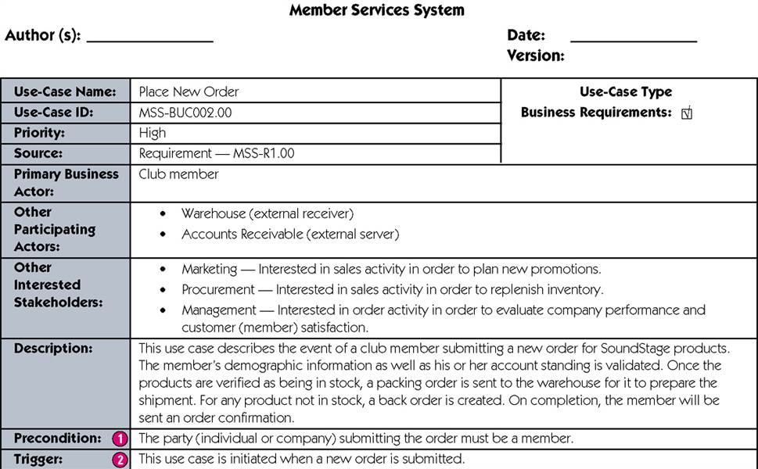
Sample Expanded Version of a Use-Case Narrative
continued

Slide 32
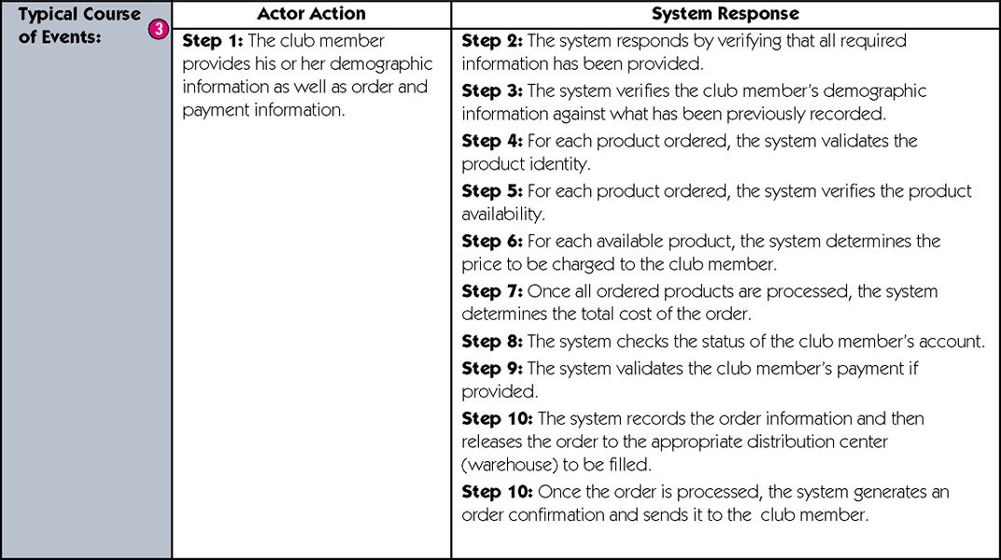
Sample Expanded Version of a Use-Case Narrative (cont)
continued

Slide 33
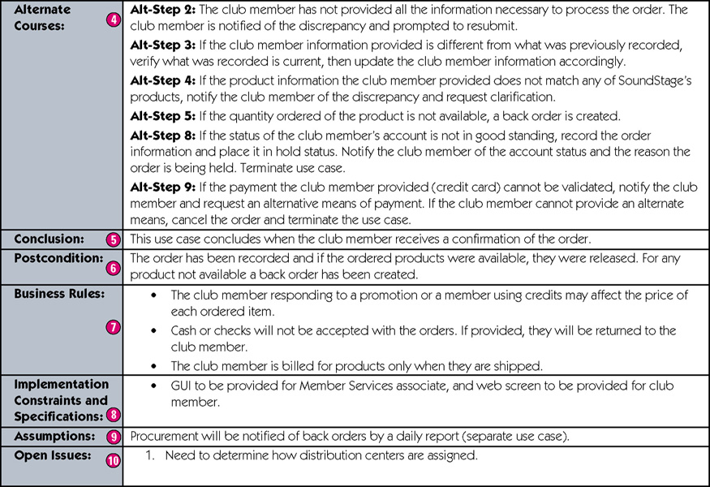
Sample Expanded Version of a Use-Case Narrative (cont)
concluded

Slide 34
Use Cases and Project Management
Use-case model can drive entire development effort.
Project manager or systems analyst uses business requirements use cases to estimate and schedule the build cycles of the project.
  Build cycles are scoped on the basis of the importance of the use case and the time it takes to implement the use case.
To determine importance of use cases, will create:
  Use-case ranking and evaluation matrix
  Use-case dependency diagram

Slide 35
Use-Case Ranking and Priority Matrix
In most projects, the most important use cases are developed first.
  Use-case ranking and priority matrix – a tool used to evaluate use cases and determine their priority.
  Evaluates use cases on 1-5 scale against six criteria.
    Significant impact on the architectural design.
    Easy to implement but contains significant functionality.
    Includes risky, time-critical, or complex functions.
    Involves significant research or new or risky technology.
    Includes primary business functions.
    Will increase revenue or decrease costs.

Slide 36
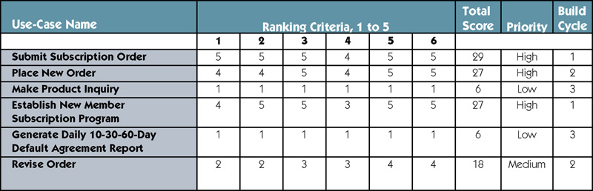
Sample Use-Case Ranking and Priority Matrix

Slide 37
Use-Case Dependency Diagram
Use-case dependency diagram – graphical depiction of the dependencies among use cases.
  Provides the following benefits:
    Graphical depiction of the system’s events and their states enhances understanding of system functionality.
    Helps identify missing use cases.
    Helps facilitate project management by depicting which use cases are more critical.

Slide 38
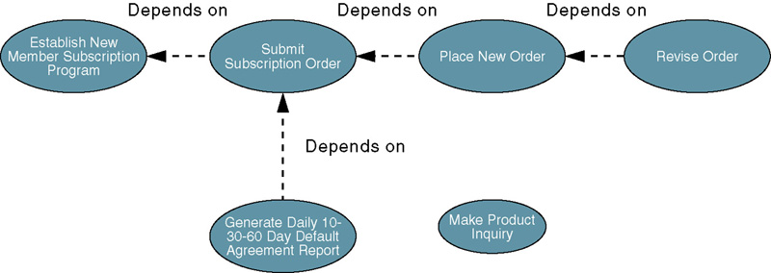
Sample Use-Case
Dependency Diagram

