Slide 1




Generative Retrieval as Multi-Vector Dense Retrieval
Shiguang Wu¹, Wenda Wei¹, Mengqi Zhang¹, Zhumin Chen¹,
Jun Ma¹, Zhaochun Ren², Maarten de Rijke³, Pengjie Ren¹
¹Shandong University ²Leiden University ³University of Amsterdam

Slide 2
Overview
There’ve been many retrieval paradigms, and many retrieval models:
Term-based retriever: BM25, etc.
Dense retriever: dual-encoder, ColBERT, etc.
LTR model: RankNet, LambdaMart, etc.
Neural ranking models: cross-encoder, DRMM, etc.
Generative retrieval: GENRE, SEAL, DSI, etc.
Instead of experimental comparison, we’d like to do a mathematical comparison of two specific paradigms
Notes:
It’s important to compare and select dense retrieval models in many different scenarios.
Normally we would conduct … which is a very convincible way

Slide 3
Overview
Multi-vector dense retrieval (MVDR) e.g., ColBERT, COIL, PLAID, etc.
One of the prevalent re-ranking models
Very effective and efficient for the re-ranking task
Generative retrieval (GR) e.g., GENRE, SEAL, DSI, NCI, GenRet, etc.
A new paradigm
Dramatically different
Use autoregressive generative LM to generate relevant documents (ID)
Notes:
As you may already see from the title, we are looking at multi-vector …, and generative retrieval

Slide 4
Overview
Multi-vector dense retrieval (MVDR) e.g., ColBERT, COIL, PLAID, etc.
One of the prevalent re-ranking models
Very effective and efficient for the re-ranking task
Generative retrieval (GR) e.g., GENRE, SEAL, DSI, NCI, GenRet, etc.
A new paradigm
Dramatically different
Use autoregressive generative LM to generate relevant documents (ID)
?
?
Notes:
Our question is

Slide 5
Overview
We would like to deconstruct the end-to-end GR paradigm
See the internal retrieval mechanism
Find deeper connection
Two operations: indexing and retrieval
Stage: training and inference
Notes:
We would like to …
If you have listened the wonderful tutorial about GR few days ago,

Slide 6
Overview
We would like to deconstruct the end-to-end GR paradigm
See the internal retrieval mechanism
Find deeper connection
Two operations: indexing and retrieval
Stage: training and inference

Slide 7
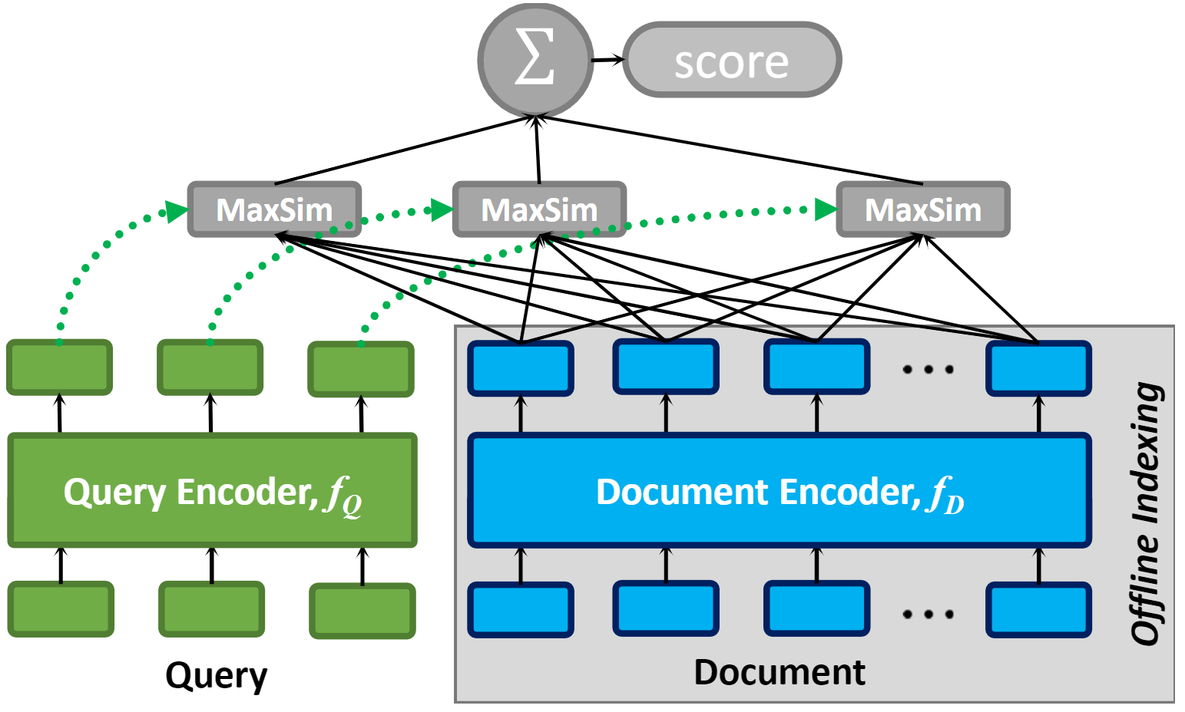
What is MVDR? – An example of ColBERT
Token vectors
Embed. vectors
Figure from ColBERT by Khattab, O., & Zaharia, M.A. (2020)
Notes:
I’ll first briefly introduce the MVDR model, and we will take colbert as an example

Slide 8








What is MVDR? – Late-Interaction Paradigm
$$\text{score}\left(q,d\right)≔\sum_{q_{i}}{\max_{d_{j}}{q_{i}^{⊤}d_{j}}}$$
$$q_{1}$$
$$q_{2}$$
$$q_{3}$$
$$d_{1}$$
$$d_{2}$$
$$d_{3}$$
$$d_{N}$$
MaxSim operation
Notes:
Colbert proposed the late …
It does the maxsim operation for each query token and aggregate to the final relevance score
Essentially, it can be seen as a generalization of single-vector bi-encoder models

Slide 9




A Deeper Look at MVDR – Sparse Alignment
$$\text{score}\left(q,d\right)=\sum_{q_{i}}{\max_{d_{j}}{q_{i}^{⊤}d_{j}}}=\sum_{ij}{\left(\begin{matrix} & \\ & \\ & \end{matrix}\begin{matrix} & \\ & \\ & \end{matrix}\begin{matrix} & \\ & \\ & \end{matrix}⊙\begin{matrix} & \\ & \\ & \end{matrix}\begin{matrix} & \\ & \\ & \end{matrix}\begin{matrix} & \\ & \\ & \end{matrix}\right)}$$
$$Q^{⊤}D$$
$$A$$
Similarity matrix
Alignment matrix
MaxSim
Sim
$$⊙$$
Max
Perspective from Qian et al., Multi-Vector Retrieval as Sparse Alignment, 2023
Notes:
I’d like to introduce a very insightful paper titled xxx from qian.
They proposed a very general framework for all mvdr models, which is the sparse alignment.
Here, for colbert,
Similarity part and the maximum q d pair indicator

Slide 10




A Deeper Look at MVDR – Sparse Alignment
$$\text{score}\left(q,d\right)=\sum_{q_{i}}{\max_{d_{j}}{q_{i}^{⊤}d_{j}}}=\sum_{ij}{\left(\begin{matrix} & \\ & \\ & \end{matrix}\begin{matrix} & \\ & \\ & \end{matrix}\begin{matrix} & \\ & \\ & \end{matrix}⊙\begin{matrix} & \\ & \\ & \end{matrix}\begin{matrix} & \\ & \\ & \end{matrix}\begin{matrix} & \\ & \\ & \end{matrix}\right)}$$
$$Q^{⊤}D$$
$$A$$
$$d$$
Similarity matrix
Alignment matrix
$A_{ij}=1$ $→$ $d_{j}$ is MaxSim of $q_{i}$
$A_{ij}=0$ $→$ otherwise.
Alignment matrix
$$q$$
$$A$$
Perspective from Qian et al., Multi-Vector Retrieval as Sparse Alignment, 2023
Notes:
You can treat the alignment score as the mask. It is one if
And this is the matrix form, the dot circle operation is the element-wise product

Slide 11
A Deeper Look at MVDR – Sparse Alignment
$$\text{score}\left(q,d\right)=\sum_{q_{i}}{\max_{d_{j}}{q_{i}^{⊤}d_{j}}}=\sum_{ij}{\left(\begin{matrix} & \\ & \\ & \end{matrix}\begin{matrix} & \\ & \\ & \end{matrix}\begin{matrix} & \\ & \\ & \end{matrix}⊙\begin{matrix} & \\ & \\ & \end{matrix}\begin{matrix} & \\ & \\ & \end{matrix}\begin{matrix} & \\ & \\ & \end{matrix}\right)}$$
$$Q^{⊤}D$$
$$A$$
max
max
[CLS]
[CLS]
a
a
c
[CLS]
[CLS]
max
a
b
DPR
ME-BERT
ColBERT
COIL
Notes:
Sparse alignment is a general relevance score framework that can be applied to many retrieval paradigms, such as DPR, ME-BERT, and COIL. Within this framework, these paradigms differ only by their alignment strategies.

Slide 12
What is GR? – retrieval operation
constrained generation
Query
Document identifiers (doc id)
GR
Autoregressive
Model
Generated: recorded as
a duet by American country
music artists
Query: Who is the singer of Does He Love You?
Query
Doc ID
Figure design and use case borrowed from Li, et al., Multiview Identifiers Enhanced Generative Retrieval, 2023
Notes:
Next, I will introduce the generative retrieval paradigm and demonstrate how it also fits within the framework.
Here is the retrieval operation.
To use GR, you first need to specify the document identifiers. We choose a substring from the passage as the document ID as an example.
Given a user query, we directly input it into the generative model and obtain the document ID using constrained generation.

Slide 13
What is GR? – retrieval operation
GR
Autoregressive
Model
Generated: recorded as
a duet by American country
music artists
Query: Who is the singer of Does He Love You?
Query
Doc ID
Trained using autoregressive cross-entropy loss (teacher forcing) to learn to generate doc id
Figure design and use case borrowed from Li, et al., Multiview Identifiers Enhanced Generative Retrieval, 2023
Notes:
The GR model is trained using xxx

Slide 14
What is GR? – retrieval operation
GR
Autoregressive
Model
Generated: recorded as
a duet by American country
music artists
Query: Who is the singer of Does He Love You?
Query
Doc ID
Usually use encoder-decoder transformer architecture, e.g., T5, BART
Figure design and use case borrowed from Li, et al., Multiview Identifiers Enhanced Generative Retrieval, 2023
Notes:
And it usually uses

Slide 15
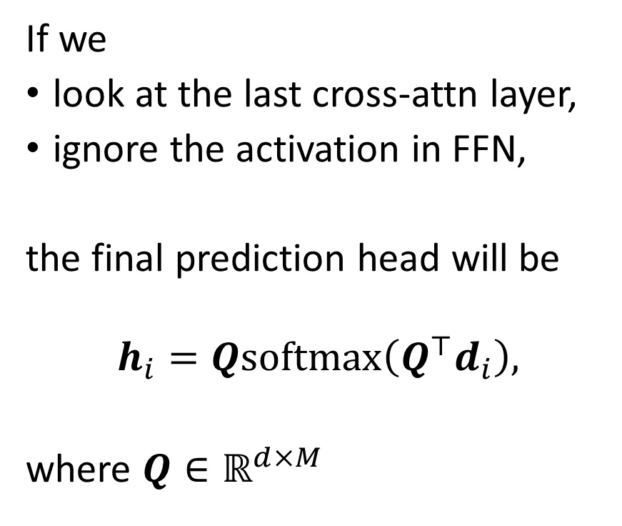



Model Architecture of GR
If we
look at the last cross-attn layer,
ignore the activation in FFN,
the final prediction head will be
$$h_{i}=Q\text{softmax}\left(Q^{⊤}d_{i}\right),$$
where $Q∈ℝ^{d×M}$
He
Love
$$h_{i}$$
GR
Decoder
…
$$Q$$
Cross-attention
Encoder
$$d_{i}$$
…
V
K
Q
Does
He
Query
Doc ID
Notes:
Now, let’s delve into the model architecture of GR. We are particularly interested in the cross-attention layer as it is the only component in the decoder that xxx
Here the Q is the token vector matrix of query, and d_i is the input at the ith position for the cross-attention.
If we look at the last xxx, and ignore the non-linear activation functions in FFN.
The final prediction head will be
Then we will multiply the hi with the embedding matrix

Slide 16
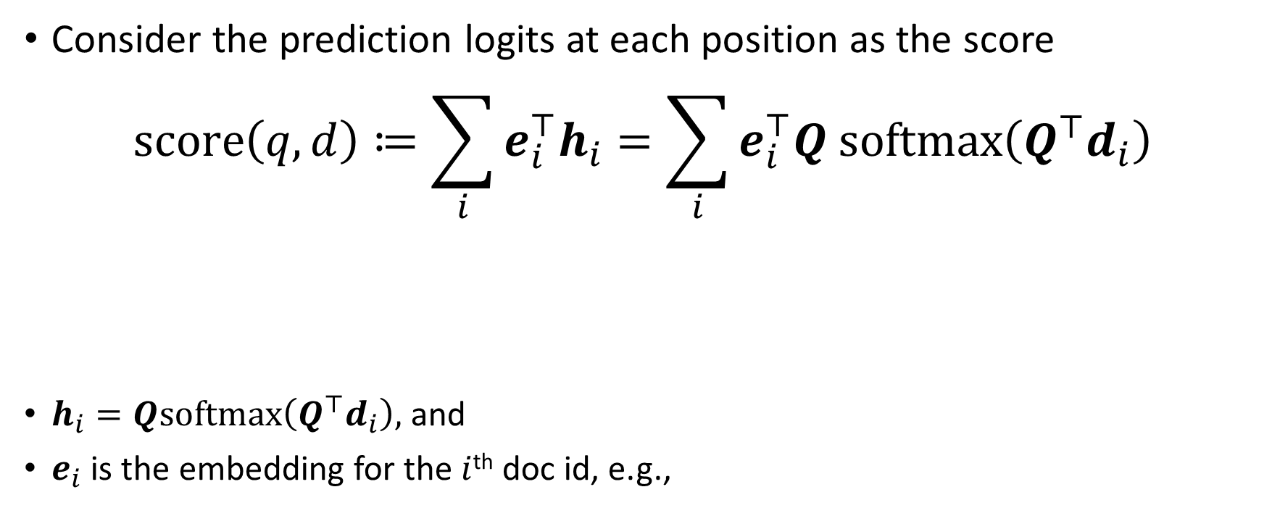


Brief Derivation of Our Discovery
Consider the prediction logits at each position as the score
$$\text{score}\left(q,d\right)≔\sum_{i}{{e_{i}^{⊤}h}_{i}}=\sum_{i}{e_{i}^{⊤}Q \text{softmax}\left(Q^{⊤}d_{i}\right)}$$
$h_{i}=Q\text{softmax}\left(Q^{⊤}d_{i}\right),$ and
$e_{i}$ is the embedding for the $i$^{th} doc id, e.g.,
Does
He
$$e_{1}$$
$$e_{2}$$
Notes:
We consider
This is calculated as
We will plug in the computation of hi which is Q and softmax term
And this is what we normally will do

Slide 17
Brief Derivation of Our Discovery
Consider the prediction logits at each position as the score
$$\text{score}\left(q,d\right)≔\sum_{i}{{e_{i}^{⊤}h}_{i}}=\sum_{i}{e_{i}^{⊤}Q \text{softmax}\left(Q^{⊤}d_{i}\right)}$$
$h_{i}=Q\text{softmax}\left(Q^{⊤}d_{i}\right),$ and
$e_{i}$ is the embedding for the $i$^{th} doc id, e.g.,
Change of compute order
Does
He
$$e_{1}$$
$$e_{2}$$
Notes:
Alternatively, we can also first compute ei transposed Q and then the softmax

Slide 18
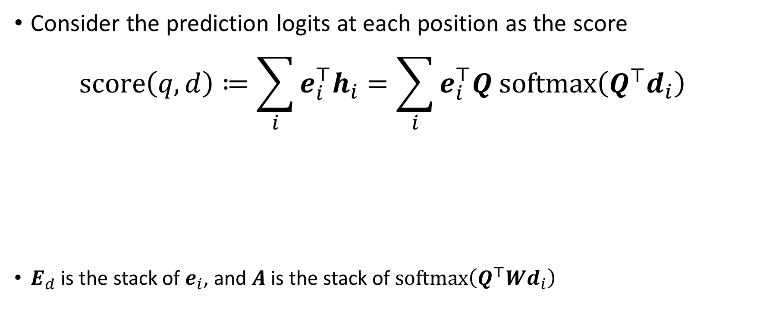

Brief Derivation of Our Discovery
Consider the prediction logits at each position as the score
$$\text{score}\left(q,d\right)≔\sum_{i}{{e_{i}^{⊤}h}_{i}}=\sum_{i}{e_{i}^{⊤}Q \text{softmax}\left(Q^{⊤}d_{i}\right)}$$
$E_{d}$ is the stack of $e_{i}$, and $A$ is the stack of $\text{softmax}\left(Q^{⊤}Wd_{i}\right)$
$$=\sum_{ij}{{\left(E_{d}^{⊤}Q⊙A\right)}_{ij}}$$
Notes:
Using a more compact formulation, we can get this result
Here the E_d is the stack of e_i, and A is the stack of softmax vectors

Slide 19
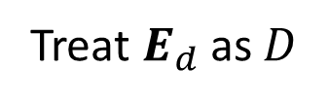

Brief Derivation of Our Discovery
Consider the prediction logits at each position as the score
$$\text{score}\left(q,d\right)≔\sum_{i}{{e_{i}^{⊤}h}_{i}}=\sum_{i}{e_{i}^{⊤}Q \text{softmax}\left(Q^{⊤}d_{i}\right)}$$
$E_{d}$ is the stack of $e_{i}$, and $A$ is the stack of $\text{softmax}\left(Q^{⊤}Wd_{i}\right)$
$$=\sum_{ij}{{\left(E_{d}^{⊤}Q⊙A\right)}_{ij}}$$
$$\sum_{ij}{{\left(D^{⊤}Q⊙A\right)}_{ij}}$$
GR
MVDR
Treat $E_{d}$ as $D$
Notes:
We can find the same structure with MVDR, here we treat E_d as the document encoding matrix D
And this is our core conclusion

Slide 20
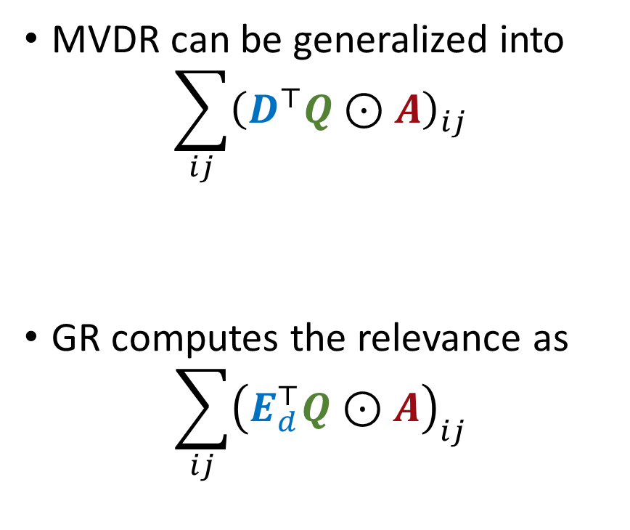
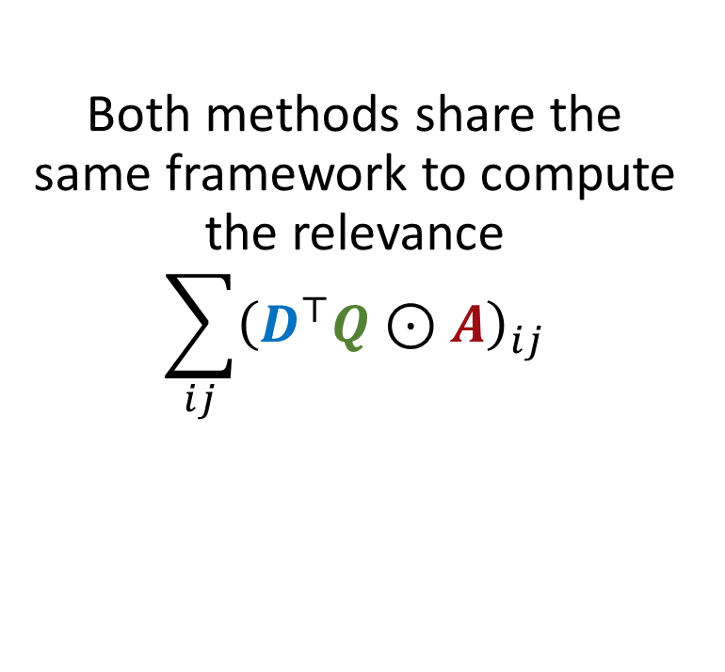
Brief Summary
MVDR can be generalized into
$$\sum_{ij}{{\left(D^{⊤}Q⊙A\right)}_{ij}}$$
GR computes the relevance as
$$\sum_{ij}{{\left(E_{d}^{⊤}Q⊙A\right)}_{ij}}$$
Both methods share the same framework to compute the relevance
$$\sum_{ij}{{\left(D^{⊤}Q⊙A\right)}_{ij}}$$
Notes:
To summarize our conclusion, both methods share the same framework for computing query-document relevance: the document encoding matrix is multiplied by the query encoding matrix, followed by an element-wise multiplication with the alignment matrix.

Slide 21
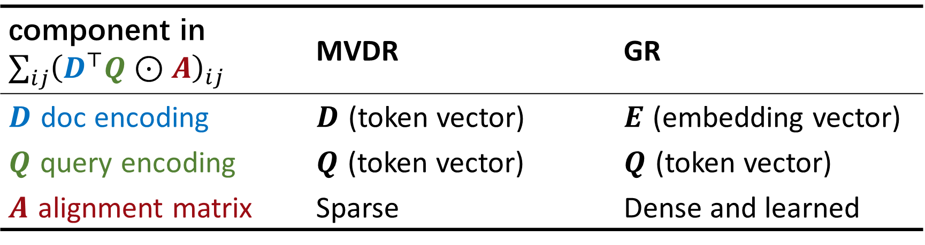
Comparison of MVDR and GR
component in $\sum_{ij}{{\left(D^{⊤}Q⊙A\right)}_{ij}}$ | MVDR | GR
$D$ doc encoding | $D$ (token vector) | $E$ (embedding vector)
$Q$ query encoding | $Q$ (token vector) | $Q$ (token vector)
$A$ alignment matrix | Sparse | Dense and learned
Notes:
Here is a comparison of the two methods. On the left, we have the different components in the framework: D (the document encoding), Q (the query encoding), and A (the alignment matrix).
GR uses the embedding vector as the document encoding instead of the token vector, making it simpler but non-contextual. Additionally, GR features a dense and learnable alignment matrix, which corresponds to the attention map in the cross-attention layer.

Slide 22
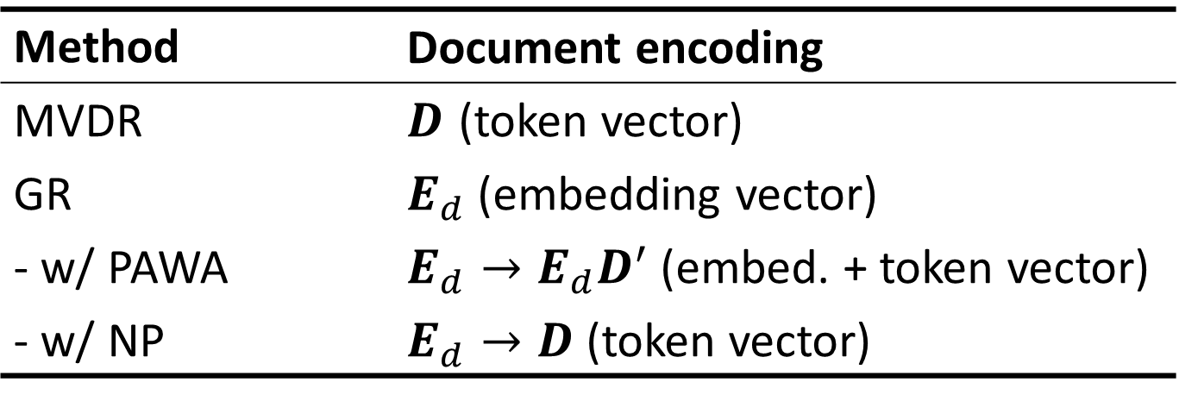
Discussion of Document Encoding
prefix-aware weight-adaptive (PAWA) decoding by Wang et al.
non-parametric (NP) decoding by Lee et al.
Method | Document encoding
MVDR | $D$ (token vector)
GR | $E_{d}$ (embedding vector)
- w/ PAWA | $E_{d}→E_{d}D^{′}$ (embed. + token vector)
- w/ NP | $E_{d}→D$ (token vector)
Wang, Y., et al. A Neural Corpus Indexer for Document Retrieval. NeurIPS 2022
Lee, H., et al. Nonparametric Decoding for Generative Retrieval. ACL Findings 2023
Notes:
Some recent works on generative retrieval have proposed several decoding methods to enhance performance. For example, there's a method called "Prefix-Aware Weight Adaptive Decoding," or PAWA, by Wang et al. This method uses different embedding tables for different positions. Another method, known as "Non-Parametric" or NP decoding, by Lee et al., directly replaces the embedding vector with the token vector.
By including these decoding methods in our framework, we can understand how they improve document encoding. PAWA, for instance, replaces the embedding vector with a combination of the embedding vector and token vector. On the other hand, NP decoding directly uses the token vectors.

Slide 23

Discussion of Alignment Matrix
Different alignment direction
$$\text{MVDR}\left(q,d\right)≔\sum_{q_{j}}{\max_{d_{i}}{d_{i}^{⊤}q_{j}}} \\ \text{GR}\left(q,d\right)≔\sum_{d_{i}}{{e_{i}^{⊤}h}_{i}}$$
Query-to-doc alignment
Doc-to-query alignment
Notes:
We believe the alignment matrix is the most critical part of the scoring process, and we have outlined many of its properties in our paper. Here, I’d like to share one of the interesting discussions about the alignment matrix.
We found that MVDR and GR have different alignment directions. MVDR finds the most similar document tokens for each query token. And it can be viewed as a summation with respect to q_j​. In our paper, we call this "query-to-doc alignment.“. It means each query token must find its best-aligned document token.
For GR, the process works in the opposite direction. Each document token has to find its best-aligned query token, achieved through the attention mechanism. Here, the score is a summation with respect to d_i​. We refer to this as "doc-to-query alignment" in our paper.

Slide 24







Discussion of Alignment Matrix
Different alignment direction $→$ normalization direction
$$d$$
$$d$$
Normalization direction
$$q$$
$$A$$
$$q$$
$$A$$
MVDR
GR
Row-wise normalization
Column-wise normalization
Notes:
There is another view of the alignment direction, which is the normalization direction of the alignment matrix
Basically MVDR, the query to doc direction is row-wise normalization, and GR the doc to query direction is the column wise normalization

Slide 25
Some of Our Conducted Experiments
Ablation study on alignment direction in the re-rank setting
Term-exact match rate between query and retrieved documents
Low-rank approximation of alignment matrix of GR

Slide 26

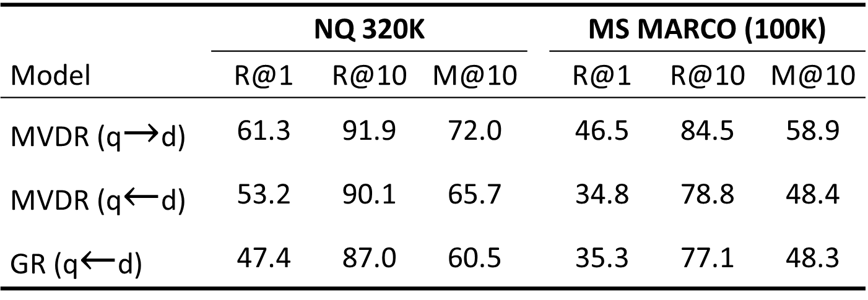
Performance in the Re-rank Setting
We trained MVDR (ColBERT) and GR (SEAL) using T5
MVDR (q $←$ d) reverses the alignment direction
Query-to-doc. alignment direction may be more suitable
 | NQ 320K | NQ320K |  |  | MS MARCO (100K)
Model | R@1 | R@10 | M@10 |  | R@1 | R@10 | M@10
MVDR (q$→$d) | 61.3 | 91.9 | 72.0 |  | 46.5 | 84.5 | 58.9
MVDR (q$←$d) | 53.2 | 90.1 | 65.7 |  | 34.8 | 78.8 | 48.4
GR (q$←$d) | 47.4 | 87.0 | 60.5 |  | 35.3 | 77.1 | 48.3
Notes:
We have conducted many experiments to analyze MVDR and GR. And this is the experiment where we want to see the performance in the re-rank setting. We trained ColBERT and SEAL using T5 architecture. The line in the middle is a modified MVDR model that uses a document-to-query alignment direction which is the same direction as GR but opposite to the original MVDR. We can see that the original MVDR is much better than the others. The performance of MVDR with changed alignment direction is similar to GR.
We conjecture that query-to-document alignment direction may be a more suitable strategy.

Slide 27
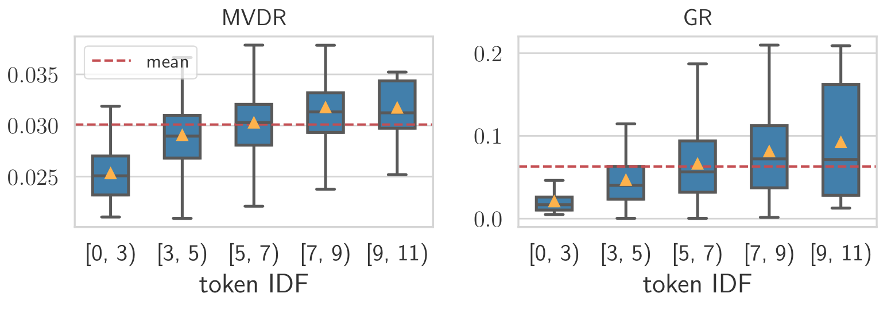

(Soft) Term-exact matching rate v.s. term IDF
Soft $→$ Softmaxed alignment score of the matching term
More rarer tokens have larger alignment scores
Notes:
We use the softmaxed alignment score as the score of matching terms, and zero if there are not exact match terms

Slide 28
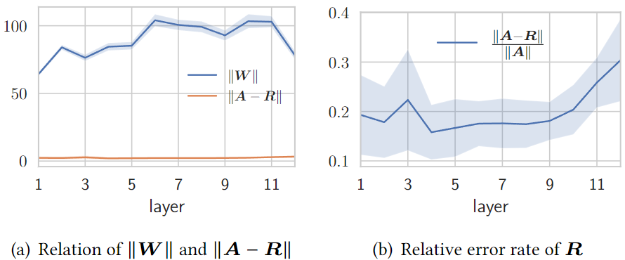
Low-rank approx. of GR alignment matrix
Relative error of the approximation in different layers of GR

Slide 29
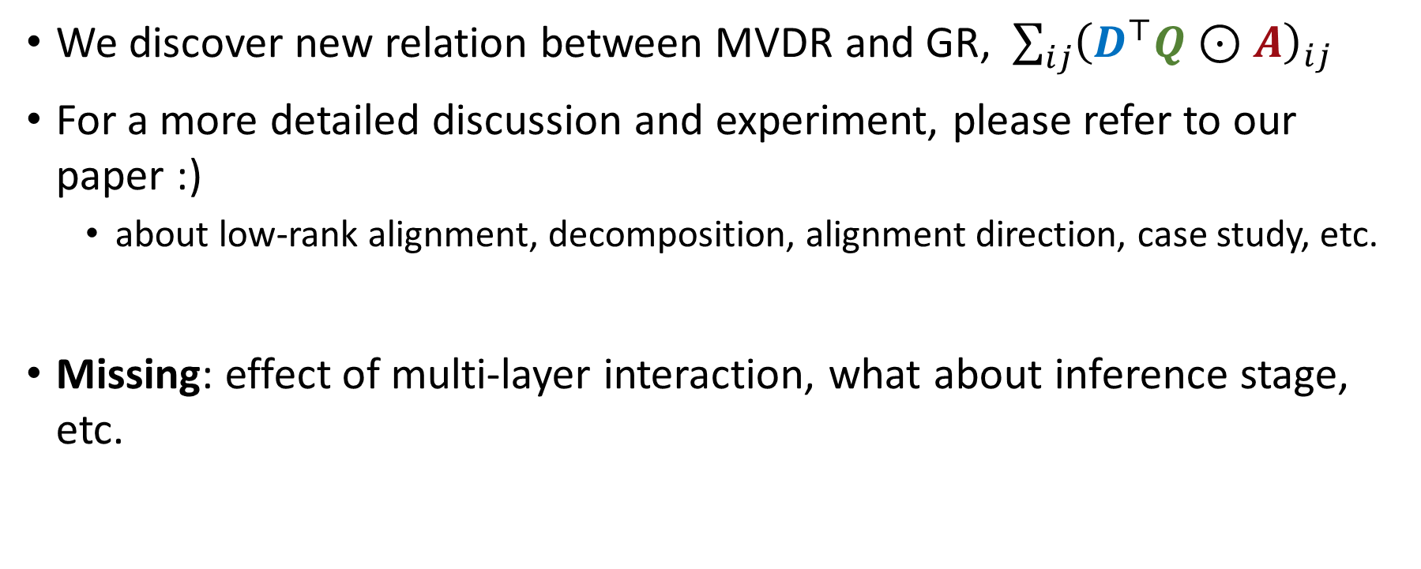
Summary
We discover new relation between MVDR and GR, $\sum_{ij}{{\left(D^{⊤}Q⊙A\right)}_{ij}}$
For a more detailed discussion and experiment, please refer to our paper :)
about low-rank alignment, decomposition, alignment direction, case study, etc.
Missing: effect of multi-layer interaction, what about inference stage, etc.

Slide 30


Discussion (back to the question)
Generative retrieval (GR)
A new paradigm (yes, of course)
Dramatically different (not totally different)
Notes:
Let me go back to the question

Slide 31
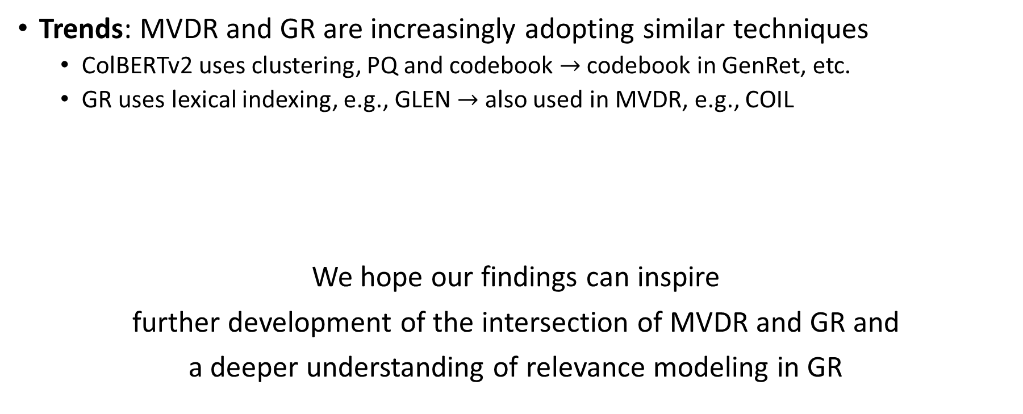
Discussion
Trends: MVDR and GR are increasingly adopting similar techniques
ColBERTv2 uses clustering, PQ and codebook $→$ codebook in GenRet, etc.
GR uses lexical indexing, e.g., GLEN $→$ also used in MVDR, e.g., COIL
We hope our findings can inspire
further development of the intersection of MVDR and GR and
a deeper understanding of relevance modeling in GR
MVDR
GR
Notes:
Although MVDR and GR are developing independently, they are increasingly adopting similar techniques.

Slide 32


Thanks for your attention
E-mail: shiguang.wu@mail.sdu.edu.cn
X (Twitter): @shiguang_wu
Code: https://github.com/Furyton/GR-as-MVDR
ArXiv: https://arxiv.org/abs/2404.00684
Notes:
That’s all, thanks for your attention

