Slide 1
Analysing 2-Dimensional ODEs
PE&RC theoretical ecology course 2025
Jasper Croll

Slide 2
Lecture goals
After this lecture you can:
Formulate a 2-ODE model
Calculate equilibria for a 2-ODE model
Determine the stability and dynamics of 2-ODE models using graphical analysis

Slide 3
Modelling two species
What interactions can occur between two species?
Predation / consumption
Consumer-resource and predator-prey models
Competition
Facilitation

Slide 4
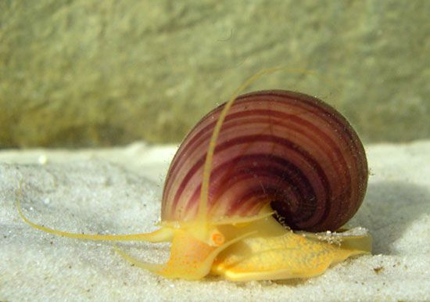
Model formulation exercise:
Freshwater snails gain most of their nutrients by consuming detritus (dead plant material) from the bottom of ponds and lakes. We study the snail dynamics in a pond with volume V (liter).
Through the year, an amount of leaves falls in the pond (K, gram/year) providing new detritus. Water is flowing out of the pond with a rate r (liter per year), flushing away part of the detritus.
Each snail searches the water with a rate a (liter/year/individual) and consumes all detritus it encounters. A snail needs c gram of detritus to produce one offspring.
Snails have a constant mortality rate µ (per year). In addition, snails migrate to other ponds when the pond is too crowded. The migration rate of a snail increases with a value m per snail in the pond.
Based on the description, formulate a model describing the dynamics of the detritus D in gram and the number of snails S.
Check the units of the parameters in your model.

Slide 5

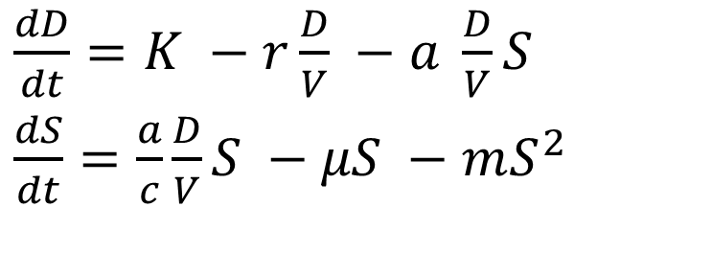

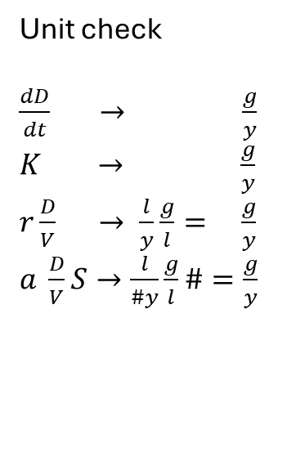
Whiteboard: model
$\frac{dD}{dt}=K −r\frac{D}{V} −a \frac{D}{V}S$
$\frac{dS}{dt}=\frac{a}{c}\frac{D}{V}S −μS −mS^{2}$
t: time ($y$)
D: Detritus ($g$)
S: snails ($\#$)
V: pond volume ($l$)
K: detritus inflow ($g/y$)
r: outflow rate ($l/y$)
a: search rate ($l/(\# y)$)
c: conversion ($g/\#$)
µ: mortality rate (1$/y$)
m: migration rate (1$/(\# y)$)
Unit check
$\frac{dD}{dt} → \frac{g}{y}$
$K → \frac{g}{y}$
$r\frac{D}{V} → \frac{l}{y}\frac{g}{l}= \frac{g}{y}$
$a \frac{D}{V}S→\frac{l}{\#y}\frac{g}{l}\#=\frac{g}{y}$
$\frac{dD}{dt} → \frac{\#}{y}$
$\frac{a}{c}\frac{D}{V}S →\frac{\#}{g}\frac{l}{\#y}\frac{g}{l}\#=\frac{\#}{y}$
$μS →\frac{1}{y}\#= \frac{\#}{y}$
$mS^{2} → \frac{l}{\# y}\#^{2}= \frac{\#}{y}$

Slide 6
Whiteboard: Isoclines
No change in equilibrium
All differential equations are zero
Isoclines are lines at which one equation is equal to zero
Equilibria occur at the intersections of isoclines

Slide 7
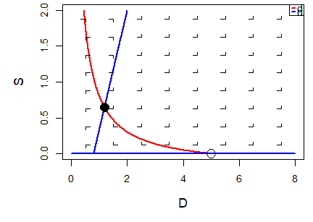
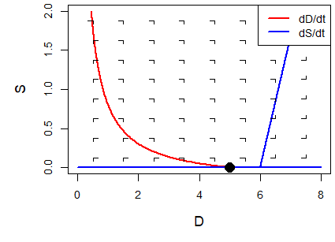
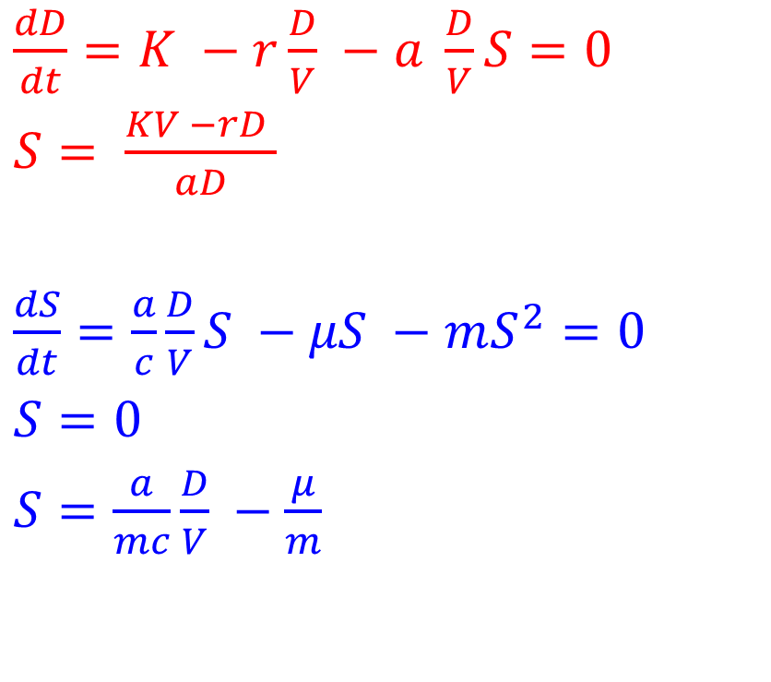
Whiteboard: isoclines
$\frac{dD}{dt}=K −r\frac{D}{V} −a \frac{D}{V}S=0$
$S= \frac{KV −rD }{aD}$
$\frac{dS}{dt}=\frac{a}{c}\frac{D}{V}S −μS −mS^{2}=0$
$S=0$
$S=\frac{a}{mc}\frac{D}{V} −\frac{μ}{m}$

Slide 8
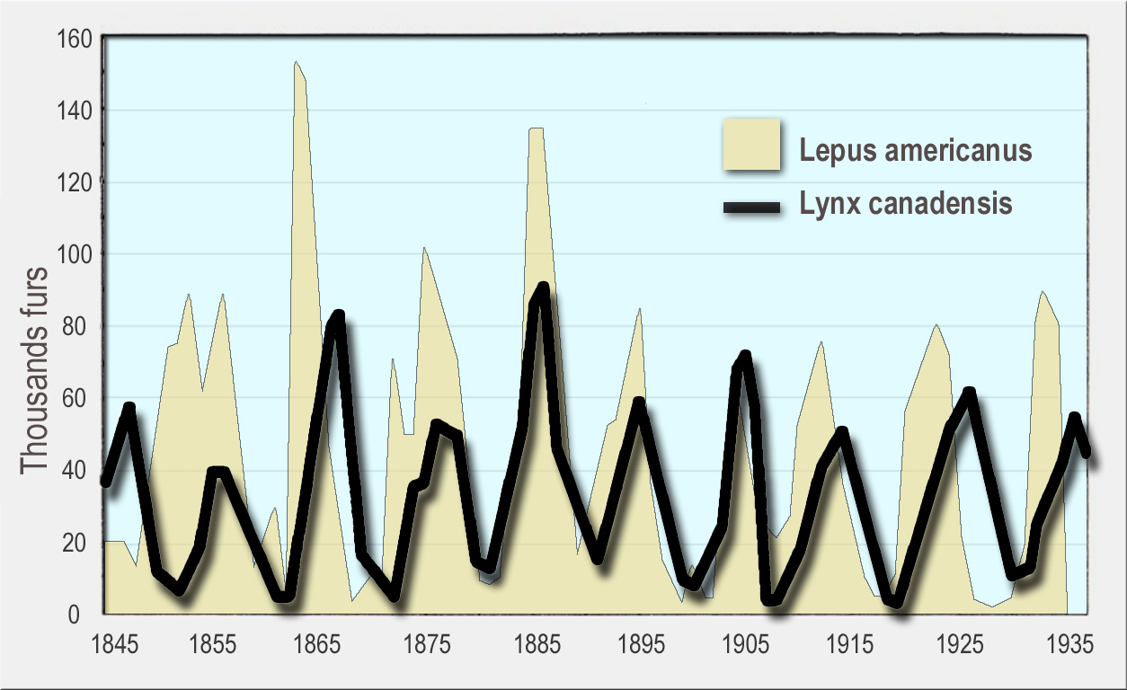
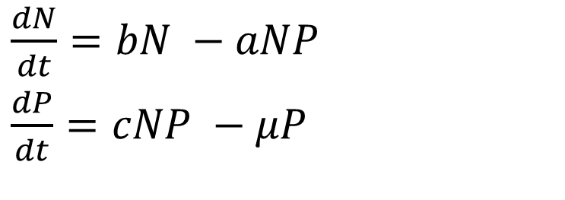
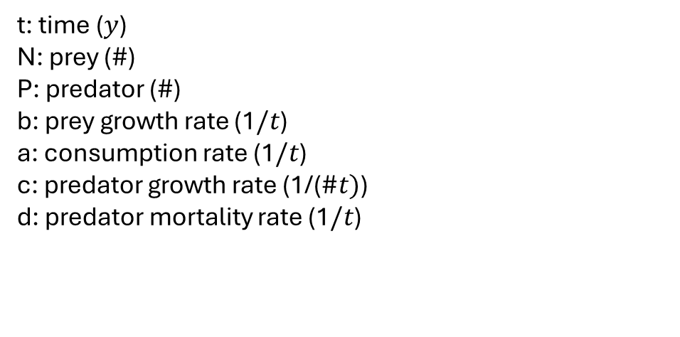
Lotka-Volterra: First predator prey model
Developed to explain fluctuations in predator and prey populations
Fluctuations in fur sold to company
Predator/prey ratios in fish catches
$\frac{dN}{dt}=bN −aNP$
$\frac{dP}{dt}=cNP −μP$
t: time ($y$)
N: prey ($\#$)
P: predator ($\#$)
b: prey growth rate (1$/t$)
a: consumption rate (1$/t$)
c: predator growth rate (1/($\#t)$)
d: predator mortality rate (1$/t$)

Slide 9
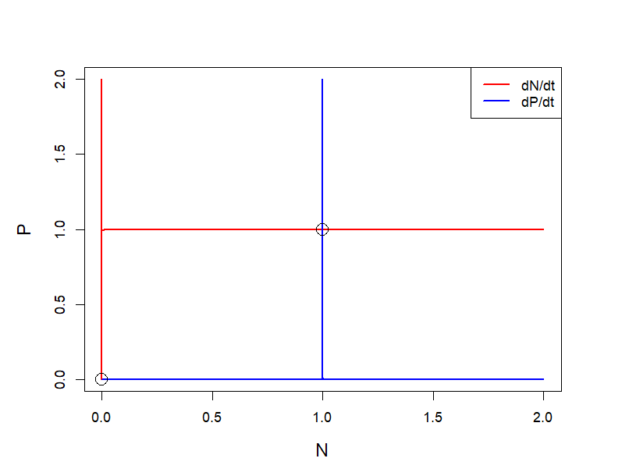
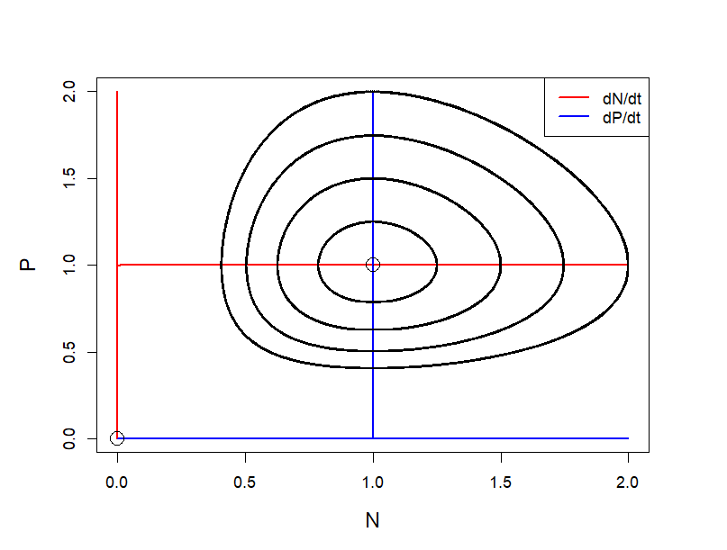
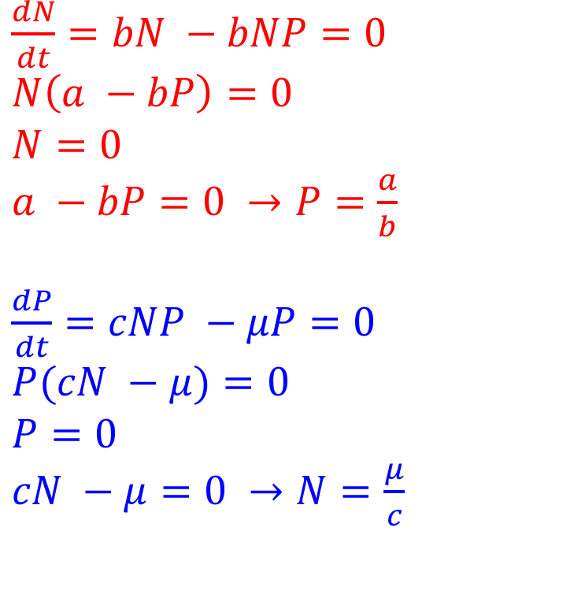
Lotka-Volterra: Isoclines
$\frac{dN}{dt}=bN −bNP=0$
$N\left(a −bP\right)=0$
$N=0$
$a −bP=0 →P=\frac{a}{b}$
$\frac{dP}{dt}=cNP −μP=0$
$P(cN −μ)=0$
$P=0$
$cN −μ=0 →N=\frac{μ}{c}$

Slide 10

More realistic predator-prey interactions
Holling functional responses
Type I:
$X=aNT$
$T=1$
$X=aN$
X: number of prey caught
N: prey density
a: attack rate (1/t)
T: total time = 1
Type I

Slide 11
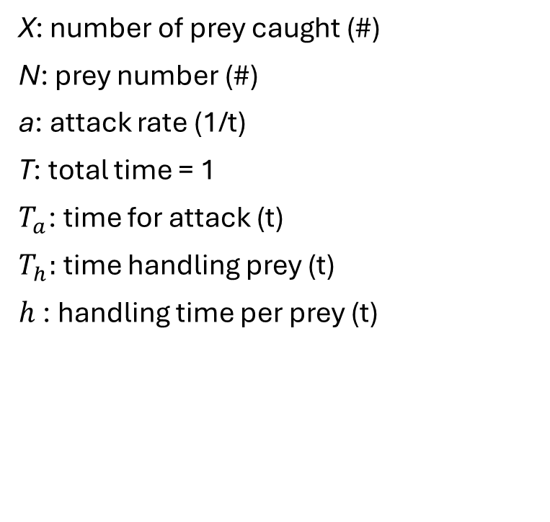


More realistic predator-prey interactions
X: number of prey caught (#)
N: prey number (#)
a: attack rate (1/t)
T: total time = 1
$T_{a}$: time for attack (t)
$T_{h}:$ time handling prey (t)
$h$: handling time per prey (t)
Holling functional responses
Type II
$X=aNT_{a}$
$X=aN(1−T_{h})$
$X=aN(1−hX)$
$X= aN−hXaN$
$X+hXaN= aN$
$X(1+haN)= aN$
$X= \frac{aN }{1+haN}$
$T=T_{a}+T_{h}=1$
$T_{a}=1−T_{h}$
$T_{h}=hX$

Slide 12





More realistic predator-prey interactions
X: number of prey caught (#)
N: prey number (#)
a: attack rate (1/t)
$h$: handling time per prey (t)
Holling functional responses
Type II:
$X= \frac{aN }{1+ahN}$
$X=I_{max}\frac{N }{N+H}$
Type I
$$I_{max}$$
Type II
$$\frac{I_{max}}{2}$$
$$H$$

Slide 13

More realistic predator-prey interactions
X: number of prey caught (#)
N: prey number (#)
a: attack rate (1/t)
$h$: handling time per prey (t)
Holling functional responses
Type I:
$X=aN$
Type II:
$X= \frac{aN }{1+ahN}$
Type III:
$X= \frac{aN^{k} }{1+ahN^{k}}$
Type I
Type II
Type III

Slide 14
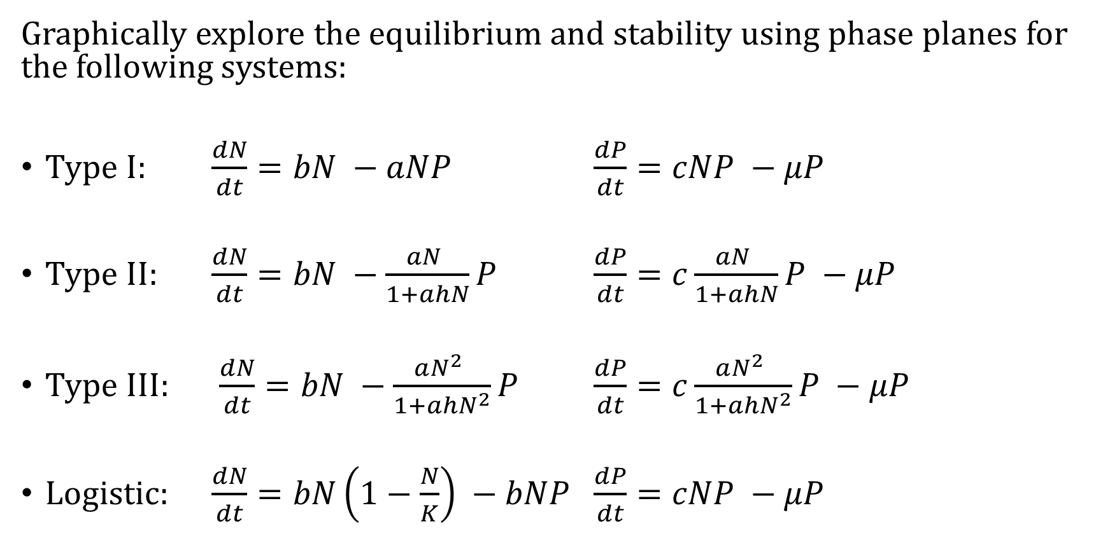
Functional responses
Graphically explore the equilibrium and stability using phase planes for the following systems:
Type I: $\frac{dN}{dt}=bN −aNP$ $\frac{dP}{dt}=cNP −μP$
Type II: $\frac{dN}{dt}=bN −\frac{aN }{1+ahN}P$ $\frac{dP}{dt}=c\frac{aN }{1+ahN}P −μP$
Type III: $\frac{dN}{dt}=bN −\frac{aN^{2} }{1+ahN^{2}}P$ $\frac{dP}{dt}=c\frac{aN^{2} }{1+ahN^{2}}P −μP$
Logistic: $\frac{dN}{dt}=bN\left(1−\frac{N}{K}\right) −bNP$ $\frac{dP}{dt}=cNP −μP$

Slide 15

Whiteboard: Type I
Type I:
$\frac{dN}{dt}=aN −bNP$
$\frac{dP}{dt}=cNP −μP$
Neutral cycles

Slide 16
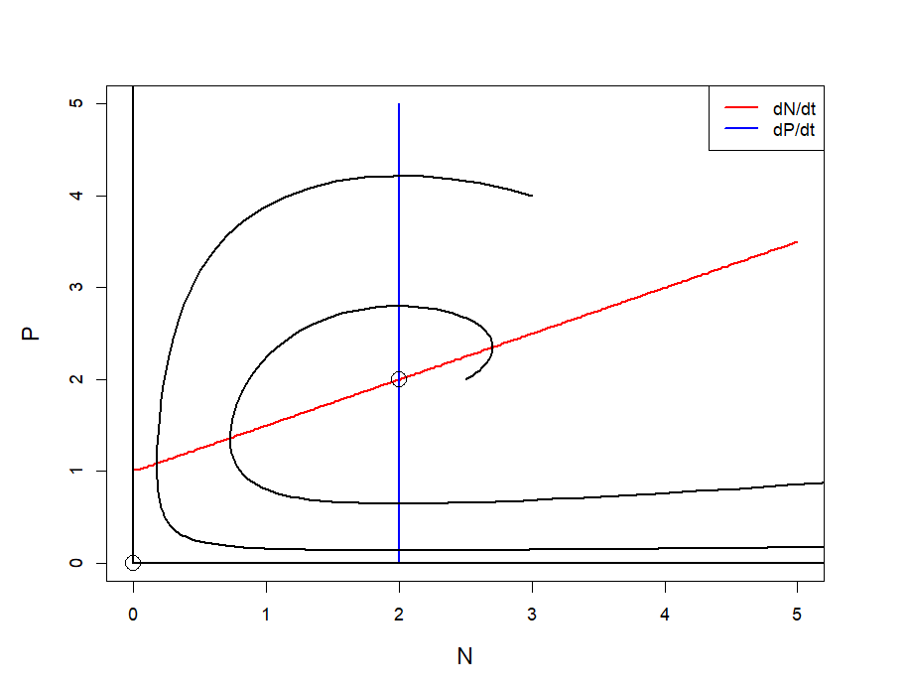

Whiteboard: Type II
Type II:
$\frac{dN}{dt}=bN −\frac{aN }{1+ahN}P$
$\frac{dP}{dt}=c\frac{aN }{1+ahN}P −μP$
Destabalizes dynamics

Slide 17
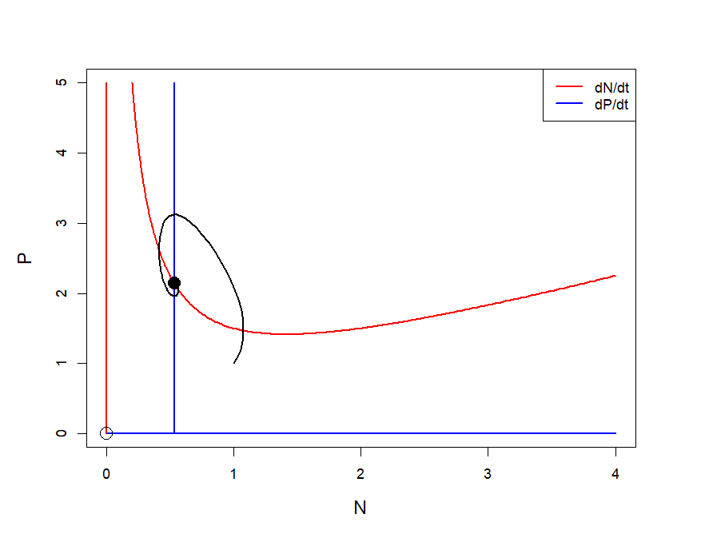
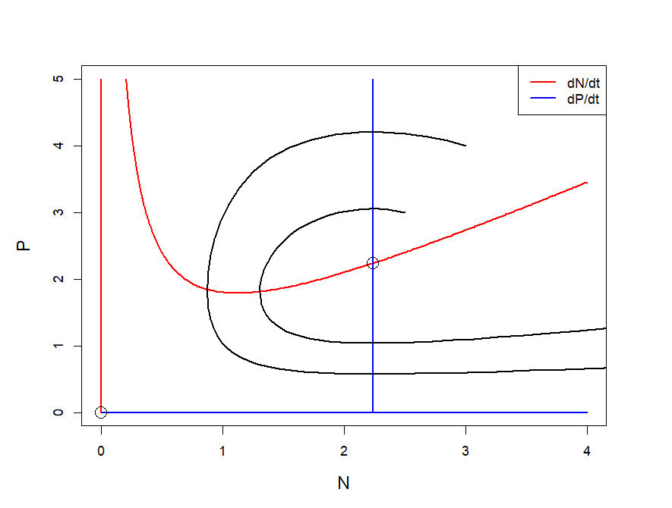

Whiteboard: Type III
Type III:
$\frac{dN}{dt}=bN −\frac{aN^{2} }{1+ahN^{2}}P$
$\frac{dP}{dt}=c\frac{aN^{2} }{1+ahN^{2}}P −μP$
Stability depends on parameters

Slide 18
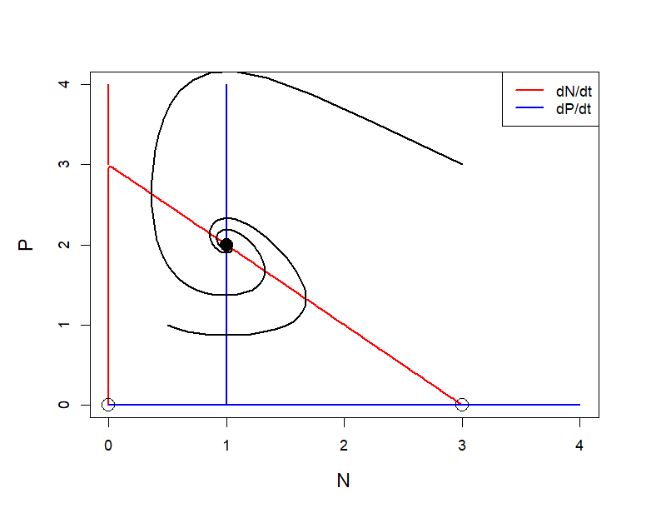

Whiteboard: Logistic growth
Logistic growth:
$\frac{dN}{dt}=bN\left(1−\frac{N}{K}\right) −bNP$
$\frac{dP}{dt}=cNP −μP$
Stabilizes dynamics

Slide 19
Short break

Slide 20
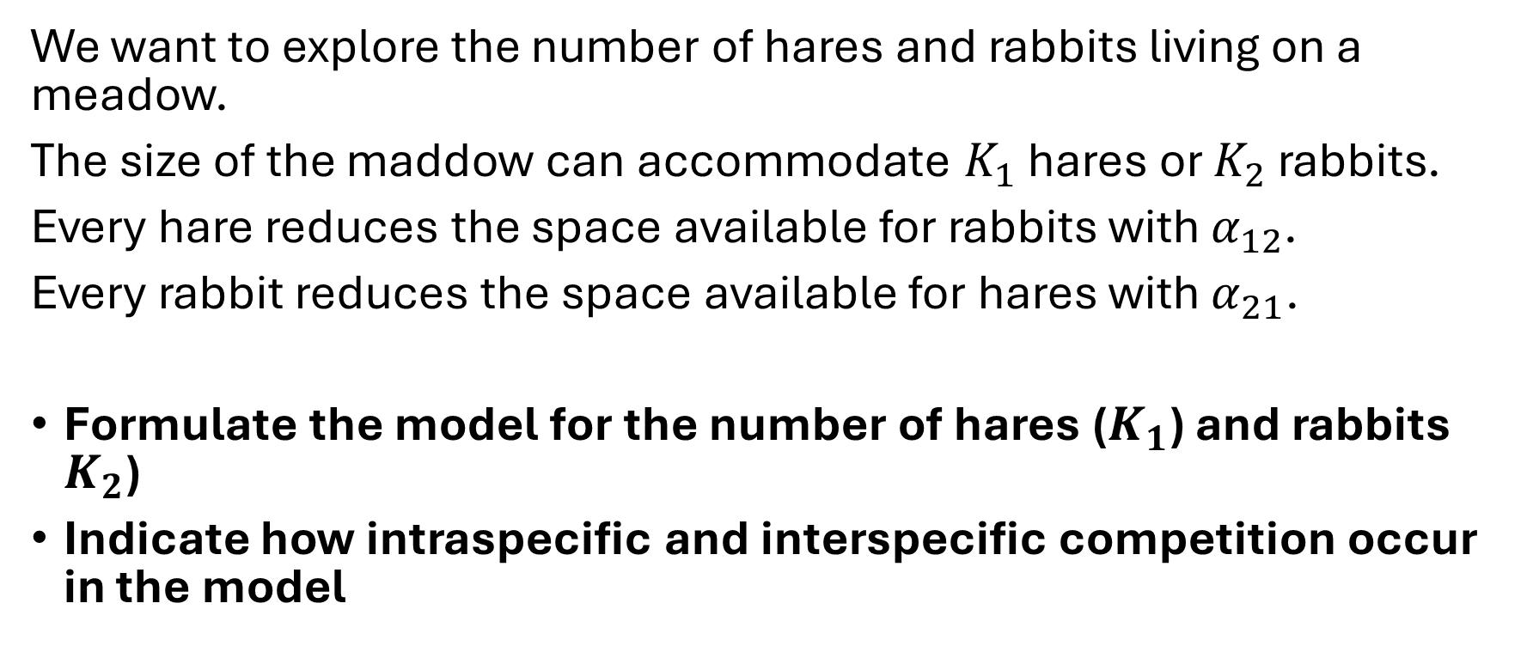
Competition between two species
We want to explore the number of hares and rabbits living on a meadow.
The size of the maddow can accommodate $K_{1}$ hares or $K_{2}$ rabbits.
Every hare reduces the space available for rabbits with $α_{12}$.
Every rabbit reduces the space available for hares with $α_{21}$.
Formulate the model for the number of hares ($K_{1}$) and rabbits $K_{2}$)
Indicate how intraspecific and interspecific competition occur in the model

Slide 21


Whiteboard: Competition between two species
Logistic growth: $\frac{dN_{1}}{dt}=rN_{1}\left(1−\frac{N_{1}}{K_{1}}\right)=rN_{1}\left(\frac{K_{1}−N_{1}}{K_{1}}\right)$
$\frac{dN_{1}}{dt}=r_{1}N_{1}\left(\frac{K_{1}−N_{1}−α_{21}N_{2}}{K_{1}}\right)$
$\frac{dN_{2}}{dt}=r_{2}N_{2}\left(\frac{K_{2}−N_{2}−α_{12}N_{1}}{K_{2}}\right)$
$r$: growth rate ($t^{−1}$)
$K$: carrying capacity (#)
$α$: competition strength
Intraspecific competition
Interspecific competition

Slide 22
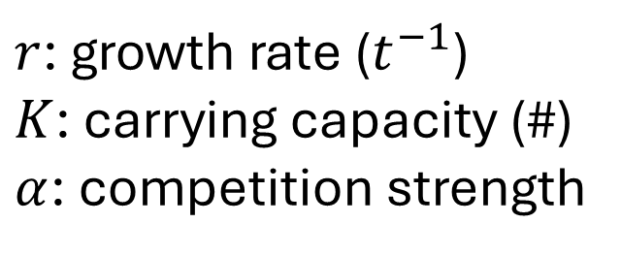
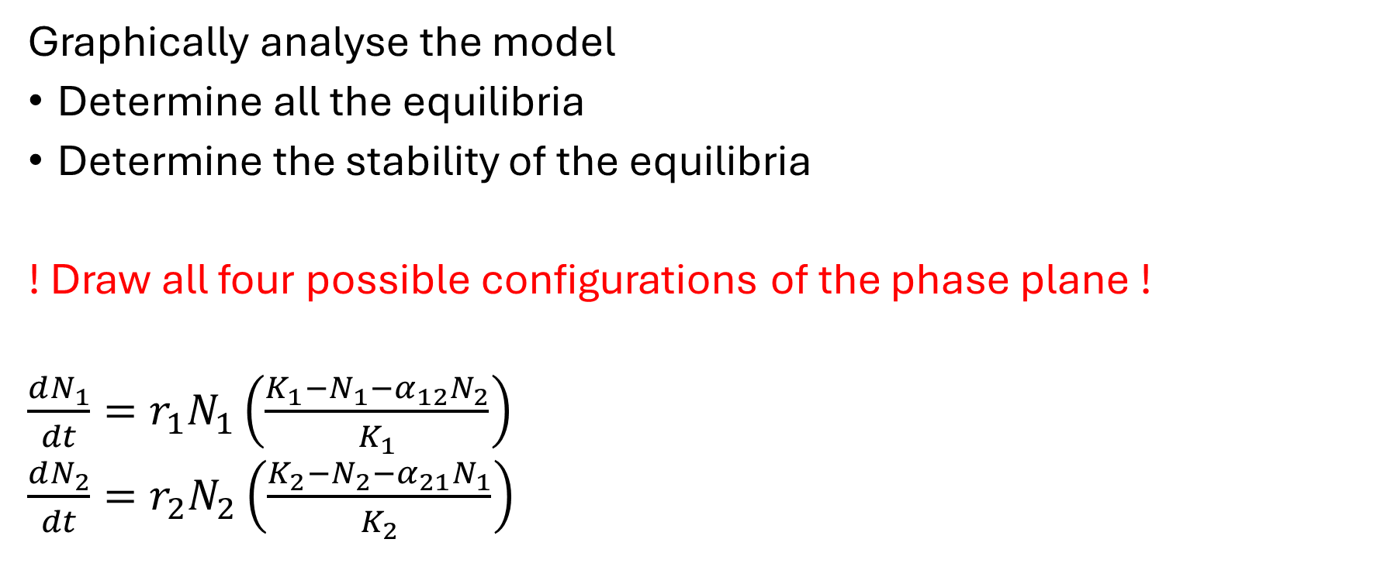
Competition between two species
Graphically analyse the model
Determine all the equilibria
Determine the stability of the equilibria
! Draw all four possible configurations of the phase plane !
$\frac{dN_{1}}{dt}=r_{1}N_{1}\left(\frac{K_{1}−N_{1}−α_{12}N_{2}}{K_{1}}\right)$
$\frac{dN_{2}}{dt}=r_{2}N_{2}\left(\frac{K_{2}−N_{2}−α_{21}N_{1}}{K_{2}}\right)$
$r$: growth rate ($t^{−1}$)
$K$: carrying capacity (#)
$α$: competition strength

Slide 23
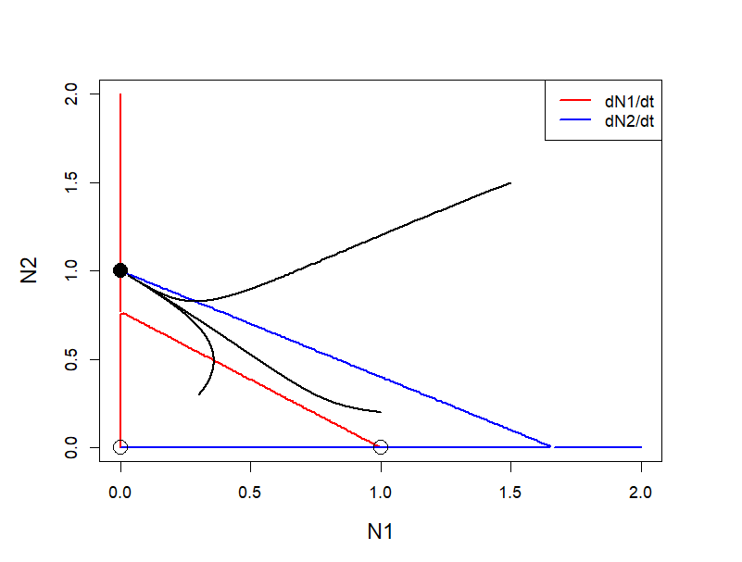
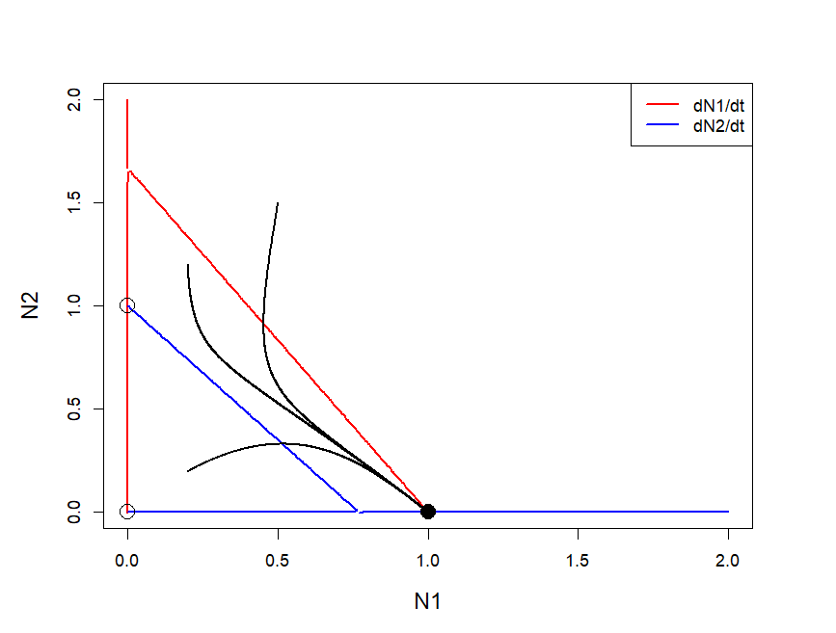

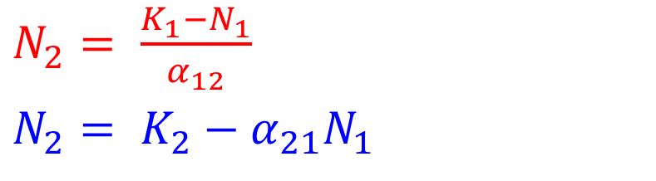

Whiteboard: Competition between two species
$\frac{dN_{1}}{dt}=rN_{1}\left(\frac{K_{1}−N_{1}−α_{12}N_{2}}{K_{1}}\right)=0$
$\frac{dN_{2}}{dt}=rN_{2}\left(\frac{K_{2}−N_{2}−α_{21}N_{1}}{K_{2}}\right)=0$
$$N_{1}=0$$
$$N_{2}=0$$
$N_{2}= \frac{K_{1}−N_{1}}{α_{12}}$
$N_{2}= K_{2}−α_{21}N_{1}$

Slide 24
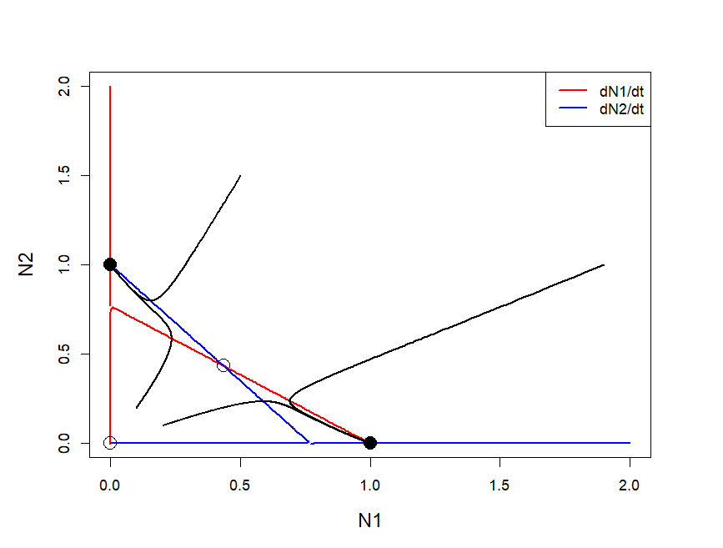
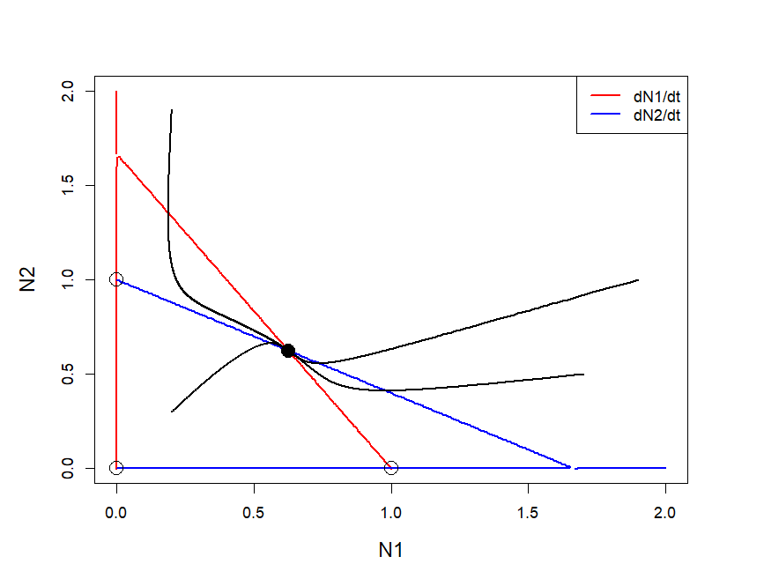

Whiteboard: Competition between two species
$\frac{dN_{1}}{dt}=rN_{1}\left(\frac{K_{1}−N_{1}−α_{12}N_{2}}{K_{1}}\right)=0$
$\frac{dN_{2}}{dt}=rN_{2}\left(\frac{K_{2}−N_{2}−α_{21}N_{1}}{K_{2}}\right)=0$
$$N_{1}=0$$
$$N_{2}=0$$
$N_{2}= \frac{K_{1}−N_{1}}{α_{12}}$
$N_{2}= K_{2}−α_{21}N_{1}$

Slide 25
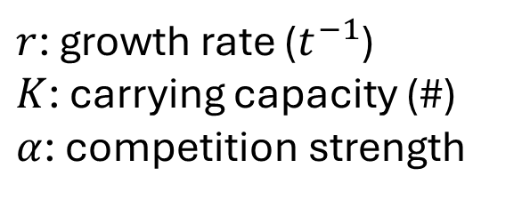
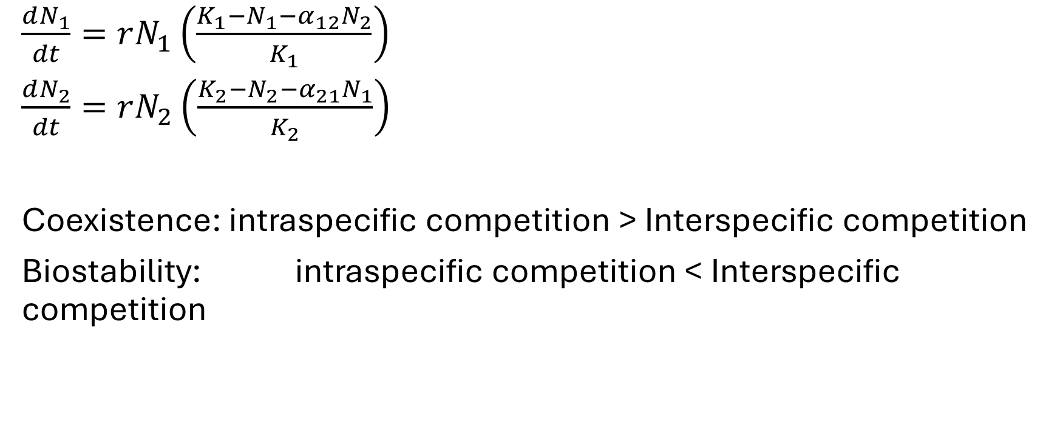
Competition between two species
$\frac{dN_{1}}{dt}=rN_{1}\left(\frac{K_{1}−N_{1}−α_{12}N_{2}}{K_{1}}\right)$
$\frac{dN_{2}}{dt}=rN_{2}\left(\frac{K_{2}−N_{2}−α_{21}N_{1}}{K_{2}}\right)$
Coexistence: intraspecific competition > Interspecific competition
Biostability: intraspecific competition < Interspecific competition
$r$: growth rate ($t^{−1}$)
$K$: carrying capacity (#)
$α$: competition strength

Slide 26
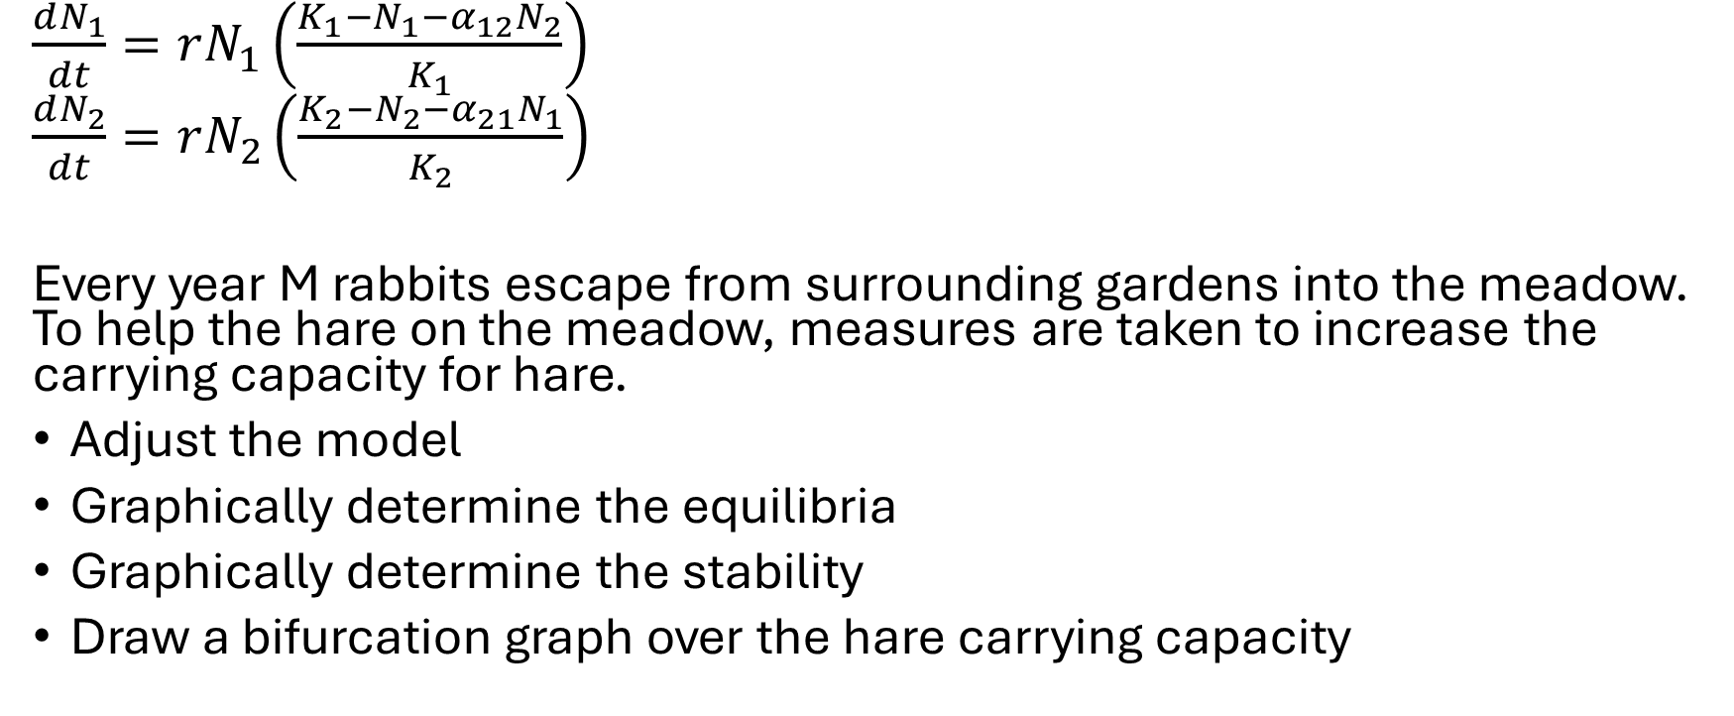
Competition between two species
$\frac{dN_{1}}{dt}=rN_{1}\left(\frac{K_{1}−N_{1}−α_{12}N_{2}}{K_{1}}\right)$
$\frac{dN_{2}}{dt}=rN_{2}\left(\frac{K_{2}−N_{2}−α_{21}N_{1}}{K_{2}}\right)$
Every year M rabbits escape from surrounding gardens into the meadow. To help the hare on the meadow, measures are taken to increase the carrying capacity for hare.
Adjust the model
Graphically determine the equilibria
Graphically determine the stability
Draw a bifurcation graph over the hare carrying capacity
$r$: growth rate ($t^{−1}$)
$K$: carrying capacity (#)
$α$: competition strength

Slide 27

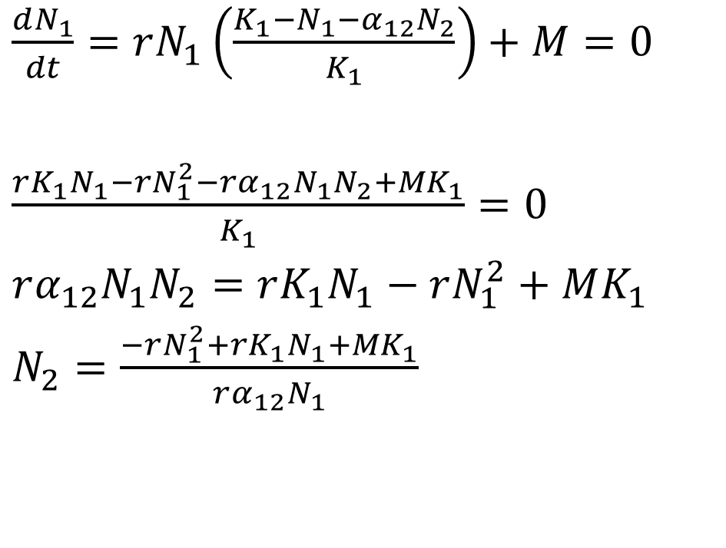

Whiteboard: Competition between two species
$\frac{dN_{1}}{dt}=rN_{1}\left(\frac{K_{1}−N_{1}−α_{12}N_{2}}{K_{1}}\right)+M=0$
$\frac{rK_{1}N_{1}−rN_{1}^{2}−rα_{12}N_{1}N_{2}+MK_{1}}{K_{1}}=0$
$rα_{12}N_{1}N_{2}=rK_{1}N_{1}−rN_{1}^{2}+MK_{1}$
$N_{2}=\frac{−rN_{1}^{2}+rK_{1}N_{1}+MK_{1}}{rα_{12}N_{1}}$
$\frac{dN_{2}}{dt}=rN_{2}\left(\frac{K_{2}−N_{2}−α_{21}N_{1}}{K_{2}}\right)=0$
$N_{2}=0$
$K_{2}−N_{2}−α_{21}N_{1}=0$
$N_{2}=K_{2}−α_{21}N_{1}$
$r$: growth rate ($t^{−1}$)
$K$: carrying capacity (#)
$α$: competition strength
$M$: inflow (${\#t}^{−1}$)

Slide 28



Whiteboard: Competition between two species
$\frac{dN_{1}}{dt}=rN_{1}\left(\frac{K_{1}−N_{1}−α_{12}N_{2}}{K_{1}}\right)+M=0$
$\frac{dN_{2}}{dt}=rN_{2}\left(\frac{K_{2}−N_{2}−α_{21}N_{1}}{K_{2}}\right)=0$
$r$: growth rate ($t^{−1}$)
$K$: carrying capacity (#)
$α$: competition strength
$M$: inflow (${\#t}^{−1}$)

Slide 29

Whiteboard: Competition between two species
$\frac{dN_{1}}{dt}=rN_{1}\left(\frac{K_{1}−N_{1}−α_{12}N_{2}}{K_{1}}\right)+M=0$
$\frac{dN_{2}}{dt}=rN_{2}\left(\frac{K_{2}−N_{2}−α_{21}N_{1}}{K_{2}}\right)=0$
$r$: growth rate ($t^{−1}$)
$K$: carrying capacity (#)
$α$: competition strength
$M$: inflow (${\#t}^{−1}$)

Slide 30

Whiteboard: Competition between two species
$\frac{dN_{1}}{dt}=rN_{1}\left(\frac{K_{1}−N_{1}−α_{12}N_{2}}{K_{1}}\right)+M=0$
$\frac{dN_{2}}{dt}=rN_{2}\left(\frac{K_{2}−N_{2}−α_{21}N_{1}}{K_{2}}\right)=0$
$r$: growth rate ($t^{−1}$)
$K$: carrying capacity (#)
$α$: competition strength
$M$: inflow (${\#t}^{−1}$)

Slide 31
Whiteboard: Competition between two species
$\frac{dN_{1}}{dt}=rN_{1}\left(\frac{K_{1}−N_{1}−α_{12}N_{2}}{K_{1}}\right)+M=0$
$\frac{dN_{2}}{dt}=rN_{2}\left(\frac{K_{2}−N_{2}−α_{21}N_{1}}{K_{2}}\right)=0$
$r$: growth rate ($t^{−1}$)
$K$: carrying capacity (#)
$α$: competition strength
$M$: inflow (${\#t}^{−1}$)

Slide 32

Whiteboard: Competition between two species
$\frac{dN_{1}}{dt}=rN_{1}\left(\frac{K_{1}−N_{1}−α_{12}N_{2}}{K_{1}}\right)+M=0$
$\frac{dN_{2}}{dt}=rN_{2}\left(\frac{K_{2}−N_{2}−α_{21}N_{1}}{K_{2}}\right)=0$
$r$: growth rate ($t^{−1}$)
$K$: carrying capacity (#)
$α$: competition strength
$M$: inflow (${\#t}^{−1}$)

Slide 33
Learning outcomes
Skills
Formulate a 2-ODE model
Graphically analyse the equilibria and stability of 2-ODE model
Insight
Understand how logistic growth and functional responses alter stability of a predator-prey system
Understand how intraspecific and interspecific competition determine the outcome of competition

