Slide 1
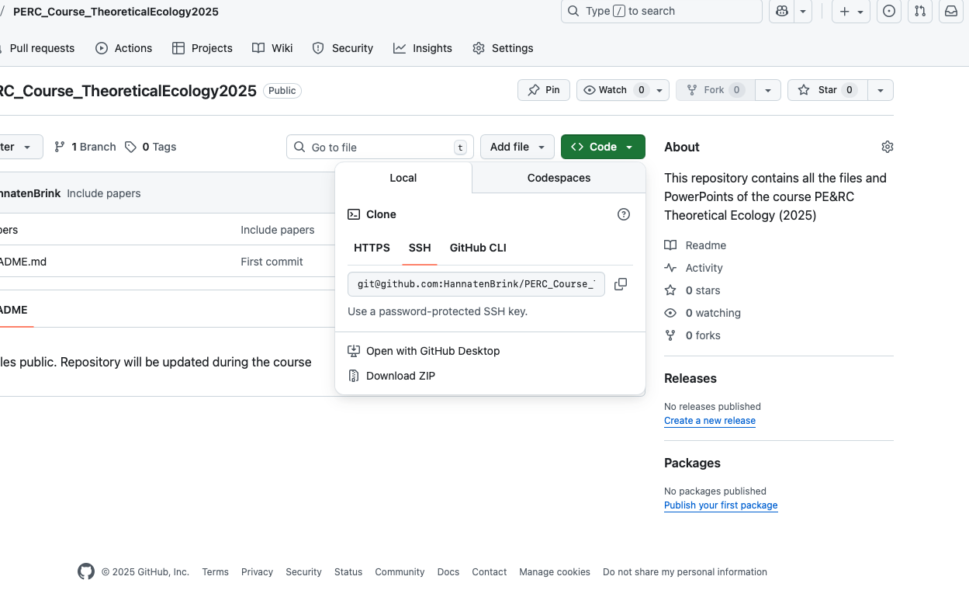
Course information: Github repository
All files (powerpoints, computer practica) will be made available via Github
https://github.com/HannatenBrink/PERC_Course_TheoreticalEcology2025
If you are not familiar with github, press the green ‘Code’ button
-> Download ZIP

