Slide 1
Computer lab The spruce-budworm

Slide 2
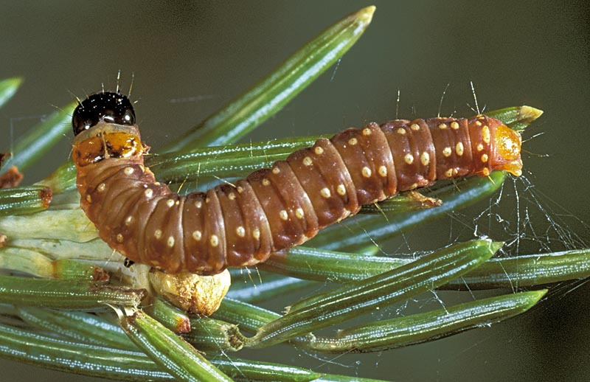
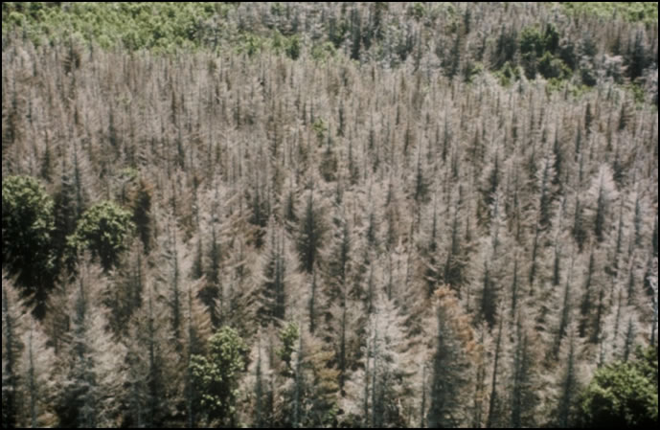
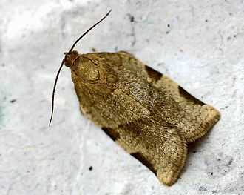
The spruce-budworm

Slide 3


The spruce-budworm
$r$: budworm growth rate
$K$: budworm carrying capacity
Logistic growth:
$\frac{dN}{dt}=rN\left(1−\frac{N}{K}\right)$

Slide 4
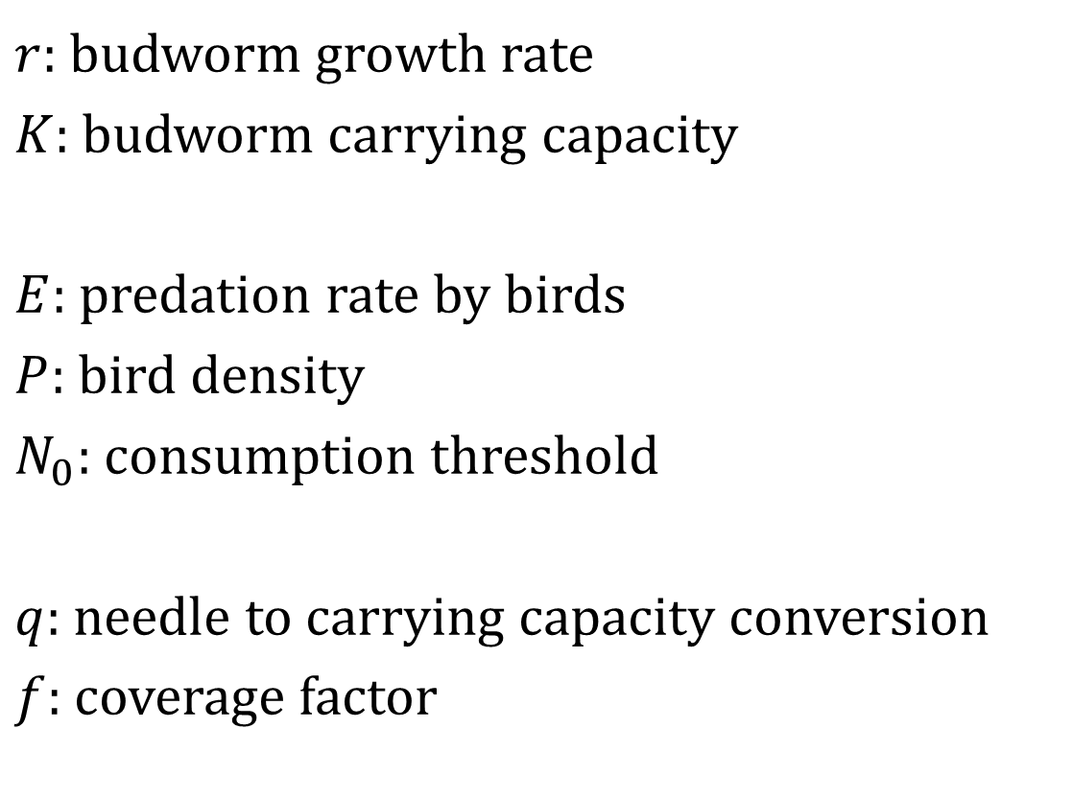
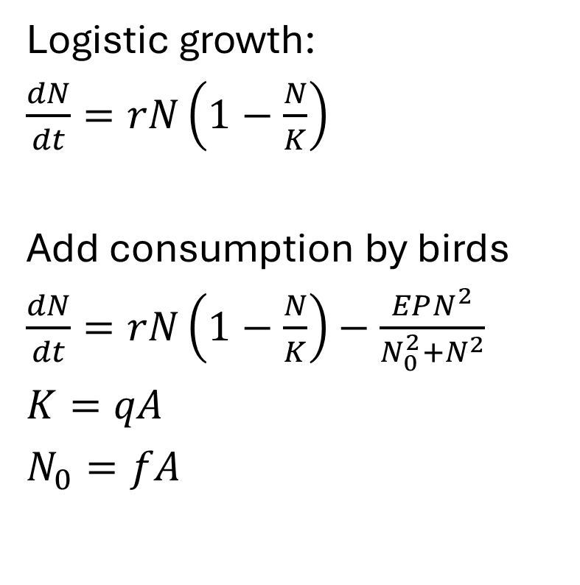
The spruce-budworm
$r$: budworm growth rate
$K$: budworm carrying capacity
$E$: predation rate by birds
$P$: bird density
$N_{0}$: consumption threshold
$q$: needle to carrying capacity conversion
$f$: coverage factor
Logistic growth:
$\frac{dN}{dt}=rN\left(1−\frac{N}{K}\right)$
Add consumption by birds
$\frac{dN}{dt}=rN\left(1−\frac{N}{K}\right)−\frac{EPN^{2}}{N_{0}^{2}+N^{2}}$
$K=qA$
$N_{0}=fA$

Slide 5
Link to the practical
https://staff.fnwi.uva.nl/a.m.deroos/projects/BifurcationTheory/60-deBifLabs.html#sec:budworm

Slide 6
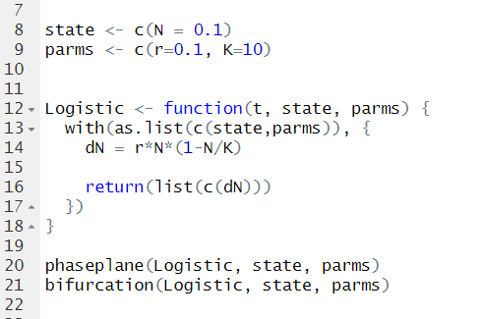
0. Model implementation

Slide 7
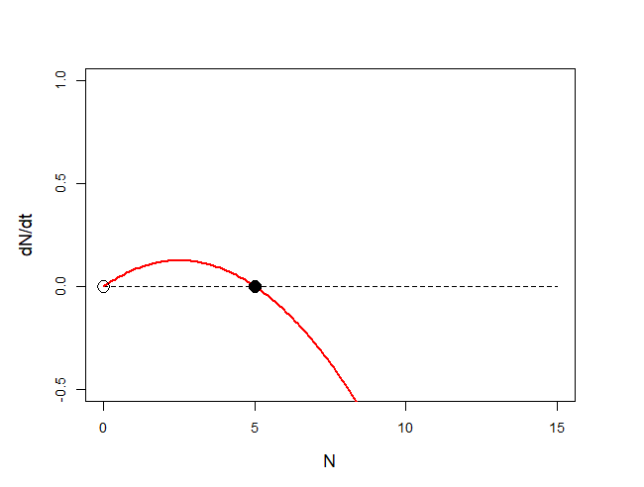
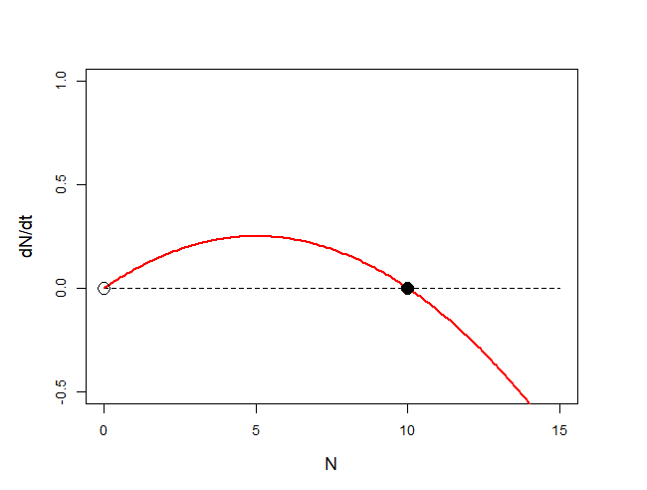
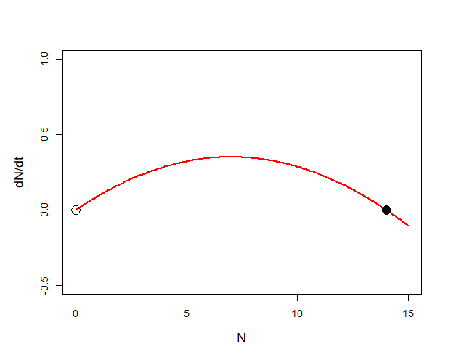
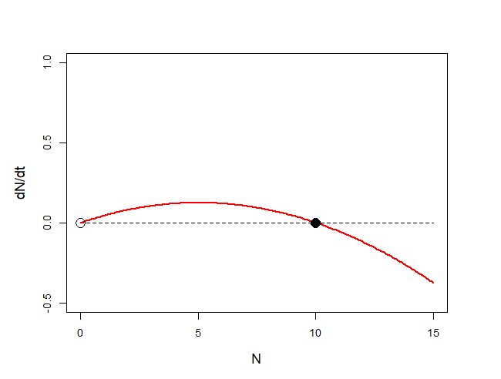
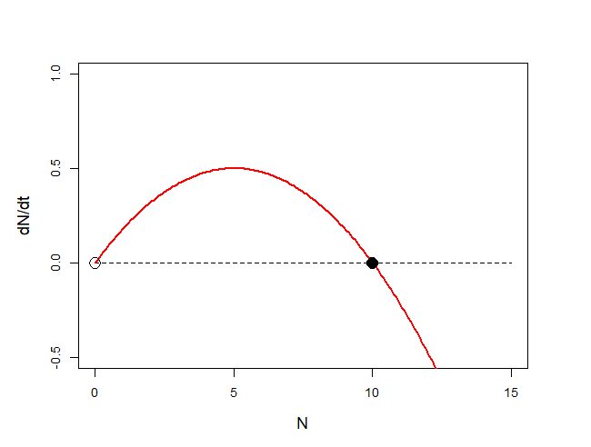
1. Phase planes for values of K and r
K=5
K=10
K=14
r=0.05
r=0.1
r=0.2

Slide 8
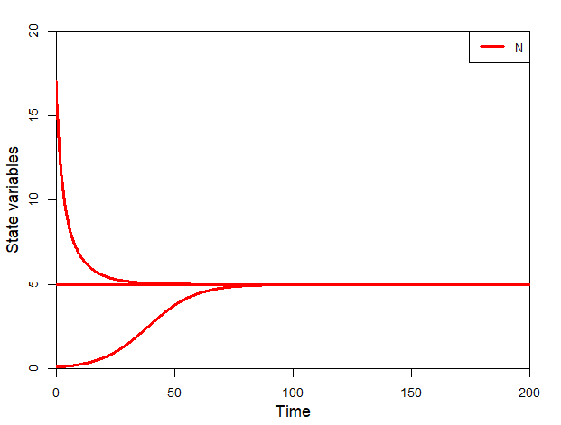
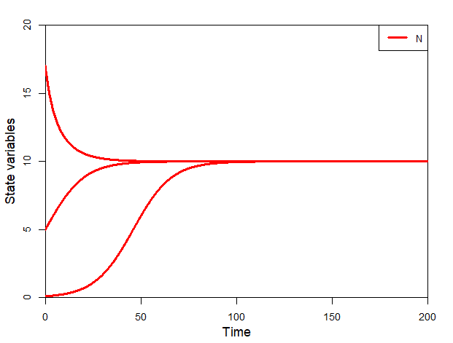
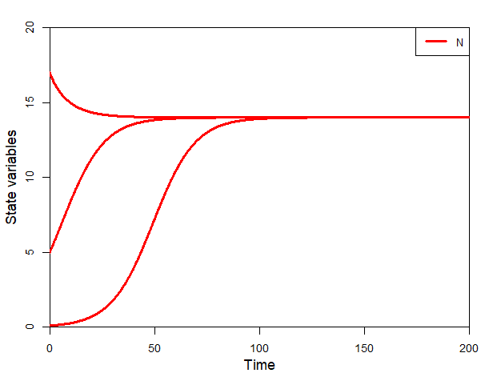
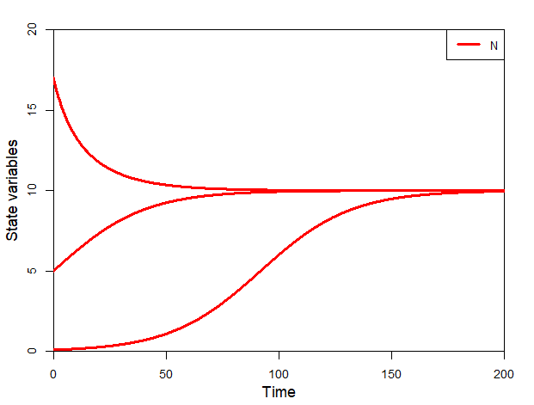
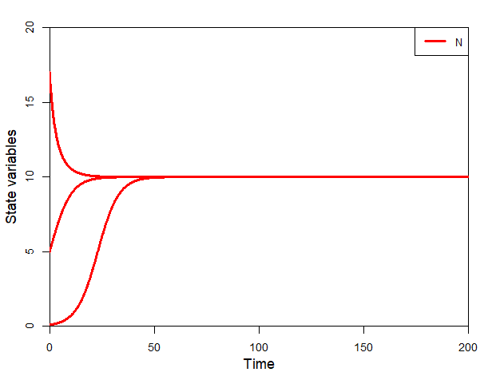
2. Orbits for values of K and r
K=5
K=10
K=14
r=0.05
r=0.1
r=0.2

Slide 9
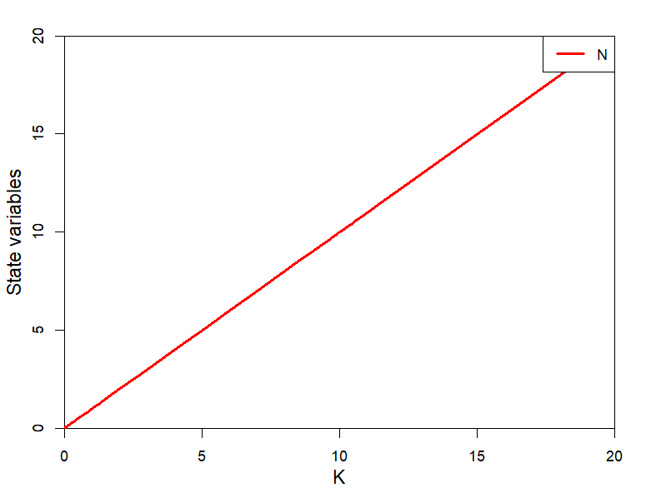
3. Bifurcation over K

Slide 10
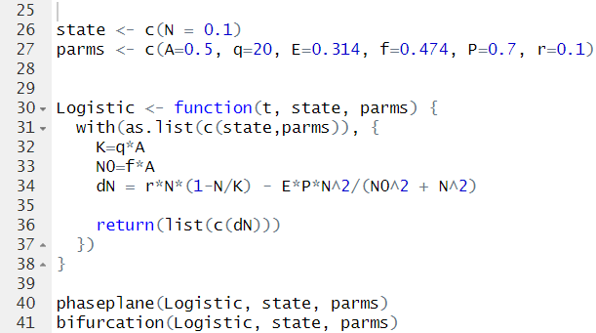
4. Model implementation

Slide 11
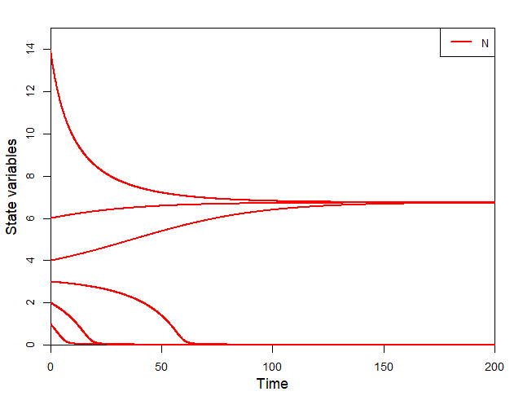
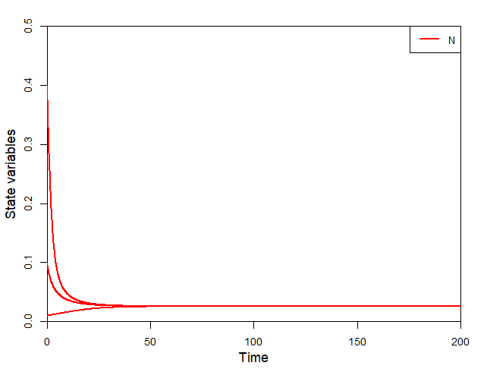
5. Orbits with various starting values

Slide 12
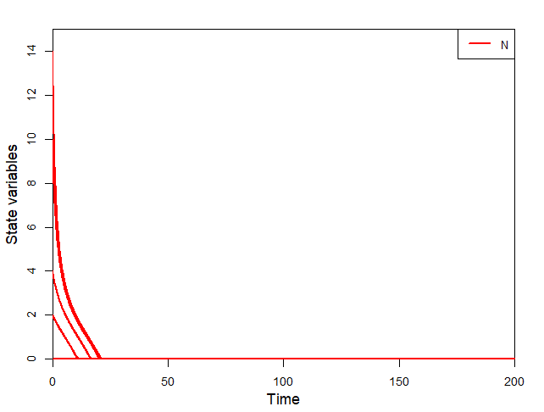
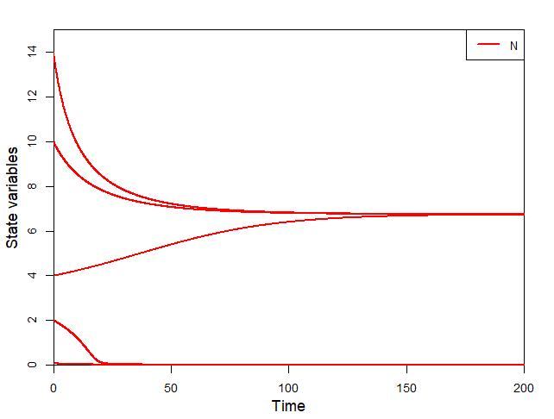
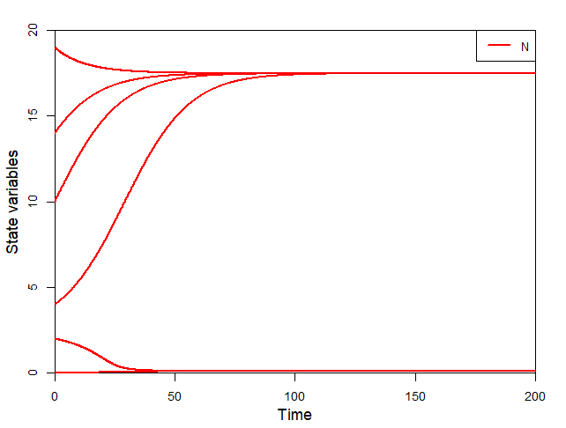
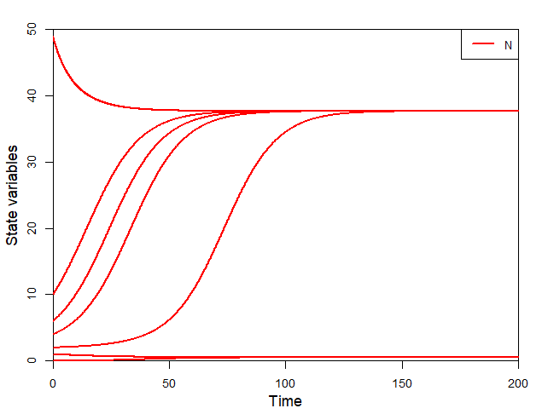
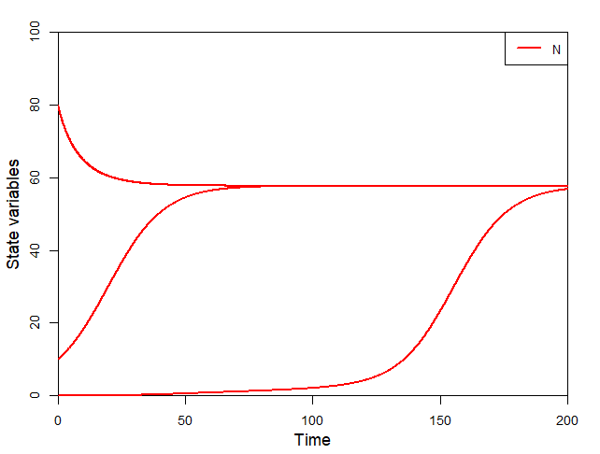
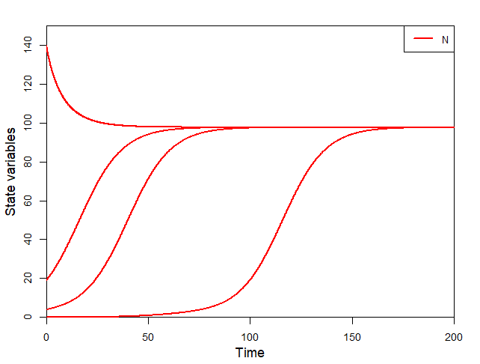
6. Orbits with various values of A
A=0.1
A=0.5
A=1
A=2
A=3
A=5

Slide 13
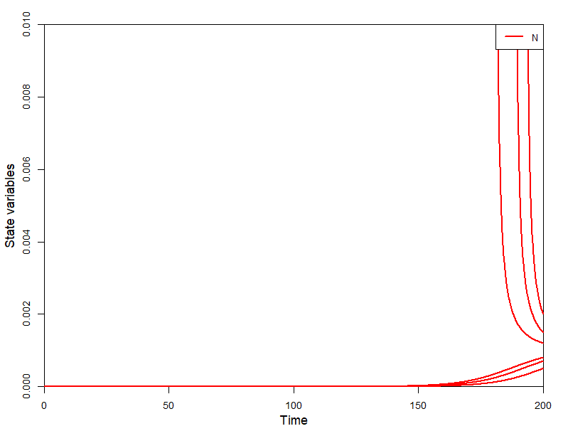
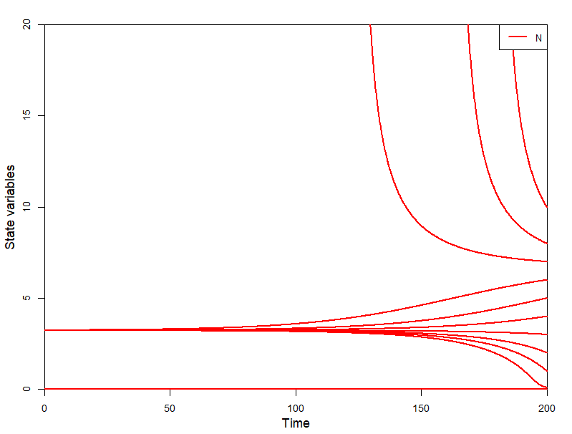
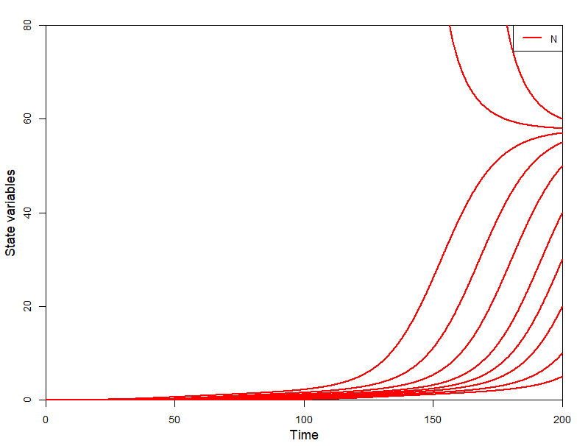
7. Backward orbits with various A values
A=0.1
A=0.5
A=3
Forward computation go towards stable equilibria
Backward computations go away from stable equilibria towards unstable equilibria or infinity

Slide 14
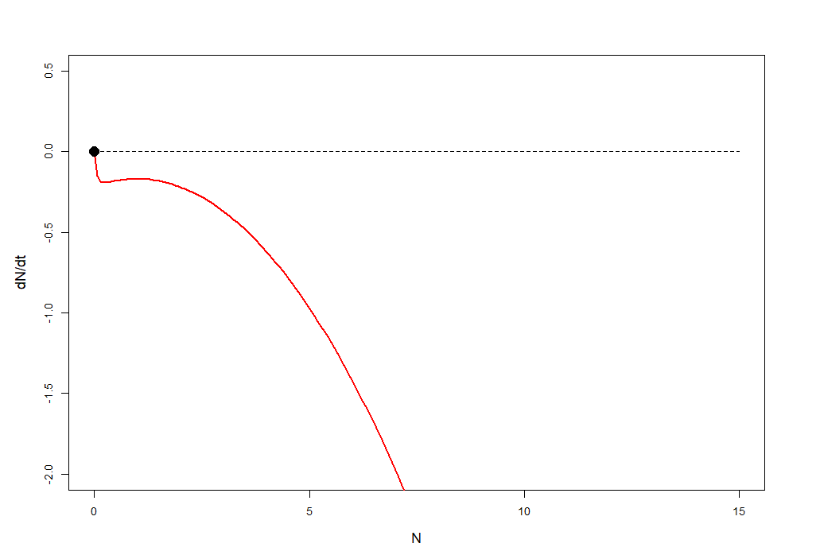
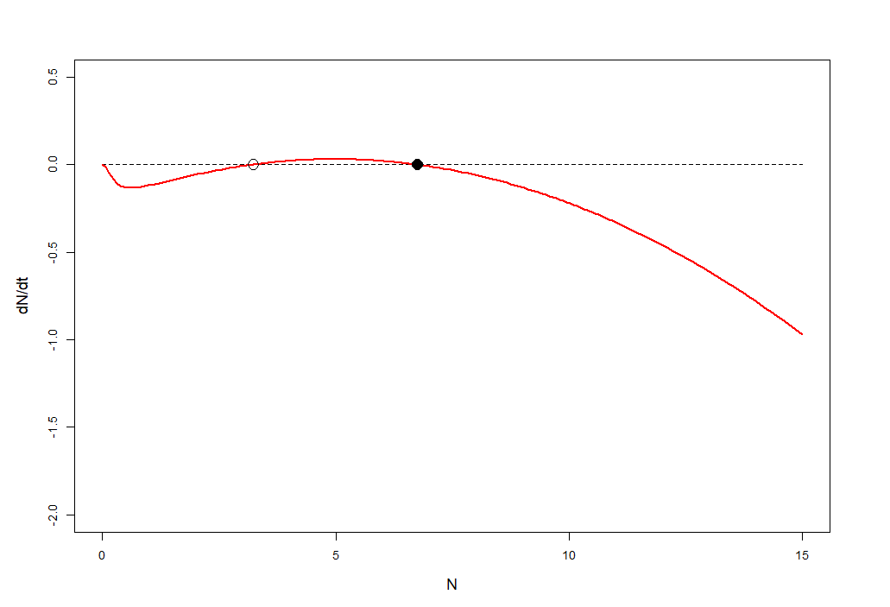
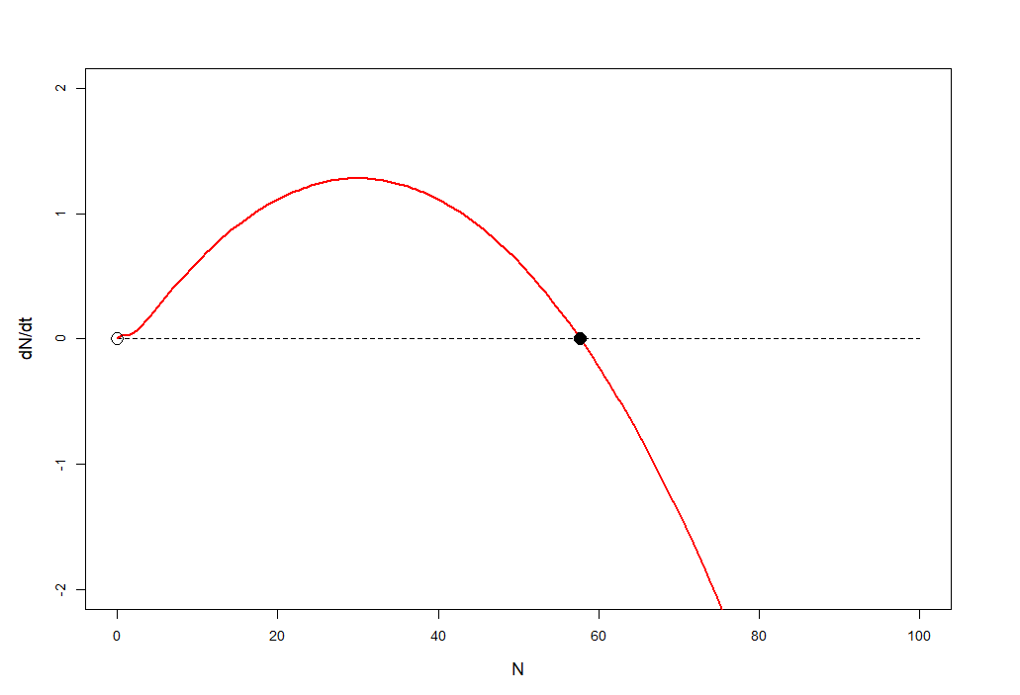
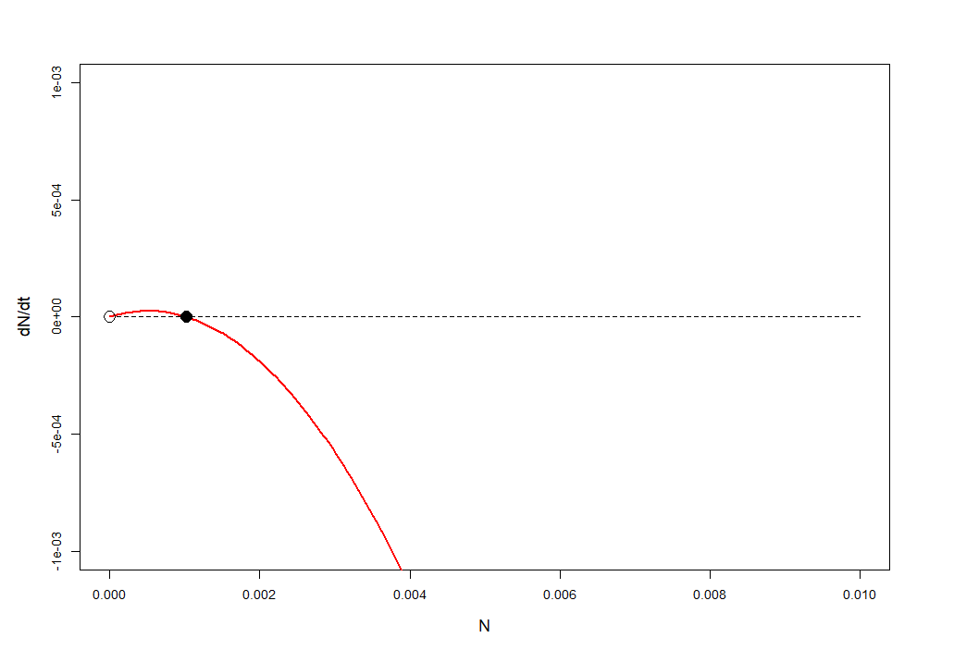
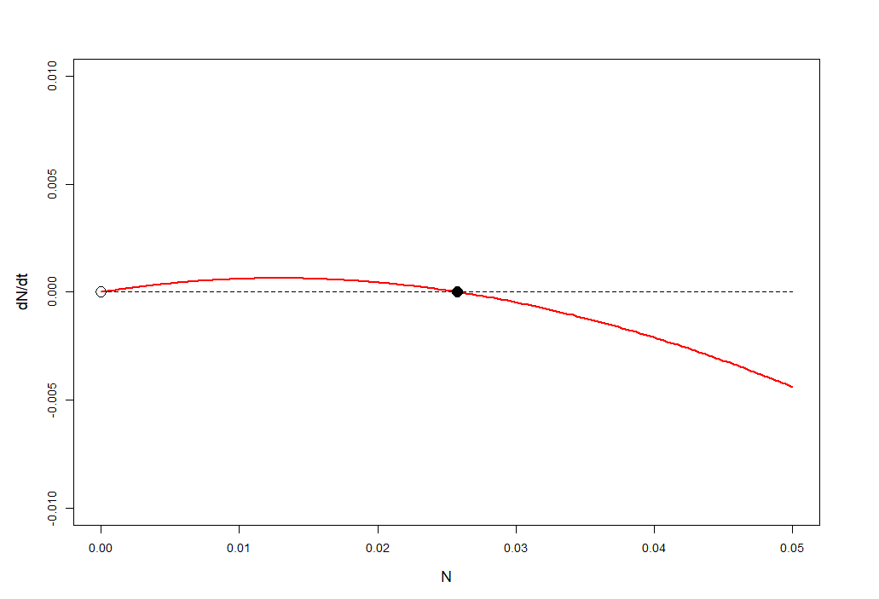
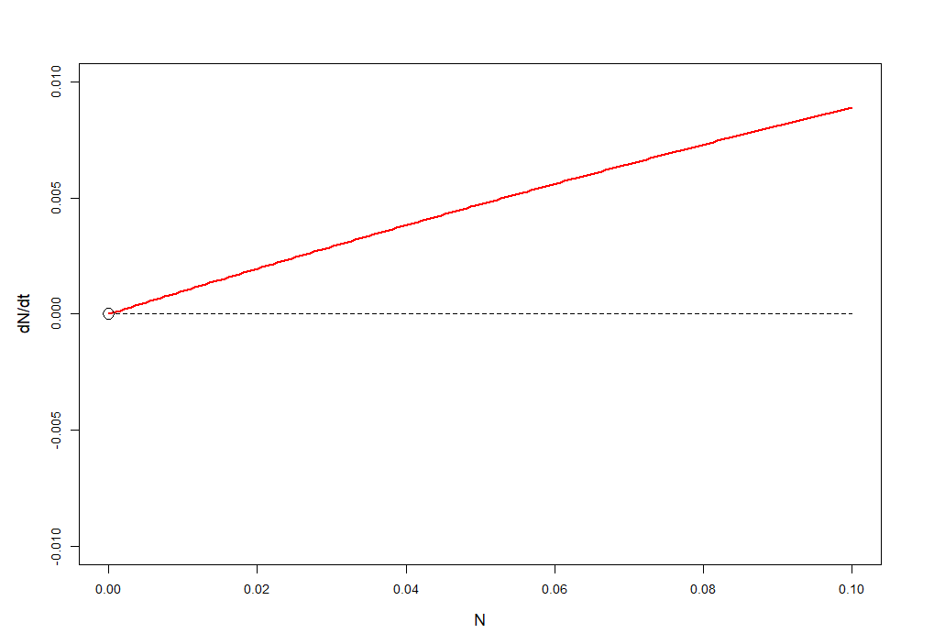
8. Phase plane for values of A
A=0.1
A=0.5
A=3

Slide 15
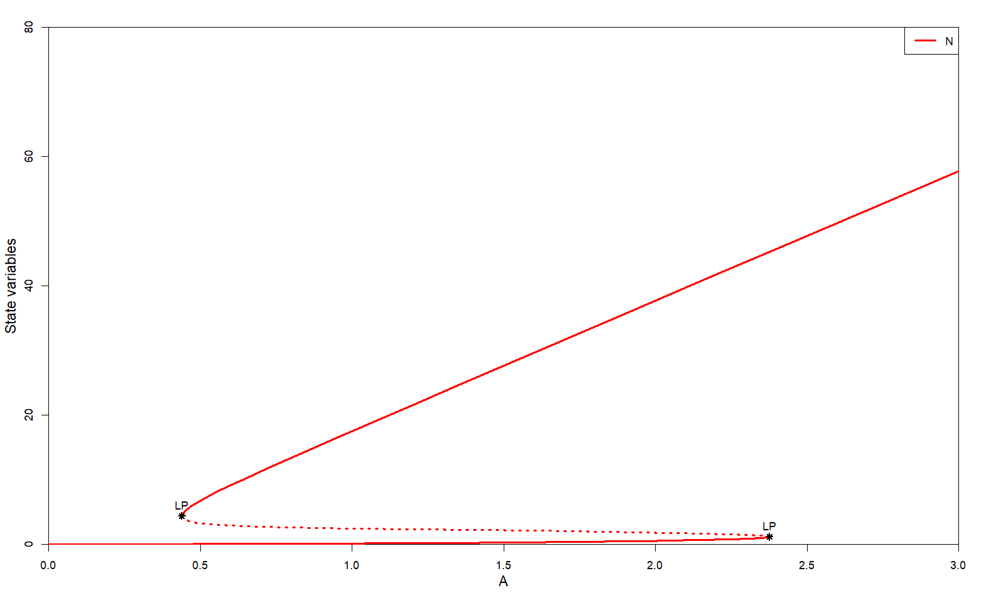
9. Bifurcations over A

Slide 16
10. Explanation of outbreaks
At low needle coverage, the budworms can only persist in a low density equilibrium.
When the needle coverage increases, the budworms remain in this equilibrium, until reaching a limit point.
The budworm density shoots to a high density equilibrium.
The budworm population remains in the high density equilibrium when the needle coverage decreases
Only at very low needle coverage the budworm population goes back to the low density equilibrium

Slide 17
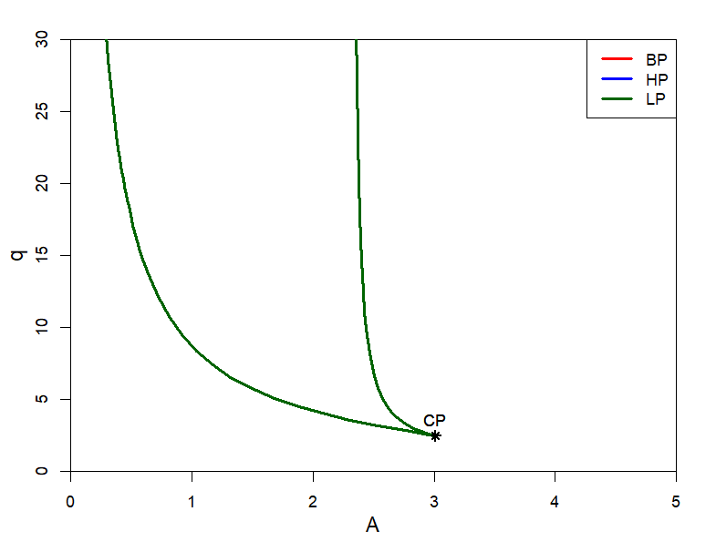
11. Two parameter bifurcation with A and q

Slide 18
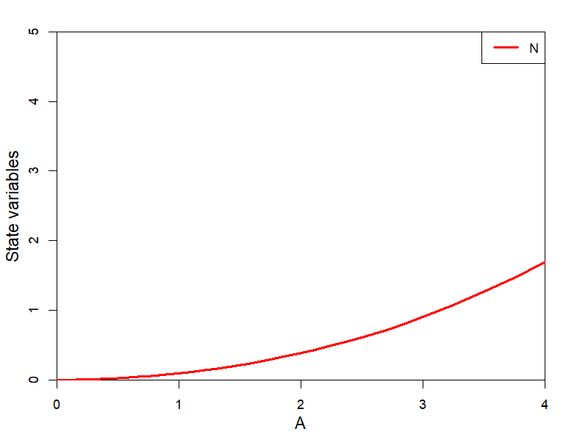
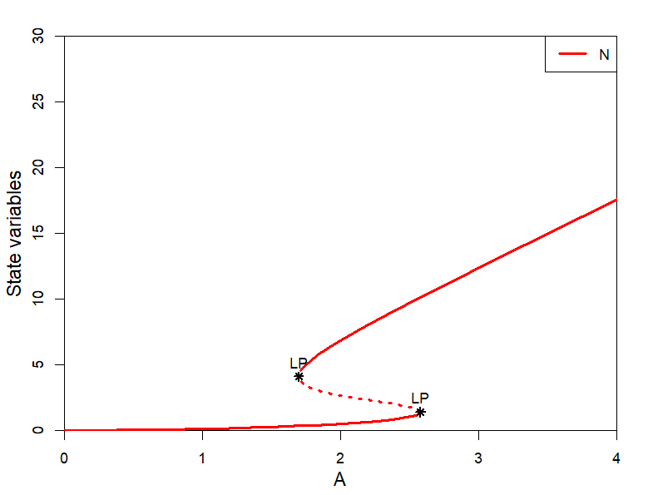
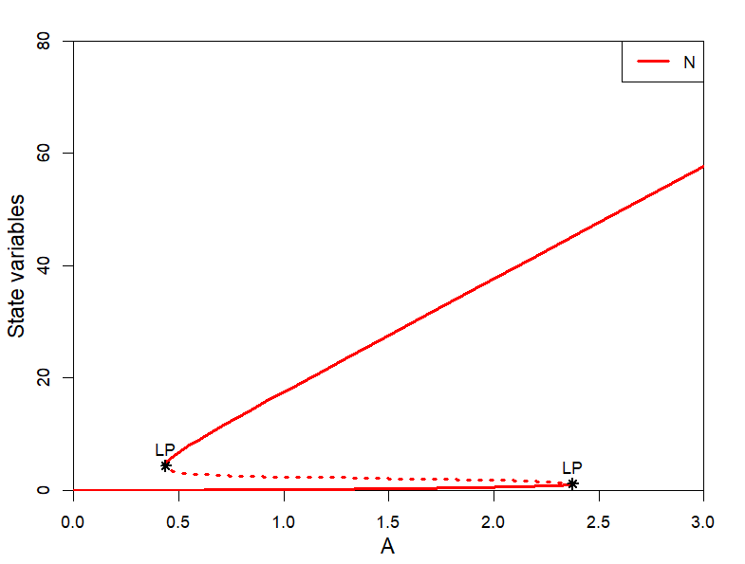
12. Sketch bifurcations over A with different values of q
q=1
q=5
q=20
At the cusp (CP) point, the two limit points are on top of each other and disappear from the system

Slide 19
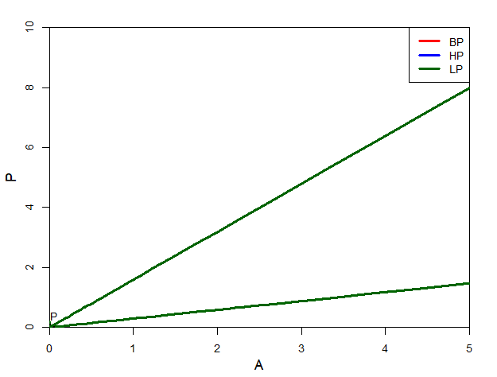
13. Two parameter bifurcation with A and p
Changing the value of P does not change the existence of the two limit points.
Increasing or decreasing nesting sites for birds does not prevent the budworm outbreaks

