Slide 1
METAGENOMIC ANALYSIS
Milk and Sewage Metagenomics
Genome-resolved analysis of microbial communities, antimicrobial resistance and virulence
Alessandro Fuschi
University of Bologna | November 2026

Slide 2
PRELIMINARY RESULTS
Study overview
Comparative shotgun metagenomic analysis of milk and cattle-farm wastewater samples.
01
Microbial communities
02
Genome reconstruction
Compare taxonomic composition across sample types.
Recover and classify metagenome-assembled genomes.
03
AMR profiling
04
Virulence screening
Screen for antimicrobial resistance genes.
Identify virulence-associated genes and taxa of interest.
Milk and Sewage Metagenomics · University of Bologna
02

Slide 3
PRELIMINARY RESULTS
Bioinformatic workflow
Milk and Sewage Metagenomics · University of Bologna
03

Slide 4
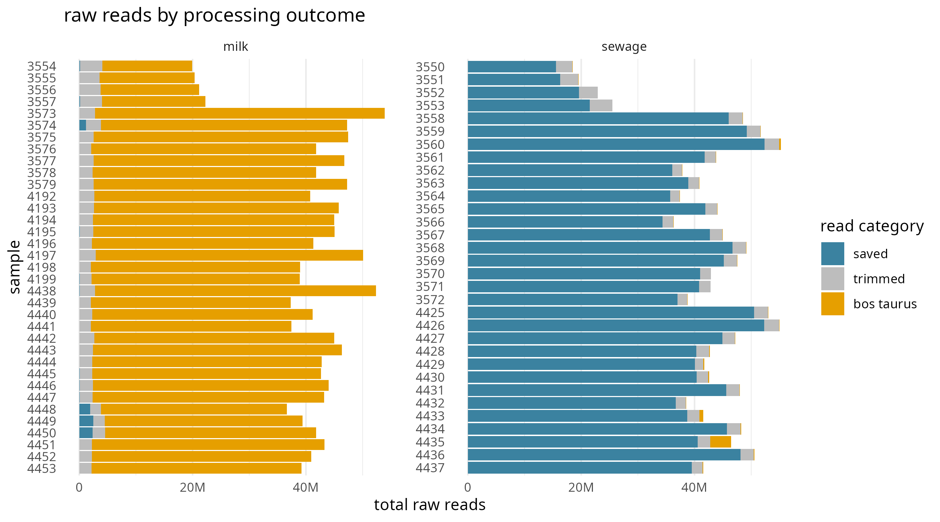
PRELIMINARY RESULTS
Read preprocessing and host DNA removal
Key observations
Most milk reads are removed as Bos taurus DNA.
Very few non-host reads remain in many milk samples.
Sewage retains substantially more reads.
Milk exceptions: 3574 and 4448–4450
Milk and Sewage Metagenomics · University of Bologna
04

Slide 5
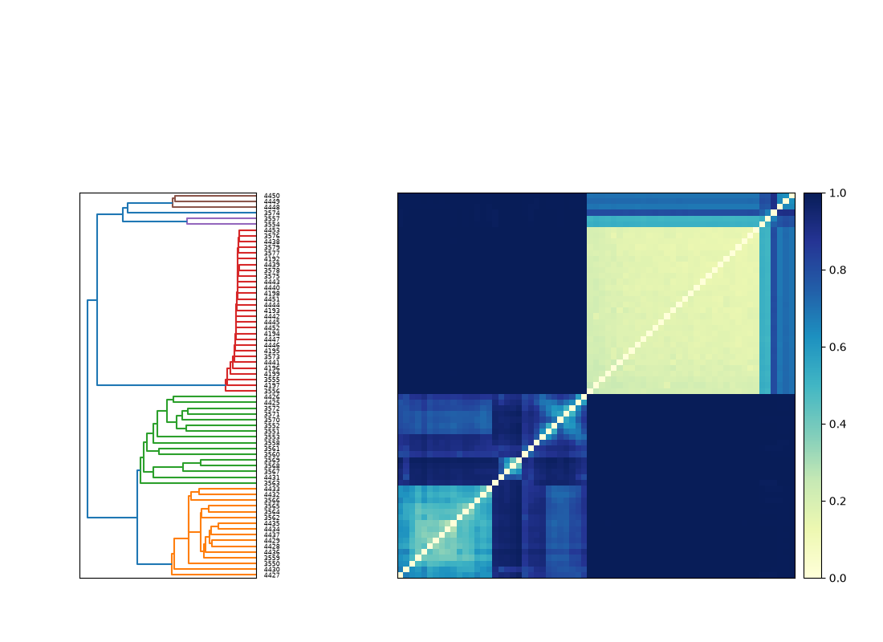
PRELIMINARY RESULTS
Sample similarity – Sourmash angular distance matrix
Median angular distance
0.184
Within milk
0.822
Within sewage
0.9997
Between biomes
Milk samples cluster more closely; sewage is more heterogeneous.
Milk and Sewage Metagenomics · University of Bologna
05

Slide 6
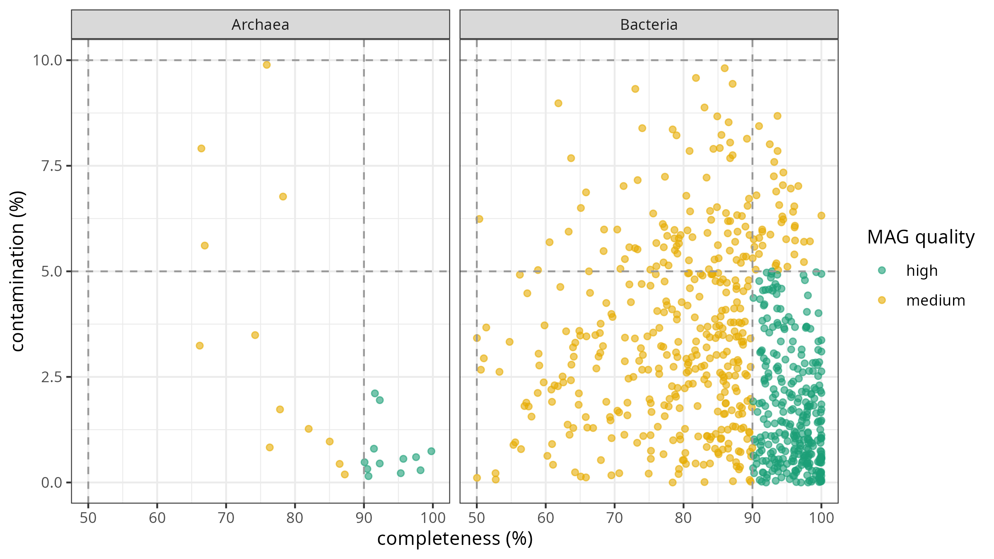
PRELIMINARY RESULTS
MAG reconstruction and quality
754
GTDB-Tk-classified MAGs
High: ≥90% complete, ≤5% contamination
Medium: ≥50% complete, ≤10% contamination
Additional MIMAG criteria not assessed here
Milk and Sewage Metagenomics · University of Bologna
06

Slide 7
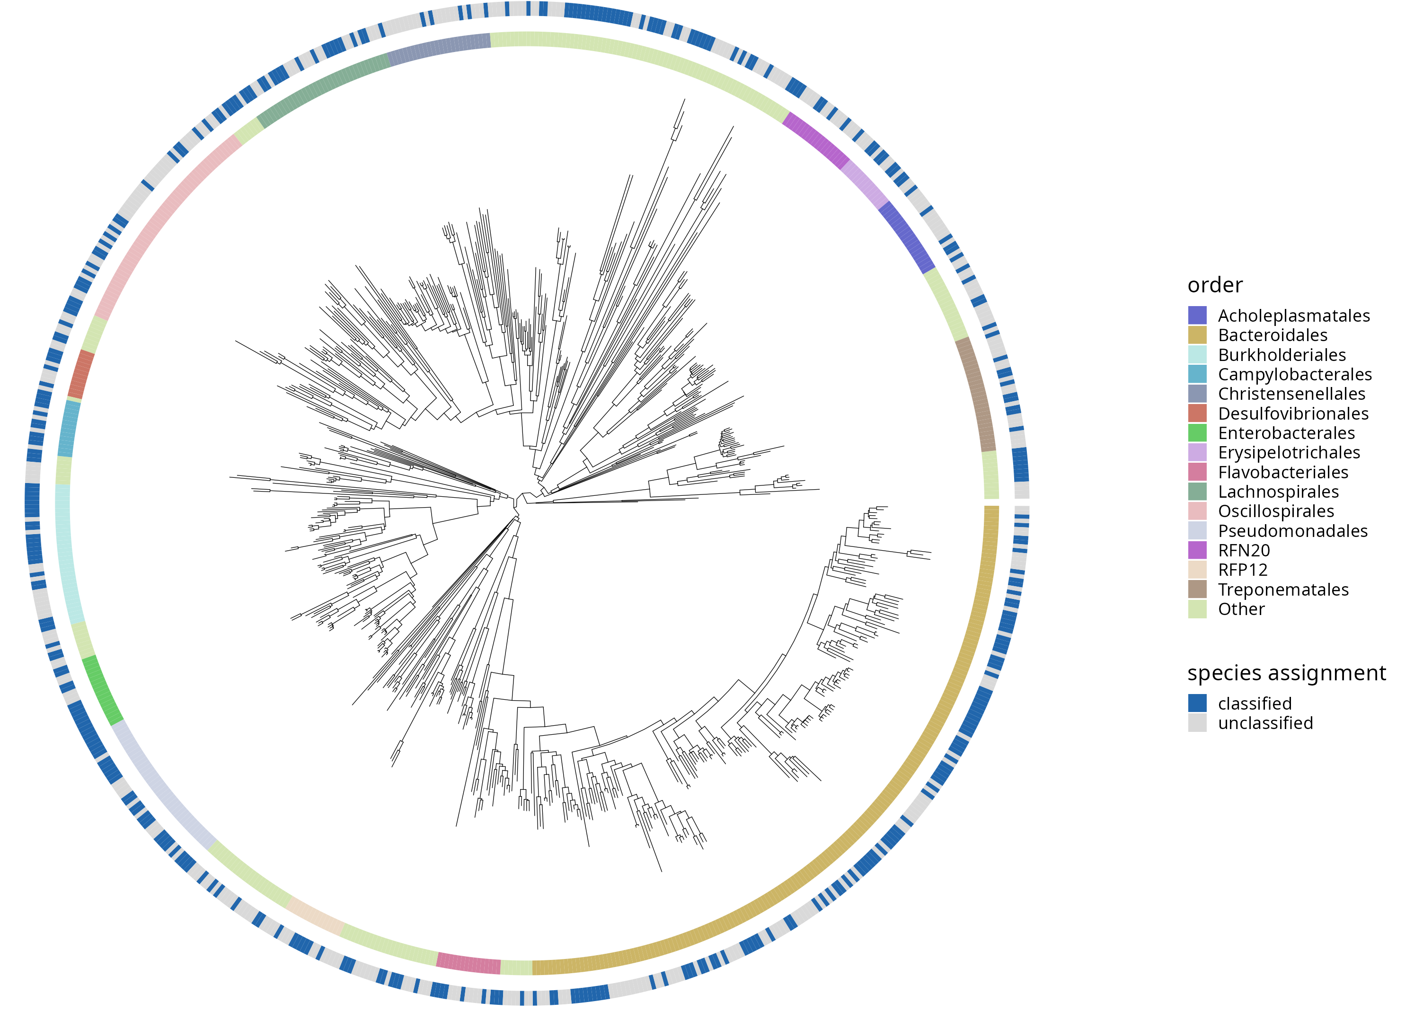
PRELIMINARY RESULTS
Phylogenetic diversity of reconstructed MAGs
730 bacterial and 24 archaeal MAGs.
Broad phylogenetic diversity across bacterial orders.
376 MAGs directly placed in the bacterial tree.
354 additional MAGs represented by their closest ANI reference genomes.
Milk and Sewage Metagenomics · University of Bologna
06

Slide 8
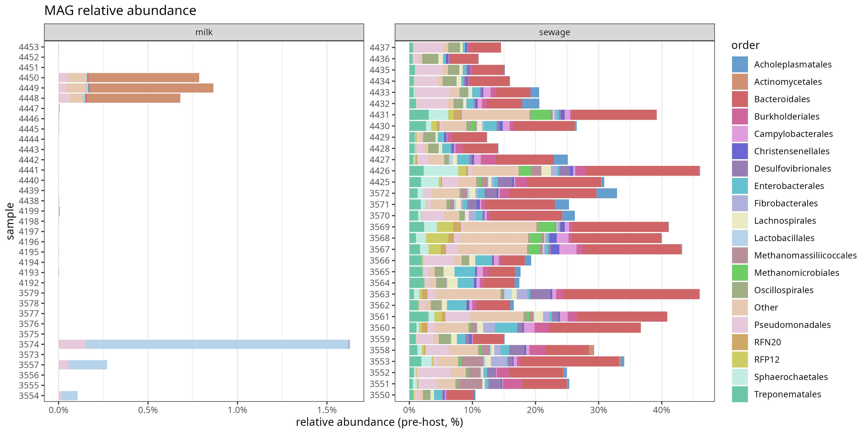
PRELIMINARY RESULTS
Taxonomic composition of reconstructed MAGs
Profiles show the fraction of reads assigned to MAGs before host DNA removal; they are not rescaled to 100%.
Milk and Sewage Metagenomics · University of Bologna
07

Slide 9
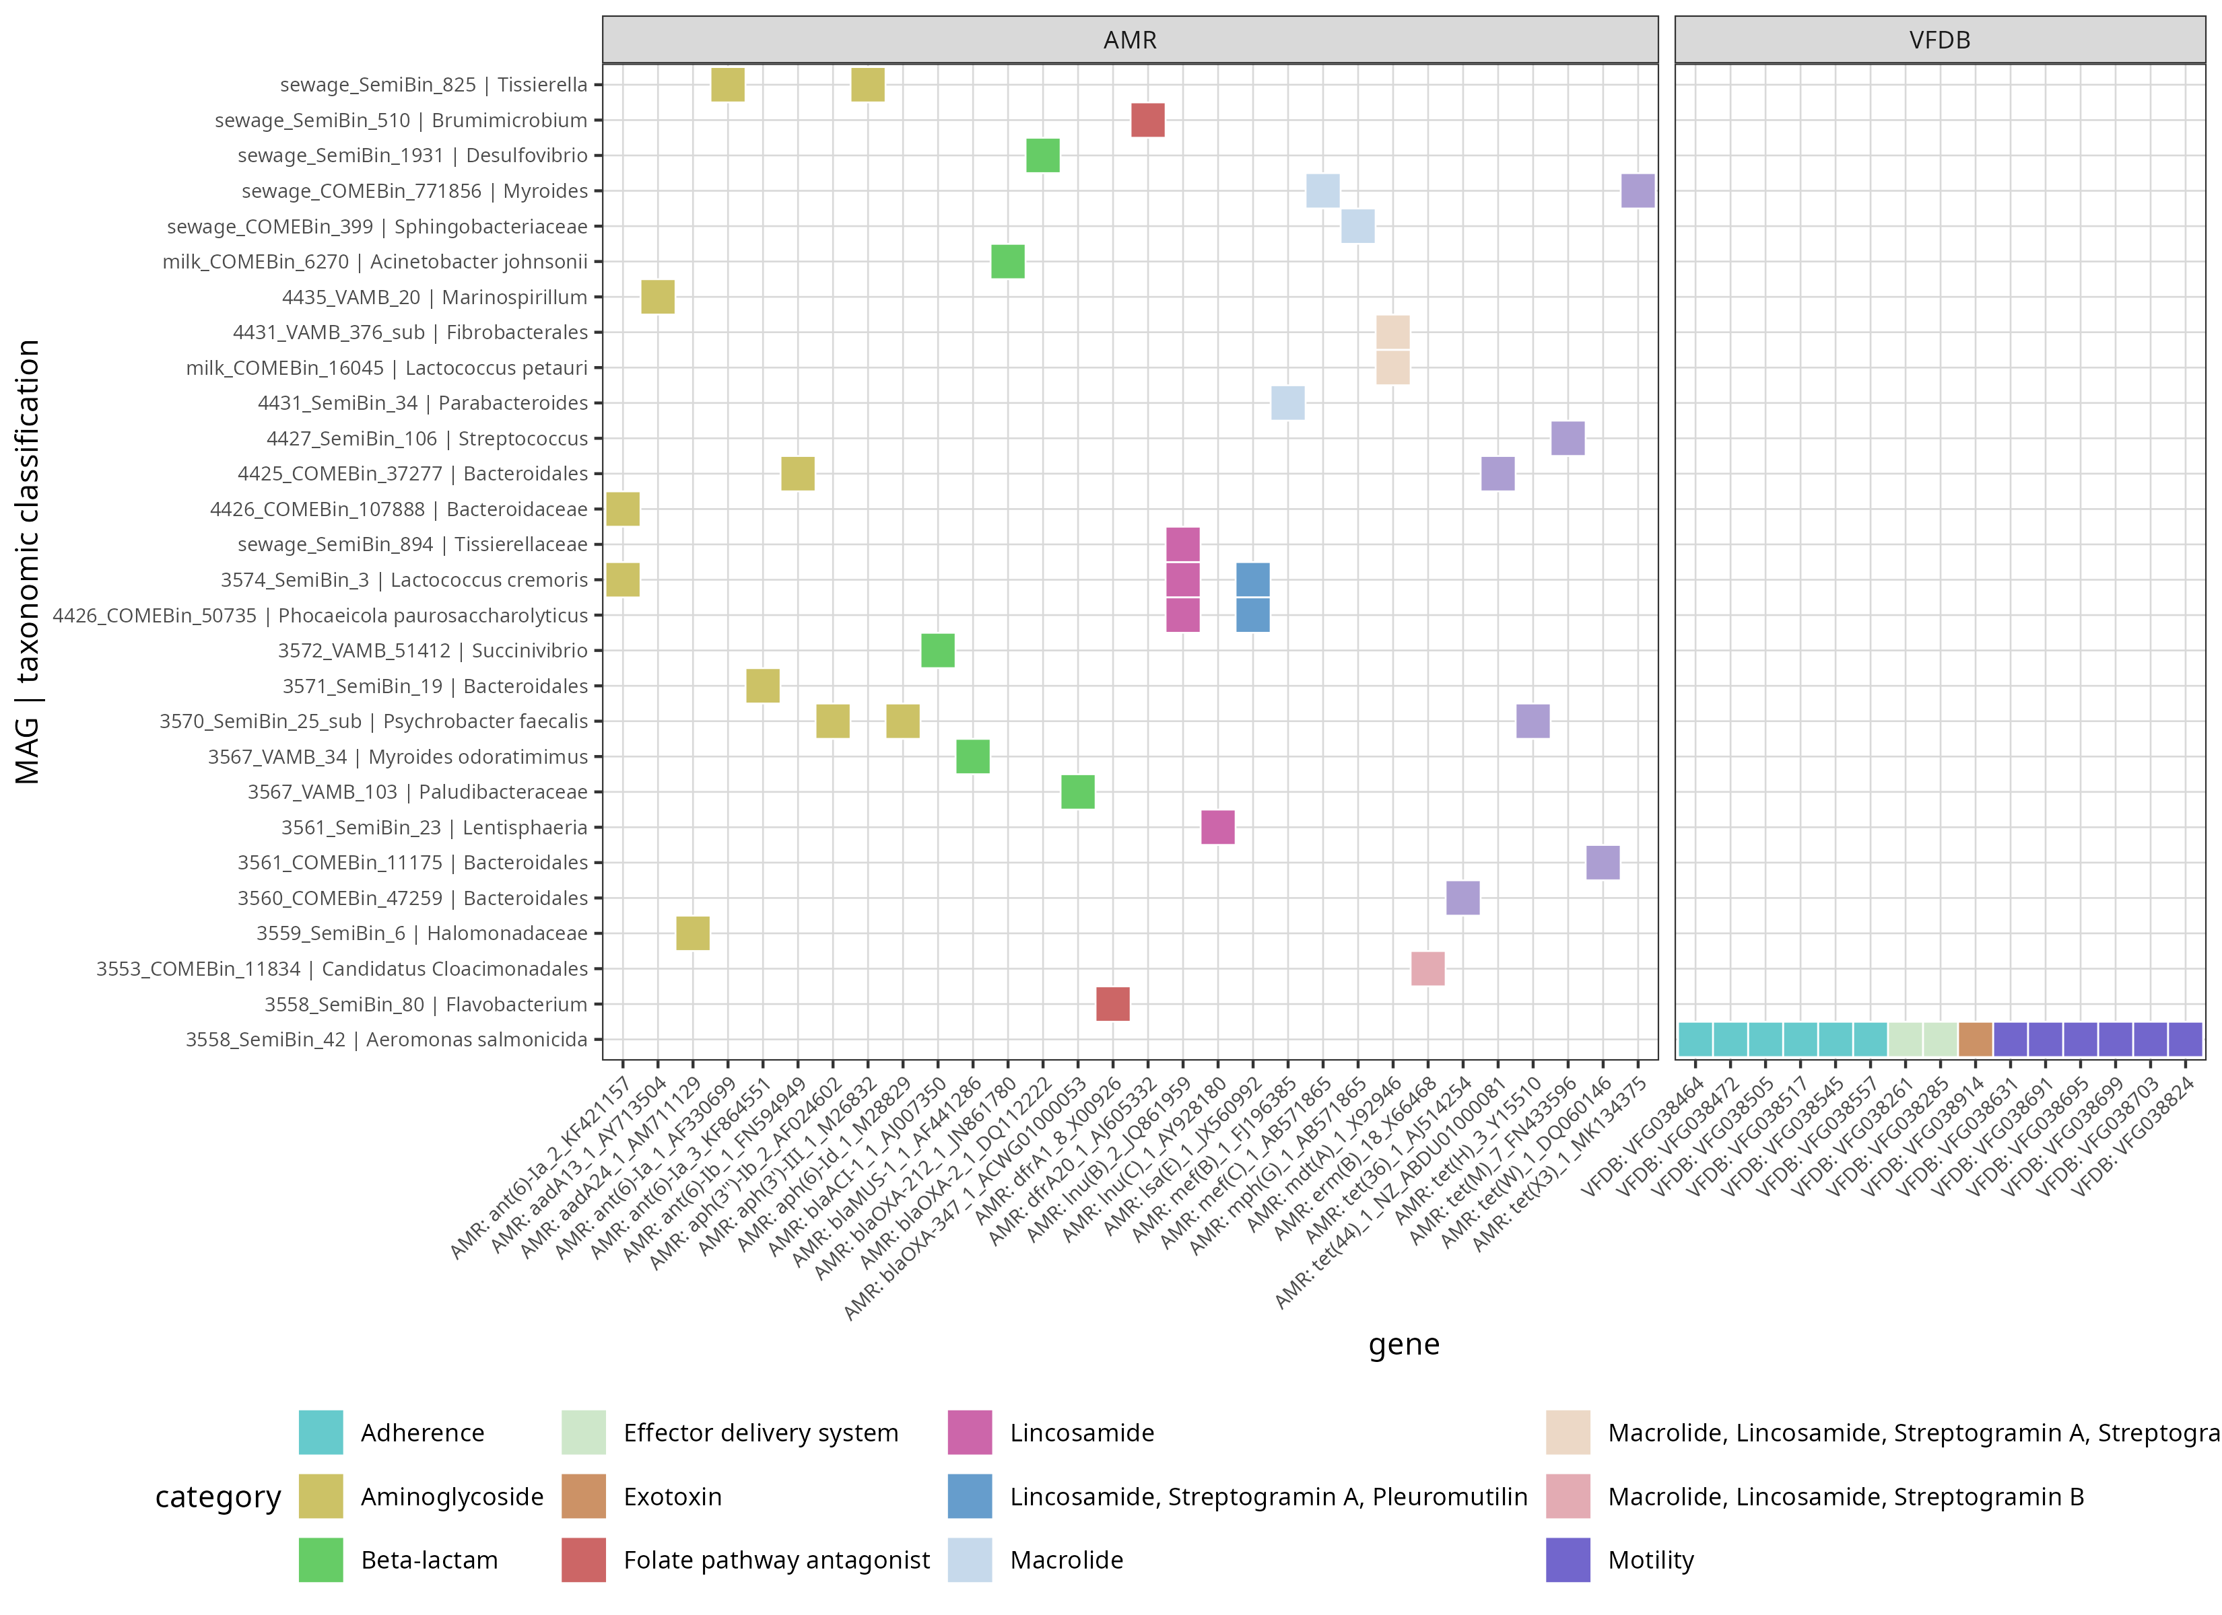
PRELIMINARY RESULTS
AMR and virulence-associated genes
Screening results
27
MAGs with AMR hits
1
MAG with VFDB hits
15
VFDB hits in that MAG
Gene detection does not establish pathogenicity.
Milk and Sewage Metagenomics · University of Bologna
08

Slide 10
PRELIMINARY RESULTS
A candidate for further investigation
VFDB HITS
Aeromonas salmonicida
MAG: 3558_SemiBin_42
15
NCBI
Next
Virulence-associated hits
Species-level assignment
Validate gene-bearing contigs
Interpretation: detection in the MAG does not confirm organism viability, host origin or pathogenic phenotype.
Milk and Sewage Metagenomics · University of Bologna
09

Slide 11
PRELIMINARY RESULTS
Preliminary conclusions
01
Host DNA is the main constraint for milk shotgun metagenomics.
02
Milk and sewage display distinct metagenomic profiles.
03
Genome-resolved analysis reveals taxonomic and functional diversity.
04
AMR and virulence hits identify MAGs for targeted validation.
Next steps: verify candidate gene-bearing contigs and examine their coverage across samples.
Milk and Sewage Metagenomics · University of Bologna
10

