Slide 1




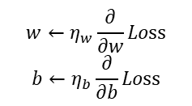


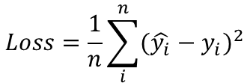










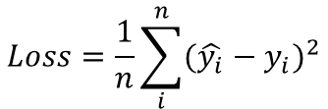

$$y_{i}$$
$$x_{i}$$
$$\hat{y_{i}}$$
$$\hat{y_{i}}=wx_{i}+b$$
$$Loss=\frac{1}{n}\sum_{i}^{n}{{({\hat{y_{i}}−y}_{i})}^{2}}$$
$$Loss$$
$$w$$
$$b$$
$$y_{i}$$
$$x_{i}$$
$$\hat{y_{i}}$$
$$\hat{y_{i}}=wx_{i}+b$$
$$Loss=\frac{1}{n}\sum_{i}^{n}{{({\hat{y_{i}}−y}_{i})}^{2}}$$
$$w$$
$$Loss$$
$$b$$
$$Grad$$
$$\frac{d}{dw}Loss$$
$$\frac{d}{db}Loss$$
$$w←η_{w}\frac{∂}{∂w}Loss$$
$$b←η_{b}\frac{∂}{∂b}Loss$$

Slide 2
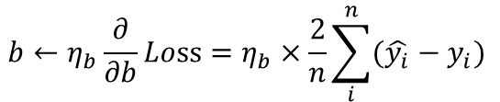
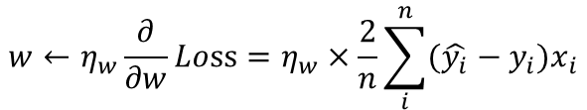
$$\frac{∂}{∂w}Loss=\frac{∂}{∂w}\left(\frac{1}{n}\sum_{i}^{n}{{({\hat{y_{i}}−y}_{i})}^{2}}\right)=\frac{∂}{∂w}\left(\frac{1}{n}\sum_{i}^{n}{{({\hat{y_{i}}−y}_{i})}^{2}}\right)=\frac{1}{n}\sum_{i}^{n}{\frac{∂}{∂w}{((wx_{i}+b)−y_{i})}^{2}=}\frac{1}{n}\sum_{i}^{n}{2(wx_{i}+b−y_{i})x_{i}=\frac{2}{n}\sum_{i}^{n}{({\hat{y_{i}}−y}_{i})x_{i}}}$$
$$\frac{∂}{∂b}Loss=\frac{∂}{∂b}\left(\frac{1}{n}\sum_{i}^{n}{{({\hat{y_{i}}−y}_{i})}^{2}}\right)=\frac{∂}{∂b}\left(\frac{1}{n}\sum_{i}^{n}{{({\hat{y_{i}}−y}_{i})}^{2}}\right)=\frac{1}{n}\sum_{i}^{n}{\frac{∂}{∂b}{((wx_{i}+b)−y_{i})}^{2}=}\frac{1}{n}\sum_{i}^{n}{2\left(wx_{i}+b−y_{i}\right)∙1 =\frac{2}{n}\sum_{i}^{n}{({\hat{y_{i}}−y}_{i}) }}$$
$$w←η_{w}\frac{∂}{∂w}Loss=η_{w}×\frac{2}{n}\sum_{i}^{n}{({\hat{y_{i}}−y}_{i})x_{i}}$$
$$b←η_{b}\frac{∂}{∂b}Loss=η_{b}×\frac{2}{n}\sum_{i}^{n}{({\hat{y_{i}}−y}_{i}) }$$

