Slide 1
Computer Organization
Mohona Ghosh

Slide 2
About the instructor …..
B. Tech (May’10)
Indira Gandhi Delhi Technological University for Women (IGDTUW), Delhi
M. Tech (May’12)
IIIT-Delhi
PhD (Apr’16)
IIIT-Delhi
Postdoc (Apr’17)
Nanyang Technological University (NTU), Singapore

Slide 3
About the instructor …..
Research Interests …..
Cryptanalysis of Symmetric Key Crypto Primitives
Design of Symmetric Key Crypto Primitives
Analysis of bio-cryptosystems (Biometrics + Cryptography)
Email ID
mohona@iiitdmj.ac.in

Slide 4
About the course …..
In this course, we will learn about the basics of computer organization
Functional components of a computer – CPU, memory hierarchy and I/O
Central Processing Unit: Registers, ALU, Control Unit, datapath, CPU cycle
Memory Subsytems: RAM , ROM, Cache memory, virtual memory, secondary storage, hard disk, RAID
I/O Subsystem: Access of I/O devices, I/O ports, Interrupts, bus interface, PCI, SCSI, USB
Instructions: Instruction representation and Format, Addressing Modes, Instruction set Architecture: CISC and RISC
Instruction Pipelining
Introduction to multi-programming and multiprocessing
Notes:
In this course, we will learn about the basics components of computer and how they interact
Organization of a processor

Slide 5
About the course …..
Marks Distribution:
1 | Quiz 1 | 15 %
2 | Mid Sem | 30 %
3 | Quiz 2 | 15%
4 | End Sem | 40%
Text Books:
C. Hamacher, Z. Vranesic and S. Zaky, “Computer Organization”, Fifth Edition, McGraw-Hill, 2002.
W. Stallings , “Computer Organization and Architecture – Designing for Performance”, Tenth Edition, Prentice Hall of India, 2015.
M. Morris Mano, Computer System Architecture, Third Edition, Prentice Hall of India, 2007.
D. A. Patterson and J. L. Hennessy, “Computer Organization and Design – The Hardware/Software Interface”, Fifth Edition, Morgan Kaufmann, 2013.
Course ID: CS203
Lectures: Wed, Thur, Fri Tutorial: Monday

Slide 6
What is a computer ?
A fast electronic machine that accepts input, processes it according to a list of internally stored instructions and produces the resulting output information
Basic Functions:
Data processing: Numerical, logical, graphical etc.
Data storage: Short-term (on the fly computation) and long term
Data Movement: Move data between itself and the outside world through input-output peripherals
Control: Manage internally the computer’s resources and synchronize the working of all the functional units

Slide 7
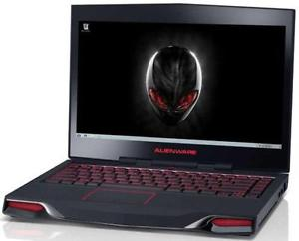

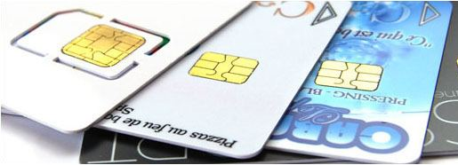
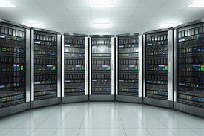
Different types of computer
Gaming Consoles
Desktops, Laptops, Tablets
Small chips and RFID
Embedded Computing
Servers and Super Computers
Notes:
Classes of Computers
•Personal computers
–General purpose, variety of software
–Subject to cost/performance tradeoff
•Server computers
–Network based
–High capacity, performance, reliability
–Range from small servers to building sized
•Supercomputers
–High-end scientific and engineering calculations
–Highest capability but represent a small fraction of the overall computer market
•Embedded computers
–Hidden as components of systems
–Stringent power/performance/cost constraints

Slide 8
Different types of computer
- All of them have different computer architecture and computer organization
Gaming Consoles
Desktops, Laptops, Tablets
Small chips and RFID
Small chips and RFID

Slide 9
Basic components of a computer
Reference: Computer organization by Hamacher, Vranesic and Zaky

Slide 10
Computer Architecture vs. Computer Organization
Computer Organization
Focus on how the internal operational units are organized and will interact with each other to execute a functionality
Focus on hardware implementation details transparent to the programmer
Computer Architecture
Set of rules and methods that describe the functionality, capabilities and programming model of computer systems
Logical aspects of system implementation as seen by the programmer
E.g., Instruction set architecture (RISC, CISC etc.), no. of bits used for processing (X86 – 32 bit, X64 - 64 bits or 8-bit microprocessor) , pipelined vs sequential architecture etc.

Slide 11
Computer Architecture vs. Computer Organization
E.g., Architectural decision – To have a multiplication functionality
Organizational decision – To implement a special multiply unit or
repeatedly use the add unit
Two computers may have the same architecture but with differences in organization
Same program may execute with different speeds
E.g., Solid state drive (SSD) vs. Hard disk drive (HDD)

Slide 12
Why Computer Organization ?
Computers are omnipresent
Performance is the buzzword !!
Performance
Speed, Memory, Power, Cost, Time to Market
Evaluate (benchmark) computer system performance
Understand time, memory, space tradeoffs
Optimization of program behaviour
Design better programs such as compilers, operating systems and device drivers
Make novel applications feasible
Computers in automobiles
Quantum computing
IoT etc.
Notes:
If we don’t know the internal computer parts, what are their functions and characteristics , how they interact etc. …. We will never be able to measure and improve the above metrics

Slide 13
Basic functional units of a computer

Slide 14
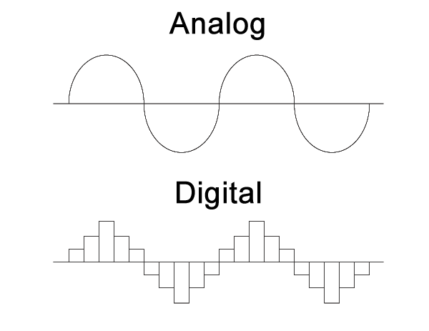
Representation of basic information
The basic functional units of computer are made of electronics circuit and it works with electrical signal
Analog signal – Signals are continuous in nature
Digital Signal – Signals are discrete in nature
In present day, most of the computers are digital in nature
High (5V)
Low (0V)
Notes:
The basic functional units of computer are made of electronics circuit and it works with electrical signal. We provide input to the computer in form of electrical signal and get the output in form of electrical signal.

Slide 15
Representation of basic information
While understanding the working principle of computer, it is always difficult to write or work with 0V or 5V
Instead we use the following convention
0 means LOW and 1 means HIGH
Termed as bits (smallest unit of information)
With the symbol 0 and 1, we have a mathematical system, which is knows as binary number system
Information is now represented as strings of bits. E.g., 00111010000 …
Four bits together is known as Nibble, and eight bits together is known as Byte

Slide 16
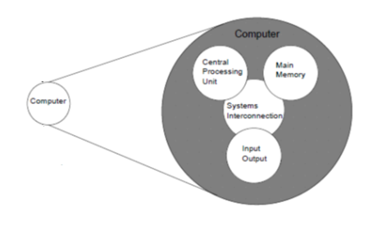
Basic components of a computer
Reference: Computer Organization and Architecture by William Stallings

Slide 17
Input Unit
Data must enter the system before any computation can be performed on the supplied data
Input unit links the external environment with the computer system
Whenever some data is entered, the corr. input is automatically translated into its corr. binary code and then transmitted over a cable to either the memory or the processor
Examples
Keyboard
Mouse
Compact Disc
Digital Versatile Disc
Scanner etc.

Slide 18
Output Unit
Counterpart of input unit
Sends processed result to the outside world
Just like in the input unit, output unit translates the internal results that are in binary codes into human readable form before supplying them to the external word
Examples
Monitor
Printer
Speaker
Projector etc.

Slide 19
Basic components of a computer
Reference: Computer Organization and Architecture by William Stallings

Slide 20
Central Processing Unit
Can be termed as the - “brain of the computer”
Controls the operation of the computer and performs its data processing functions
Also termed as PROCESSOR

Slide 21
Central Processing Unit
3 major structural components:
Arithmetic and Logic Unit (ALU) – Handles all the calculations that CPU may need
ALU routinely performs the following operations:
Logical Operations: These include AND, OR, NOT, XOR, NOR, NAND, etc.
Bit-Shifting Operations: This pertains to shifting the positions of the bits by a certain number of places to the right or left
Arithmetic Operations: This refers to bit addition, subtraction, multiplication and division

Slide 22
Central Processing Unit
3 major structural components:
Registers
High speed storage elements internal to CPU
Whenever any computation needs to be done, the required operands are fetched from the memory, the processing is done in the ALU and the result is stored back into memory
When operands are brought into the processor, they are stored in registers
High speed means accessing data from registers is the fastest, i.e., data access time is the lowest
Registers are always used for temporary storage of data

Slide 23
Central Processing Unit
3 major structural components:
Control Unit – Nerve center of computer
Generates timing and control signals to coordinate the operation of ALU, memory and input output units
E.g., timing signals determine when data transfer between the processor and memory will take place

Slide 24
Memory Unit
Memory unit is used to store the data and program
All the data to be processed and the instructions required for processing (received from input devices)
Intermediate results required for ongoing processing
Final results of processing before these results are released to an output device
Two classes of storage:
Primary
Secondary

Slide 25
Memory Unit
Primary storage is also known as “main memory”
Used to hold input data, intermediate results and recently produced processing results on which the computer is correctly working on
CPU works with the information stored in main memory
Programs must be stored in main memory while they are being executed
Primary storage operates at electronic speeds
Can be classified as:
Volatile: Loses data as soon as the device loses power, e.g., RAM
Non Volatile: Contents are retained even if the device loses power, e.g., ROM

Slide 26
Memory Unit
n
bits
first word
Examples of Primary Storage:
RAM (Random Access Memory)
Mostly, CPU works with the information stored in RAM
Contains large number of semiconductor storage cells, each capable of storing one bit of information
Cells are always read/written in fixed size groups called words (e.g., 16-bit or 32-bits)
Organization is such that contents of one word are stored/retrieved in one basic operation
second word
•
•
•
i
th word
•
•
•
last word

Slide 27
Memory Unit
n
bits
first word
Examples of Primary Storage:
RAM (Random Access Memory)
To provide easy access to any word in memory, a distinct address is associated with each word location
Addresses are numbers that identify successive locations
E.g., a 16 x 4 memory module will have 16 memory locations (16 addresses), each location is capable of storing 4-bit word
Time required to access one word is called the Memory Access Time
Fixed and independent of the location being accessed
Typically ranges from few nanoseconds to about 100 nanoseconds
second word
•
•
•
i
th word
•
•
•
last word

Slide 28
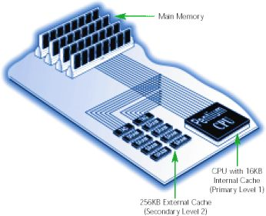
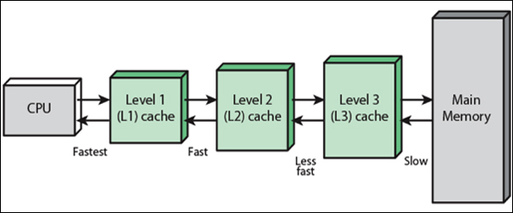
Memory Unit
Examples of Primary Storage:
Cache Memory
Small but very fast RAM units
Volatile memory
Tightly coupled with the processor and often contained on the same integrated circuit chip to achieve high performance
Stores instructions that computer programs frequently call upon during operation for faster access
Since it is physically closer than RAM, this is the first place where the processor looks for instructions. If it finds the data it needs here, the processor can bypass the more time-consuming process of reading RAM or other storage devices

Slide 29
Memory Unit
Examples of Primary Storage:
ROM (Read Only Memory)
Non-volatile and permanent form of memory
Cannot change the data once written on it but rather just read it
The information is stored permanently in such memories during manufacture
ROM stores instructions that are required to start a computer referred to as bootstrapping
Other types : PROM (Programmable ROM), EPROM (Erasable Programmable ROM) etc.
Notes:
usually refers to the process of loading the basic software into the memory of a computer after power-on or general reset, especially the operating system which will then take care of loading other software as needed.
ncluding PROM (programmable read-only memory) that is manufactured as blank memory (e.g. a CD-ROM) and EPROM (erasable programmable read-only memory).

Slide 30
Memory Unit
Secondary storage is also known as “auxiliary memory”
Used to supplement the limited storage capacity and the volatile characteristics of primary storage
Much cheaper than primary storage and can retain information even when the computer system is switched off or reset
Used to hold data and programs on which computer is not currently working on
Examples: CD-ROM, DVD, Hard disk, Pen Drives etc.

