Slide 1
Parallel Algorithms
  several operations can be executed at the same time
  many problems are most naturally modeled with parallelism
A Simple Model for Parallel Processing
Approaches to the design of parallel algorithms
Speedup and Efficiency of parallel algorithms
A class of problems NC
Parallel algorithms, e.g.

Slide 2
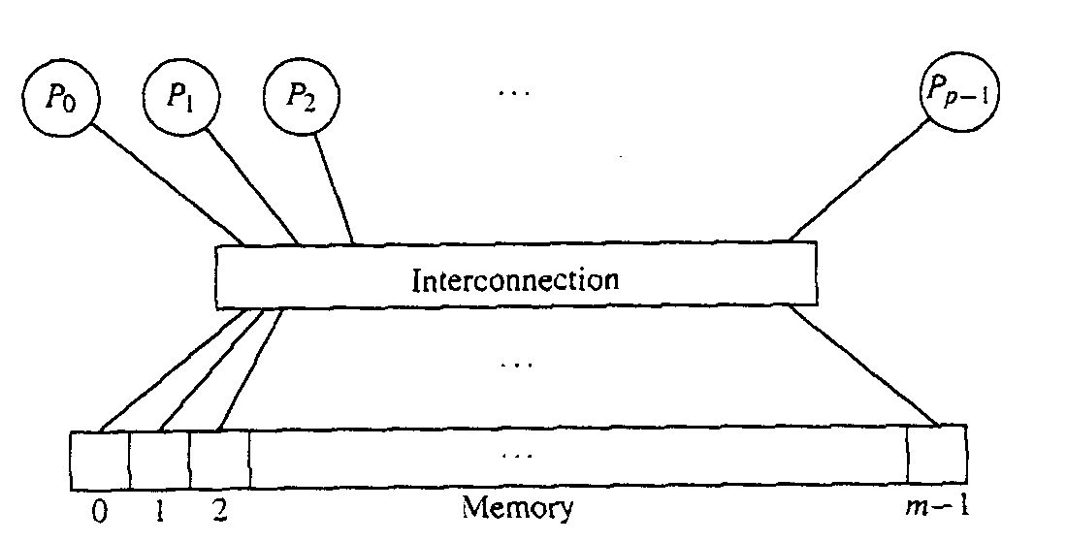
A Simple Model for Parallel Processing
Parallel Random Access Machine (PRAM) model
  a number of processors all can access
  a large share memory
  all processors are synchronized
  all processor running the same program
    each processor has an unique id, pid. and
    may instruct to do different things depending on their pid

Slide 3
PRAM models
PRAM models vary according
  how they handle write conflicts
  The models differ in how fast they can solve various problems.
Concurrent Read Exclusive Write (CREW)
  only one processor are allow to write to
  one particular memory cell at any one step
Concurrent Read Concurrent Write (CRCW)
Algorithm works correctly for CREW
  will also works correctly for CRCW
  but not vice versa

Slide 4
Approaches to the design of parallel algorithms
Modify an existing sequential algorithm
  exploiting those parts of the algorithm that are naturally parallelizable.
Design a completely new parallel algorithm that
  may have no natural sequential analog.
Brute force Methods for parallel processing:
  Using an existing sequential algorithm but
    each processor using differential initial conditions
  Using compiler to optimize sequential algorithm
  Using advanced CPU to optimize code

Slide 5
Speedup and Efficiency of parallel algorithms
  Let T*(n) be the time complexity of a sequential algorithm to solve a problem P of input size n
  Let T_{p}(n) be the time complexity of a parallel algorithm to solves P on a parallel computer with p processors
Speedup
  S_{p}(n) = T*(n) / T_{p}(n)
  S_{p}(n) <= p
  Best possible, S_{p}(n) = p
    when T_{p}(n) = T*(n)/p
Efficiency
  E_{p}(n) = T₁(n) / (p T_{p}(n))
    where T₁(n) is when the parallel algorithm run in 1 processor
  Best possible, E_{p}(n) = 1

Slide 6
A class of problems NC
The class NC consists of problems that
  can be solved by parallel algorithm using
    polynomially bounded number of processors p(n)
    p(n) ∈ O(n^{k}) for problem size n and some constant k
  the number of time steps bounded by a polynomial in the logarithm of the problem size n
    T(n) ∈ O( (log n)^{m} ) for some constant m
Theorem:
  NC ⊆ P

Slide 7
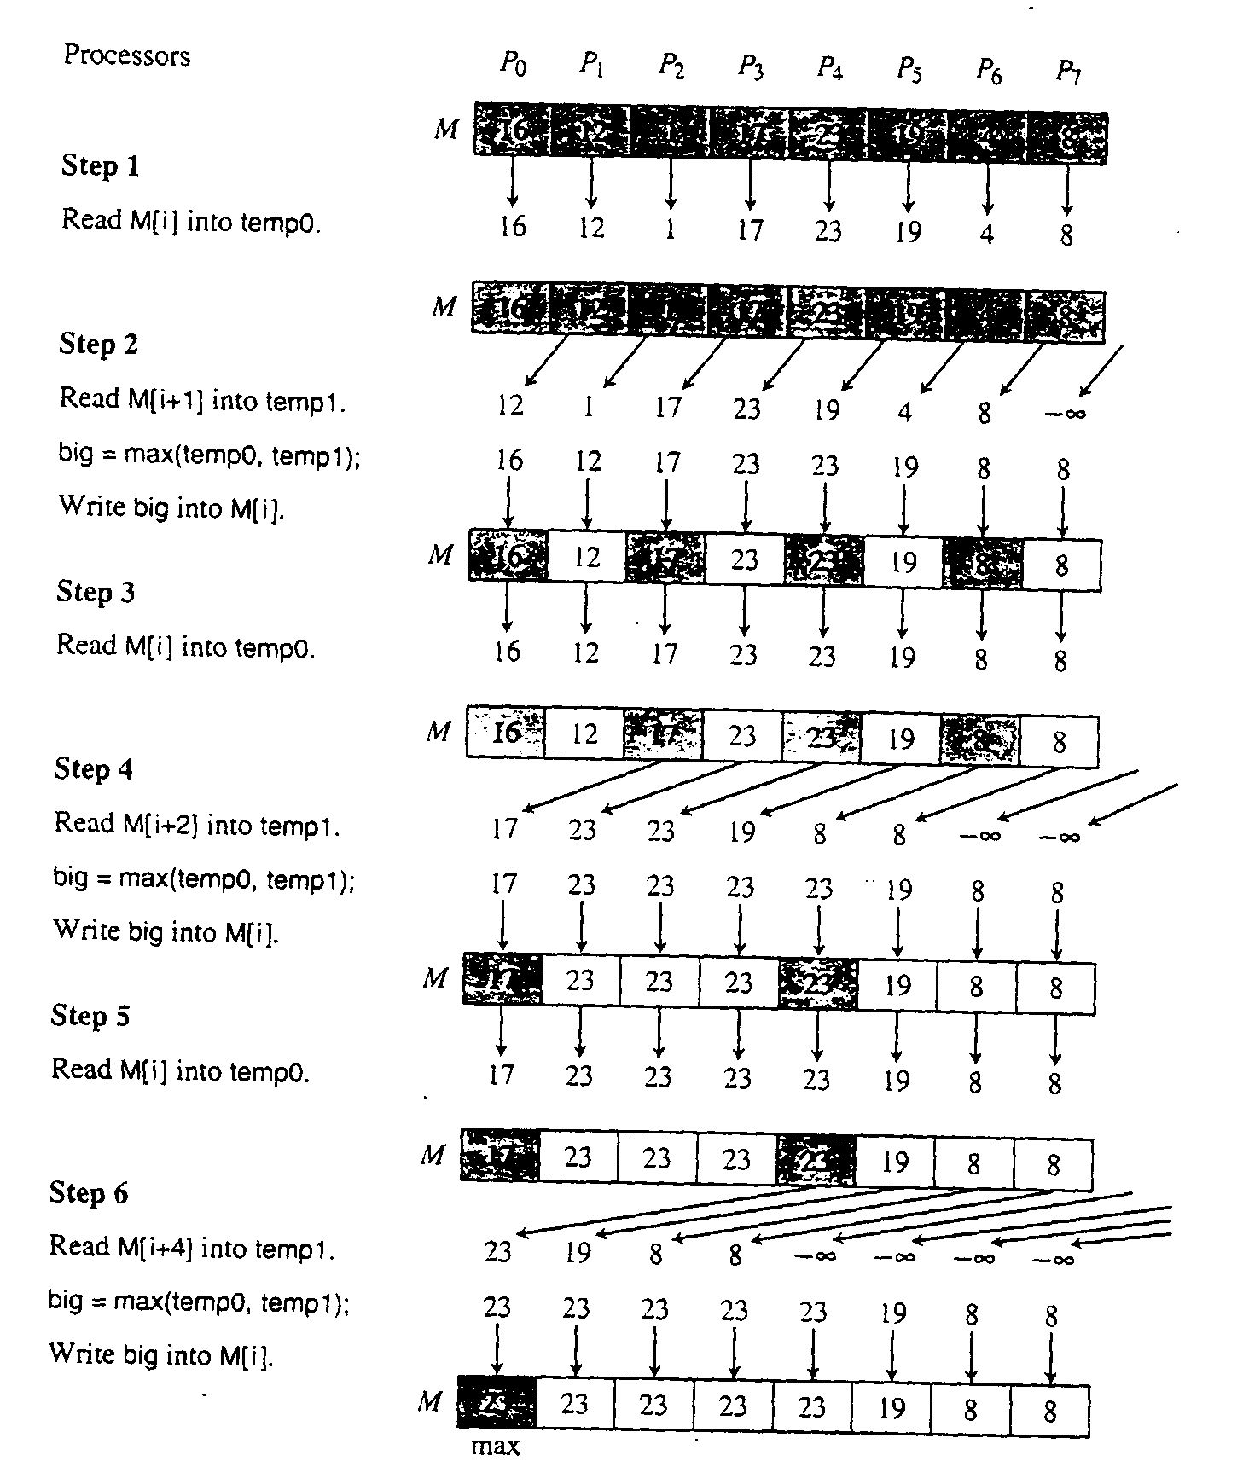
Parallel algorithms, e.g.
Binary Fan-In Technique

Slide 8
Algorithm: Parallel Tournament for Max
Algorithm:Parallel Tournament for Maximum
Input: Keys x[0],x[1],....x[n-1],
initially in memory cells M[0] ,...,M[n-1], and integer n.
Output:The largest key will be left in M[0].
parTournamentMax(M,n)
int incr
Write -(some very small value) into M[n+pid]
incr=1;
while(incr<n)
key big, temp0,temp1;
Read M[pid] into temp0
Read M[pid+incr] into temp1
big=max(temp0,temp1);
Write big into M[pid].
incr=2*incr;
Analysis: Use n processor and θ(log n) time

Slide 9
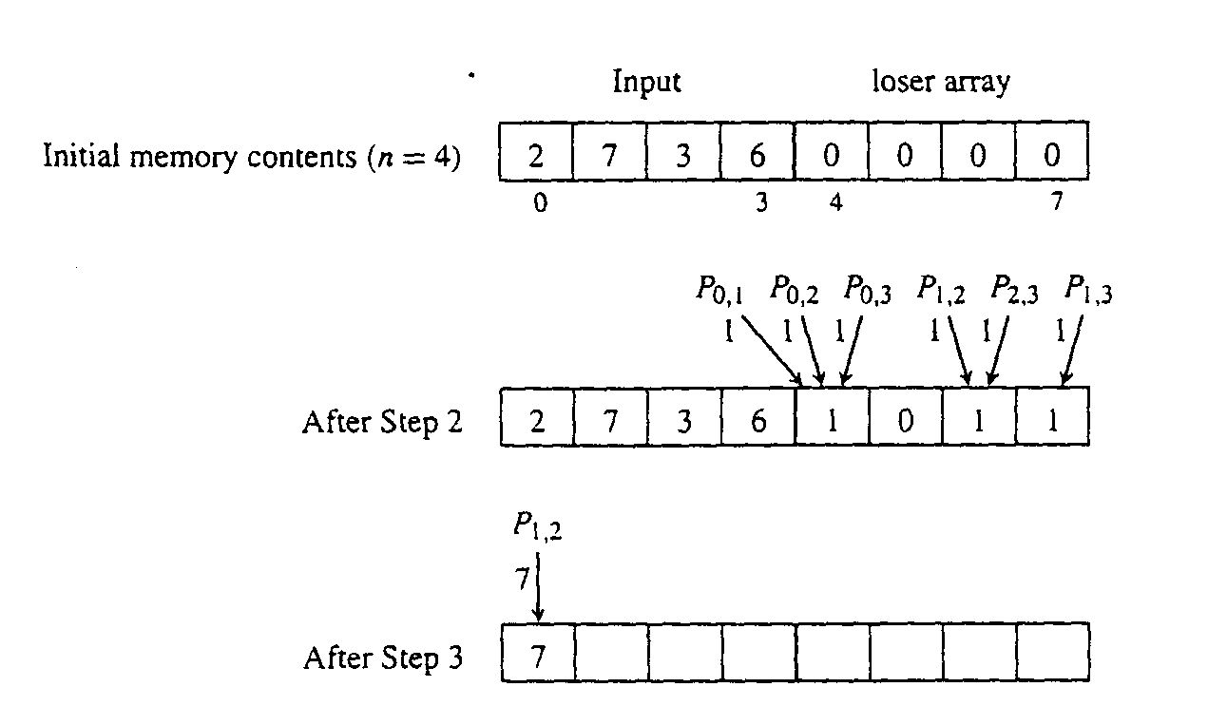
Algorithm: Finding Max in Constant Time
CRCW method

Slide 10
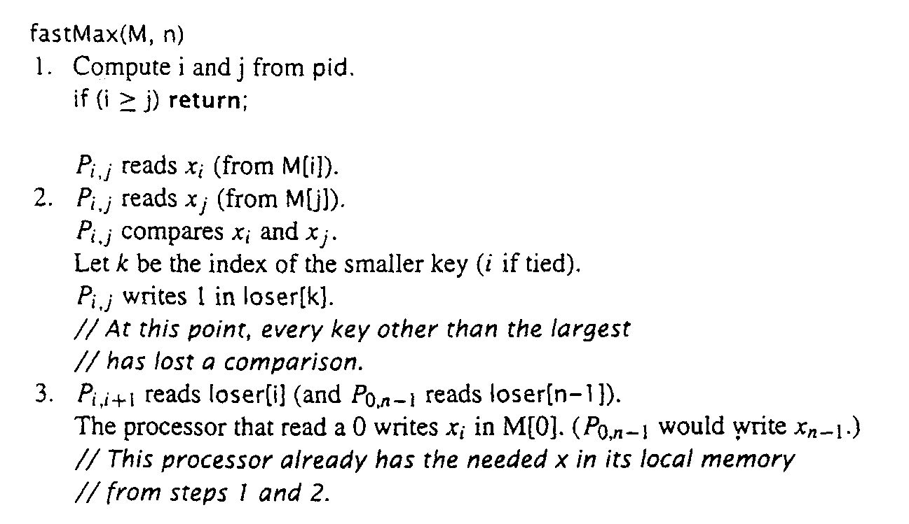
Algorithm: Common-Write Max of n Keys
Uses n² processors, does only three read/write steps!

