Slide 1
Introduction to Linux
Francisco Fuster Tormo
13 - 03 - 18
ffuster@carrerasresearch.org

Slide 2
What is Linux?
Operating System (OS) based on UNIX
Multiuser → Allows more than one user at the same time
Multitasking → Allows more than one program executed at the same time
Networking → Allows network access
Various user interfaces → Different “desktops” allowed
Other UNIX-based OS?
Mac OS
Android

Slide 3
How many Linux are?
Debian
Ubuntu
Linux Mint
Red Hat
Fedora
OpenSuse
CentOS
Gentoo
...

Slide 4
Is Linux difficult to use?
Graphic User Interface (Desktop)

Slide 5
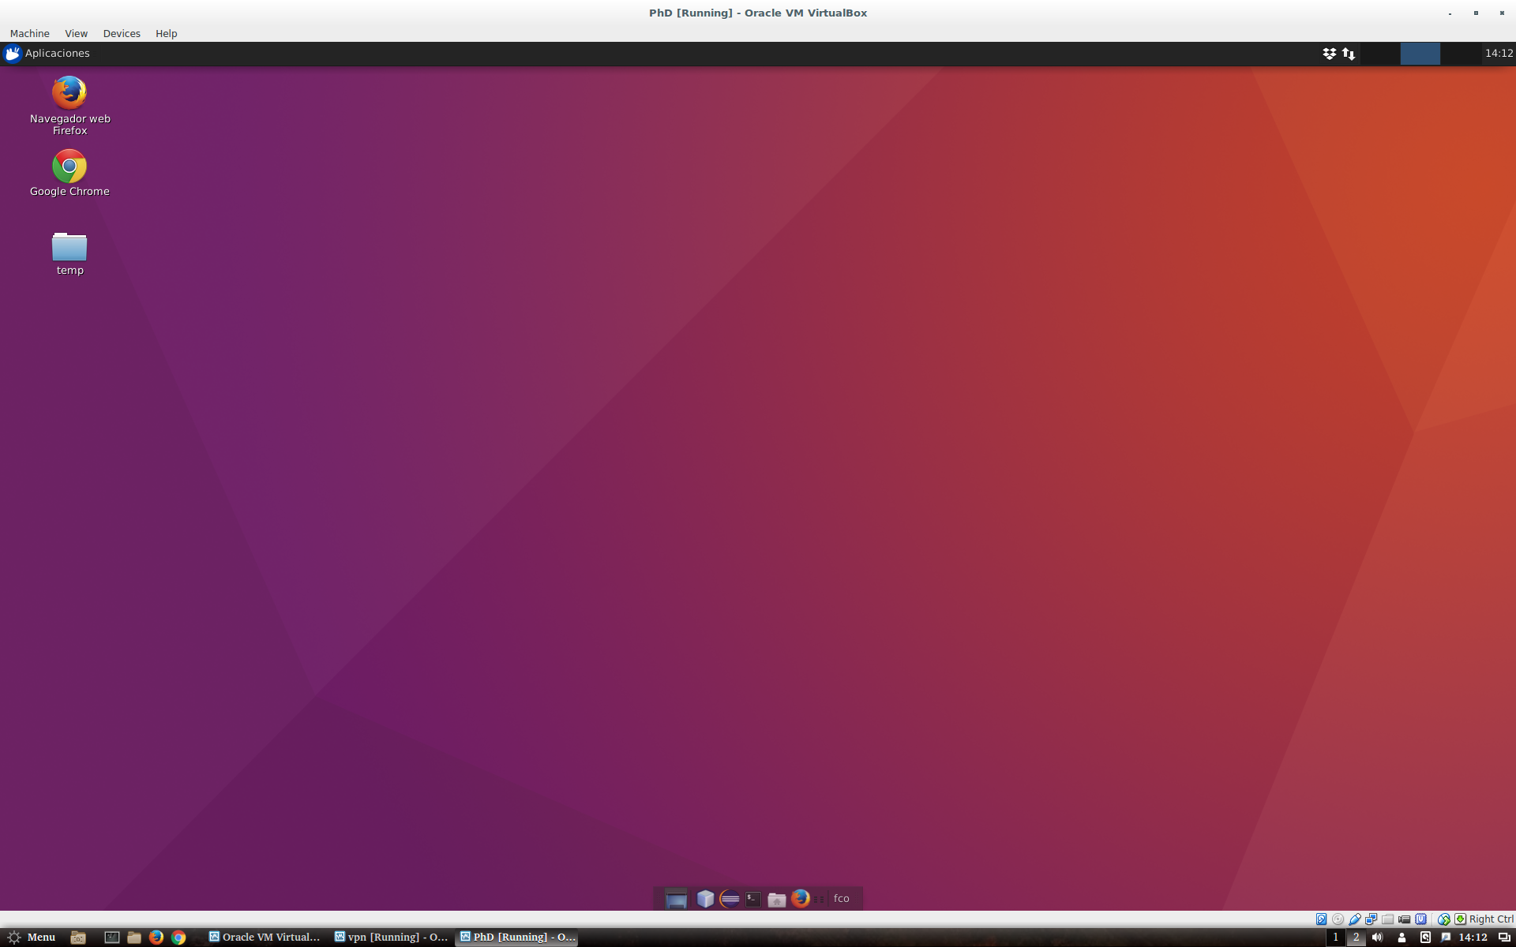
Is Linux difficult to use?
Graphic User Interface

Slide 6
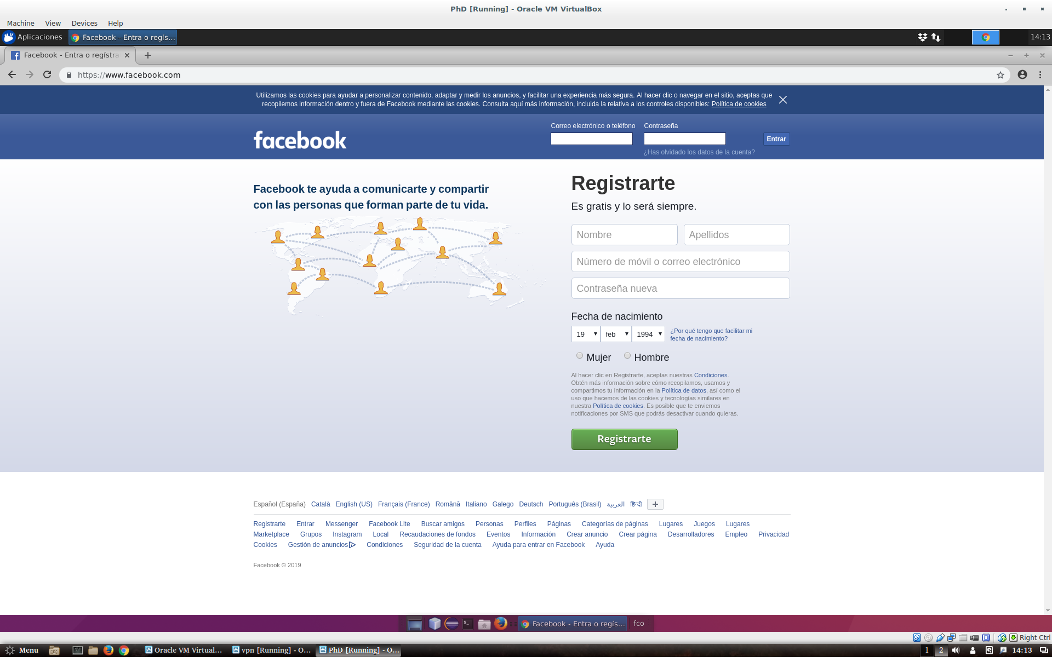
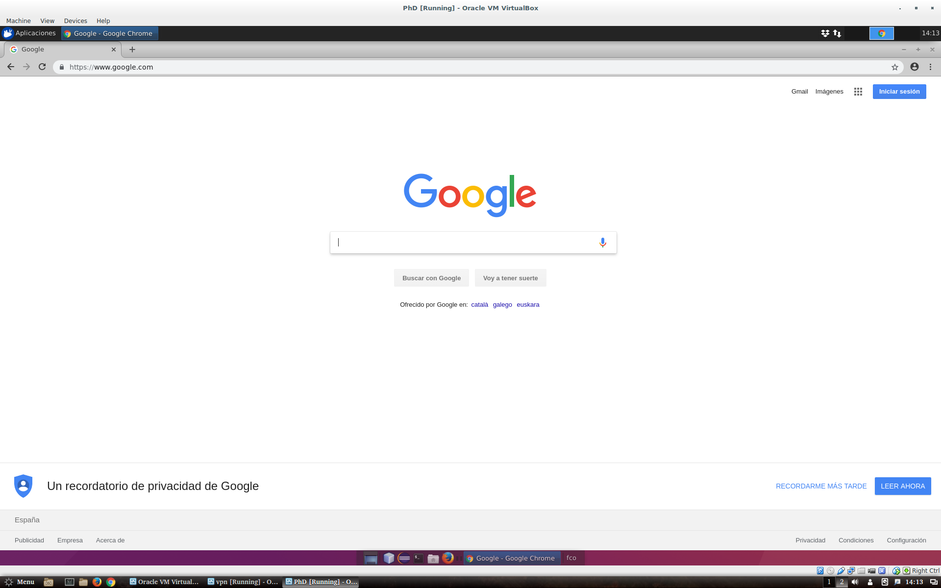
Is Linux difficult to use?
Graphic User Interface

Slide 7
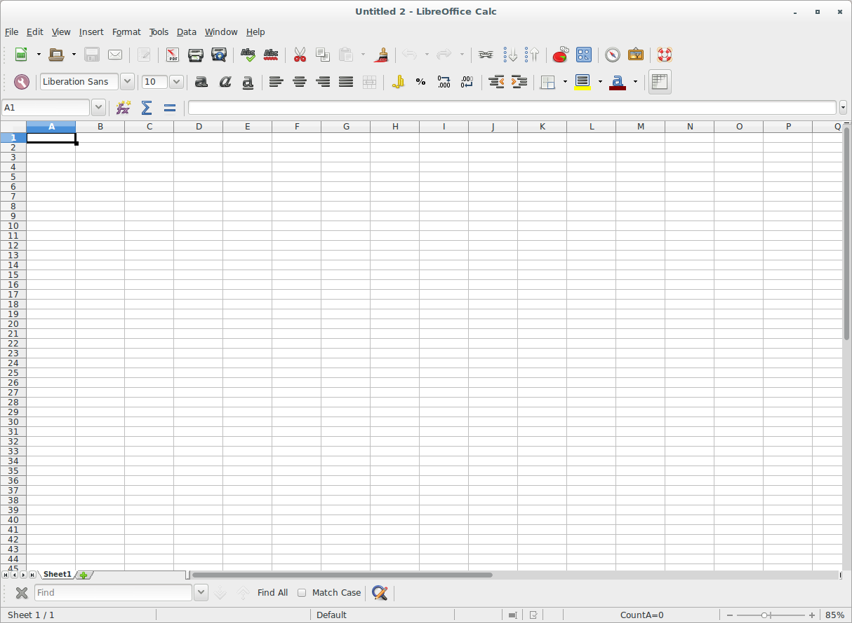
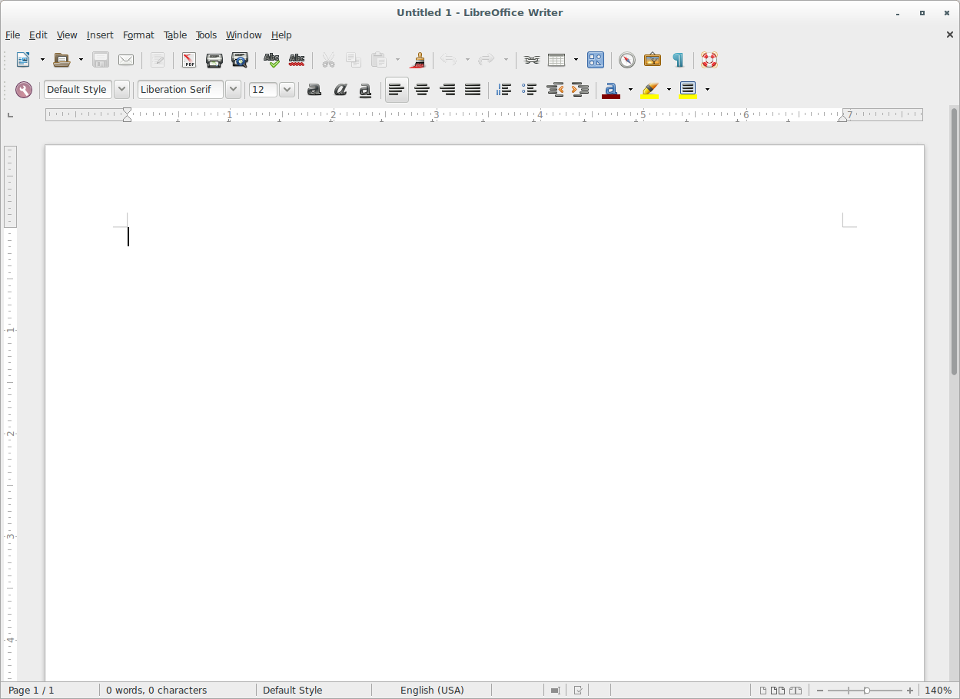
Is Linux difficult to use?
Graphic User Interface

Slide 8
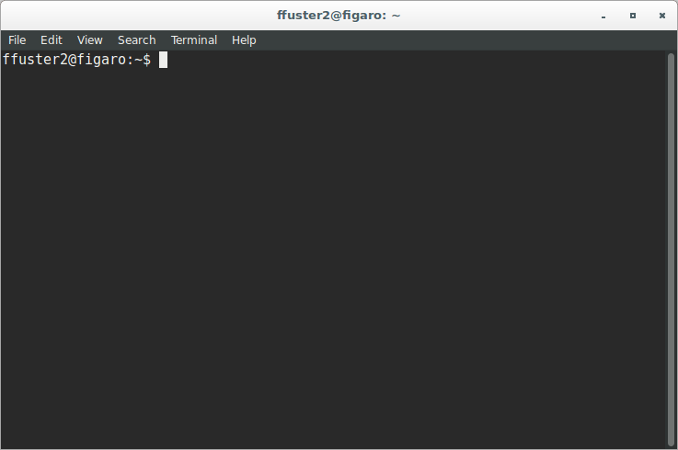
But...

Slide 9
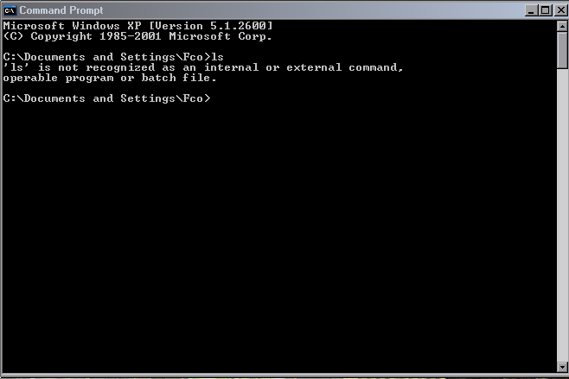
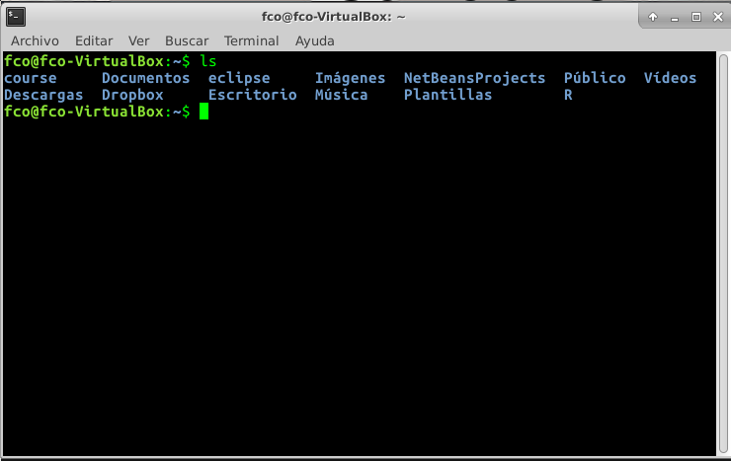
Differences between Windows & UNIX

Slide 10
Special considerations
command -x -y --option [other_parameters]
Command is in bold
Other parameters are surrounded by ‘[ ]‘. Square brackets are written just to distinguish between parameters
Command options start by ‘-’ or ‘--’

Slide 11
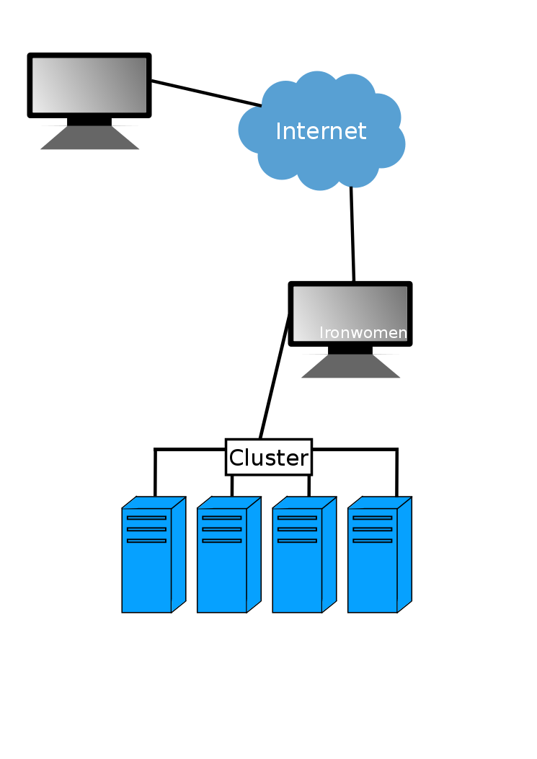
Course connection schema

Slide 12

Linux commands (0). Connecting to ironwomen
Open virtual box
Start EpiBioinfoVPN virtual machine
User: vpnuser
Password: vpnuser
Open “network connect”
Go to profiles → new
Type this data
Click “OK”
Click on “Connect”
Open terminal and write: ssh msuser@ironwomen
Password: nZM0M8S7
Name this profile: Epi_student
Username: student
Password: Ijc2019
Server/URL: https://172.27.2.252/ijc
Realm: Temp

Slide 13
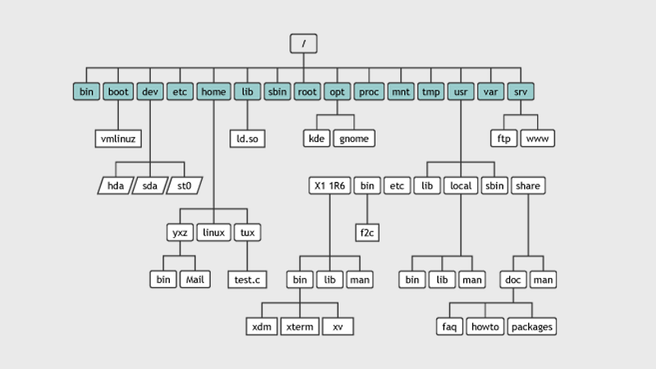
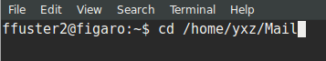
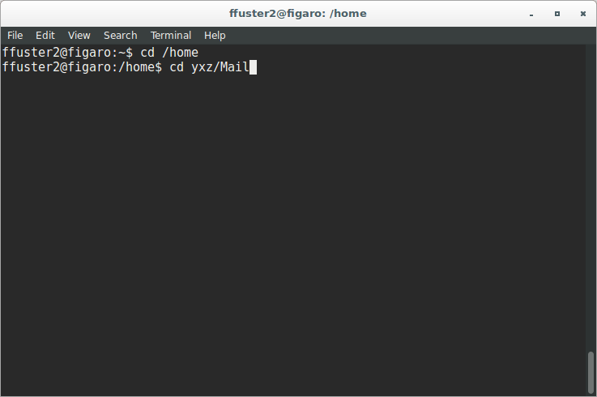
The Linux filesystem

Slide 14
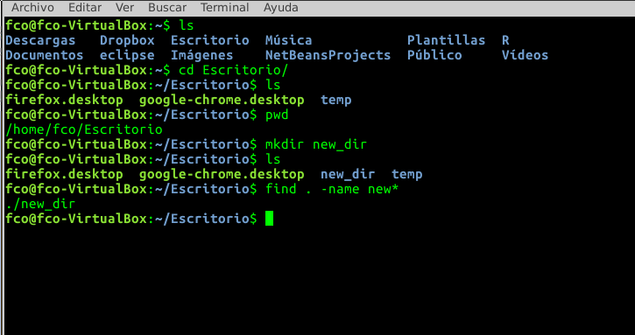
Linux basic commands (1). Folder navigation
cd [folder] → Navigation in directories
ls → List the files/directories in a path
pwd → Get absolute path of current directory
mkdir [folder_name] → creates the folder [folder_name] in the current path
find [path] -name [pattern] → Searches files in the specified position

Slide 15
Exercise (1)
Connect to ironwomen
Create the directory ‘your_name’ in the folder you are
List all the elements in that home folder
Get absolute path of your folder

Slide 16
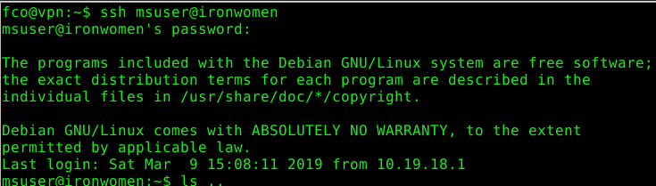
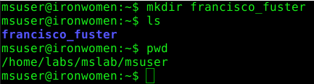
Exercise (1)
Connect to ironwomen
Create the directory ‘your_name’ in the folder you are
List all the elements in that home folder
Get absolute path of your folder

Slide 17
Linux basic commands (2). Copy, move, remove files
touch [file_name] → creates an empty file called [file_name]
cp [file_origin] [file_destination] → copy [file_origin] in [file_destination]
scp [user]@[server]:[path_file] [destination] → copy files from remote server
rsync [origin_folder] [destination_folder] → synchronize both folders
rsync [user]@[server]:[path_file] [destination] → synchronize from remote server
mv [file_origin] [file_destination] → move [file_origin] to [file_destination]
rm [file] → removes [file]

Slide 18
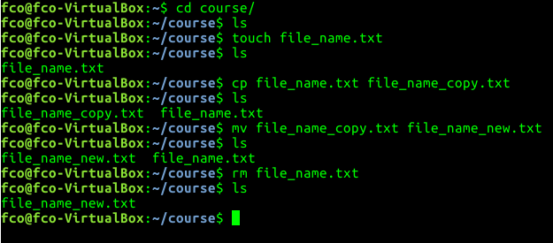
Linux basic commands (2). Copy, move, remove files
touch [file_name] → creates an empty file called [file_name]
cp [file_origin] [file_destination] → copy [file_origin] in [file_destination]
rsync [origin_folder] [destination_folder] → Synchronize both folders
mv [file_origin] [file_destination] → move [file_origin] to [file_destination]
rm [file] → removes [file]

Slide 19
Exercise (2)
Disconnect from ironwomen (type logout). Create a local folder ‘course’ in virtual machine
Create a new file called ex2.sh in your home folder
Copy this file to your recently created folder
Remove the file from your home folder

Slide 20

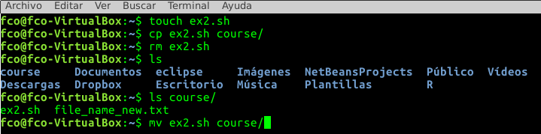
Exercise (2)
Disconnect from ironwomen (type logout). Create a local folder ‘course’ in virtual machine
Create a new file called ex2.sh in your home folder
Copy this file to your recently created folder
Remove the file from your home folder

Slide 21
Exercise (2)
Disconnect from ironwomen (type logout). Create a local folder ‘course’ in virtual machine
Create a new file called ex2.sh in your home folder
Copy this file to your recently created folder
Remove the file from your home folder

Slide 22
Linux commands (3). Working with files
head -n [number_of_lines] [file]→ Show first [number_of_lines] of the [file]
tail -n [number_of_lines] [file] → Show last [number_of_lines] of the [file]
cat [file] → Print all the file
less [fille] → Print all the file
grep [word] [file] → Find [word] in [file]
cut -f [columns] [file] → Show only [columns] of [file]
sort -k [column] [file]→ Sort the lines of a file by [column]
diff [file1] [file2] → Compare [file1] and [file2] line by line
uniq [file] → Report or omit repeated lines in file
tr → Translate or delete characters

Slide 23
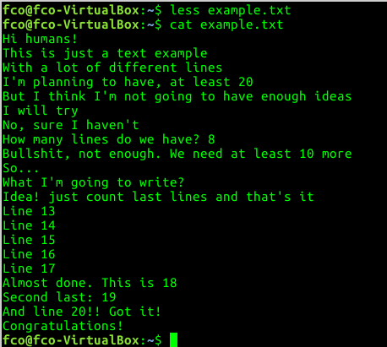
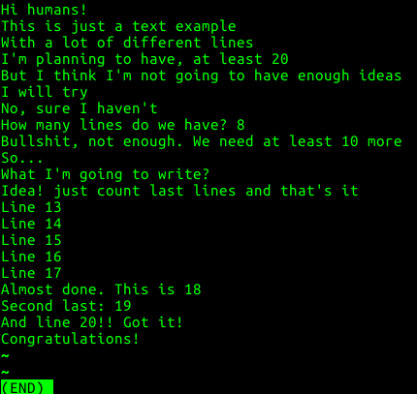
Examples (2)
cat & less

Slide 24
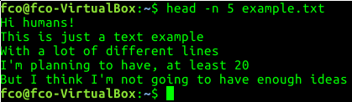
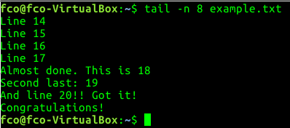
Examples
head & tail

Slide 25
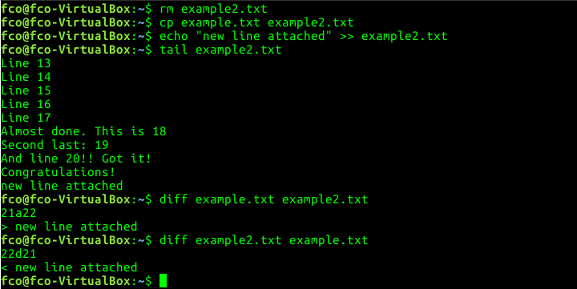
Examples (3)
diff

Slide 26
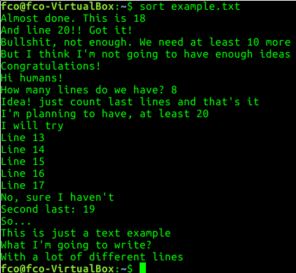
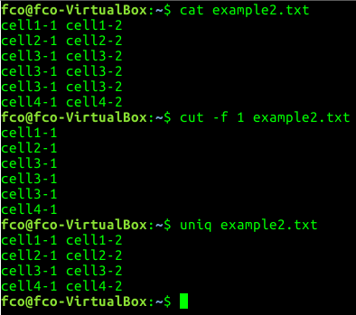
Examples (4)
sort, uniq & cut

Slide 27
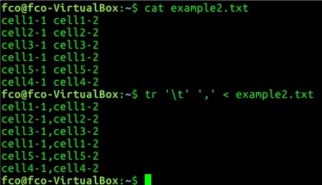
Examples (5)
tr

Slide 28
Exercise (3)
Copy exercise.tsv (msuser@ironwomen:/home/labs/mslab/msuser/fco/exercise.tsv) in course folder
Print last 10 lines of the file
Print 6th column of the file
Convert all the ‘:’ to ‘-’ in the file

Slide 29
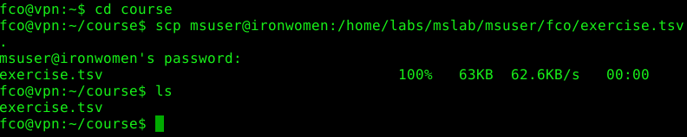
Exercise (3)
Copy exercise.tsv (msuser@ironwomen:/home/labs/mslab/msuser/fco/exercise.tsv) in course folder

Slide 30
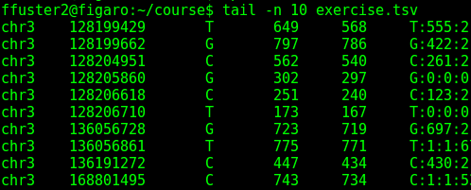
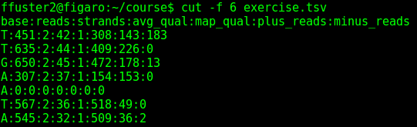
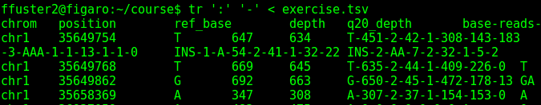
Exercise (3)
Print last 10 lines of the file
Print 6th column of the file
Convert all the ‘:’ to ‘-’ in the file

Slide 31
Special characters
‘>’ [file] → Store the output in [file]
‘>>’ [file] → Append output to [file]
2> [file] → Store error output to [file]
2>> [file] → Append output error to [file]
‘<’ [file] → Use [file] as input
‘;’ → Separator between commands
‘|’ → Send the output to other program (pipe)
‘*’ → All characters
‘.’ → Current folder
‘..’ → Parent folder

Slide 32
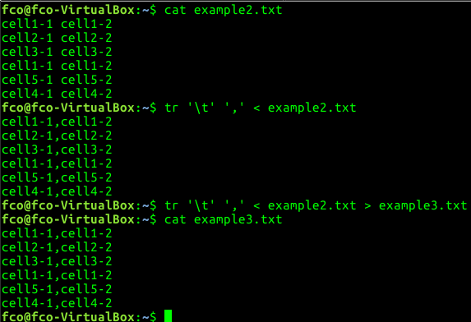
Examples

Slide 33
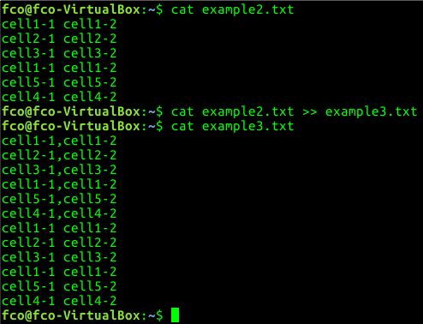
Examples

Slide 34
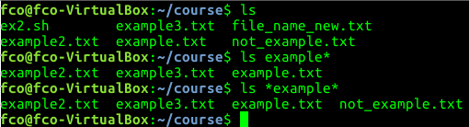
Examples

Slide 35
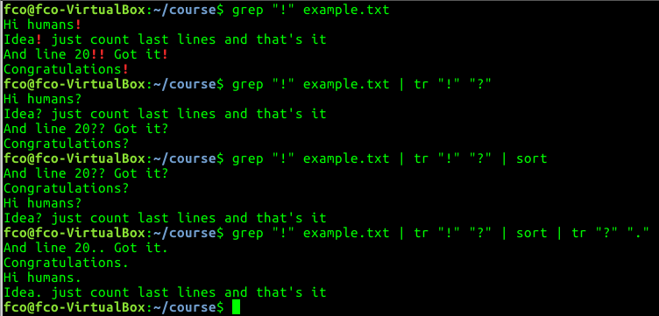
Examples

Slide 36
Exercise (4)
Print 1st column of exercise.tsv and store the output in a new file called exercise2.tsv
Add to exercise2.tsv, the first 5 lines of exercise.tsv
Find ‘:’ in exercise2.tsv. Convert ‘.’ to ‘,’. Store the output in new file called exercise3.tsv

Slide 37
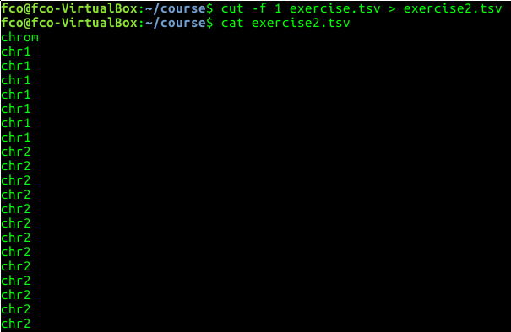
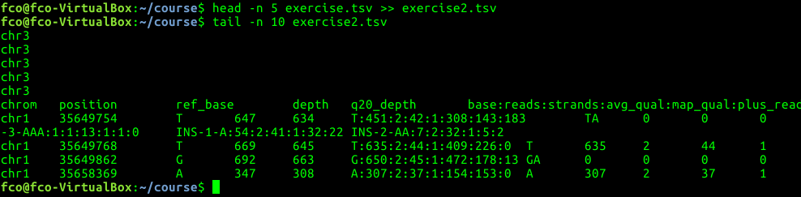
Exercise (4)
Print 1st column of exercise.tsv and store the output in a new file called exercise2.tsv
Add to exercise2.tsv, the first 5 lines of exercise.tsv
Find ‘:’ in exercise2.tsv. Convert ‘:’ to ‘,’. Store the output in new file called exercise3.tsv

Slide 38
Linux commands (4). Other useful commands
man [command] → Get the manual of [command]
wc [file] → Print newline, word, and byte counts of [file]
history → Print all the commands used
clear → “Cleans” the terminal
echo [“Some words”] → Prints [“some words”] in the terminal

Slide 39
Exercise (5)
What is the parameter in ‘wc’ command to print only the number of lines that file has?
Print all the ‘cd’ command you have used during the course

Slide 40

Exercise (5)
What is the parameter in ‘wc’ command to print only the number of lines that file has?
Print all the ‘cd’ command you have used during the course

Slide 41
Merging all
We can combine different instructions if needed
#!/bin/bash
#Do all exercises at once
cd /home/fco #Go to home folder
mkdir course #Create new folder
cd course #Go to folder
touch ex2.sh #Create new blank file
cp /media/ffuster/USB/exercise.tsv . #Copy example exercise from the USB.
tr ':' '-' < exercise.tsv > exercise2.tsv #Change ‘:’ to ‘-’ in the file and store the ouput in a new file
sort exercise2.tsv > exercise3.tsv #Sort the file and store it in a new file

Slide 42
Merging all
We can combine different instructions if needed
#!/bin/bash
#Do all exercises at once
cd /home/fco #Go to home folder
mkdir course #Create new folder
cd course #Go to folder
touch ex2.sh #Create new blank file
cp /media/ffuster/USB/exercise.tsv . #Copy example exercise from the USB.
tr ':' '-' < exercise.tsv > exercise2.tsv #Change ‘:’ to ‘-’ in the file and store the ouput in a new file
sort exercise2.tsv > exercise3.tsv #Sort the file and store it in a new file
My first bash script!!

Slide 43
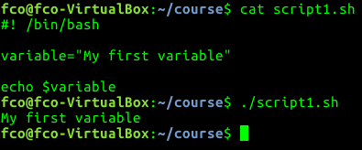
Bash scripts. Variables
Pieces of code that can get whatever value
Special variables:
$1 - $9 → Get the value of first - ninth option
…
More variables → https://www.mylinuxplace.com/bash-special-variables/

Slide 44
Bash Scripting. If statement
Piece of code that will be executed if a condition is true
#!/bin/bash
#My first if statement
if [ condition ]
then
[Commands that will be executed if condition is true]
else
[Commands that will be executed if the condition is false]
fi

Slide 45
Bash Scripting. If statement
Piece of code that will be executed if a condition is true. Examples
#!/bin/bash
if [ -f file.txt ]
then
[Commands will be executed if file exists]
fi
if [ -d folder ]
then
[Commands will be executed if folder exists]
fi
More examples → https://ryanstutorials.net/bash-scripting-tutorial/bash-if-statements.php

Slide 46
Bash scripting. For loop
Piece of code that will be executed several times
#!/bin/bash
#My first for loop
for [times]
do
[Commands that will be executed several times]
done

Slide 47
Bash scripting. For loop
Piece of code that will be executed several times. Examples
#!/bin/bash
for variable in *.txt
do
[Commands will be executed in all txt files that are in the folder]
done
for variable in file1 file2 file3 file4
do
[Commands will be executed only in file1, file2, file3, and file4]
done
More examples → https://www.poftut.com/linux-bash-loop-files/

Slide 48

Cluster

Slide 49
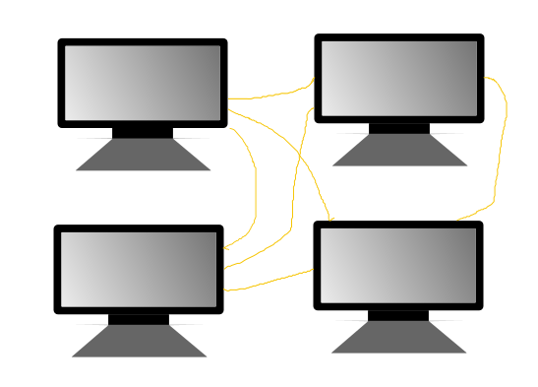
Cluster

Slide 50

Cluster

Slide 51
Queuing system
Orders the jobs sent to cluster according to priorities
SGE
SLURM
...

Slide 52
SGE useful commands
qsub [bash_script] → Sends [bash_script] to cluster
qstat →Check status of your jobs
qdel → Delete a job from cluster

Slide 53
Exercise (6)
Connect to ironwomen
Copy cluster_template.sh to “your_name” folder
Modify cluster_template.sh, with your name [use nano]
Send the job to cluster
Check the cluster status

Slide 54
Additional exercises (1)
Print last 10 lines of exercise.tsv, but excluding last one
Print 2nd column of exercise.tsv, sort the output and store it in a new file called exercise2.tsv
Find the files in course folder that starts with ‘ex’ and has ‘2’ in the name
Print 6th column of exercise.tsv, change ‘:’ to ‘,’ and sort the output. Append the output to exercise2.tsv
Count the number lines that have chr1 in file1.tsv
Check if there are chromosomal regions repeated in file1.tsv

Slide 55
Additional exercises (2)
How many genes are in file1.tsv? and in file2.tsv?
Which file has more regions: file1.tsv or file2.tsv?
Which file is bigger (occupies more bytes): file1.tsv or file2.tsv?
Find regions regions in common in both files
Find how many times NF1 gene appears in file2.tsv

Slide 56
Additional exercises (3)
File2.tsv is unsorted. Sort it by chromosome and chromosomal position
File1 is tab-separated file, but customer says that he/she needs comma-separated file. Can you do it using bash?
There is a typo in a gene in file2.tsv. Are you able to find it? (Tip: use sort + uniq)

