Slide 1
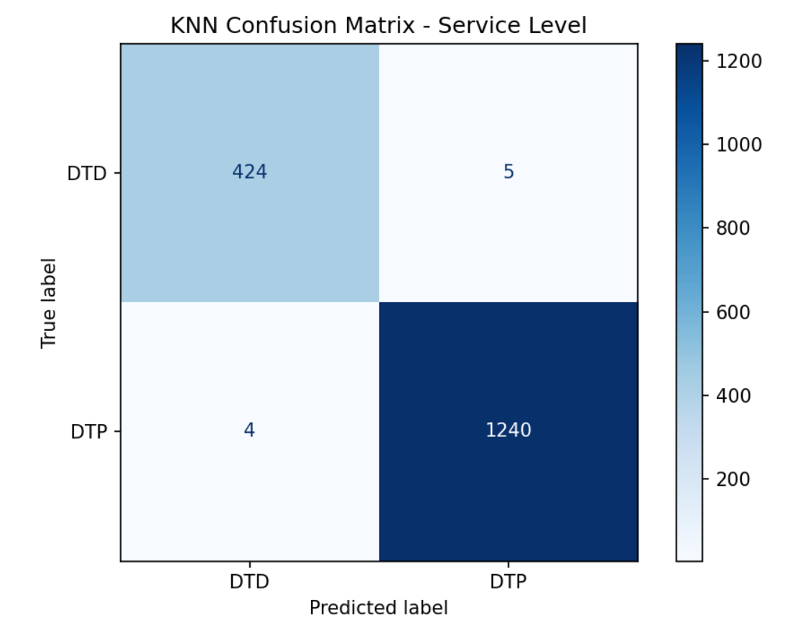
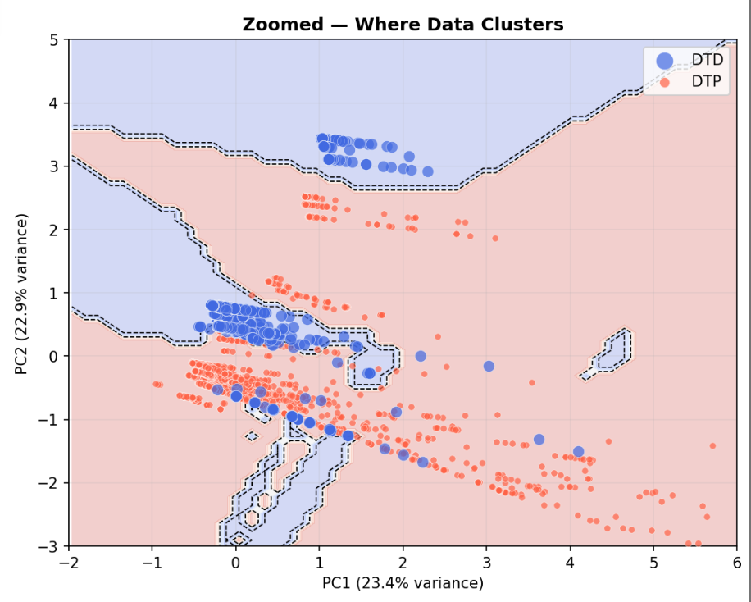
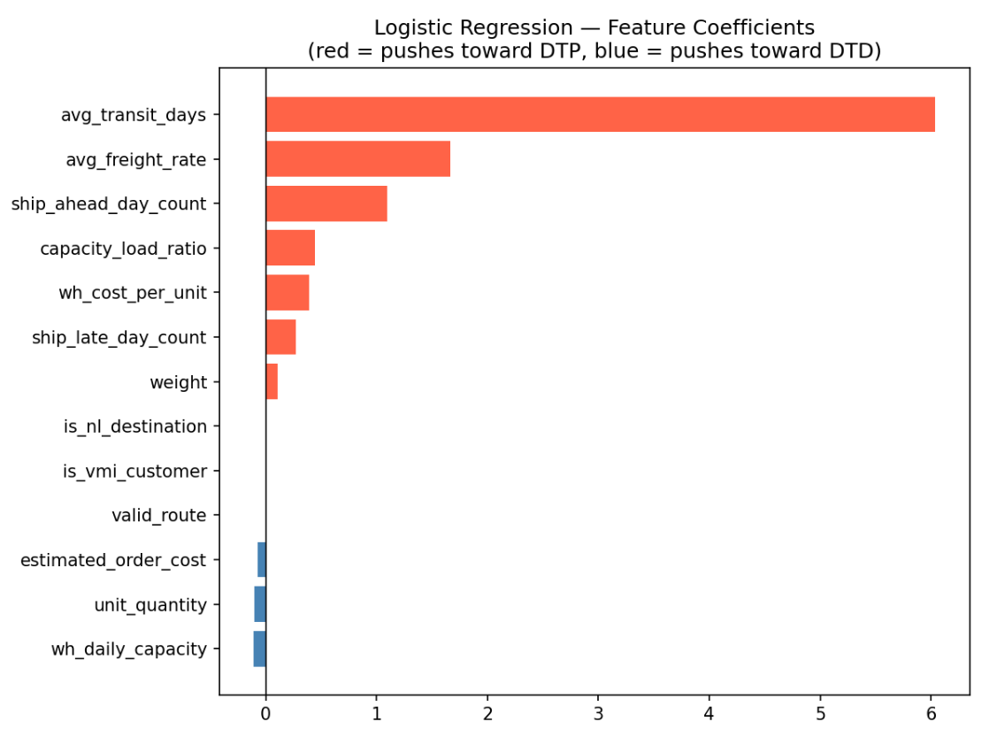
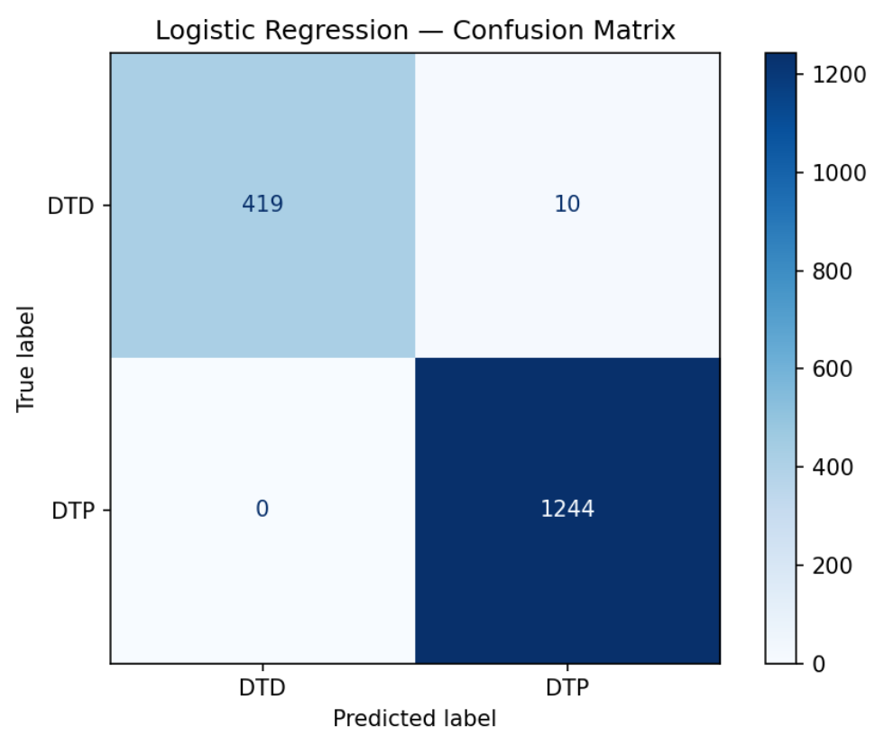
Predicting Delivery Service Levels in Dutch Supermarket Supply Chains
8,361
7
99%
9
2
Total Orders
Merged Tables
Model Accuracy
Total Errors
NL Ports Flagged
KNN Confusion Matrix
KNN Decision Boundary
Logistic Regression Coefficients
Logistic Regression Confusion Matrix
[ Drop your image here ]
[ Drop your image here ]
[ Drop your image here ]
[ Drop your image here ]
424 DTD + 1240 DTP correct | Only 9 errors
DTD = urgent orders | DTP = bulk restocking
avg_transit_days is the strongest predictor
0 DTP misclassified | Perfect bulk detection
DTP
Bulk restocking | Slow & cheap | High quantity | Long transit
DTD
Urgent top-ups | Premium rate | Small orders | Fast delivery
NL
Rotterdam & Amsterdam flagged
Pre-allocate couriers & warehouse capacity before order is confirmed
USE

