Slide 1
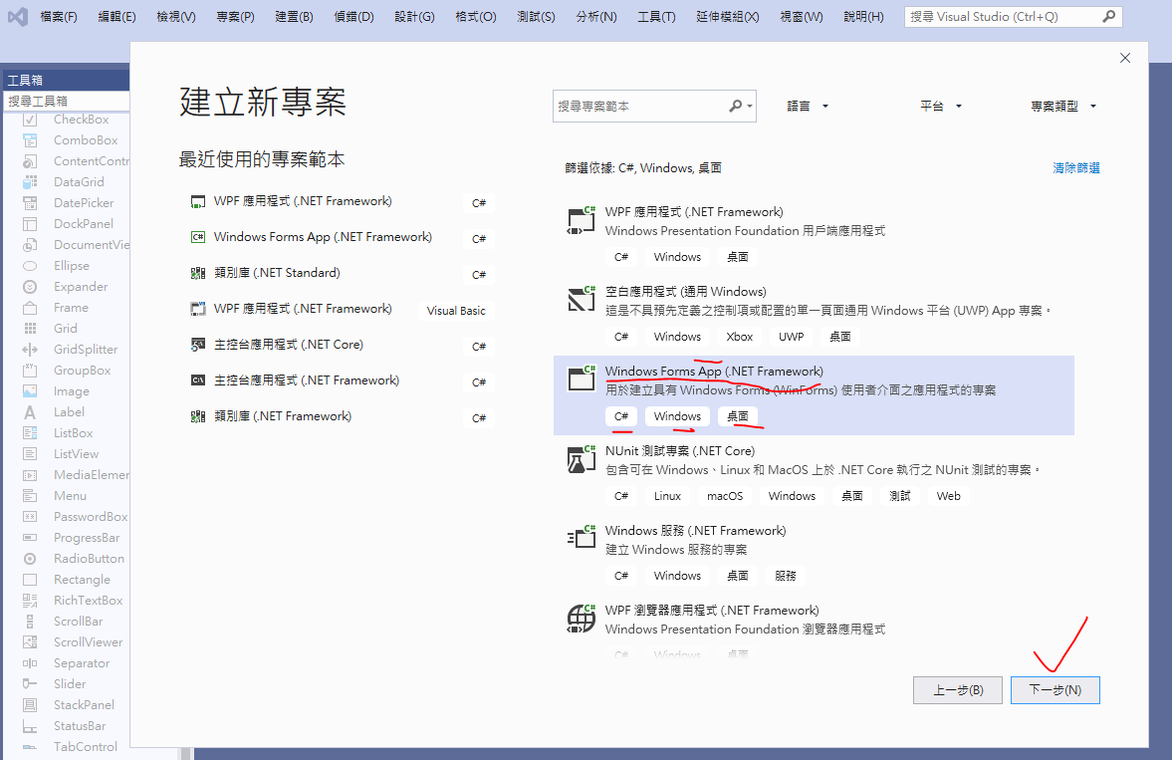
建立新專案

Slide 2
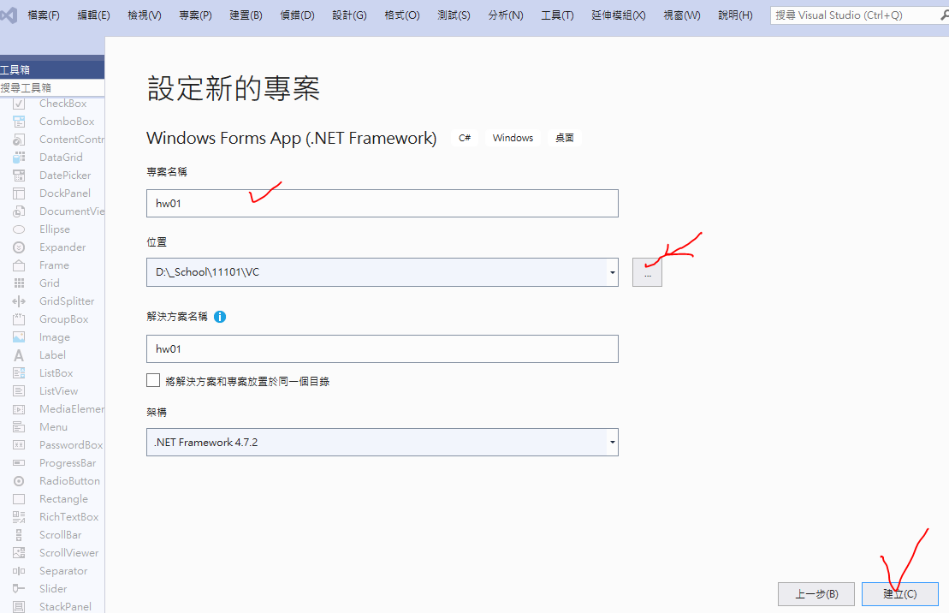

Slide 3
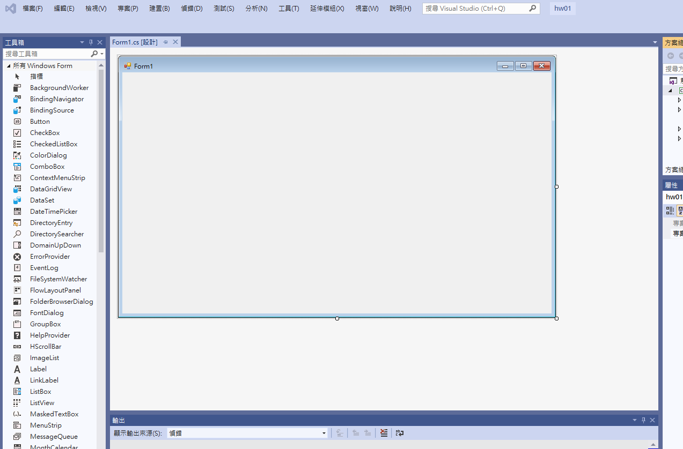
空白視窗

Slide 4
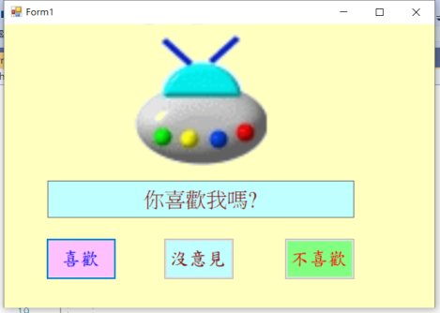
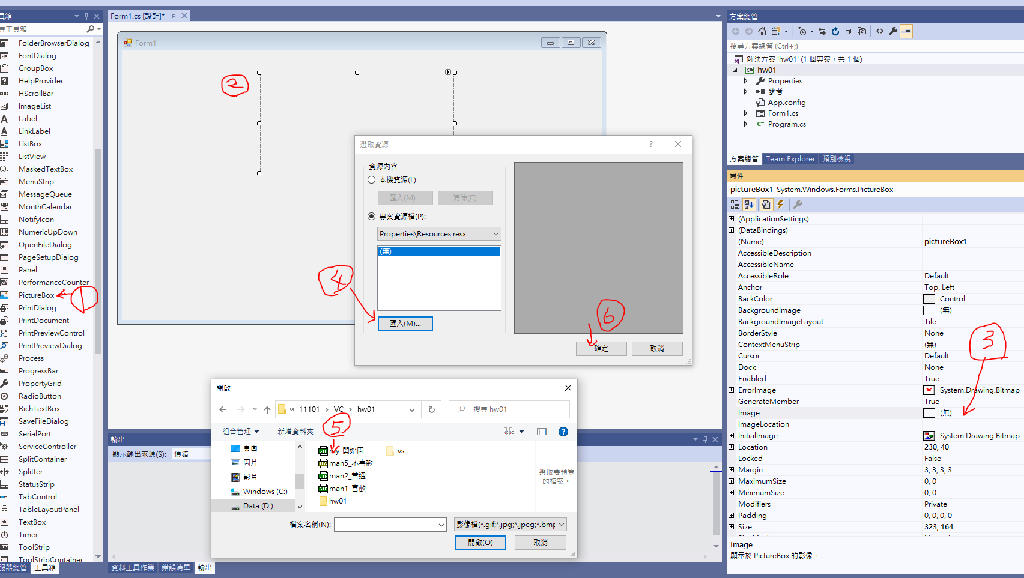

Slide 5
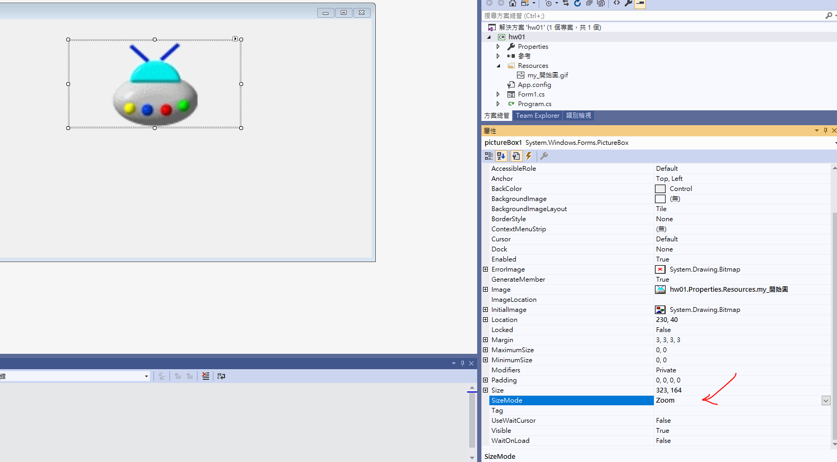

Slide 6
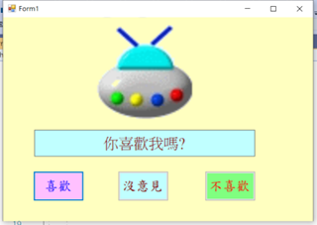
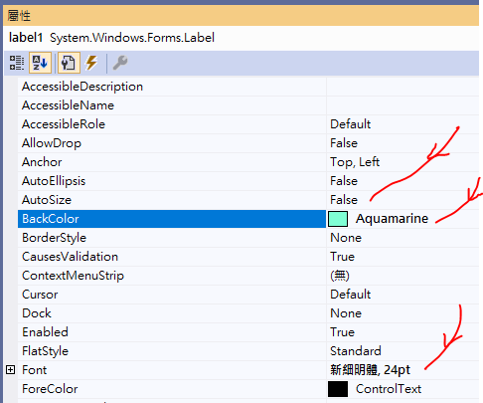
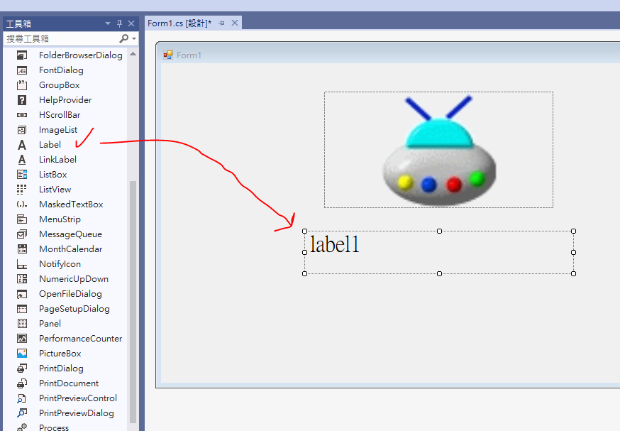
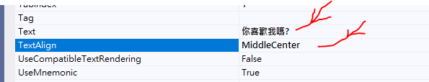

Slide 7

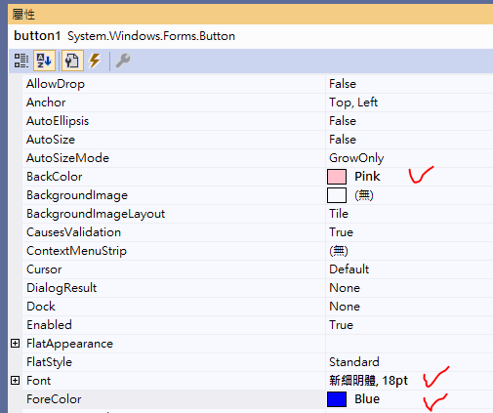
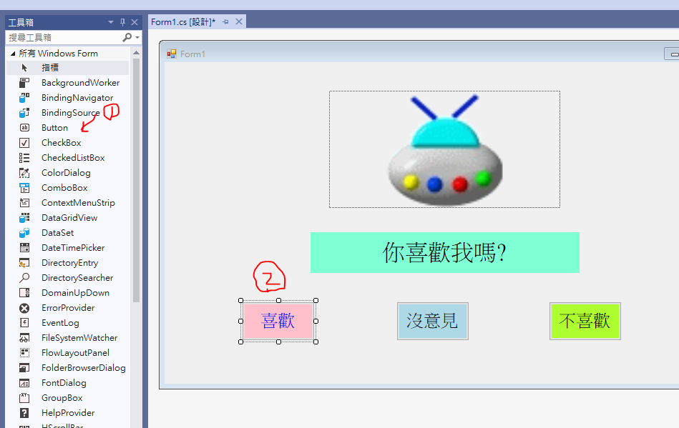


Slide 8
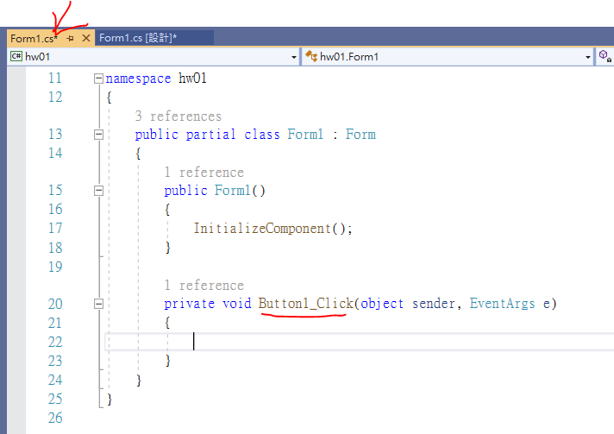
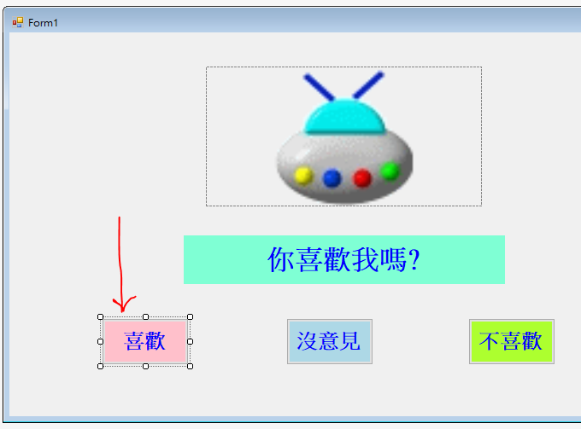
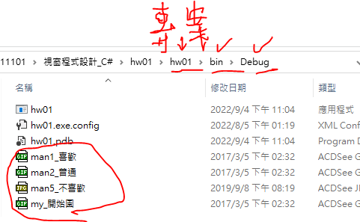
點擊兩次
進入編輯
圖片存放位置
private void Button1_Click(object sender, EventArgs e)
{
pictureBox1.Image = new Bitmap("man1_喜歡.gif");
label1.Text = "謝謝你!";
label1.ForeColor = Color.Blue;
label1.BackColor = Color.Pink;
}

Slide 9
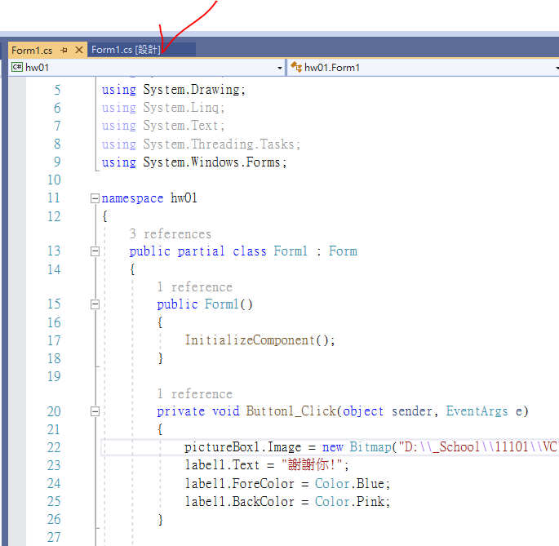
回到視窗，再點擊另兩個按鈕，進入編輯
private void Button1_Click(object sender, EventArgs e)
{
pictureBox1.Image = new Bitmap("man1_喜歡.gif");
label1.Text = "謝謝你!";
label1.ForeColor = Color.Blue;
label1.BackColor = Color.Pink;
}
private void Button2_Click(object sender, EventArgs e)
{
pictureBox1.Image = new Bitmap("man2_普通.gif");
label1.Text = "你真沒趣!";
label1.ForeColor = Color.Black;
label1.BackColor = Color.LightBlue;
}
private void Button3_Click(object sender, EventArgs e)
{
pictureBox1.Image = new Bitmap("man5_不喜歡.jpg");
label1.Text = "你閃一邊!";
label1.ForeColor = Color.Red;
label1.BackColor = Color.GreenYellow;
}

Slide 10
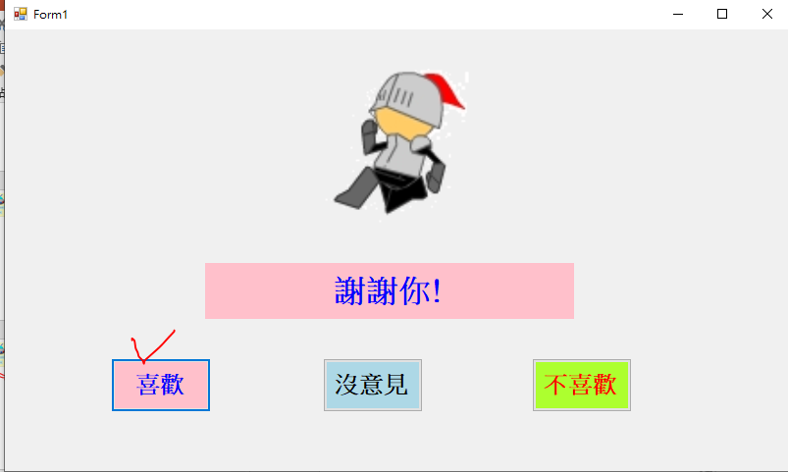
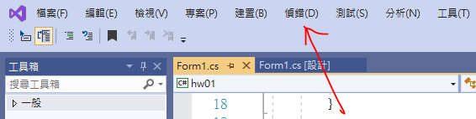
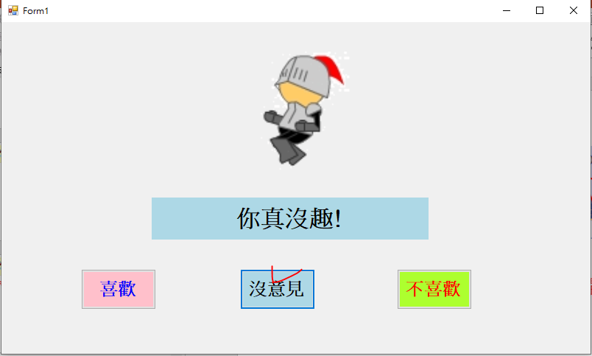
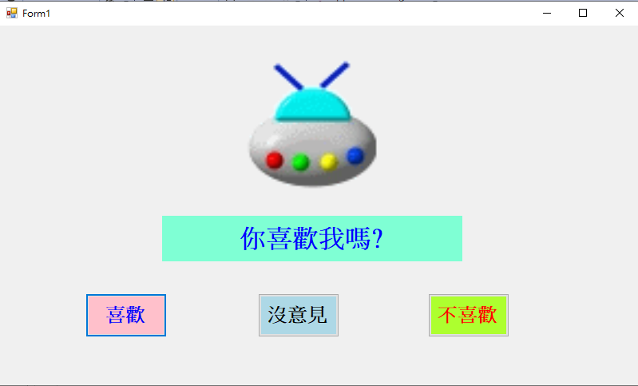
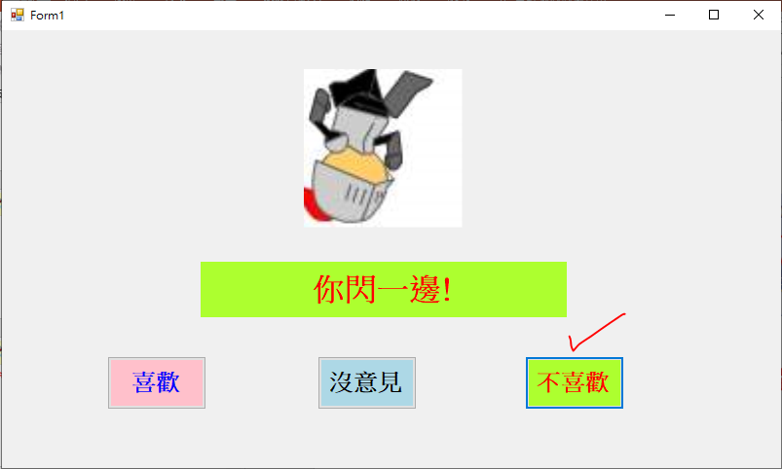
執行程式
開始偵錯

