Slide 1


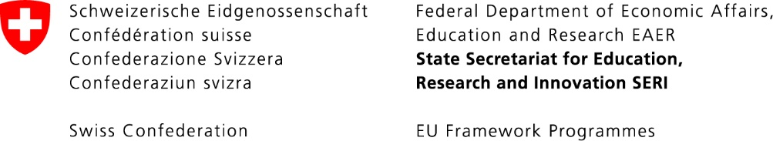

Future technology: first outline of a methodological approach for SF modelling _{16/06/23 Maria Ljunggren}

Slide 2
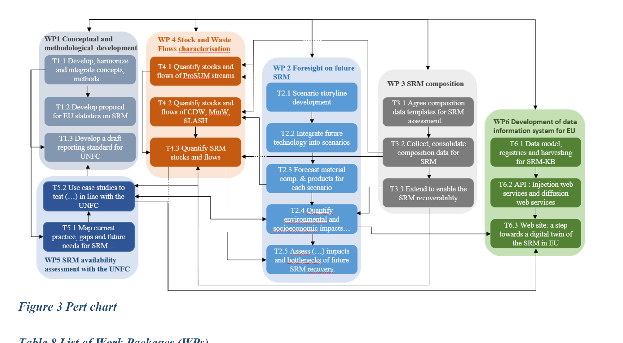
WP2-WP3-WP4 interdependencies
What general development until 2050?
How does the development differ between scenarios?
What technologies can become available until 2050?
How does technologies and their availability differ between scenarios?
What is the composition of the products identified in T2.2?
How does the composition differ between scenarios?

Slide 3
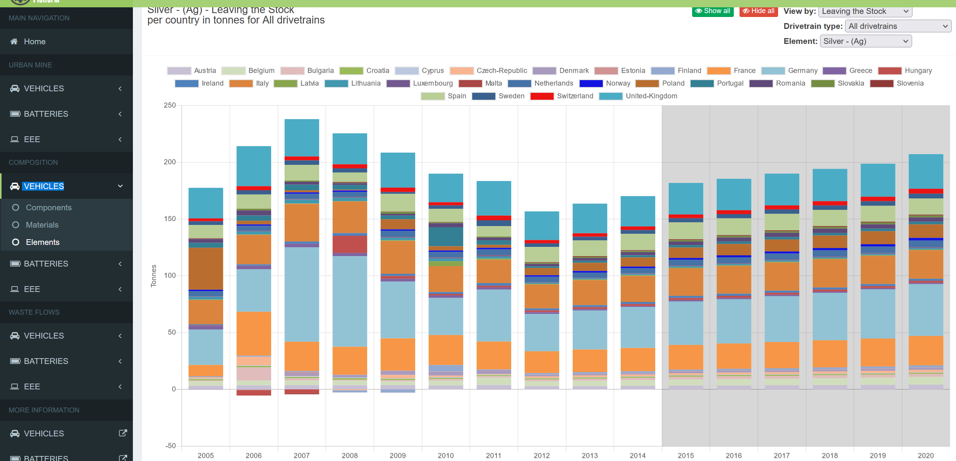
Why consider technology development?
Products develop over time => waste quantity and composition change over time
Recovery processes develop over time => recovery pathways and their efficiency change over time
Scenarios can explore (not predict) these changes over time Datasets covering ~50 years (2000-2050?) and 27+4 MS/EU total in three scenarios could be provided for all(?) waste streams using dMFA modelling
Example: Silver in vehicles leaving the stock per MS in 2005-2020 (extrapolation 2015-2020) from the Urban mine platform (ProSUM)
?
History: based on reported data
Future: based on assumptions
2050
Notes:
Tag bort för mycket intro. Gå mer på approach/methodology. Skilj på emerging/existing tech. Lägg in recovery o product tech. Tänk igenom new, phasing in/out. Se över approach. Skriv next steps. Tänk igenom recovery targets och hur modellera dem, vilka är de – BAT och CRM act. Se över CRM som begrepp.

Slide 4
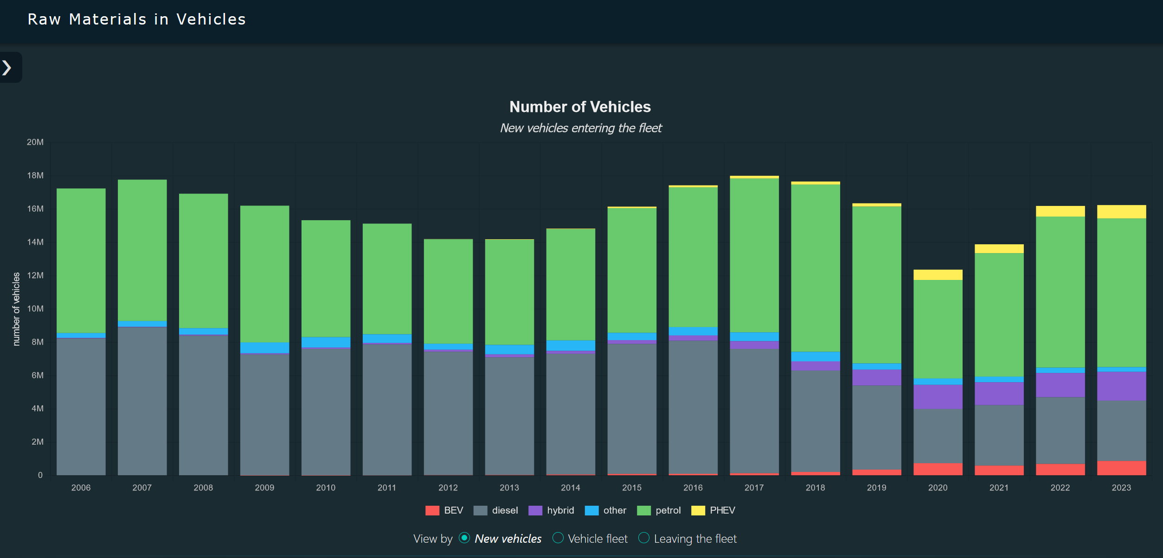
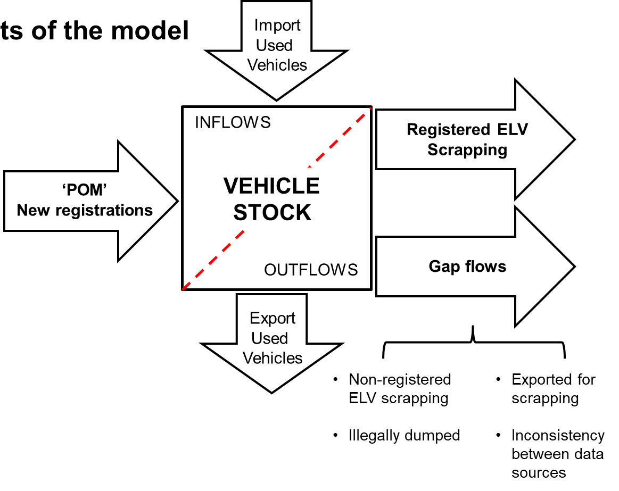
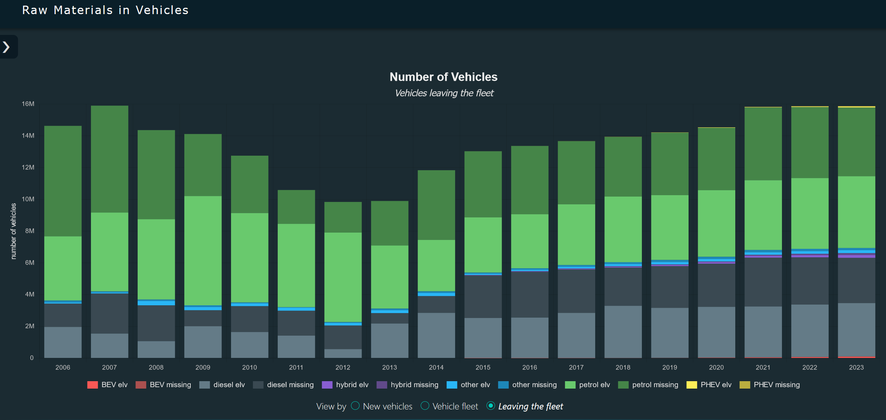
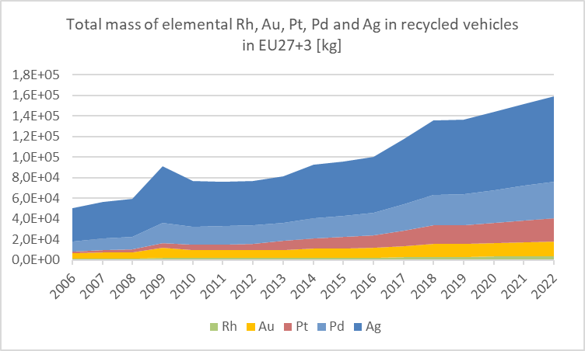
Example: observed historical changes in vehicles have resulted in changes in waste quantity and composition
Number of vehicles placed on the market
Number of vehicles reported as recycled
Recovery
Precious elements in vehicles reported as recycled
Observed historical changes affecting waste quantity and composition:
Total number of vehicles
New keys (e.g. BEV and PHEV)
Share of keys (e.g. increasing/decreasing diesel)
Composition per key (e.g. PGM due to stricter emission legislation)
Update for RMIS (2022)

Slide 5
Technology development in future scenarios?
The future cannot be predicted, assumptions on technology development are needed
Concerns both future products and recovery technology
Scenario descriptions should guide assumptions, but specific assumptions are likely needed at the level of each waste stream
What methodological approach: (1) are assumptions about technology development based? (2) is used for implementing technology development in SF models?
Each waste stream needs to choose and describe the approach. Align and share between waste streams if helpful.

Slide 6
What assumptions on technology development in future scenarios need to be addressed in SF modelling?
What technologies could be in demand over the studied period?
Existing technologies (currently, i.e. on the market in ~ 2023)
New technologies (not on the market in ~ 2023)
What are the properties of these technologies over time?
Products: e.g. composition
Recovery: e.g. efficiency
How are the technologies diffused to the market?
Existing and new tech grows/declines at certain rates and over certain periods
How does the above differ between scenarios?

Slide 7
Importance of addressing product technology development until 2050 differs between waste streams
Very important: EEE (new keys, increasing numbers, many short-lived meaning several product generations until 2050)
Important: ELV and BAT (shift between keys, composition changes, but relatively long-lived so fewer product generations until 2050)
Less important?: CDW (long-lived, mainly historic changes to appear in SRM until 2050?), SLASH (general demand for metals/minerals not linked to product tech changes?, link to waste generated by recycling of FutuRaM products?)
Not considered: MIN (focus on already generated waste)

Slide 8
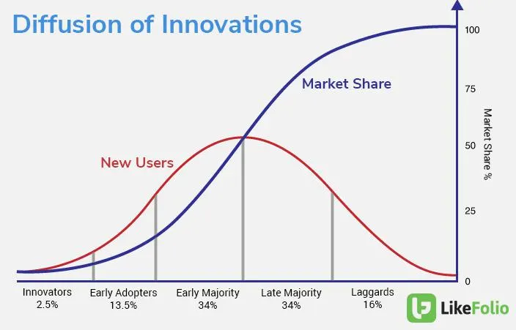
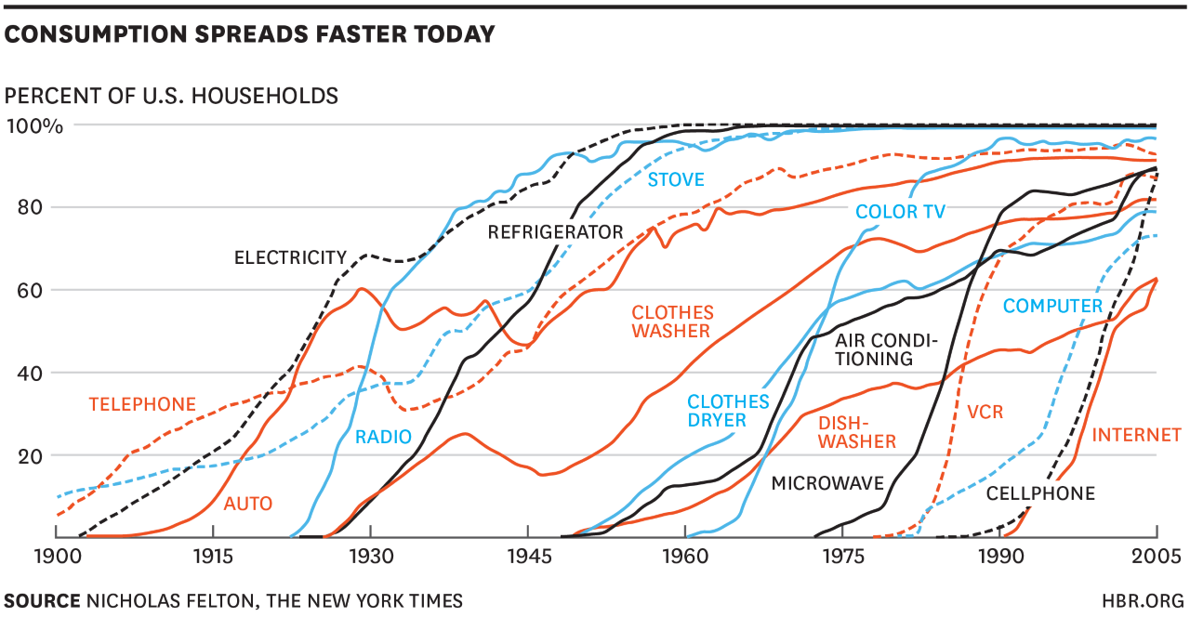
Technology diffusion: the process by which a technology increases its market share (is adopted by the market)
Historical examples
Rate of diffusion differs, e.g.
Internet from 0 to 60% over 15 years
Auto from 0 to 90% over >100 years
Telephone from 5 to 90% over 105 years
Cellphone from 0 to 90% over 20 years
Diffusion is often depicted as an S curve, where the diffusion rate is assumed as:
Slower for new tech
More rapid for existing tech not yet at full market potential
Slower for existing tech approaching market saturation
Could hold for both products and recovery processes

Slide 9
Assumptions on technology diffusion in FutuRaM scenarios
Assumptions on technology diffusion are needed to describe the development of the market share over time (products and recovery processes)
Diffusion depends on many factors such as price, legislation, acceptance, R&D, competition, organizational and institutional support… It can be made very complicated and is a research field in itself.
Regardless of how waste streams choose to approach diffusion, assumptions will be implicit in the scenarios
This is why the approach chosen needs to be stated so that the basis for the scenarios are as transparent as possible
Examples of diffusion patterns:
Replicating ”real” diffusion patterns (closer to ”prediction”)
Testing ”what if” diffusion patterns (closer to ”exploring”)
Market share
Tech A
O
O
X
gradual diffusion
O
This example is a case of two existing tech
(possibly A is replaced by B)
Tech B
X
X
X
O
2022
2030
2040
2050
Time

Slide 10
Assumptions on how product technology development can differ between scenarios
 | Development of product technology (placed on market 2022-2050)
BAU | Keys, Market share/key (diffusion), Composition/key, Total number of products
Difference to BAU:
Circularity | Keys: no difference Market share/key: other diffusion as a consequence of circularity Composition/key: differs as a consequence of increased reusability, reparability and longer life etc (e.g. more and/or other material). Total number of products: fewer as consequence of longevity, sharing, reuse etc. (slower flow through stock)
Recoverability | Keys: no difference Market share/key: other diffusion as a consequence of recoverability Composition/key: differs as a consequence of increased recoverability (e.g. fewer materials, increased dismantlability) Total number of products: no difference (same flow through stock)

Slide 11
Assumptions on how recovery technology development can differ between scenarios
 | Development of recovery technology (placed on market 2022-2050)
BAU | Processes, Process efficiency (TC), Market share/process (diffusion), Total capacity per process, Pathways (sequence of processes)
Difference to BAU:
Circularity | Since more focus on maintaining products in use => Processes and process efficiency: no difference since legislative targets are not met Market share/process: slower diffusion Total capacity per process: lower since less waste is generated per unit of time Pathways: no difference
Recoverability | Since more focus on recovering materials in products => Processes: more developed Process efficiency: higher for CRM to meet legislative targets (CRM act benchmarks and other) Market share/process: more rapid diffusion Total capacity per process: same as BAU since same amount of waste is generated per unit of time Pahtways: more developed

Slide 12
Suggestions
focus on products that would change the composition compared to current products (increasing or decreasing) and would leave the stock before 2050
decide on an approach for technology diffusion, make sure that it can be implemented in the SF model
account for the differences in product and recovery technology between the scenarios
collect data from various sources (e.g. patents, scientific publications, business reports, experts)
assume that there technology development is equal in all MS
each waste stream decides on and states the approach and conducts the work (considering available project resources in terms of time and competence)

Slide 13
Timeline and responsibilities
Needs to be discussed and defined

