Slide 1

BEYOND
THE RATINGS
What 56K displayed football player records reveal about performance, potential and playing style
EA SPORTS FC • POWER BI CASE STUDY

Slide 2
Can one rating tell the whole story?
A surprising example from the player profile
85
34
51
Courtois: goalkeeper
Courtois: centre-back
Point difference
Same player. Very different position suitability.
Historical player-edition profile shown in the dashboard; not a current rating.
EA SPORTS FC | POWER BI ANALYTICS
02 / 18

Slide 3
The question behind the project
Why explore beyond the overall score?
• Thousands of records across players, teams and coaches
• Multiple FIFA editions — the same player can appear repeatedly
• Different roles require different strengths
• Goal: move from headline ratings to meaningful comparisons
EA SPORTS FC | POWER BI ANALYTICS
03 / 18

Slide 4
Six datasets. Three parts of football.
Source overview
PLAYERS
TEAMS
COACHES
Male + female
Ratings • potential • attributes
Male + female
Overall • attack • midfield • defense
Male + female
Age • nationality • team links
Important: displayed player counts may represent player-edition records, not unique individuals.
EA SPORTS FC | POWER BI ANALYTICS
04 / 18

Slide 5
How the data was prepared
Power Query workflow — technical overview from project planning
01
02
03
04
Combine
Clean
Reshape
Connect
Male and female source tables
Check blanks and data types
Unpivot position rating columns
Use player + edition + gender keys
The PDF does not show Power Query Applied Steps; insert your actual transformation screenshot before presenting.
EA SPORTS FC | POWER BI ANALYTICS
05 / 18

Slide 6
How the model connects the analysis
Conceptual design — verify against final Power BI Model View
FactPlayer
Dimensions
FactPlayerPositions
→
→
Player-edition grain
Edition • gender • team
Player-position ratings
Add a screenshot of your actual Model View here; relationships are illustrative, not PBIX-verified.
EA SPORTS FC | POWER BI ANALYTICS
06 / 18

Slide 7
Turning raw values into dynamic KPIs
Selected DAX examples from the development approach
Average rating
AVERAGE(FactPlayer[overall])
Highest potential
MAX(FactPlayer[potential])
Position rating
AVERAGE(FactPlayerPositions[PositionRating])
Example formulas from planning; replace with screenshots of your verified final DAX measures.
EA SPORTS FC | POWER BI ANALYTICS
07 / 18

Slide 8
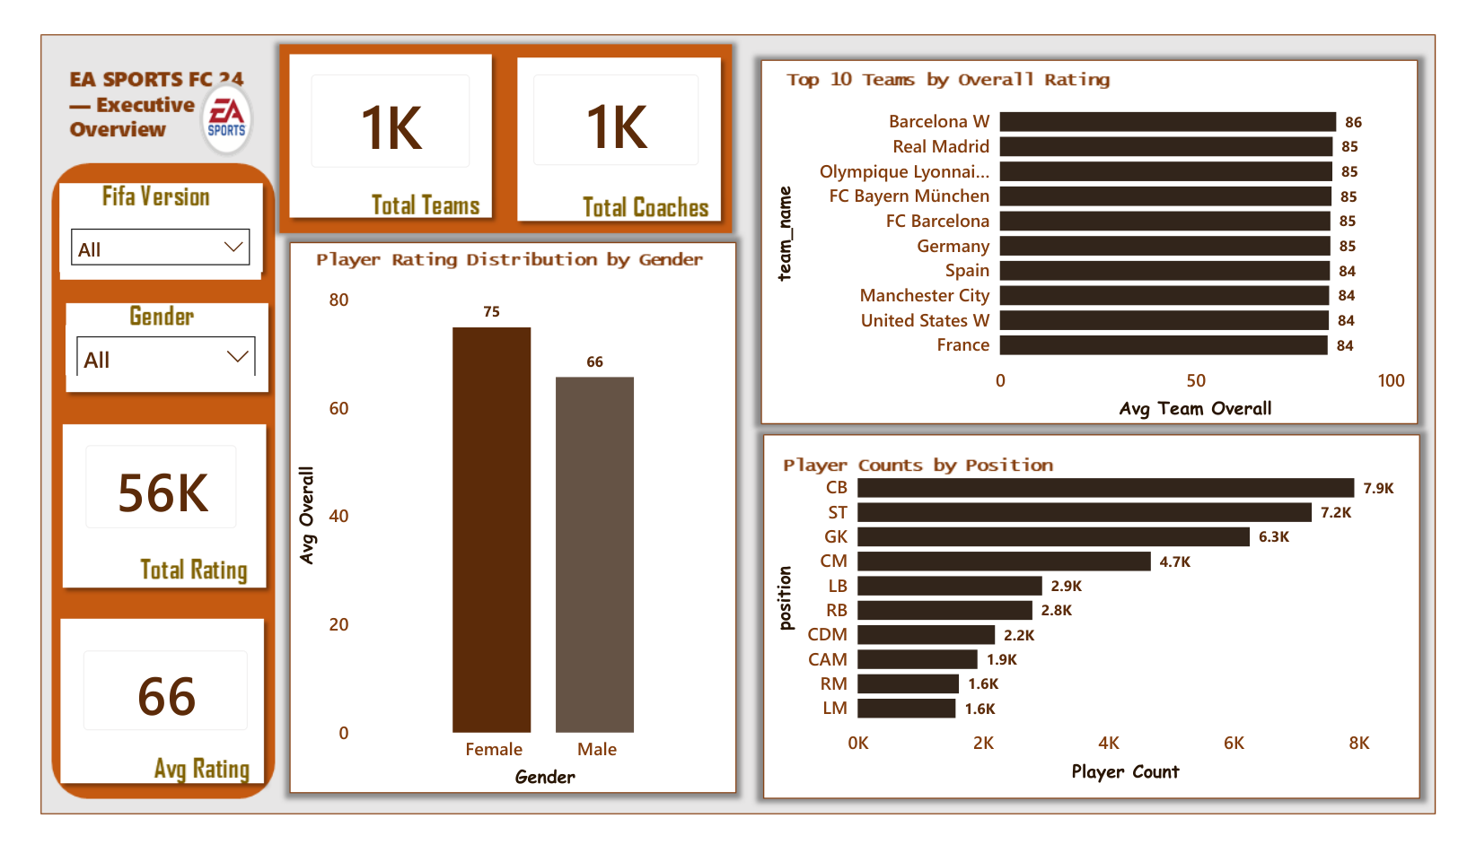
First look: the football dataset
Executive Overview — dashboard PDF page 2
56K
Displayed player count
66
Average overall rating
94
Highest overall rating
EA SPORTS FC | POWER BI ANALYTICS
08 / 18

Slide 9
Where are the player records concentrated?
The three largest position groups in the overview
Centre-back
7.9K
Striker
7.2K
Goalkeeper
6.3K
Central midfield
4.7K
Left-back
2.9K
≈21.4K records across CB, ST and GK
EA SPORTS FC | POWER BI ANALYTICS
09 / 18

Slide 10
Current ability versus potential
A five-point difference in displayed averages
66
71
+5
Average overall
Average potential
Rating-point gap
Potential adds context that overall rating alone cannot show.
This is an average difference, not a predicted five-point increase for every player.
EA SPORTS FC | POWER BI ANALYTICS
10 / 18

Slide 11
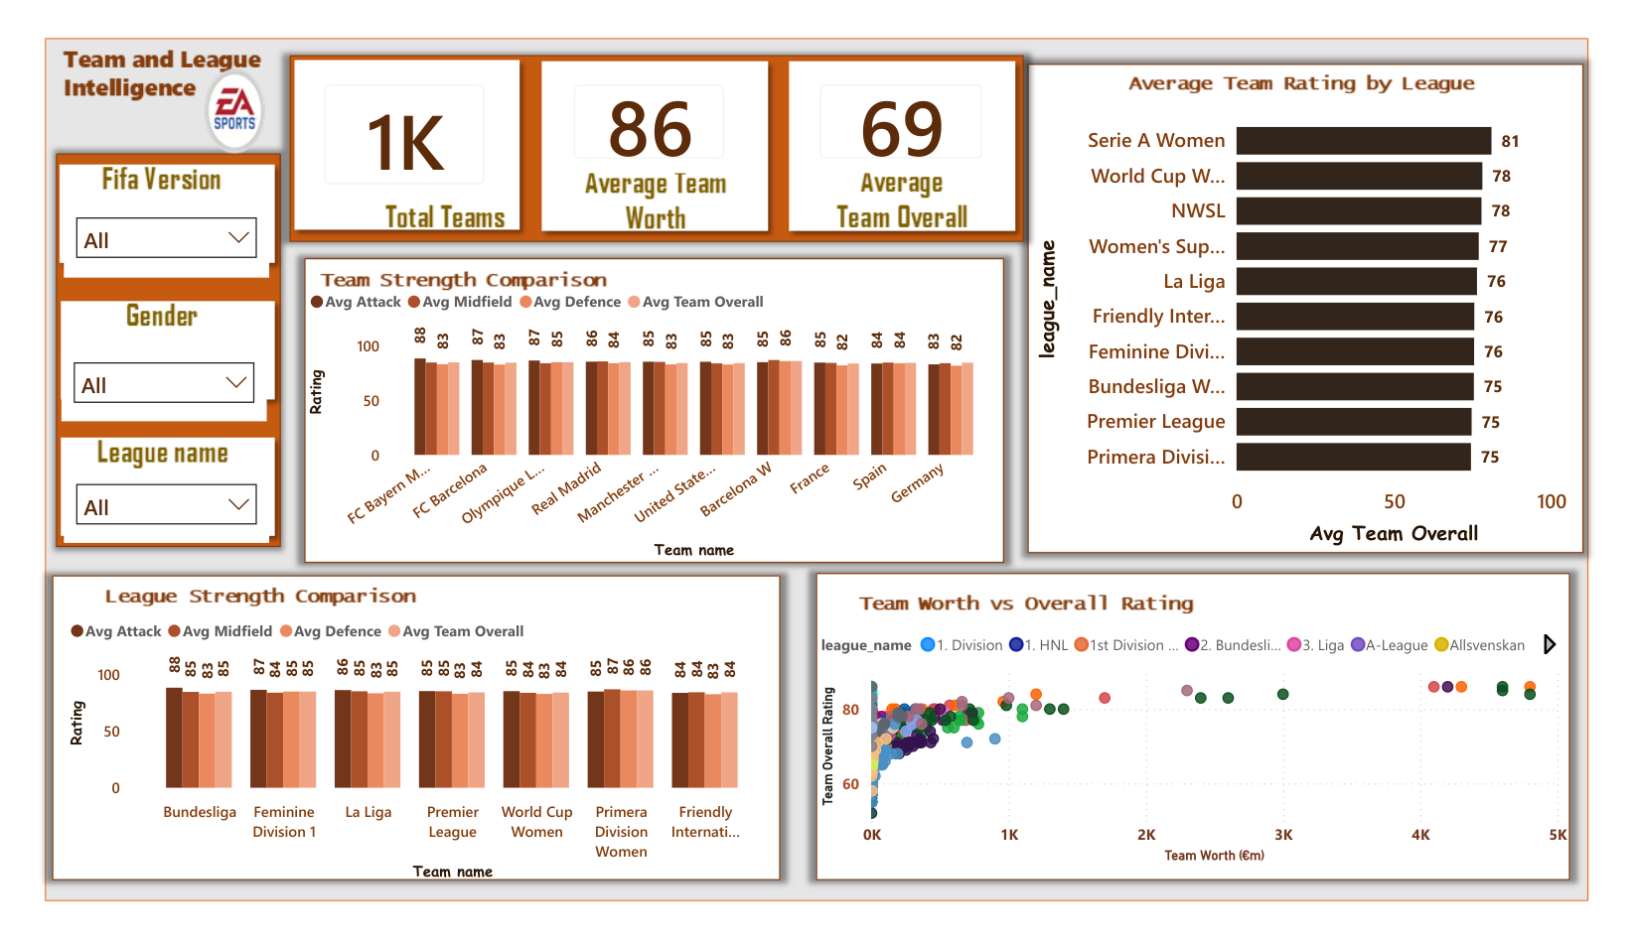
Strong teams have different strengths
Team and League Intelligence — PDF page 4
86
Barcelona W overall
85
Several leading teams
Attack, midfield and defense add context.
EA SPORTS FC | POWER BI ANALYTICS
11 / 18

Slide 12
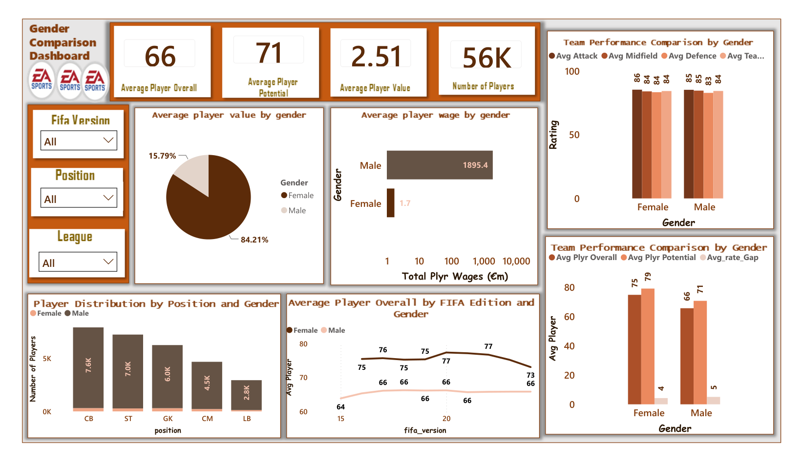
Comparisons depend on data coverage
Gender Comparison — PDF page 5
CHECK BEFORE
PRESENTING
Financial fields and FIFA-edition coverage differ across groups.
Do not interpret game wages as real-world pay.
Do not label the 84.21% / 15.79% pie as player counts until its metric is verified.
EA SPORTS FC | POWER BI ANALYTICS
12 / 18

Slide 13
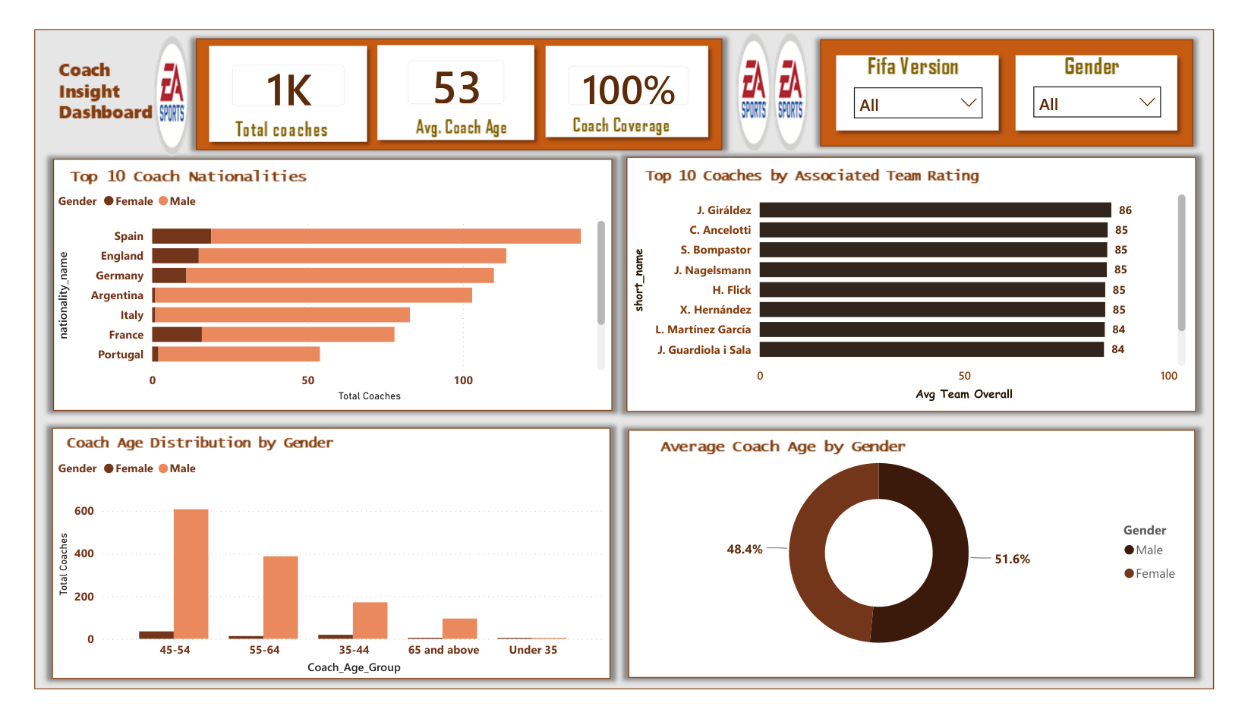
The people behind the teams
Coach Insight — PDF page 6
53
Average coach age
Age groups, nationalities and associated team ratings offer another angle on the data.
EA SPORTS FC | POWER BI ANALYTICS
13 / 18

Slide 14
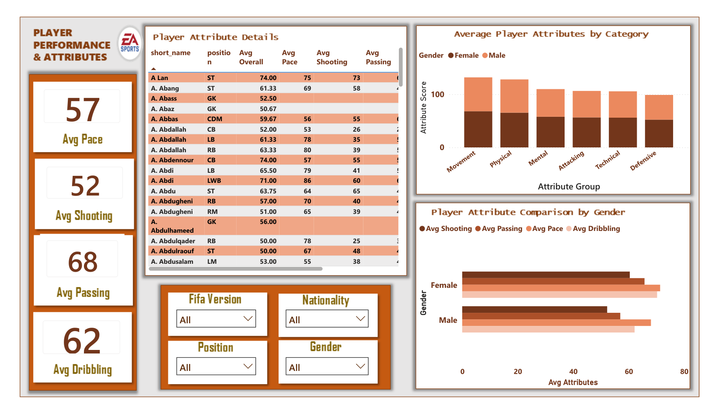
Overall ratings hide different skills
Player Performance & Attributes — PDF page 7
68
Passing
62
Dribbling
57
Pace
52
Shooting
Attribute averages may have different nonblank denominators; compare with care.
EA SPORTS FC | POWER BI ANALYTICS
14 / 18

Slide 15
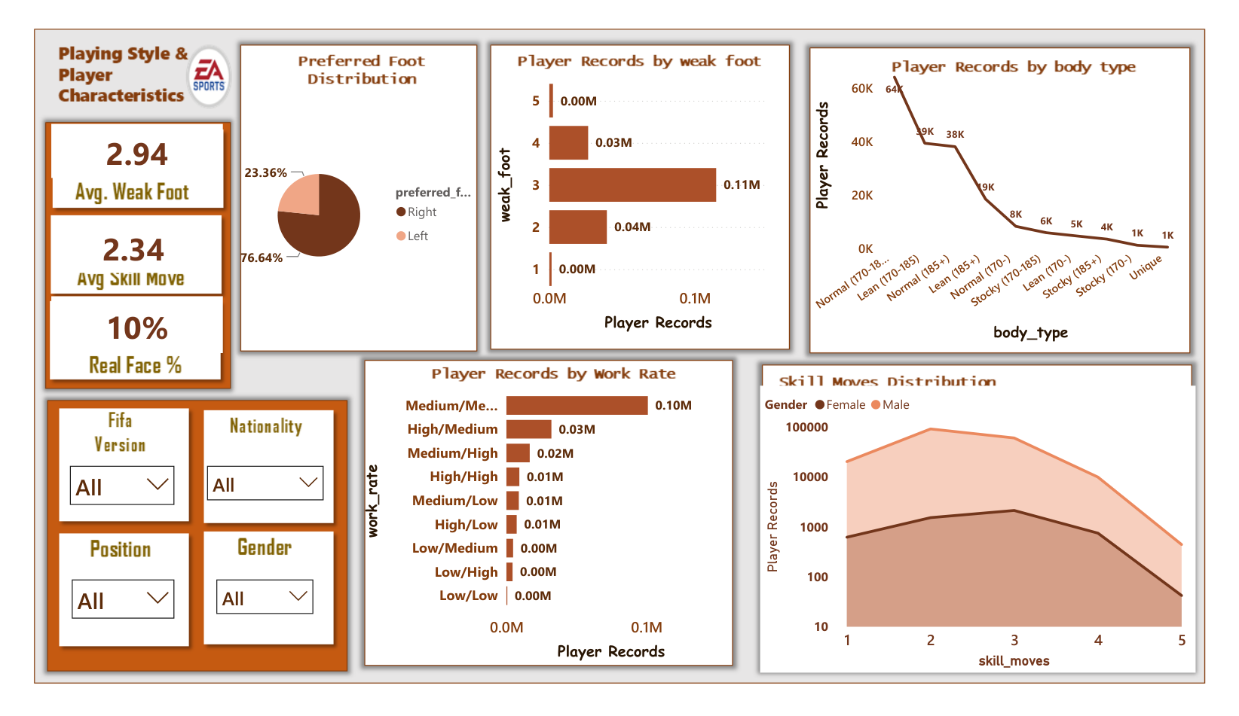
Right foot dominates the displayed records
Playing Style & Characteristics — PDF page 8
76.64%
Right-footed
23.36%
Left-footed
Weak foot: 2.94 | Skill moves: 2.34
EA SPORTS FC | POWER BI ANALYTICS
15 / 18

Slide 16
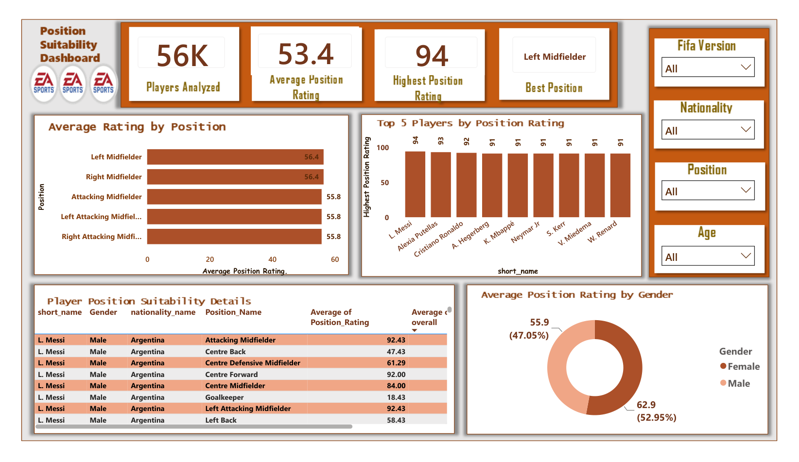
Position suitability changes the story
Position Suitability — PDF page 9
53.4
Average position rating
94
Highest position rating
LM and RM both display ≈56.4
EA SPORTS FC | POWER BI ANALYTICS
16 / 18

Slide 17
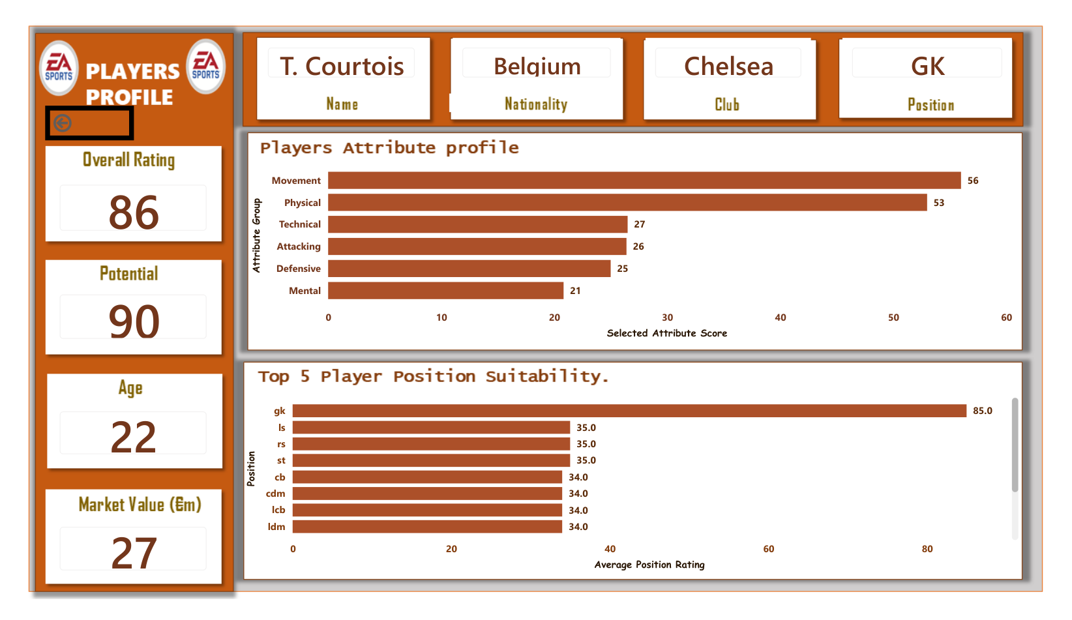
One player. A 51-point difference.
Courtois historical profile — PDF page 10
85
Goalkeeper rating
34
Centre-back rating
51
Point difference
EA SPORTS FC | POWER BI ANALYTICS
17 / 18

Slide 18
The biggest lesson: look beyond the number
What this project shows
• Context matters: ratings, potential and editions answer different questions
• Positions matter: the same player can be rated very differently by role
• Data quality matters: check missing values, filters and aggregations
• Power BI makes the patterns explorable — not automatically correct
A good dashboard does more than show numbers. It helps explain them.
Project sources: EA Sport Analytics 2.pdf. Add your GitHub and published Power BI links when available.
EA SPORTS FC | POWER BI ANALYTICS
18 / 18

