Slide 1

BEYOND
THE RATINGS
What 56K displayed football player records reveal about performance, potential and playing style
EA SPORTS FC • POWER BI CASE STUDY

Slide 2
Can one rating tell the whole story?
A surprising example from the player profile
85
34
51
Courtois: goalkeeper
Courtois: centre-back
Point difference
Same player. Very different position suitability.
This difference made me curious about how much a player's position influences their rating. It became one of the main questions behind my analysis.
EA SPORTS FC | POWER BI ANALYTICS
02 / 18

Slide 3
The question behind the project
Why explore beyond the overall score?
• Thousands of records across players, teams and coaches
• Multiple FIFA editions — the same player can appear repeatedly
• Different roles require different strengths
• Goal: move from headline ratings to meaningful comparisons
I wanted to go beyond identifying the highest-rated players and understand the differences in their abilities, potential, and playing styles.
EA SPORTS FC | POWER BI ANALYTICS
03 / 18

Slide 4
Six datasets. Three parts of football.
Source overview
PLAYERS
TEAMS
COACHES
Male + female
Ratings • potential • attributes
Male + female
Overall • attack • midfield • defense
Male + female
Age • nationality • team links
I brought these datasets together to explore football from different angles, while keeping track of gender and FIFA editions.
EA SPORTS FC | POWER BI ANALYTICS
04 / 18

Slide 5
How the data was prepared
01
02
03
04
Combine
Clean
Reshape
Connect
Male and female source tables
Check blanks and data types
Unpivot position rating columns
Use player + edition + gender keys
One of the important transformations was reshaping player position ratings. This made it possible to compare how suitable each player was for different positions.
EA SPORTS FC | POWER BI ANALYTICS
05 / 18

Slide 6
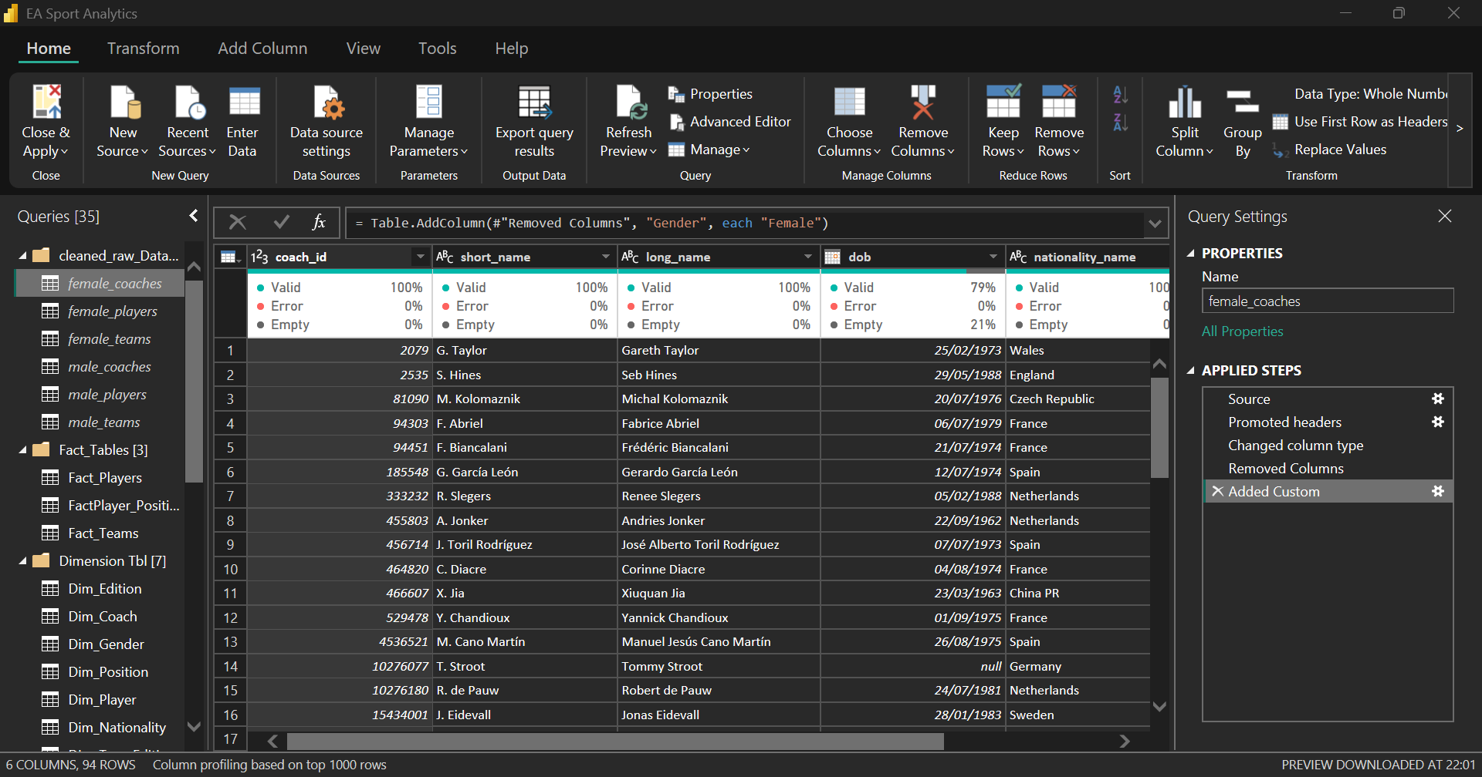

Slide 7
How the model connects the analysis
FactPlayer
Dimensions
FactPlayerPositions
→
→
Player-edition grain
Edition • gender • team
Player-position ratings
I structured the data to connect players, teams, editions, and position ratings, making it easier to filter and analyze related information.
EA SPORTS FC | POWER BI ANALYTICS
06 / 18

Slide 8
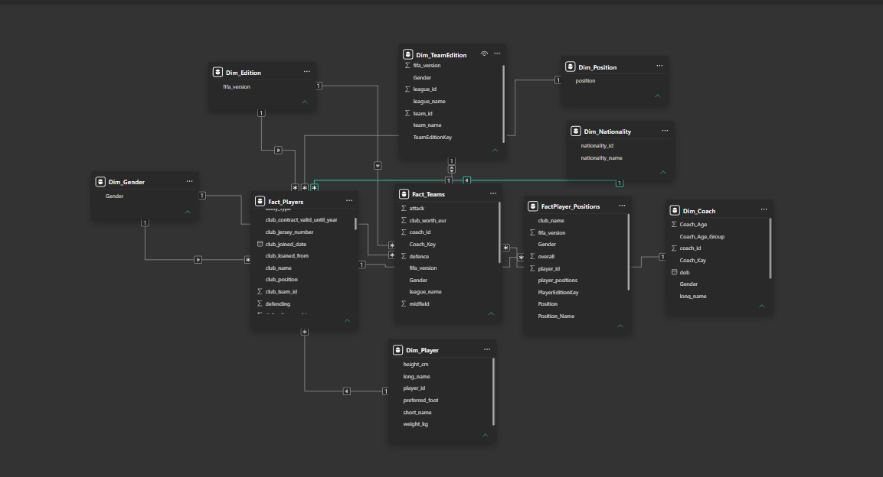

Slide 9
Turning raw values into dynamic KPIs
I used DAX measures to calculate the key statistics shown throughout the dashboard. These measures update when users interact with the report filters.
Average rating
AVERAGE(FactPlayer[overall])
Highest potential
MAX(FactPlayer[potential])
Position rating
AVERAGE(FactPlayerPositions[PositionRating])
EA SPORTS FC | POWER BI ANALYTICS
07 / 18

Slide 10
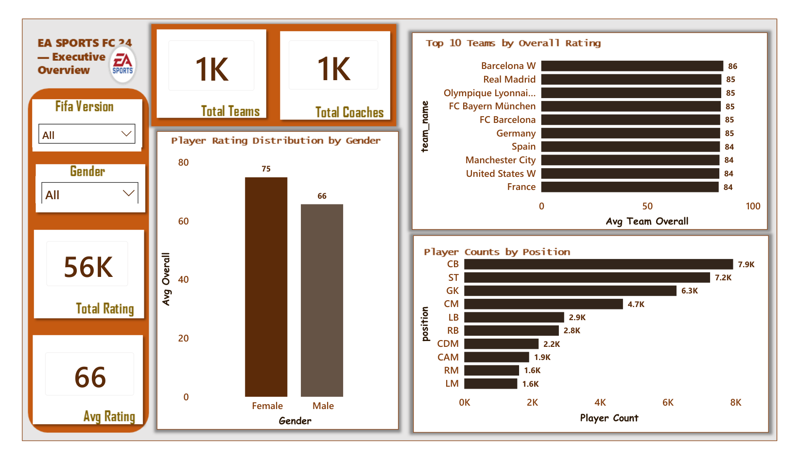
First look: the football dataset
56K
Displayed player count
66
Average overall rating
94
Highest overall rating
The dataset contains a wide range of player ratings. While the average overall rating is 66, the highest reaches 94, showing why I needed to explore the differences between players.
EA SPORTS FC | POWER BI ANALYTICS
08 / 18

Slide 11
Where are the player records concentrated?
The three largest position groups in the overview
Centre-back
7.9K
Striker
7.2K
Goalkeeper
6.3K
Central midfield
4.7K
Left-back
2.9K
Centre-backs, strikers, and goalkeepers account for approximately 21,400 displayed records. This showed me why playing position matters when comparing football attributes.
EA SPORTS FC | POWER BI ANALYTICS
09 / 18

Slide 12
Current ability versus potential
A five-point difference in displayed averages
66
71
+5
Average overall
Average potential
Rating-point gap
Potential adds context that overall rating alone cannot show.
The average potential rating is five points higher than the average overall rating. This suggests that the game data generally identifies room for player development.
This is an average difference, not a predicted five-point increase for every player.
EA SPORTS FC | POWER BI ANALYTICS
10 / 18

Slide 13
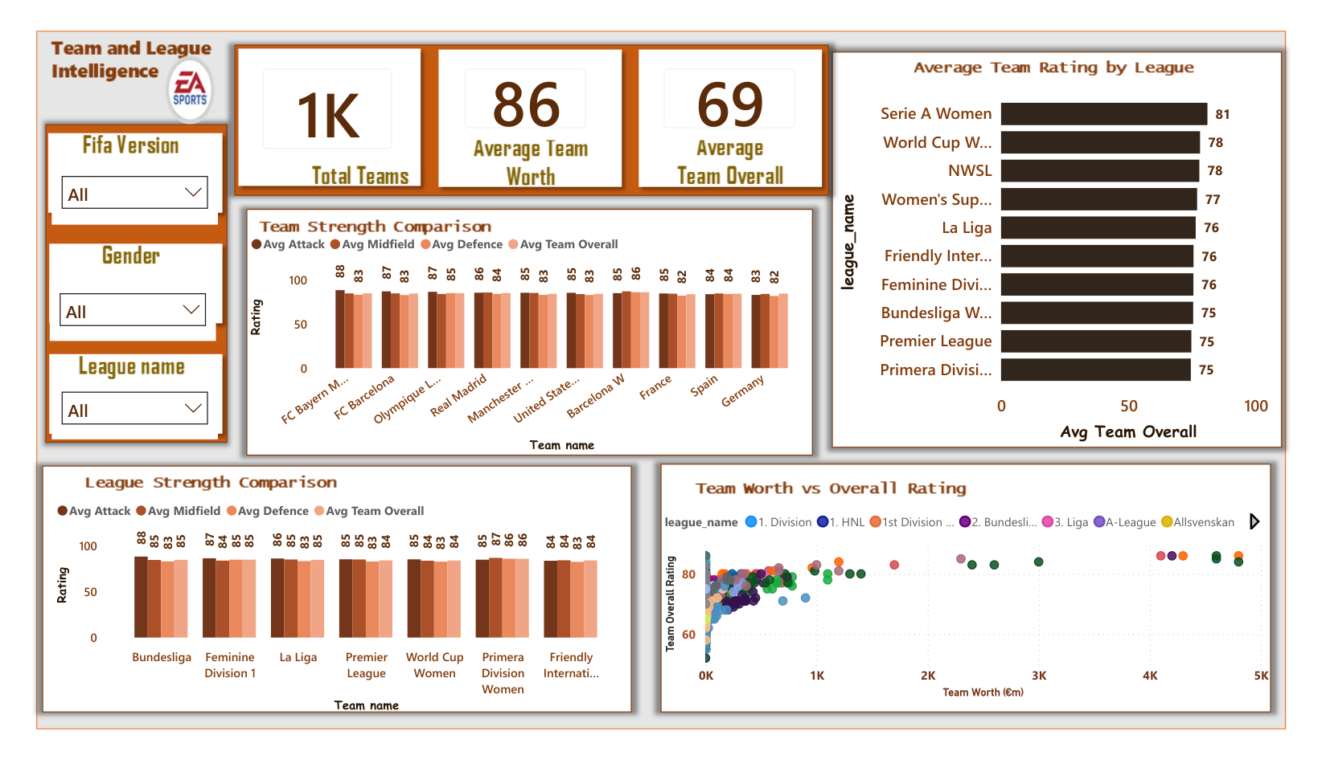
Strong teams have different strengths
86
Barcelona W overall
85
Several leading teams
Attack, midfield and defense add context.
Barcelona W leads the displayed ranking with an average rating of 86. But I found that comparing attack, midfield, and defence provides more context than looking at overall team ratings alone.
EA SPORTS FC | POWER BI ANALYTICS
11 / 18

Slide 14
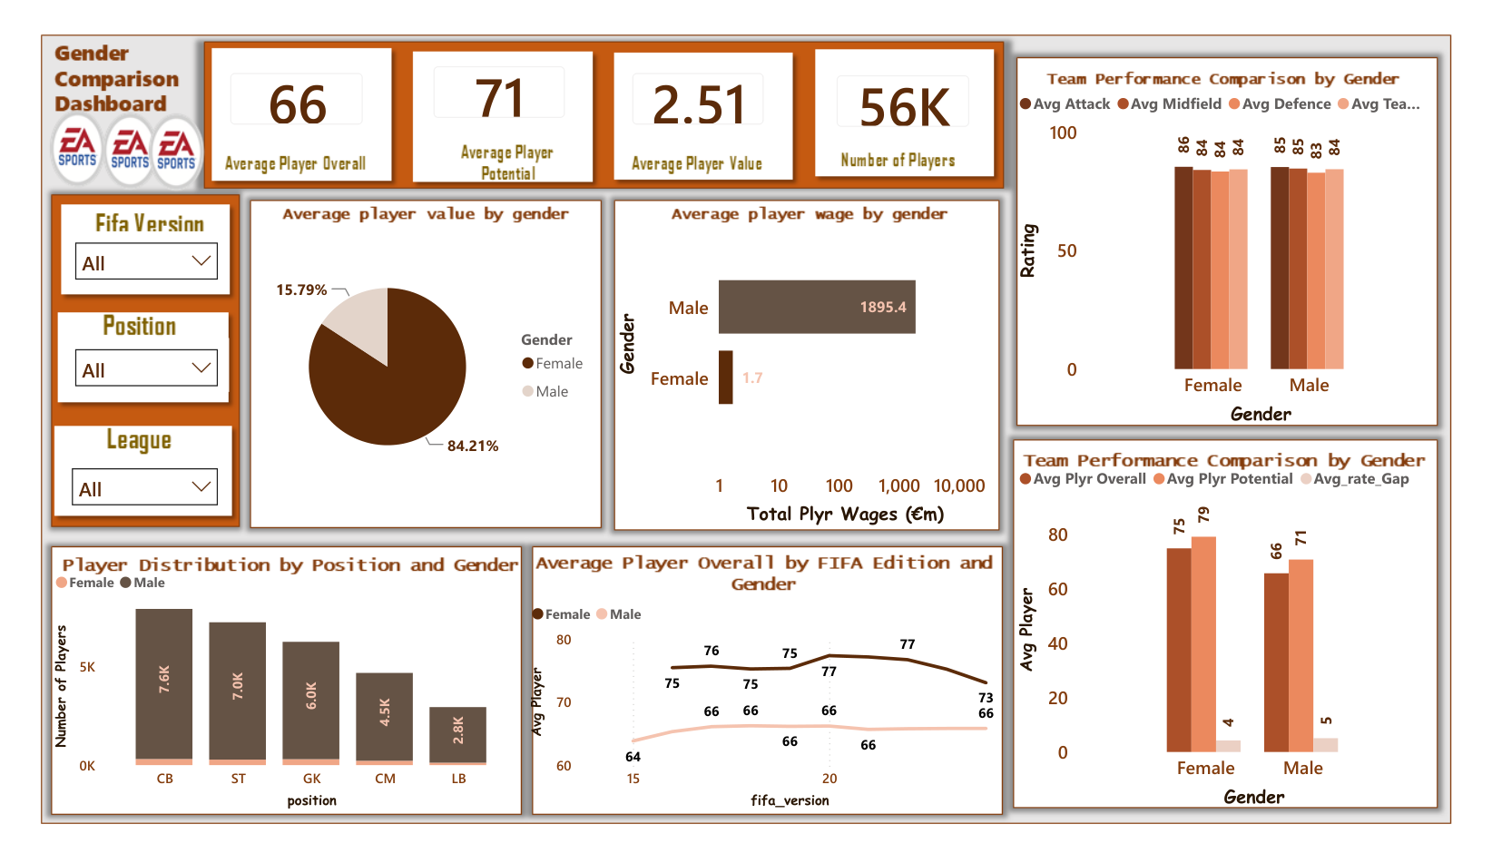
Comparisons depend on data coverage
Gender Comparison
One challenge I noticed was that male and female player records did not have equal coverage across FIFA editions. This meant I had to be careful when interpreting financial comparisons and missing values.
Keep the existing warning about the 84.21% and 15.79% pie chart until its measure is verified.
EA SPORTS FC | POWER BI ANALYTICS
12 / 18

Slide 15
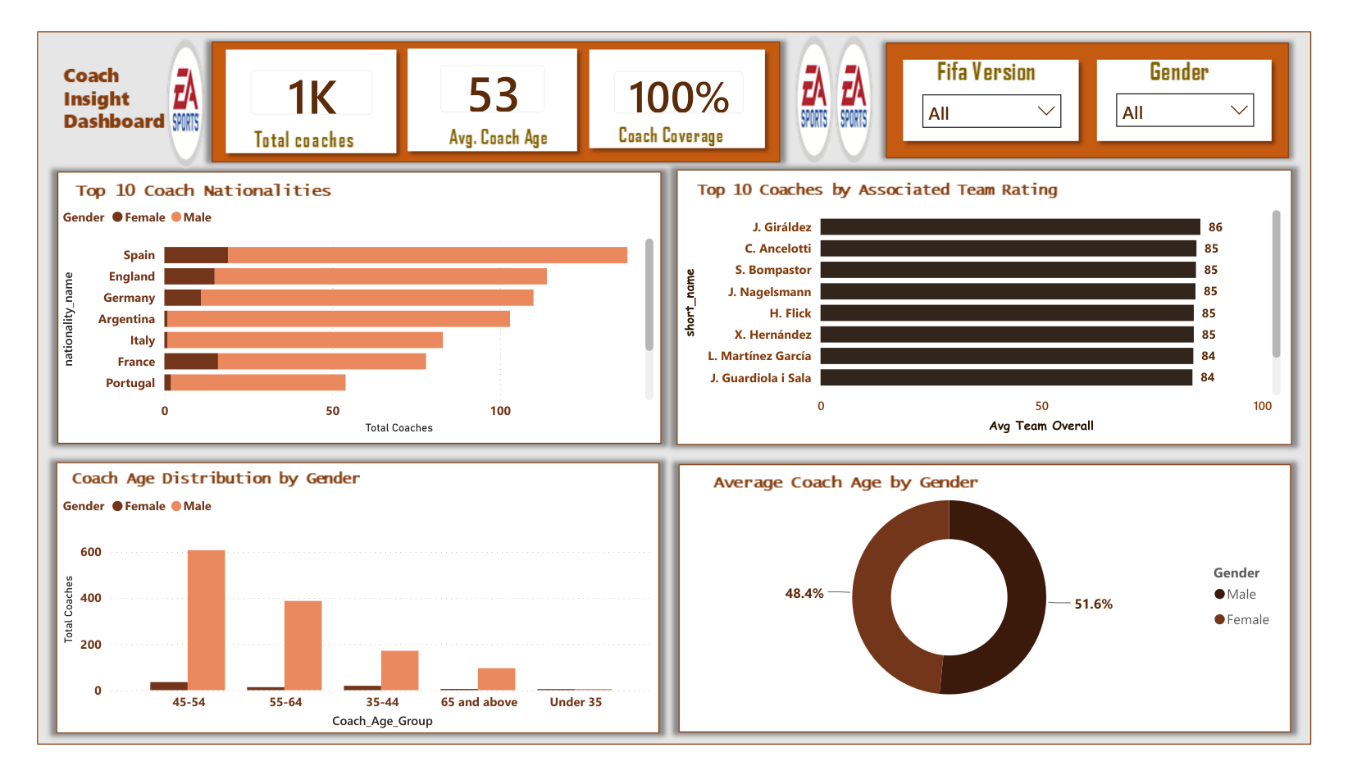
The average coach age in the displayed data is 53. I also explored coach nationalities and age groups to understand another part of the football dataset beyond player performance.
The people behind the teams
Coach Insight
53
Average coach age
Age groups, nationalities and associated team ratings offer another angle on the data.
EA SPORTS FC | POWER BI ANALYTICS
13 / 18

Slide 16
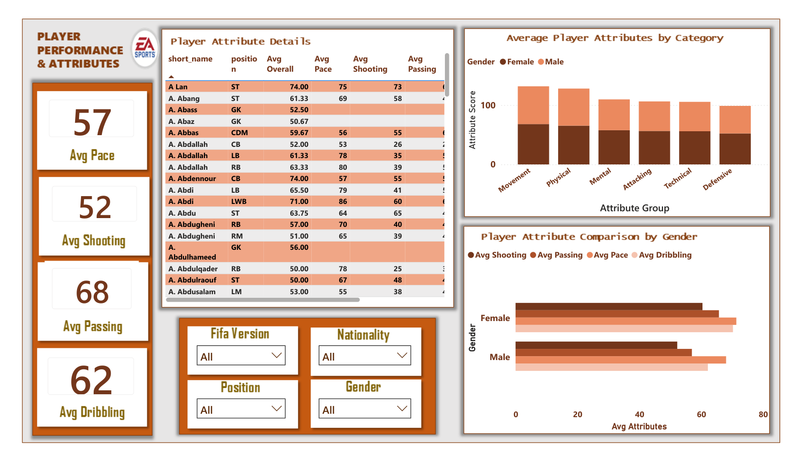
Passing has the highest displayed average among these four attributes, at 68, while shooting is 52. This helped me see why detailed skills are important when comparing players.
Overall ratings hide different skills
Player Performance & Attributes
68
Passing
62
Dribbling
57
Pace
52
Shooting
Attribute averages may have different nonblank denominators; compare with care.
EA SPORTS FC | POWER BI ANALYTICS
14 / 18

Slide 17
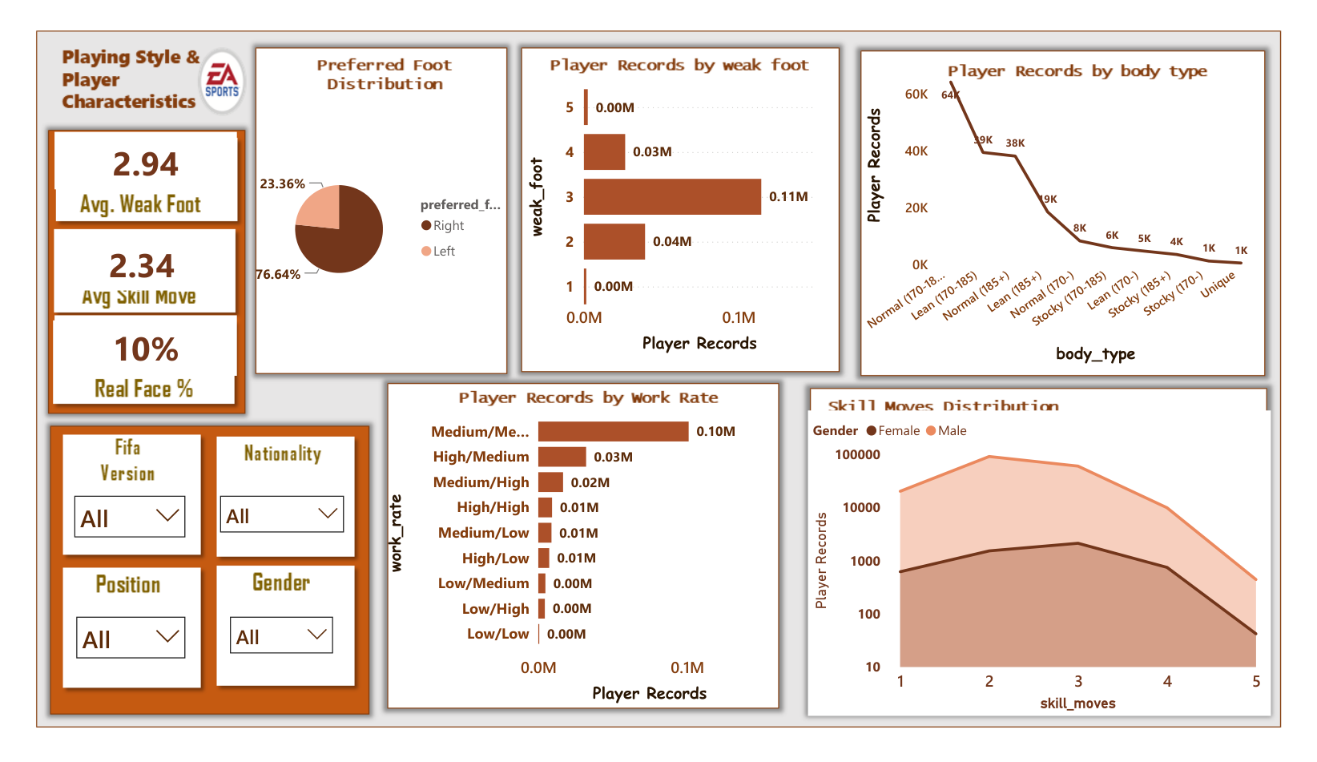
I found that approximately three out of every four displayed player records were right-footed. The weak-foot and skill-move ratings revealed additional differences in playing characteristics.
Right foot dominates the displayed records
Playing Style & Characteristics
76.64%
Right-footed
23.36%
Left-footed
Weak foot: 2.94 | Skill moves: 2.34
EA SPORTS FC | POWER BI ANALYTICS
15 / 18

Slide 18
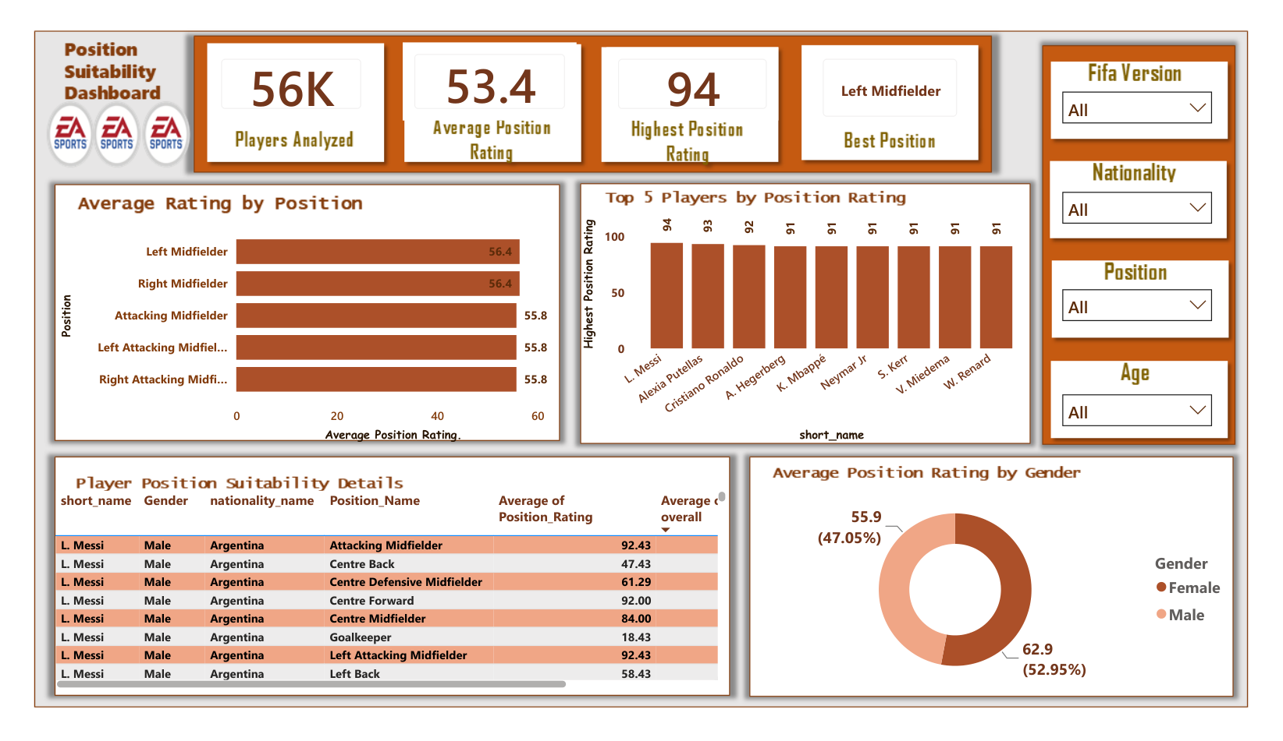
The average position suitability rating is 53.4, but the ratings vary across playing roles. This made me want to examine how one player's ratings change between positions.
Position suitability changes the story
Position Suitability
53.4
Average position rating
94
Highest position rating
LM and RM both display ≈56.4
EA SPORTS FC | POWER BI ANALYTICS
16 / 18

Slide 19
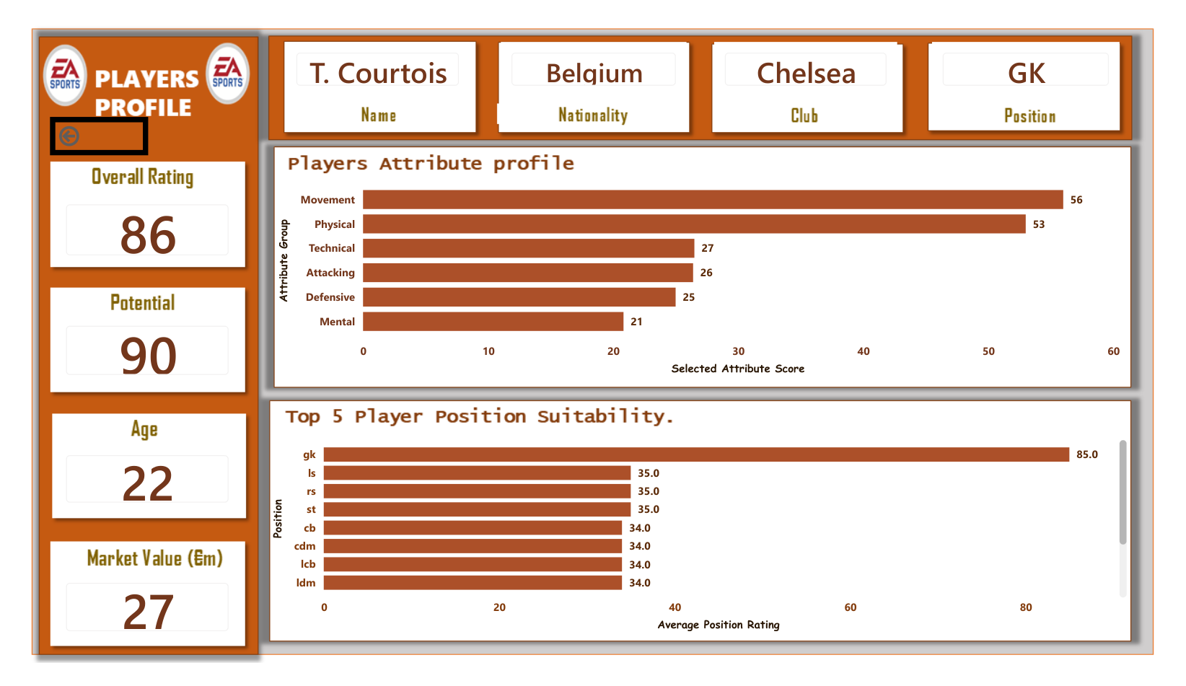
Courtois has a goalkeeper suitability rating of 85 and a centre-back rating of 34 in the displayed historical record. This was the clearest example of why overall ratings alone cannot explain a player's strengths.
One player. A 51-point difference.
Courtois historical profile
85
Goalkeeper rating
34
Centre-back rating
51
Point difference
EA SPORTS FC | POWER BI ANALYTICS
17 / 18

Slide 20
The biggest lesson: look beyond the number
What this project shows
• Context matters: ratings, potential and editions answer different questions
• Positions matter: the same player can be rated very differently by role
• Data quality matters: check missing values, filters and aggregations
• Power BI makes the patterns explorable — not automatically correct
This project taught me that good data analysis isn't just about finding the highest numbers. It's about understanding what those numbers represent, how they were calculated, and the story they tell.
A good dashboard does more than show numbers. It helps explain them.
EA SPORTS FC | POWER BI ANALYTICS
18 / 18

