Slide 1
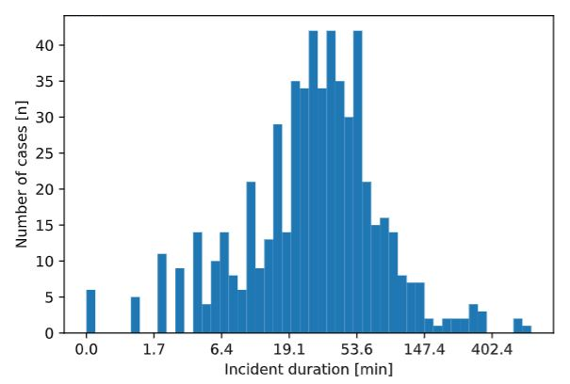
All traffic incidents
Features: Hour of day Incident Subtype Incident Reporting Source Affected Lanes
…
Train set
Test set
Generate hyper-parameters for the model and ORM
Random Search cycle
ORM
ORM
Best combination of ORM and model hyper-parameters
Cross-validation cycle
Regression
model
Regression
model
Cross-validation score
Test score

Slide 2
All traffic incidents
Features: Hour of day Incident Subtype Incident Reporting Source Affected Lanes
…
Train set
Test set
Generate hyper-parameters for the model and ORM
Random Search cycle
ORM
ORM
Best combination of ORM and model hyper-parameters
Regression
model
Regression
model
Cross-validation cycle
Cross-validation score
Test score

Slide 3
All traffic incidents
Features: Hour of day Incident Subtype Incident Reporting Source Affected Lanes
…
Train set
Test set
a)
Generate hyper-parameters for the model and ORM
b)
Generate hyper-parameters for the model and ORM
ORM
ORM
ORM
Best combination of ORM and model hyper-parameters
Cross-validation cycle
Regression
model
Regression
model
Regression
model
Cross-validation cycle
Random Search cycle
Random Search cycle
Cross-validation score
Cross-validation score
Test score

