Slide 1
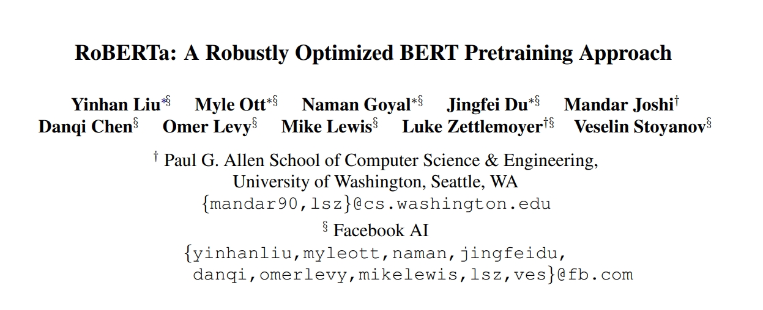
Notes:
FACEBOOK 做的 AI
使用Pytorch
看要不要補一個1分鐘BERT介紹

Slide 2
Abstract
本篇論文在做的事情: 重新train 一個 優化版的Bert
相關資料: a replication study of BERT pretraining (Devlin et al. , 2019) that carefully measures the impact of many key hyperparameters and training data size
緣起: BERT was significantly undertrained, and can match or exceed the performance of every model published after it
重點及目標: hyperparameter choices have significant impact on the final results
評分標準: GLUE, RACE and SQuAD
結果: highlight the importance of previously overlooked design choices, and raise questions about the source of recently reported improvements
Notes:
大意: 重新train 一個 優化版的Bert
相關資料: a replication study of BERT pretraining (Devlin et al. , 2019) that carefully measures the impact of many key hyperparameters and training data size
緣起: BERT was significantly undertrained, and can match or exceed the performance of every model published after it
重點及目標: hyperparameter choices have significant impact on the final results
評分標準: GLUE, RACE and SQuAD
結果: highlight the importance of previously overlooked design choices, and raise questions about the source of recently reported improvements

Slide 3
Background
1.Architecture
2.Training Objectives
3.Optimization
4.Data

Slide 4
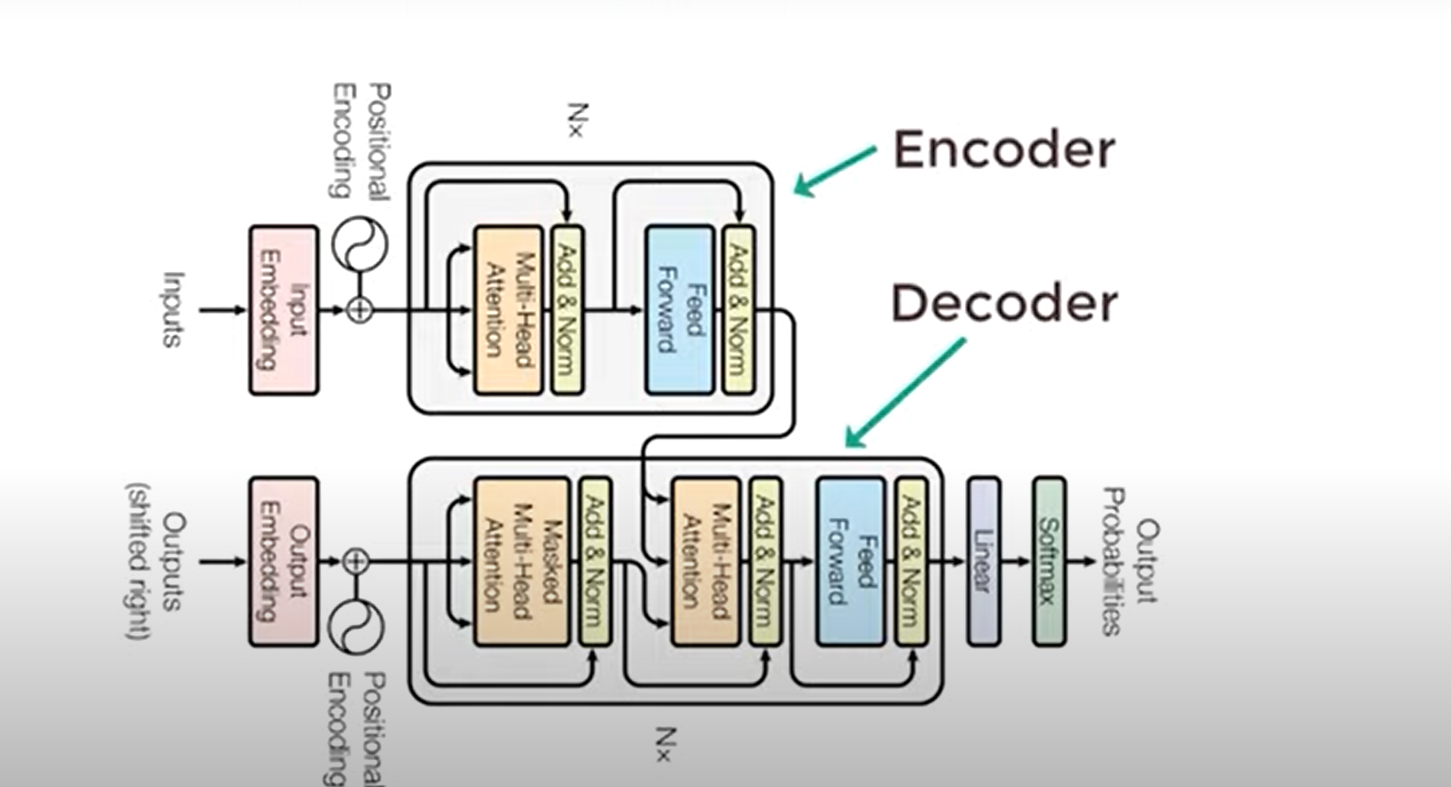
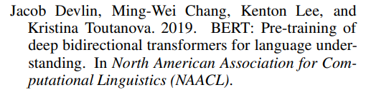
Architecture
Notes:
TRANSFORMER 來源 : 右下角

Slide 5
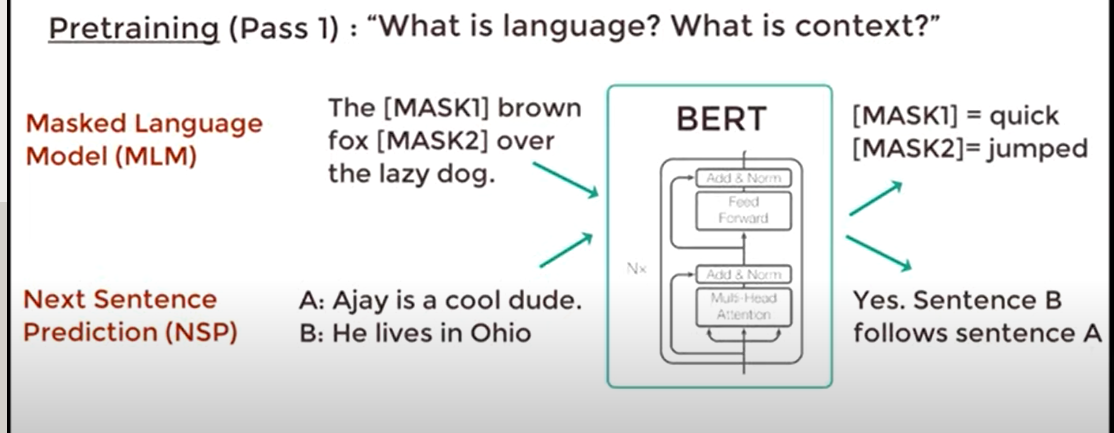
Training Objectives

Slide 6


Optimization
Optimizer: Adam
Activation Function: GELU

Slide 7

Data
BOOKCORPUS (Zhu et al., 2015) plus English WIKIPEDIA, which totals 16GB of uncompressed text

Slide 8
Tranining Procedure Analysis
static vs dynamic masking
Input format and next sentence prediction
Training with large batches
Text Encoding (Byte-Pair Encoding(BPE) )
Notes:
快速解釋四種方法優劣

Slide 9
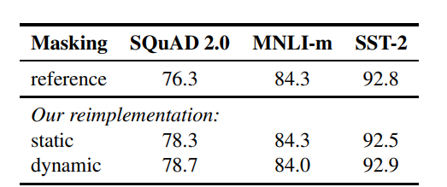
static vs dynamic masking
Notes:
簡單來說，就是training的時候，到底是用masking固定的句子中 word的位置，還是 隨機變換的
dynamic tasking actually much more useful

Slide 10
Model Input Format and Next Sentence Prediction
NSP: Next Sentence Prediction Loss
1.SEGMENT-PAIR+NSP (用片段TRAIN)使用NSP LOSS
2.SENTENCE-PAIR+NSP (用句子TRAIN)使用NSP LOSS
3.FULL-SENTENCES不使用NSP LOSS
4.DOC-SENTENCES不使用NSP LOSS
Notes:
重點，選或不選NSP
FULL SENTENCE 隨機取 橫跨文章的
DOC-SENTENCE 選取不跨文章的
SEGMENT-PAIR+NSP (用片段TRAIN)
Each input has a pair of segments(which can each contain multiple natural sentences), total combined length must be less than 512 tokens. 使用NSP LOSS
SENTENCE-PAIR+NSP (用句子TRAIN)使用NSP LOSS
Each input contains a pair of natural sentences, either sampled from a contiguous portion of one document or from separate documents.FULL-SENTENCES:
有跨DOCUMENT BOUNADRIES 不使用NSP LOSS
DOC-SENTENCES :
沒有跨DOCUMENT BOUNDAIRES 不使用NSP LOSS
以上四種方式的結論: REMOVE NLP Loss會對你表現比較好

Slide 11
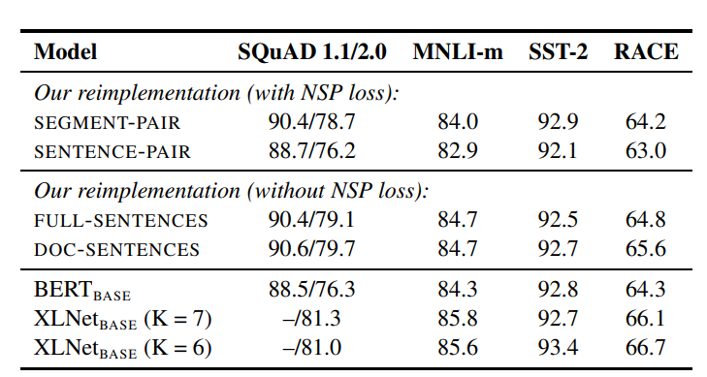

Slide 12
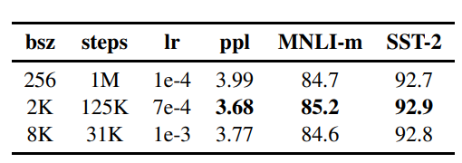
Training with large batches
Notes:
Bert BASE 的模型調整

Slide 13
Text Encoding (Byte-Pair Encoding(BPE) )
Subword Tokenization: Byte Pair Encoding – YouTube
[1909.03341] Neural Machine Translation with Byte-Level Subwords (arxiv.org)
Notes:
需要介紹一下技術

Slide 14

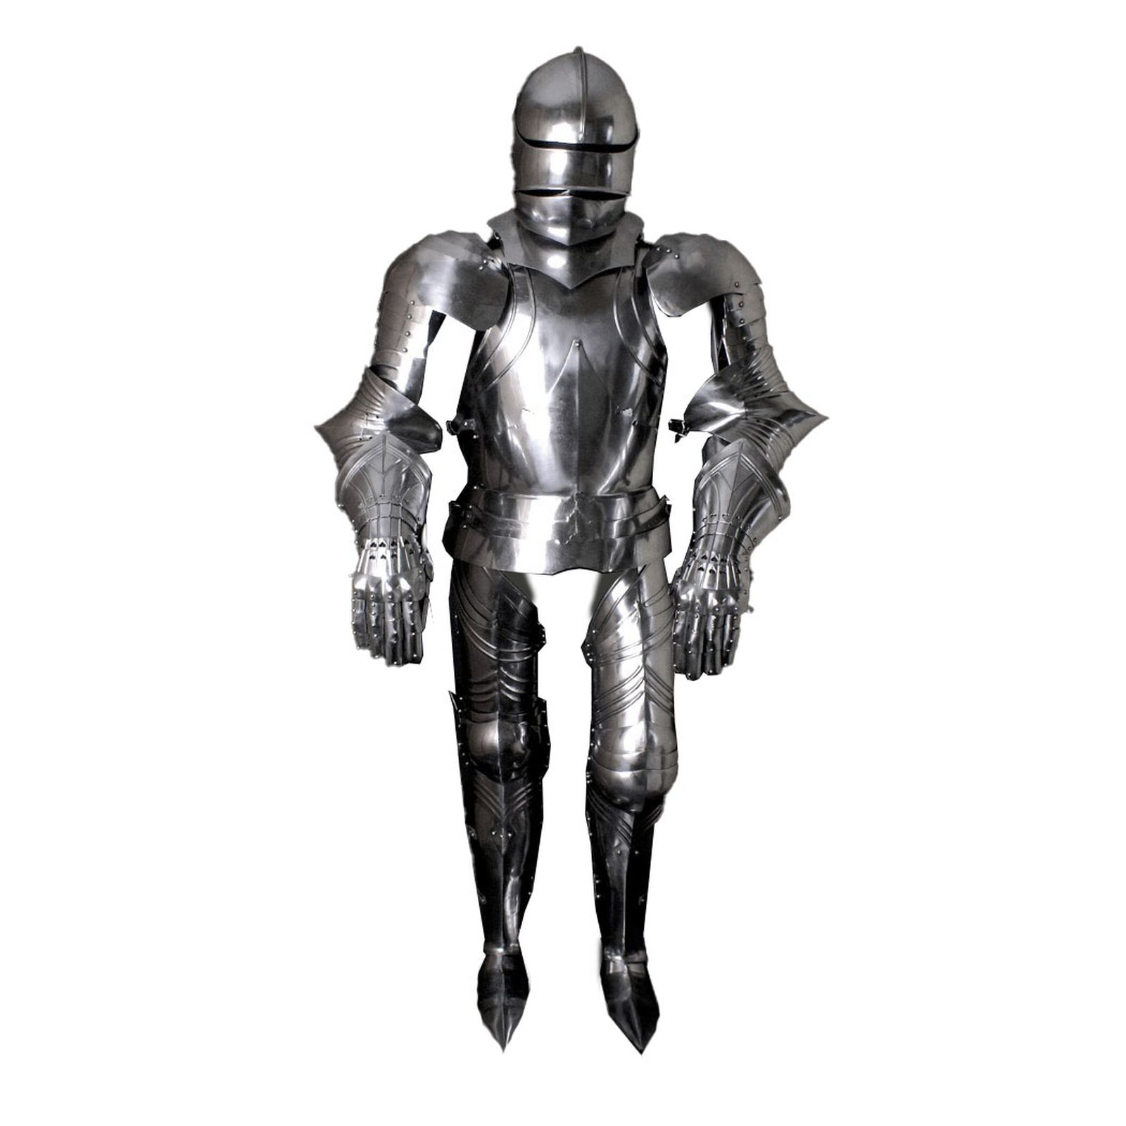

RoBERTa

Slide 15
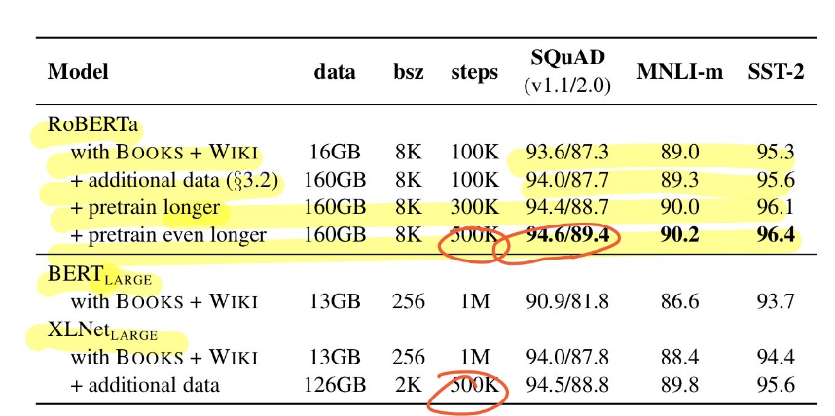
Overall Result
Notes:
這裡需要補充XL NET 是甚麼 MAYBE 花30秒 ~ 1分鐘
XL NET 使用Transformer-XL

Slide 16
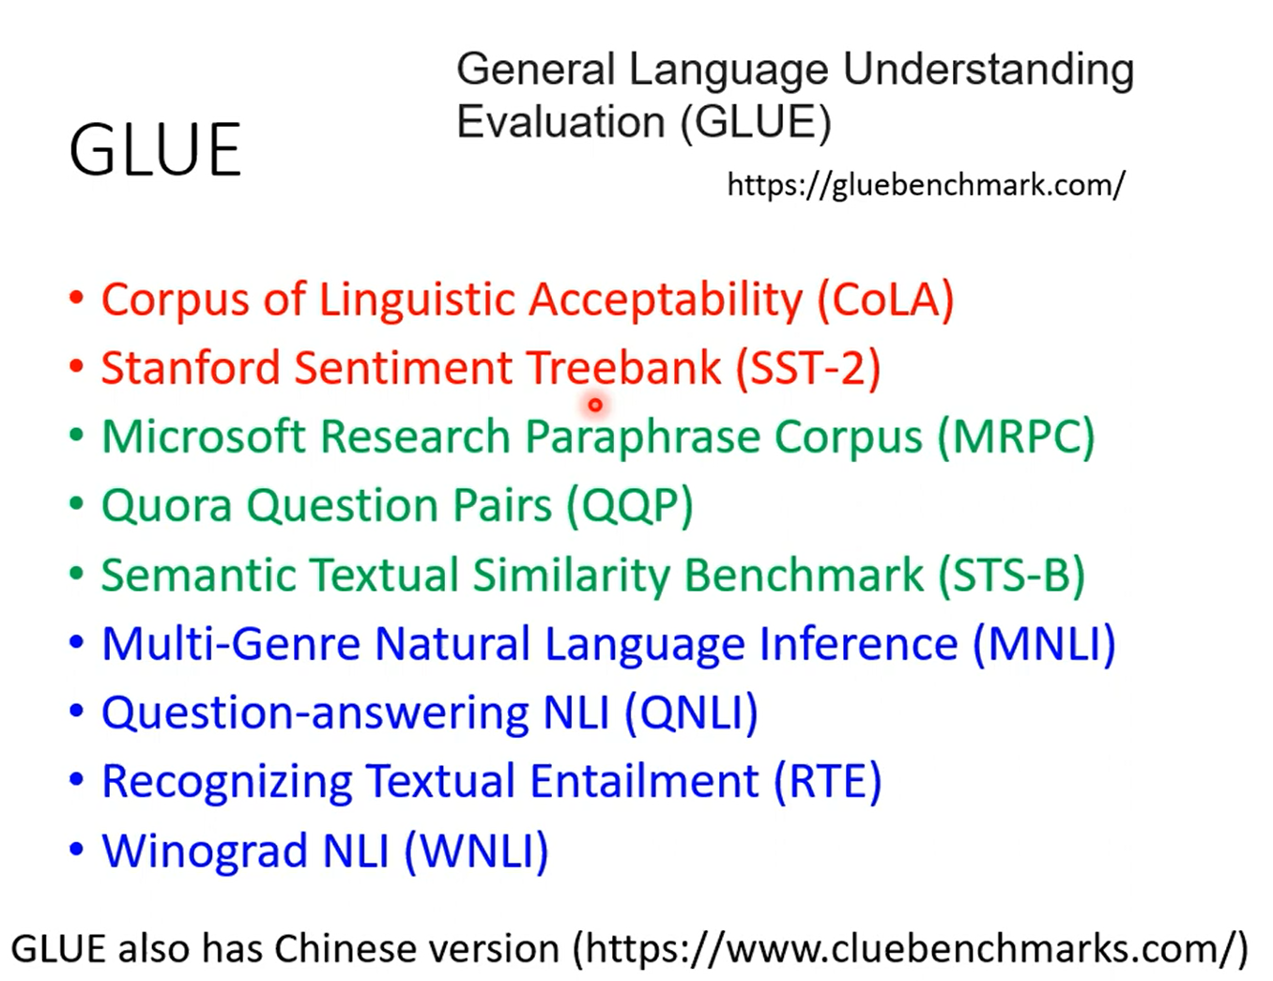

Slide 17
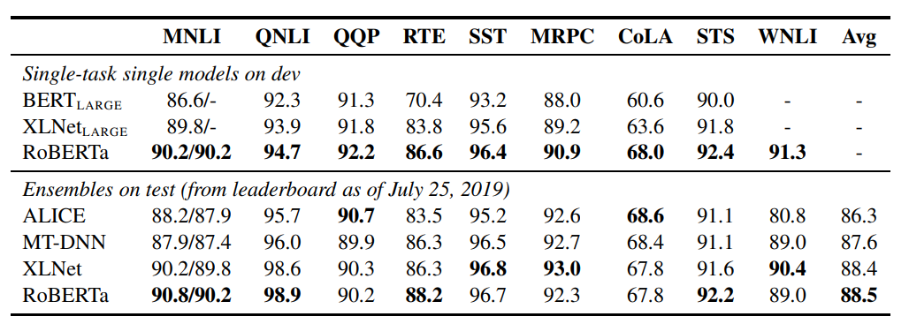
Glue Result

Slide 18
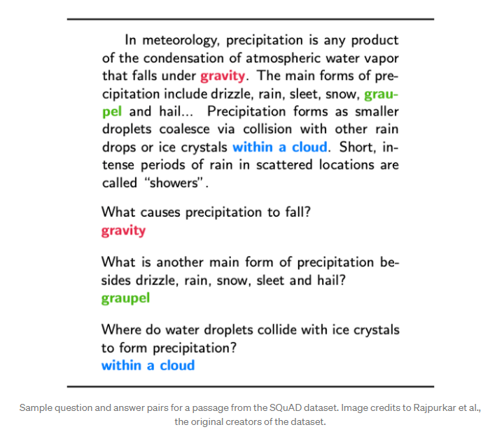
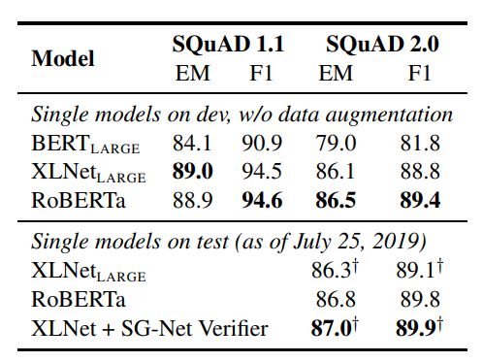
SQuAD Introduction and Result
Notes:
a set of question and answer pairs that present a strong challenge for NLP models.
是簡答題

Slide 19
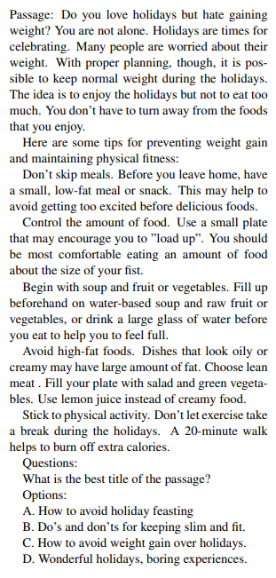
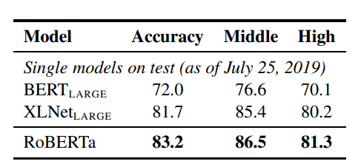
RACE Introduction and Result
ReAding Comprehension Dataset From Examinations
Notes:
是選擇題拉
這裡有PAPER FROM CMU: [1704.04683] RACE: Large-scale ReAding Comprehension Dataset From Examinations (arxiv.org)

