Slide 1

G2M Case Study
Virtual Internship LISUM03
ILYAS NAYLE
05-Sep-2021

Slide 2
Background –G2M(cab industry) case study
XYZ is a private firm in US. Due to remarkable growth in the Cab Industry in last few years and multiple key players in the market, it is planning for an investment in Cab industry and as per their Go-to-Market(G2M) strategy they want to understand the market before taking final decision.

Slide 3
Data Description
Data Set: 4 individual data sets. Time period of data is from 31/01/2016 to 31/12/2018. Below are the Data sets information.
Cab_Data.csv – this file includes details of transaction for 2 cab companies
Customer_ID.csv – this is a mapping table that contains a unique identifier which links the customer’s demographic details
Transaction_ID.csv – this is a mapping table that contains transaction to customer mapping and payment mode
City.csv – this file contains list of US cities, their population and number of cab users
Total data points: 359392

Slide 4
EDA (EXPLORATORY DATA ANALYSIS)

Slide 5
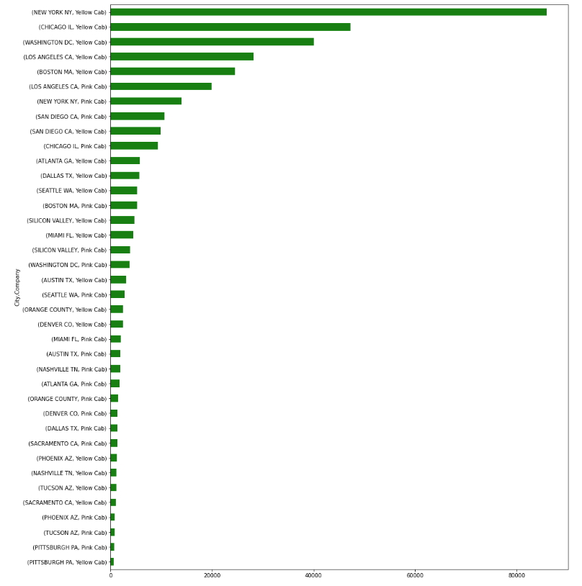
Cab Analysis
From the graph we can see that there are more YELLOW CABs than the PINK CABs and NEW YORK city has more YELLOW CABS and PETISBURG has the less PINK CABs

Slide 6
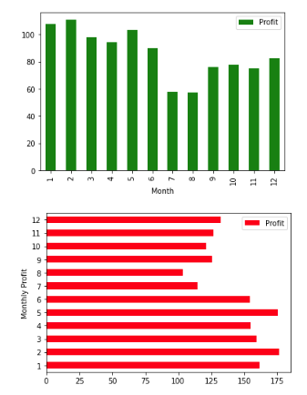
Monthly profits
Profit is higher in the beginning of a month. And the highest profit is in the 2nd and 5th month because people tend to travel larger distance and therefore there is more profit.

Slide 7
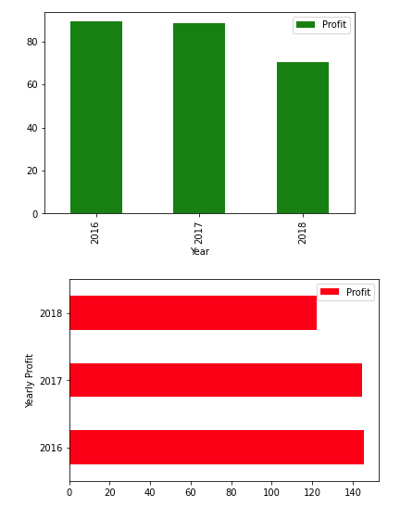
Yearly Profit
In 2018 price charged was less than 2017 and 2016.

Slide 8
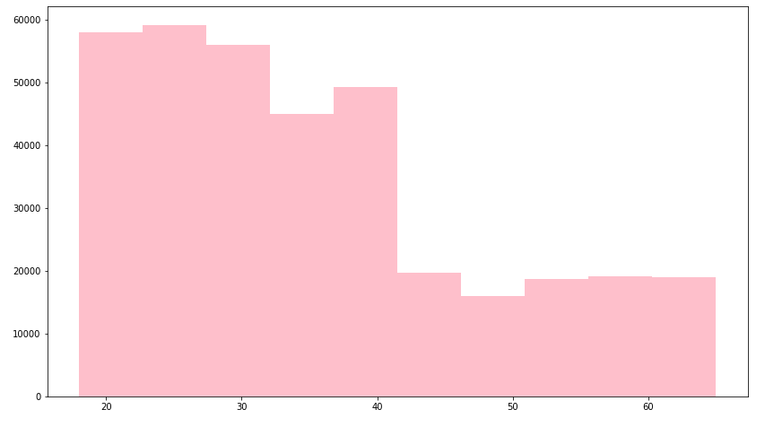
AGE
Most of the users are between the age 20 – 40 years old and the less are between 45 – 52 years old

Slide 9
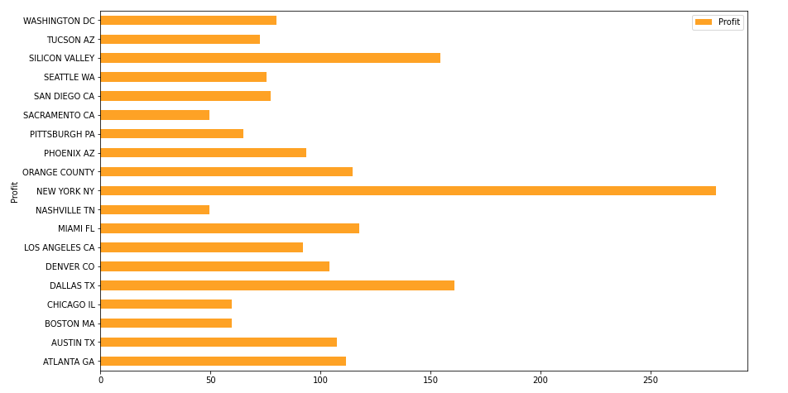
Cities with highest profit
The cities NEW YORK NY, DALLAS TX, SILICON VALLEY and MIAMI FL are the top cities with the highest profit

Slide 10
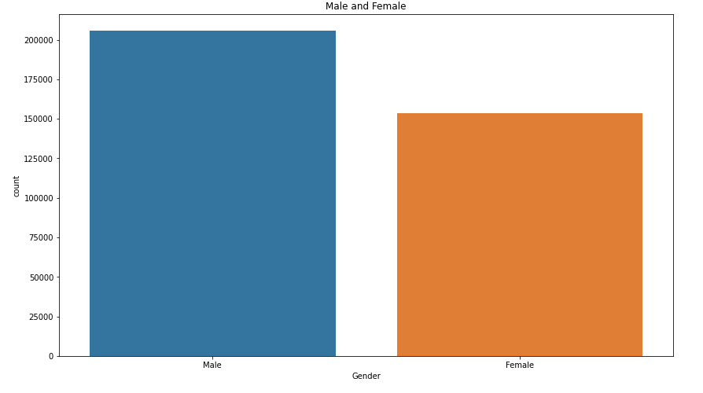
Gender Analysis
There are more male users than female users

Slide 11
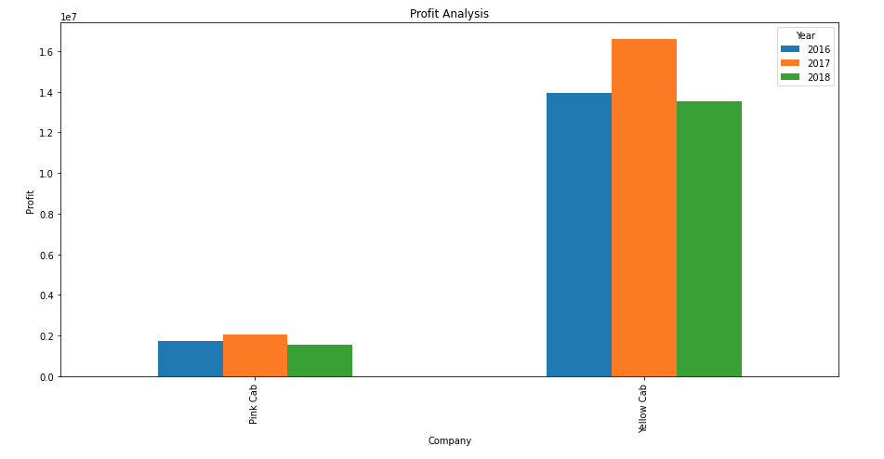
Preferred Cab Company
Pink cabs are used less than Yellow cab and in the year 2017 Yellow cabs were used the most.

Slide 12
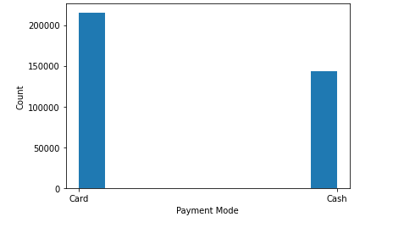
Payment
Payment by card is used most than cash

Slide 13
Hypothesis

Slide 14
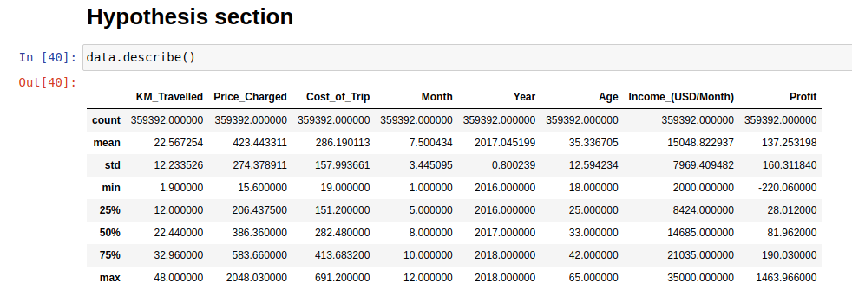
Data Description

Slide 15
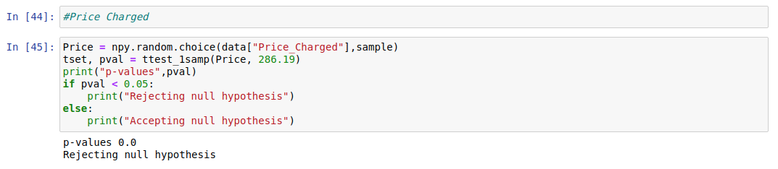
Price Charged
Since p-value is less than 0.05 and it is 0.0 therefore we are rejecting the null hypothesis

Slide 16
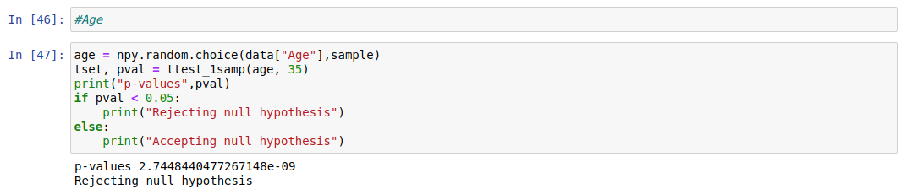
Age
Since p-value is less than 0.05 and it is 2.7448440477267148 therefore we are rejecting null hypothesis

Slide 17
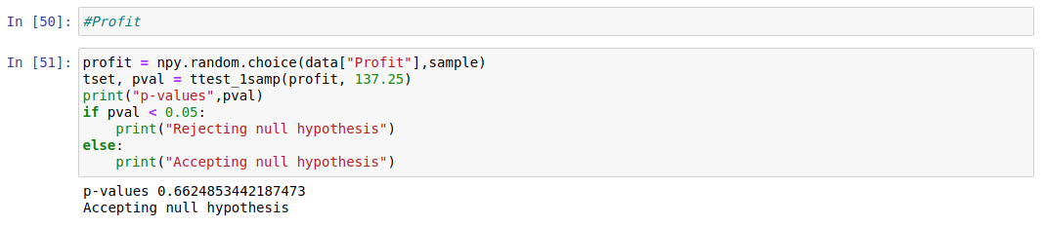
Profit
Since p-value is greater than 0.05 so we are accepting null hypothesis.

Slide 18
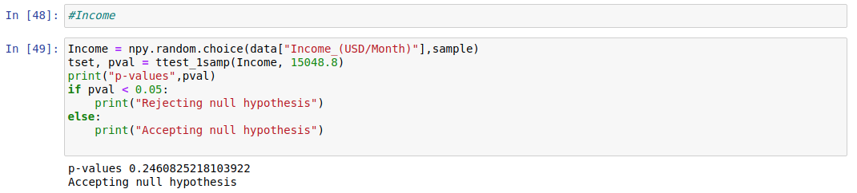
Income
Since p-value is greater than 0.05 and it is 0.24608 so we are accepting null hypothesis

Slide 19
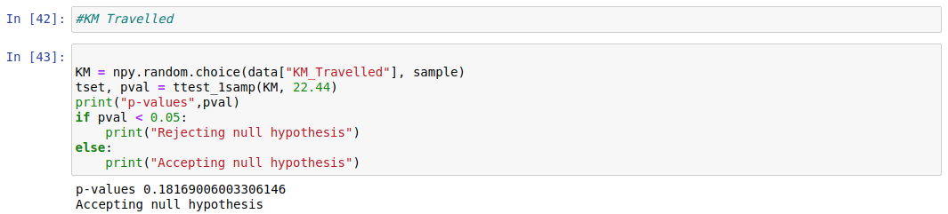
KM Travelled
Since p-value is greater than 0.05 and it is 0.1816 so we are accepting null hypothesis

Slide 20
Recommendations
We have evaluated both the cab companies on following points and found Yellow cab better than Pink cab:
Customer Reach : Yellow cab has higher customer reach in most of the cities but high in 5 cities while Pink cab has higher customer reach in less cities. The yellow cab transaction almost double than the Pink cab.
Margin per Age : Most of the users are between 20 years old to 40 years old.
Payment: Most of the customers preferred using card for payments than cash.
Profit margin : it was observed that the cost of travel was steady across the cities, but the price charged was highest in the cities as NEW YORK NY, DALLAS TX, SILICON VALLEY and MIAMI. And the yellow cab profit is higher in the year 2017 the most.
Margin per Gender: It was shown that male customers are more than the female customers
Based on above points and our decision is that we highly recommend Yellow cab for investment and better result.

Slide 21
Thank You

