Slide 1

Bank Marketing (campaign)
Final Report
Name | Email | Country | Specialization
ILYAS NAYLE | Ilyasnayle5@gmail.com | Turkey | Data Science
Virtual Internship LISUM03​ 15-Nov-2021

Slide 2
Table of Content
Abstract
Problem Description
Data Description
EDA
EDA Summary
Analysis Of Model Performance
Feature Importance
Final Recommendation

Slide 3
Abstract
ABC Bank wants to sell its deposit term product to the customers
By evaluating and implying the EDA and afterwards analyzing it , we tried to understand the data and its pattern on the opt policy.
Different attributes were considered for analysis
The bank data has information of 45221 customers with 17 columns
First we focused on the customers who bought the Policy

Slide 4
Problem Description
Business Understanding, Data understanding, Exploratory data Analysis, Data Preparation
Identifying age group, marital status, educational level, and job description of the clients who purchased the policy.
Is contacting clients before of after the campaign beneficial ?
What is the time taken for the communication of those clients who purchased the policy?

Slide 5
Data set Characteristics: Multivariate
Number of Instance: 45221
Date of data: 2012-02-14
Attribute Characteristics: Real
Null Values: No
Data Description

Slide 6
EDA (EXPLORATORY DATA ANALYSIS)

Slide 7
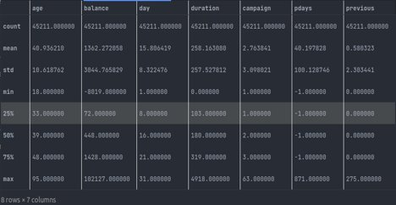
Understanding the Data
Knowing the purchase policy
Anlayzing the Duration
Finalizing the Recommendation

Slide 8
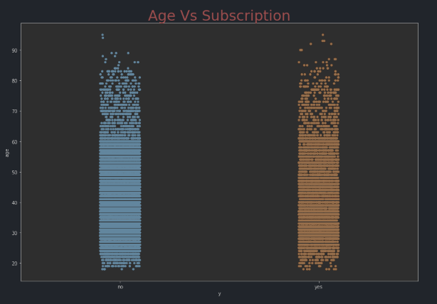
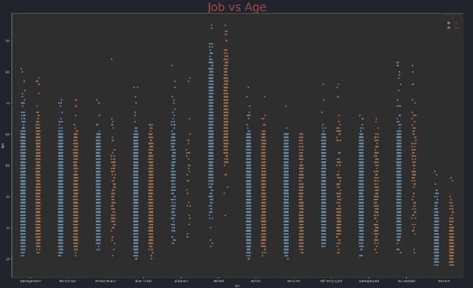
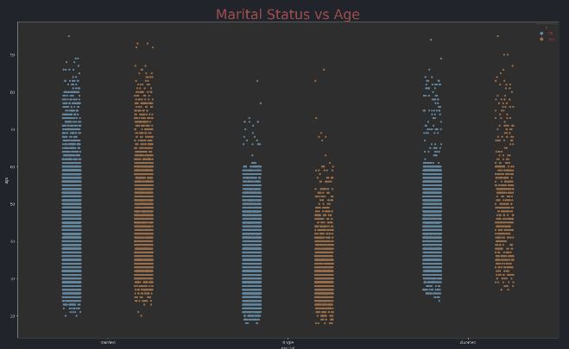
Customer Vs Age
Those Who bought the policy are more likely to be between 20-60 and on the other hand those who are above the 70 have already bought the policy.

Slide 9
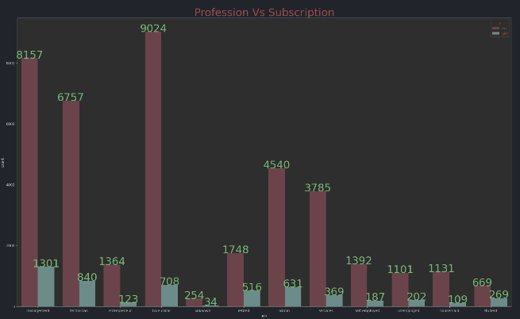
Job type vs Policy Purchase
Clients who are retired have the highest customer purchase rate

Slide 10
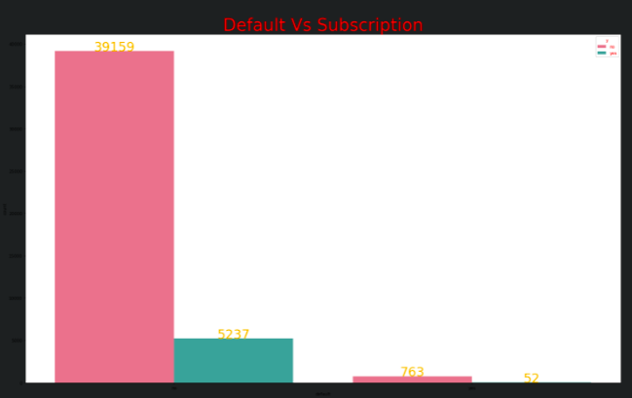
Clients Financial status
Clients who have 'no' in their default status are more likely to buy the policy and also housing status those who have and don’t have housing loan still apply for the policy

Slide 11
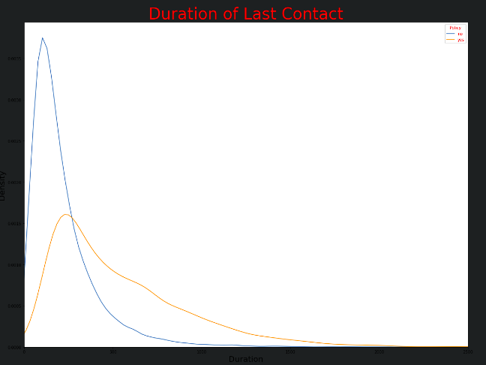
Customer Vs Contact
On average the call lasted 426.00 seconds for those who opted the policy and those who did not the call lasted 164.00 seconds. And they spend more time on the communication.

Slide 12
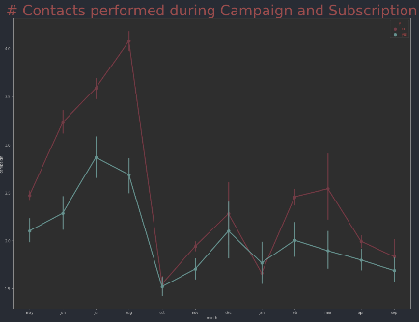
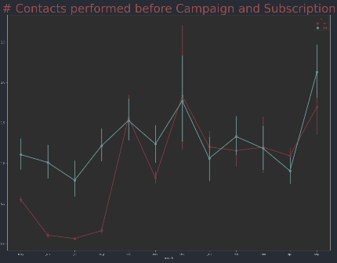
Contacts before campaign for the policy brings more clients during the may – oct, but however positive subscription to the policy subscription during the campaign doesn’t outnumber the failure to subscription And the month of December seems to be the favorable month.

Slide 13
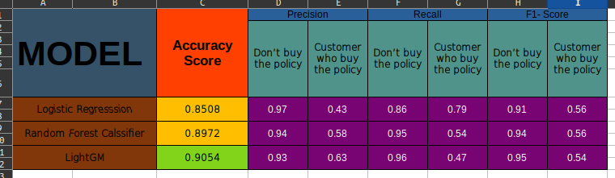
Analysis of the Model Performance
As we can observe from the Accuracy score the best performance has the LIGHTGM model. The Precision And F1-Score is good in LightGM and therefore the recommended Model is LIGHTGM

Slide 14
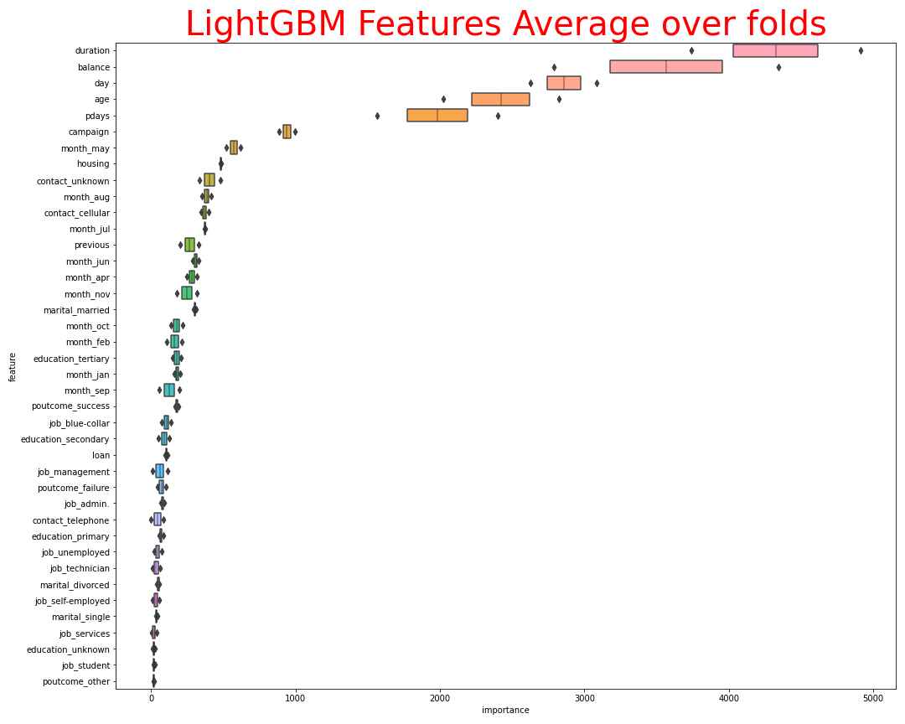
Feature Importance

Slide 15
Final Recommendations
The following are the final recommendation that is finalized after implying
the EDA on the Bank data set file;
Note: The word “ Those” refers to clients.
Those Retired are more likely to buy policy than others
Those who are between age 20-50 are more likely those who bought the policy and there are those above 70 also have opted the policy.
Those Married are more likely to buy between the age of 60 – 80.
Those without “no” as their option in default column are more likely to buy the policy.
Those who are in management section are more likely to get the policy
Those in the Secondary are more than others in term of subscription.

Slide 16
Final Recommendations
Those who will most likely opt for policy are between the month of May – October as well as September. Moreover, the contacts before the campaign brings more clients.
Those with the cell-phones have higher rate of subscription than those with none and telephone.
There is an average of 426 seconds for those who opt the policy and for those who did not where the call lasted for 146 seconds which is fewer than those who opt for the policy. Although they spend more time on the communication when they opt for the policy.
Those with “no” in their default and more likely between the age of 20- 60 years old.
The Recommendation is to use the LightGM model for the prediction of who will buy the policy

Slide 17
Thank You

