Slide 1

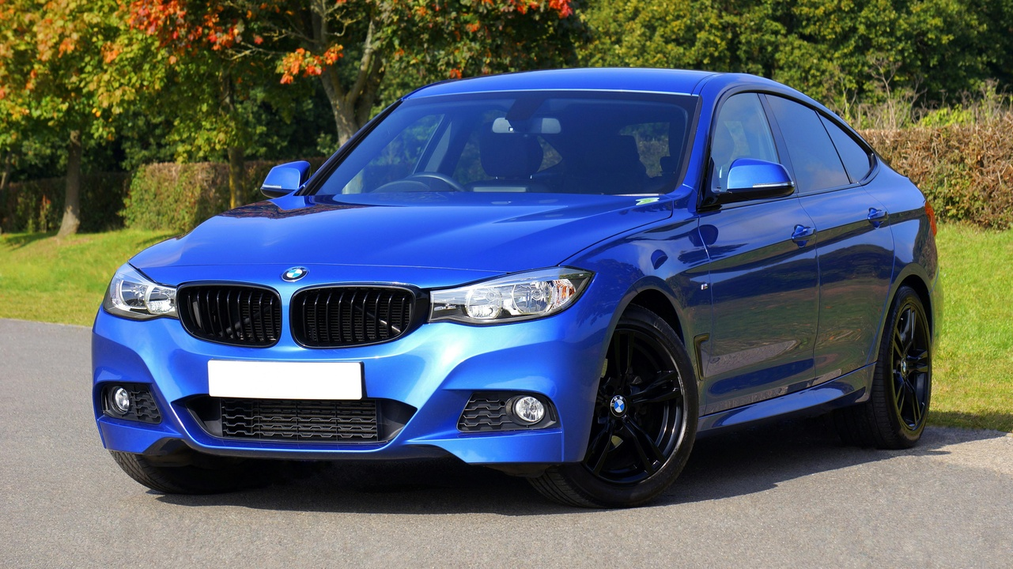
Enhancing Real-Time Car Detection with YOLO
University Of San Diego: Troy Crawford, Mani Katuri

Slide 2
Table of contents
Introduction to YOLO for Real-Time Car Detection
Project Setup and Dataset Preparation
Pre-Processing Steps for Car Detection
Model Architecture: YOLO and CSPDarknet5
Training the YOLO Model for Car Detection
Validation and Performance Metrics Analysis
Prediction Visualization and Qualitative Evaluation
Model Results and Performance Comparison
01
02
03
04
05
06
07
08

Slide 3
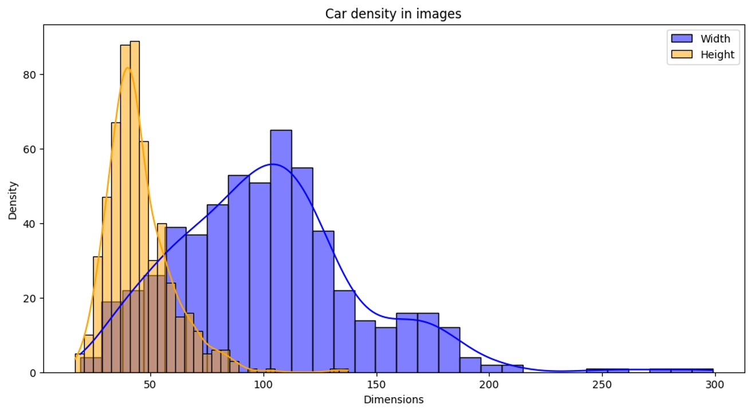
Introduction to YOLO for Real-Time Car Detection
Introduction to YOLO for Real-Time Car Detection
Focus on Artificial Intelligence and Computer Vision
Enhancing Real-Time Car Detection with YOLO

Slide 4
Project Setup and Dataset Preparation
Obtain Dataset
Preprocess Images
Extract Bounding Box Dimensions
Obtain annotated car images dataset from Kaggle
Preprocess images to 640x640 pixels for YOLO compatibility
Extract bounding box dimensions for annotation consistency
Visualize Bounding Box Distributions
Augment Images
Visualize bounding box distributions for dataset analysis
Augment images for improved generalization
Enhancing Real-Time Car Detection with YOLO

Slide 5
Pre-Processing Steps for Car Detection
01
02
03
04
Resize Images
Extract Bounding Box Dimensions
Analyze Bounding Box Distributions
Augment Images
Resize car images to 640x640 pixels for YOLO compatibility.
Extract bounding box dimensions (width and height) from the images.
Analyze the distributions of bounding box dimensions for dataset consistency.
Augment images to improve generalization and robustness of the model.
Enhancing Real-Time Car Detection with YOLO

Slide 6
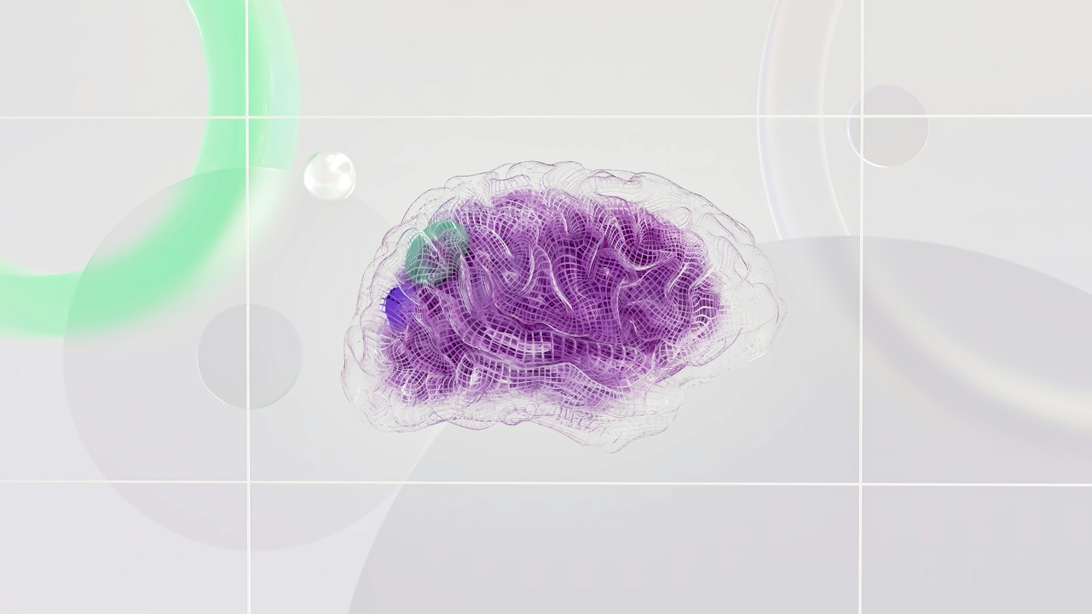
Model Architecture: YOLO and CSPDarknet5
YOLO (You Only Look Once) Model
Fully Convolutional Architecture
Chosen for speed and accuracy in real-time car detection.
Simultaneous bounding box and class probability prediction.
CSPDarknet53 Backbone
Utilized for feature extraction balance between efficiency and performance.
Provides robust feature extraction capabilities for accurate object detection.
Enhancing Real-Time Car Detection with YOLO

Slide 7
Training the YOLO Model for Car Detection
01
02
03
04
05
Define YOLO Model Training Parameters
Configure Custom Dataset
Optimize Model Weights
Implement Loss Function
Ensure Efficient and Accurate Car Detection
Specify Epochs, Batch Size, and Image Size
Utilize YAML File for Training and Validation Data Paths
Use Stochastic Gradient Descent for Weight Optimization
Account for Classification and Bounding Box Regression Errors
Focus on Real-Time Performance and Feature Extraction
Enhancing Real-Time Car Detection with YOLO

Slide 8
Validation and Performance Metrics Analysis
0.7084
0.9840
0.9059
Mean Average Precision at IoU threshold 0.5 to 0.95
Mean Average Precision at IoU threshold 0.50
Mean Average Precision at IoU threshold 0.70
Enhancing Real-Time Car Detection with YOLO

Slide 9
Prediction Visualization and Qualitative Evaluation
01
02
03
04
Overlay predicted bounding boxes on original test images
Direct assessment of detection accuracy
Identify false positives or missed detections
Validate model's performance visually
Enhancing Real-Time Car Detection with YOLO

Slide 10
Model Results and Performance Comparison
YOLO Model Performance
YOLO vs. Faster R-CNN
mAP@0.5:0.95: 0.6938
mAP@0.50: 0.9921
mAP@0.70: 0.8216
YOLO processes up to 155 frames per second
Faster R-CNN is slower due to its two-stage detection process
Enhancing Real-Time Car Detection with YOLO

