Slide 1
Protecting Your VMware and Physical Machines to Azure Using Microsoft Azure Site Recovery
Anoop KV
Senior Program Manager
Microsoft Corporation
Ashish Gangwar
Program Manager
Microsoft Corporation

Slide 2
Agenda
Introduce Azure Site Recovery (ASR) DR solution to protect VMware / Physical Machines to Azure
Features
Architecture
Prerequisites
Demo
Capacity Planning
Migration to Azure with ASR
ASR Logistics and Resources

Slide 3
Azure Site Recovery Preview of VMware / Physical Machines to Azure

Slide 4
Features – Heterogeneity, Discovery, Protection
Heterogeneous workload support
All Windows and many Linux distributions supported on Azure
Automated discovery of VMware vSphere ESXi VMs
With or without VMware vCenter Server
Manual discovery of physical machines
IP address based discovery
Continuous Data Protection for near zero RPOs
Active-passive replication not requiring running target Azure VMs
Multi-VM consistency using Protection Groups
For n-tier Windows apps to replicate consistently and failover at the same time

Slide 5
Features – Security, Recovery, Monitoring
Connectivity over the internet or Site to Site VPN
ExpressRoute with or without forced tunneling
Secure data and control channel communication
No inbound ports needed on-premises
Single-click failovers with Recovery Plans for low RTOs
Scripting via Azure Automation, manual action support
Failback to on-premises VMware infrastructure
No failback to physical machines
Rich protection health and recovery status monitoring
Events and e-mail notifications

Slide 6







Deployment Architecture
Process Server
Customer 1
Source: VMware VMs & Physical Machines
Microsoft Azure Site Recovery
Customer 1
Customer 2
Target: Microsoft Azure
Data Channel
Process Server
Source: VMware VMs & Physical Machines
Microsoft Azure
Microsoft Azure
Customer 2
Mobility Service – Captures all data writes from memory
Process Server – Used for Caching, Compression & Encryption
Master Target – Used as a repository & for retention
Config Server – Used for Centralized Management
Notes:
To go into a little more depth, in the future, we’ll be providing capability to enable VMware customers, and those with physical servers, to be able to replicate and recover their key workloads, from on-premises, into Microsoft Azure. This will again utilize the InMage capabilities, with InMage components existing both on-premises, and in Microsoft Azure, with customers being able to replicate into their respective Azure subscriptions, and make use of Azure IaaS as a failover target in the event of a disaster. In the example on the slide, you’ll see 2 customers, Contoso and Fabrikam, with on-premises resources. They have a number of vSphere hosts, but also a physical server. Through integration between ASR and InMage, these 2 customers will be able to independently replicate their key data into Azure, securely, with each having their own set of InMage components in Azure connecting back to their on-premises InMage components. ASR with InMage will orchestrate failover of the key workloads into Azure, should a disaster arise.
This flexibility enables organizations to protect key vSphere workloads, to an enterprise-class public cloud, Azure, and gain a rich, granular level of control for the orchestration of failover.
<next slide>

Slide 7
Demo
SharePoint Server on VMware to Azure

Slide 8
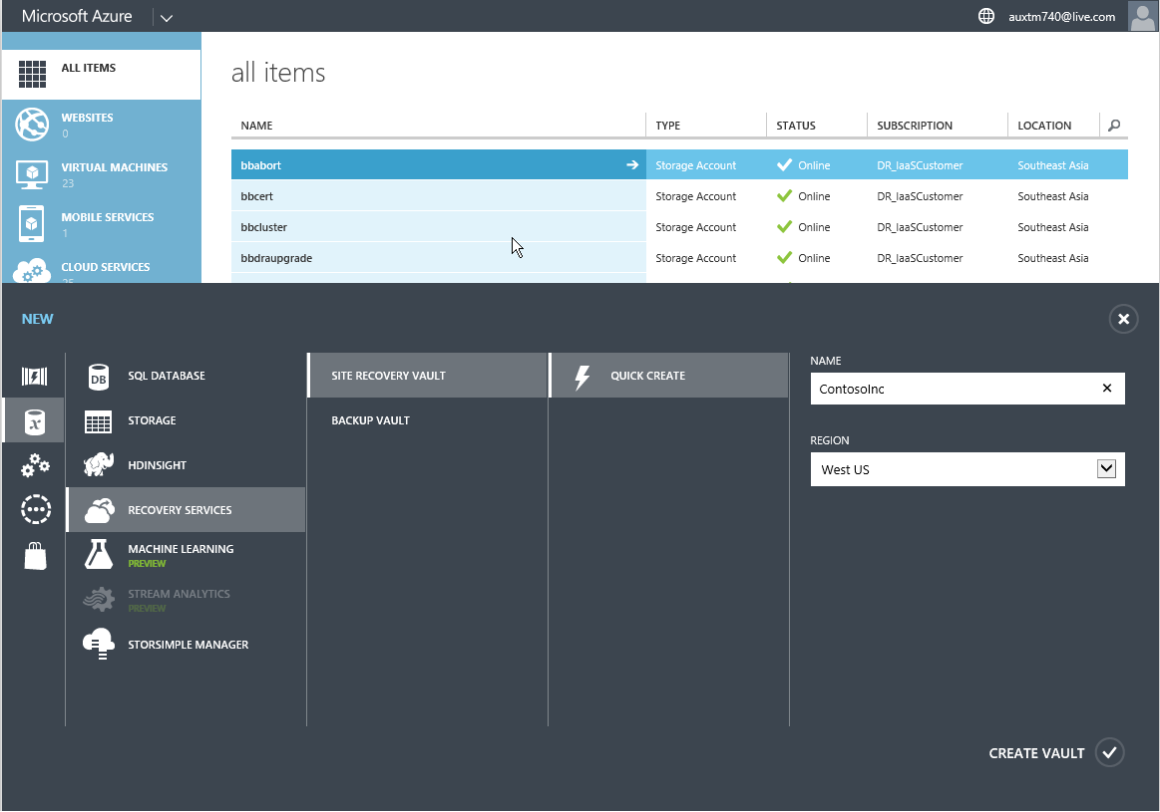
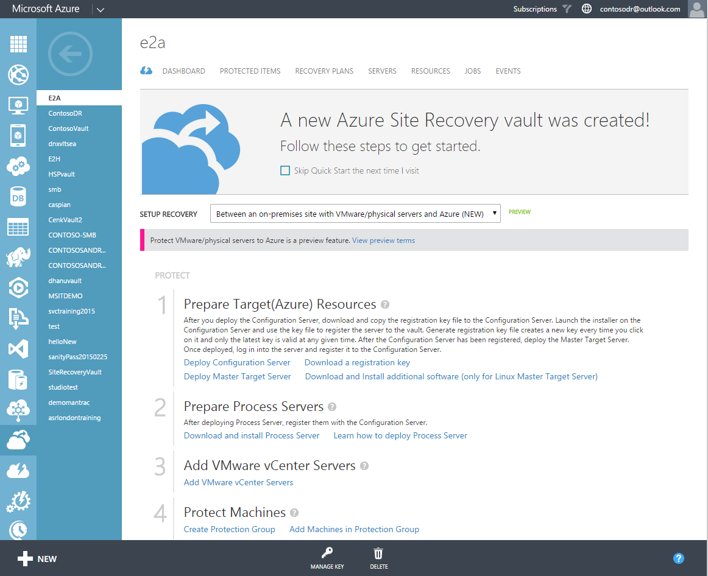
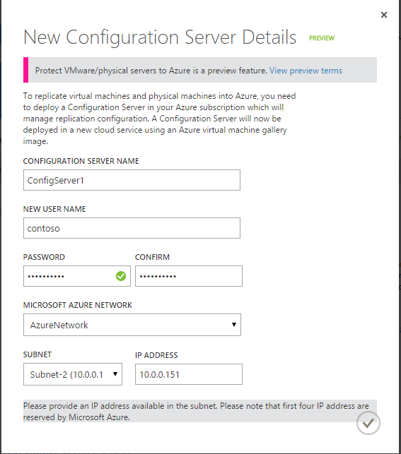
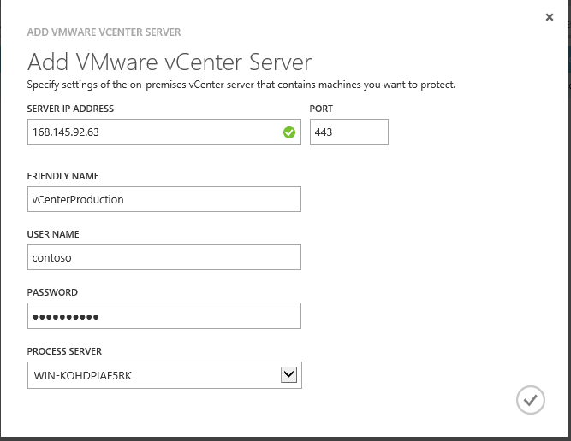
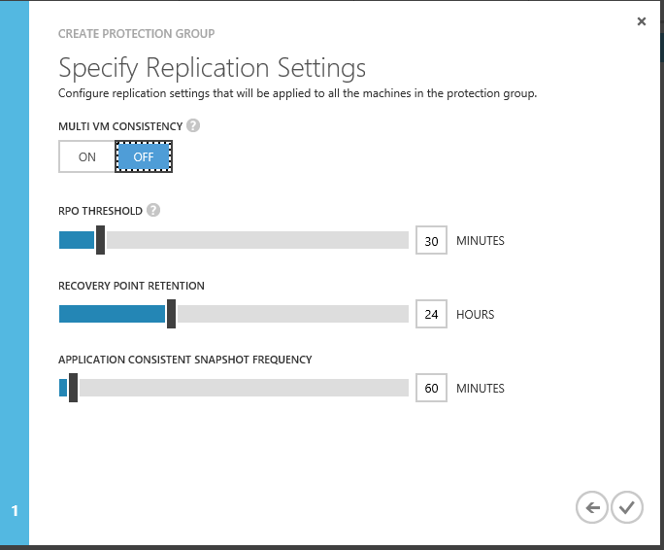
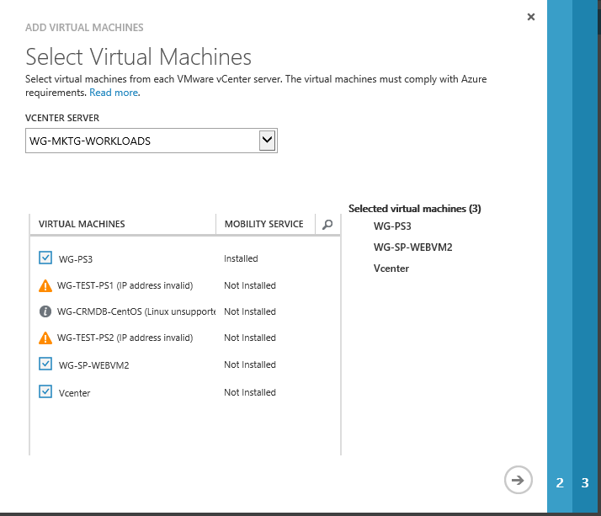
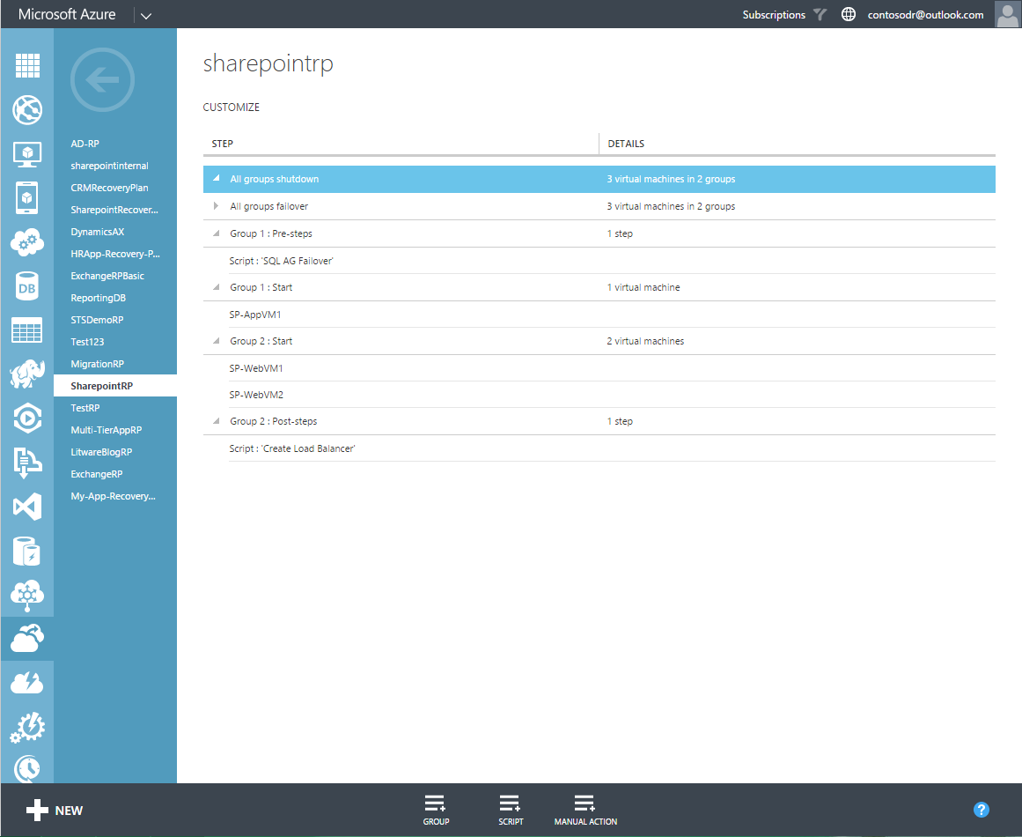
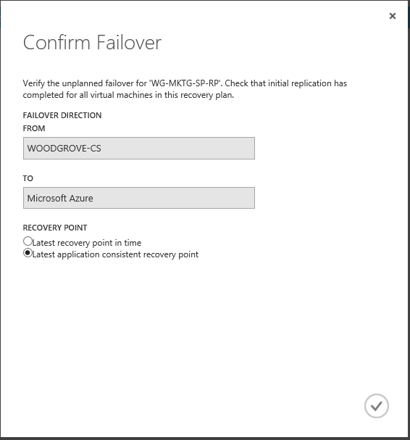
Summary of Actions
1
2
3
4
CREATE VAULT
QUICK START
SETUP SERVERS (CS, MT, PS)
REGISTER
Customer selects recovery region
View step-by-step guidance
Infrastructure servers needed
Register vCenter Server
5
6
7
8
CONFIGURE PROTECTION
PROTECT VIRTUAL MACHINES
CREATE RECOVERY PLAN
FAILOVER TO AZURE
Define protection policy
Replicate disks to Azure
Define recovery plan
Perform failover

Slide 9
Azure Prerequisites
Subscription with sufficient resources
Following in the same region
Azure virtual network
Geo Redundant Storage account
Azure Site Recovery vault
Standard A3 Configuration Server
Standard A4 or standard D14 Master Target Servers
Source machines comply with Azure VM requirements
Disk count – maximum of 31 disks per protected source machine
Disk sizes – individual disk capacity not more than 1023 GB
Clustering – clustered servers not supported
Boot – UEFI / EFI boot not supported
Volumes – BitLocker encrypted volumes not supported

Slide 10
On-Premises Prerequisites
VMware
vCenter Server / vSphere ESXi 5.1 or 5.5 with latest updates
VMs with VMware tools installed and running
All vCenter Server resource names in English
Process Server
Windows Server 2012 R2 physical or virtual machine
Same network / subnet as source machines
VMware vSphere CLI 5.5 for automatic discovery of VMware vSphere ESXi VMs
Network connectivity
Sufficient bandwidth to replicate source machines to Azure
Firewall rules allow outbound connectivity to Azure
Upfront decision on optional use of Site to Site VPN / ExpressRoute

Slide 11
Windows Source Machine Prerequisites
Operating systems (64-bit)
Windows Server 2012 R2
Windows Server 2012
Windows Server 2008 R2 with Service Pack 1
Storage
No dynamic disk support
Single or multiple NICs
All NICs on protected Azure VMs can be assigned to Azure VNETs

Slide 12
Linux Source Machine Prerequisites
Operating systems (64-bit)
CentOS 6.4 / 6.5 / 6.6
Oracle Linux 6.4 / 6.5
SUSE Linux Enterprise Server (SLES) 11 Service Pack 3
Storage
File systems - EXT3 / EXT4 / ReiserFS / XFS
Multipath software – Device Mapper-Multipath
Volume manager – LVM2
Physical servers with HP CCISS controller storage not supported
Single NIC
For multi-NIC source machines, only one NIC on protected Azure VM can be assigned to Azure VNET

Slide 13
Common Source Machine Prerequisites
Source machines turned on
ASR-guest based replication requires running source machines
Remote Desktop or Secure Shell enabled
For connectivity to recovered Azure VMs
English naming
Machine name
System path
Mount points
Device names
File and folder names

Slide 14
Capacity Planning

Slide 15
Azure Capacity Planning - Compute
Configuration Server
Single Standard A3 VM manages up to ~750 protected source machine volumes
Assuming average three volumes per source machine, single Configuration Server scales to ~250 protected machines
Master Target Server
Two Master Target Server VM sizes
Standard A4 -16 data disks
Standard D14 - 32 data disks
One disk on every Master Target Server reserved for retention
Maximum protected disks per standard A4 =15 and per standard D14 = 31
Better scale out economics with multiple standard A4 Master Target Servers
Recommend using standard D14 only if single source machine has greater than 15 total disks
Windows sources need Windows Master Target Servers, Linux sources need Linux Master Target Servers

Slide 16
Azure Capacity Planning - Storage
Storage accounts provisioning
Single Master Target Server spans multiple storage accounts
One for its operating system and retention disks
One or more for replicated data disks
ASR-guest based replication has a ~2.5 IOPS multiplier on the Azure subscription
For every source I/O, two I/Os issued on replicated data disk and ~0.5 I/O issued on retention disk
Every standard Azure storage account supports maximum 20000 IOPS
Best practice to provision new storage account for every 8000-10000 source machine IOPS

Slide 17
On-Premises Capacity Planning
Process Server and network
Data Change Rate Per Day | CPU | Memory | Cache Directory Disk Size | Minimum Total Disk Throughput Required | Minimum Network Throughput Required | NIC
< 250 GB | 2 CPUs [1 socket * 2 cores @ 2.50 GHz] | 4 GB | Minimum of 300 GB | 4 to 6 MBps | 12 to 15 MBps | 1 GigE NIC
250 GB to 600 GB | 12 CPUs [3 sockets * 4 cores @ 2.50 GHz] | 12 GB | Minimum of 1 TB | 8 to 10 MBps | 18 to 22 MBps | 1 GigE NIC
600 GB to 1 TB | 24 CPUs [6 sockets * 4 cores @ 2.50 GHz] | 24 GB | Minimum of 1 TB | 12 to 15 MBps | 28 to 35 MBps | 1 GigE NIC
> 1 TB | Recommend multiple Process Servers

Slide 18
Migration to Azure with ASR

Slide 19
Migrate Workloads to Azure Limit your datacenter footprint
Reduce the burden on IT and lower costs for your on-premises infrastructure
Control where you run apps and store data for a true hybrid experience
A scalable and reliable platform for both Tier 1 and Tier 2 workloads
Increase datacenter agility with on demand, near-limitless cloud scalability
Notes:
Creating net new workloads in the cloud is a breeze, but moving complex existing workloads into the cloud can be quite a challenge. With Availability on Demand, workloads can be effortlessly moved into the cloud with just a few clicks leveraging the replication functionality in ASR.

Slide 20
Migration to Azure with ASR
All source types supported in ASR
VMware vSphere ESXi VMs
Hyper-V VMs
Physical machines
Amazon Web Services VMs
Azure VMs cross-region
Feedback incorporated from Migration Accelerator Preview
Automated deployment of infrastructure components
No inbound ports needed on-premises
Enhanced push installation of mobility service to source machines
Consistent, unified experience in Azure with ASR portal
Security, scale, and quality improvements

Slide 21
ASR Logistics and Resources

Slide 22
ASR Preview Logistics and Resources
Blog – Preview announcement
Sign-Up – Azure Preview features website
Documentation – Protection between on-premises VMware VMs or physical machines to Azure
Contact – gaurav.daga@microsoft.com

Slide 23
ASR Resources
Blog
Pricing Guide
Service Updates
Documentation Center
Support Forum
User Voice

Slide 24
Related Sessions
Disaster Recovery for on-premises data centers
Friday 8 May 9 am: Managing Storage with Microsoft System Center Virtual Machine Manager: A Deep Dive
Friday 8 May 12:30 pm: Best Practices for Deploying Disaster Recovery Services with Microsoft Azure Site Recovery
Azure Site Recovery: Microsoft Azure As a Destination for Disaster Recovery
Disaster Recovery for Azure apps
Best Practices for Disaster Recovery for Azure Applications
Migration
Microsoft Azure Migration Roadmap
Migrating to Microsoft: VMware to Hyper-V and Microsoft Azure

