Slide 1

Lecture 14.2 Key exchange and the Diffie-Hellman protocol
（深圳）
Lecturer: Zoe L. JIANG蒋琳

Slide 2
Digital Signatures
In PK setting, privacy is provided by PKE
Integrity/authenticity is provided by digital signatures (counterpart of MACs in PK world)
Definition: A Digital signature scheme Π consists of three PPT algorithms (Gen, Sign, Vrfy):
sk
pk
1^{n}
pk, sk ∈ {0, 1}^{n}
Gen
m∈ {0, 1}*
σ
m, σ
b ∈ {0, 1}
Sign
Vrfy
Randomized
Deterministic
pk: public key (verification key)
Usually Randomized
b = 0 → invalid signature
sk: private key (signing key)
σ is signature for m
b = 1 → valid signature
(pk, sk) plays a different “role” compared to public-key encryption
>> sk – signature generation (whereas pk was used for ciphertext generation)
>> pk – public verification of the signature (whereas sk was used for decryption)
Signatures cannot be obtained by “reversing” a public-key encryption scheme
Correct ness: Except with a negligible probability over (pk, sk) output by Gen(1^{n}), we require the following for every (legal) plaintext m
Vrfy_{pk}(m, Sign_{sk}(m)) = 1

Slide 3



Digital Signatures : Security
Π = (Gen, Sign, Vrfy)
Goal: we want to prevent a situation like the following:
m₁ = (“My Lord how are you ?”) σ₁ = Sign_{sk}(m₁)
m₂ = (“Ravana is misbehaving with me”) σ₂ = Sign_{sk}(m₂)
sk
pk

Slide 4



Digital Signatures : Security
Π = (Gen, Sign, Vrfy)
Goal: we want to prevent a situation like the following:
m’₁ = (“Ravana is not that bad”) σ’₁ = Sign_{sk}(m’₁)
m’₂ = (“I am fine here”) σ’₂ = Sign_{sk}(m’₂)
sk
pk
How to model the above requirement via security experiment ?
--- Experiment Sig-forge (n)
A, Π
PPT Attacker A
pk
m₁, …, m_{q}
Pk, sk
σ₁, …, σ_{q}
σ_{i} ← Sign_{sk}(m_{i})
(m*, σ*)
Let me verify
Gen(1^{n})
I can forge Π
Π is existentially-unforgeable/CMA if for every PPT A:
b = 1 if Vrfy_{pk}(m*, σ*) ≠ 0 and (m*, σ*) ∉ {(m_{i}, σ_{i})}
≤
Pr
Sig-forge (n) =1
negl(n)
b = 0 otherwise
A, Π

Slide 5
MAC vs Digital Signature
MAC
Digital Signature
- Key distribution has to be done apriori.
Not completely correct! Relies on the fact that there is a way to send the public key in an authenticated way to the verifiers
+ No such assumption needed!
- In multi-verifier scenario, a signer/prover need to hold one secret key for every verifier
+ One signer can setup a single public-key/secret key and all the verifiers can use the same public key
- Well-suited for closed organization (university, private company, military). Does not work for open environment (Internet Merchant)
+ Better suited for open environment (Internet) where two parties have not met personally but still want to communicate securely (Internet merchant & Customer)
+ Very fast computation. Efficient Communication. Only way to do auth in resource-constrained devices such as mobile, RFID, ATM cards etc
- Orders of magnitude slower than Private-key. Heavy even for desktop computers while handling many operations at the same time
- NO Public Verifiability & Transferability
+ Public Verifiability & Transferability
- NO Non-repudiation (cannot deny only to the person holding the key)
+ Non-repudiation (cannot deny to anyone)

Slide 6
Some Results on Digital Signatures
Feasibility Results for DS: Unlike PKE (which needs more assumption than HF/OWF), DS can be constructed just based on HF (in fact just from OWF) [Rompel STOC’90]
DS Schemes in Practice:
>> RSA-FDH (Full Domain Hash) - RSA Assumption + HF – PKCS #1 v2.1
>> Digital Signature Algorithm (DSA)- DL + HF- Digital Signature Standard (DSS)

Slide 7
Digital Certificates and Public-key Infrastructure (PKI)
Public-key World
Is pk_{S} indeed a genuine public-key of Sita ?
My public-key is pk_{S}
(pk_{S}, sk_{S})
Sita
Rama

Slide 8


Digital Certificates and Public-key Infrastructure (PKI)
Trusted Authority
PKI
(After verification)
(pk_{M}, sk_{M})
cert_{M→S} = Sign_{skM}(“Sita’s public key is pk_{S}”)
cert_{M → S}
Certify my public key pk_{S}
Certificate Authority (CA)
Knows that the public-key of is pk_{M}
My public-key is pk_{S}
(pk_{S}, sk_{S})
cert_{M → S}
Sita
Rama
Several types of PKI used in practice
Single CA, multiple CA, PGP, etc
pk_{S} is a genuine public key if and only if
Public keys of CA are pre-configured in web browsers
Vrfy_{pkM}(“Sita’s public key is pk_{S}”, cert_{M→S}”) = 1
Programmed to verify the certificates issued by those CAs

Slide 9

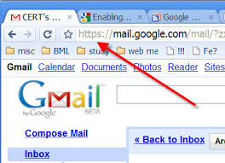
Putting It All Together – TLS (Transport Layer Security)
Handshake protocol
Authenticated Key Exchange
(Public-key crypto)
https://mail.google.com
Server
Client
(Private-key crypto)
Authenticated Private Communication (Using keys established by handshake protocol)
Record-layer protocol

Slide 10


Putting It All Together – SSL/TLS
(The Handshake Protocol)
(pk₁, sk₁)
(pk₂, sk₂)
(pk₃, sk₃)
(pk₄, sk₄)
CA₁
CA₂
CA₃
CA₄
cert_{2→ S}
Certifying that pk_{S} is the public key of the server
pk₁, pk₂, pk₃, pk₄
(pre-configured)
Server
(pk_{S}, sk_{S})
Client

Slide 11
Putting It All Together – SSL/TLS
(The Handshake Protocol)
(pk₁, sk₁)
(pk₂, sk₂)
(pk₃, sk₃)
(pk₄, sk₄)
transcript’
transcript
CA₁
CA₂
CA₃
CA₄
cert_{2→ S}
Supported ciphersuites (hash functions, block ciphers, etc), N_{C}
pk₁, pk₂, pk₃, pk₄
(pre-configured)
cert_{2→ S}
Corresponding ciphersuites, N_{S}, pk_{S},
c
(pk_{S}, sk_{S})
τ_{C} := Mac_{mk}(transcript)
Random nonce N_{C}
Random nonce N_{S}
?
τ_{S} := Mac_{mk}(transcript’)
Vrfy_{pk2}(pk_{S}, cert_{2→S}) = 1
pmk:= Decaps_{skS}(c)
(c, pmk) ← Encaps_{pkS}(1^{n})
mk:= KDF(pmk, N_{c}, N_{s})
mk:= KDF(pmk, N_{c}, N_{s})
k_{C}, k’_{C}, k_{S}, k’_{S}:= PRG(mk)
Agreed symmetric keys
k_{C}, k’_{C}, k_{S}, k’_{S}:= PRG(mk)
?
Vrfy_{mk}(transcript, τ_{C}) = 1
?
Vrfy_{mk}(transcript’, τ_{S}) = 1

Slide 12
Putting It All Together – SSL/TLS
(The Record-layer Protocol)
Authenticated communication
(k_{S}, k’_{S})
Authenticated communication
k_{C}, k’_{C}, k_{S}, k’_{S}
(k_{C}, k’_{C})
k_{C}, k’_{C}, k_{S}, k’_{S}

Slide 13
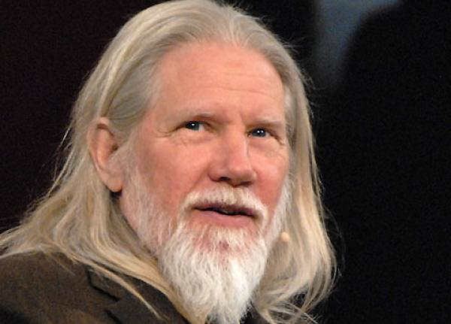
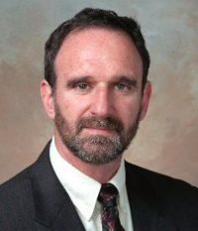
Public Key Cryptography
Whitfield Diffie, Martin E. Hellman:
New directions in cryptography. IEEE Transactions on Information Theory 22(6): 644-654 (1976)

Slide 14
What We have seen and not seen?
Secure (multi-party) Computation
Electronic election, auction, private information retrieval, Outsourcing computation to cloud, Privacy-preserving data mining, signal processing, bioinformatics etc. etc.
Cryptanalysis
Leakage Resilient Cryptography
Finding flaws/attacks/insecurities.
Side-channels
Takes into account the side channel information.
Secure + Authenticated Message Communication
Special Purpose Encryption Schemes
Special Purpose Digital Signatures
Non-committing Encryption, Deniable Encryption, Id-based Encryption, Attribute-based Encryption, Functional Encryption
Homographic Encryption, Fully Homomorphic Encryption
Blind Signatures, Group Signature, Signcryption
Secure Storage
Disc encryption, cloud storage,
Cryptography

Slide 15
Course on Secure Computation
Primitives
Definition Paradigms
Proof Paradigms
>> Oblivious Transfer
>> Real World- Ideal World Paradigm
>> Black-box Reduction
>> Commitment Schemes
>> Non-black-box reduction
>> Universal Composability (UC) Paradigm
>> Zero Knowledge Proofs
>> Random-Oracle Model (ROM)
>> Secret Sharing
For many constructions based on HF
Modeled as a random oracle (a truly random function from X → K)
>> Threshold Encryption
Access to H is via oracle calls
To compute H(a), call oracle with a, who returns a random value from co-domain as the output --- once a value is associated as H(a), the association remains fixed for future instances
>> Secure Computation in various setting
Calls to the oracle are private
>> Secure Computation of Practical Problems- Set Intersection, Genomic Computation
If attacker has not queried for H(a), then H(a) remains uniformly random for the attacker
>> Byzantine Agreement & Broadcast

Slide 16

Concluding Remarks

Slide 17
References
[1] http://drona.csa.iisc.ernet.in/~arpita/Cryptography15.html
[1] Jonathan Katz, Yehuda Lindell. Chapter 12, Introduction to Modern Cryptography, 2nd Edition, Chapman & Hall/CRC Cryptography and Network Security Series, 2014

