Slide 1

Course Information and prerequisites
Lecturer: Zoe L. JIANG蒋琳
Notes:
Good morning, everyone! Thanks for coming. In the following 15 minutes, I’ll give a brief introduction about the course, including about me, your tutor, what will be covered and uncovered in the course. The prerequisites will also be listed for you to make sure whether you have some basic knowledge on cryptography and mathematics. Your tutor will distribute a piece of questionaire for you to fill in.

Slide 2
Teacher and TA
Lecturer | Zoe Lin JIANG蒋琳 | Office phone |  | (86)755-26033461
Lecture time | 15:45-17:30 (Tue/Thur, Week 3, 4, 6-9) 8:00-9:45 (Wed, Week 3, 4, 6, 7)
Lecture venue | A-309 | Email | zoeljiang@hit.edu.cn
Office location | C-303B | Office hour | 10:30-12:00 (Tue) or by appointment
Website | BlackBoard教学系统 http://219.223.252.201 | QQ group
TA | Zhentian Xiong熊圳天 | Office hour | by appointment
Office location | C-302 | Email | 2821785913@qq.com

Slide 3
Course Goal
Principles and practice of cryptography
the security and privacy mindset
the idea of modern cryptography (post-1980s): the definitions, precise assumptions, and rigorous proofs of security
the fundamental concept of the most common cryptographic algorithms and protocols
the advanced cryptographic schemes can be used in cloud computing, big data and blockchain
Academic research skills
survey and review ability
problem-finding ability
analytical and problem-solving ability

Slide 4
Content Covered
Introduction to classical and modern cryptography (4 credit hours)
Modern cryptography I – symmetric cryptography (8 credit hours)
Modern cryptography II – asymmetric cryptography (12 credit hours)
Applied cryptography – cryptographic algorithm (8 credit hours)

Slide 5
Content Uncovered
Computer security, such as virus
Network security, such as network attacks
Secure network protocols, such as SSL

Slide 6
Grading (tentative)
10% Classroom
Attendance
Class discussion/exercise
50% Assignment/project
6 assignments/projects
40% Final exam

Slide 7
Prerequisites
Information security
Public-key infrastructure (PKI)
Encryption algorithm (DES, AES, RSA)
Signature algorithm (DSA, ElGamal signature)
Mathematical background (this is not a math course)
Discrete mathematics (elementary number theory, abstract algebra)
Probability
Computer science background
Computational complexity theory (polynomial-time algorithm, reduction between computational problems)

Slide 8
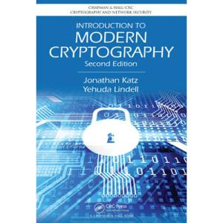
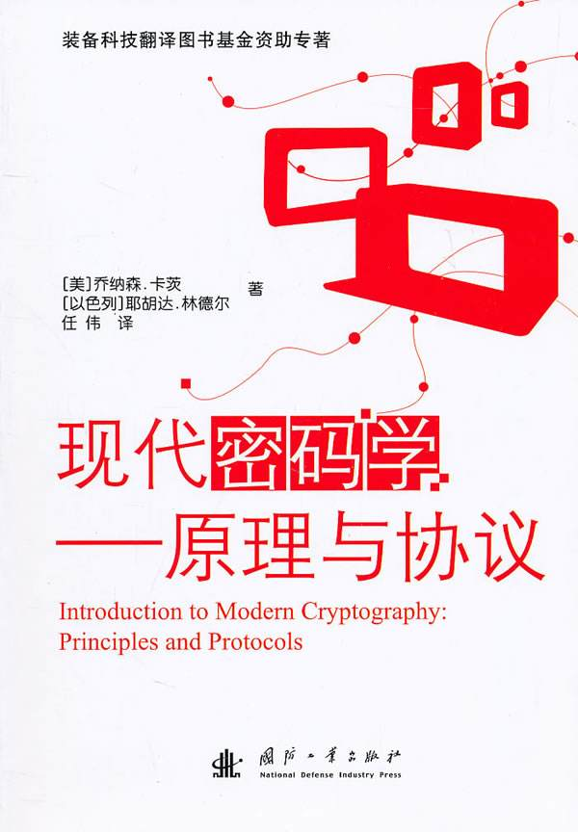
Textbook
Jonathan Katz, Yehuda Lindell. Introduction to Modern Cryptography, Second Edition, Chapman & Hall/CRC Cryptography and Network Security Series, 2014
[美]乔纳森.卡茨, [以色列]耶胡达.林德尔 著，任伟 译. 现代密码学—原理与协议，国防工业出版社，2012

Slide 9
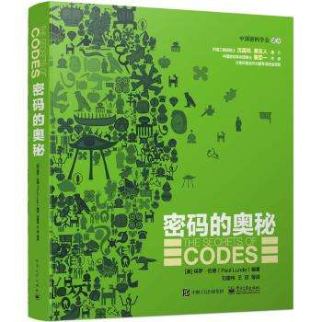
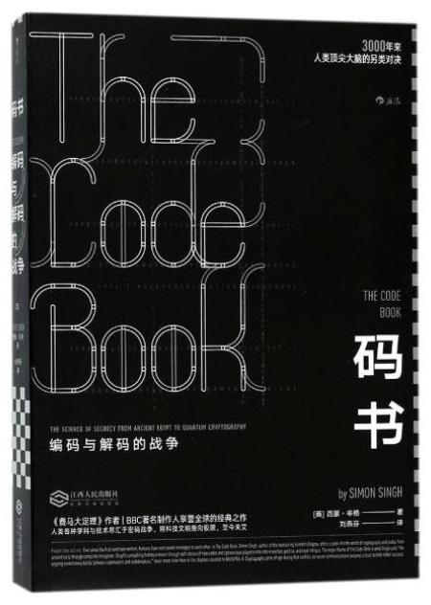
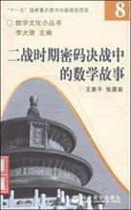
Recommended Books
Story
[美]保罗.伦德 编著，刘建伟，王琼 等译，密码的奥秘，电子工业出版社，2015
[英]西蒙.辛格 著，刘燕芬 译，码书，江西人民出版社，2018
王善平，张奠宙，二战时期密码决战中的数学故事，高等教育出版社，2008

Slide 10
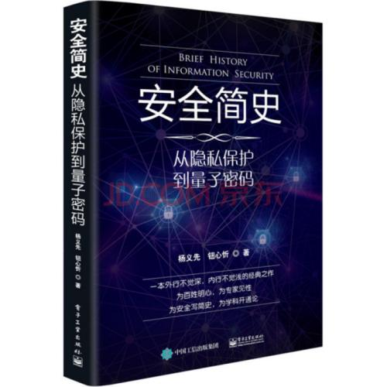
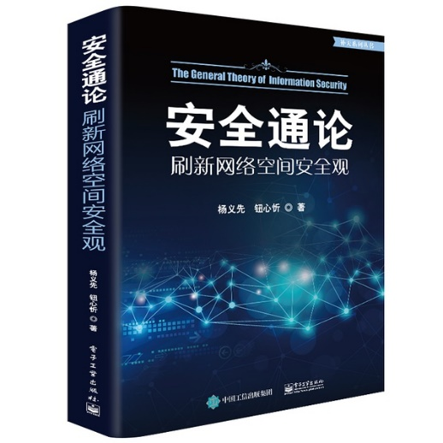

Recommended Books
Introduction
杨义先，钮心忻 著，安全简史（从隐私保护到量子密码），电子工业出版社，2017
杨义先，钮心忻 著，安全通论（刷新网络空间安全观），电子工业出版社，2018
[日]结城浩 著，周自恒 译，图解密码技术，人民邮电出版社，2014

Slide 11
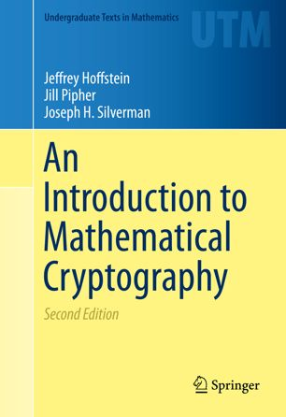
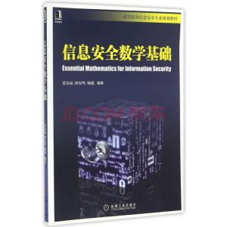
Recommended Books
Math
Jeffrey Hoffstein, Jill Pipher, Joseph H. Silverman. Introduction to Mathematical Cryptography, 2th Edition. Springer, 2014
贾春福，钟安鸣，杨骏 编著，信息安全数学基础，机械工业出版社，2017

Slide 12
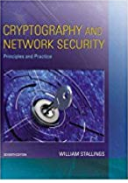
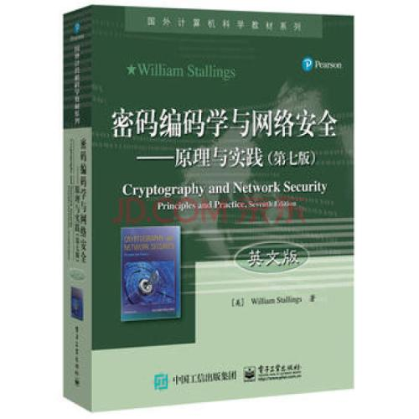
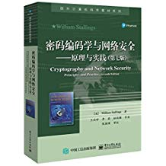
Recommended Books
Crypto theory
William Stallings, Cryptography and Network Security, Principles and Practice, 7th ed., Pearson, 2016
William Stallings, Cryptography and Network Security, Principles and Practice, 7th ed., 电子工业出版社, 2016
[美] William Stallings 著，唐明，李莉等 译，密码编码学与网络安全，电子工业出版社，2017

Slide 13
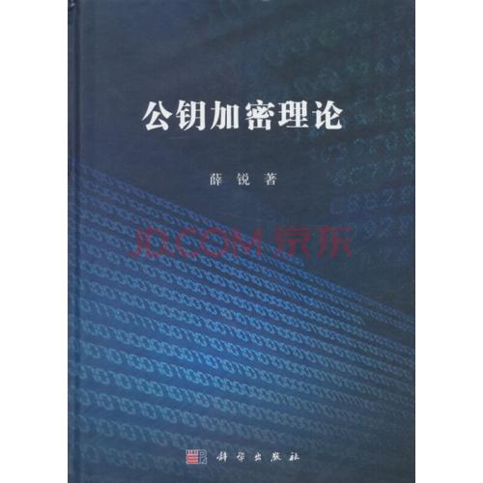
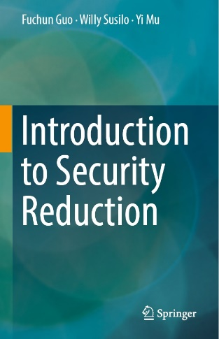
Recommended Books
Crypto theory
薛锐 著，公钥加密理论，科学出版社，2016
Fuchun Guo, Willy Susilo, Yi Mu, Introduction to Security Reduction, Springer, 2018

Slide 14
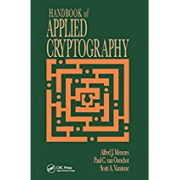
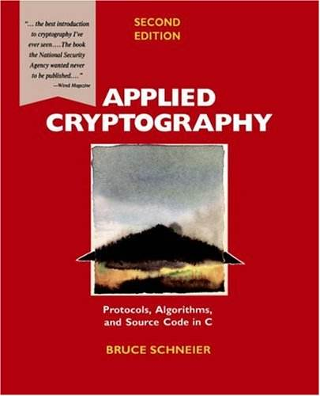
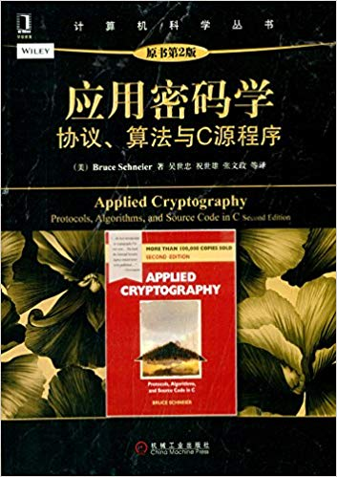
Recommended Books
Crypto application
Alfred J. Menezes, Paul C. van Oorschot and Scott A. Vanstone. Handbook of Applied Cryptography, 5th Edition. CRC, 2001
Bruce Schneier. Applied Cryptography: Protocols, Algorithms and Source Code in C. 2nd, Wiley, 2014
[美]施奈尔 著，吴世忠等 译，应用密码学-协议、算法与C源程序，第2版，机械工业出版社，2014

Slide 15
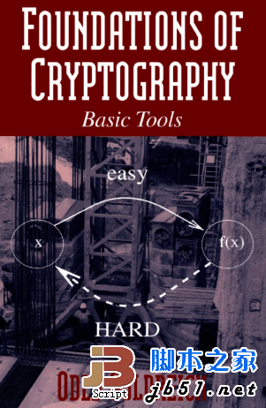
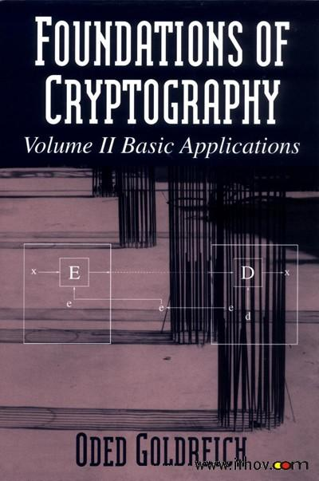
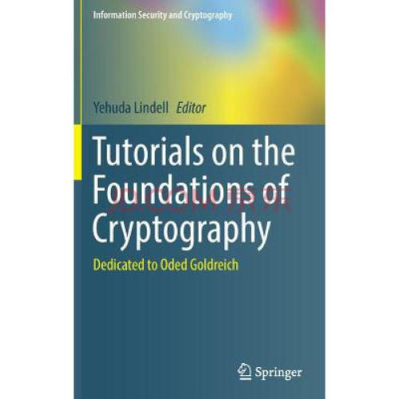
Recommended Books
Advanced crypto theory
Oded Goldreich, Foundations of Cryptography: Volume 1, Basic Tools, Cambridge University, 2007
Oded Goldreich, Foundations of Cryptography: Volume 2, Basic Applications, Cambridge University, 2009
Yehuda Lindell, Tutorials on the Foundations of Cryptography: Dedicated to Oded Goldreich, Springer, 2017

Slide 16
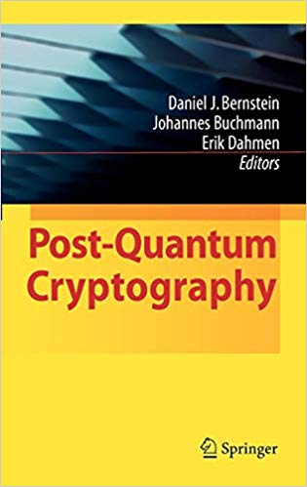
Recommended Books
Post-quantum Crypto
Daniel J. Bernstein, Johannes Buchmann, Erik Dahmen, Post-quantum Cryptography, Springer, 2009
Jonathan Katz, Vadim Laybashevsky, Lattice-based Cryptography, Chapman and Hall/CRC, 2019

Slide 17
Recommended papers
ACM Conference on Computer and Communications Security (CCS)
International Cryptology Conference (Crypto)美密
European Cryptology Conference (Eurocrypt)欧密
IEEE Symposium on Security and Privacy (S&P)
Annual International Conference on the Theory and Application of Cryptology and Information Security (Asiacrypt)亚密
International Workshop on Practice and Theory in Public Key Cryptography (PKC)
Financial Cryptography and Data Security (FC)
RSA Conference, Cryptographers' Track
Journal of Cryptology
IEEE Transactions on Information Forensics and Security (TIFS)
IEEE Transactions on Dependable and Secure Computing (TDSC)

