Slide 1

L1.1: Introduction to cryptography
Lecturer: Zoe L. JIANG
A309
15:45-17:30

Slide 2
Outline
The origin, development and status of the cryptography
Basic knowledge about cryptography
The applications of cryptography
The overview of cryptography

Slide 3
The origin, development and status of the cryptography
Before 1800, cryptography is the art – 1st phase
1800-1975, cryptography becomes the science – 2nd phase
In 1976, public key cryptography (asymmetric cryptography) was proposed – 3rd phase
In 1984, quantum cryptography was proposed
In 2006, post-quantum cryptography was gained greater attention

Slide 4
The 1st phase – classical cryptography
Cryptography is the art
Feature:
Little theory: Constructing good codes, or breaking existing ones, relied on creativity and a developed sense of how codes work
Military use

Slide 5

Greek Cryptography – the scytale密码棒
5th BC
古斯巴达人 天书
An unknown period (the circumference of the scytale) is the secret key, shared by sender and receiver

Slide 6

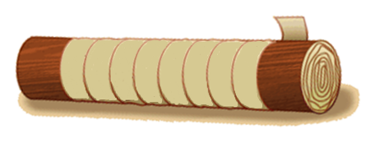
Greek Cryptography – the scytale密码棒
密文C₁：
K T M I O I L M D L O N K R I I R G N O H G W T
如何解密?
竖排横读
明文M₁：
K I L L K I N G T O M O R R O W M I D N I G H T
换位密码(transposition cipher)： 对数据中的字符重新排列，但不改变它们本身。
明文M₂：
S A V E K I N G
T O M O R R O W
M I D N I G H T
如何加密？
横排竖读
密文C₂：
S T M A O I V M D E O N K R I I R G N O H G W T

Slide 7
The 2nd phase – 1800A.D. to WWII
The computer makes the algorithms of cipher even more complicated
Feature:
Rich theory
Used everywhere

Slide 8
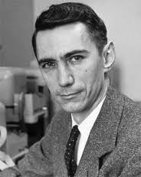
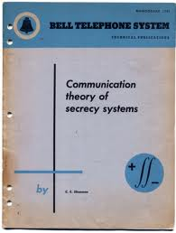
Claude Shannon (1916-2001)
“Communication Theory of Secrecy Systems” in Sept 1945 (Bell Labs memo, classified)
Information-theoretic in character – proves unbreakability of one-time pad. (Published1949)
Notes:
Two famous people published two famous books, which two are landmarks in the progress of cryptography.
The first one is Claude Shannon known as the father of information theory.

Slide 9
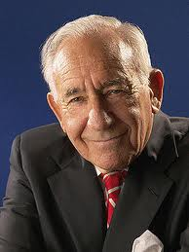
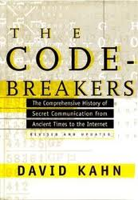
David Kahn - The Code-breakers
In 1967, David Kahn published The Code-breakers (破译者) – The Story of Secret Writing. A monumental history of cryptography. NSA attempted to suppress its publication.
Notes:
NSA: National Security Agency (美国)国家安全局

Slide 10
The 3rd phase – modern cryptography
Cryptography becomes the science
The progress
In 1976, Data Encryption Standard (DES) was published as the symmetric encryption standard
In 1976, Diffie & Hellman proposed public key cryptosystem (PKC)
In 1977, Rivest, Shamir & Adleman proposed the public key encryption algorithm RSA
In 1984, elliptic curve asymmetric key algorithm was proposed
In 1991, Message Digest 5 (MD5) was proposed
Feature: a central topic within computer science

Slide 11
Summary
Art → Science
Secret communication → Encryption, message authentication, digital signature, secure protocol
Military, government → Everywhere

Slide 12
Outline
The origin, development and status of the cryptography
Basic knowledge about cryptography
The applications of cryptography
The overview of cryptography

Slide 13


(A)Symmetric Encryption
Ciphertext c
Plaintext m
Enc(m, k_{E})
Dec(c, k_{D})
Plaintext m
unsecure channel
k_{E}
k_{D}
Alice
k_{E} = k_{D} ➔ Symmetric encryption
k_{E} ≠ k_{D} ➔ Asymmetric encryption
Bob
Notes:
Alice wants to share a plaintext with Bob, which should be kept secret from others. To do this, Alice…
The concept is very simple. However, from the implementation point of view, is it the case?
Both symmetric encryption and asymmetric encryption have advantages and disadvantages.

Slide 14
Basic crypto notions
Syntax of symmetric encryption
Key generation (Gen): a probabilistic algorithm that outputs a key k chosen from a key space K
Encryption (Enc): takes as input a key k and a plaintext m from the message space M, and outputs a ciphertext c, denoted as Enc(m, k)
Decryption (Dec): takes as input a key k and a ciphertext c and outputs a plaintext m, denoted as Dec(c, k)
Correctness: Dec(Enc(m, k), k) = m
Notes:
It takes the ciphertext and the secret key and produces the original plaintext.

Slide 15
Basic crypto notions
Syntax of asymmetric encryption
Key generation (Gen): a probabilistic algorithm that outputs a public and private key pair (pk, sk)chosen from a key space K
Encryption (Enc): takes as input a key pk and a plaintext m from the message space M, and outputs a ciphertext c, denoted as Enc(m, pk)
Decryption (Dec): takes as input a key sk and a ciphertext c and outputs a plaintext m, denoted as Dec(c, sk)
Correctness: Dec(Enc(m, pk), sk) = m

Slide 16
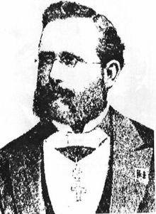
Keys and Kerckhoffs’ Principle
To maintain security key k should be definitely a secret
What about Enc and Dec algorithm ?
More security by keeping them private too ?
Kerckhoffs’ Principle:
“The cipher method must not be required to be secret and it must be able to fall into the hands of the enemy without any inconvenience ”
a.k.a
Security rely solely on the secrecy of the key
19th century Dutch cryptographer

Slide 17
Outline
The origin, development and status of the cryptography
Basic knowledge about cryptography
The applications of cryptography
The overview of cryptography

Slide 18
Crypto: Past and Present
Until 1970s
After 1970s and Until Now
Authenticated Message Communication
Message Communication
E-cash
E-election, E-auction
Cryptography: Study of mathematical techniques for securing digital information, systems and distributed computation against adversarial attacks
Activism with Safety
Secure Storage, Disk encryption
Secure Information Retrieval
Secure outsourcing to Cloud
Blockchain, cryptocurrency
……….and the list goes on
All these fall under the purview of Cryptography

Slide 19
Outline
The origin, development and status of the cryptography
Basic knowledge about cryptography
The applications of cryptography
The overview of cryptography

Slide 20
The overview of cryptography
Cryptology
Cryptography
Cryptanalysis
Classic cryptography
Modern cryptography
Steganography
Substitution
Transposition
Caesar cipher
Rail fence
Vigenere cipher
Hill cipher

Slide 21
The overview of cryptography
Cryptology
Cryptography
Cryptanalysis
Classic cryptography
Modern cryptography
Symmetric cryptography
Asymmetric cryptography
Message authentication
Block cipher
Stream cipher
DES
RC4
MAC
AES
Hash

Slide 22
The overview of cryptography
Cryptology
Cryptography
Cryptanalysis
Classic cryptography
Modern cryptography
Symmetric cryptography
Asymmetric cryptography
Public key cryptography
ID-based cryptography
Advanced cryptography
RSA encryption
Attribute-based encryption
ElGamal signature
Predicate encryption
Elliptic curve cryptography
Ring signature
Secret sharing

Slide 23
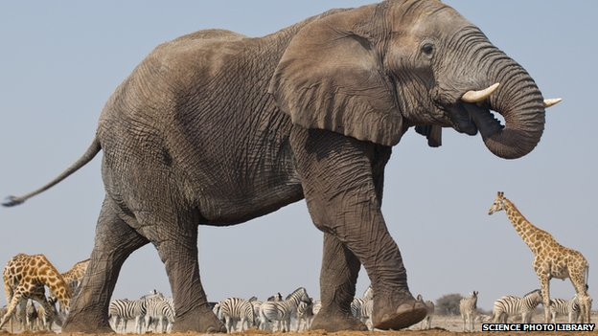
Crypto Zoo
Real life Applications: Including previous ones
Homomorphic Encryption
Primitives:
Functional Encryption
Deniable Encryption
Multiparty Computation
Stream Cipher
PRP
Symmetric Key Encryption
Leakage Resilient Crypto
Commitment Schemes
SPRP
Oblivious Transfer
PRG
Secret Sharing
Key Agreement
Key Derivation
SPRP
Zero Knowledge Proofs
Public Key Encryption
PRF
Blind Signature
Obfuscation
Key Agreement
Block Cipher
One way Function
Digital Signature
Authenticated Encryption
One way permutation
Hash Functions
MAC
Assumptions: Number Theoretic/crude assumptions like AES/DES are secure PRF schemes, SHA 3 secure hash function etc.
Slide Idea courtesy: Manoj Prabhakaran
Notes:
Cryptomania & Minicrypt

