Slide 1

L1.2: Classical cryptography - I
Lecturer: Zoe L. JIANG
A309
15:45-17:30
Notes:
We have discussed that classical cryptography is the first phase of cryptography. Therefore, after the introduction, we start with classical cryptography.

Slide 2
Outline
Steganography隐写术
Substitution cipher替换密码
Monoalphabetic cipher单字母单表密码
Caesar cipher (Shift cipher)
Mixed alphabetic cipher
Morse code
Polyalphabetic cipher单字母多表密码
Vigenère cipher
Multiple letter cipher多字母单表密码
Playfair cipher
Hill cipher
A special substitution cipher
One-time pad (OTP)
Transposition cipher置换密码
Rotor machine转轮密码机
Notes:
Classical cryptography can be divided into three parts, Steganography, Substitution cipher, and Transposition cipher.
Rotor machine is a kind of complicated substitution cipher implemented by electric-mechanical machine.
Remember that I have given you an example of steganography? It arranges the words within an apparently innocuous mail.
Steganography is an important branch of cryptography, which is more related to information hiding. So due to the time limitation, we shall not discuss more on it.

Slide 3

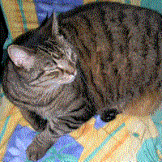
Steganography
Fig 2.1 Image of a tree with a steganographically hidden image
Fig 2.2 Image of a cat extracted from the tree image in Fig 2.1
http://en.wikipedia.org/wiki/Steganography

Slide 4
Substitution cipher
What is substitution cipher?
Each character in the plaintext is substituted by another character in the ciphertext
How many kinds of substitution cipher?
Monoalphabetic cipher单字母单表密码
Caesar cipher (Shift cipher)
Mixed alphabetic cipher
Morse code
Polyalphabetic cipher单字母多表密码
Vigenère cipher
Multiple letter cipher多字母单表密码
Playfair cipher
Hill cipher
A special substitution cipher
One-time pad (OTP)
Notes:
Let’s look at substitution cipher. It includes monoalphabetic, multiple-letter and polyalphabetic ciphers. For each kind of cipher, I will give you an example.
One-time pad is a special substitution cipher which is the only cipher can be proved absolutely secure.

Slide 5
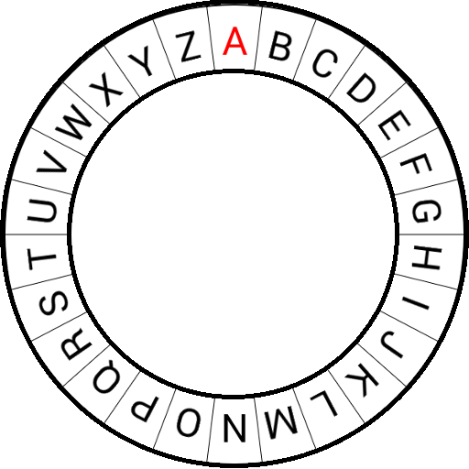
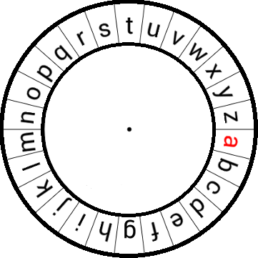
Exercise
K_{E1} = 3
M₁ =
C₁ =
a t t a c k n o w
D W W D F N Q R Z
C₂ =
K_{E2} =
M₂ =
O V D T H U F
7
n u c s g t e
h o w m a n y
m t b r f s d
Brute-force attack
Try all 26 possible keys
Types of Attack | Known to Cryptanalyst
Ciphertext Only Attack (COA) | Encryption algorithm Ciphertext

Slide 6
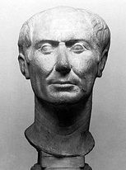
Caesar cipher (Shift cipher)
Plaintext: are you ready
Key: k=3
Ciphertext: DUH BRX UHDGB
Interpret the alphabet set {a, b , …, z} as set {0, 1, …, 25}
C_{i} = Enc(m_{i},3)=(m_{i}+3) mod 26
m_{i} = Dec(C_{i},3)=(C_{i}−3) mod 26
Message space M =ciphertext space C = set of strings over {0, 1, …, 25}
Key space K:
{0, 1, …, 25}
26 alphabetic tables
Enc
c_{i} ∈ M
Dec
m_{i} ∈ C
m_{i} ∈ M
c_{i} ∈ C
Gen
c_{i} := (m_{i}+3) mod 26
m_{i} := (c_{i}-3) mod 26
Notes:
In Caesar cipher, each character of a message is replaced by a character three position down in the alphabet. So A is replaced by D, B is replaced by E, and so on.
Usually, we use small letters to express plaintext, capital letters to express ciphertext.
If we represent each letter of the alphabet by an integer that corresponds to its position in the alphabet, the formular for replacing each character p of the plaintext with a character c of the ciphertext can be expressed as.
If you are not familiar with modulo division, the mod operation returns the integer remainder of the division when p+3 is divided by 26.
Caesar cipher is a very simple cipher and can be broken easily with brute-force attack.

Slide 7
Sufficient key space principle
Any secure encryption scheme must have a key space that is not vulnerable to exhaustive search
How to improve shift cipher to support a bigger key space?
a | b | c | d | e | f | g | h | i | j | k | l | m | n | o | p | q | r | s | t | u | v | w | x | y | z
X
E
U
Key space: 26!

Slide 8
Mixed alphabetic cipher
With this cipher, rather than performing a mathematical operation on the values of each letter, or just shifting the alphabet, we create a random order for the ciphertext alphabet
C₁ = G D O O K V C X E F L G C D
m₁ = ?
a | b | c | d | e | f | g | h | i | j | k | l | m | n | o | p | q | r | s | t | u | v | w | x | y | z
X | E | U | A | D | N | B | K | V | M | R | O | C | Q | F | S | Y | H | W | G | L | Z | I | J | P | T
Brute-force attack does not work

Slide 9
This figure is from Dr. Richar Newman’s course of Advanced cryptography
Notes:
Note that all human languages have varying letter frequencies, though the number of letters and their frequencies varies. Stallings Figure 2.5 shows English letter frequencies. Seberry & Pieprzyk, "Cryptography - An Introduction to Computer Security", Prentice-Hall 1989, Appendix A has letter frequency graphs for 20 languages (most European & Japanese & Malay). Also useful are tables of common two-letter combinations, known as digrams, and three-letter combinations, known as trigrams.
Note that cipher-0 frequency histogram is the same as English only shifted over – must be a rotational cipher!
E is replaced by X.

Slide 10
Mixed alphabetic cipher
Plaintext characters are substituted by a different alphabet stream of characters, which is a random permutation of the 26 letters of the alphabet
Key: the sequence of the substitution letters
Key space: how many possible substitutions?
26!= 403,291,461,126,605,635,584,000,000 > 4 x 10²⁶ possibilities
Statistical attack
One character at a time substitution obviously leaves too much of the plaintext structure in ciphertext
If you know the nature of plaintext, any substitution cipher, regardless of the size of the key space, can be broken easily with a statistical attack.
Types of Attack | Known to Cryptanalyst
Ciphertext Only Attack (COA) | Encryption algorithm Ciphertext
Notes:
The shift pattern above could be replaced by random assignment of characters for each alphabet
Therefore, # of permutations of the letter in the alphabet
= # of all the possible monoalphabetic substitutions
= 26! (26 factorial)
Wouldn’t such a large key space make this cipher extremely difficult to break? Not really.
The very large key space means the total number of all possible keys that would need to be guessed by brute-force attack would be much too large. So brute-force attack is not feasible for monoalphabetic cipher.

Slide 11
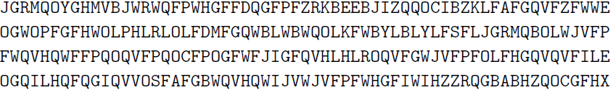
An example of statistical attack on mixed alphabetic cipher-single letter frequency
Ciphertext
Average letter frequencies in the English language
Average letter frequencies of the above ciphertext

Slide 12
An example of statistical attack on mixed alphabetic cipher-digraphs frequency
The most common digraphs in the English language are
TH, HE, AN, IN, ER, ON, RE, ED, ND, HA, AT, EN
The most common digraphs in the ciphertext are
QV, FP, GF, VF, QO, PF, FG, FW, OL, WQ, LF, GQ, JV
An example of statistical attack on mixed alphabetic cipher-trigraphs frequency
The most common trigraphs in the English language are
THE, AND, THA, ENT, ION, TIO, FOR, NDE, HAS, NCE, TIS, OFT, MEN
The most common trigraphs in the ciphertext are
FPF, QVF, VFP, QOC, WJV, JVF, QVH, JGR, GRM, RMQ, WHG, HGF, FAF

Slide 13
An example of statistical attack on mixed alphabetic cipher-double letter frequency
The most common double letters in the English language are
SS, EE, TT, FF, LL, MM, OO
The most common double letters in the ciphertext are
FF, EE, QQ, WW, VV, ZZ

Slide 14
Two properties of Mixed alphabetic cipher
The mapping of each letter is fixed
The probability distribution of individual letters in the English (or any other) language is known

Slide 15


An improved attack on the shift cipher
Observation
Let p_{i}, with 0≤ p_{i} ≤1, denote the frequency of the ith letter in normal English text
Calculation using the figure gives
In shift cipher
p_{i} should be roughly equal to q_{i+k} for all i
Computer I_{j} for all j, and then output the value for which k for which I_{k} is closest to 0.065
$$\sum_{i=0}^{25}{p_{i}^{2}≈0.065}$$
$$I_{j}≝\sum_{i=0}^{25}{pi∙qi+j}$$

Slide 16
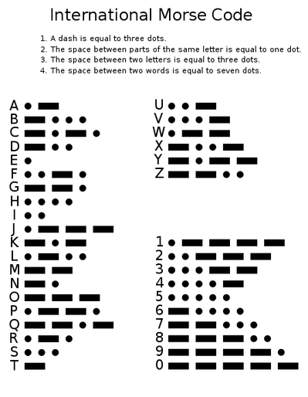
Morse Code
Can be transmitted by written, sound or light. Each letter is replaced by a series of dots and dashes

