Slide 1

L10.2: Hash 第10.2讲：哈希
（深圳）
Lecturer: Zoe L. JIANG
A309
Oct 16, 2018, 15:45-17:30
Most of the slides come from https://drona.csa.iisc.ac.in/~arpita/Cryptography18.html

Slide 2
Recall
Message Authentication Code (MAC)
Definitions- cma, scma, cmva, scmva
Construction from PRF
Domain Extension: How to find a tag for long message
CBC-MAC
Authenticated Encryption (AE)- message privacy + integrity
Definition
Any AE is cca-secure. Stronger than cca-security. Nontrivial proof
Construction of AE from- cpa-secure SKE + cma-secure MAC
Notes:
Today we will see a primitive that lies somewhere between private key and public key world. We will see its application in private key world today. It contributes to both the world with equal poise. . It’s extremely useful and fundamental.

Slide 3
Today’s Roadmap
>> Hash Function: Various Security Notions
>> Markle-Damgaard Domain Extension
>> Davis Meyer Hash function
>> Domain Extension for MAC using Hash function: Hash-and-Mac
Notes:
Today we will see a primitive that lies somewhere between private key and public key world. We will see its application in private key world today. It contributes to both the world with equal poise. . It’s extremely useful and fundamental.

Slide 4

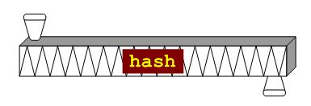
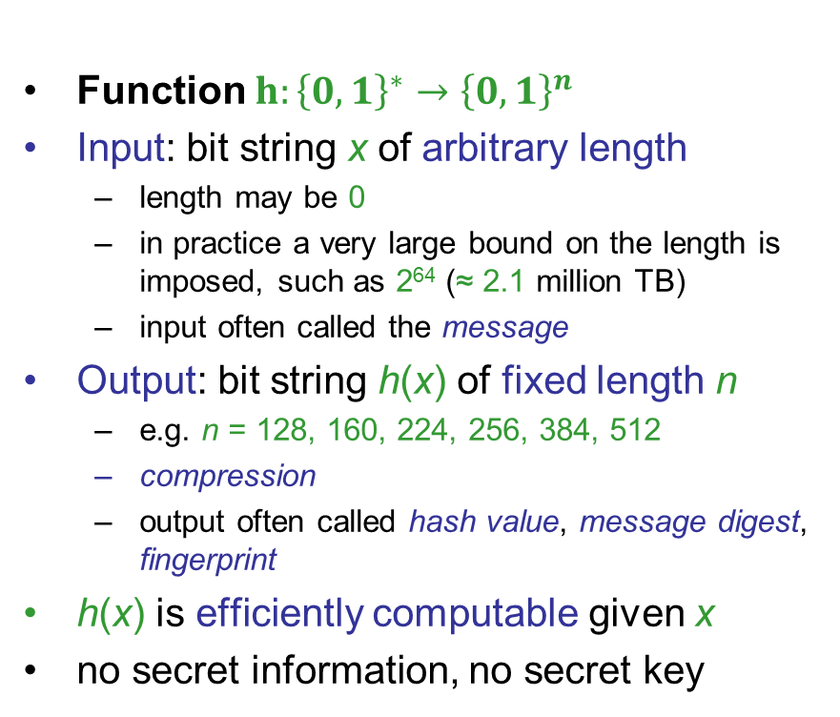
Hash Functions
Informally a hash-function is an efficient (ease of computation) (many-to-one) function mapping arbitrary-length bit-string to fixed-length bit-strings (compression)
Function $h:{\left\{0,1\right\}}^{∗}→{\left\{0,1\right\}}^{n}$
Input: bit string x of arbitrary length
length may be 0
in practice a very large bound on the length is imposed, such as 2⁶⁴ (≈ 2.1 million TB)
input often called the message
Output: bit string h(x) of fixed length n
e.g. n = 128, 160, 224, 256, 384, 512
compression
output often called hash value, message digest, fingerprint
h(x) is efficiently computable given x
no secret information, no secret key
h
{0, 1}^{l(n)}
{0, 1}*

Slide 5
Hash Functions – security requirement
Usually |domain| >>>> |Co-domain| → collisions exist (∃ x₁ ≠ x₂: h(x₁) = h(x₂))
Requirement from a good cryptographic hash function :
Given the description of h, finding collisions should be infeasible- Collision Resistance
Given the description of h, x and h(x) finding x’ with h(x’) = h(x) should be infeasible- Second Preimage Resistance
Given the description of h, given y = h(x) finding x’ with y = h(x’) should be infeasible- Preimage Resistance

Slide 6

Applications of Hash Functions
Application to MAC - Domain Extension
Message digest (hash) of file X
Hash Function
File X
Message digest of a file serves as its unique identifier (unless a collision is found)
The above idea has several applications
File Integrity Check
When a file is downloaded, its hash is also supplied, which is then compared with the hash of the downloaded file
Virus Fingerprinting
Virus scanners store the hashes of known viruses
When an email attachment or an application is downloaded, its hash is compared with the known hashes in the table to identify viruses
Deduplication
When a cloud storage is shared by several users, then storing the same file multiple times by multiple users is avoided by comparing the digests of uploaded files
Password Hashing

Slide 7

Hash Functions
Ivan Damgård:
Collision Free Hash Functions and Public Key Signature Schemes. EUROCRYPT 1987: 203-216

Slide 8


Collision Resistance Security
Experiment Hash-CR (n)
Π = (Gen, h), n
A, Π
Attacker A
k
(x,x’)
k
I can break Π
Let me verify
Collision
Gen(1^{n})
Run time: Poly(n)
game output
1 (A succeeds) if h(x) = h(x’)
0 (A fails) otherwise
Π is Collision Resistant HF if for every A, there is a negl(n) such that
Pr [Hash-CR (n) = 1] ≤ negl(n)
A, Π

Slide 9
Second Preimage Resistance Security
Experiment Hash-SPR (n)
Π = (Gen, h), n
A, Π
Attacker A
k and a uniform x
x’
k
I can break Π
Let me verify
Gen(1^{n})
Run time: Poly(n)
game output
1 (A succeeds) if h(x) = h(x’)
0 (A fails) otherwise
Π is second preimage resistant HF if for every A, there is a negl(n) such that
Pr [Hash-SPR (n) = 1] ≤ negl(n)
A, Π

Slide 10
Collision Resistance & Second Preimage Resistance
h(x)
h(x)
{0, 1}^{n}
{0, 1}^{n}
{0, 1}^{m}
{0, 1}^{m}
g(x)
Collision Resistance → second preimage resistance. Otherway?
Let h: {0, 1}^{m} → {0, 1}^{n} be a second preimage resistant hash function
We can design a new hash function from h which is second preimage resistant but not collision resistant ?
Define a new hash function g: {0, 1}^{m} → {0, 1}^{n} as follows:
0^{n}, if x = 0^{m} or x = 1^{m}
g(x) =
h(x), otherwise
g is collision resistant with probability 0
If h is second preimage resistant with probability negl() then g is second preimage resistant with probability =
1/2^{m-1} + negl() = negligible

Slide 11
Preimage Resistance Security
Experiment Hash-PR (n)
Π = (Gen, h), n
A, Π
Attacker A
k and uniform y
x
k
I can break Π
Let me verify
Gen(1^{n})
Run time: Poly(n)
game output
1 (A succeeds) if h(x) = y
0 (A fails) otherwise
Π Is Preimage Resistant HF if for every A, there is a negl(n) such that
Pr [Hash-PR (n) = 1] ≤ negl(n)
A, Π

Slide 12
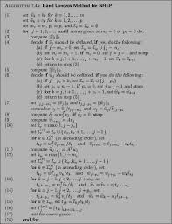
Second Pre-image Resistance → Pre-image Resistance
h(x)
Let h: {0, 1}^{m} → {0, 1}^{n} be a pre-image resistant hash function
{0, 1}^{n}
{0, 1}^{m}
Define a new hash function g: {0, 1}^{m} → {0, 1}^{n} as follows:
Function g
x = (x₀ x₁ … x_{m-2} x_{m-1})
h(x₀ x₁ … x_{m-2} 0)
If h is pre-image resistant with probability negl() then g is pre-image resistant with probability at least
2 negl() = negligible
g is second-preimage resistant with probability 0
Given a random x and g(x), trivial to find x’ ≠ x with g(x’) = g(x)
x’ is the whole x with final bit flipped --- in fact g is also not collision-resistant

Slide 13
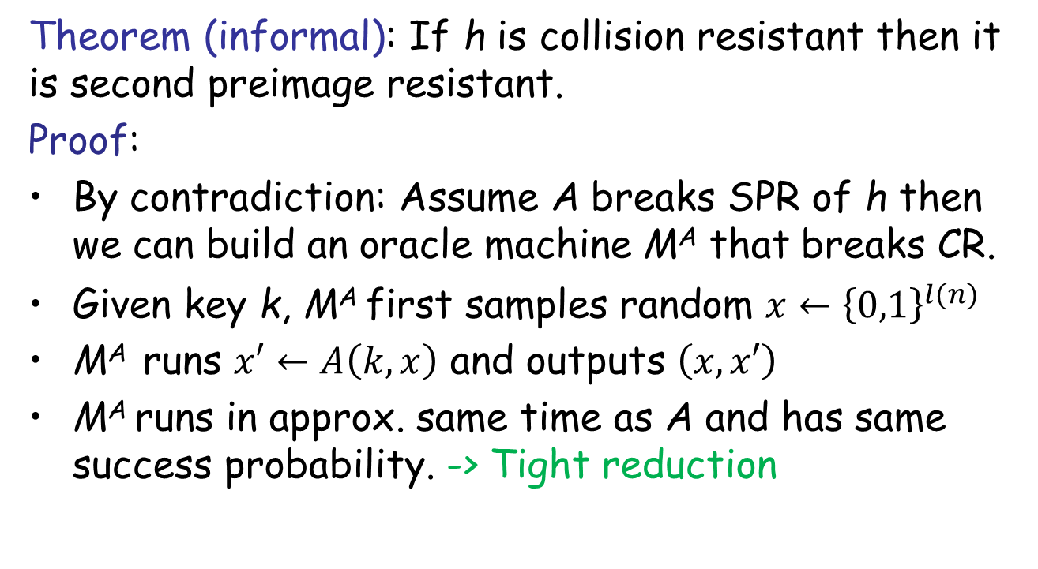
Relation among Security Notions
Easy start: CR -> SPR
Theorem (informal): If h is collision resistant then it is second preimage resistant.
Proof:
By contradiction: Assume A breaks SPR of h then we can build an oracle machine M^{A} that breaks CR.
Given key k, M^{A} first samples random $x←{\left\{0,1\right\}}^{l(n)}$
M^{A} runs $x′←A\left(k,x\right)$ and outputs $\left(x,x′\right)$
M^{A} runs in approx. same time as A and has same success probability. -> Tight reduction

Slide 14
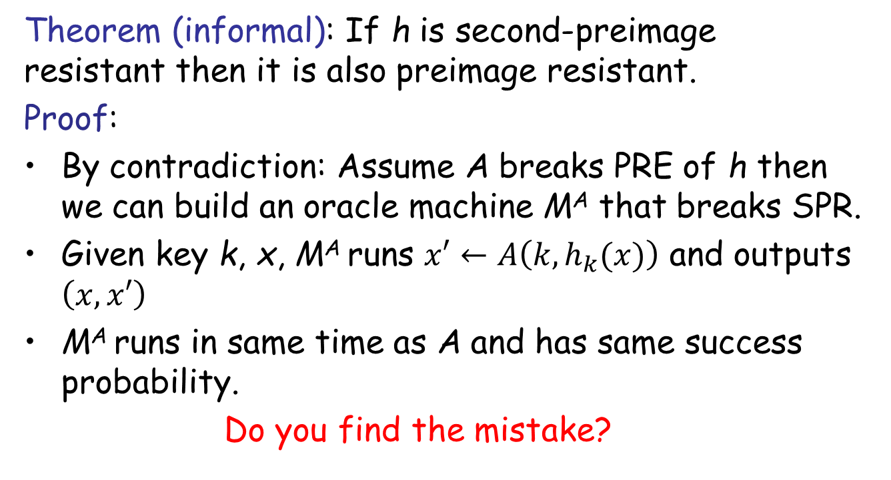
Relation among Security Notions
SPR -> PRE
Theorem (informal): If h is second-preimage resistant then it is also preimage resistant.
Proof:
By contradiction: Assume A breaks PRE of h then we can build an oracle machine M^{A} that breaks SPR.
Given key k, x, M^{A} runs $x′←A\left(k,h_{k}(x)\right)$ and outputs $\left(x,x′\right)$
M^{A} runs in same time as A and has same success probability.
Do you find the mistake?

Slide 15
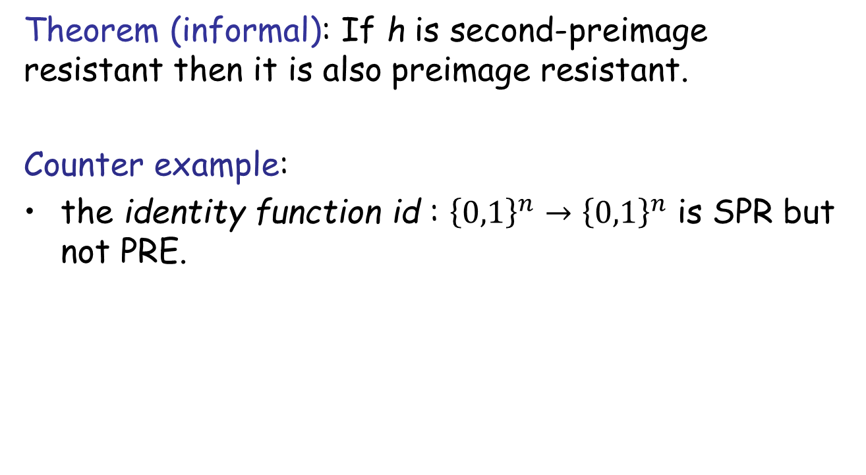
Relation among Security Notions
SPR -> PRE
Theorem (informal): If h is second-preimage resistant then it is also preimage resistant.
Counter example:
the identity function id : ${\left\{0,1\right\}}^{n}→{\left\{0,1\right\}}^{n}$ is SPR but not PRE.

Slide 16

Relation among Security Notions
SPR -> PRE
Theorem (informal): If h is second-preimage resistant then it is also preimage resistant.
Proof:
By contradiction: Assume A breaks PRE of h then we can build an oracle machine M^{A} that breaks SPR.
Given key k, x, M^{A} runs $x′←A\left(k,h_{k}(x)\right)$ and outputs $\left(x,x′\right)$
M^{A} runs in same time as A and has same success probability.
Do you find the mistake?
We are not guaranteed that $x≠x^{′}$ !

Slide 17
Relation among Security Notions
Collision resistance
Second pre-image resistance
Pre-image resistance (One-wayness)

Slide 18
Constructing Hash Functions
Goal: h: {0, 1}* → {0, 1}^{n}
Design a collision-resistant compression function handling fixed-length inputs
>> Stage I: h: {0, 1}^{l’(n)} → {0, 1}^{l(n)} ; l’(n) > l(n)
Use domain extension to handle arbitrary-length inputs
>> Stage II: Domain Extension
Implies compressing by bit as hard (easy) as compressing arbitrary number of bits

Slide 19
The Merkle-Damgaard Transform
Given: A fixed-length collision-resistant function h: {0, 1}^{2n} → {0, 1}^{n}
Goal: A arbitrary-length collision-resistant function h: {0, 1}* → {0, 1}^{n} * < 2^{n}
Divide input x into blocks of length n --- B = L/ n (use 0-padding to make L a multiple of n)
Construction 5.3
x
x₁
x₂
…
x_{B}
x_{B+1} = L
Z₀ = 0^{n}
h
Z₁
h
Z₂
h
Z_{B}
h
g(x)
Used Everywhere in practice! SHA2, MD5

Slide 20
The Merkle-Damgard Transform: Security
Theorem 5.4: If h is a hash function for messages of length 2n, then the Merkle-Damgard transformation yields a collision-resistant hash function for arbitrary length messages.
Proof: Reduction yet again!
If Merkle-Damgard is not collision-resistant then h is also not collision resistant
Let x = (x₁ x₂ … x_{B} L) and x’ = (x’₁ x’₂ … x’_{B’} L’) be two different messages of length L and L’ respectively, such that g(x) = g(x’)
Case I: L’ ≠ L :
x
x₁
x₂
…
x_{B}
L
x’
x’₁
x’₂
…
x’_{B’}
L’
h
h
Z₂
h
Z_{B}
h
0^{n}
h
Z’₂
h
h
g(x’)
0^{n}
Z₁
g(x)
h
Z’₁
Z’_{B’}
Can you spot a collision for h in this case ?

Slide 21
The Merkle-Damgard Transform: Security
Theorem 5.4: If h is a hash function for messages of length 2n, then the Merkle-Damgard transformation yields a collision-resistant hash function for arbitrary length messages.
If Merkle-Damgard is not collision-resistant then h is also not collision resistant
Let x = (x₁ x₂ … x_{B} L) and x’ = (x’₁ x’₂ … x’_{B’} L’) be two different messages of length L and L’ respectively, such that g(x) = g(x’)
Case I: L’ ≠ L :
x
L
x’
L’
Z_{B}
h
g(x)
Z’_{B’}
h
g(x’)
Can you spot a collision for h in this case ?
(Z_{B} || L) ≠ (Z’_{B’} || L’) is a collision for h --- contradiction

Slide 22
The Merkle-Damgard Transform: Security
Theorem 5.4: If h is a hash function for messages of length 2n, then the Merkle-Damgard transformation yields a collision-resistant hash function for arbitrary length messages.
If Merkle-Damgard is not collision-resistant then h is also not collision resistant
Let x = (x₁ x₂ … x_{B} L) and x’ = (x’₁ x’₂ … x’_{B’} L’) be two different messages of length L and L’ respectively, such that g(x) = g(x’)
Case II: L’ = L :
x
x₁
x₂
…
x_{B}
L
x’
x’₁
x’₂
…
x’_{B}
L
h
Z₁
h
Z₂
h
Z_{B}
h
g(x)
h
Z’₁
h
Z’₂
h
Z’_{B}
h
g(x’)
0^{n}
0^{n}
Can you spot a collision for h in this case ?

Slide 23
The Merkle-Damgard Transform: Security
Theorem 5.4: If h is a hash function for messages of length 2n, then the Merkle-Damgard transformation yields a collision-resistant hash function for arbitrary length messages.
If Merkle-Damgard is not collision-resistant then h is also not collision resistant
Let x = (x₁ x₂ … x_{B} L) and x’ = (x’₁ x’₂ … x’_{B’} L’) be two different messages of length L and L’ respectively, such that g(x) = g(x’)
Case II: L’ = L :
x
x₁
x₂
…
x_{B}
L
x’
x’₁
x’₂
…
x’_{B}
L
h
Z₁
h
Z₂
h
Z_{B}
h
g(x)
h
Z’₁
h
Z’₂
h
Z’_{B}
h
g(x’)
0^{n}
0^{n}
Can you spot a collision for h in this case ?
Define I_{i} = (x_{i} || Z_{i-1}) and I’_{i} = (x’_{i} || Z’_{i-1} ) --- inputs for the i^{th} invocation of h
Let N be the largest index with I_{N} ≠ I’_{N} --- such an N always exist

Slide 24
The Merkle-Damgard Transform: Security
Theorem 5.4: If h is a hash function for messages of length 2n, then the Merkle-Damgard transformation yields a collision-resistant hash function for arbitrary length messages.
If Merkle-Damgard is not collision-resistant then h is also not collision resistant
Let x = (x₁ x₂ … x_{B} L) and x’ = (x’₁ x’₂ … x’_{B’} L’) be two different messages of length L and L’ respectively, such that g(x) = g(x’)
Case II: L’ = L :
x
x_{N}
L
x’
x’_{N}
L
Z_{N-1}
h
Z_{N}
Z’_{N-1}
h
Z’_{N}
By maximality of N, Z_{N} = Z’_{N} as I_{N+1} = I’_{N+1} and so on
(x’_{i} || Z_{i-1}) ≠ (x’_{i} || Z’_{i-1} ) is a collision for h --- contradiction

Slide 25
The Merkle-Damgard Transform: Security
Theorem 5.4: If h is a hash function for messages of length 2n, then the Merkle-Damgard transformation yields a collision-resistant hash function for arbitrary length messages.
If Merkle-Damgard is not collision-resistant then h is also not collision resistant
Let x = (x₁ x₂ … x_{B} L) and x’ = (x’₁ x’₂ … x’_{B’} L’) be two different messages of length L and L’ respectively, such that g(x) = g(x’)
Case II: L’ = L :
x
x_{N}
x_{N+1}
L
x’
x’_{N}
x’_{N+1}
L
Z_{N-1}
h
h
Z’_{N-1}
h
Z’_{N}
Z_{N}
h
By maximality of N, Z_{N} = Z’_{N} as I_{N+1} = I’_{N+1} and so on
So h(I_{N}) = h(I’_{N}), even though I_{N} ≠ I’_{N}
(I_{N}, I’_{N}) constitutes a collision for h --- a contradiction

Slide 26
Constructing Hash Functions
Goal: h: {0, 1}* → {0, 1}^{n}
>> Stage I: h: {0, 1}^{l’(n)} → {0, 1}^{l(n)} ; l’(n) > l(n)
>> Stage II: Domain Extension
>> Davies-Meyer construction,
>> Matyas-Meyer-Oseas construction,
>> Miyaguchi-Preneel construction, etc
>> Heuristics.
>> None of them are provably secure
>> Weak guarantees of them being collision resistant is known☹

Slide 27
Practical Construction of Hash Functions
MD5 :
128-bit output; designed in 1991 and believed to be secure (collision-resistant)
Completely broken in 2004 by Chinese cryptanalysts; collision can be found in less than a minute on a desktop PC
SHA (Secure Hash Algorithm) Family
Standardized by NIST. Got two flavors SHA-1 and SHA-2
First a fixed-length compression function designed from a block cipher
In the second stage, the Merkle-Damgard transformation is applied
Special block ciphers designed for the stage I
SHA-3 (Keccak)
Winner of the NIST competition for hash functions
Construction very different from previous constructions
For stage I uses an un-keyed permutation of block length 1600 bits
For stage II uses a new approach called sponge construction

Slide 28

Message Authentication Using Hash Functions
Given a fixed-length MAC, we can design arbitrary-length MAC using two methods:
Method I: Generic (randomized) but inefficient construction
l
m
m₁
m₂
m₃
1
l
r
2
l
r
3
l
r
Mac_{k}(m) = t = (r, t₁ || t₂ || t₃)
k
Mac
Mac
Mac
t₁ = Mac_{k}(m₁ || 1 || l || r)
t₂ = Mac_{k}(m₂ || 2 || l || r)
t₃ = Mac_{k}(m₃ || 1 || l || r)
Method II: Efficient CBC-Mac
m
m₂
Can we do further improvement using hash functions ?
m₁
m₃
|m|
⊕
⊕
⊕
k
F
F
F
F
t = Mac_{k}(m)

Slide 29
Message Authentication Using Hash Functions (Hash-and-MAC Paradigm)
Given an arbitrary-length message, compute its Mac-tag in two stages:
Step I: Compress the arbitrary-length message to a fixed-length string using a CRHF
Step II: Compute the Mac-tag on the message digest (output of the CRHF)
Let:
Π_{MAC} = (Mac, Vrfy) be a MAC for messages of length l(n)
h: {0, 1}* → {0, 1}^{l(n)} be a collision-resistant hash function
Then Π’_{MAC} = (Mac’, Vrfy’) is a MAC for arbitrary-length messages constructed as follows:
Construction 5.5
Tag Generation
Tag Verification
m ∈ {0, 1}*
m ∈ {0, 1}*
h
h
d
t
d
⊥
k
0
k
Mac
Vrfy
t
Mac’
Vrfy’

Slide 30
Message Authentication Using Hash Functions (Hash-and-MAC Paradigm)
Given an arbitrary-length message, compute its Mac-tag in two stages:
Step I: Compress the arbitrary-length message to a fixed-length string using a CRHF
Step II: Compute the Mac-tag on the message digest (output of the CRHF)
Let:
Π_{MAC} = (Mac, Vrfy) be a MAC for messages of length l(n)
h: {0, 1}* → {0, 1}^{l(n)} be a collision-resistant hash function
Then Π’_{MAC} = (Mac’, Vrfy’) is a MAC for arbitrary-length messages constructed as follows:
Construction 5.5
Tag Generation
Tag Verification
m ∈ {0, 1}*
m ∈ {0, 1}*
h
h
d
t
d
m
k
1
k
Mac
Vrfy
t
Mac’
Vrfy’
The above construction is more efficient than CBC-Mac --- is it secure ?

Slide 31
Hash-and-MAC Paradigm: Security (Sketch)
Tag Generation
Tag Verification
m ∈ {0, 1}*
m ∈ {0, 1}*
h
h
d
t
d
m
k
1
k
Mac
Vrfy
t
Mac’
Vrfy’
Theorem 5.6: The above construction gives a secure MAC for arbitrary-length messages
m₁, m₂, …, m_{q}
PPT Attacker A
t₁, t₂, …, t_{q}
t_{i} = Mac_{k}(h(m_{i}))
k
(m*, t*)
Gen(1^{n})
I can forge (Mac’, Vrfy’)
MAC-Oracle
A successfully forges (Mac’, Vrfy’) if m* ≠ m₁, m₂, …, m_{q} and Vrfy_{k}(m*, t*) = 1
The above is possible under two possible cases:
Case I: There exists some m_{i} ∈ {m₁, …, m_{q}} such that h(m_{i}) = h(m*) --- then Mac’_{k}(m_{i}) = Mac’_{k}(m*) = t_{i}
But the probability that h(m*) = h(m_{i}) for m* ≠ m_{i} is negligible ---- as h is a CRHF

Slide 32
Hash-and-MAC Paradigm: Security (Sketch)
Tag Generation
Tag Verification
m ∈ {0, 1}*
m ∈ {0, 1}*
h
h
d
t
d
m
k
1
k
Mac
Vrfy
t
Mac’
Vrfy’
Theorem 5.6: The above construction gives a secure MAC for arbitrary-length messages
m₁, m₂, …, m_{q}
PPT Attacker A
t₁, t₂, …, t_{q}
t_{i} = Mac_{k}(h(m_{i}))
k
(m*, t*)
Gen(1^{n})
I can forge (Mac’, Vrfy’)
MAC-Oracle
Need to formally prove the two cases via suitable reductions
A successfully forges (Mac’, Vrfy’) if m* ≠ m₁, m₂, …, m_{q} and Vrfy_{k}(m*, t*) = 1
The above is possible under two possible cases:
Case II: There exists no m_{i} ∈ {m₁, …, m_{q}} such that h(m_{i}) = h(m*)
Then Vrfyk(m*, t*) = 1 only if A is able to forge Π_{MAC} = (Mac, Vrfy) --- contradiction

Slide 33
References
[1] Jonathan Katz, Yehuda Lindell. Chapter 5.1-5.3, Introduction to Modern Cryptography, 2nd Edition, Chapman & Hall/CRC Cryptography and Network Security Series, 2014
[2] http://drona.csa.iisc.ernet.in/~arpita/Cryptography17.html

Slide 34
Private-key Cryptography: A Top-down Approach
Private-key Cryptography
Message Authentication Codes
Pseudorandom Permutations
Block Ciphers
Pseudorandom Generators
Next few lectures
One-way Functions
Number Theoretic Assumptions
Public-key Cryptography

