Slide 1

L11.1: Block cipher-DES 第11.1讲：分组密码-DES
（深圳）
Lecturer: Zoe L. JIANG
A309
Oct 17, 2018, 8:00-9:45
Notes:
The objective of this lecture is to illustrate the principle of block cipher, one of the most important modern symmetric ciphers.

Slide 2
Recall
Substitution cipher替换密码: Each character in the plaintext is substituted by another character in the ciphertext
Monoalphabetic cipher单字母单表密码
Caesar cipher (Shift cipher)
Mixed alphabetic cipher
Morse code
Polyalphabetic cipher单字母多表密码
Vigenère cipher
Multiple letter cipher多字母单表密码
Playfair cipher
Hill cipher
A special substitution cipher
One-time pad (OTP)
Transposition cipher置换密码: Hide the message by rearranging the letter order
Rotor machine转轮密码机

Slide 3
Outline
Block cipher vs stream cipher
Ideal block cipher
Substitution-Permutation networks
Feistel networks
The simplified DES
The Data Encryption Standard (DES)
Notes:
The objective of this chapter is to illustrate the principles of modern symmetric ciphers. For this purpose, we briefly go through the notion of block cipher and stream cipher, introduce the ideal block cipher, and then focus on the most widely used symmetric cipher: the Data Encryption Standard (DES). Although numerous symmetric ciphers have been developed since the introduction of DES, and although it is destined to be replaced by the Advanced Encryption Standard (AES), DES remains the most important of such algorithms. To make the algorithm easy, I introduce the simplified DES for education purpose. Further, the core component of DES, the Feistel structure will be discussed. Lastly, I’ll share with you the specific algorithm of DES. I heard that some of the students take the course of network security, which also introduces such concept.

Slide 4
Block cipher vs stream cipher
Block ciphers process messages in blocks, each of which is then en/decrypted
like a substitution on very big characters, 64-bits or more
Stream ciphers process messages a bit or byte at a time when en/decrypting
Block ciphers have been better analyzed with broader range of applications, especially in network-based security
Notes:
Block ciphers work a on block / word at a time, which is some number of bits. All of these bits have to be available before the block can be processed. Stream ciphers work on a bit or byte of the message at a time, hence process it as a “stream”. Block ciphers are currently better analysed, and seem to have a broader range of applications, hence focus on them. In this course, our discussion will primarily focus on block cipher.

Slide 5
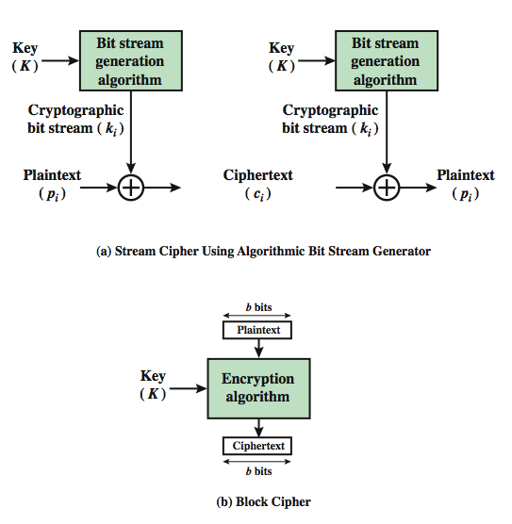
Block cipher vs stream cipher
This figure is from Chapter 3 of William Stallings: “Cryptography and Network Security”, Fifth Edition, Prentice-Hall.
Notes:
A block cipher is one in which a block of plaintext is treated as a whole and used to produce a ciphertext block of equal length. Typically, a block size of 64 or 128 bits is used. As with a stream cipher, the two users share a symmetric encryption key. A stream cipher is one that encrypts a digital data stream one bit or one byte at a time.

Slide 6
Outline
Block cipher vs stream cipher
Ideal block cipher
Substitution-Permutation networks
Feistel networks
The simplified DES
The Data Encryption Standard (DES)
Notes:
The objective of this chapter is to illustrate the principles of modern symmetric ciphers. For this purpose, we briefly go through the notion of block cipher and stream cipher, introduce the ideal block cipher, and then focus on the most widely used symmetric cipher: the Data Encryption Standard (DES). Although numerous symmetric ciphers have been developed since the introduction of DES, and although it is destined to be replaced by the Advanced Encryption Standard (AES), DES remains the most important of such algorithms. To make the algorithm easy, I introduce the simplified DES for education purpose. Further, the core component of DES, the Feistel structure will be discussed. Lastly, I’ll share with you the specific algorithm of DES. I heard that some of the students take the course of network security, which also introduces such concept.

Slide 7
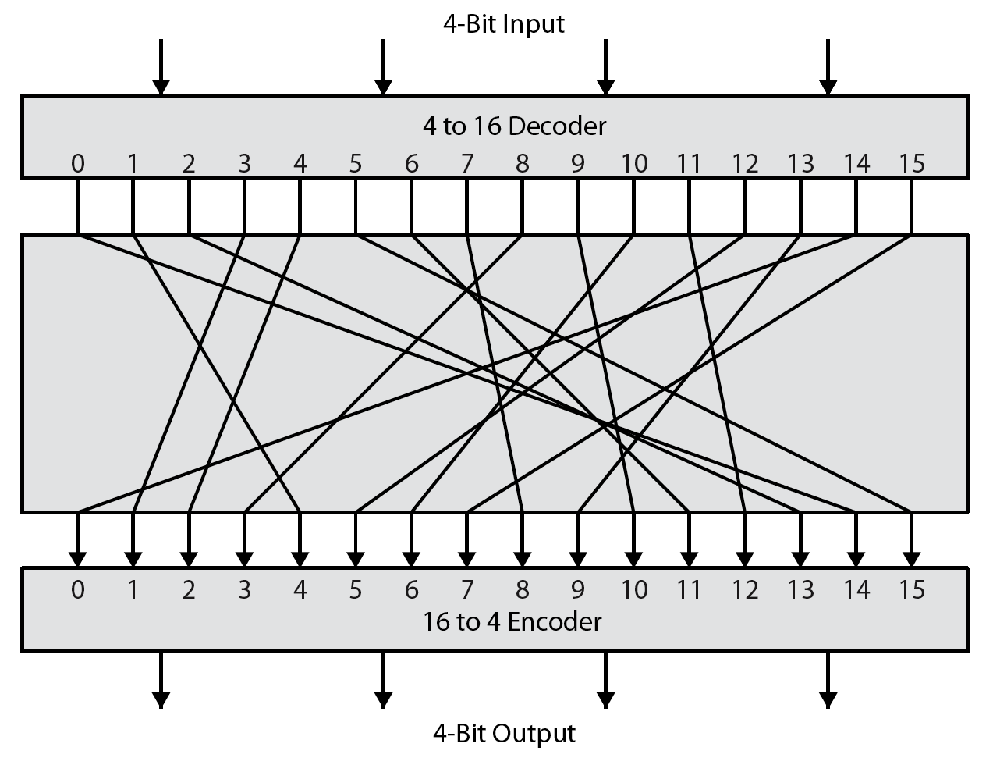
Ideal block cipher
codebook
Random permutation
This figure is from Chapter 3 of [1]
Notes:
We try to replace a block of 4 bits from the plaintext with a block of 4 bits from the ciphertext.
There are 16 different possible 4-bit patterns, from 0000 to 1111. We can represent each pattern by an integer between 0 and 15. So the bit pattern 0000 could be represented by the integer 0, the bit pattern 0001 by integer 1, and so on. The bit pattern 1111 would be represented by the integer 15. In an ideal block cipher, the relationship between the input blocks and the output blocks is completely random. But it must be invertible for decryption to work. Therefore, it has to be one-to-one, meaning that each input block is mapped to a unique output block.
The mapping from the input bit blocks to the output bit blocks can also be construed as a mapping from the integers corresponding to the input bit blocks to the integers corresponding to the output bit blocks

Slide 8
Ideal block cipher
1110
0110
1101
0001
0010
1111
1011
1000
0011
1010
0110
1100
0101
1001
0000
0111
Encryption key: codebook
Meaning the table that shows the relationship between the input blocks and the output blocks
With a 4-bit block cipher
2⁴ different possible patterns <==> 2⁴ different integers
A 4-bit block output for each integer
The size of the codebook is 4×2⁴ = 64 bits
With a 64-bit block cipher
2⁶⁴ different possible patterns <==> 2⁶⁴ different integers
A 64-bit block output for each integer
The size of the codebook is 64×2⁶⁴ ≈ 10²¹ (bits)
Notes:
With a 64-bit block, we can think of each possible input block as one of 2^64 integers and for each such integer we can specify an output 64-bit block. We can construct the codebook by displaying just the output blocks in the order of the integers corresponding to the input blocks. Such a codebook will be of size 64×2^64 ≈ 10^21.
That implies that the encryption key for the ideal block cipher using 64-bit blocks will be of size 10^21. The size of the encryption key would make the ideal block cipher an impractical idea. Think of the logistical issues related to the transmission, storage, and processing of such large keys.

Slide 9
Outline
Block cipher vs stream cipher
Ideal block cipher
Substitution-Permutation networks
Feistel networks
The simplified DES
The Data Encryption Standard (DES)
Notes:
The objective of this chapter is to illustrate the principles of modern symmetric ciphers. For this purpose, we briefly go through the notion of block cipher and stream cipher, introduce the ideal block cipher, and then focus on the most widely used symmetric cipher: the Data Encryption Standard (DES). Although numerous symmetric ciphers have been developed since the introduction of DES, and although it is destined to be replaced by the Advanced Encryption Standard (AES), DES remains the most important of such algorithms. To make the algorithm easy, I introduce the simplified DES for education purpose. Further, the core component of DES, the Feistel structure will be discussed. Lastly, I’ll share with you the specific algorithm of DES. I heard that some of the students take the course of network security, which also introduces such concept.

Slide 10
Diffusion and confusion扩散与混淆
Diffusion: make the relationship between the plaintext and ciphertext as complex as possible in order to thwart attempts to deduce the key
have each plaintext digit affect the value of many ciphertext digits
The effect is the statistical structure of the plaintext has been dissipated
repeatedly perform permutation on the data followed by applying a function to that permutation
The effect is that bits from different positions in the original plaintext contribute to a single bit of ciphertext
Notes:
These two terms were introduced by Shannon to capture the two building blocks for any cryptographic system.
Shannon’s concept was to thwart cryptanalysis based on statistical analysis. The reasoning is as follows. Assume the attacker has some knowledge of the statistical characteristics of the plaintext. For example, in a human-readable message in some language, the frequency distribution of the various letters may be known. Or there may be words or phases likely to appear in the message. If these statistics are in any way reflected in the ciphertext, the cryptanalyst may be able to deduce the encryption key, or part of the encryption key. Therefore, Shannon claims that all statistics of the ciphertext should be independent of the particular key used. The ideal block cipher is such a cipher, but as we have seen, it is impractical. Shannon suggests two methods for frustrating statistical cryptanalysis: diffustion and confusion.
Permutation is not equal to diffusion. Permutation, by itself, does not change the statistics of the plaintext at the level of individual letter or permuted blocks.

Slide 11
Diffusion and confusion
Confusion: make the relationship between the statistics of the ciphertext and the value of the encryption key as complex as possible, again to thwart attempts to discover the key
Achieved by using a complex substitution algorithm

Slide 12
Substitution-Permutation Networks
A variant of the Confusion-Diffusion Paradigm
{f_{i}} are fixed and are called s-boxes
Sub-keys are XORed with intermediate result
Sub-keys are generated from the master key according to a key schedule
Each round has three steps
Message XORed with sub-key
Message divided and went through s-boxes
Message goes through a mixing permutation (bits reordered)

Slide 13
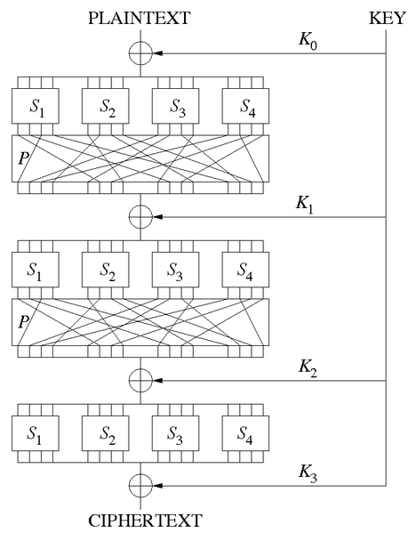
Taken from http://en.wikipedia.org/wiki/Substitution-permutation_network

Slide 14
Design Principles of Substitution-Permutation Networks
Design Principle 1. S-boxes are invertible
Design Principle 2. The avalanche effect: small changes in input result in large changes in output.
A single-bit difference in each s-box results in changes in at least two bits in output
The mixing permutation distributes the output bits of any s-box into different s-boxes
The above, with sufficient number of rounds, achieves the avalanche effect.

Slide 15
Outline
Block cipher vs stream cipher
Ideal block cipher
Substitution-Permutation networks
Feistel networks
The simplified DES
The Data Encryption Standard (DES)
Notes:
The objective of this chapter is to illustrate the principles of modern symmetric ciphers. For this purpose, we briefly go through the notion of block cipher and stream cipher, introduce the ideal block cipher, and then focus on the most widely used symmetric cipher: the Data Encryption Standard (DES). Although numerous symmetric ciphers have been developed since the introduction of DES, and although it is destined to be replaced by the Advanced Encryption Standard (AES), DES remains the most important of such algorithms. To make the algorithm easy, I introduce the simplified DES for education purpose. Further, the core component of DES, the Feistel structure will be discussed. Lastly, I’ll share with you the specific algorithm of DES. I heard that some of the students take the course of network security, which also introduces such concept.

Slide 16
Feistel Networks
A high-level structure that constructs an invertible function from non-invertible components
Components do not need to be invertible
Can thus behave “more randomly”
A Feistel network is fully specified given
the block size: n = 2w
number of rounds: d
d round functions f₁, …, f_{d}: {0,1}^{w} → {0,1}^{w}
Used in DES, IDEA, RC5, and many other block ciphers; but not in AES

Slide 17
Feistel Networks
w bits
w bits
L₀
R₀
Encryption:
L₁=R₀ R₁=L₀ ⊕ f₁(R₀)
L₂=R₁ R₂=L₁ ⊕ f₂(R₁)
…
L_{d}=R_{d-1} R_{d}=L_{d-1}⊕f_{d}(R_{d-1})
⊕
f₁
L₁
R₁
⊕
f₂
Decryption:
R_{d-1}=L_{d} L_{d-1}=R_{d} ⊕ f_{d}(L_{d}) … R₀=L₁; L₀=R₁ ⊕f₁(L₁)
L_{d-1}
R_{d-1}
⊕
f_{d}
R_{d}
L_{d}

Slide 18
Feistel Network
Always invertible no matter what the round function is.
Each round function is similar to that in the substitution-permutation network
Except that the s-boxes do not need to be invertible

Slide 19
Outline
Block cipher vs stream cipher
Ideal block cipher
Substitution-Permutation networks
Feistel networks
The simplified DES
The Data Encryption Standard (DES)
Notes:
The objective of this chapter is to illustrate the principles of modern symmetric ciphers. For this purpose, we briefly go through the notion of block cipher and stream cipher, introduce the ideal block cipher, and then focus on the most widely used symmetric cipher: the Data Encryption Standard (DES). Although numerous symmetric ciphers have been developed since the introduction of DES, and although it is destined to be replaced by the Advanced Encryption Standard (AES), DES remains the most important of such algorithms. To make the algorithm easy, I introduce the simplified DES for education purpose. Further, the core component of DES, the Feistel structure will be discussed. Lastly, I’ll share with you the specific algorithm of DES. I heard that some of the students take the course of network security, which also introduces such concept.

Slide 20
The simplified DES
Not a secure encryption algorithm
Only for educational purpose
Use smaller parameters
Key size = 10 bits (56 bits for DES)
Number of rounds = 2 (16 for DES)
Plaintext block = 8 bits (64 bits for DES)
Ciphertext block = 8 bits (64 bits for DES)
Notes:
The simplified DES includes 2 rounds, one key for each round.

Slide 21
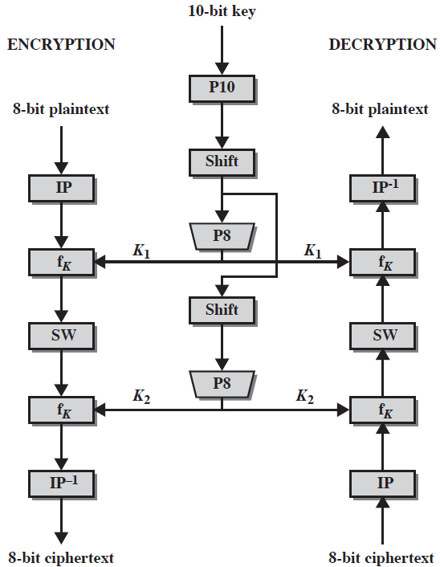
Overview
Subkey Gen
K₁ = P10 ° shift ° P8
K₂ = P10 ° shift ° shift ° P8
Enc
IP⁻¹ ° f_{K2} ° SW ° f_{K1} ° IP
Dec
IP⁻¹ ° f_{K1} ° SW ° f_{K2} ° IP
This figure is from Appendix G of [1]
Notes:
The S-DES encryption algorithm takes an 8-bit block of plaintext (example: 10111101) and a 10-bit key as input and produces an 8-bit block of ciphertext as output. The S-DES decryption algorithm takes an 8-bit block of ciphertext and the same 10-bit key used to produce that ciphertext as input and produces the original 8-bit block of plaintext.

Slide 22
Subkey Generation
Two 8-bit subkeys are generated from the 10-bit key (sixteen 48-bit subkeys are generated from the 64-bit key (actually 56 bits) for DES)
P10: 10-bit permutation
P8: 8-bit permutation
LS-1: left circular shift with 1 position
LS-2: left circular shift with 2 positions
Notes:
We shall use the following operations for the subkey generation.

Slide 23
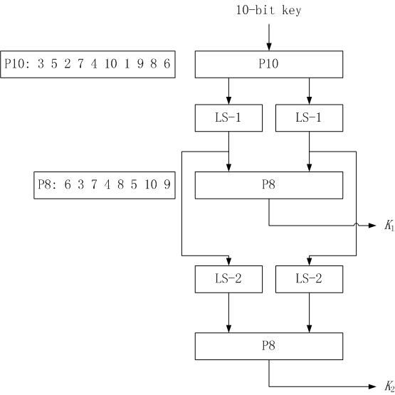
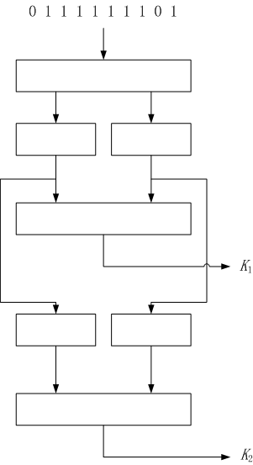
Subkey Generation
1 1 1 1 1 1 0 0 1 1
1 1 1 1 1
0 0 1 1 1
0 1 0 1 1 1 1 1
1 1 1 1 1
1 1 1 0 0
1 1 1 1 1 1 0 0
Notes:
As the flow shows, the 10-bit key is permuted using P10, then performs the left circular shift with 1 position. On one hand, it is further permuted using P8 to get K₁. On the other hand, the left circular shift result is divided into 2 parts. The left half part further left circularly shifts 2 positions. Similarly, the right half part left circularly shifts 2 position. The combined result performs P8 to get the second subkey.

Slide 24
Encryption
Two rounds
IP: Initial permutation
IP⁻¹: Inverse initial permutation
E/P: Expansion/permutation
P4: 4-bit permutation
S₀, S₁: Substitution box
The first and last bits of the input to S₀ form a 2-bit binary number to select one of 4 rows. The middle two bits of the input to S₀ select one of the 4 columns. The decimal value in the cell selected by the row and column is then converted to its 2-bit representation to produce the output

Slide 25
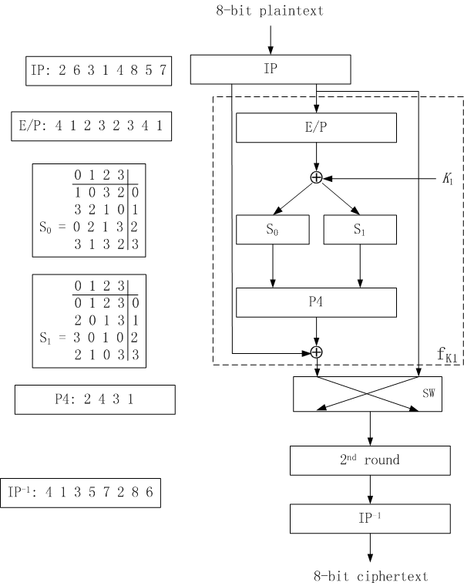
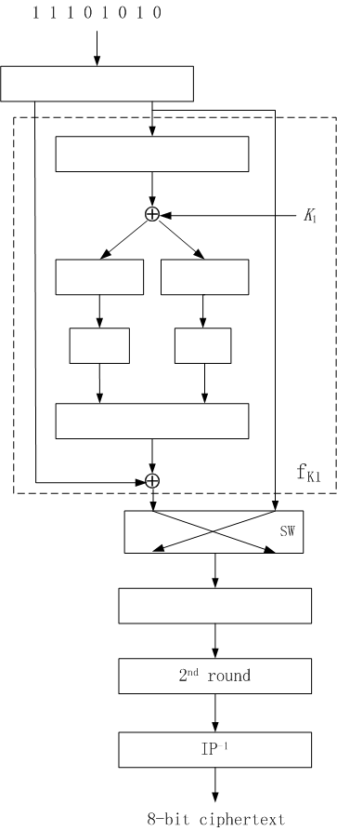
Encryption
1 0 1 1 0 0 1 1
1 0 0 1 0 1 1 0
0 1 0 1 1 1 1 1
1 1 0 0
1 0 0 1
0 1
1 0
1 0 1 0
f_{K}(L, R) = (L ⊕ F(R, SK), R)
Notes:
The encryption algorithm performs initial permutation on 8-bit plaintext, the right half part then performs the expansion and permutation operation, which is XORed with the first subkey K1. The left half part and right half part of the output are further fit into S0 and S1 box to perform substitutions. The substitution result performs 4-bit permutation, which is XORed with the left half 4 bits after IP. Then the result combining with the right half 4 bits after IP is taken as the input of the second round.
The first and last bits of the input to S0 form a 2-bit binary number to select one of 4 rows. The middle two bits of the input to S0 select one of the 4 columns. The decimal value in the cell selected by the row and column is then converted to its 2-bit representation to produce the output.

Slide 26
Security analysis
Key space is 2¹⁰
Given a 8-bit plaintext and the corresponding 8-bit ciphertext, the corresponding10-bit key can be written as 8 nonlinear equations with 10 unknowns
Not secure!

Slide 27
Outline
Block cipher vs stream cipher
Ideal block cipher
Substitution-Permutation networks
Feistel networks
The simplified DES
The Data Encryption Standard (DES)
Notes:
The objective of this chapter is to illustrate the principles of modern symmetric ciphers. For this purpose, we briefly go through the notion of block cipher and stream cipher, introduce the ideal block cipher, and then focus on the most widely used symmetric cipher: the Data Encryption Standard (DES). Although numerous symmetric ciphers have been developed since the introduction of DES, and although it is destined to be replaced by the Advanced Encryption Standard (AES), DES remains the most important of such algorithms. To make the algorithm easy, I introduce the simplified DES for education purpose. Further, the core component of DES, the Feistel structure will be discussed. Lastly, I’ll share with you the specific algorithm of DES. I heard that some of the students take the course of network security, which also introduces such concept.

Slide 28
Data Encryption Standard (DES)
Most widely used block cipher in the world
Adopted in 1977 by NBS (now NIST) as FIPS PUB 46
Encrypt 64-bit data using 56-bit key

Slide 29
DES History
IBM developed Lucifer cipher
by team led by Feistel in the late 1960’s
used 64-bit data blocks with 128-bit key in 1971
then redeveloped as a commercial cipher with input from NSA and others with a reduced key size of 56 bits to fit on a single chip
in 1973 NBS issued a request for proposals for a national cipher standard
IBM submitted their revised Lucifer which was eventually accepted as the DES
Notes:
In the late 1960s, IBM set up a research project in computer cryptography led by Horst Feistel. The project concluded in 1971 with the development of the LUCIFER algorithm. LUCIFER is a Feistel block cipher that operates on blocks of 64 bits, using a key size of 128 bits.
Because of the promising results produced by the LUCIFER project, IBM embarked on an effort, headed by Walter Tuchman and Carl Meyer, to develop a marketable commercial encryption product that ideally could be implemented on a single chip. It involved not only IBM researchers but also outside consultants and technical advice from NSA. The outcome of this effort was a refined version of LUCIFER that was more resistant to cryptanalysis but that had a reduced key size of 56 bits, to fit on a single chip.
In 1973, the National Bureau of Standards (NBS) issued a request for proposals for a national cipher standard. IBM submitted the modified LUCIFER. It was by far the best algorithm proposed and was adopted in 1977 as the Data Encryption Standard.

Slide 30
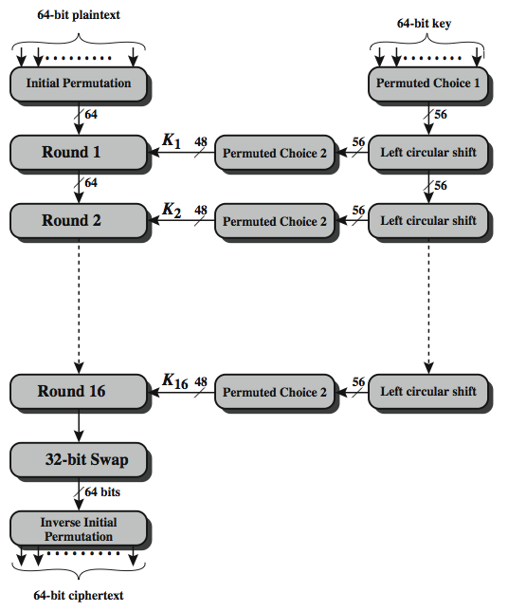
DES Encryption Overview
This figure is from Chapter 3 of William Stallings: “Cryptography and Network Security”, Fifth Edition, Prentice-Hall.
Notes:
The overall scheme for DES encryption is illustrated in Stallings Figure 3.4, which takes as input 64-bits of data and of key.
The left side shows the basic process for enciphering a 64-bit data block which consists of:
- an initial permutation (IP) which shuffles the 64-bit input block
- 16 rounds of a complex key dependent round function involving substitutions & permutations
- a final permutation, being the inverse of IP
The right side shows the handling of the 56-bit key and consists of:
- an initial permutation of the key (PC1) which selects 56 bits out of the 64-bit input, in two 28-bit halves
- 16 stages to generate the 48-bit subkeys using a left circular shift and a permutation of the two 28-bit halves

Slide 31
DES Encryption Overview
The overall scheme for DES encryption takes as input 64-bits of data and of key
The left side shows the basic process for enciphering a 64-bit data block which consists of:
an initial permutation (IP) which shuffles the 64-bit input block
16 rounds of a complex key dependent round function involving substitutions & permutations
Left and right halves are swapped
a final permutation, being the inverse of IP

Slide 32
DES Encryption Overview
The right side shows the handling of the 56-bit key and consists of:
an initial permutation of the key (PC1) which selects 56 bits out of the 64-bit input, in two 28-bit halves
16 stages to generate the 48-bit subkeys using a left circular shift and a permutation of the two 28-bit halves

Slide 33
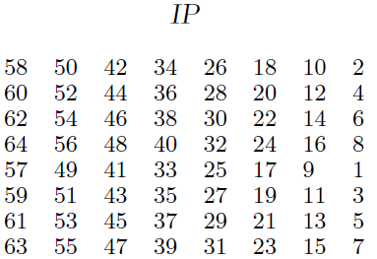
Initial Permutation IP
IP reorders the input data bits
Even bits to LH, odd bits to RH
No cryptographic value
Example: IP(675a6967 5e5a6b5a) = (ffb2194d 004df6fb)
Notes:
It is the first step of the data computation.

Slide 34
One round of DES structure
This figure is from Chapter 3 of William Stallings: “Cryptography and Network Security”, Fifth Edition, Prentice-Hall.

Slide 35
One round of DES structure
Use two 32-bit L & R halves
Round function as any Feistel cipher describes:
L_{i} = R_{i–1}
R_{i} = L_{i–1} ⊕ F(R_{i–1}, K_{i})
F takes 32-bit R half and 48-bit subkey
Expand R to 48-bits using permutation E/P
Add to subkey using XOR
Pass through 8 S-boxes to get 32-bit result
Permute using 32-bit permutation P-box

Slide 36
DES Round in Full
Notes:
This is a DES round in full. I’ll stop here to not go into more details about it. Basically, this picture shows how E/P, S-boxes and P-box work.

Slide 37
Strength of DES – Key Size
56-bit keys have 2⁵⁶ = 7.2 x 10¹⁶ values
Brute force search looks hard
A parallel machine with 1 million encryption devices, each of which could perform one encryption per ms. The average search time down to about 10 hours.
Proved insecure
“DES cracker” by EFF broke DES less than three days in 1998
Must now consider alternatives to DES

Slide 38
Weak Keys
Let C₀ and D₀ be the 28 bit key halves
There are 4 week keys in the keyspace (256)
C₀ = All zeros & D₀ = All zeros
C₀ = All ones & D₀ = All zeros
C₀ = All zeros & D₀ = All ones
C₀ = All ones & D₀ = All ones
There are 12 semi-weak keys, where C₀ & D₀ are the following in some combination
All zeros, All ones, 010101…, 101010…
-- for details see Handbook of Applied Cryptography.

Slide 39
Attacks on DES
Brute force
Linear Cryptanalysis
Known plaintext attack
Differential cryptanalysis
Chosen plaintext attack
Modify plaintext bits, observe change in ciphertext
No dramatic improvement on brute force

Slide 40
Countering Attacks
Large keyspace combats brute force attack
Triple DES, typically two key mode: E_{k1}D_{k2}E_{k1}
Encryption:
c = Ek₁(Dk₂(Ek₁(m))
Decryption:
m = Dk₁(Ek₂(Dk₁(c))
Use AES

Slide 41
References
[1] Stallings William. Chapter 3, Cryptography and Network Security: Principles and Practice, 5th Edition. Prentice Hall, 2011
[2] http://terenceli.github.io/assets/file/mimaxue/SDES.pdf
[3] C. Shannon. Communication Theory of Secrecy Systems, Bell System Technical Journal, No. 4, 1949

Slide 42
Homework
Why 2DES is insecure?

Slide 43
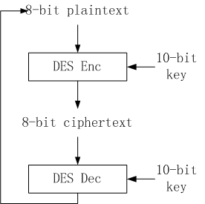
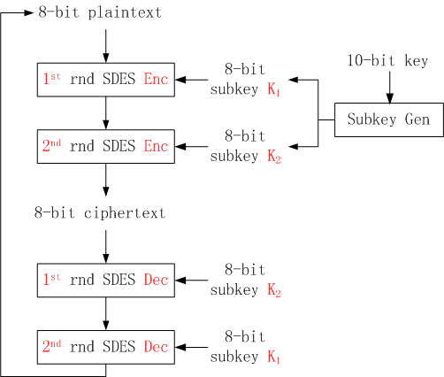
Overview
Notes:
The S-DES encryption algorithm takes an 8-bit block of plaintext (example: 10111101) and a 10-bit key as input and produces an 8-bit block of ciphertext as output. The S-DES decryption algorithm takes an 8-bit block of ciphertext and the same 10-bit key used to producethat ciphertext as input and produces the original 8-bit block of plaintext.

Slide 44
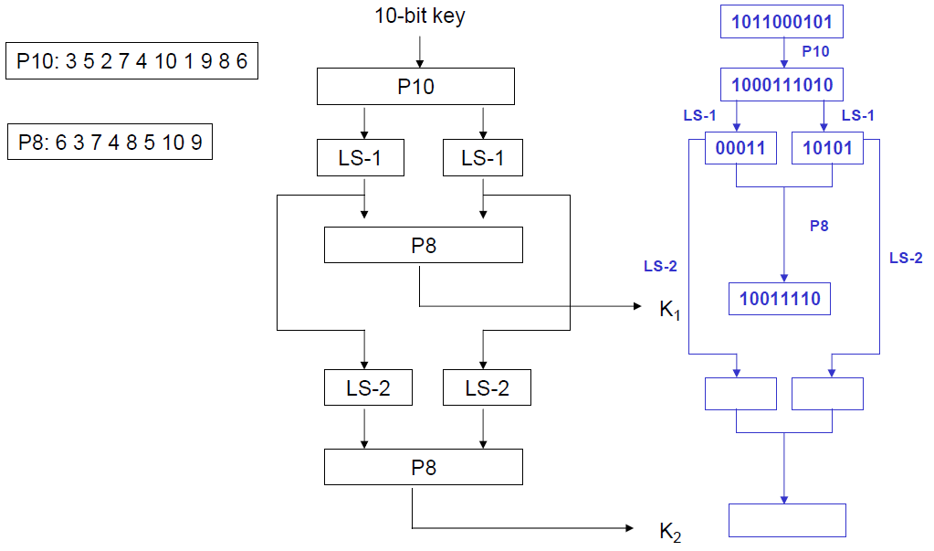
Subkey Generation
Notes:
As the flow shows, the 10-bit key is permuted using P10, then performs the left circular shift with 1 position. On one hand, it is further permuted using P8 to get K₁. On the other hand, the left circular shift result is divided into 2 parts. The left half part further left circularly shifts 2 positions. Similarly, the right half part left circularly shifts 2 position. The combined result performs P8 to get the second subkey.

Slide 45
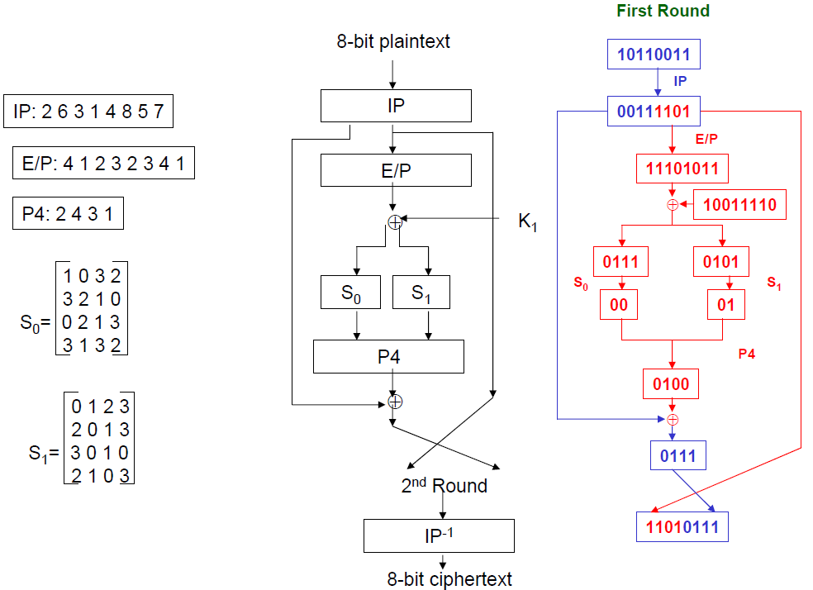
Encryption
Notes:
The encryption algorithm performs initial permutation on 8-bit plaintext, the right half part then performs the expansion and permutation operation, which is XORed with the first subkey K1. The left half part and right half part of the output are further fit into S0 and S1 box to perform substitutions. The substitution result performs 4-bit permutation, which is XORed with the left half 4 bits after IP. Then the result combining with the right half 4 bits after IP is taken as the input of the second round.
The first and last bits of the input to S0 form a 2-bit binary number to select one of 4 rows. The middle two bits of the input to S0 select one of the 4 columns. The decimal value in the cell selected by the row and column is then converted to its 2-bit representation to produce the output.

