Slide 1

Advanced Encryption Standard (AES)
（深圳）
Lecturer: Zoe L. JIANG

Slide 2
Outline
Simplified AES
AES

Slide 3
Simplified AES overview
Not a secure encryption cipher
Only for educational purpose
Use smaller parameters
Key size = 16 bits (128/192/256 bits for AES)
Number of rounds = 2 (10/12/14 for AES)
Plaintext block = 16 bits (128 bits for AES)
Ciphertext block = 16 bits (128 bits for AES)
Notes:
Simplified AES (S-AES) was developed by Professor Edward Schaefer of Santa Clara University and several of his students. It is an educational rather than a secure encryption algorithm. It has similar properties and structure to AES with much smaller parameters. A good grasp of S-AES will make it easier for the students to appreciate the structure and workings of AES.

Slide 4
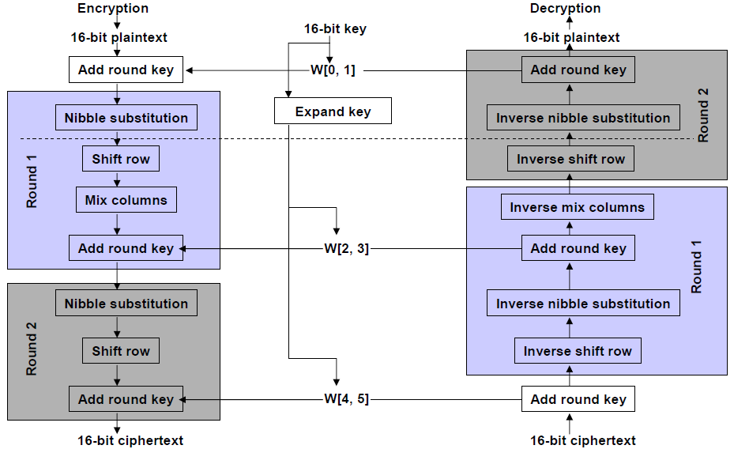
Overall structure 1/2
source [2]
Notes:
This figure illustrates the overall structure of S-AES. The encryption algorithm takes a 16-bit block of plaintext as input and a 16-bit key and produces a 16-bit ciphertext as output. The S-AES decryption algorithm takes a 16-bit block of ciphertext as input and the same 16-bit key used to produce that ciphertext as input, and produces the original 16-bit plaintext as output.
The encryption algorithm involves the use of four different functions or transformations, add key, nibble substitution, shift row and mix column, whose operation will be explained subsequently. The encryption algorithm is organized into 2 rounds. After the add key function, round 1 is a full round of 4 functions; and round 3 contains only 3 functions. Each round includes the add key function, which makes use of 16 bits of key. The initial 16-bit key is expanded to 48 bits, so each round uses a distinct 16-bit round key.

Slide 5
Overall structure 2/2
There are four different functions used in AES encryption
Add key A_{k}
Nibble substitution NS
Shift row SR
Mix columns MC
The functions used in AES decryption are
Add key A_{k}
Inverse nibble substitution INS
Inverse shift row ISR
Inverse mix columns IMC
With these notations, the S-AES encryption and decryption algorithms can be expressed concisely as
Enc: A_{k2} ° SR ° NS ° A_{k1} ° MC ° SR ° NS ° A_{k0}
Dec: A_{k0} ° INS ° ISR ° IMC ° A_{k1} ° INS ° ISR ° A_{k2}
Notes:
We denote Add key A_{k}, Nibble substitution as NS, Shift row as SR, Mix columns as MC.
Then with these notations, the AES encryption and decryption algorithms can be expressed concisely as
Enc: A_{k2} • SR • NS • A_{k1} • MC • SR • NS • A_{k0}
Dec: A_{k0} • INS • ISR • IMC • A_{k1} • INS • ISR • A_{k2}

Slide 6
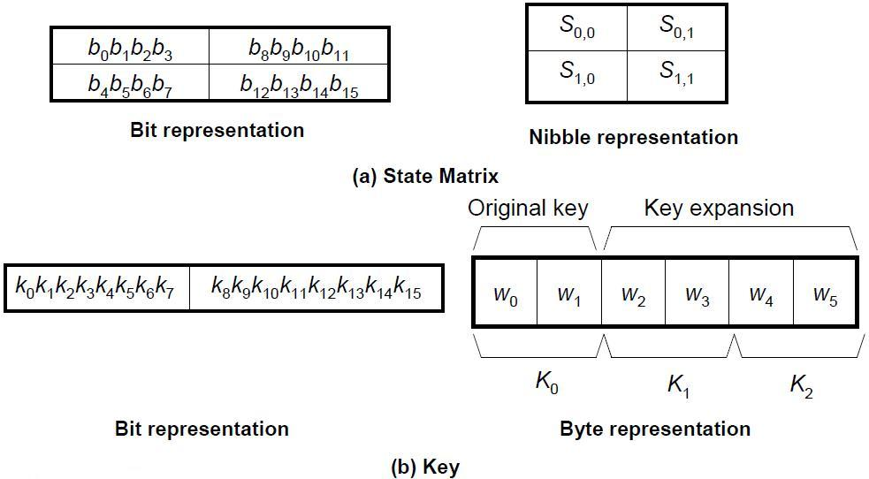
Data structures
source [2]
Notes:
Each function operates on a 16-bit state, treated as a 2 × 2 matrix of nibbles, where one nibble equals 4 bits. The initial value of the State matrix is the 16-bit plaintext; State is modified by each subsequent function in the encryption process, producing after the last function the 16-bit ciphertext. As the figure shows, the ordering of nibbles within the matrix is by column. So, for example, the first 8 bits occupy the first column of the matrix, and the second 8 bits occupy the second column. The 16-bit key is organized as 2 bytes rather than 4 nibbles.

Slide 7
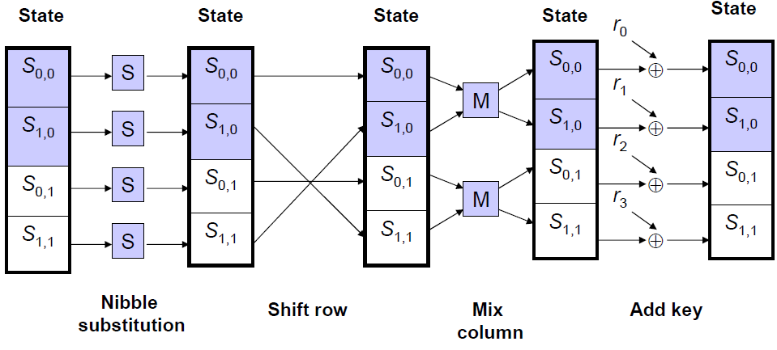
An encryption round
source [2]
Notes:
The figure shows the essential elements of a full round of S-AES.

Slide 8
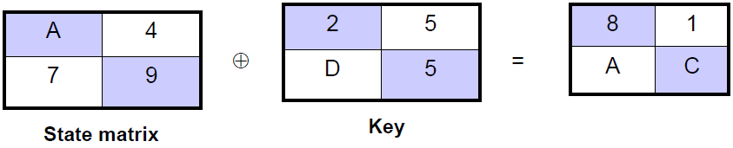
The functions – Add key
This is the bitwise XOR of the state matrix and the round key
The add key function is its own inverse
Example (from [2])
source [2]

Slide 9
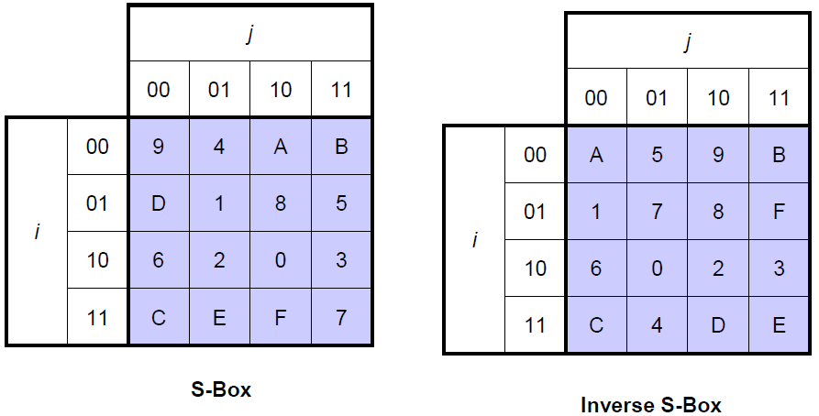
The functions – Nibble substitution 1/2
The S-box
The leftmost 2 bits of the nibble are used as row value and the rightmost 2 bits are used as column value
source [2]
Notes:
Nibble substitution is a simple table lookup. It defines a 4*4 matrix of nibble values, called S-box. Each nibble is a 4-bit string which can be converted into a hexadecimal value. Each individual nibble of state is mapped into a new nibble in the following way: the leftmost 2 bits of the nibble are used as row value and the rightmost 2 bits are used as column value. These values serve as indexes into the S-Box to select a unique 4-bit output value.

Slide 10
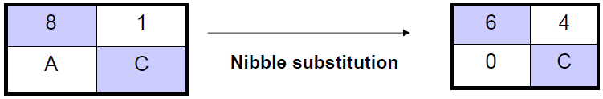
The functions – Nibble substitution 2/2
Example (from [2])
Table lookup
source [2]

Slide 11
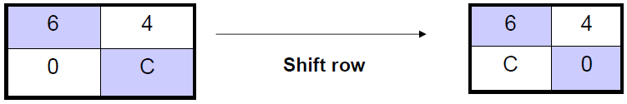
The functions – Shift row
Perform a circular shift of the second row of the state matrix leaving the first row unaltered
The shift row function is its own inverse
Example (from [2])
source [2]

Slide 12


The functions – Mix column 1/3
The mix column function is defined by the following matrix multiplication
The inverse mix column function is defined by the following matrix multiplication
Note that multiplications are performed in GF(2⁴)

Slide 13

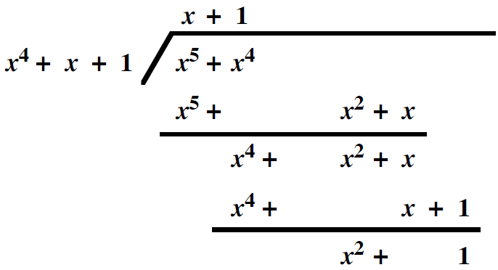
The functions – Mix column 2/3
Example (from [2])
1 × 6 = 0001 × 0110 = 0110
4 × C = 0100 × 1100 = 0101
[x² × (x³ + x²)] mod x⁴ + x + 1
= (x⁵ + x⁴) mod x⁴ + x + 1
= x² + 1
1 × 6 + 4 × C
= 0110 ⊕ 0101 = 0011 = 3
Notes:
We can use long division, bitwise operation and table lookup for mix column.

Slide 14
The functions – Mix column 3/3
4 × C = 0100 × 1100 = 1100 × 0100
= 1100 × 0010 × 0010
= (1000 ⊕ 0011) × 0010
= 1011 × 0010
= 0110 ⊕ 0011
= 0101

Slide 15
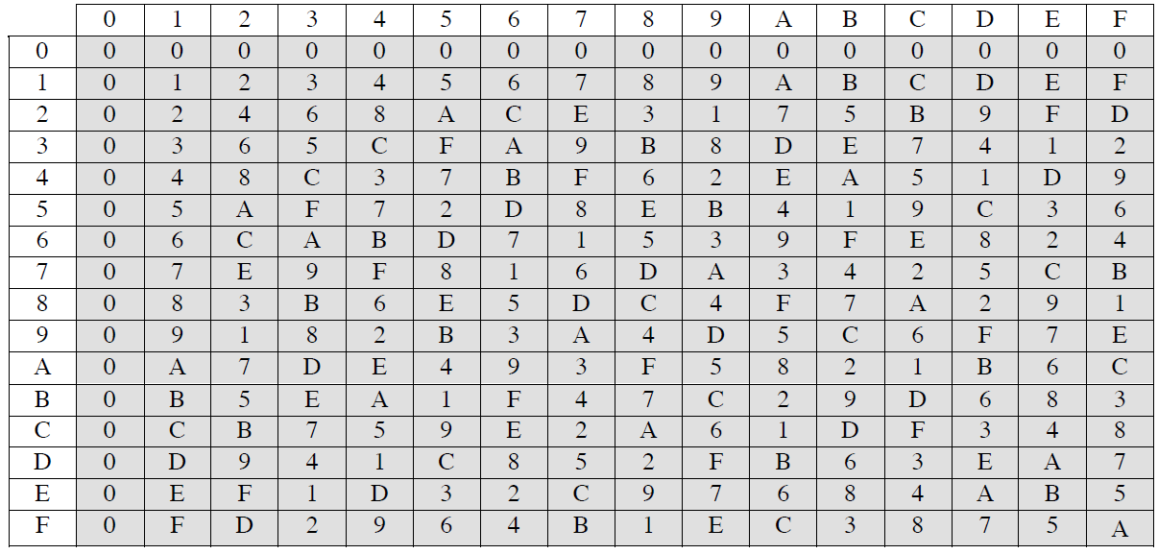
Multiplication table of mix column
Table lookup: a table of 2⁴ × 2⁴ = 2⁸ entries with each entry of 4 bits
source [2] Appendix I

Slide 16
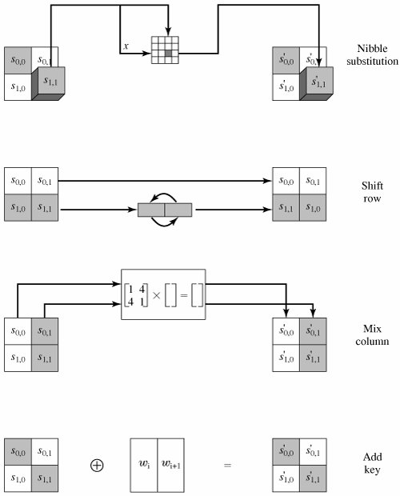
source [2]

Slide 17
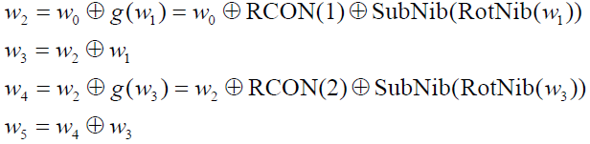
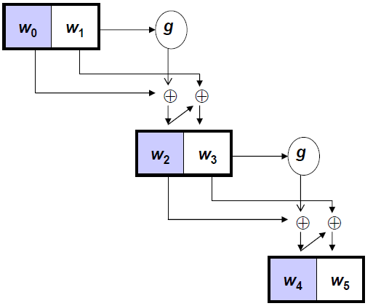
Key expansion – Overall algorithm
The algorithm is defined as follows
RCON is a round constant defined:
Use RCON(i) = x^{i+2} mod x⁴ + x + 1 to form the leftmost nibble of a byte with the rightmost nibble being all zeros
RCON(1) = x³ mod x⁴ + x + 1 = 10000000
RCON(2) = x⁴ mod x⁴ + x + 1 = 00110000
source [2]
Notes:
For key expansion, the 16 bits of the initial key are grouped into a row of 2 8-bit words. This slides shows how to expand the 16-bit key into six words, by calculating 4 new words from the initial 2 words. RobNib rotates the input by exchanging the left half part and the right half part.

Slide 18
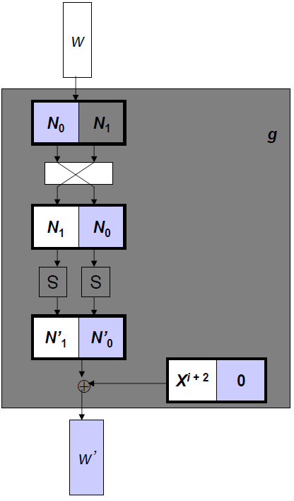
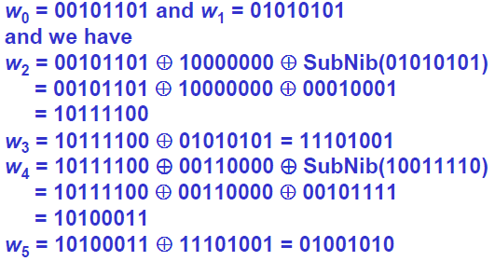
Key expansion – the function g
Example (from [2])
Let the key be 2D55, then
source [2]

Slide 19
AES origins
NIST issued a call for new symmetric block ciphers to replace DES in 1997
A symmetric block cipher that is faster and stronger then 3DES
A life span of 20-30 years
Implementation flexibility
Block size: 128 bits
Key size: 128/192 bits
15 proposed algorithms were accepted in the first round
5 remained in the second round
Rijndael designed by the Belgium cryptographers Dr. Joan Daemen and Dr. Vincent Rijmen was selected as AES
Published as FIPS PUB 197 in Nov. 2001

Slide 20
The AES cipher
Process data as block of 4 columns of 4 bytes – state array
Operates on entire data block in every round
Designed to have:
resistance against known plaintext attack
speed and code compactness on many CPUs
design simplicity

Slide 21
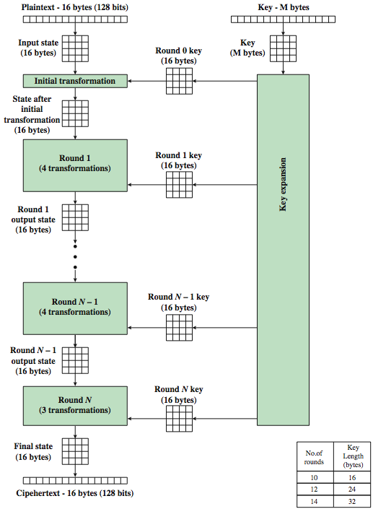
AES encryption
source [2]
Notes:
The cipher consists of N rounds, where the number of rounds depends on the key length: 10 rounds for a 16-byte key; 12 rounds for a 24-byte key; and 14 rounds for a 32-byte key. The first N – 1 rounds consist of four distinct transformation functions: SubBytes, ShiftRows, MixColumns, and AddRoundKey, which are described subsequently. The final round contains only 3 transformation, and there is a initial single transformation (AddRoundKey) before the first round, which can be considered Round 0. Each transformation takes one or more 4 x 4 matrices as input and produces a 4 x 4 matrix as output. The figure shows that the output of each round is a 4 x 4 matrix, with the output of the final round being the ciphertext. Also, the key expansion function generates N + 1 round keys, each of which is a distinct 4 x 4 matrix. Each round key serve as one of the inputs to the AddRoundKey transformation in each round.

Slide 22
AES structure 1/2
Data block of 4 columns of 4 bytes is state
Key is expanded to array of words
Initial XOR with key
Has 9/11/13 rounds in which state undergoes:
Byte substitution (Use an S-box to perform a byte-by-byte substitution of the block)
Shift rows (A simple permutation)
Mix columns (A substitution making use of arithmetic over GF(2⁸))
Add round key (A simple bitwise XOR of the current block with a portion of the expanded key)
Incomplete last round

Slide 23
AES structure 2/2
Add round key: XOR operation
The other 3 functions: provide confusion, diffusion and nonlinearity, but no security because no key is used
View the cipher as alternating operations of XOR encryption (Add round key) of a block, followed by scrambling of the block (the other 3 functions), followed by XOR encryption, and so on

Slide 24
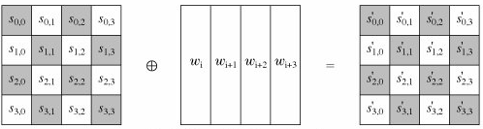
Add round key
source [2]

Slide 25
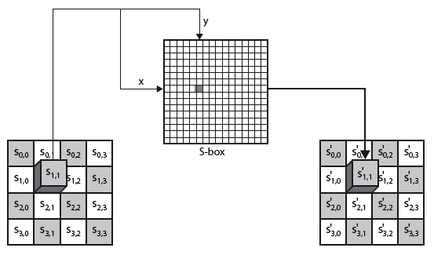
Byte substitution
source [2]
Notes:
It is a simple table lookup. AES defines a 16*16 matrix of byte values, called an S-box, that contains a permutation of all possible 256 8-bit values.
Each individual byte of sate is mapped into a new byte in the following way: the leftmost 4 bits of the byte are used as a row value and the rightmost 4 bits are used as a column value. These row and column values serve as indexed into the S-box to select a unique 8-bit output value.

Slide 26
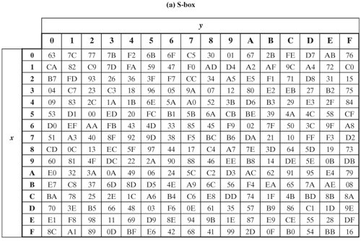
S-box
Table lookup
source [2]

Slide 27
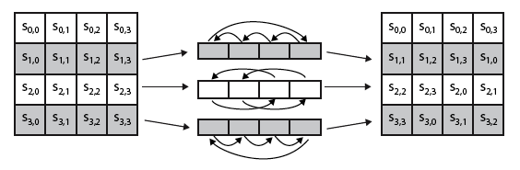
Shift row
source [2]

Slide 28
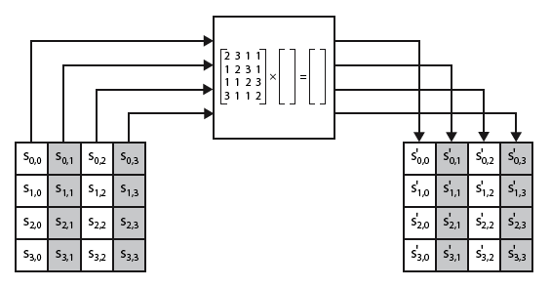
Mix column
source [2]

Slide 29
Implementation Aspects
Can efficiently implement on 8-bit CPU
Byte substitution works on bytes using a table of 256 entries, with each entry of 8 bits
Shift rows is simple byte shift
Add round key works on byte XOR’s
Mix columns requires matrix multiplications in GF(2⁸) which works on byte values, which can be replaced by table lookups (a 256-byte table) & byte XOR’s at the cost of some storage

Slide 30
Implementation Aspects
Can efficiently implement on 32-bit CPU
Redefine steps to use 32-bit words
Precompute 4 tables of 256-words
Each column in each round can be computed using 4 table lookups + 4 XORs
At a cost of 4Kb to store tables
Designers believe this very efficient implementation was a key factor in its selection as the AES cipher

Slide 31
References
[1] A. Kak. Lecture Notes on Computer and Network Security, Lecture 4: Finite Fields, 2012
[2] Stallings William. Cryptography and Network Security: Principles and Practice, 5th Edition. Prentice Hall, 2011

