Slide 1

L2: Classical cryptography - II
Lecturer: Zoe L. JIANG
A309
8:00-9:45

Slide 2
Shift cipher
Recall
a | b | c | d | e | f | g | h | i | j | k | l | m | n | o | p | q | r | s | t | u | v | w | x | y | z
D | E | F | G | H | I | J | K | L | M | N | O | P | Q | R | S | T | U | V | W | X | Y | Z | A | B | C
k₁ = 3
m₁ = b e g i n t h e a t t a c k n o w
C₁ =
C₂ = O V D T H U F W V Z Z P I S L R L F Z H Y L A O L Y L
k₂ = ?
m₂ = ?
E H J L Q W K H D W W D F N Q R Z
7
Types of Attack | Known to Cryptanalyst
Ciphertext Only Attack (COA) | Encryption algorithm Ciphertext
Brute-force attack
Try all 26 possible keys

Slide 3
Mixed monoalphabetic cipher
Recall
a | b | c | d | e | f | g | h | i | j | k | l | m | n | o | p | q | r | s | t | u | v | w | x | y | z
X | E | U | A | D | N | B | K | V | M | R | O | C | Q | F | S | Y | H | W | G | L | Z | I | J | P | T
C₁ = G D O O K V C X E F L G C D
m₁ = ?
Brute-force attack does not work
Statistical attack works well

Slide 4
Outline
Steganography隐写术
Substitution cipher替换密码
Monoalphabetic cipher单字母单表密码
Caesar cipher (Shift cipher)
Mixed alphabetic cipher
Morse code
Polyalphabetic cipher单字母多表密码
Vigenère cipher
Multiple letter cipher多字母单表密码
Playfair cipher
Hill cipher
A special substitution cipher
One-time pad (OTP)
Transposition cipher置换密码
Rotor machine转轮密码机

Slide 5
Exercise
m | t | e | l | l | h | i | m | a | b | o | u | t | m | e
K | c | a | f | e | c | a | f | e | c | a | f | e | c | a
C
W
F
R
Q
K
J | S | F | E | P | A | Y | P | F
a | b | c | d | e | f | g | h | i | j | k | l | m | n | o | p | q | r | s | t | u | v | w | x | y | z
D | E | F | G | H | I | J | K | L | M | N | O | P | Q | R | S | T | U | V | W | X | Y | Z | A | B | C
a | b | c | d | e | f | g | h | i | j | k | l | m | n | o | p | q | r | s | t | u | v | w | x | y | z
B | C | D | E | F | G | H | I | J | K | L | M | N | O | P | Q | R | S | T | U | V | W | X | Y | Z | A
a | b | c | d | e | f | g | h | i | j | k | l | m | n | o | p | q | r | s | t | u | v | w | x | y | z
G | H | I | J | K | L | M | N | O | P | Q | R | S | T | U | V | W | X | Y | Z | A | B | C | D | E | F
a | b | c | d | e | f | g | h | i | j | k | l | m | n | o | p | q | r | s | t | u | v | w | x | y | z
F | G | H | I | J | K | L | M | N | O | P | Q | R | S | T | U | V | W | X | Y | Z | A | B | C | D | E

Slide 6
Exercise
Multiple shift ciphers in sequence
Encrypt
the 1st, 5th, 9th, and so on characters with the shift cipher with k = 3
the 2nd, 6th, 10th, and so on characters with the shift cipher with k = 1
the 3rd, 7th, and so on characters with the shift cipher with k = 6
the 4th, 8th, and so on characters with the shift cipher with k = 5

Slide 7
Polyalphabetic cipher
The substitution rule changes continuously from one character position to the next in the plaintext according to the elements of the encryption key
Feature: same plaintext character is substituted by different ciphertext characters (i.e., polyalphabetic)
Notes:
To improve on the simple monoalphabetic technique, in addition to multi-letter substitution, polyalphabetic cipher uses different monoalphabetic substitutions as one proceeds through the plaintext message.
For example, if a is substituted by D, the substitution will not change any more.
It is a kind of substitution, but which letter will be the replacement of a keeps changing according to the encryption key.

Slide 8
Vigenère cipher
At the time, and for many centuries since its invention, it was renowned for being a very secure cipher, and for a very long time it was believed to be unbreakable. It was this thought that earned it the nickname "le chiffre indéchiffrable" (French for "the unbreakable cipher")
Although this is not true (it was fully broken by Friedrich Kasiski in 1863), it is still a very secure cipher in terms of paper and pen methods, and is usable as a field cipher.

Slide 9

Vigenère cipher - Gen
Choose a keyword (or keyphrase), repeat this keyword over and over until it is the same length as the plaintext. This is called the keystream.
The keystream using the keyword battista

Slide 10
Vigenère cipher - Enc
For each plaintext letter, find the letter down the left hand side of the tabula recta, and take the corresponding letter from the keystream, and find this across the top of the tabula recta. Where these two lines cross in the table is the ciphertext letter you use
As an example, we shall encrypt the plaintext "a simple example" using the keyword battista. First we must generate the keystream, by repeating the letters of the keyword until it is the same length as the plaintext.

Slide 11
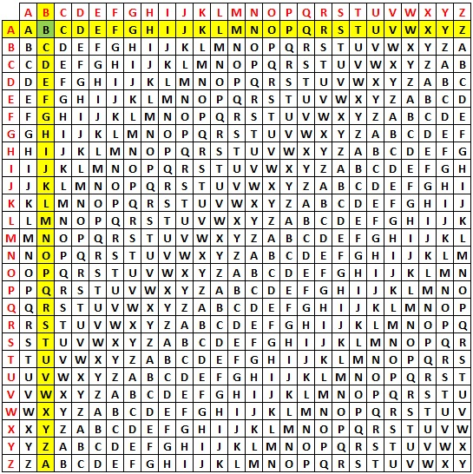
Vigenère cipher - Enc
The keystream b means we choose the column with B at the top, and the plaintext "a" means we choose the row with A at the left. We get the ciphertext "B".
Tabula Recta

Slide 12
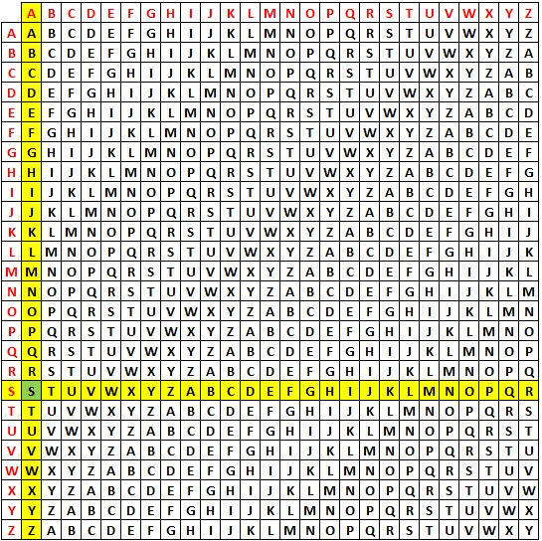
Vigenère cipher - Enc
For the second plaintext letter "s", we go down to S on the left, and use the keystream a to go to A along the top. We get the ciphertext letter "S".
Tabula Recta

Slide 13
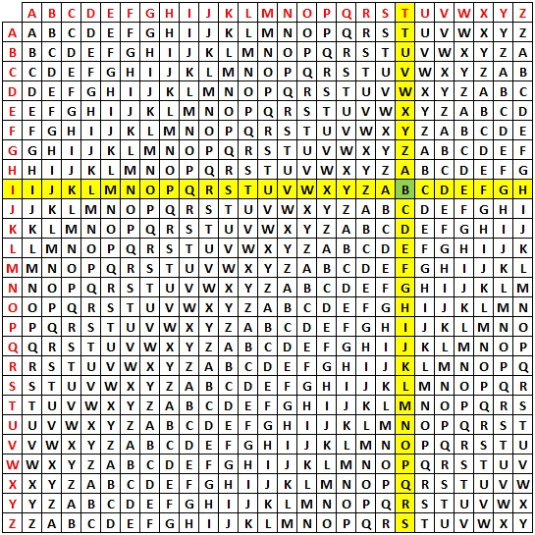
Vigenère cipher - Enc
With the plaintext letter "i", we go down to I on the left, and the keystream letter t means we go to T across the top. We get the ciphertext letter "B".
Tabula Recta

Slide 14

Vigenère cipher - Enc
Continuing in this way we get the final ciphertext "BSBF XDXEYA FITW“
Notice that the "a" and "i" both encrypt to "B", and also that the three "e"s that appear encrypt to "X", "E" and "W"

Slide 15
Vigenère cipher - Dec
To decrypt a ciphertext with the keyword, we first have to generate the keystream by repeating the keyword until we have a keystream the same length as the ciphertext. Then you find the column with the letter of the keystream at the top, and go down this column until you find the ciphertext letter. Now read across to the far left of the table to reveal the plaintext letter
As an example we shall decipher the ciphertext "ZPSPNOXMOFAORMQDPUKZ" which has been encoded using the keyword giovan. We start by generating the keystream.

Slide 16
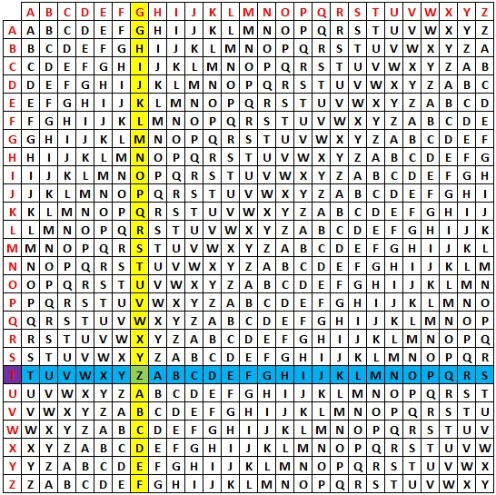
Vigenère cipher - Dec
look along the top row to find the letter from the keystream, G. We look down this column (in yellow) and find the ciphertext letter "Z" (in green). We then go along this row (in blue) to the left hand edge, and the letter here (in purple) is the plaintext letter. In this case it is "t".

Slide 17
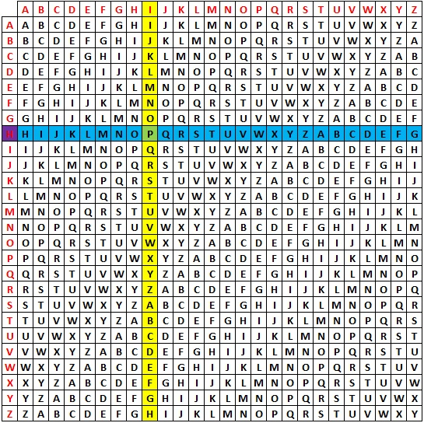
Vigenère cipher - Dec
In the same way as above, we find the keystream letter I, and find the ciphertext letter "P" in this column. We then follow this row to find the plaintext letter "h".

Slide 18

Vigenère cipher - Dec
Continuing in this way we retrieve the ciphertext "the unbreakable cipher"
The Vigenère Cipher was the biggest step in cryptography for over 1000 years. The idea of switching between ciphertext alphabets as you encrypt was revolutionary, and an idea that is still used to make ciphers more secure. One of the most famous examples of codes and ciphers in history, the ENIGMA machine, is just a modified polyalphabetic substitution cipher!

Slide 19
Vigenère cipher
General equation of the encryption process is
C_{i} = (m_{i} + k_{i mod l}) mod 26
General equation of the decryption process is
m_{i} = (C_{i} - k_{i mod l}) mod 26
Compare the equation with that of the Caesar cipher
C = (m + 3) mod 26
m = (C − 3) mod 26
l: the length of the key words

Slide 20
Why does Vigenère cipher belong to monoalphabetic cipher?

Slide 21
Security analysis
The relative frequency distribution becomes obscured, but not totally lost
Obviously, the longer the encryption key, the greater the masking of the structure of the plaintext
How to break it? Cha1.3, P14-16
Autokey system: The best possible key is as long as the plaintext message and consists of a purely random permutation of the 26 letters of the alphabet, which is labeled “Random polyalphabetic”

Slide 22
Outline
Steganography隐写术
Substitution cipher替换密码
Monoalphabetic cipher单字母单表密码
Caesar cipher (Shift cipher)
Mixed alphabetic cipher
Morse code
Polyalphabetic cipher单字母多表密码
Vigenère cipher
Multiple letter cipher多字母单表密码
Playfair cipher
Hill cipher
A special substitution cipher
One-time pad (OTP)
Transposition cipher置换密码
Rotor machine转轮密码机

Slide 23
Multiple letter cipher
How about destroying some of the statistic characters in monoalphabatic cipher by mapping multiple characters at a time to ciphertext characters?
Encrypt multiple letters of plaintext: multiple letter cipher

Slide 24
Playfair KeyGen
a 5*5 matrix of letters based on a keyword
fill in letters of keyword first
fill rest of matrix with other letters in sequence
eg. using the keyword MONARCHY
M | O | N | A | R
C | H | Y | B | D
E | F | G | I/J | K
L | P | Q | S | T
U | V | W | X | Z
Key Matrix
Notes:
The best-known multiple-letter encryption cipher is the Playfair, which treats digrams in the plaintext as single units and translates these units into ciphertext digrams. The Playfair algorithm is based on the use of a 5x5 matrix of letters constructed using a keyword. The rules for filling in this 5x5 matrix are: L to R, top to bottom, first with keyword after duplicate letters have been removed, and then with the remain letters, with I/J used as a single letter. This example comes from Dorothy Sayer's book "Have His Carcase", in which Lord Peter Wimsey solves it, and describes the use of a probably word attack.

Slide 25
Playfair Encryption
plaintext is encrypted two letters at a time
if a pair is a repeated letter, insert filler like ‘x’
if both letters fall in the same row, replace each with letter to right (wrapping back to start from end)
if both letters fall in the same column, replace each with the letter below it (wrapping to top from bottom)
otherwise each letter is replaced by the letter in the same row and in the column of the other letter of the pair

Slide 26
Playfair Encryption Example
Message = Move forward
Plaintext = mo ve fo rw ar dx
Here x is just a filler, message is padded and segmented
Encryption:
mo → ON; ve → UF;
fo → PH, etc.
Ciphertext = ON UF PH NZ RM BZ
M | O | N | A | R
C | H | Y | B | D
E | F | G | I/J | K
L | P | Q | S | T
U | V | W | X | Z
Notes:
In monoalphabetic cipher, characters in plaintext are replaced one by one.
Using Playfair, characters in plaintext are replaced pair by pair.

Slide 27
How secure is the Playfair cipher?
Playfair was thought to be unbreakable for many decades
It was used as the encryption system by the British Army in World War I. It was also used by the U.S. Army and other Allied forces in World War II
As expected, the cipher does alter the relative frequencies associated with the individual letters, but not sufficiently

Slide 28
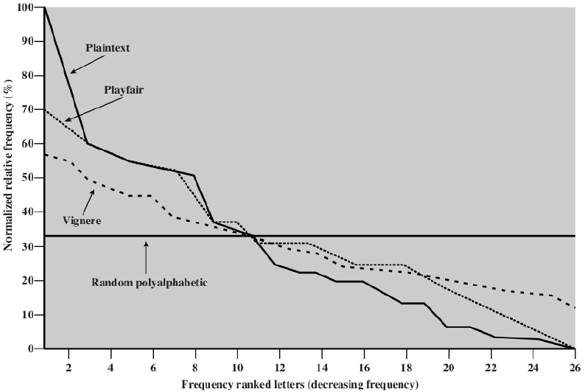
Relative frequency of occurrence of letters
This figure is from Chapter 2 of William Stallings: “Cryptography and Network Security”, Fifth Edition, Prentice-Hall.
Notes:
This figure shows the single-letter relative frequencies in descending order (and normalized to the relative frequency of the letter e) for some different ciphers. There is still considerable information left in the distribution for good guesses. If the frequency distribution information were totally concealed in the encryption process, the ciphertext plot of frequencies would be flat, and cryptanalysis using ciphertext only would be effectively impossible. As the figure shows, the Playfair cipher has a flatter distribution than does plaintext, but nevertheless, it still reveals plenty of structure for a cryptanalyst to work with.

Slide 29
Outline
Steganography隐写术
Substitution cipher替换密码
Monoalphabetic cipher单字母单表密码
Caesar cipher (Shift cipher)
Mixed alphabetic cipher
Morse code
Polyalphabetic cipher单字母多表密码
Vigenère cipher
Multiple letter cipher多字母单表密码
Playfair cipher
Hill cipher
A special substitution cipher
One-time pad (OTP)
Transposition cipher置换密码
Rotor machine转轮密码机

Slide 30
Another multi-letter cipher: The Hill Cipher
The Hill cipher takes a very different (more mathematical) approach to multi-letter substitution:
Mathematically give each letter a number
a b c d e f g h i j k l m n o p q r s t u v w x y z
0 1 2 3 4 5 6 7 8 9 10 11 12 13 14 15 16 17 18 19 20 21 22 23 24 25
The encryption key, K, consists of a 3×3 matrix of integers:
k₁₁ k₁₂ k₁₃
K = k₂₁ k₂₂ k₂₃
k₃₁ k₃₁ k₃₁
Plaintext m is represented by
m₁
m₂
m₃
Notes:
Assign an integer to each letter of the alphabet. For the sake of discussion, let’s say that you have assigned the integers 0 through 25 to the letters ‘a’ through ‘z’ of the plaintext.

Slide 31
Another multi-letter cipher: The Hill Cipher
Transform three letters at a time from plaintext m
C₁ = (k₁₁m₁ + k₁₂m₂ + k₁₃m₃) mod 26
C₂ = (k₂₁m₁ + k₂₂m₂ + k₂₃m₃) mod 26
C₃ = (k₃₁m₁ + k₃₂m₂ + k₃₃m₃) mod 26
Express in terms of row vectors and matrices:
C₁ k₁₁ k₁₂ k₁₃ m₁
C = C₂ = k₂₁ k₂₂ k₂₃ m₂
C₃ k₃₁ k₃₁ k₃₁ m₃
Encryption: C = Km mod 26
Decryption: m = K⁻¹C mod 26 = K⁻¹Km = m
Notes:
Now we can transform three letters at a time from plaintext, the letters being represented by the numbers p1, p2, and p3, into three ciphertext letters c1, c2, and c3 in their numerical representations by

Slide 32
The Hill cipher example
Plaintext: paymoremoney
Encryption key:
17 17 5
K = 21 18 21
2 2 19 15
pay are represented by the vector m = 0
24
11
Km mod 26 = 13
18
Ciphertext: LNS

Slide 33
The Hill cipher example
Calculate the inverse of the matrix K
4 9 15
K⁻¹ = 15 17 6
24 0 17
4 9 15 11 15
K⁻¹C mod 26 = 15 17 6 13 = 0
24 0 17 18 24
Please finish the exercise by yourself
Notes:
You can go over linear algebra about how to calculate the inverse of K.

Slide 34
How secure is the Hill cipher?
A 3×3 Hill cipher hides not only single-letter but also two-letter frequency information
Against ciphertext-only attack
Broken with known plaintext attack
Types of Attack | Known to Cryptanalyst
Ciphertext Only Attack (COA) | Encryption algorithm Ciphertext
Known Plaintext Attack (KPA) | Encryption algorithm Ciphertext One or more plaintext-ciphertext pairs formed with the secret key
Notes:
By using a 3×3 Hill cipher, the characters in the plaintext are substituted triple by triple.

Slide 35
Cryptanalytic Attacks
Types of Attack | Known to Cryptanalyst
Ciphertext Only Attack (COA) | Encryption algorithm Ciphertext
Known Plaintext Attack (KPA) | Encryption algorithm Ciphertext One or more plaintext-ciphertext pairs formed with the secret key
Chosen Plaintext Attack (CPA) | Encryption algorithm Ciphertext Plaintext message chosen by cryptanalyst, together with its corresponding ciphertext generated with the secret key
Chosen Ciphertext Attack (CCA) | Encryption algorithm Ciphertext Ciphertext chosen by cryptanalyst, together with its decrypted plaintext generated with the secret key
Notes:
We classify attacks based on the amount of information known to the cryptanalyst.
Monoalphabetic cipher can be easily broken by ciphertext only attack.
How about the Hill cipher under the ciphertext only and known plaintext attacks?

Slide 36
Outline
Steganography隐写术
Substitution cipher替换密码
Monoalphabetic cipher单字母单表密码
Caesar cipher (Shift cipher)
Mixed alphabetic cipher
Morse code
Polyalphabetic cipher单字母多表密码
Vigenère cipher
Multiple letter cipher多字母单表密码
Playfair cipher
Hill cipher
A special substitution cipher
One-time pad (OTP)
Transposition cipher置换密码
Rotor machine转轮密码机

Slide 37
One-time Pad (OTP)
A truly random key as long as the message is used
Unbreakable since ciphertext bears no statistical relationship to the plaintext
The security of OTP is entirely due to the randomness of the key
Disadvantage in practice
Large quantities of random keys
Key distribution and protection
OTP is the only cryptosystem that achieves perfect secrecy
Notes:
For each character

Slide 38
Outline
Steganography隐写术
Substitution cipher替换密码
Monoalphabetic cipher单字母单表密码
Caesar cipher (Shift cipher)
Mixed alphabetic cipher
Morse code
Polyalphabetic cipher单字母多表密码
Vigenère cipher
Multiple letter cipher多字母单表密码
Playfair cipher
Hill cipher
A special substitution cipher
One-time pad (OTP)
Transposition cipher置换密码
Rotor machine转轮密码机

Slide 39
Transposition cipher
Hide the message by rearranging the letter order
Permuting the plaintext
The cipher can be made more secure by performing multiple rounds of permutation
Notes:
All the techniques examined so far involve the substitution of a ciphertext symbol for a plaintext symbol. A very different kind of mapping is achieved by performing some sort of permutation on the plaintext letters. This technique is referred to as a transposition cipher, and form the second basic building block of ciphers. The core idea is to rearrange the order of basic units (letters/bytes/bits) without altering their actual values.

Slide 40
Rail Fence cipher
Write plaintext letters out diagonally over a number of rows
Read off cipher row by row
E.g. plaintext: meet me after the toga party
Write plaintext out as:
m e m a t r h t g p r y
e t e f e t e o a a t
Ciphertext: MEMATRHTGPRYETEFETEOAAT
Notes:
The simplest such cipher is the rail fence technique, in which the plaintext is written down as a sequence of diagonals and then read off as a sequence of rows.
The example plaintext is: "meet me after the toga party" with a rail fence of depth 2.
This sort of thing would be trivial to cryptanalyze.

Slide 41
Column Transposition Cipher
Write letters of plaintext out in rows over a specified number of columns
Reorder the columns according to some key before reading off the columns
Read the plaintext in the column order specified by the key
E.g. plaintext: attack postponed until two am
Key:
Plaintext:
Ciphertext: TTNAAPTMTSUOAODWCOIXKNLYPETZ
4 | 3 | 1 | 2 | 5 | 6 | 7
a | t | t | a | c | k | p
o | s | t | p | o | n | e
d | u | n | t | i | l | t
w | o | a | m | x | y | z
Notes:
A more complex transposition is to write the plaintext in a rectangle, row by row, and read the plaintext off, column by column, but permute the order of the columns. The order of the columns then becomes the key to the algorithm. The ciphertext can be generated by reading the plaintext in the column order specified by key.

Slide 42
Product Ciphers
Ciphers using substitutions or transpositions are not secure because of language characteristics
Using several ciphers in succession to make harder
two substitutions make a more complex substitution
two transpositions make more complex transposition
a substitution followed by a transposition makes a new much harder cipher
This is bridge from classical to modern ciphers
Notes:
Have seen that ciphers based on just substitutions or transpositions are not secure, and can be attacked because they do not sufficient obscure the underlying language structure
So consider using several ciphers in succession to make harder.
A substitution followed by a transposition is known as a Product Cipher, and makes a new much more secure cipher, and forms the bridge to modern ciphers.

Slide 43
Rotor Machines
Before modern ciphers, rotor machines were most common complex ciphers in use
Widely used in WWII
German Enigma, Allied Hagelin, Japanese Purple
Implemented a very complex, varying substitution cipher
Used a series of cylinders, each giving one substitution, which rotated and changed after each letter was encrypted
With 3 cylinders have 26³=17576 alphabets

Slide 44
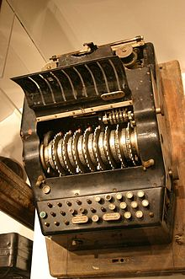
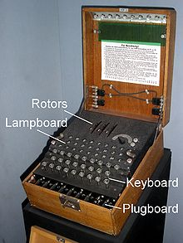
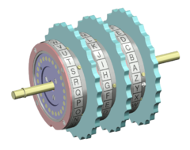
Enigma
http://en.wikipedia.org/wiki/Enigma_machine

Slide 45
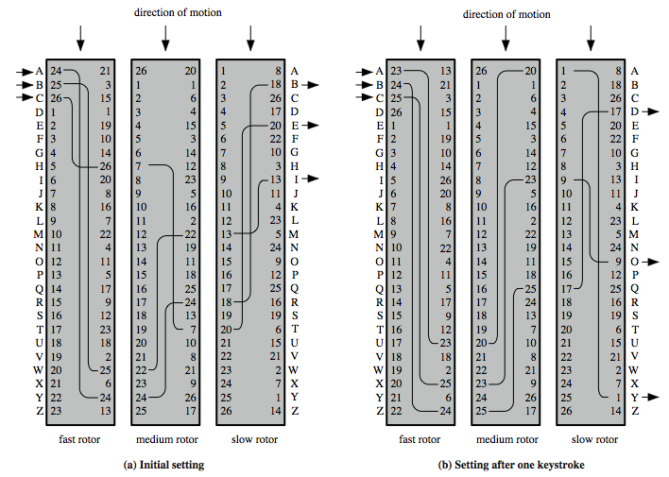
Rotor Machine Principles
This figure is from Chapter 2 of William Stallings: “Cryptography and Network Security”, Fifth Edition, Prentice-Hall.

Slide 46
References
[1] Stallings William. Chapter 2, Cryptography and Network Security: Principles and Practice, 5th Edition. Prentice Hall, 2011
[2] http://crypto.interactive-maths.com/vigenegravere-cipher.html

