Slide 1

L5.1: Semantic Security and Indistinguishability-based Security for SKE 第5.1讲：对称加密的语义安全和不可区分安全
（深圳）
Lecturer: Zoe L. JIANG蒋琳
A309
Sept 26, 2018, 8:00-9:45
Most of the slides come from http://drona.csa.iisc.ernet.in/~arpita/Cryptography17.html

Slide 2
Recall
>> Computational Security
Make the adversary bounded, efficient or polynomial time
Allow the break with some small/negligible probability
Make ‘polynomially bounded/efficient’ and ‘small/negligible prob.’ precise

Slide 3
Today’s goal
Paradigm I- Semantic Security for SKE- computational analogue of Shannon’s perfect security
Paradigm II- Indistinguishability-based Security for SKE – computational analogue of game/experiment based security definition of perfect security
Look for assumptions needed for construction of a scheme

Slide 4
Definition of Symmetric Key Encryption (SKE)
Definition 3.7
1. Key-generation Algorithm: k ← Gen(1^{n})
> Outputs a key k chosen according to some probability distribution.
> MUST be a Randomized algorithm
2. Encryption Algorithm: c ← Enc_{k}(m); m in {0,1}^{l(n)}
> c ← Enc_{k}(m) when randomized and c:=Enc_{k}(m) when deterministic
> Deterministic/Randomized algorithm
3. Decryption Algorithm: m or ⊥:= Dec_{k}(c)
> Outputs m:= Dec_{k}(c)
> Deterministic
Correctness. For every key k output by Gen and every message m∈M, it holds that Dec_{k}(Enc_{k}(m)) = m
(Gen, Enc, Dec) is a fixed-length private-key encryption scheme for messages of length l(n)

Slide 5
Today’s goal
Paradigm I- Semantic Security for SKE- computational analogue of Shannon’s perfect security
Paradigm II- Indistinguishability-based Security for SKE – computational analogue of game/experiment based security definition of perfect security
Look for assumptions needed for construction of a scheme

Slide 6
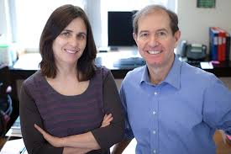


Semantic security for SKE
S. Goldwasser and S. Micali. Probabilistic Encryption. Journal of Computer and System Sciences, 28(2): 270-299, 1984
Impossible to break
Infeasible to break with high prob.
Randomized
PPT
COA
Given prior information about message, the ciphertext leaks no additional information about the message
h(m): prior info about m; history function
f(m): additional information about m that adv wants to compute

Slide 7


Semantic security
Two worlds: In one adv gets ciphertext and in another it does not. If the difference between probabilities of guessing f(x) in the both worlds are negligibly apart, then semantic security is achieved.
m
c ← Enc_{k}(m)
h(m)
|m|
h(m)
Enc
A
A’
Gen(1^{n})
k
Computational Analogue of Shannon’s definition of perfect-security
guess about f(m)
guess about f(m)
Definition 3.12: Π = (Gen, Enc, Dec) is semantically-secure if for every PPT A there exists a PPT A’ such that for any Samp and PPT functions f and h:
|
Pr [ A(1^{n},c,h(m)) =f(m)]
-
|
≤ negl(n)
Pr [ A’(1^{n},|m|,h(m)) =f(m)]
Probability taken over
>> uniform k,
>> m output by Samp(1^{n}),
>> the randomness of A and
>> the randomness of Enc
Probability taken over
>> m output by Samp(1^{n}) and
>> the randomness of A’

Slide 8
Today’s goal
Paradigm I- Semantic Security for SKE- computational analogue of Shannon’s perfect security
Paradigm II- Indistinguishability-based Security for SKE – computational analogue of game/experiment based security definition of perfect security
Look for assumptions needed for construction of a scheme

Slide 9



Indistinguishability based definition
An Experiment / a game between a challenger and an adversary
ind
Indistinguishability experiment
PrivK (n)
Π = (Gen, Enc, Dec), M
A, Π
Attacker A
Challenger
b ← {0, 1}
m₀, m₁∈ M ; |m₀|=|m₁|
(freedom to choose any pair)
c ← Enc_{k}(m_{b})
I can break Π
b’ ∈ {0, 1}
k
Let me verify
Run time: Poly(n)
(Attacker’s guess about encrypted message)
Gen(1^{n})
b = b’
ind
PrivK (n)
b ≠ b’
A, Π
0 --- attacker lost
1 --- attacker won
Π has is ind-secure if for every PPT attacker A, there is a negligible function negl(n) such that
ind
Probability is taken over the randomness used by A and the challenger
Pr
PrivK (n)
½ + negl(n)
= 1
≤
A, Π
Notes:
Published in the same paper. It captures the fact that the adversary gets just a single ciphertext. Even though the adversary knows that the ciphertext corresponds to one two message m0 and m1, it cannot tell apart which message the ciphertext corresponds to. Very strong.

Slide 10
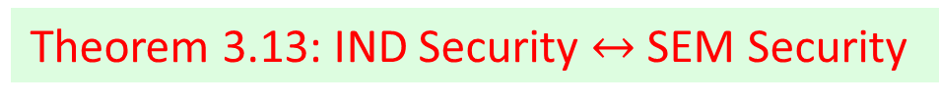

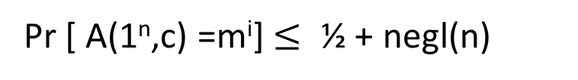

Semantic vs. indistinguishability security
SEM: Given prior information about message, the ciphertext leaks no additional information about the message
Randomized
PPT
COA
IND: Given the knowledge of two messages, it cannot be distinguished if the ciphertext corresponds to the first or second message.
IND Security $→$ SEM Security
IND Security $←$ SEM Security
IND Security is the de facto style followed in Crypto community
Theorem 3.10: If a scheme is ind-secure then for all PPT A and any index i, there is a negligible function negl(n) s.t.
Pr [ A(1^{n},c) =m^{i}] $≤$ ½ + negl(n)
For uniform distribution of k and m.
Theorem 3.13: IND Security $↔$ SEM Security

Slide 11
Indistinguishability based definition: renaming
An Experiment / a game between a challenger and an adversary
coa
Indistinguishability experiment
PrivK (n)
Π = (Gen, Enc, Dec), M
A, Π
Attacker A
Challenger
b ← {0, 1}
m₀, m₁∈ M ; |m₀|=|m₁|
(freedom to choose any pair)
c ← Enc_{k}(m_{b})
I can break Π
b’ ∈ {0, 1}
k
Let me verify
Run time: Poly(n)
(Attacker’s guess about encrypted message)
Gen(1^{n})
b = b’
coa
PrivK (n)
b ≠ b’
A, Π
0 --- attacker lost
1 --- attacker won
Definition 3.8: Π has is coa-secure if for every PPT attacker A, there is a negligible function negl(n) such that
Probability is taken over the randomness used by A and the challenger
coa
Pr
PrivK (n)
½ + negl(n)
= 1
≤
A,Π
Notes:
Published in the same paper. It captures the fact that the adversary gets just a single ciphertext. Even though the adversary knows that the ciphertext corresponds to one two message m0 and m1, it cannot tell apart which message the ciphertext corresponds to. Very strong.

Slide 12
Equivalent formulation of ind definition
Attacker A
Π = (Gen, Enc, Dec), M , n
Challenger
b ← {0, 1}
m₀, m₁∈ , |m₀| = |m₁|
(freedom to choose any pair)
c ← Enc_{k}(m_{b})
I can break Π
b’ ∈ {0, 1}
k
Let me verify
Run time: Poly(n)
(Attacker’s guess about encrypted message)
Gen(1^{n})
b = b’
Game Output
b ≠ b’
1 --- attacker won
0 --- attacker lost
coa
Pr
PrivK (n)
½ + negl(n)
= 1
≤
A, Π
Intuition behind the definition ?
>> Attacker should behave in the same way irrespective of m₀ or m₁
>> What does same behavior mean ? --- Attacker just outputs a bit
>> Same behavior means that attacker outputs 1 with almost the same probability in each case (irrespective of whether it sees an encryption of m₀ or m₁)

Slide 13
Equivalent formulation
coa
PrivK (n, b) : the experiment with m_{b} selected by challenger
A,Π
coa
coa
PrivK (n, b))
Output(PrivK (n, b)) : output bit of the attacker during
A, Π
A,Π
Definition 3.9: Π = (Gen, Enc, Dec) is coa-secure if for every PPT adversary A, there is a negligible function negl, such that :
|
coa
coa
|
≤ negl(n)
-
Pr[Output(PrivK (n, 0)) = 1]
Pr[Output(PrivK (n, 1)) = 1]
A,Π
A,Π
Definition 3.8: Π = (Gen, Enc, Dec) is coa-secure if for every PPT adversary A, there is a negligible function negl, such that :
coa
Pr
PrivK (n)
½ + negl(n)
= 1
≤
A,Π

Slide 14
Today’s goal
Paradigm I- Semantic Security for SKE- computational analogue of Shannon’s perfect security
Paradigm II- Indistinguishability-based Security for SKE – computational analogue of game/experiment based security definition of perfect security
Look for assumptions needed for construction of a scheme

Slide 15
Assumptions for coa-secure SKEs
Recall the promises of computational security?
- Shorter key for big message
A suggestion: Try to BE good rather than trying to pretend to be good.
- Key reuse
Let’s go OTP style: key will be used to pad/mask the message
- The pad can’t be just the key
- Pad = f(key) and the function is length-expanding ??
- For perfect security the pad needed to be truly random
- For computational security, enough if the pad ‘looks’ random to a PPT adversary but actually not
M = K = C = {0, 1}^{l}
k
k
k ∈_{R} K
m ∈ M
Enc
c:= m⊕k
c
c ∈ C
Dec
m:= c⊕k
Gen
m

Slide 16

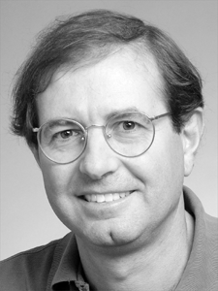
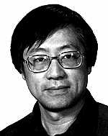
Assumptions for coa-secure SKEs
M. Blum, S. Micali. How to Generate Cryptographically strong sequences of pseudo-random bits. SIAM Journal of Computing, 13(4), 850-864, 1984
A. C.-C. Yao. Theory and Applications of Trapdoor Functions. FOCS, 80-91, 1982.
Pseudorandom Generators (PRGs): Tool to cheat the PPT adversaries

Slide 17
References
[1] Jonathan Katz, Yehuda Lindell. Chapter 3.1 and 3.2, Introduction to Modern Cryptography, 2nd Edition, Chapman & Hall/CRC Cryptography and Network Security Series, 2014
[2] http://drona.csa.iisc.ernet.in/~arpita/Cryptography17.html

