Slide 1

L7: CPA-secure PRF-based SKE 第7讲：CPA安全的基于伪随机函数的对称加密
（深圳）
Lecturer: Zoe L. JIANG蒋琳
A309
Oct 9, 2018, 15:45-17:30
Most of the slides come from http://drona.csa.iisc.ernet.in/~arpita/Cryptography17.html

Slide 2
Recall
Pseudorandomness and PRGs
Construction for Ind-secure scheme
Proof: If there is a PRG, then the construction is coa-secure according to ind definition
Introduction to Reduction-based proofs
Proof for our construction
Short-comings of the current construction/definition
Better definition / better construction / better assumption?

Slide 3
Outline
Introduction to cpa attack and cpa security
Look for assumption needed to construct a scheme
Pseudo-random Functions
Definition
Non-trivial to construct
Pseudo-random Permutation (Strong/weak variant)
Construction based on PRF
cpa-secure scheme from PRF
Proof of security
Practical cpa-secure schemes from PRF/PRP/SPRP for long messages
SSL (Secure Sockets Layer) 3.0,
TLS (Transport Layer Security) 1.0

Slide 4


Security for SKE with COA to CPA
Randomized
PPT
COA
Given the knowledge of two messages (vector of messages), it cannot be distinguished if the ciphertext corresponds to the first or second message (message vector).
Randomized
PPT
CPA
Given the knowledge of two messages (vector of messages), it cannot be distinguished if the ciphertext corresponds to the first or second message (message vector).

Slide 5
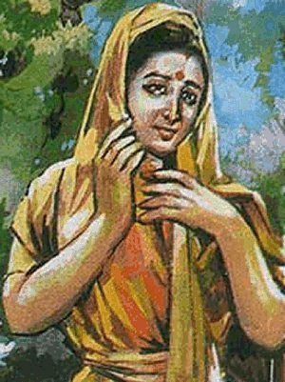



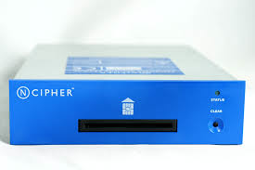
Chosen-Plaintext Attacks (CPA)
m
c = Enc_{k}(m)
Enc
??
m₁
m₂
k
m_{t}
k
c₁
c₂
c_{t}
(m₁, c₁), (m₂, c₂), …, (m_{t}, c_{t}): c_{i} = Enc_{k}(m_{i})
Encryption Oracle
>> Adversary influences the honest parties to encrypt messages (using the same key) of its choice
>> Adv’s Goal: to determine the plaintext encrypted in a new cipher-text
Is CPA mountable only against a moron???
Notes:
Don’t shout right away that this attack is unmountable, unrealistic, adversary cannot do it. It is very much doable.

Slide 6
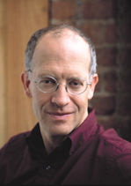


Chosen-Plaintext Attacks (CPA)
M. Luby: Pseudorandomness and Cryptographic Applications; Princeton University Press, 1996
Mihir Bellare, Anand Desai, E. Jokipii, Phillip Rogaway:
A Concrete Security Treatment of Symmetric Encryption. FOCS,1997.

Slide 7
Is CPA Realistic ?
How can an attacker influence parties to encrypt messages of its choice (using the same key) ?
Consider a secure hardware with secret-key embedded
>> Often used in military applications
An insider may have access to the hardware (not the key)
>> Can choose messages of its choice and get their encryptions

Slide 8
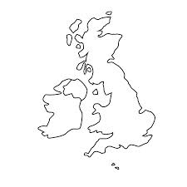

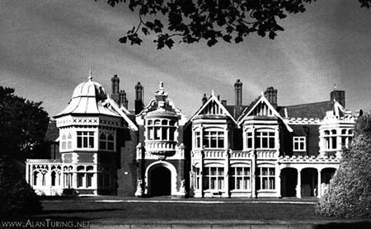
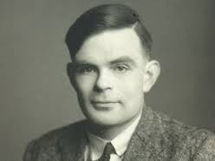

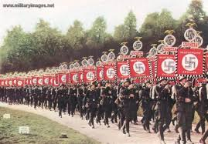
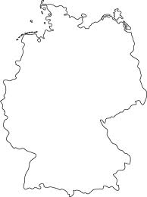
CPA shortened WWII by 2-3 Years
Break of German codes by British during WW II
Allied Power
Loc₃
Loc₁
Loc₂
At Bletchley Park
Axis Power
Enc_{k}(Loc₁)
Trivia: Who played a key role in this cryptanalysis process
Enc_{k}(Loc₂)
Enc_{k}(Loc₃)
Notes:
CPA has a great contribution to humankind. Bletchley park was the mecca of cryptanalysis + crypto during WWII.

Slide 9

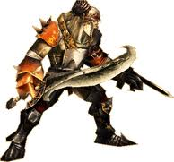
CPA Indistinguishability Experiment
cpa
PrivK (n)
Π = (Gen, Enc, Dec), M , n
A, Π
Query: Plain-text
Response: Ciphertext
PPT Attacker A
k
Let me verify
Gen(1^{n})
I can break Π
Training Phase:
>> A is given oracle access to Enc_{k}()
>> A adaptively submits its query (free to submit m₀, m₁) and receives their encryption

Slide 10

CPA Indistinguishability Experiment
cpa
PrivK (n)
Π = (Gen, Enc, Dec), M , n
A, Π
Training Phase
b ← {0, 1}
PPT Attacker A
m₀, m₁∈ M, |m₀| = |m₁|
c ← Enc_{k}(m_{b})
k
Let me verify
Gen(1^{n})
I can break Π
Challenge Phase:
>> A submits two equal length challenge plaintexts
>> A is free to submit any message of its choice (including the ones already queried during the training phase)
>> One of the challenge plaintexts is randomly encrypted for A (using fresh randomness)

Slide 11
CPA Indistinguishability Experiment
cpa
PrivK (n)
Π = (Gen, Enc, Dec), M , n
A, Π
Training Phase
b ← {0, 1}
PPT Attacker A
m₀, m₁∈ M, |m₀| = |m₁|
c ← Enc_{k}(m_{b})
k
Query: Plaintext
Let me verify
Gen(1^{n})
I can break Π
Response: Ciphertext
Post-challenge Training Phase:
>> A is given oracle access to Enc_{k}()
>> A adaptively submits its query (possibly including m₀, m₁) and receives their encryption

Slide 12
CPA Indistinguishability Experiment
cpa
PrivK (n)
Π = (Gen, Enc, Dec), M , n
A, Π
Training Phase
b ← {0, 1}
PPT Attacker A
m₀, m₁∈ M, |m₀| = |m₁|
c ← Enc_{k}(m_{b})
k
Post-challenge Training
Let me verify
Gen(1^{n})
I can break Π
b’ ∈ {0, 1}
b = b’
Game Output
b ≠ b’
1 --- attacker won
0 --- attacker lost
Response Phase:
A finally submits its guess regarding encrypted challenge plaintext
A wins the experiment if its guess is correct

Slide 13
CPA Security
cpa
PrivK (n)
Π = (Gen, Enc, Dec), M , n
A, Π
Training Phase
b ← {0, 1}
PPT Attacker A
m₀, m₁∈ M, |m₀| = |m₁|
c ← Enc_{k}(m_{b})
k
Post-challenge Training
Let me verify
Gen(1^{n})
I can break Π
b’ ∈ {0, 1}
b = b’
Game Output
b ≠ b’
1 --- attacker won
0 --- attacker lost
Definition 3.22: Π is CPA-secure if for every PPT A, there is a negligible function negl, such that:
cpa
Pr
PrivK (n)
½ + negl(n)
= 1
≤
Why it is stronger than multi-coa?
A, Π

Slide 14
CPA Security for Multiple Encryptions
cpa-mult
PrivK (n)
Π = (Gen, Enc, Dec), M , n
A, Π
Training Phase
b ← {0, 1}
→
→
PPT Attacker A
M₀ = (m_{0,1}, …, m_{0, t})
M₁ = (m_{1,1}, …, m_{1, t})
(freedom to choose any pair)
c₁ ← Enc_{k}(m_{b,1})
c_{t} ← Enc_{k}(m_{b, t})
,…,
k
Let me verify
Gen(1^{n})
I can break Π
Post-challenge Training
b’ ∈ {0, 1}
b = b’
Game Output
b ≠ b’
1 --- attacker won
0 --- attacker lost
Π is CPA-secure for multiple encryptions if for every PPT A, there is a negligible function negl, such that:
cpa-mult
Pr
PrivK (n)
½ + negl(n)
= 1
≤
A, Π

Slide 15
CPA Security for Multiple Encryptions – Another definition
LR-cpa
PrivK (n)
Π = (Gen, Enc, Dec), M , n
A, Π
Training Phase
b ← {0, 1}
PPT Attacker A
m_{0,1},
m_{1,1}
(m_{0,1}, m_{1,1})
LR_{k,b}
(freedom to choose any pair)
c₁ ← Enc_{k}(m_{b,1})
k
Let me verify
Gen(1^{n})
I can break Π

Slide 16
CPA Security for Multiple Encryptions – Another definition
LR-cpa
PrivK (n)
Π = (Gen, Enc, Dec), M , n
A, Π
Training Phase
b ← {0, 1}
PPT Attacker A
m_{0,2},
m_{1,2}
(m_{0,1}, m_{1,1})
LR_{k,b}
(freedom to choose any pair)
LR_{k,b}(m_{0,2}, m_{1,2})
c₂ ← Enc_{k}(m_{b,2})
k
Let me verify
Gen(1^{n})
I can break Π

Slide 17
CPA Security for Multiple Encryptions – Adaptive definition
LR-cpa
PrivK (n)
Π = (Gen, Enc, Dec), M , n
A, Π
Training Phase
b ← {0, 1}
PPT Attacker A
m_{0,t},
m_{1,t}
(m_{0,1}, m_{1,1})
LR_{k,b}
(freedom to choose any pair)
LR_{k,b}(m_{0,2}, m_{1,2})
c_{t} ← Enc_{k}(m_{b,t})
LR_{k,b}(m_{0,t}, m_{1,t})
k
Let me verify
Gen(1^{n})
I can break Π
Post-challenge Training
b’ ∈ {0, 1}
b = b’
Game Output
b ≠ b’
1 --- attacker won
0 --- attacker lost
Definition 3.23: Π is CPA-secure for multiple encryptions if for every PPT A, there is a negligible function negl, such that:
LR-cpa
Pr
PrivK (n)
½ + negl(n)
= 1
≤
A, Π

Slide 18


CPA Multiple-message vs Single-message Security
cpa
cpa-mult
Experiment is a special case of
PrivK (n)
PrivK (n)
A, Π
A, Π
→
→
Set |M₀| = |M₁| = 1
Any cipher that is CPA-secure for multiple encryptions is also CPA-secure (for single encryption)
Converse was not true in the case of coa-security
What about the converse ?
Theorem 3.24: Any cipher that is CPA-secure is also CPA-secure for multiple encryptions
Sufficient to prove CPA-security for single encryption; rest is “for free”

Slide 19
CPA-security Guarantee in Practice
Ensures security against CPA even if multiple messages are encrypted using a single key and communicated
>> Even if the adversary knows that the encrypted messages belong to one of the two possible “classes”
>> Even if the adversary has seen encryptions of the messages in those classes in the past
Very good security guarantees
>> The least we should expect from a SKE
Notes:
We have overcome both the drawbacks perfectly-secure scheme: (a) key size as big as message (b) key cannot be reused

Slide 20

Search for Assumptions of CPA-Secure Scheme
Encryption procedure cannot be deterministic. Can u find an attack?
Encryption procedure MUST be randomized
>> Need “fresh” randomness for each run of Enc. Results different ciphertexts for the same message
>> At the same time want to use a “single key”.
m
c = (x_{i}, m ⊕ y_{i})
Enc
??
x₁ = 00000…0
y₁ ∈_{R} {0,1}^{n}
x₁ = 00000…0
y₁ ∈_{R} {0,1}^{n}
x₂ = 00000…1
y₂ ∈_{R} {0,1}^{n}
x₂ = 00000…1
y₂ ∈_{R} {0,1}^{n}
…
…
y_{i}
…
…
x₂^{n} = 11111… 1
y₂^{n} ∈_{R} {0,1}^{n}
Pad y_{i} is truly random
x₂^{n} = 11111… 1
y₂^{n} ∈_{R} {0,1}^{n}
f: {0,1}^{n} → {0, 1}^{n}
>> Instances of OTP
f: {0,1}^{n} → {0, 1}^{n}
>> Problem with the above solution
--- size of f is n2^{n} bits

Slide 21

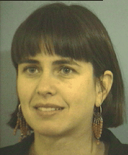
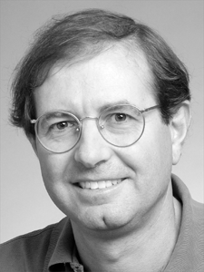
Assumptions for cpa-secure SKEs
O. Goldreich, S. Goldwasser and S. Micali. How to Construct Random Functions. JACM, 33(4), 792-807, 1986
Pseudorandom Functions (PRF) that “look” like TRF but actually not!!

Slide 22
Pseudorandomness
- It’s a property of a probability distribution on a set
Func_{n} = { Set of all functions f: {0,1}^{n} → {0, 1}^{n} }
G: a prob. Dist. = { Set of probabilities }
U: Uniform probability Distribution
We are interested in certain type of G.
A function drawn according to U is called truly random function (TRF)
Sampler for G and U
y
Give me output for x
G is pseudorandom if a function drawn according to G is indistinguishable from a function drawn according to U to a PPT distinguisher who can make PPT no. of queries

Slide 23
Funcn & Uniform Distribution & TRF
Func_{n} = { Set of all functions f: {0,1}^{n} → {0, 1}^{n} }
= {f₁, f₂, …, f }
2^{n. 2n}
U = {1/ ,1/ , …, 1/ }
|Func_{n}| =
2^{n. 2n}
2^{n. 2n}
2^{n. 2n}
2^{n. 2n}
x₁ = 00000…0
x₂ = 00000…1
…
x₂^{n} = 11111… 1
2^{n} possibilities
2^{n} possibilities
2^{n} possibilities
2^{n} possibilities
The look-up table for each f has 2^{n} rows
Each row contains an n-bit string
Any function can be represented by a
string of length n2^{n}
Each string of length n2^{n} defines a unique
function in Func_{n}
Truly Random Function (TRF): chosen according to U
>> Output behavior is completely unpredictable
>> Every string of length n is a possible image with equal probability

Slide 24

Pseudorandom Functions (PRF)
> PRF- A function chosen from Func_{n} according to some distribution different from U
- yet, its output behavior “looks like” a TRF
- must be efficiently computable
- Function specification must be concise (poly size)
Definitely not by truth table which will be of size n2^{n}
The sender & the receiver needs to agree on the function
> keyed functions
f_{k} (.): {0,1}^{n} → {0, 1}^{n}
Example: f_{k} (x): k $⨁$x
Func_{n} :{ Set of all functions f: {0,1}^{n} → {0, 1}^{n} }
|Func_{n}| =
2^{n. 2n}
TRF: A function chosen uniformly at random from Func_{n}
KFunc_{n}
KFunc_{n} :{ Set of all KEYED functions f_{k}: {0,1}^{n} → {0, 1}^{n} }
|KFunc_{n}| =
2^{n}
Func_{n}
PRF: A function chosen uniformly at random from KFunc_{n} and “behaves” like a TRF

Slide 25
A possible Definition of PRF in PRG style
Give F (table) either uniformly sampled from Func_{n} or from KFunc_{n} to PPT distinguisher D and ask if it is a TRF or PRF.
>> Does it work?
>> No, since the description of the function is of exponential size
>> Instead we give D oracle access to either a TRF or a PRF and ask “tell us who are you interacting with?”
>> If D cannot tell apart the “behavior” of the function F_{k} (for a uniformly random k) from a truly random function f: {0,1}^{n} → {0,1}^{n}, then we say F_{k} is a PRF.

Slide 26


Indistinguishability Game for PRF
F: {0, 1}^{n} x {0, 1}^{n} → {0, 1}^{n}
Func_{n} = {f₁, f₂, …, f }
Oracle
2^{n. 2n}
x₁
Value of the function at x₁
y₁ = f(x₁)
f ∈_{R} Func_{n}
b= 0
PPT distinguisher D
Value of the function at x₁ is y₁
KFunc_{n}
= {F_{k1}, …, F_{k} }
b
2^{n}

Slide 27
Indistinguishability Game for PRF
F: {0, 1}^{n} x {0, 1}^{n} → {0, 1}^{n}
Func_{n} = {f₁, f₂, …, f }
Oracle
2^{n. 2n}
x_{t}
Value of the function at x_{t}
y_{t} = f(x_{t})
f ∈_{R} Func_{n}
b= 0
PPT distinguisher D
Value of the function at x_{t} is y_{t}
KFunc_{n}
= {F_{k1}, …, F_{k} }
b
2^{n}
D can adaptively asks its queries
D allowed to ask polynomial number of queries

Slide 28
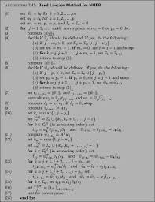
Indistinguishability Game for PRF
F: {0, 1}^{n} x {0, 1}^{n} → {0, 1}^{n}
Func_{n} = {f₁, f₂, …, f }
2^{n. 2n}
Value of the function at x₁
PPT distinguisher D
Value of the function at x₁ is y₁
b= 1
k ∈_{R} {0,1}^{n}
KFunc_{n}
= {F_{k1}, …, F_{k} }
2^{n}
b
x₁
y₁= F_{k}(x₁)
F_{k}

Slide 29
Indistinguishability Game for PRF
F: {0, 1}^{n} x {0, 1}^{n} → {0, 1}^{n}
Func_{n} = {f₁, f₂, …, f }
2^{n. 2n}
Value of the function at x_{t}
PPT distinguisher D
Value of the function at x_{t} is y_{t}
b= 1
k ∈_{R} {0,1}^{n}
KFunc_{n}
= {F_{k1}, …, F_{k} }
b
2^{n}
x_{t}
y_{t}= F_{k}(x_{t})
F_{k}
D can adaptively asks its queries
D allowed to ask polynomial number of queries

Slide 30

Modeling PRF as an Indistinguishability Game
F: {0, 1}^{n} x {0, 1}^{n} → {0, 1}^{n}
Func_{n} = {f₁, f₂, …, f }
2^{n. 2n}
?
?
PPT distinguisher D
(x₁, y₁), (x₂, y₂),…, (x_{k}, y_{k})
KFunc_{n}
= {F_{k1}, …, F_{k} }
2^{n}
Definition 3.25: F is a PRF if for every PPT D there is an negl(n)
|
F_{k}( )
-
f( )
|
Pr [D (1^{n}) = 1]
Pr [D (1^{n}) = 1]
≤ negl(n)
>> uniformly random k
>> D‘s randomness
>> uniform choice of f
>> D’s randomness
>> D not given k in the above game
--- otherwise D can distinguish with high probability

Slide 31



Let’s Try to Construct a PRF
Example 3.26: Consider the following keyed function F
Input: x
Output: k ⊕ x
length-preserving
For any x, uniformly random output (if k is uniformly random)
F is no way a PRF
x_{i}
F is a PRF
Oracle
y_{i} = f(x_{i})
Value of the function at x₁
Value of the function at x₂
b= 0
f ∈_{R} Func_{n}
PPT distinguisher D
(x₁, y₁), (x₂, y₂)
Value of the function at x₁ is y₁
k ∈_{R} {0,1}^{n}
Value of the function at x₂ is y₂
b= 1
x₁⊕x₂=y₁⊕ y₂
x₁⊕x₂≠y₁⊕ y₂
x_{i}
1
0
y_{i}= F_{k}(x_{i})
If D interacted with a keyed F_{k}
If D interacted with a random function
|
F_{k}( )
-
f( )
|
= 1 – 2^{-n}
F_{k}
Pr [D (1^{n}) = 1]
Pr [D (1^{n}) = 1]
D outputs 1 with probability 1
D outputs 1 only if f(x₂) = f(x₁) ⊕ x₁ ⊕ x₂ --- prob: 2^{-n}

Slide 32
Do PRFs exist?
No proof…
But we strongly believe they do
Didn’t we just say we believe something is true but don’t have a proof?
Yet another Assumption: PRFs exist.
Later in the course……….
PRFs exist
??
Goldreich-Goldwasser-Micali
Because no good distinguisher
PRGs exist
Block Ciphers: DES, AES
Far from practical
Highly practical

Slide 33
Pseudo Random Permutation (PRP)
F: {0, 1}^{n} x {0, 1}^{n} → {0, 1}^{n}
Perm_{n} be the set of all permutations (i.e., bijections) on {0, 1}^{n}
= {f₁, f₂, …, f }
(2^{n})!
x₁ = 00000…0
x₂ = 00000…1
…
x₂^{n} = 11111… 1
2^{n} possibilities
2^{n}-1 possibilities
1 possibility
The look-up table for each f has 2^{n} rows
Each row contains an n-bit string
Entries in any two distinct rows must be differnt
Kperm_{n} be the set of all keyed permutation if l_{in} = l_{out}, and for all k l_{key}(n) the function
is one-to-one
l_{in}(n)
l_{out}(n)
l_{in}(n)
F_{k}: {0, 1} x {0, 1} → {0, 1}

Slide 34
Pseudo Random Permutation (PRP)
F: {0, 1}^{n} x {0, 1}^{n} → {0, 1}^{n}
Perm_{n} = {f₁, f₂, …, f }
(2^{n})!
?
?
PPT distinguisher D
(x₁, y₁), (x₂, y₂),…, (x_{k}, y_{k})
KPerm_{n}
= {F_{k1}, …, F_{k} }
Distinct pairs
2^{n}
F is a PRP if for every PPT D there is an negl(n)
|
F_{k}( )
-
f( )
|
Pr [D (1^{n}) = 1]
Pr [D (1^{n}) = 1]
≤ negl(n)
>> uniformly random k
>> D‘s randomness
>> uniform choice of f
>> D’s randomness

Slide 35
Strong PRP
F: {0, 1}^{n} x {0, 1}^{n} → {0, 1}^{n}
Perm_{n} = {f₁, f₂, …, f }
(2^{n})!
?
>> Any strong PRP is by default a PRP
?
>> What about the converse ?
PPT distinguisher D
KPerm_{n}
= {F_{k1}, …, F_{k} }
(x₁, y₁), (x₂, y₂),…, (x_{k}, y_{k})
2^{n}
(y₁, x₁), (y₂, x₂),…, (y_{k}, x_{k})
Definition 3.28: F is a PRP if for every PPT D there is an negl(n)
|
F_{k}( )
, F_{k}⁻¹( )
-
f( )
, f⁻¹( )
|
Pr [D (1^{n}) = 1]
Pr [D (1^{n}) = 1]
≤ negl(n)
>> uniformly random k
>> D‘s randomness
>> uniform choice of f
>> D’s randomness

Slide 36
Do PRPs/SPRPs exist?
No proof…
But we strongly believe they do
Yet another Assumption: PRPs/SPRPs exist.
Later in the course……….
PRPs/SPRPs exist
Luby-Rackoff
Because no good distinguisher
PRFs exist
Block Ciphers: DES, AES
Far from practical
Highly practical
Efficiency of SPRPs based cpa-secure schemes are better than PRF-based ones

Slide 37
Fixed-length cpa-secure SKE from PRF
Construction 3.30
Enc_{k}(m)
- r in {0, 1}^{n}
- c = (r, m ⊕ F_{k}(r))
m,k
c
c,k
Dec_{k}(c = (c₀,c₁))
- m = c₁ ⊕ F_{k}(c₀)
Secret PRF-key k
(key-agreement)
K = {0, 1}^{n} M = {0, 1}^{n} C = {0, 1}^{2n}
k
k
Enc_{k}(m)
- r in {0, 1}^{n}
- c = (r, m ⊕ F_{k}(r))
Gen
k ∈_{R} K
m ∈ M
c
c ∈ C
m
Dec_{k}(c = (c₀,c₁))
- m = c₁⊕F_{k}(c₀)

Slide 38
Recall Security Proof of PRG-based Scheme
m,k
Enc_{k}(m)
>> c = m ⊕ G(k)
c
c,k
Dec_{k}(c)
>> m = c ⊕ G(k)
Secret PRG-key k
Construction 3.17
Theorem 3.18. If G is a PRG, then Π is a coa-secure scheme.
Proof: Assume Π is NOT secure
coa
coa
A, p(n):
Pr
PrivK (n)
½ + 1/p(n)
= 1
>
Pr
PrivK (n)
½
= 1
=
A, Π
A, Π
=
=
Pr [D(G(s)) = 1]
Pr [D(y) = 1]
coa
Let us run
PRS or RS?
PrivK (n)
A, Π
y∈{0,1}^{n}
D
m₀, m₁∈M , |m₀| = |m₁|
A
c = m_{b} ⊕ y
1 if b = b’
0 otherwise
b’ ∈ {0, 1}
b

Slide 39


Security Proof
Theorem 3.31: If F_{k} is a PRF, then Π is a CPA-secure scheme.
Proof: Assume Π is NOT secure
cpa
cpa
A, p(n):
Pr
PrivK (n)
½ + 1/p(n)
= 1
>
Pr
PrivK (n)
= ?
= 1
A, Π
A, Π
D
A
r₁
m₁
y₁
(r₁, y₁ ⊕ m₁)
F_{k}(PRF)
f (TRF)
Repeat
Repeat
r
m₀,m₁ ∈ M, |m₀| = |m₁|
y
(r, y ⊕ m_{b})
b
r_{i}
m_{i}
y_{i}
(r_{i}, y_{i} ⊕ m_{i})
Repeat
Repeat
b’ ∈ {0, 1}

Slide 40
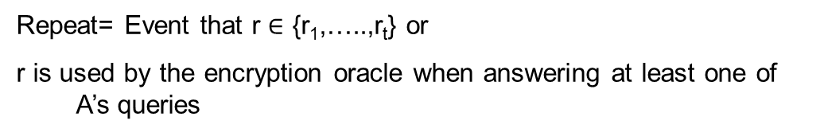
Security Proof
cpa
Repeat= Event that r $∈$ {r₁,…..,r_{t}} or
r is used by the encryption oracle when answering at least one of A’s queries
Pr
PrivK (n)
= 1
A, Π
cpa
Pr
PrivK (n)
= 1
Repeat
= 1/2
A, Π
D
A
r₁
m₁
y₁
(r₁, y₁ ⊕ m₁)
F_{k}(PRF)
f (TRF)
Repeat
Repeat
r
m₀,m₁ ∈ M, |m₀| = |m₁|
y
(r, y ⊕ m_{b})
b
r_{i}
m_{i}
y_{i}
(r_{i}, y_{i} ⊕ m_{i})
Repeat
Repeat
b’ ∈ {0, 1}

Slide 41




Security Proof
cpa
Pr
PrivK (n)
= 1
$≤$ ½ + t/2^{n}
A, Π
cpa
cpa
= Pr
PrivK (n)
= 1
Repeat
Pr (Repeat) +
Pr
PrivK (n)
= 1
Repeat
Pr (Repeat)
A, Π
A, Π
$≤$ Pr (Repeat)
cpa
$≤$ Pr
PrivK (n)
= 1
Repeat
A, Π
≤ t/2^{n}
= 1/2
cpa
Repeat= Event that r $∈$ {r₁,…..,r_{t}}
Pr
PrivK (n)
= 1
Repeat
= 1/2
A, Π

Slide 42

Security Proof
Theorem 3.31: If F_{k}: is a PRF, then Π is a CPA-secure scheme.
Proof: Assume Π is not secure
cpa
cpa
A, p(n):
Pr
PrivK (n)
½ + 1/p(n)
= 1
>
Pr
PrivK (n)
= 1
$≤$ ½ + t/2^{n}
A, Π
A, Π
=
F_{k}
=
f
Pr [D () = 1]
Pr [D () = 1]
D
A
r₁
m₁
y₁
(r₁, y₁ ⊕ m₁)
F_{k}(PRF)
f (TRF)
Repeat
Repeat
r
m₀,m₁ ∈ M, |m₀| = |m₁|
y
(r, y ⊕ m_{b})
b
r_{i}
m_{i}
y_{i}
(r_{i}, y_{i} ⊕ m_{i})
Repeat
Repeat
1 if b = b’
0 otherwise
b’ ∈ {0, 1}

Slide 43
References
[1] Jonathan Katz, Yehuda Lindell. Chapter 3.5, Introduction to Modern Cryptography, 2nd Edition, Chapman & Hall/CRC Cryptography and Network Security Series, 2014
[2] http://drona.csa.iisc.ernet.in/~arpita/Cryptography17.html

