Slide 1
Http Protocol Analysis and Webpage Reverting
Team: 李为、卢金莹、杨培基、梁缘

Slide 2
Goal
Step 1
Step 2
Step 3
Results
Conclusion
Goal: write a program that can capture the coming packets and revert the webpage which you select to test by using the captured data.
Step1: capture the packets
Step2: packets processing
Step3: revert the webpage with captured data

Slide 3
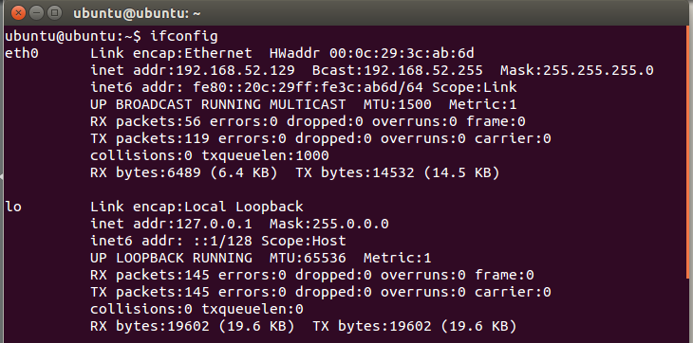
Goal
Step 1
Step 2
Step 3
Results
Conclusion
Ubuntu 14.04，IP：192.168.52.129，
subnet mask：255.255.255.0

Slide 4
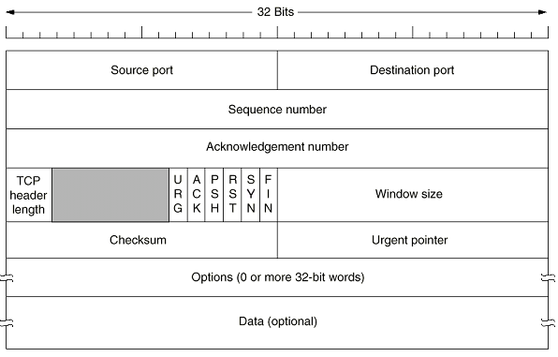
Goal
Step 1
Step 2
Step 3
Results
Conclusion
TCP segment header
Notes:
We need source port , sequence number.

Slide 5
Goal
Step 1
Step 2
Step 3
Results
Conclusion
IP datagram
ver
head.
len
type of
service
length
fragment
offset
16-bit identifier
flgs
time to
live
upper
layer
header
checksum
32 bit source IP address
32 bit destination IP address
Options (if any)
data
(variable length,
typically a TCP
or UDP segment)
Notes:
We need destination IP address.

Slide 6
Goal
Step 1
Step 2
Step 3
Results
Conclusion
Specific steps(capture the packets):
Capture packets using the libpcap framework.
Look up device network address and mask.
Open network device for packet capture.
Process packets from a live capture .
Close device.
Filter out the required packets.
TCP Source port is 80.
IP destination address is local address.

Slide 7
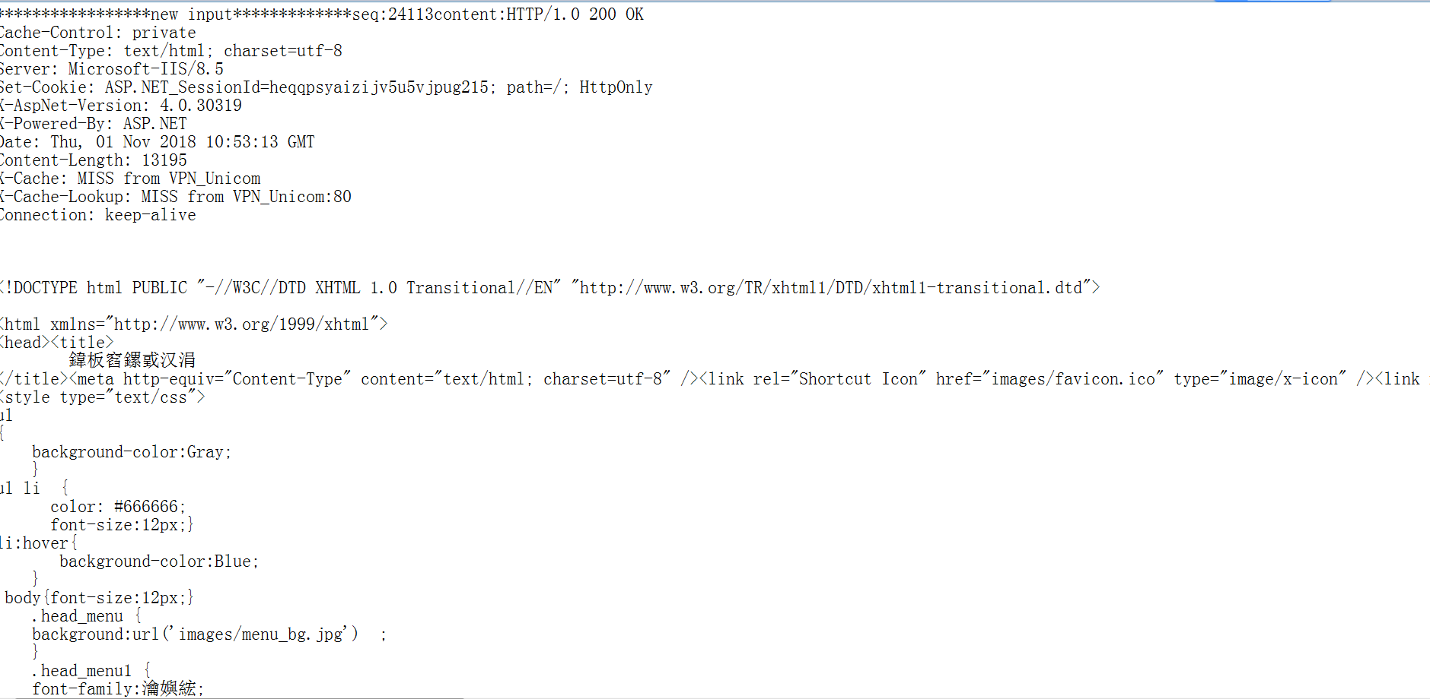
Goal
Step 1
Step 2
Step 3
Results
Conclusion
Example:

Slide 8
Goal
Step 1
Step 2
Step 3
Results
Conclusion
Packets processing:
Classify content type.
Text
Html
Css
Js
Image
img
Gif
Sort by seq number.

Slide 9
Goal
Step 1
Step 2
Step 3
Results
Conclusion
Besides,
use insert sort to sort seq in ascending order so that it is a stable sorting algorithm.

Slide 10
Goal
Step 1
Step 2
Step 3
Results
Conclusion
Revert the webpage with captured data :
Find the first packet with HTTP data for each type.
Get the TCP seq number and the data type and length at the http header
Traverse the packet list in turn, and determine whether to splicing the data.
Write data to the file when the total data matches the length in the http header

Slide 11
Goal
Step 1
Step 2
Step 3
Results
Conclusion
Final Step:
Convert html's URL to a local address.
css
html
link
js
img/gif
local

Slide 12
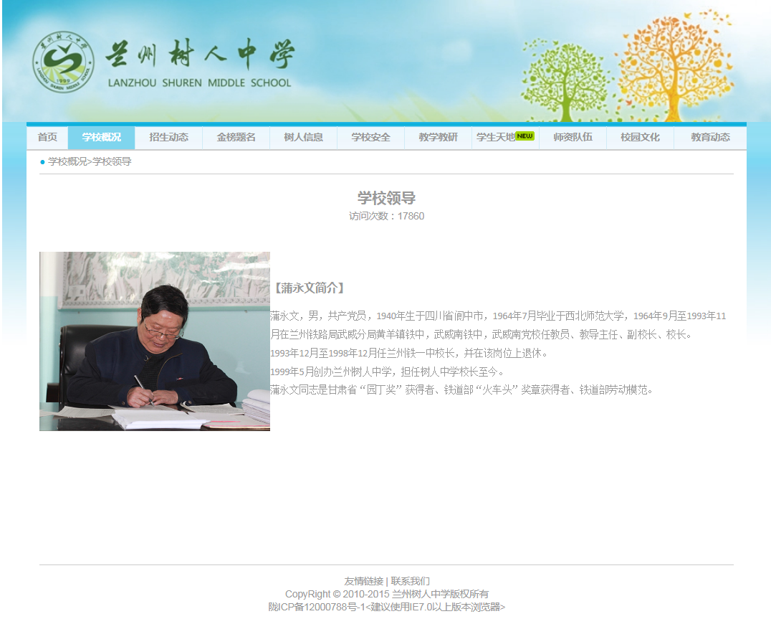
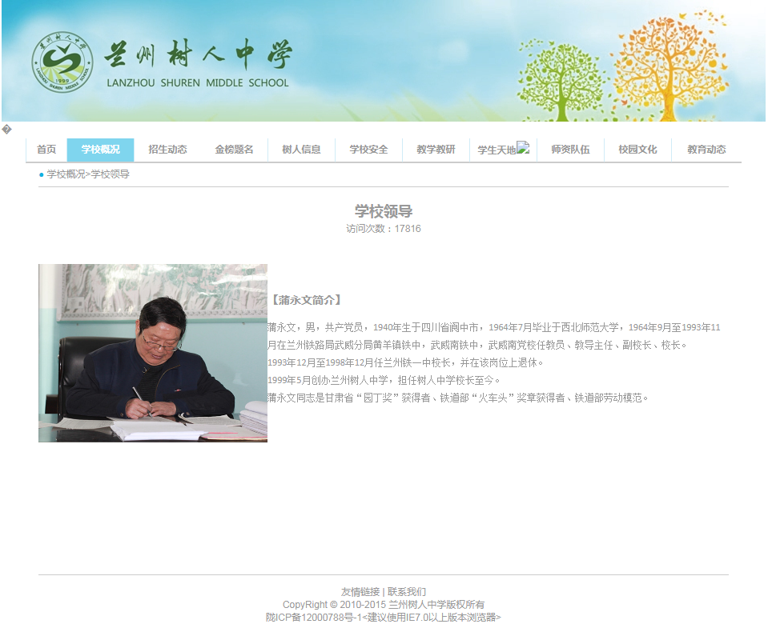
Goal
Step 1
Step 2
Step 3
Results
Conclusion
original
recovery

Slide 13

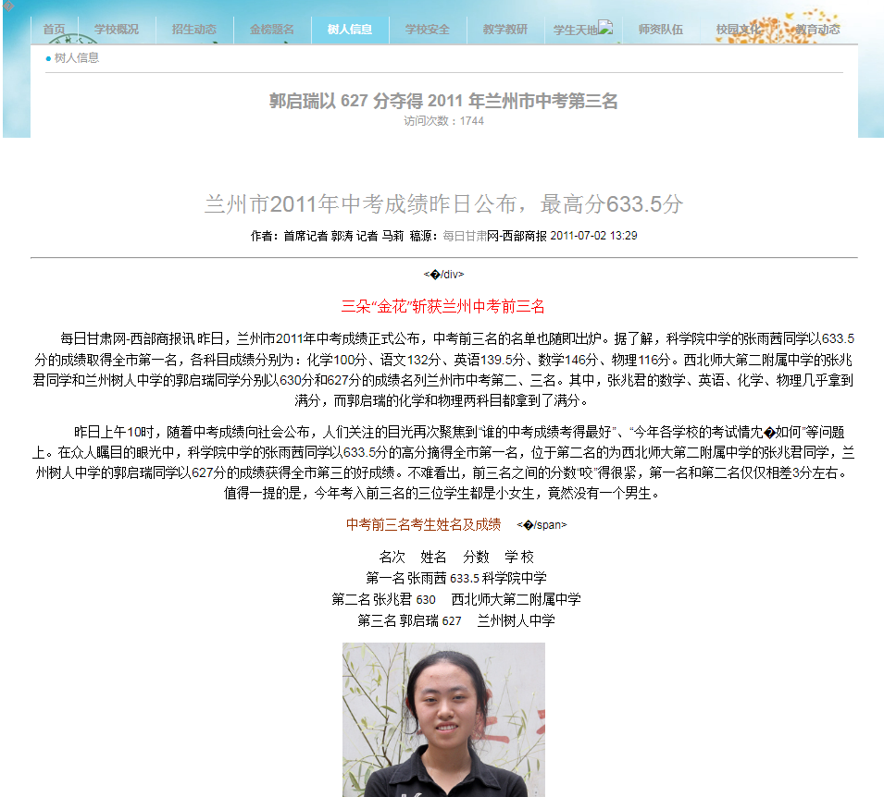
Goal
Step 1
Step 2
Step 3
Results
Conclusion
original
recovery

Slide 14
Goal
Step 1
Step 2
Step 3
Results
Conclusion
To be continue…

Slide 15
Goal
Step 1
Step 2
Step 3
Results
Conclusion

Slide 16
Goal
Step 1
Step 2
Step 3
Results
Conclusion
如果你一定要彩色

Slide 17
Acknowledge

