Slide 1
Machine Learning
Chapter 4 Artificial Neural Network（ANN）

Slide 2
4.1 Introduction
ANN provide a robust approach to approximating real-valued, discrete-valued, and vector-valued functions
For certain types of problem, such as learning to interpret complex real-world sensor data, ANN are very effective
BP Algorithm has proven successful in many practical problems

Slide 3
4.1.1 Biological Motivation
The biological learning system is built of very complex webs of interconnected neurons.
The human brain is a densely interconnected network (10¹¹ neurons, each connected to 10⁴ others)
Neuron activity is typically excited or inhibited through connections to other neurons.
The information-processing abilities of biological neural systems
The neuron switching times is slow compared to computer speed. Yet humans are able to quickly make complex decisions (why?)
highly parallel computation based on distributed representations
ANN system is designed to capture such abilities

Slide 4
In fact, ANN are loosely motivated by biological neural systems
Two groups of researchers in ANN
Using ANNs to study and model biological learning processes
Obtaining highly effective machine learning algorithms, independent of whether these algorithms mirror biological processes
Within this book our interest fits the latter group

Slide 5
4.2 Neural Network Representations
ALVINN (Pomerleau 1993)
Automatically driving
The input : 30x32 image
the lines entering the node from below are its inputs.
Hidden units
their output is available only within the network and is not available as part of the network output.
Output units
Each output unit corresponds to a particular steering direction, and the output values determine the driving action

Slide 6
ALVINN
Drives 70 mph on a public highway
Camera
image
30x32 weights
into one out of
four hidden
unit
30 outputs
for steering
4 hidden
units
30x32 pixels
as inputs

Slide 7
The network structure of ALVINN
The individual units are interconnected in layers that form a directed acyclic graph.
Types of structures of ANN
Acyclic or cyclic
Directed or undirected
We focus on the BP Network
structure : a directed graph, possible containing cycles.
Learning: choosing a weight value for each edge in the network

Slide 8
4.3 Appropriate Problems For Neural Network Learning
Problem with the following characteristics
Instances are represented by many attribute-value pairs
more symbolic representations, high dimensions
The target function : discrete-valued, real-valued, or a vector
The training examples may contain errors
noisy, complex sensor data.(Cameras, microphones)

Slide 9
Fast evaluation of the learned target function may be required
Long training times are acceptable
The ability of humans to understand the learned target function is not important
BP is the most commonly used ANN learning technique

Slide 10
The Organization of the rest of this chapter
Learning algorithms for training single units
Several designs for the primitive units
perceptron
linear unit
sigmoid unit
BP algorithm
Several general issues
The representational capabilities of ANNs
Nature of the hypothesis space search
Overfitting problems
Alternatives to the BP algorithm
A detailed example

Slide 11
4.4 Perceptron
Linear threshold unit (LTU)
x₀=1
x₁
w₁
w₀
w₂
x₂
Σ
o
.
.
.
Σ_{i=0}^{n} w_{i} x_{i}
w_{n}
x_{n}

Slide 12
Perceptron function
Hypotheses space in perceptron learning

Slide 13
4.4.1 Representational Power of Perceptrons
Perceptron can be viewed as a hyperplane decision surface in n-dimensional space of instances
Positive instances lying on one side of the hyperplane
Negative instances lying on the other side
The equation for this decision hyperplane
Linearly separable sets

Slide 14
Representational Power of a single perceptron .
Boolean functions : m-of-n functions (and or)
AND OR NAND NOR
Functions that are not linearly separable (e.g. Xor) are not representable

Slide 15
Decision Surface of a Perceptron
x₂
x₂
+
+
+
-
+
-
-
x₁
x₁
+
-
-
+
-
And(x₁,x₂) choose weights w₀=-1.5, w₁=1, w₂=1
Xor are not representable

Slide 16
Representational Power of Networks of threshold units
representing a rich variety of functions
Every boolean function can be represented by some network of perceptrons only two level deep
One way
Representing the Boolean function in disjunctive normal form
(x₁ ∧ x₂ ∧ x₃ ) v (x₃ ∧ x₄ ∧ x₅ )

Slide 17
4.4.2 The Perceptron Training Rule
Understanding how to learn the weights for a single perceptron
The learning problem
determining a weight vector that causes the perceptron to produce the correct 1 or -1 for training examples
Learning algorithms
Perceptron training rule
The delta rule
Both converge to an acceptable weight vector .
the base for multi-layer network learning algorithm.

Slide 18
Perceptron Learning Rule
w_{i} = w_{i} + Δw_{i}
Δw_{i} = η (t - o) x_{i}
t=c(x) : the target value
o : the perceptron output
η : a small constant (e.g. 0.1), called learning rate
If the output is correct (t=o), w_{i} are not changed
If the output is incorrect (t≠o), w_{i} are changed
such that the output of the perceptron for the new weights
is closer to t.
Converge condition of the learning algorithm
the training data is linearly separable
η is sufficiently small

Slide 19
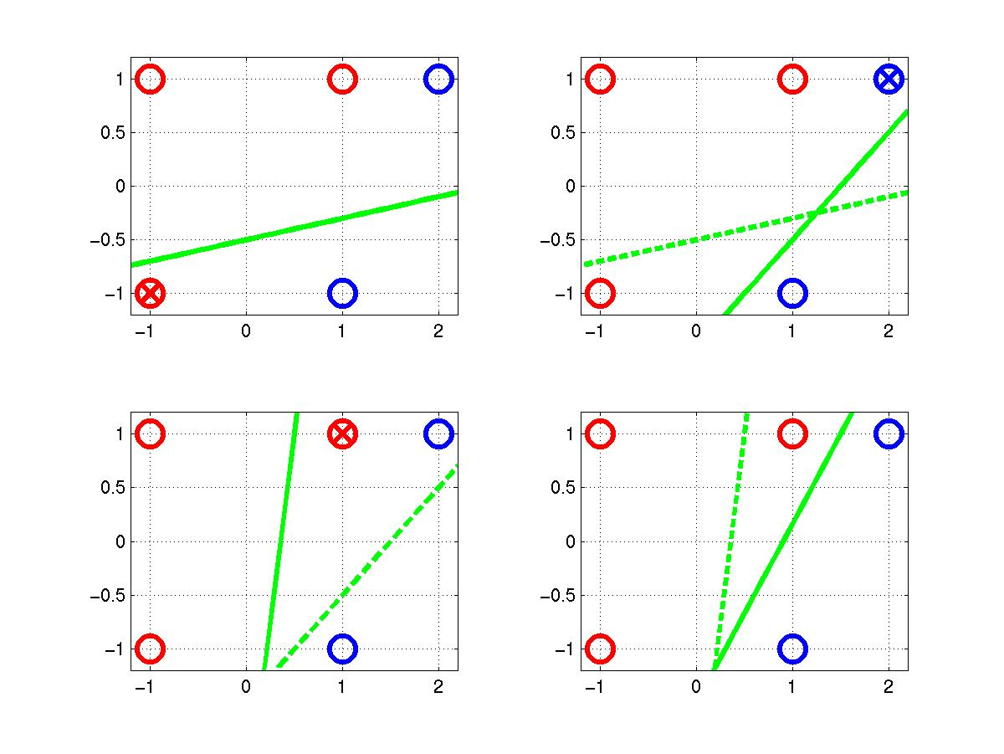
(x,t)=([2,1],-1)
o=sgn(0.45-0.6+0.3) =1
(x,t)=([1,1],1)
o=sgn(0.25-0.7+0.1) =-1
t=-1
t=1
o=1
w0=[0.25 –0.1 0.5]
0.25-0.1 x₁+0.5 x₂=0
o=-1
(x,t)=([-1,-1],1)
o=sgn(0.25+0.1-0.5)
=-1
Δw1=[0.2 –0.2 –0.2]
Δw2=[-0.2 –0.4 –0.2]
Δw3=[0.2 0.2 0.2]

Slide 20
Convergence is assured（Minskey & Papert 1969）
Provided the training examples are linearly separable and provided a sufficiently small η
If the data are not linearly separable， Convergence is not assured

Slide 21
4.4.3 Gradient Descent and the Delta Rule
Delta Rule overcome the difficulty of the perceptron rule
if the training example are not linearly separable, the delta rule converges toward a best-fit approximation to the target concept
The key idea behind the delta rule
using gradient descent to search H to find the weights that best fit the training examples

Slide 22

Understanding Delta rule
Task of Delta rule: training an unthresholded perceptron
Specify a measure for the training error of a hypothesis (weight vector)
Finding hypothesis that minimizes E
that Chapter 6 provides a Bayesian justification for choosing this particular definition of E, under certain conditions the hypothesis that minimizes E is also the most probable hypothesis in H given the training data

Slide 23
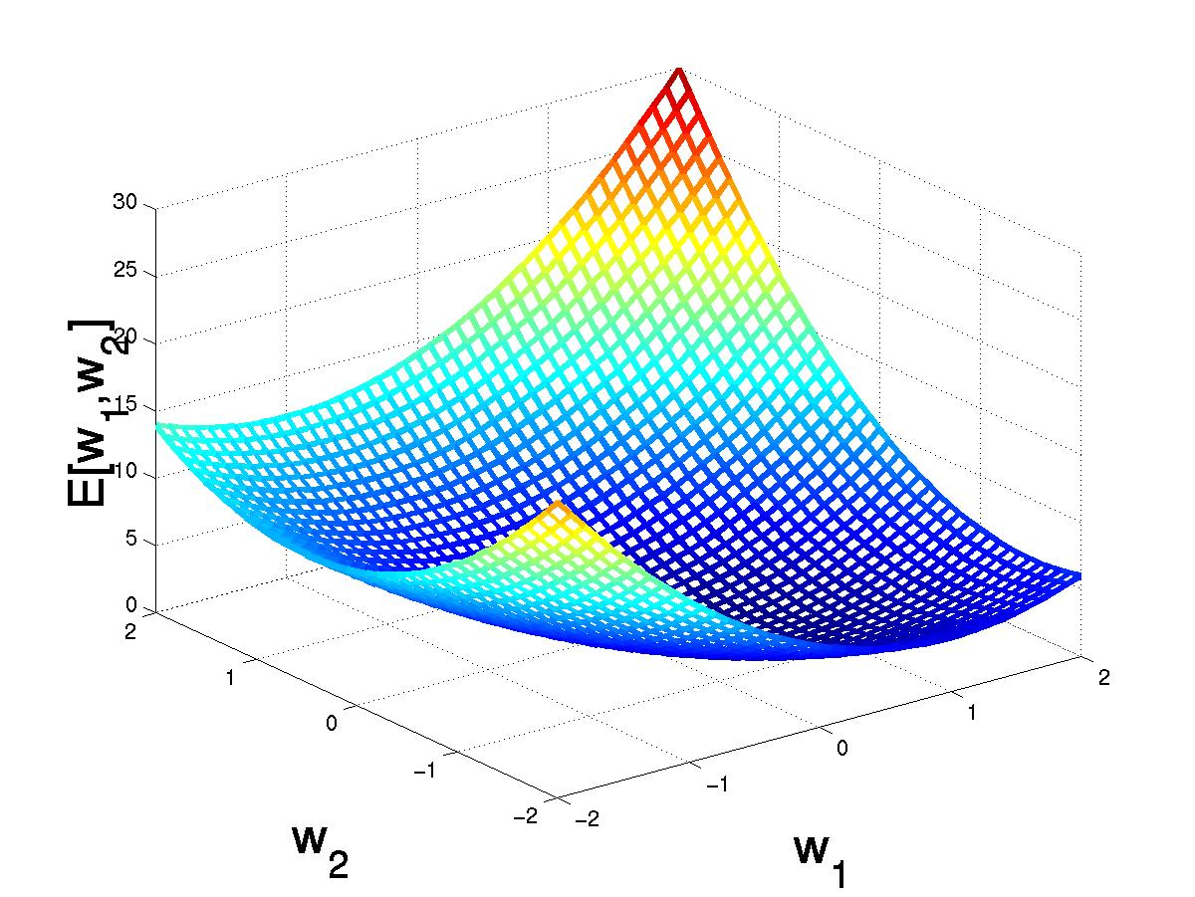
4.4.3.1 Visualizing The Hypothesis Space
Figure 4-4
Hypothesis space H is w1,w2 plane. For linear units this error surface has a single global minimum
(w₁,w₂)
(w₁+Δw₁,w₂ +Δw₂)

Slide 24
Gradient descent search
determines a weight vector that minimizes E
starting with an arbitrary initial weight vector w
w is altered in the direction that produces the steepest decent along the error surface
repeatedly modifying w at each step until the global minimum error is reached

Slide 25
4.4.3.2 Derivation of The Gradient Descent Rule
How can we find the direction of steepest descent?
computing the derivative of E with respect to each component of the vector , written
The gradient specifies the direction that produces the steepest increase in E.
the negative of this vector therefore gives the direction of steepest decrease
Training rule for gradient descent
where

Slide 26
Gradient Descent
D={<(1,1),1>,<(-1,-1),1>, <(1,-1),-1>,<(-1,1),-1>}
(w₁,w₂)
Gradient:
∇E[w]=[∂E/∂w₁,… ∂E/∂w_{n}]
(w₁+Δw₁,w₂ +Δw₂)
Δw=-η ∇E[w]
Δw_{i}=-η ∂E/∂w_{i}
= -η ∂ (1/2Σ_{d}(t_{d}-o_{d})²) /∂w_{i}
= -η 1/2Σ_{d} ∂ ((t_{d}-o_{d})²) /∂w_{i}
= -η 1/2Σ_{d} ∂ ((t_{d}-o_{d})²) / ∂o_{d}* (∂o_{d} / ∂w_{i})
= η Σ_{d}(t_{d}- o_{d})(x_{id})
o_{d}=Σ w_{i} x_{id}

Slide 27
Gradient Descent
Gradient-Descent(training_examples, η)
Each training example is a pair of the form <(x1,…xn),t> where (x1,…,xn) is the vector of input values, and t is the target output value, η is the learning rate (e.g. 0.1)
Initialize each wi to some small random value
Until the termination condition is met, Do
Initialize each Δwi to zero
For each <(x1,…xn),t> in training_examples Do
Input the instance (x1,…,xn) to the linear unit and compute the output o
For each linear unit weight wi Do
Δwi= Δwi + η (t-o) xi
For each linear unit weight wi Do
wi=wi+Δwi

Slide 28
Convergence is assured
Because the error surface contain only a single global minimum, this algorithm will converge to a weight vector with minimum error, regardless of whether the training examples are linearly separable, given a sufficiently small learning rate
One common modification to the algorithm
gradually reducing the value of learning rate as the number of gradient descent steps grows

Slide 29
4.4.3.3 Stochastic Approximation to Gradient Descent
Gradient descent is an important general paradigm for learning.
Used for searching through a larger or infinite H
H should satisfy the following conditions
H contains continuously parameterized hypotheses
The error can be differentiated with respect to these hypothesis parameters
The key practical difficulties in applying gradient descent
Converging speed is slow
If there are multiple local minimum in the error surface, then there is no guarantee that the procedure will find the global minimum

Slide 30
Stochastic gradient( incremental gradient descent)
Approximate this gradient descent search by updating weights incrementally, following the calculation of the error for each individual example
The modified training rule on table 4.1

Slide 31
Stochastic gradient(training_examples, η)
Each training example is a pair of the form <(x1,…xn),t> where (x1,…,xn) is the vector of input values, and t is the target output value, η is the learning rate (e.g. 0.1)
Initialize each wi to some small random value
Until the termination condition is met, Do
Initialize each Δwi to zero
For each <(x1,…xn),t> in training_examples Do
Input the instance (x1,…,xn) to the linear unit and compute the output o
Δwi= Δwi + η (t-o) xi
wi=wi+Δwi

Slide 32
Understanding Stochastic gradient
Create a distinct error function for each individual training example d
The sequence of these weight updates, when iterated over all training examples, provides a reasonable approximation to the gradient of the original error function
Δwi= Δwi + η (t-o) xi
SGD approximates true GD arbitrarily closely
When the learning rate sufficiently small,

Slide 33
The key difference between standard gradient descent and stochastic gradient descent
See page94 (three points)
Number of training samples
Step size per weight update
Chance for escaping local minima
Both stochastic and standard gradient descent methods are commonly used in practice

Slide 34
Delta rule are also called LMS rule, Adaline rule, Windrow-Hoff rule
The difference between Delta rule equation(4.10) and the perceptron training rule in equation (4.4.2) (Same?)
Δwi= η (t-o) xi
Delta can also be used to train thresholded perceptron units
If the unthresholded output o can be trained to fit these values perfectly, then the threshold output o’ will fit them as well
Even when the target values cannot be fit perfectly, the thresholded o’ value will correctly fit the target value whenever the linear unit output o has the correct sign
Delta rule will learn weights that minimize the error in the linear unit output o, these weights will not necessarily minimize the error in the thresholded output o’

Slide 35
4.4.4 Remarks
Key difference between the perceptron rule and delta rule
Perceptron rule update weights based on the error in the thresholded perceptron output
Delta rule updates weights based on the error in the unthresholded linear combination inputs
Difference in convergence properties
Perceptron rule converges after a finite numberof iterations to a h, provided the training examples are linearly separable
Delta rule converges only toward the minimum error h, possible requiring unbounded time, regardless of whether the training data are linearly separable

Slide 36
A third algorithm for learning the weight vector is linear programming
Linear programming is a general, efficient method for solving sets of linear inequalities
This approach is valid only when the training examples are linearly separable
This approach can’t scale to training multilayer networks. In contrast, the gradient descent approach can be easily extended to multilayer network

