Slide 1




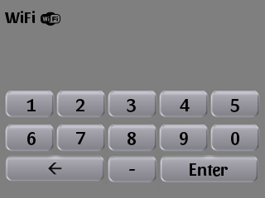





















Pi-Ager
menu
settings
2 °C
UV
64%
brightness
shutdown / reboot
1
2
3
4
5
6
7
8
9
0
←
-
Enter
←

