Slide 1
Valentin Manes

Slide 2
I – Problem?
“A problem well stated is a problem half solved.”
Charles Kettering

Slide 3
I - What problem?
Programme behavorial space is too large:
The natural unit of a program execution is a path,
but: path explosion problem.
No understanding/grasp of the space:
what’s the relationship between paths?

Slide 4




Space Description Precision
Path enumeration
“Tuple” coverage
So far, coverage has won the consensus:
Fuzzing
Used to build unit tests
Branch coverage
Node coverage
None

Slide 5
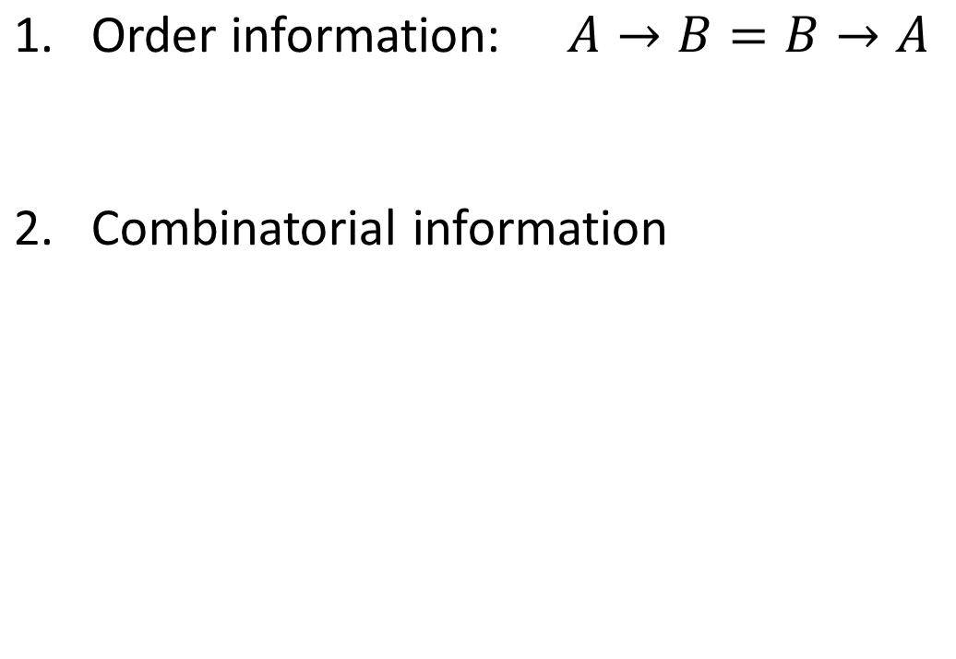
What do we lose using coverage?
branches | A | B | C
covered

Slide 6
What do we lose using coverage?
branches | A | B | C
covered
test case 1

Slide 7
What do we lose using coverage?
branches | A | B | C
covered
test case 1
test case 2

Slide 8
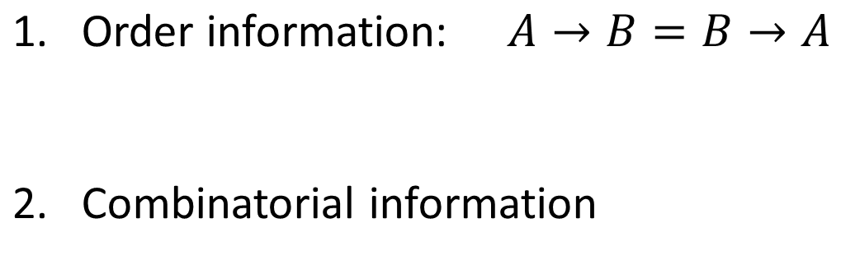
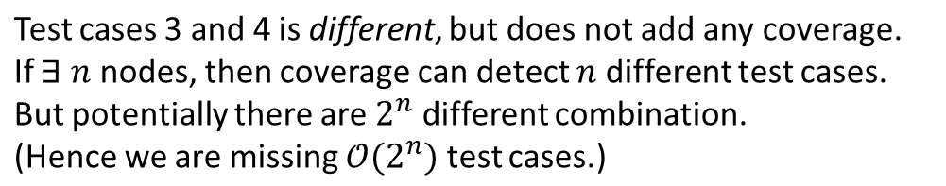
What do we lose using coverage?
nodes | A | B | C
covered
test case 1
test case 2
test case 3
test case 4

Slide 9
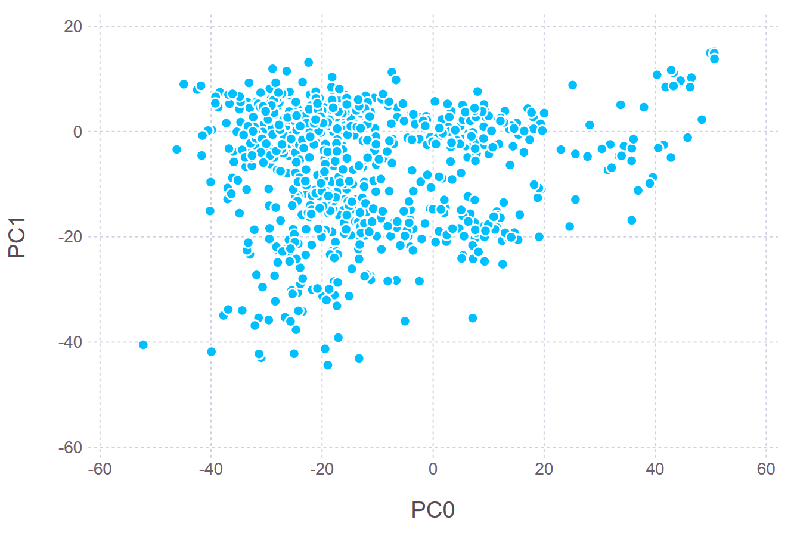
Proposed solution: build a map of the space
What’s to gain in having a map? How is it useful?
Notes:
Can be used for culling… But also as a fitness!

Slide 10
II – Reducing the space

Slide 11
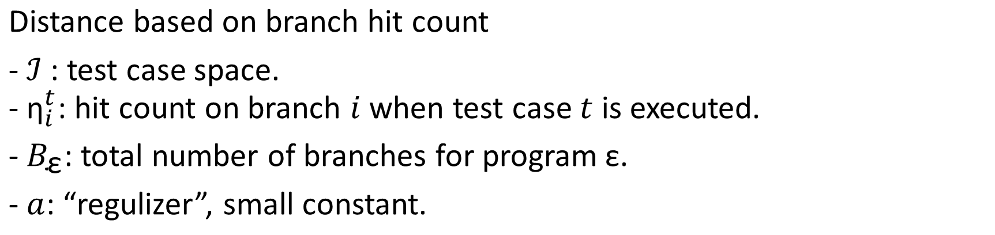
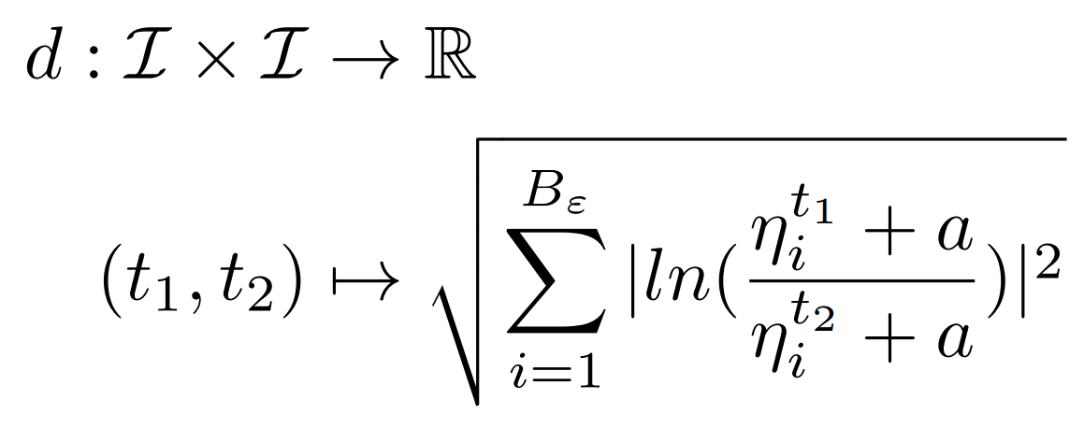
How to build a map?
Define the relation between points in the space.
Note: What’s a good distance? Question for later…

Slide 12
Reducing the space
Problem: distance computation is too slow.
Why: too many dimensions.
Solution: reduce the number of dimensions.

Slide 13
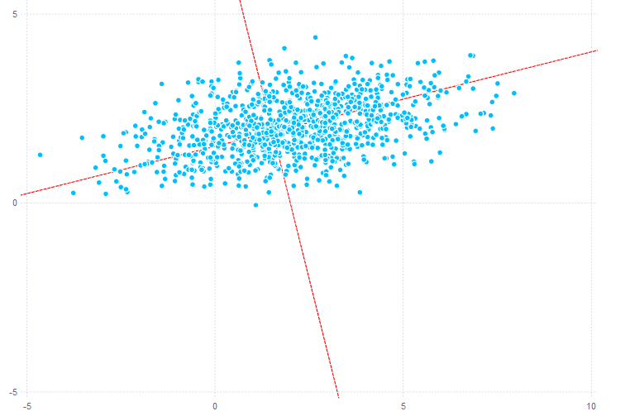
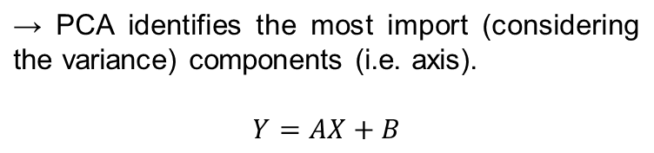
Principal Component Analysis (PCA)
Projected data
center
Projecting basis
Data point
→ Choosing the “most important” components to describe the data (i.e. dimension reduction), is an approximate space description.
PCA guarantees this information loss is minimal (considering the available data).

Slide 14
Does it work for fuzzing?
- Not out of the box: too many test cases on too many dimensions
But, work around:
Based on seeds (~1000), find a basis.
While fuzzing, a) compute the covariance matrix of this basis, and b) detect points that are badly projected and add them to the basis.
(This loses the “minimal loss” guarantee.)
Notes:
Here I’m hiding some math…

Slide 15
III – Evaluation

