Slide 1
DIN based Look-Alike model

Slide 2
Workflow
- Necessary steps
Inactive user elimination
Input
User feature
User behavior (represented as keywords history)
DIN model
Kernel computation
User profile generation – user vs keyword correlation
User profile normalization
LookAlike model
seed_user vs non-seed_user similarity measurements

Slide 3
Inactive user elimination (user prescreen)
All Users
User’s traffic contribution > predefined threshold*
Active Users
“Prefined threshold” is defined as a range of normal traffic (with low and high bounds) to eliminate:
users with consistent low traffic (inactive user, traffic < low bound)
users with extremely high traffic for some specific period (robot user, traffic > high bound)
*

Slide 4
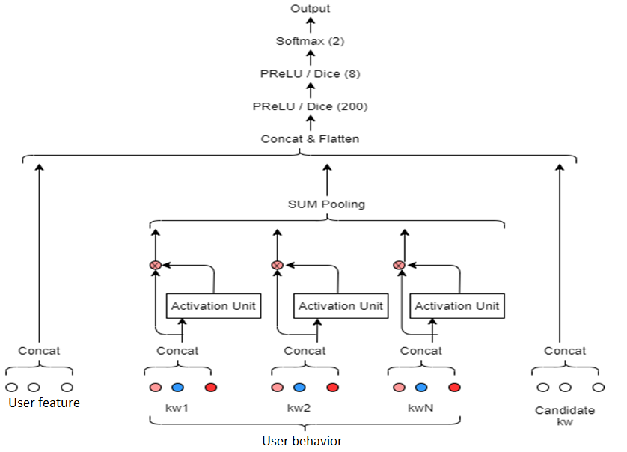
DIN Model

Slide 5
DIN Model Output
– user vs keyword correlation (user profile generation)
 | Keyword₁ | Keyword₂ | Keyword₃ | Keyword₄ | … | Keyword_{m}
User₁ | score₁₁ | score₁₂ | score₁₃ | score₁₄ | … | score_{1m}
User₂ | score₂₁ | score₂₂ | score₂₃ | score₂₄ | … | score_{2m}
... | ... | ... | ... | ... | ... | ...
User_{n} | score_{n1} | score_{n2} | score_{n3} | score_{n4} | … | score_{nm}
DIN

Slide 6
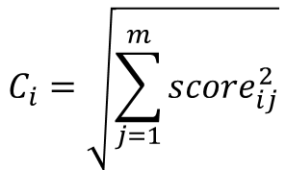

DIN Model Output
– user profile normalization
DIN
 | Keyword₁ | Keyword₂ | Keyword₃ | Keyword₄ | … | Keyword_{m}
User₁ | score₁₁ | score₁₂ | score₁₃ | score₁₄ | … | score_{1m}
User₂ | score₂₁ | score₂₂ | score₂₃ | score₂₄ | … | score_{2m}
... | ... | ... | ... | ... | ... | ...
User_{n} | score_{n1} | score_{n2} | score_{n3} | score_{n4} | … | score_{nm}
Normalization constant
C₁
C₂
…
C_{n}
Score normalization
 | Keyword₁ | Keyword₂ | Keyword₃ | Keyword₄ | … | Keyword_{m}
User₁ | norm_score₁₁ | norm_score₁₂ | norm_score₁₃ | norm_score₁₄ | … | norm_score_{1m}
User₂ | norm_score₂₁ | norm_score₂₂ | norm_score₂₃ | norm_score₂₄ | … | norm_score_{2m}
... | ... | ... | ... | ... | ... | ...
User_{n} | norm__Score_{n1} | norm_score_{n2} | norm_score_{n3} | norm_score_{n4} | … | norm_score_{nm}
$${norm_score}_{ij}=\frac{{score}_{ij}}{C_{i}}$$
$$C_{i}=\sqrt{\sum_{j=1}^{m}{{score}_{ij}^{2}}}$$

Slide 7
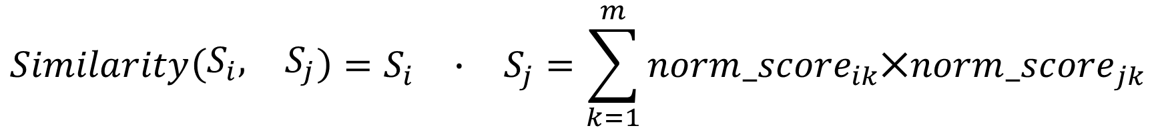

DIN Model Output
– user similarity measurement
$${User}_{i}^{′}s normalized profile:$$
$$S_{i}= \left\{\begin{matrix}{norm_score}_{i1}, & {norm_score}_{i2}, & \begin{matrix}… & {norm_score}_{im}\end{matrix}\end{matrix}\right\}$$
$$Cross user similarity:$$
$$Similarity\left(\begin{matrix}S_{i}, & S_{j}\end{matrix}\right)=\begin{matrix}S_{i} & ∙ & S_{j}=\sum_{k=1}^{m}{{norm_score}_{ik}⨉}\end{matrix}{norm_score}_{jk}$$

Slide 8
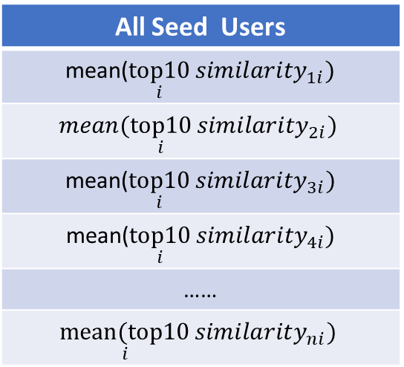
DIN based Look-Alike model
– seed_user vs non-seed_user similarity measure
All Seed Users
mean($\underset{i}{top10}{{similarity}_{1i}})$
$$mean(\underset{i}{top10}{{similarity}_{2i}})$$
mean($\underset{i}{top10}{{similarity}_{3i}})$
mean($\underset{i}{top10}{{similarity}_{4i}})$
……
$$\underset{i}{mean(top10}{{similarity}_{ni}})$$
 | Seed_user₁ | Seed_user₂ | …… | Seed_user_{m}
Nonseed_user₁ | Similary₁₁ | Similary₁₂ | …… | Similary_{1m}
Nonseed_user₂ | Similary₂₁ | Similary₂₂ | …… | Similary_{2m}
Nonseed_user₃ | Similary₃₁ | Similary₃₂ | …… | Similary_{3m}
Nonseed_user₄ | Similary₄₁ | Similary₄₂ | …… | Similary_{4m}
…… | …… | …… | …… | ……
Nonseed_user_{n} | Similary_{n1} | Similary_{n2} | …… | Similary_{nm}
sort
Parallel computed and only maximum value for each row need to be stored
Rank₁ nonseed_user
Rank₂ nonseed_user
Rank₃ nonseed_user
Rank₄ nonseed_user
…
Rank_{n} nonseed_user

Slide 9
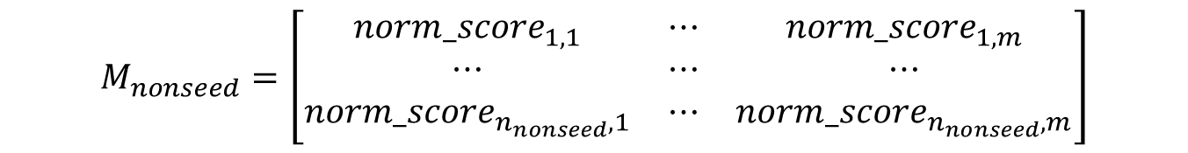

Similarity computation estimation
$$M_{seed}=\left[\begin{matrix}{norm_score}_{1,1} & ⋯ & norm_{score}_{1,m} \\ ⋯ & ⋯ & ⋯ \\ norm_{score}_{n_{seed},1} & ⋯ & norm_{score}_{n_{seed},m}\end{matrix}\right]$$
$$M_{nonseed}=\left[\begin{matrix}{norm_score}_{1,1} & ⋯ & {norm_score}_{1,m} \\ ⋯ & ⋯ & ⋯ \\ {norm_score}_{n_{nonseed},1} & ⋯ & norm_{score}_{n_{nonseed},m}\end{matrix}\right]$$
$$M_{similarity}=\begin{matrix}M_{seed} & × & M_{nonseed}^{T}\end{matrix}$$

Slide 10

Similarity computation estimation
seed_user
1 million x 100
nonseed_user
1 million x 100
50k x 100
…
50k x 100
50k x 100
…
50k x 100
20 partitions
20 partitions
400 (20 x 20) 50k x 50k matrix multiplication
400 X 4 sec = 1,600 sec (<30 minutes)

Slide 11
Workflow
- Necessary + optional steps
Inactive user elimination
Input
User feature
User behavior (represented as keywords history)
DIN model
Kernel computation
User profile generation – user vs keyword correlation
Non-targeting user elimination
User profile normalization
LookAlike model
User profile clustering (grouping)
Intra-group seed_user vs non-Seed_user similarity measurements
seed_user vs non-Seed_user similarity measurements

Slide 12
DIN Model Output
– non-targeting user elimination
 | Keyword₁ | Keyword₂ | Keyword₃ | Keyword₄ | … | Keyword_{m}
User₁ | score₁₁ | score₁₂ | score₁₃ | score₁₄ | … | score_{1m}
User₂ | score₂₁ | score₂₂ | score₂₃ | score₂₄ | … | score_{2m}
... | ... | ... | ... | ... | ... | ...
User_{n} | score_{n1} | score_{n2} | score_{n3} | score_{n4} | … | score_{nm}
DIN
$${User}_{i}^{′}s profile: S_{i}= \left\{\begin{matrix}{score}_{i1}, & {score}_{i2}, & \begin{matrix}… & {score}_{im}\end{matrix}\end{matrix}\right\}$$
* The purpose is to eliminate users that have no interest of any keywords (ineffective traffic)
Eliminate $max\left(S_{i}\right)$ = $\max_{j}{{score}_{ij}<prefined threshold}$
$$targeting users$$

Slide 13
DIN Model Output
– user clustering
User₁, user₂, user₃, ……, user_{n-3}, user_{n-2}, user_{n-1}, user_{n}
User profile clustering
User_grp₁
User_grp₂
User_grp_{m}
……

Slide 14
DIN based Look-Alike model
– group-wise seed_user vs non-seed_user similarity measure (active user only)
 | Seed user in grp₁ | Seed user in grp₂ | …… | Seed user in grp_{m}
Nonseed user in grp₁ | similarity matrix₁₁ | 0 | …… | 0
Nonseed user in grp₂ | 0 | similarity matrix₂₂ | …… | 0
…… | …… | …… | …… | 0
Nonseed user in grp_{m} | 0 | 0 | …… | similarity matrix_{mm}

Slide 15
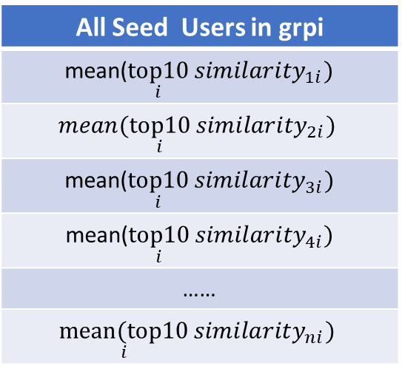
DIN based Look-Alike model
– within group seed_user vs non-seed_user
similarity measure
All Seed Users in grpi
mean($\underset{i}{top10}{{similarity}_{1i}})$
$$mean(\underset{i}{top10}{{similarity}_{2i}})$$
mean($\underset{i}{top10}{{similarity}_{3i}})$
mean($\underset{i}{top10}{{similarity}_{4i}})$
……
$$\underset{i}{mean(top10}{{similarity}_{ni}})$$
Similarity matrix_{ii}
 | Seed_user_{grpi,1} | Seed_user_{grpi},₂ | …… | Seed_user_{grpi},_{m}
Nonseed_user_{grpi},₁ | Similary₁₁ | Similary₁₂ | …… | Similary_{1m}
Nonseed_userg_{rpi},₂ | Similary₂₁ | Similary₂₂ | …… | Similary_{2m}
Nonseed_user_{grpi},₃ | Similary₃₁ | Similary₃₂ | …… | Similary_{3m}
Nonseed_user_{grpi},₄ | Similary₄₁ | Similary₄₂ | …… | Similary_{4m}
…… | …… | …… | …… | ……
Nonseed_user_{grpi},_{n} | Similary_{n1} | Similary_{n2} | …… | Similary_{nm}
sort
Rank₁ nonseed_user
Rank₂ nonseed_user
Rank₃ nonseed_user
Rank₄ nonseed_user
…
Rank_{n} nonseed_user
Parallel computed and top 10 values for each row need to be stored

Slide 16
Log preprocessing steps for DIN model training/validation
Persona table
keyword table
showlog table
clicklog table
Remove Did with
multi-gender or multi-age
Remove impression from unstable slot_id
Remove impression whose Did not in persona table
Merge cleaned showlog and clicklog
Add keyword info in merged log table
Sort merged log table by time
Compute each Did’s keyword daily histogram (impression & click)
Generate each Did’s train & test behavior history samples

Slide 17
DIN model test performance

Slide 18
Keyword traffic contribution (impression)
keyword | % of total traffic
video | 44.83%
shopping | 21.21%
info | 18.13%
social | 6.53%
reading | 3.27%
travel | 2.15%
entertainment | 0.91%
Total | 97.03%

Slide 19
Keyword traffic contribution (click)
keyword | % of click traffic
video | 46.69%
info | 18.41%
shopping | 11.14%
social | 9.16%
reading | 5.73%
travel | 5.27%
entertainment | 2.09%
Total | 98.48%

Slide 20
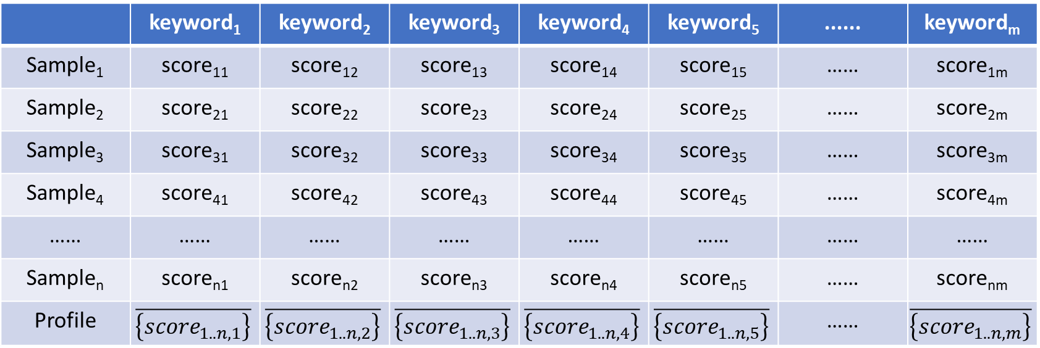
User profile generation (DIN model output)
User i’s keyword history
Sample 1
Sample 3
Sample 2
Sample 4
Sample 5
Sample 7
Sample 6
Sample 8
 | keyword₁ | keyword₂ | keyword₃ | keyword₄ | keyword₅ | ...... | keyword_{m}
Sample₁ | score₁₁ | score₁₂ | score₁₃ | score₁₄ | score₁₅ | …… | score_{1m}
Sample₂ | score₂₁ | score₂₂ | score₂₃ | score₂₄ | score₂₅ | …… | score_{2m}
Sample₃ | score₃₁ | score₃₂ | score₃₃ | score₃₄ | score₃₅ | …… | score_{3m}
Sample₄ | score₄₁ | score₄₂ | score₄₃ | score₄₄ | score₄₅ | …… | score_{4m}
…… | …… | …… | …… | …… | …… | …… | ……
Sample_{n} | score_{n1} | score_{n2} | score_{n3} | score_{n4} | score_{n5} | …… | score_{nm}
Profile | $$\overline{\left\{{score}_{1..n,1}\right\}}$$ | $$\overline{\left\{{score}_{1..n,2}\right\}}$$ | $$\overline{\left\{{score}_{1..n,3}\right\}}$$ | $$\overline{\left\{{score}_{1..n,4}\right\}}$$ | $$\overline{\left\{{score}_{1..n,5}\right\}}$$ | …… | $$\overline{\left\{{score}_{1..n,m}\right\}}$$

Slide 21
Validation

Slide 22
LookAlike model test results - expected
% seed users in total of extendable users

Slide 23

Test scenario illustration (Definable audience)
Grp 5
Grp 3
Scenario 1: homogeneous seed users (focused within single group)
Seed user % in total extendable users:10% -> 90%
Grp 4
Grp 1
Grp 2
Scenario 2: heterogeneous seed users (across multiple groups)
Seed user % in total extendable users:10% -> 90%
User clusters

Slide 24
Test scenario illustration (non-definable audience)
Grp 5
Grp 3
Scenario 1: matched homogeneous seed users (focused within single group)
Seed user % in total extendable users: 10% -> 90%
Grp 4
Grp 1
Scenario 2: matched heterogeneous seed users (across multiple groups)
Seed user % in total extendable users: 10% -> 90%
Grp 2
Scenario 3: random seed users (mismatch between advertiser’s user definition and system user definition, may include non-targeting seed users)
User clusters

Slide 25
Scenario 1- same group seed users
Test case 1:
All users clicked on keyword 26 at least one time in the last 10 days
Total number of users in this groups: 5325
keyword 29
keyword 14
keyword 26
keyword 25
# of seed users = 1000 did % of seed users : 18.77 % | 2X extension = 2000 dids | 3X extension = 3000 dids
#Click – based on model | 17 | 20
#Click – based on random selection | 7 | 12

Slide 26
Scenario 1- same group seed users
Test case 2:
All seed users clicked on keyword 28 at least one time in the last 10 days
The total number of users in this group is 250. With selecting 100 as a seed users the chance of model selecting the 150 users is extremely low.
keyword 29
keyword 14
keyword 26
keyword 25
Keyword 28
# of seed users = 100 did % of seed users = 40% | 2X extension = 200 dids | 3X extension = 300 dids
#Click – based on model | 1 | 1
#Click – based on random selection | 0 | 0

Slide 27
Scenario 1- same group seed users
Test case 3:
All users clicked on both keyword 26 and keyword 29 at least once in the last 10 days
Total number of users in these groups : 6485
keyword 29
keyword 14
keyword 26
keyword 25
# of seed users = 500 did % of seed users = 7.71 % | 2X extension = 1000 dids | 3X extension = 1500 dids
#Click – based on model | 109 | 153
#Click – based on random selection | 78 | 140

Slide 28
Scenario 2- different groups seed users
Test case 1:
Seed users are from three different groups:
Seed users who clicked on keyword 26
Seed users who clicked on keyword 14
Seed users who clicked on keyword 29
Total number of users in these groups : 12562
keyword 29
keyword 14
keyword 26
keyword 25
# of seed users = 800 did | 2X extension = 1600 dids | 3X extension = 2400 dids
#Click – based on model | 201 | 304
#Click – based on random selection | 151 | 207

Slide 29
Scenario 2- different groups seed users
Test case 2:
Seed users are from three different groups:
Seed users who clicked on keyword 26
Seed users who clicked on keyword 29
Total number of users in these groups : 11301
keyword 29
keyword 14
keyword 26
keyword 25
# of seed users = 1000 did | 2X extension = 2000 dids | 3X extension = 3000 dids
#Click – based on model | 196 | 289
#Click – based on random selection | 165 | 244

Slide 30
Scenario 3 – Random seed users
When the seed users are chosen randomly there is no specific behavior pattern. In this scenario, the model is not expected to perform well.
These is a test case with random seed users which shows mixed result compare to random extension.

Slide 31
Scenario 3 – Random seed users
keyword 29
keyword 14
keyword 26
keyword 25
The click result for Random users is also random
 | 2X extension = 2000 dids
# of seed users = 1000 did | Keyword = 26 | keyword = 29 | keyword = 14
Click – based on model | 7 | 235 | 13
Click – based on random selection | 28 | 207 | 26

Slide 32
Conclusion
The look alike model, similar to any other AI based model needs a quality input data.
The higher the quality of the input data, the better the result of the model.
In the first scenario when all seed users are from one cluster, the result of look alike extension users has higher click rate.
In the last scenario when users are picked randomly, there is no ground choose to evaluate the performance.

