Slide 1
USER TO USER DISTANACE CALCULATION USING MULTI-GPUS
Security Level:

Slide 2
Methodology
We have used FAISS framework
We have randomly generated the data of 30M user , each having 64 dimensions
Calculated distance of 30M users and picked top 10 users with highest similarity score
With 4-GPU resources, our job is completed within 2-3 hour

Slide 3
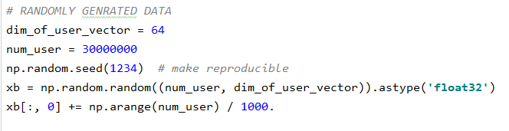
FAISS Code Overview
FAISS Lib Installation
command : pip3 install faiss-gpu
Randomly generate 30M user data

Slide 4
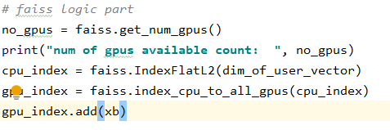

FAISS Code Overview
Indexed 30M user data on 4-GPU machine
Search top 10 Users which are similar to 30M query users.
Function gpu_index.search() return top 10 user index and its Distance from 30M queried users

