Slide 1
Large pickle file for training for lookalike model
Issue 161 on Github

Slide 2
Problem description
Issue 161: we have pickle file of size 17 GB. So when we run the model training script we get memory overflow error. We tried with the best machine available on MTP but not able to train the model.
Pickle file used for training is too large to load into memory for training

Slide 3
Data flow (tfrecord -> training)
tfrecord
Training & testing sample extraction (lookalike_build_dataset.py -> pickle file)
User-wise
training

Slide 4
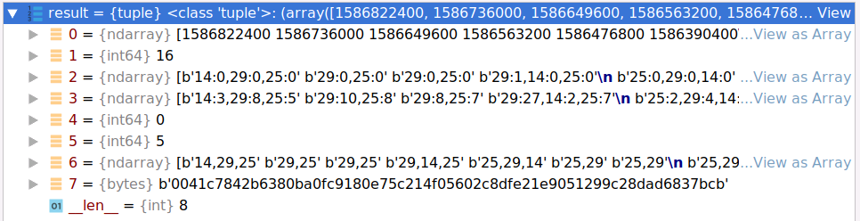
Data flow (tfrecord)
Time stamp
Mapped User index
Full click history
Full impression history
gender
age
Full keyword list
Original user index
Training samples
8
9
Testing samples
5
6
7
2
3
4
2
3
1
1
Time line
training
testing

Slide 5
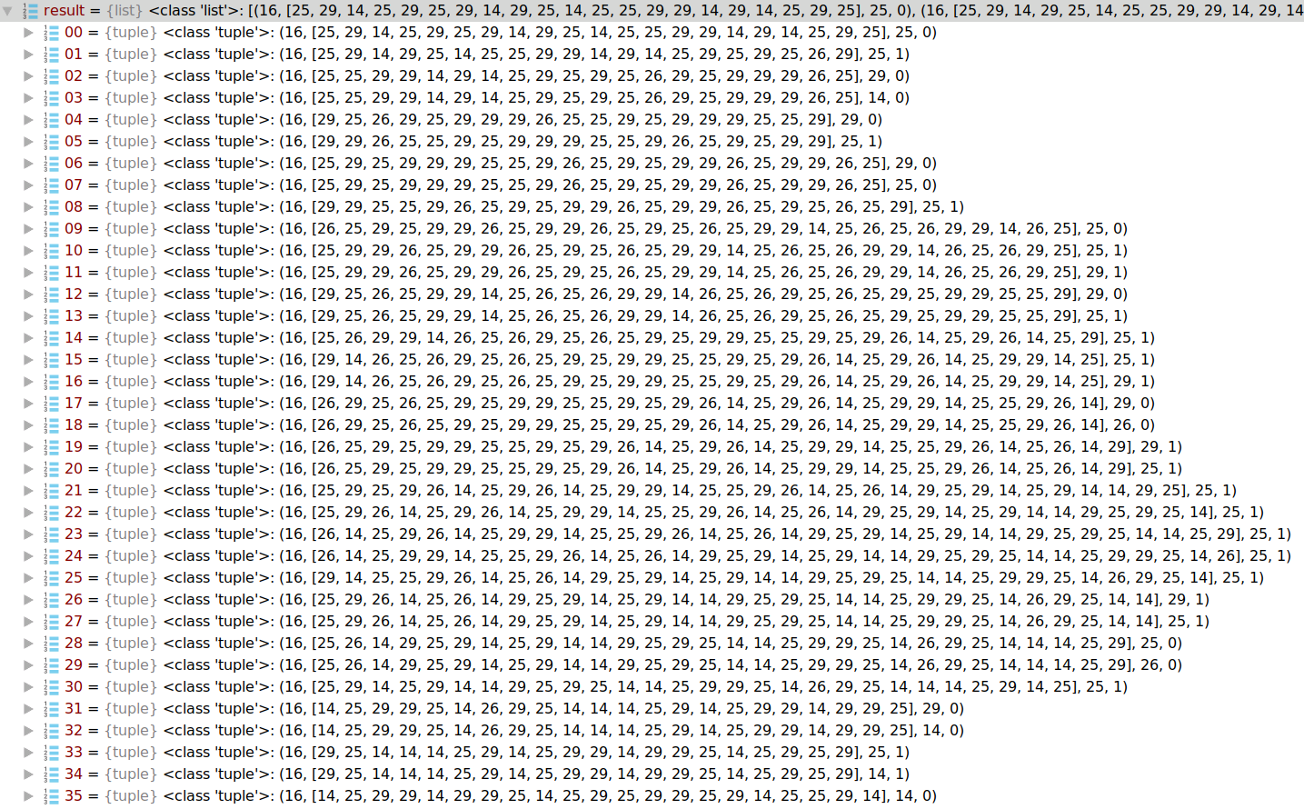
Data flow (extracted training samples)
Mapped user index
Keyword history
Targeted keyword
Label

Slide 6
Data characteristics
The training samples from different users are independent to each other.
Pickle file includes training & testing samples for all users
Training are performed in batches

Slide 7
Suggested solutions
Keep current code structure: split full set of users into groups, save training samples for each group to a separate pickle file
Change code structure -> integrate lookalike_build_dataset.py into train.py, do training & testing samples extraction after reading each tfrecord file and then do training, until all tfrecord files have been processed.

