Slide 1
Implementation of Mandatory Access Control(MAC) in Linux system
By Sen Shen
Shang Da

Slide 2
What is MAC (Mandatory Access Control)
MAC: a type of access control by which the operating system constrains the ability of a subject or initiator to access or generally perform some sort of operation on an object or target. (From wiki)
MAC to Decide:
Allow?
Disallow?
Pocess_1
File_1
Subject
Pocess_2
Port_5000
Object
Pocess_3
Access
request
inode
Processes & Threads
Resource: file, io, port…

Slide 3
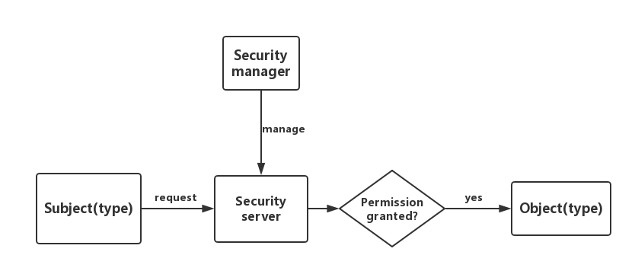
Architecture

Slide 4
How to implement
LSM(Linux Security Module)
Override system calls

Slide 5
What is Linux Security Module (LSM)
LSM is an access control framework (2002)
Implemented by: (5 primary ways)
Add opaque security fields to kernel data structure
Patch inserts calls to security hook functions at various points within the kernel code
......
Linux kernel provides discretionary access controls.
LSM allows Linux kernel to support a variety of security models:
SELinux
AppArmor

Slide 6
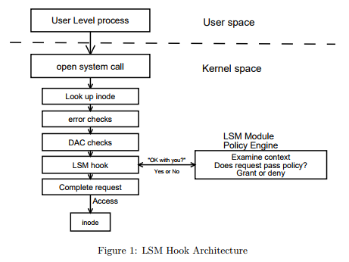
mechanism LSM

Slide 7
LSM Interface: callback method
Policy Registration
Task Hooks
Program Loading Hooks
File System Hooks
Super Block Hooks
Inode Hooks
File Hooks
IPC Hooks
Object Specific IPC Hooks
Module Hooks
Network Hooks
Other System Hooks

Slide 8
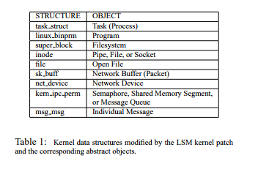
Implementation of LSM: kernel modification

Slide 9
Security modules of LSM
AppArmor: name-based access controls, no need to re-labeling of the file system.
AppArmor utilizes kernel API provided by LSM that allows modules of kernel code to govern ACL (DAC ACL, access control lists).
Policy on file access: give an application explicit read, write, or execute access to files.
SELinux: label subjects & objects to grant access among them.
Type Enforcement (TE)
Domains: Classification of a subject; Types: Classification of an object
Labeling subjects and objects: Domains for processes and Types for files and other objects
Rules enforce how domains can access types.
Two basic security enforcement decisions
Access control: Can subject access object?
Labeling: What label should a new object have?
Notes:
Called through a function pointer

Slide 10
Progress on LSM:
Has done:
Have compiled and installed the kernel 3.6.2 on Ubuntu 12.04
Have programmed and executed a simple module on that kernel
Have read some source code and paper about LSM, was trying to figure out a way to implement a simple policy
Have analyzed several security module mechanisms.
Going to do next:
Learn more about the framework of LSM
Write a simple module to implement a simple policy.
Form a complete runnable policy to implement.

Slide 11
How to implement
LSM(Linux Security Module)
Override system calls

Slide 12
Our idea
Operations like open/read/write etc. are all executed by system calls.
If we can override certain system calls such that, every time a subject want to access an object it calls our functions instead of system call. In our function we provide a security check, if passed, then we call the system call for it. Therefore, we can implement our MAC system without LSM.

Slide 13
System call
A set of userspace request of a kernel service.
User processes only run in user mode
They need kernel's service
Implemented by interrupt (0x80)

Slide 14
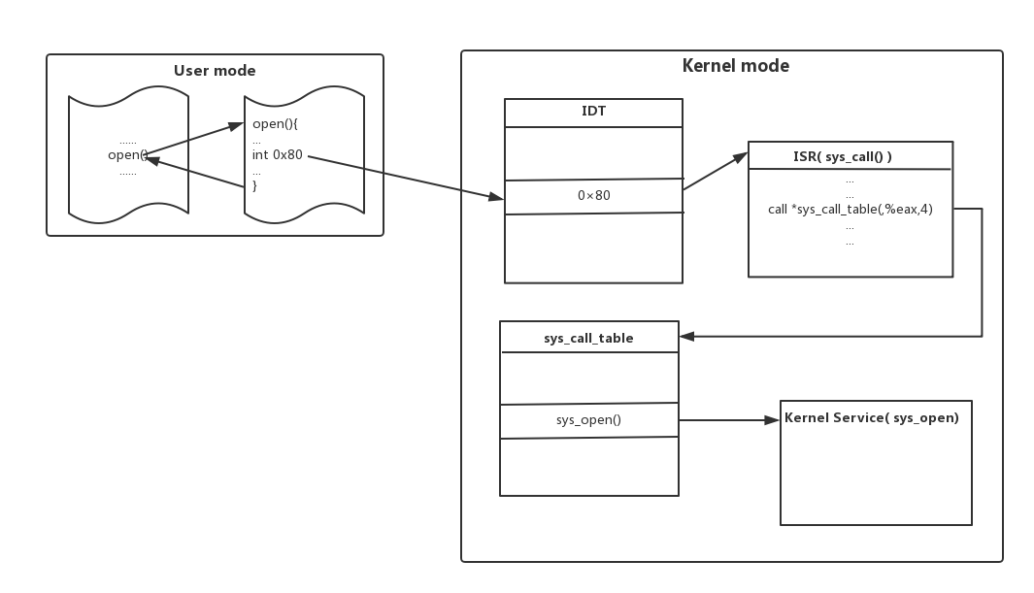

Slide 15
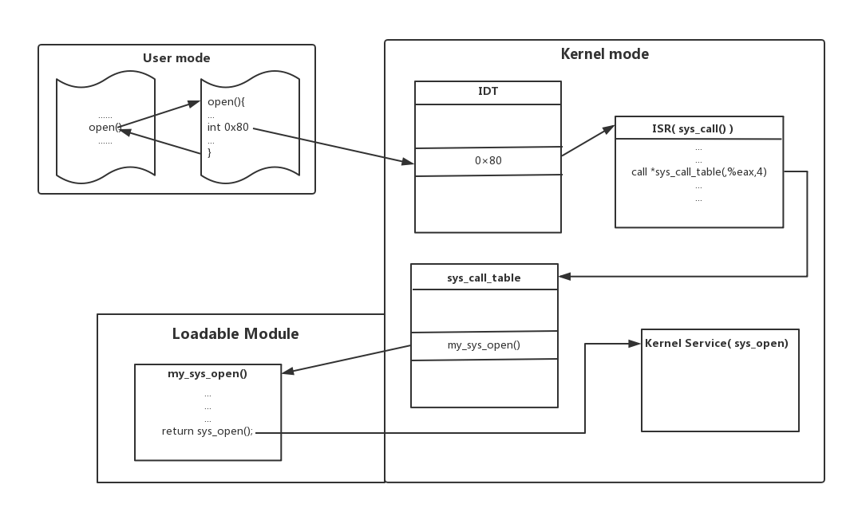

Slide 16
How to override
Modify sys_call_table.
2 problems:
Address of sys_call_table(after linux 2.4)
Write to sys_call_table
2 methods
Change source code and recompile kernel
Intercept address of sys_call_table from 0x80 interrupt and change CR0 register.

Slide 17
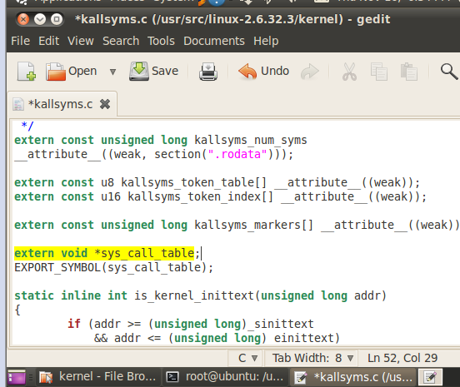
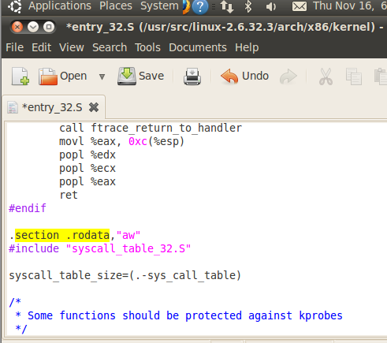

Slide 18
How to override
Modify sys_call_table.
2 problems:
Address of sys_call_table(after linux 2.4)
Write to sys_call_table
2 methods
Change source code and recompile kernel
Intercept address of sys_call_table from 0x80 interrupt and change CR0 register.

Slide 20
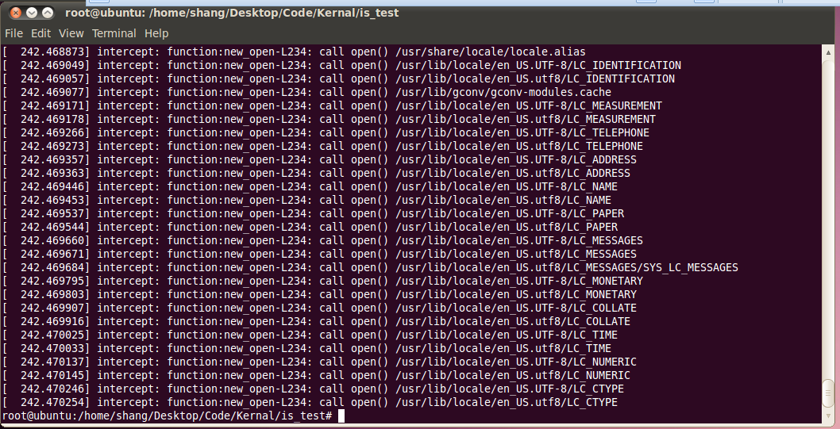

Slide 21
Progress
Our first Linux kernel module
Intercept and override sys_open

Slide 22
Thank you!

