Slide 1
Implementation of Mandatory Access Control(MAC) in Linux system
By Sen Shen
Shang Da

Slide 2
Components of our system:
Method to intercept and overwrite system calls
Logic for Security Check for each system call
A Security Server to store security policies and also provide enquiry for Security Check
A Security Manager to modify policies in Security Server.

Slide 3
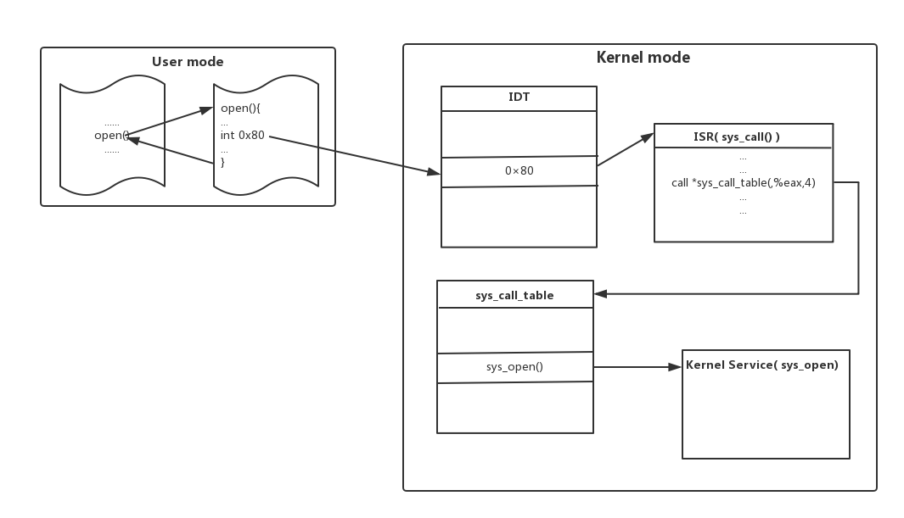

Slide 4
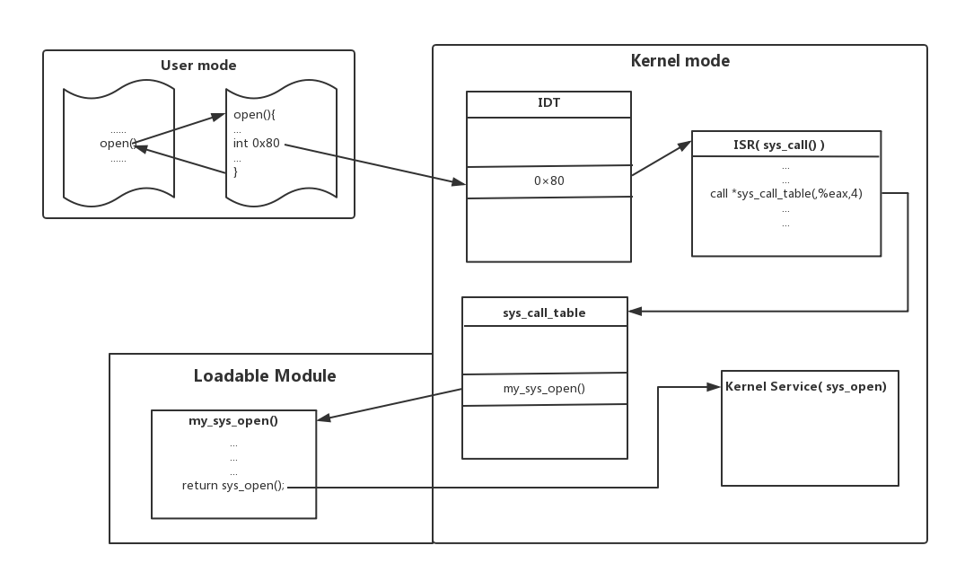

Slide 5

Security Server
Maintains 3 tables for subject types, object types, and authority.
Provide methods for enquiring three tables
Denying access from subject except Security Manager.

Slide 6
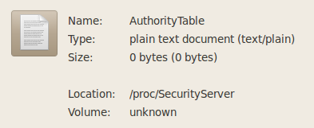
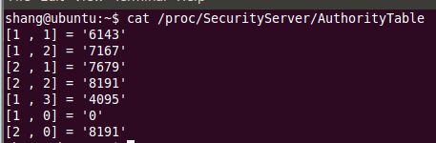
Security Server
Implemented by procfs(proc filesystem).
proc is a virtual file system
It provides a more convenient and standardized method for dynamically accessing data in Kernel Mode.
Need to rewrite call back functions for reading and writing virtual files.

Slide 7

Security Check
Enquire and get permission from Security Server.
For some specific system call, we need to get absolute path of the object.
e.g.
and

Slide 8
Security Manager
Security Manager operates in User Mode and can communicate with our module, which runs in Kernel Mode.
Capable of enquire Security Server.
Capable of grant/deny access of a subject(type) to an object(type).

Slide 9
Demo.

Slide 10
Drawback of our system
System calls are vulnerable(LSM should be a better solution for access control)
Mapping from subject to type and object to type is stored in Table(is better to modify certain structures in kernel code)

