Slide 1
Compiler Design and Construction
Predictive Parsing

Slide 2
Predictive parsing
Recall the main idea of top-down parsing:
  Start at the root, grow towards leaves
  Pick a production and try to match input
  May need to backtrack
Can we avoid the backtracking?
  Given A → α | β the parser should be able to choose between α and β
How?
  What if we do some "preprocessing" to answer the question: Given a non-terminal A and lookahead t, which (if any) production of A is guaranteed to start with a t?

Slide 3
Cont..
If we have two productions: A→α⏐β , we want a distinct way of choosing the correct one.
If FIRST(α) and FIRST(β) contain no common symbols, we will know whether we should choose A→α or A→β by looking at the lookahead symbol.

Slide 4
Cont..
Compute FIRST(X) as follows:
  if X is a terminal, then FIRST(X)={X}
  if X→ε is a production, then add ε to FIRST(X)
  if X is a non-terminal and X→Y₁Y₂...Y_{n} is a production, add FIRST(Y_{i}) to FIRST(X)

Slide 5
Cont..
Compute FOLLOW as follows:
  FOLLOW(S) contains EOF ($)
  For productions A→αBβ, everything in FIRST(β) except ε goes into FOLLOW(B)
  For productions A→αB or A→αBβ where FIRST(β) contains ε, FOLLOW(B) contains everything that is in FOLLOW(A)
  ➔ If FOLLOW (B) is A and A→ ε then:
  FOLLOW (B): FIRST (A) & FOLLOW (A)

Slide 6
Cont..
Armed with
  FIRST
  FOLLOW
we can build a parser where no backtracking is required!

Slide 7
Building a parser
Original grammar:
This grammar is left-recursive, ambiguous and requires left-factoring. It needs to be modified before we build a predictive parser for it:
E→E+E
E→E*E
E→(E)
E→id
Remove ambiguity:
Remove left recursion:
E→TE'
E'→+TE'|ε
T→FT'
T'→*FT'|ε
F→(E)
F→id
E→E+T
T→T*F
F→(E)
F→id

Slide 8
First ()
FIRST(E) = { ( , id}
FIRST(E’) ={+ , ε }
FIRST(T) = { ( , id}
FIRST(T’) = {*, ε }
FIRST(F) = { ( , id }
E→TE'
E'→+TE'|ε
T→FT'
T'→*FT'|ε
F→(E)
F→id

Slide 9
Follow ()
FOLLOW(E) = { $, ) }
FOLLOW(E’) = { $, ) }
FOLLOW(T) = { +, $, ) }
FOLLOW(T’) = { +, $, ) }
FOLLOW(F) = {*, + , $ , ) }
E→TE'
E'→+TE'|ε
T→FT'
T'→*FT'|ε
F→(E)
F→id
FOLLOW (T): FIRST (E’) & FOLLOW (E)
FOLLOW (F): FIRST (T’) & FOLLOW (T)

Slide 10
Building a parser
The grammar:
E→TE'
E'→+TE'|ε
T→FT'
T'→*FT'|ε
F→(E)
F→id
FIRST(E) = FIRST(T) = FIRST(F) = {(, id}
FIRST(E') = {+, ε}
FIRST(T') = {*, ε}
FOLLOW(E) = FOLLOW(E') = {$, )}
FOLLOW(T) = FOLLOW(T') = {+, $, )}
FOLLOW(F) = {*, +, $, )}
Now, we can either build a table or design a recursive descend parser.

Slide 11
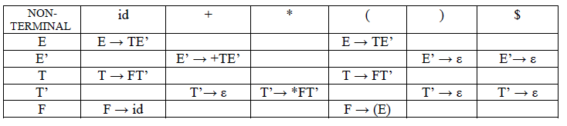
Predictive parsing table
Fill non-terminal by FIRST (A) if ε then FOLLOW (A)

Slide 12
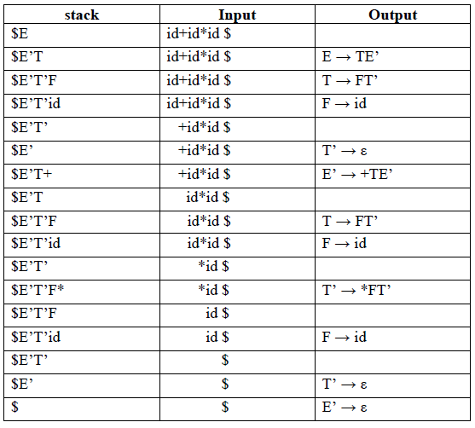
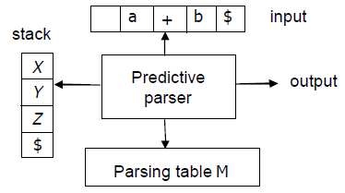
Parsing table
E→TE'
E'→+TE'|ε
T→FT'
T'→*FT'|ε
F→(E)
F→id

Slide 13
LL(1) parsing
Our parser scans the input Left-to-right, generates a Leftmost derivation and uses 1 symbol of lookahead.
It is called an LL(1) parser.
If you can build a parsing table with no multiply-defined entries, then the grammar is LL(1).
Ambiguous grammars are never LL(1)
Non-ambiguous grammars are not necessarily LL(1)

Slide 14
LR parsing techniques
SLR (Simple LR)
  Simple LR parsing
  Easy to implement, not strong enough
  Uses LR(0) items
Canonical LR
  Larger parser but powerful
  Uses LR(1) items
LALR (Look-Ahead LR)(not in the book)
  Condensed version of canonical LR
  May introduce conflicts
  Uses LR(1) items

Slide 15
Cont..
Steps to solve LR(0)
  Augment the grammar
  Draw conical collection of LR(0) item
  Number the production
  Create the parsing table
  Stack implementation
  Draw parse tree

Slide 16
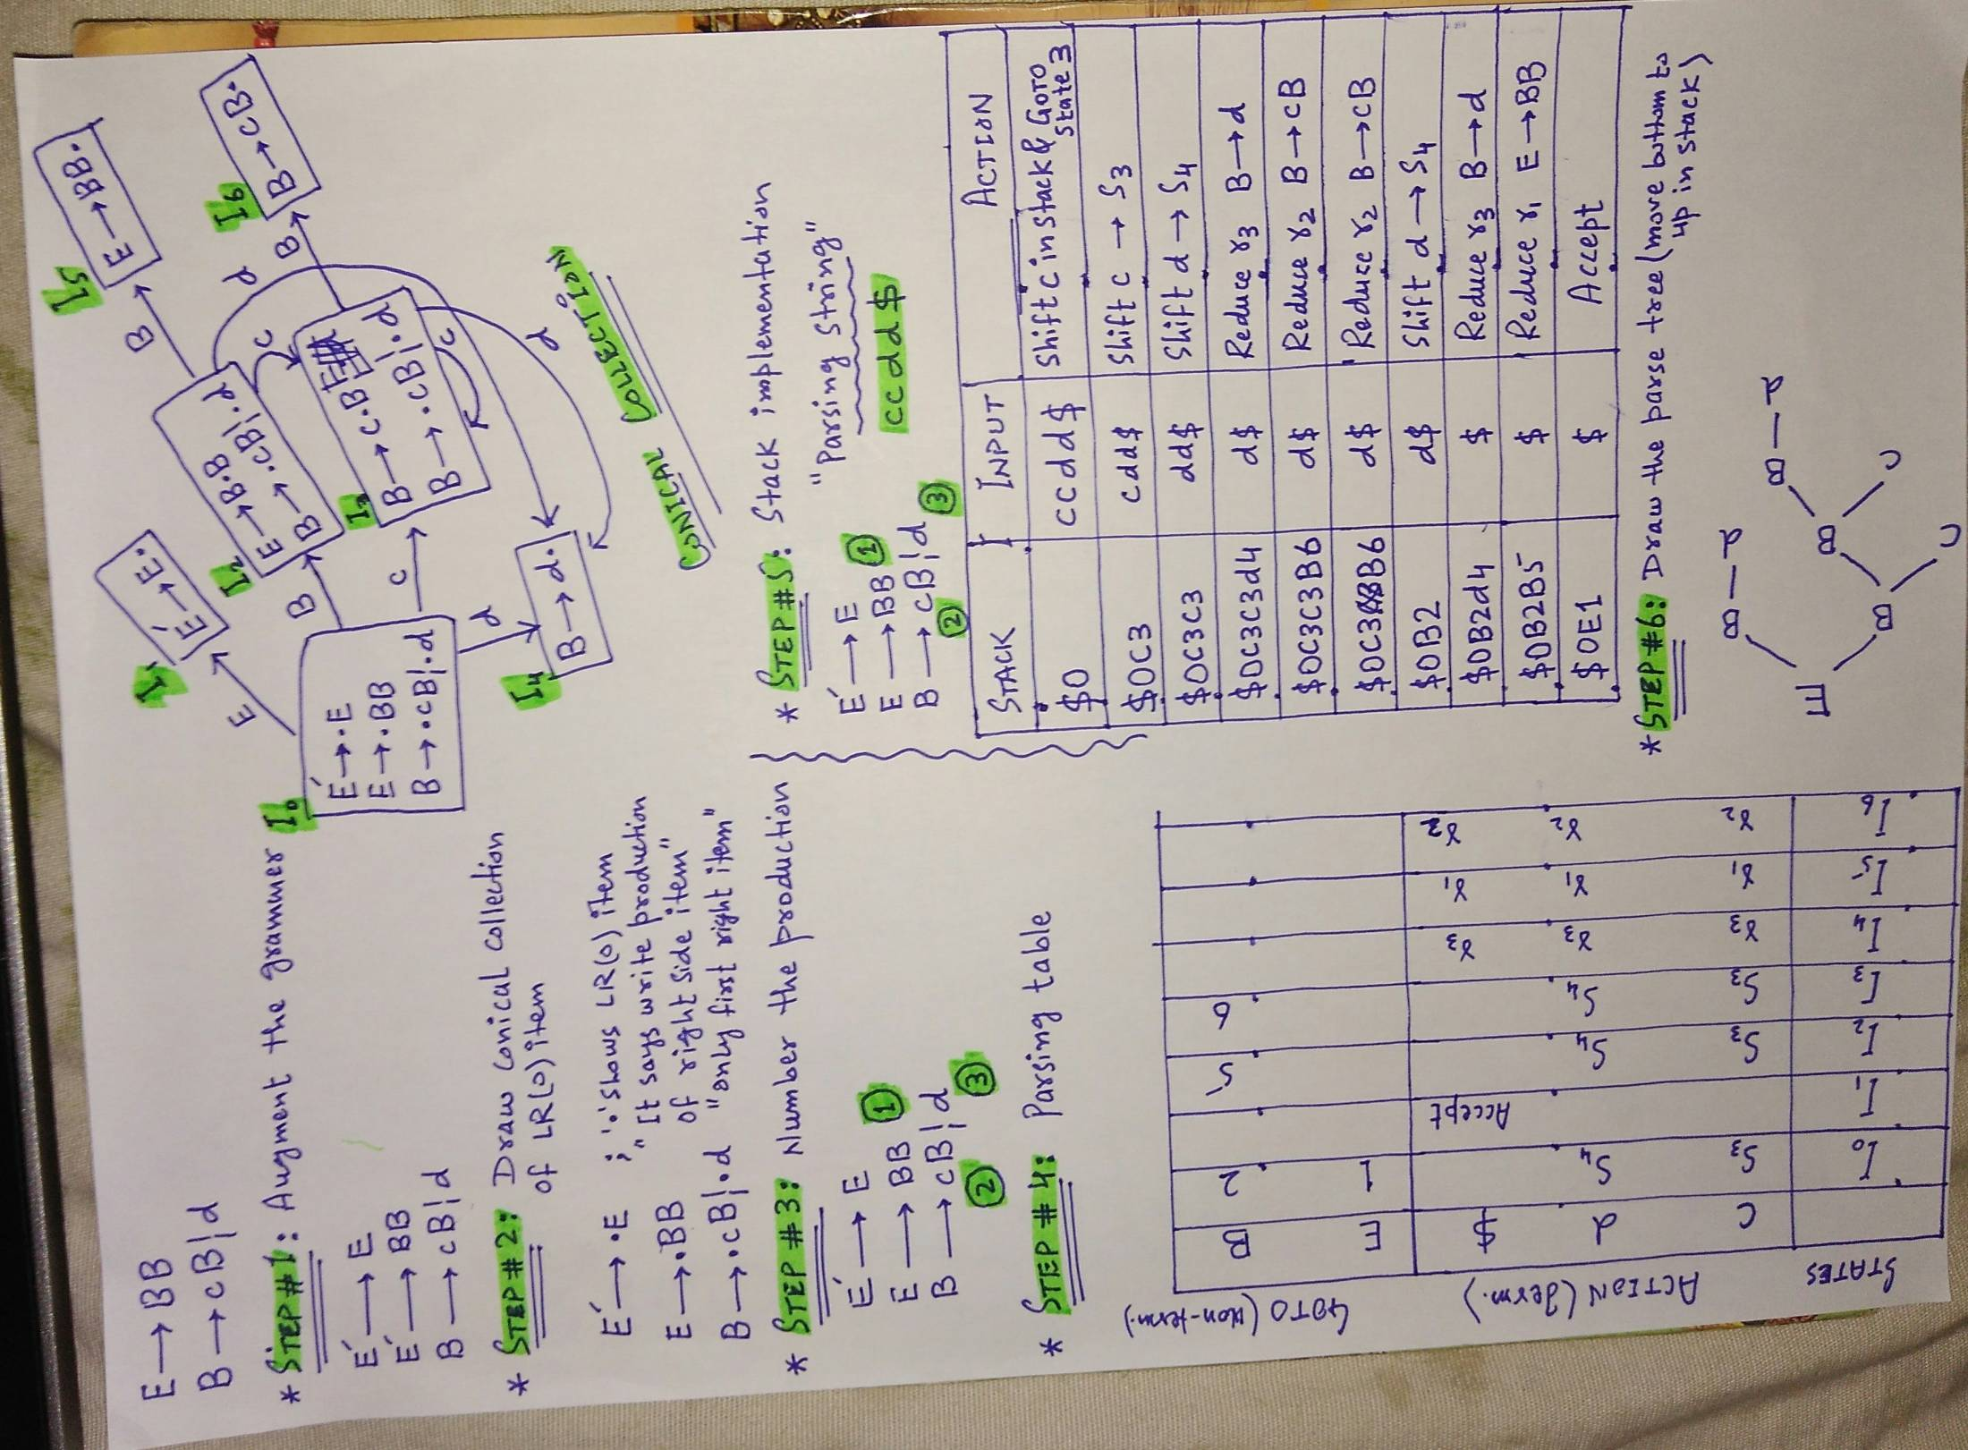

Slide 17
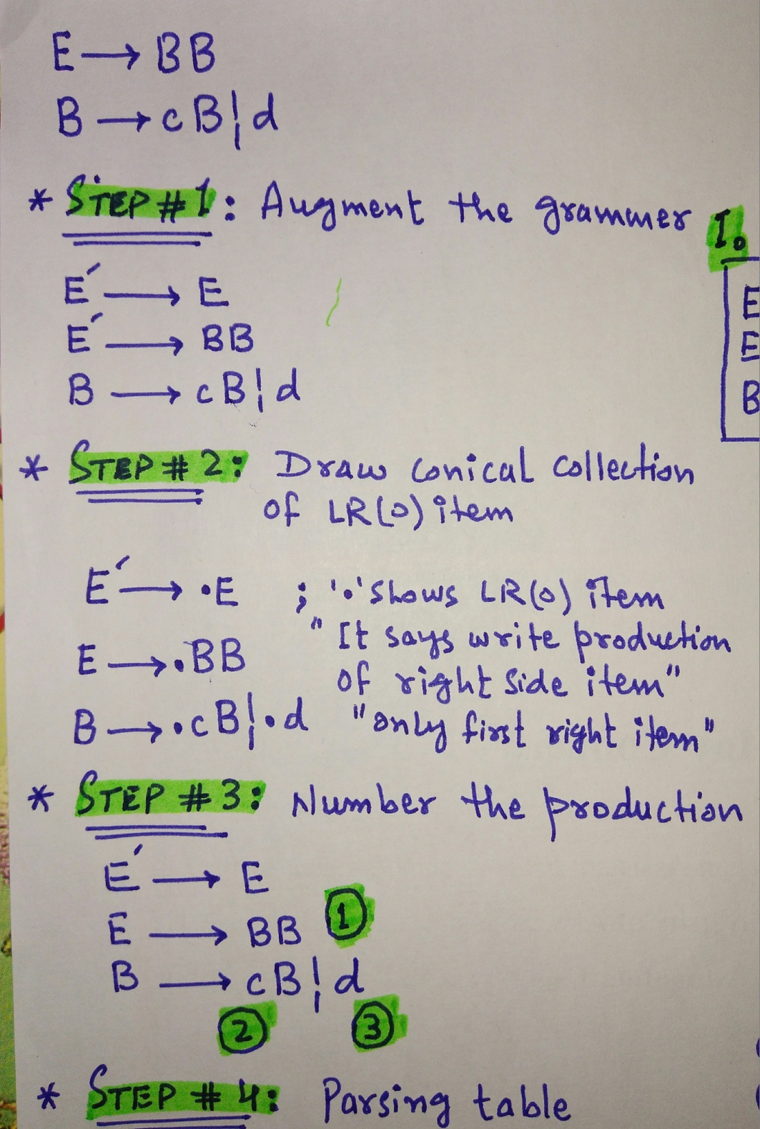

Slide 18
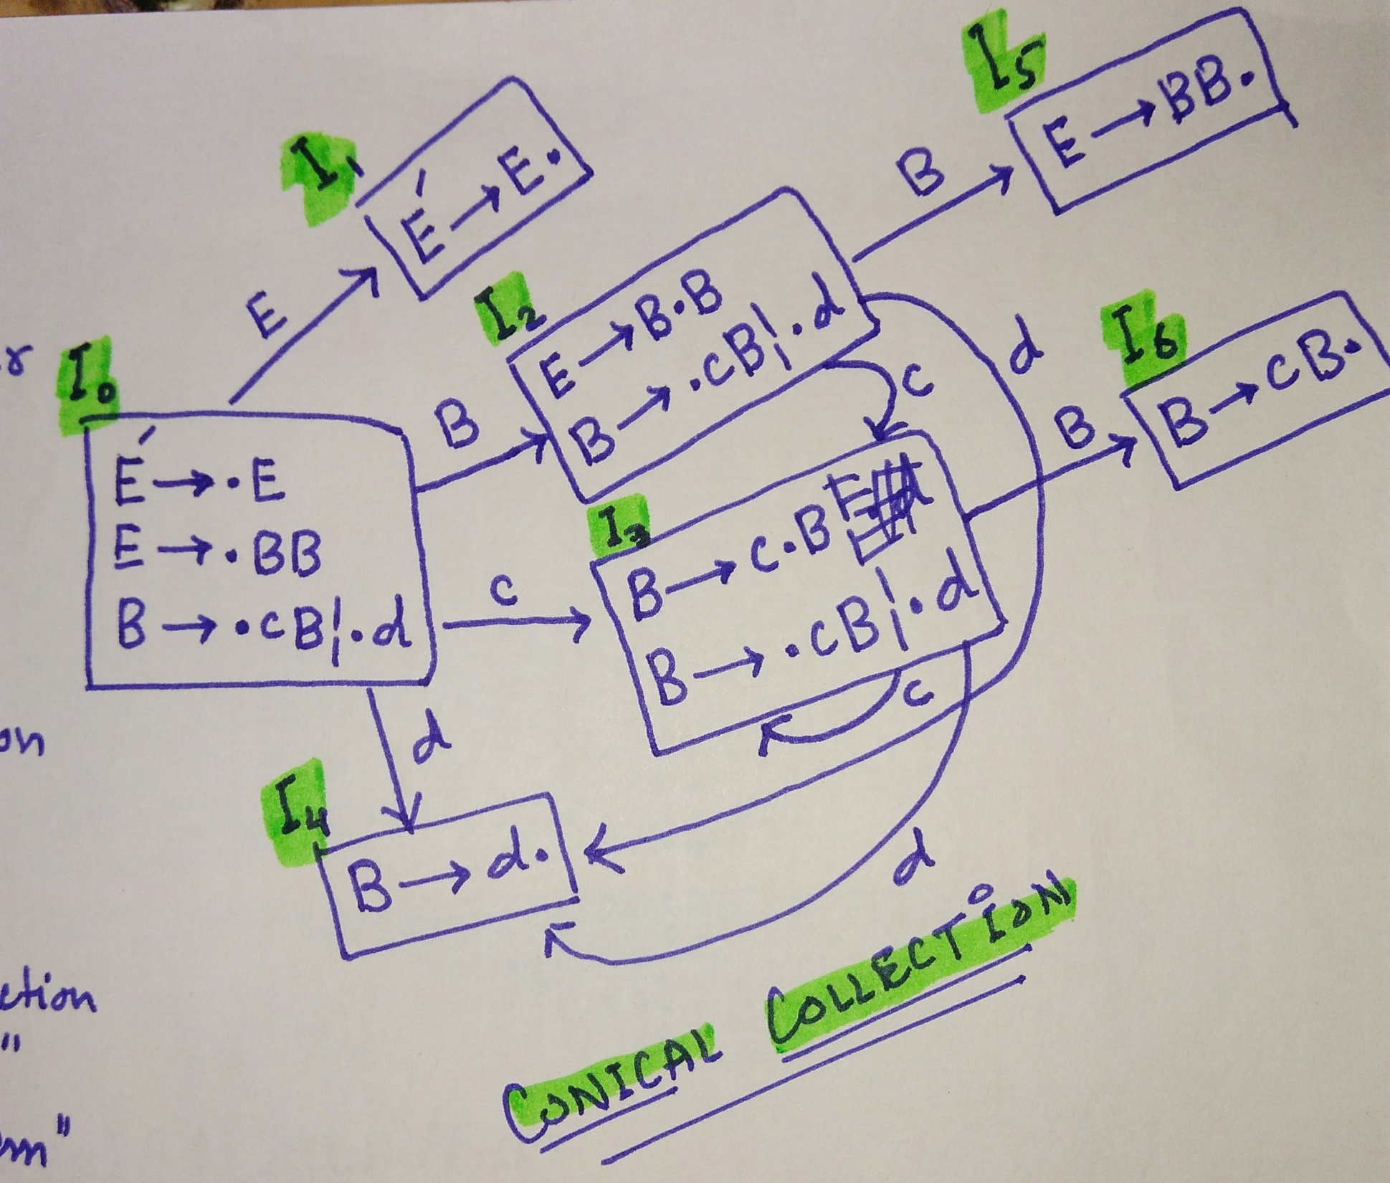


Slide 19
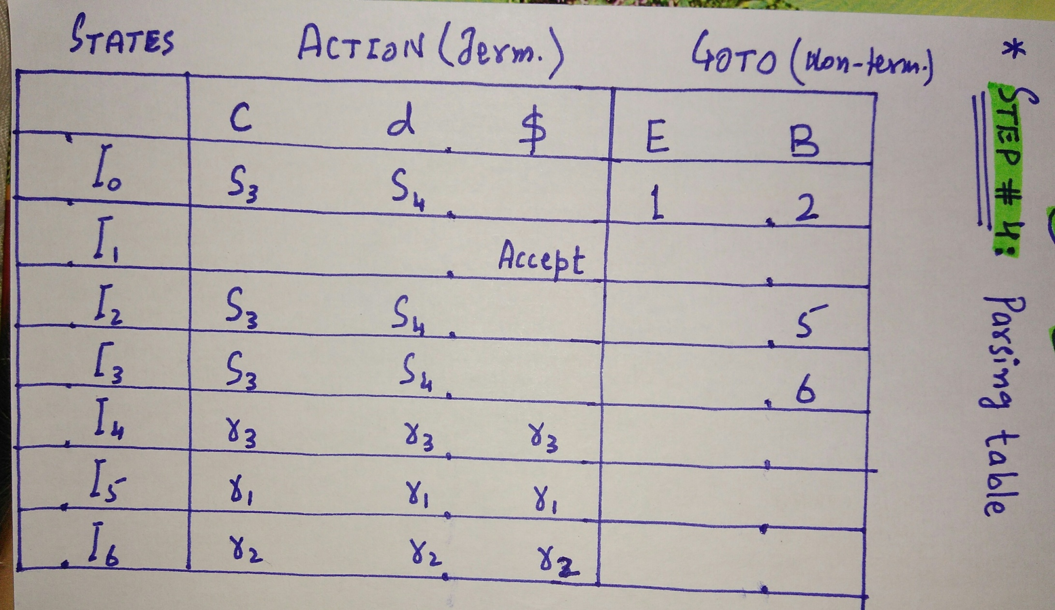

Slide 20
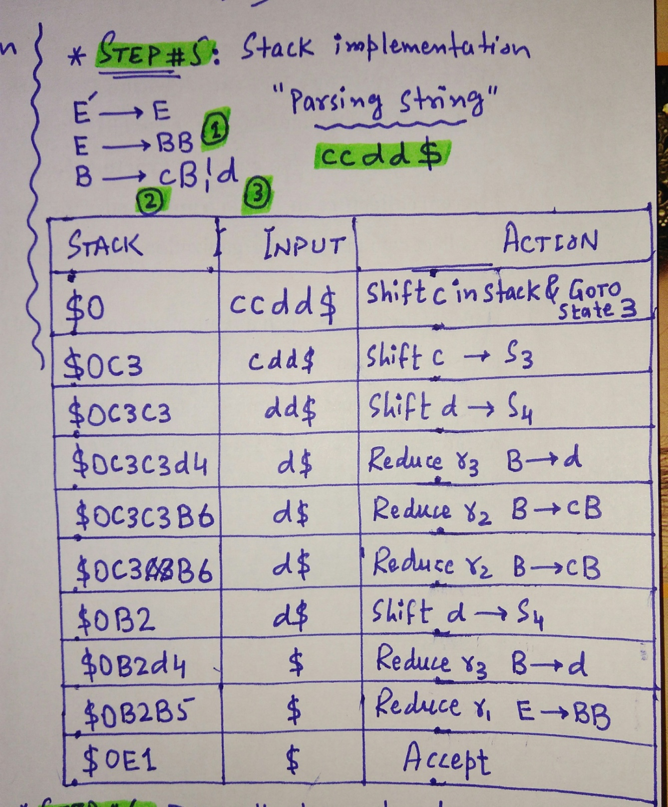

Slide 21
