Slide 1
Analysing Market Basket
Association Rule
Dr Akhter Raza

Slide 2
Association rule An unsupervised learning model
Fast Algorithms for Mining Association
By
(R. Agrawal & R. Srikant) 1994.

Slide 3
Association rule An unsupervised learning model
90% of transactions that purchase bread and butter also purchase milk
Antecedent: bread and butter
Consequent: milk
Confidence factor: 90%

Slide 4
Association rule
Find all the rules that have “bread” as consequent.
Find all rules that have “Diet Coke” in the antecedent.
Find all rules that have “sausage” in the antecedent and “mustard” in the consequent.
Find all the rules relating items located on shelves A and B in the store.
Find the “best” (most confident) k rules that have “margarine” in the consequent.

Slide 5
Association rule help us
placing things near to things that are associated to each other on the shelves in a physical store
it's also used for music recommendation systems
on websites where to place advertisements where to place articles and content in general

Slide 6
Grocery Data
Market Basket analysis in a grocery store so this data set is a quite popular among data scientists it's used to illustrate these techniques and other techniques as well machine learning techniques

Slide 7
Grocery Data
there is no target feature to learn the model
for example if a customer buy butter and jam then there is a high probability of purchasing bread

Slide 8
Grocery Data
This type of data is unstructured because each row represent a transaction but there will not be same number of columns in each transacation
may be some customer bought only 3 items but some took as many as they want so columns are not fixed for each row

Slide 9
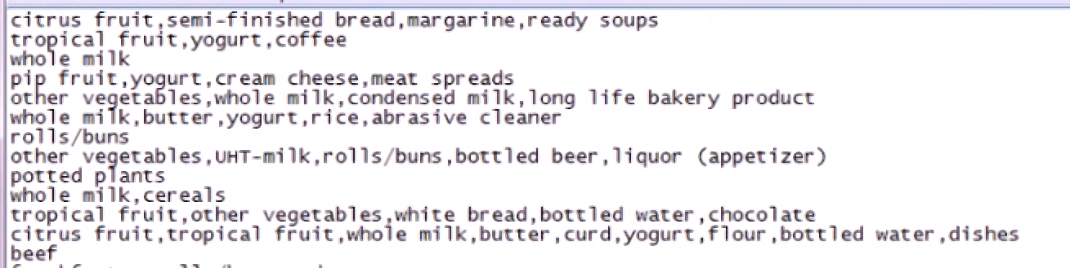
Grocery Data – a look
Each individual purchase is in a row
Items are separated by commas
Data doesn’t organized in tabular form
5 col in row 1, 3 in row 2, and 1 col in row3

Slide 10
Grocery Data – a look
If we want to keep this data in table then we need a grid having 169 columns and 9835 rows
In 169 columns most of the columns remains blanks and waste memory
A sample table is represented in the following slide

Slide 11
Grocery Data – a look
Tr. # | milk | butter | drink | rice | … | … | Item 169
1 | 1 | 0 | 0 | 1 |  |  | 0
2 | 0 | 1 | 1 | 0 |  |  | 0
3 | 1 | 1 | 1 | 1 |  |  | 1
…
…
9835 | 1 | 0 | 0 | 1 |  |  | 0
1 indicates the person bought that item
0 indicates the person didn’t buy it
Most cells contains 0 and waste memory

Slide 12
Sparse Matrix
It saves the memory to keep such data that has most of the cells 0’s
Sparse doesn’t keep 0’s if that item not purchased but it remain blank
It saves memory
It gives us solution to make structure of unstructured data
read.csv cant be used b/c it mixes the data

Slide 13
Sparse Matrix
Two methods of representation of a sparse matrix
Triplet representation
Linked list representation

Slide 14
Triplet representation
we consider only non-zero values along with their row and column index values.
0th row stores total rows, total columns and total non-zero values in matrix

Slide 15
Triplet representation
For example, consider a matrix of size 5 X 6 containing 6 number of non-zero values. This matrix can be represented as shown in the image on next slide...

Slide 16
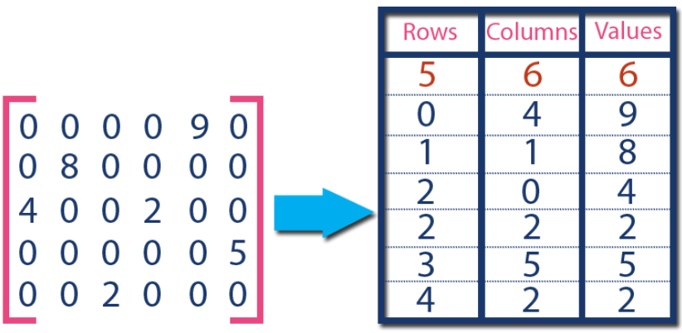
Triplet representation

Slide 17
Linked List representation
rowId | item | Next
1 | Citrus fruit | 2
2 | Semi finished bread | 3
3 | Margrine | 4
4 | Ready soup | 0
5 | Tropical fruit | 6
6 | Yogurt | 7
7 | coffee | 0
…
…
…
Tr# | Start
1 | 1
2 | 5
3
4
5
9835

Slide 18
Grocery Data
# Sparse matrix is used to handle the data
# A rule package is needed for analysis
install.packages("arules")
require("arules")

Slide 19
Grocery Data
# Groceries data set is the part of arules package
data("Groceries")
Groc <- Groceries
# if you have your own data set then read it using following command
Groc <- read.transactions("groceries.csv", Sep = ",")

Slide 20
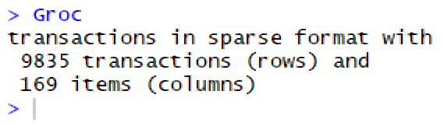
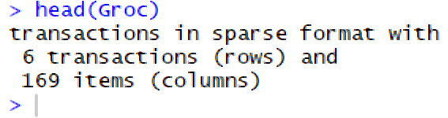
Grocery Data
Groc
head(Groc)

Slide 21
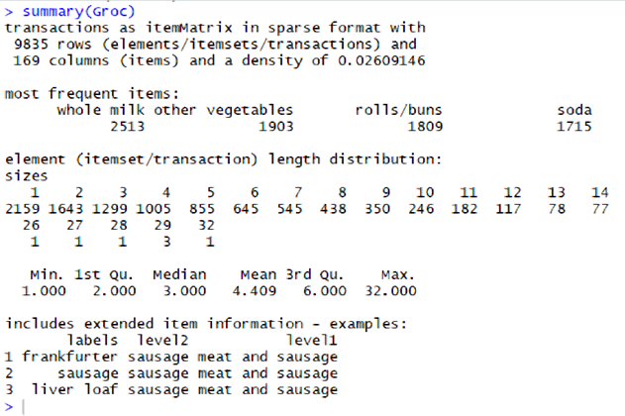
Grocery Data
summary(Groc)

Slide 22
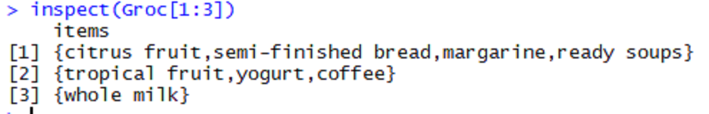
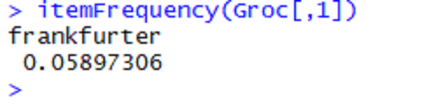
First three rows in groceries
inspect(Groc[1:3])
# association rule is called support how frequently an item occur in our data
itemFrequency(Groc[,1])

Slide 23
Finding occurrences of First item
itemFrequency(Groc[,1])
Total item are 9835 in this data set then
Frankfurter occurs 0.0589*9835 = 580 times
The item Frankfurter occurs 580 times in our data

Slide 24
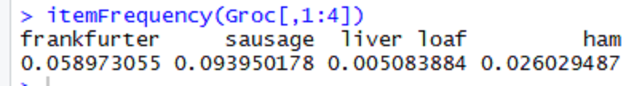

Probabilities and Frequencies
First four items are
Frequencies of first four items

Slide 25
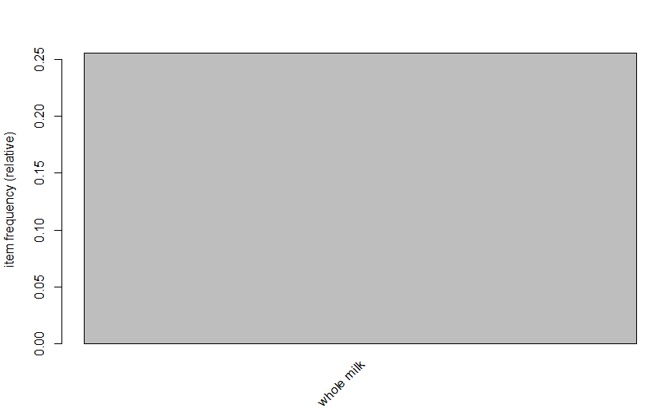
Item Frequencies
We want to plot the frequencies
itemFrequencyPlot(Groc, support = .20)

Slide 26
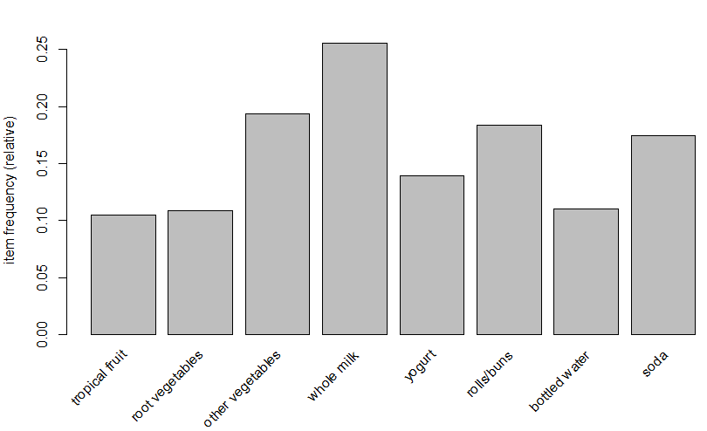
Item Frequencies
itemFrequencyPlot(Groc, support = .10)

Slide 27
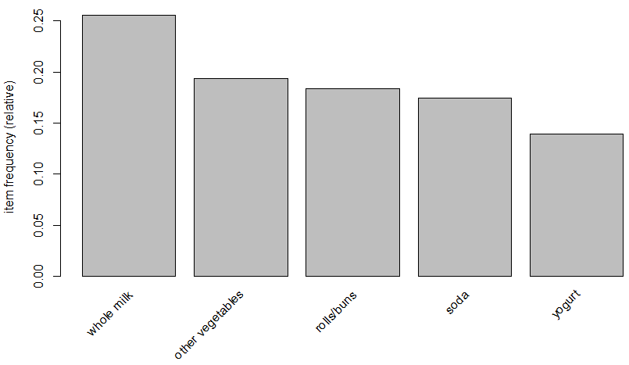
Five Items having highest Support
Draw item frequency for top 5 items
itemFrequencyPlot(Groc, topN = 5)

Slide 28
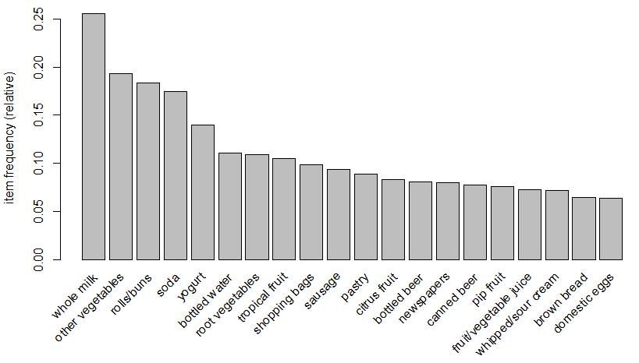
Twenty Items having highest Support
# Top 20 items in the market basket
itemFrequencyPlot(Groc, topN = 20)

Slide 29
Support of an Item
an item that has high support shows up frequently in the data so whole-milk was the one with the highest support it showed up in the most transactions

Slide 30
Confidence of an item
Confidence is a measure of the proportion of transactions where the presence of an item or a set of items results in the presence of another set of items
basically it's like conditional probability so if I buy item A and item B how likely is it that I'll also buy item C
so the confidence of a B implying C is how likely is it that given I bought A and B that I'll also buy C

Slide 31
Support of an Item
Support of whole milk is 0.25 and other vegetables is about 0.18 and so on. The highest support means the item having high sales in market basket. This item shows up in most transactions

Slide 32
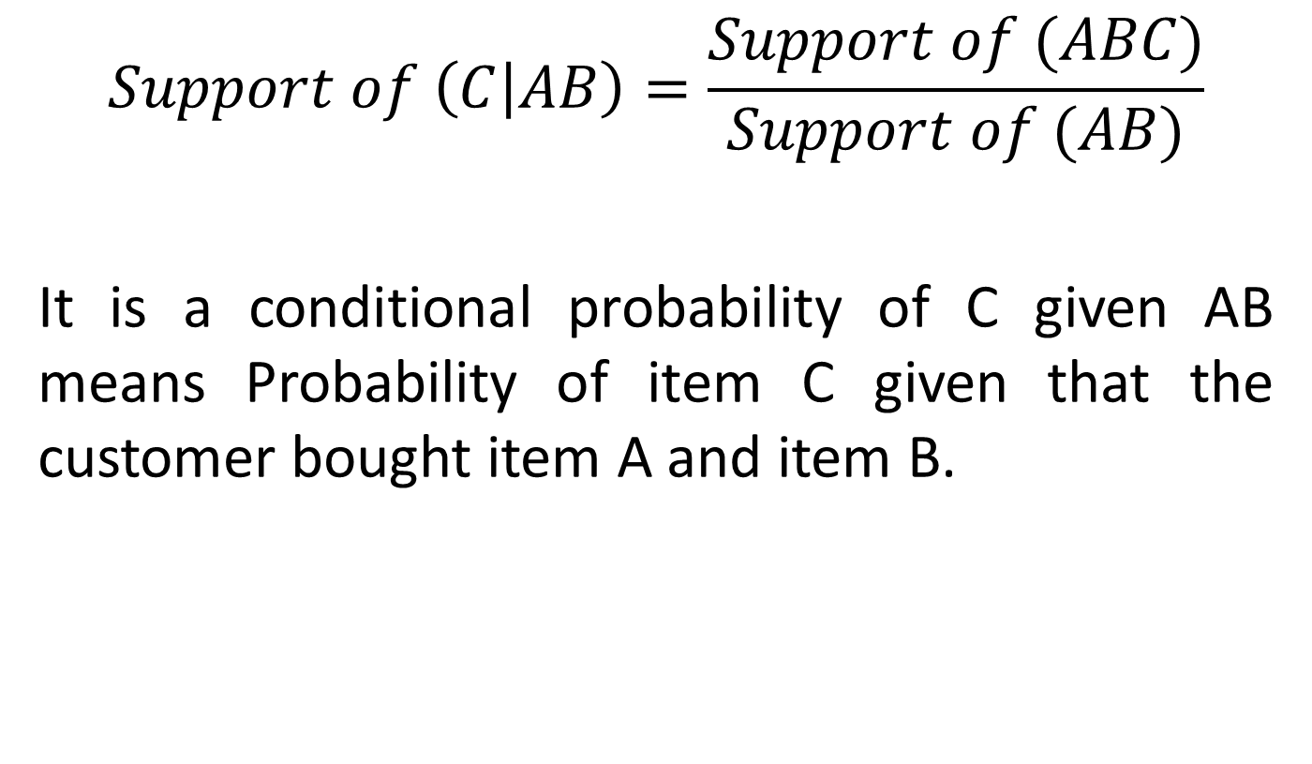
Support of an Item
$$Support of \left(C | AB\right)=\frac{Support of (ABC)}{Support of (AB)}$$
It is a conditional probability of C given AB means Probability of item C given that the customer bought item A and item B.

Slide 33
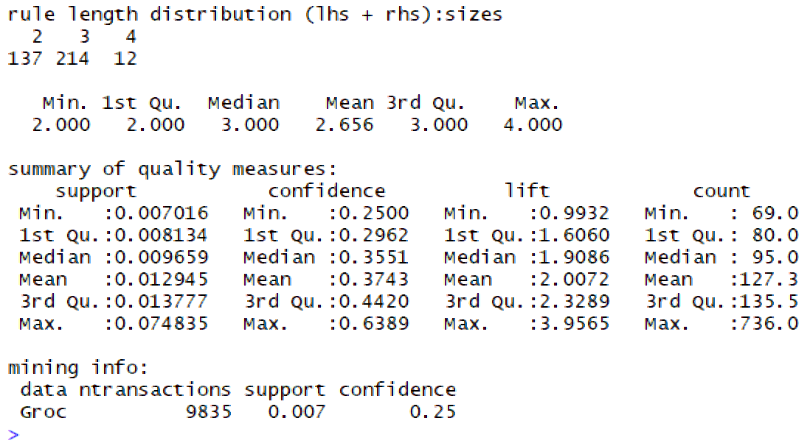

Slide 34
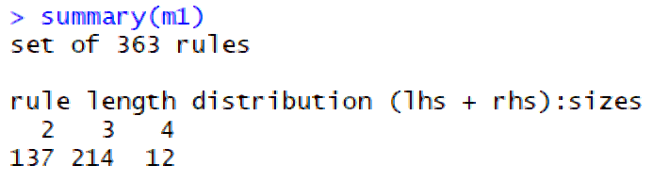
Apriori model Summary
Total number of rules 363
137 rules bases on two items means if you buy item A you also buy item B
214 rules bases on 3 items means if you buy item A and B you also buy item C
12 rules bases on 4 items means if you buy item A, B and C you also buy item D

Slide 35
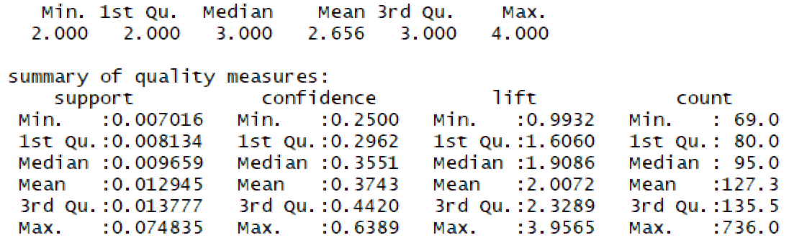
Apriori model Summary
Total number of rules 363

Slide 36
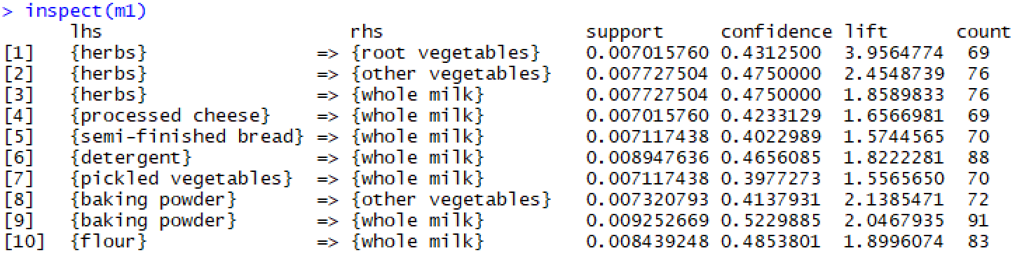
Apriori model Summary
Out of all rules first 10 displayed here

Slide 37
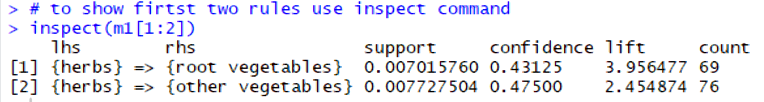
Apriori Summary 2 rules
Customers who buy herbs is likely to buy root vegetables having support of 0.007 and confidence of 43% and lift of 3.96
Higher the lift mean higher chances of purchasing root vegetables with herbs
Total such rules are 69 means out of total customers 69 chooses root vegs with herbs

Slide 38
Apriori inspect
You can sort the output of inspect by any of four features either support, confidence, lift or count
inspect(sort(m1, by="lift")[1:4])
inspect(sort(m1, by="support")[1:4])
inspect(sort(m1, by="confidence")[1:4])
inspect(sort(m1, by="count")[1:4])

Slide 39
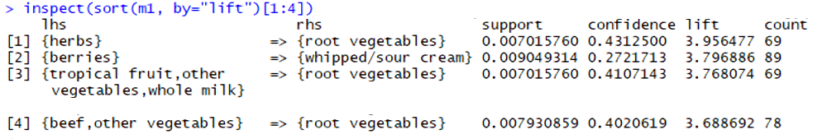
Output sort by lift
Customers who bought barries will likely to buy whipped and or sour cream with a lift of 3.8
Whipped and cream shows up 3.8 times more in general transactions
These rules help in grocery setting in shelves

